Slide 1
Theme: Subject of philosophy. Its significance in the life of a man and mankind.
The term “philosophy” has appeared from combination of two greek words: “phileo” (love) and “sophia” (wisdom). Ancient Greek scientist and philosopher Pythagoras first used this term (580-500 Before Christians).
Man can think and ask questions about yourself and world, for example:
What is world? What is man? What is the first: matter or idea? Can we cognize world? What is the sense of my life?
There are questions of philosophy.

Slide 2
Questions of philosophy are questions of world outlook.
World outlook is the system of man’s views on world and place of man and mankind in this world.
It is the interconnection in system man and world, man and yourself, as a part of this world. World outlook is necessary part of consciousness and cognition.
Components of world outlook are knowledge, mind in whole.

Slide 3
World outlook has two levels: 1) sensual or emotional; 2) rational. World outlook has two sorts: 1) world outlook of personality 2) social world outlook. The first form of world outlook was mythology. This form of world outlook rose at the beginning of human history.

Slide 4
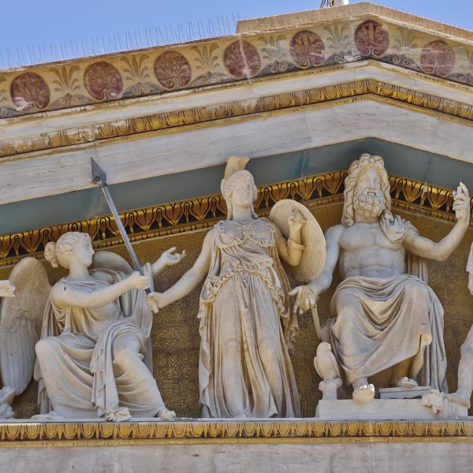
It was the dominant form of world explanation. This attempt of explanation was fulfilled through the personification of natural forces. Natural forces were considered as living creatures (anthropomorphism). Attempts of explanation were the stories about origin and creation.
Myths of Ancient Greece. Zeus, Athena.

Slide 5
From 800 to 200 Before Christian in India, China and Ancient Greece sharp change in the history took place. A man began to realize being as a whole, himself and his limits.
The spiritual struggle began and during it mythological way of thinking began to be filled with rational content and corresponding forms of thinking on (at the early stage of history). The force of generalizing and analytical thought increased, concepts and categories of philosophical mind appeared. Thus, transformation mythology into philosophy took place.

Slide 6
Second form of world outlook was religion. The base of religion is faith. Religion is the system of faith, senses and actions, directed to the connection with supernatural.
Philosophy and religion arise from mythology but they are different forms of world outlook. The origin of philosophy from mythology has some preconditions: disappearance of primitive society, appearance of division of labor, private property and social inequality.

Slide 7
The base of philosophy is the mind, reason, but base of religion is emotional-imaginative component.
Most scientists regard philosophy as world outlook in the first side and science in the second side.
There are two ways of spiritual mastering of the world, which form different types of world outlook:
emotionally-imaginative (myth, religion, art).
logically-rational (philosophy, science).

Slide 8
Philosophy is not only the world outlook, we can consider it to be a science.
There are three criteria of science status:
1) Language;
2) Subject, object;
3) Methods.
Philosophy has all this criteria, therefore it is a science.
The subject of philosophy is the world as a whole, man as a whole, general principles and laws of being and cognition.
The object of philosophy is the interconnection in system “man-world”.

Slide 9
Method is the system of practical or theoretical rules that leads to achieve necessary result. Philosophical method is cooperation only of theoretical rules. Methods of philosophy are dialectics, sophistic, metaphysics, eclecticism, dogmatism, and hermeneutics.
There are two main opposite methods: metaphysics and dialectics. Metaphysics supposes that the base of world is substance. Substance is the essence of all things or that which makes it what it is. According to metaphysics world is immovable, fundamental, infinity and eternal.

Slide 10
Dialectics is the philosophical theory of development. Development is happened due to opposites.
The main low of dialectics is low of the union and struggle of opposites. This low expresses essence of development.
Second low of dialectics is the low of the negation of the negation. It expresses the direction of development. Development is transformation from one thing or phenomena to its opposite. Changes in culture, in science, creation of new paradigm are happened due to the negation of the negation.
Third low of dialectics is low of the transition of quantity into quality. It expresses mechanism of development. Quantitative changes in object achieve to limit of measure. If measure is broken, the appearance of new quality takes place. Measure is the unity of quantitative and qualitative changes.

Slide 11
Функции философии:
Philosophy consists of number of parts:
Ontology –theory of being
Gnosiology – the theory of knowledge
Axiology – the theory of values
Praxeology – the theory of action
Epistemology – the theory about scientific knowledge
Logic – science about laws and forms of human thinking
Ethics – science about moral
Aesthetics – science about beauty and art
Rhetoric – is the oratorical skill
Philosophical anthropology
History of philosophy
Philosophy of science
Philosophy of religion
Philosophy of politics and law.

Slide 12
According to answer on question: what is the first - being or consciousness, can be distinguished two main philosophical directions: materialism and idealism. Materialism supposes that the matter is the first base of world, idea is the second.
Idealism (opposite) supposes that idea or spirit is the first, matter is the second.
Dualism (representative of this direction was Descartes, philosopher of New Time) supposes that matter and idea is two independent, equal realities.

Slide 13
Философия и наука, философия и медицина.
Philosophy has two main functions:
world outlook function
methodological function
Only in base of world outlook forms and develops scientific picture of world.
Philosophy is theoretical base of world outlook. Philosophy connects independent, particular elements of world outlook. In result world outlook arises as a
whole, all-embracing system.
Philosophy is only one form of consciousness and cognition that synthesizes all sciences knowledge and forms wholeness. The role of philosophy is unique, because it uncovers the most general connections and laws of nature, human society and mind.

Slide 14
Methodological function of philosophy consists in the interconnection between philosophy and science. Philosophy is fundamental system of cognition and philosophical principles is the basis of science. Philosophy as a system of fundamental principles of knowledge and activity makes suppositions for scientific researches. Philosophy gives to science methods, conceptions, ideas, arguments. Philosophy combines and synthesizes all parts of scientific knowledge and creates generality.

Slide 15
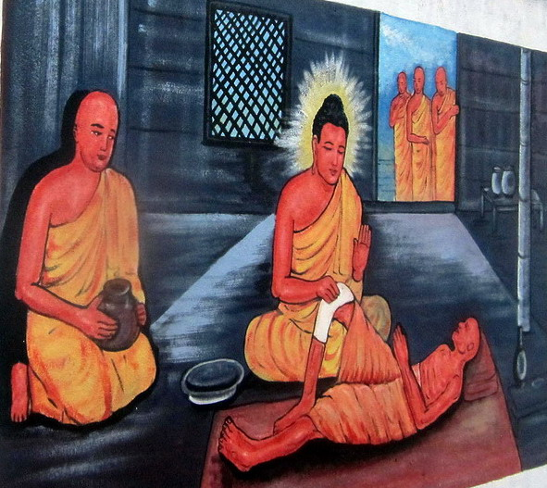
The interconnection of philosophy and medicine is very special theme. Modern medicine is the complex of scientific disciplines, which are theoretical basis for medical practice. Medical knowledge is vast and very heterogeneous. Hence it follows the goal of theoretical synthesis of medical notions and definition of the object of theorization. Medicine deals with man. It is obvious that doctor’s activity is impossible without biological, humanist and technological knowledge.

Slide 16
The vital activity of man has integrated character, which is not reduced to function of his organism.
The concepts such as “holos” that means “whole” have been used more often in modern medicine.
Quite new models of influence at integrate his soul and body, are formed in methods of medicine.
Modern medicine has at its disposal huge reserves of knowledge, but it hasn’t got integrated, fundamental knowledge about man. There are no united connecting lines between different medical theories, conception and philosophic systems of world’s interpretation. The search of such medicine’s basis is the most important task of philosophy. In other words, medicine gives philosophy vast actual material, but philosophy gives medicine general method of scientific and theoretical cognition of life as a whole and vital activity of man especially.

