Slide 1
«General pharmaceutical chemistry »
identification of drugs of organic nature
Identification of organoelement drugs
Associate Professor Gureeva E.S.

Slide 2
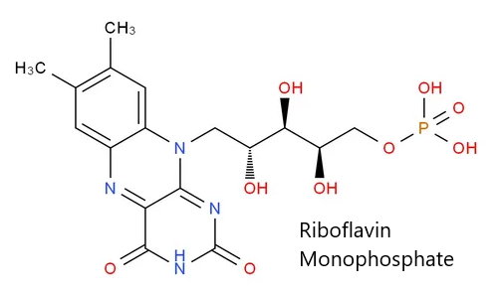
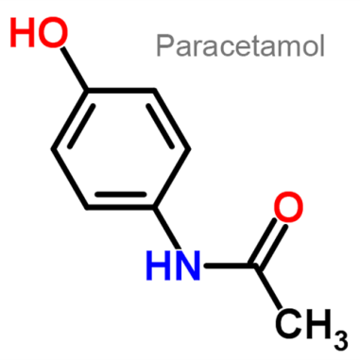
A functional group
A functional group is a reactive atom or group of atoms that determines the chemical properties of a substance, its pharmacological activity and its belonging to a certain class of organic compounds.
The analysis of drugs by functional groups makes it possible
to unify the methods of identification and quantification reactions;
to predict test methods according to their structure.
Medicinal substances are usually polyfunctional compounds. In the identification, reactions are usually conducted for all functional groups, which makes it possible to correctly identify the drug substance.

Slide 3
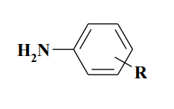
Identification of primary aromatic aminogroup
1. Azo dye formation
1) Diazotization (production of a diazonium salt):

Slide 4
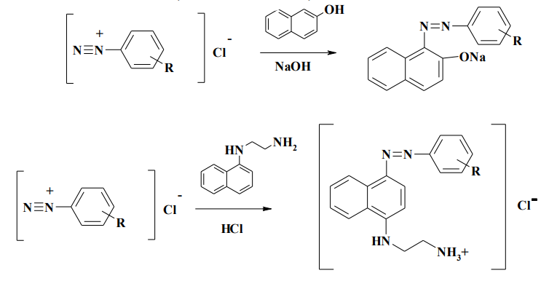
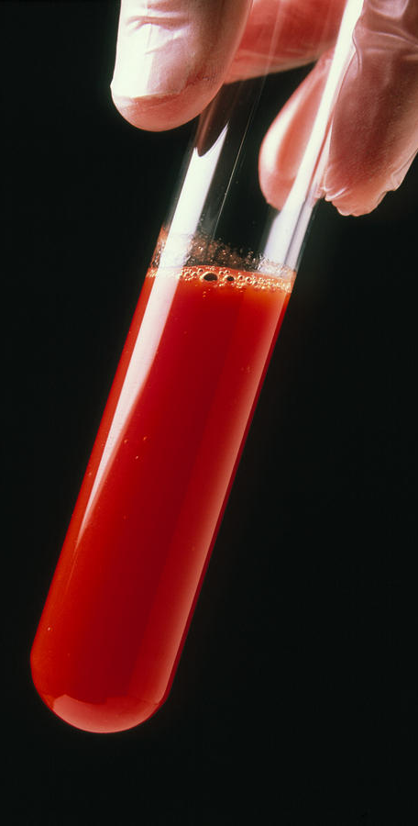
Identification of primary aromatic aminogroup
2) Azo coupling:
Azo dyes are coloured (red, brown and orange) products

Slide 5
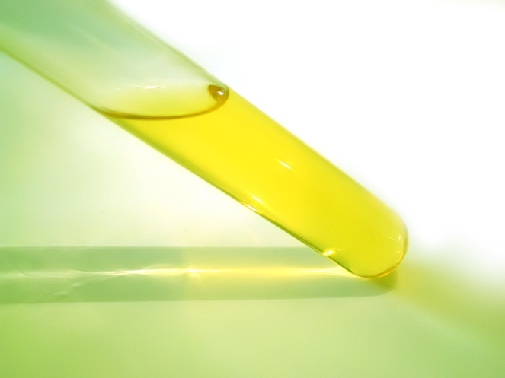
Identification of primary aromatic aminogroup
2. Interaction with 2,4-dinitrochlorobenzene
A sodium acisol dinitrophenyl derivative (yellow) is formed.

Slide 6
Identification of primary aromatic aminogroup
3. Isonitrile test
The resulting isonitriles are detected by the characteristic nauseating smell.

Slide 7
Identification of primary aromatic aminogroup
4. Condensation reaction with aromatic aldehydes (formation of Schiff bases)
The reaction products are usually colored yellow-orange.

Slide 8
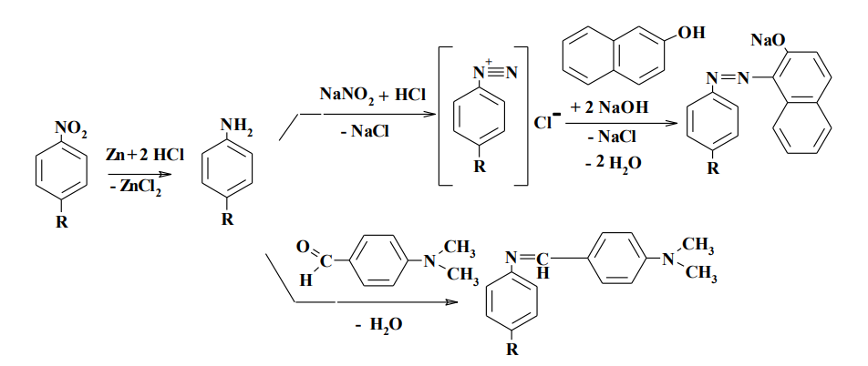
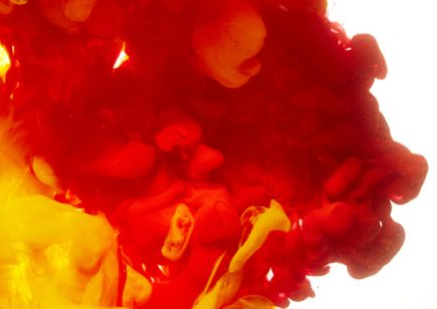
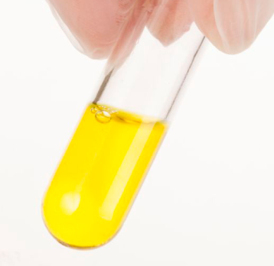
Identification of aromatic nitrogroup
1. Reduction reaction of an aromatic nitro group to a primary aromatic amino group (followed by determination)

Slide 9
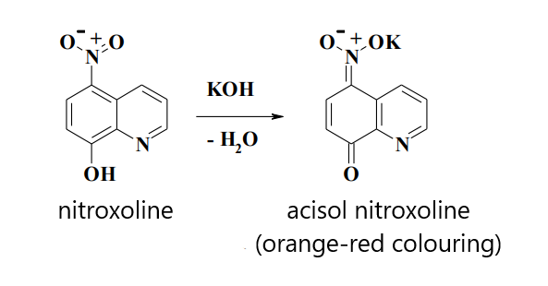
Identification of aromatic nitrogroup
2. The acisol formation reaction

Slide 10
Identification of monobasic alcohols
1. Esterification reaction or acetylation with using acetic anhydride

Slide 11
Identification of monobasic alcohols
2. Oxidation reactions

Slide 12
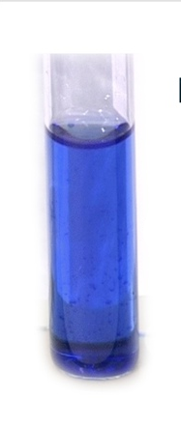
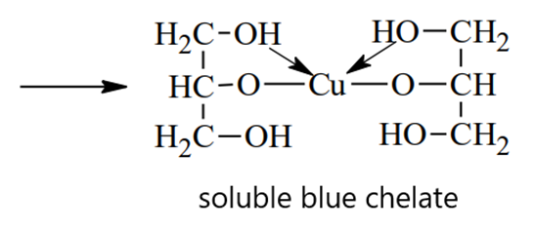
Identification of polybasic alcohols
Reactions of complex compound formation

Slide 13
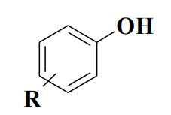
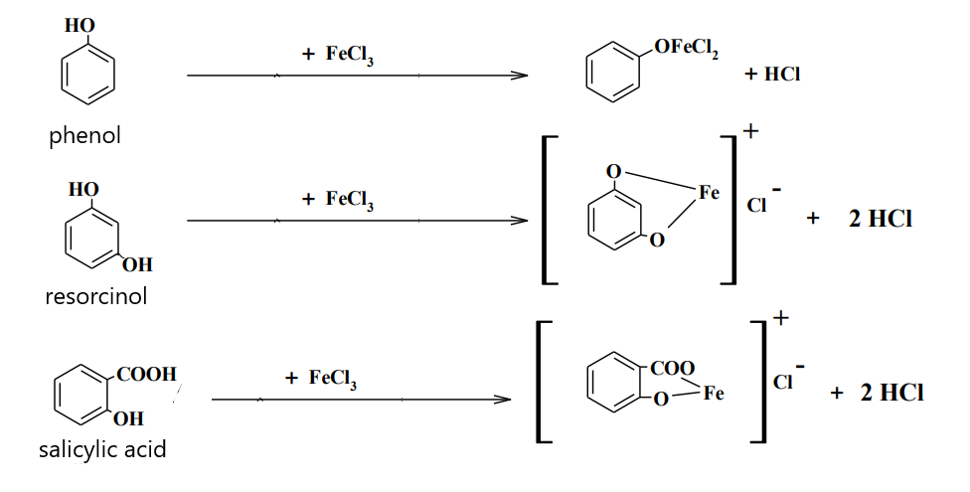
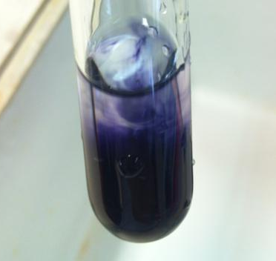
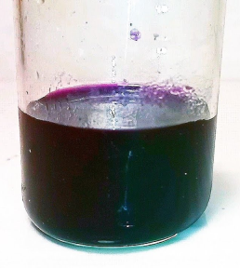
Identification of phenols
1. Complexation reaction with iron (III) ions

Slide 14
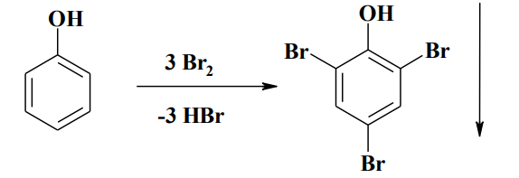
Identification of phenols
2. Halogenation reactions (bromination and iodination)

Slide 15
Identification of phenols
3. Azo coupling (formation of an azo dye)
An intensely colored precipitate is formed

Slide 16
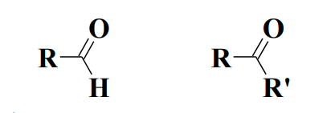
Aldehyde and keto group identification reactions
1. Formation of Schiff bases

Slide 17
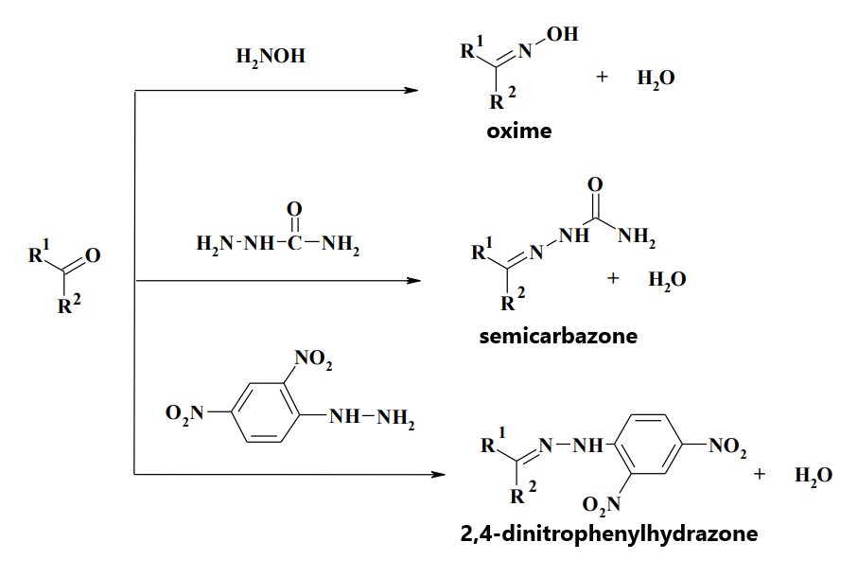
Aldehyde and keto group identification reactions
2. Formation of oximes and hydrazones

Slide 18
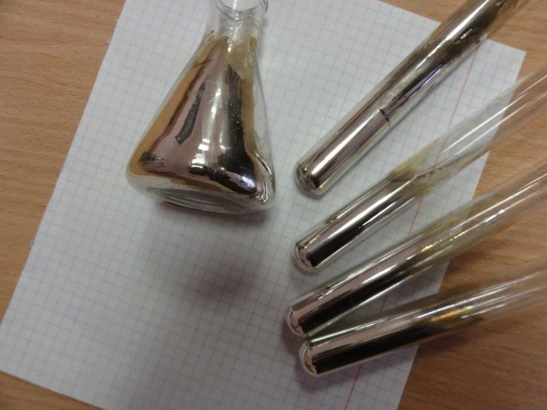
Aldehyde and keto group identification reactions
3. Oxidation reactions of the aldehyde group
a) The reaction of the "silver mirror" with an ammonia solution of silver nitrate:

Slide 19
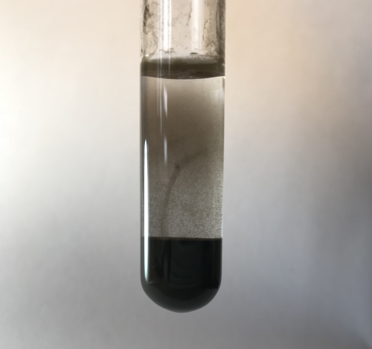
Aldehyde and keto group identification reactions
3. Oxidation reactions of the aldehyde group
b) Interaction with the Nessler reagent in an alkaline medium:

Slide 20
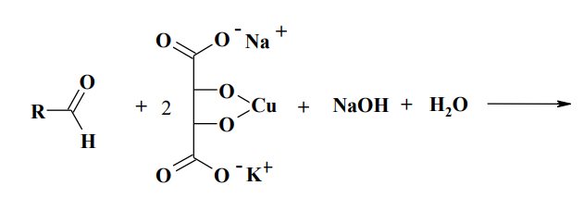
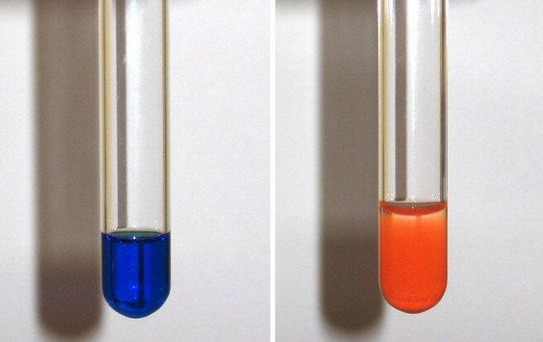
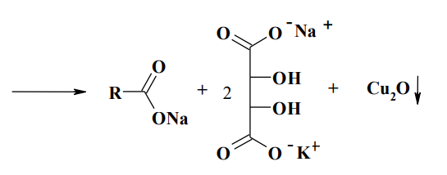
Aldehyde and keto group identification reactions
3. Oxidation reactions of the aldehyde group
c) Interaction with the Fehling reagent:

Slide 21
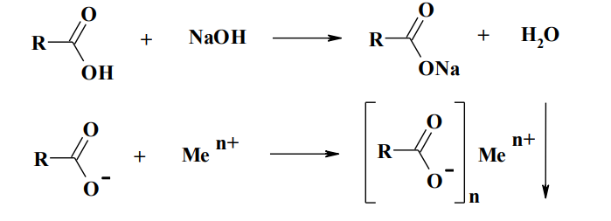
Identification of the carboxyl group
1. Reactions with heavy metal salts

Slide 22
Identification of the carboxyl group
2. Esterification reactions
fruity smell

Slide 23
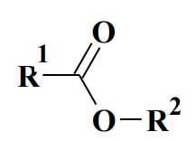
Identification of the ester group
1. Hydrolysis

Slide 24
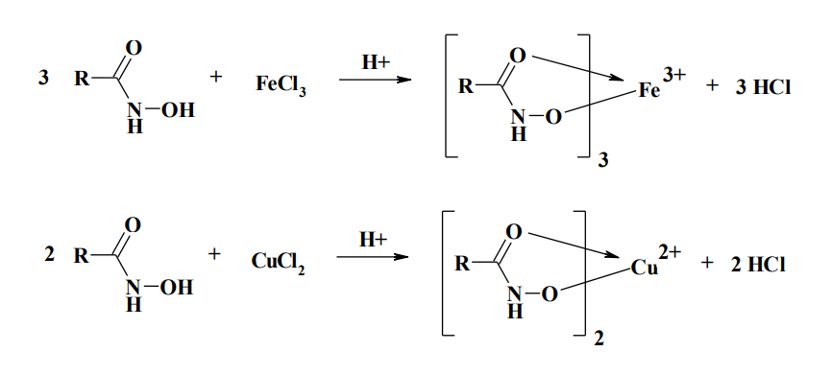
Identification of the ester group
2. Reaction of formation of hydroxamic acids (hydroxamic test)

Slide 25
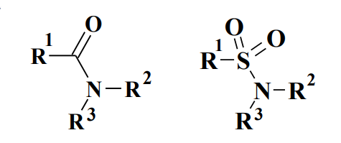
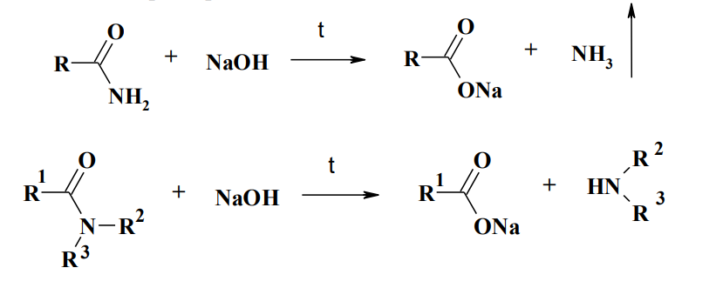
Identification of amide and sulfamide groups
Decomposition reactions of amides

Slide 26
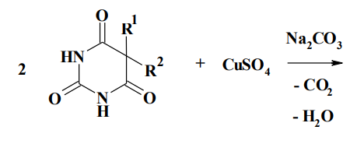
Identification of the secondary amino group
Complexation reactions

Slide 27
Identification multiple bonds
1. Bromination
2. Test with potassium permanganate (Wagner reaction)

Slide 28
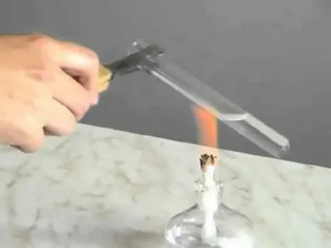
IDENTIFICATION OF ORGANOELEMENT COMPOUNDS
Mineralization
The organic part of the molecule is partially or completely destroyed to carbon monoxide (IV) and water. Other elements form corresponding ions.
Lassen test
Mineralization by heating the test substance with metallic sodium. After mineralization, the resulting solution must be filtered. The filtrate is then used to detect sulfur, halogens and nitrogen.

Slide 29
Sulfur detection
1. Detection in the solution obtained after decomposition by the Lassen method, under the action of sodium nitroprusside
A purple coloration appears, usually turning into a blood-red
2. Detection in a solution obtained after decomposition by the Lassen method using lead acetate

Slide 30
Sulfur detection
3. Detection in the form of sulfate. When organic substances are treated with nitric acid, hydrogen peroxide or potassium permanganate, sulfur is oxidized to sulfate, which is most easily detected when barium chloride is added.
4. Detection of sulfur by direct interaction with sodium hydroxide. The medicinal sulfur-containing organic substance is fused with sodium hydroxide or heated with a 10% solution of it. Covalently bound sulfur forms sulfide, which is proved by smell; by reaction with sodium nitroprusside or after acidification by darkening of filter paper moistened with lead acetate
5. Detection of sulfide obtained by fusing the test substance with a sintering mixture (Na2CO3 + KNO3).

Slide 31
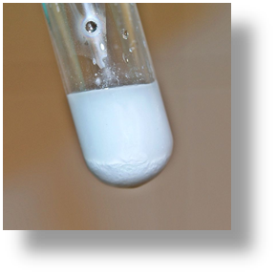
Detection of organically bound halogens
1. Hydrolytic decomposition for medicinal substances containing halogen in the aliphatic chain
chloroethyl

Slide 32
Detection of organically bound halogens
2. Recovery methods. Reactions of reduction of halogen derivatives are usually reduced to the effect on the drug:
atomic hydrogen, which is obtained by the interaction of metallic sodium with anhydrous alcohol,
powdered zinc with a solution of acetic or mineral acid or with a solution of caustic soda.

Slide 33
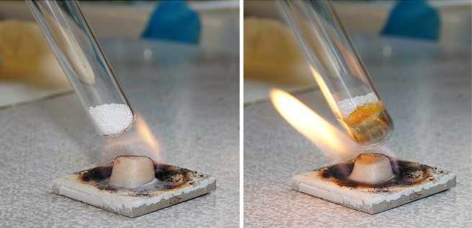
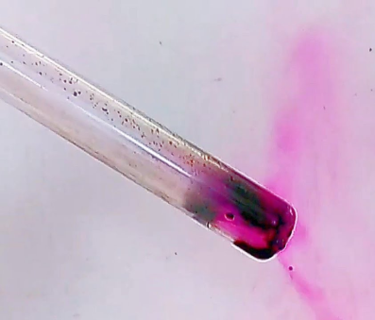
Detection of organically bound halogens
3. Sintering method
4. Detection of iodine

Slide 34
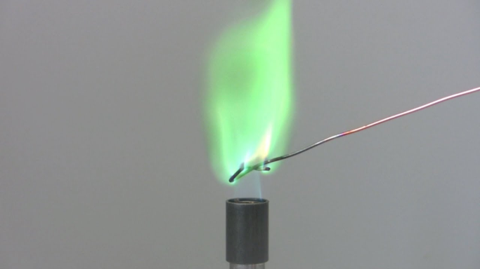
Detection of organically bound halogens
5. The Beilstein test
6. Fluoride detection
The color of the solution changes from red-purple to yellow

Slide 35
Detection of organically bound phosphorus
Phosphorus-containing compounds are mineralized with a mixture of concentrated sulfuric and nitric acids or a mixture for sintering to phosphate ions. Phosphates are detected by the reaction of formation of ammonium phosphorolybdate (yellow precipitate):

Slide 36
Thank you for attention!

