Slide 1
«Special pharmaceutical chemistry»
Pyrimidine-thiazole vitamins
Associate Professor Gureeva E.S.

Slide 2
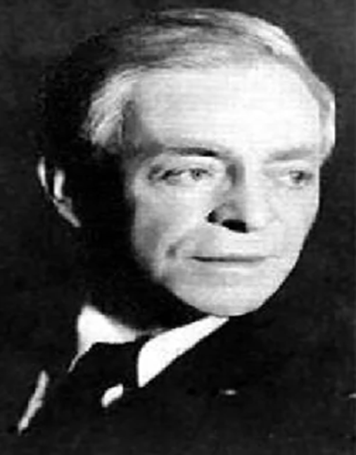
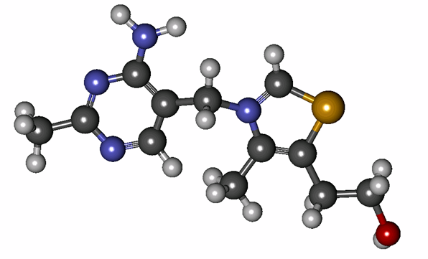
Pyrimidine-thiazole vitamins
History of discovery
Vitamin B1 was isolated in 1912 by Polish scientist K. Funk from rice bran. The discovery of vitamin B1 was associated with an interesting observation. At the beginning of the twentieth century was widespread, especially among sailors, the disease "beri-beri", which means "skin fetters" in Indian. This disease was so named because it is associated with damage to motor and sensory nerves.
Casimir Funk

Slide 3
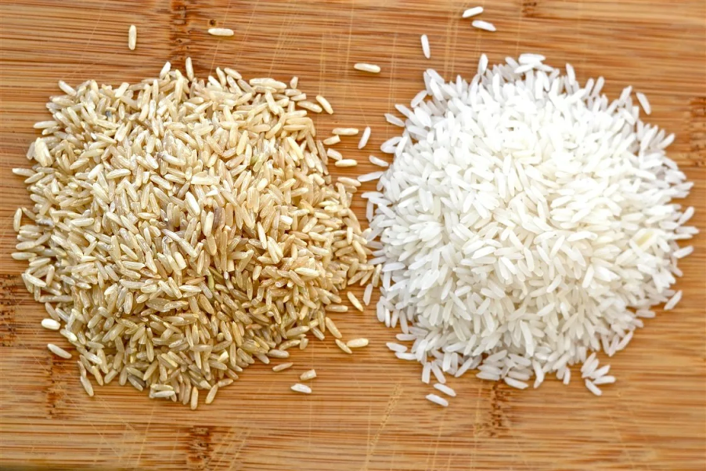
Pyrimidine-thiazole vitamins
History of discovery
A similar disease was found in chickens eating purified rice and was called polyneuritis. Polyneuritis in chickens and beri-beri in humans were found to be the same disease caused by the absence of some substance in the purified rice.

Slide 4
Pyrimidine-thiazole vitamins
Causes of vitamin B1 deficiency
1. Regular coffee intake
2. Reducing the amount of crude fiber in plant material
3. Consumption of refined carbohydrate foods
4. Prolonged heat treatment of food
5. Canning of fruits and vegetables
6. Heavy sweating
7. Presence of chronic infectious diseases.
8. Pregnancy
9. Excessive heating or hypothermia of the body

Slide 5
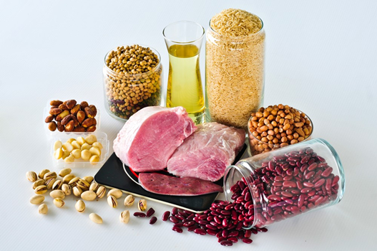
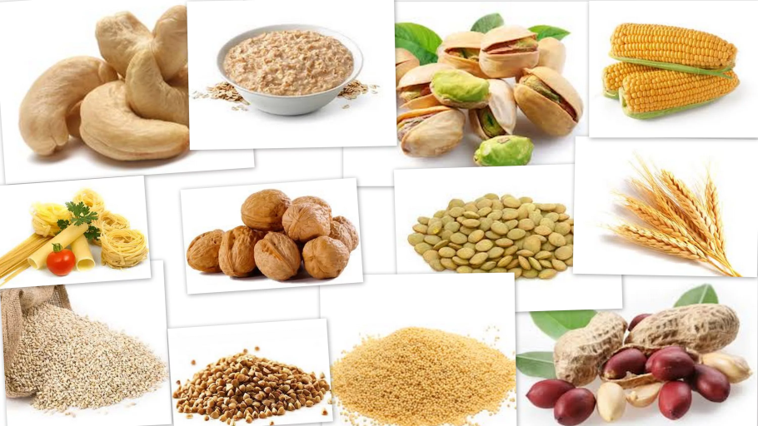
Pyrimidine-thiazole vitamins
Sources of vitamin B1

Slide 6
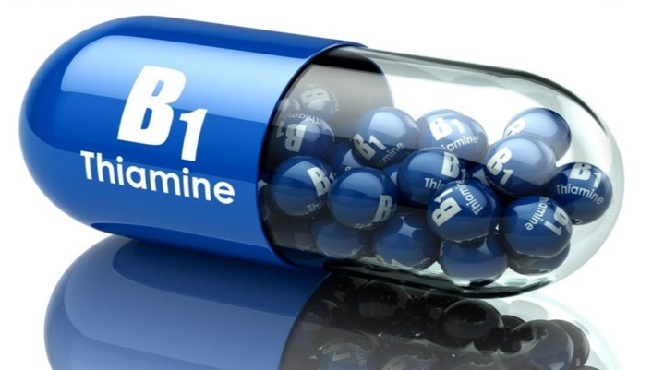
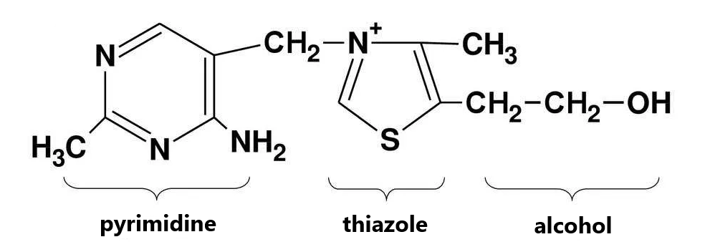
Pyrimidine-thiazole vitamins
The chemical structure
pyrimidine thiazole

Slide 7
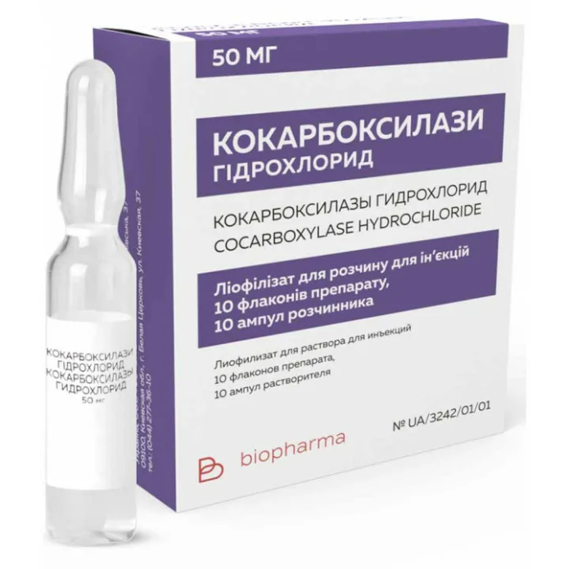
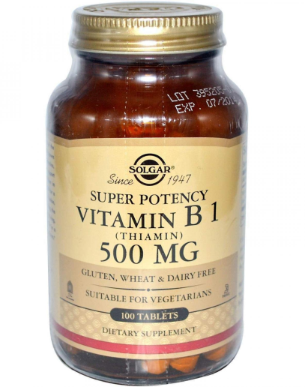
Pyrimidine-thiazole vitamins
In medical practice, thiamine is used in the form of 4 drugs:
benfotiamine
phosphothiamine
thiamine
cocarboxylase (thiamine diphosphate)

Slide 8
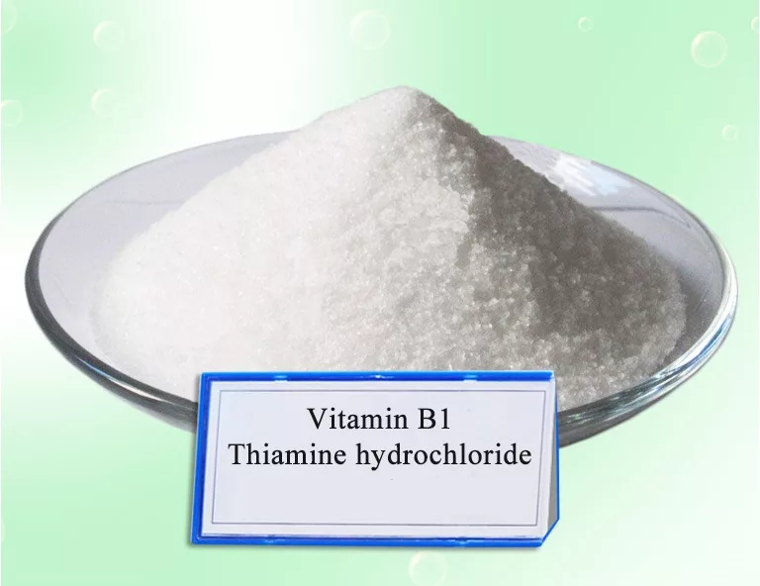
Thiamine bromide and thiamine chloride
Thiamine bromide
They are white or yellowish tinged crystalline substances with a faint characteristic odor. Thiamine chloride is characterized by a slightly higher hygroscopicity.
Easily soluble in water and methyl alcohol, hardly soluble in ethyl alcohol, practically insoluble in ether, acetone, benzene, chloroform.
Thiamine chloride

Slide 9
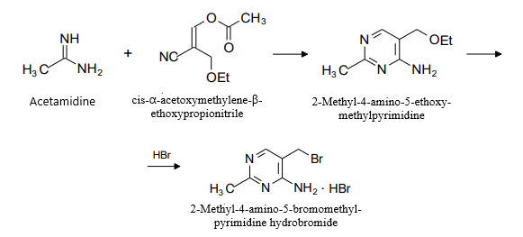
Thiamine bromide and thiamine chloride
Obtaining
The synthesis of the pyrimidine cycle is based on the condensation of acetamidine and cis-α-acetoxymethylene-β-ethoxypropionitrile:

Slide 10
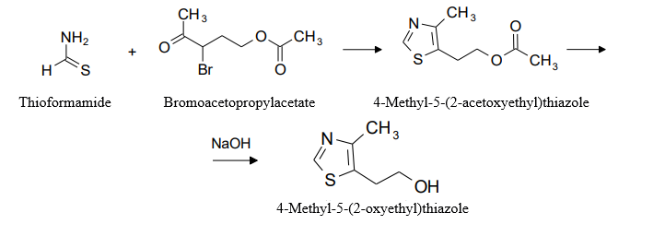
Thiamine bromide and thiamine chloride
Obtaining
The thiazole cycle is synthesized by condensation of thioformamide and bromacetopropylacetate:

Slide 11
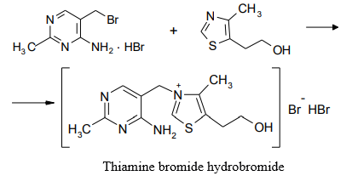
Thiamine bromide and thiamine chloride
Obtaining
The pyrimidine and thiazole parts are linked into one molecule by fusion of the obtained products at 100-120°C or by heating in an organic solvent, e.g., butyl alcohol:

Slide 12
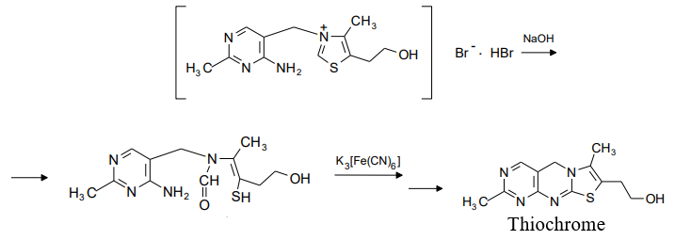
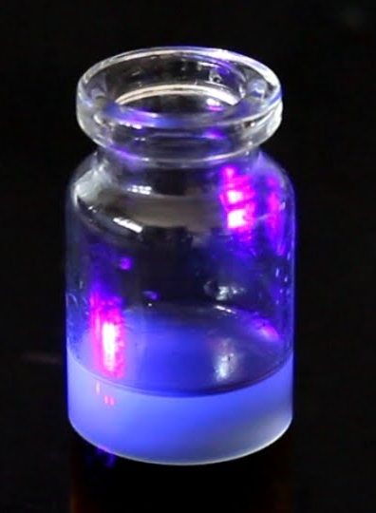
Thiamine bromide and thiamine chloride
Identification
UV spectrometry
Thiochrome test
Thiochrome is extracted from aqueous solutions with butyl or isoamyl alcohol. The obtained alcoholic solutions have a characteristic blue fluorescence under UV irradiation, which disappears upon acidification and reappears upon alkalinization.

Slide 13
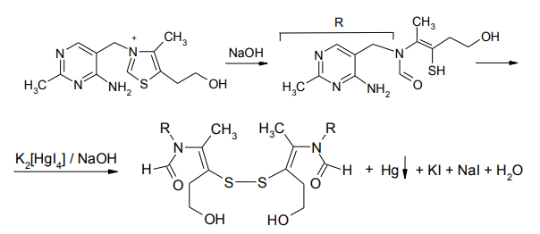
Thiamine bromide and thiamine chloride
Identification
Oxidation with Nessler's reagent
yellow coloration
black

Slide 14
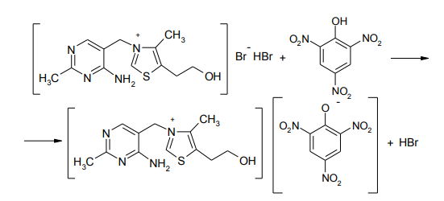
Thiamine bromide and thiamine chloride
Identification
Interaction with common alkaloid reagents
formation of a white precipitate with saturated mercuric (II) chloride solution;
red-brown precipitate with 0.02 M iodine solution;
yellow precipitate of picrate with a saturated solution of picric acid (melting point 206-208 °C).

Slide 15
Thiamine bromide and thiamine chloride
Identification
Alloying with alkalis
When alloying with crystalline caustic alkalis, thiamine is destroyed with the formation of sulfides, which are easily detected with the help of sodium nitroprusside solution:
red-violet coloration appears
Sulfides can be detected by adding lead acetate to the solution obtained after dissolution of thiamine alloy with alkali - a black precipitate is formed:

Slide 16
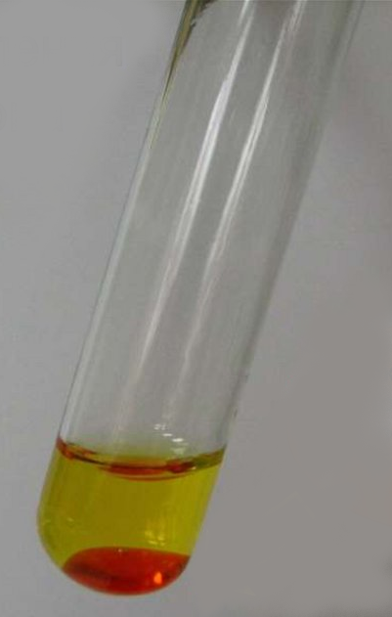
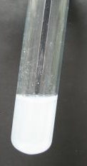
Thiamine bromide and thiamine chloride
Identification
Determination of halides
bromides
The formed bromine stains the chloroform layer red-orange in color
chlorides
A white precipitate is formed

Slide 17
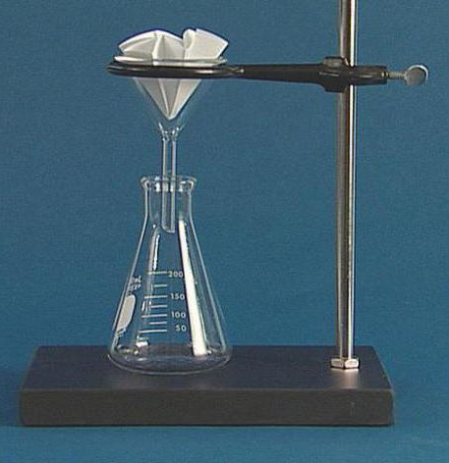
Thiamine bromide and thiamine chloride
Quantification
Gravimetry
The essence of the quantitative gravimetric determination of thiamine bromide recommended by the pharmacopoeial article is to heat a mixture of an aqueous solution of the drug suspension, concentrated hydrochloric acid and 10% solution of silicon tungstic acid.
The formed precipitate is separated, washed on a filter successively with hot dilute hydrochloric acid, then with water and acetone. All operations are carried out on a funnel dried to a constant mass, which is dried together with the precipitate, cooled in the desiccator and weighed. The mass of the precipitate multiplied by a factor of 0.25 corresponds to the amount of thiamine bromide.

Slide 18
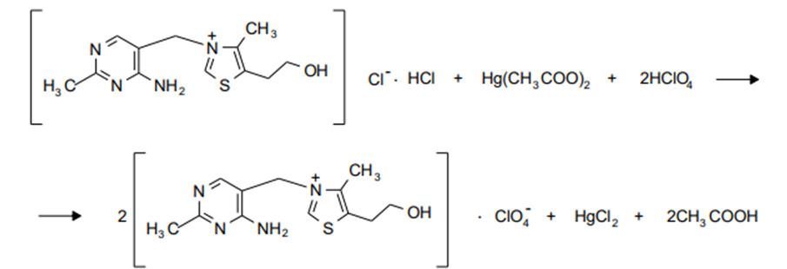
Thiamine bromide and thiamine chloride
Quantification
Non-aqueous titration
Anhydrous acetic acid is used as a solvent, 0.1 M chloric acid solution serves as a titrant, and crystal violet is the indicator:
Titrate until the color changes from violet through blue to bluish-green.

Slide 19
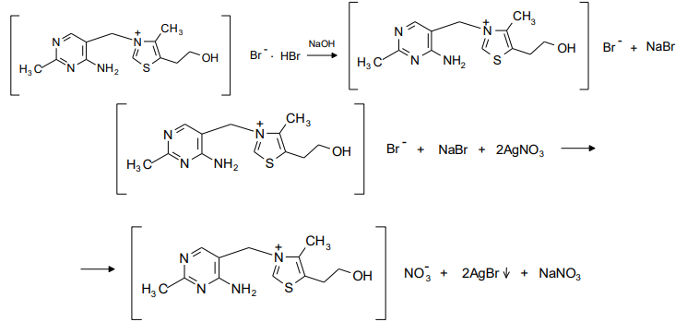
Thiamine bromide and thiamine chloride
Quantification
Argentometry. Volgard method

Slide 20
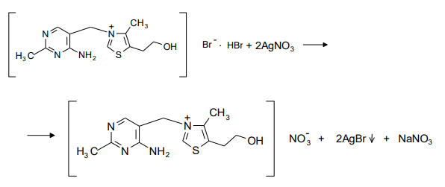
Thiamine bromide and thiamine chloride
Quantification
Argentometry. Fayans method
Bromophenol blue is an indicator in the presence of dilute acetic acid

Slide 21
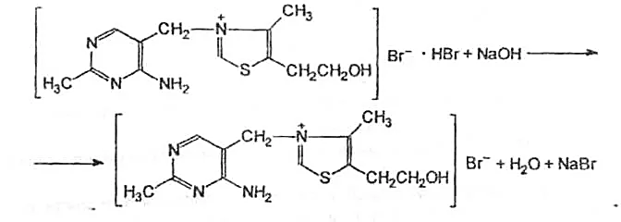
Thiamine bromide and thiamine chloride
Quantification
Alkalimetric titration
The indicators are bromthymol blue or phenolphthalein

Slide 22
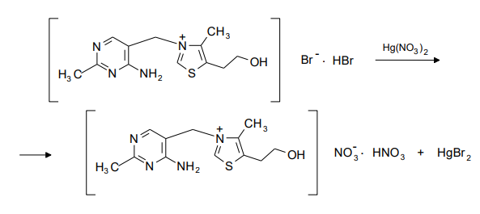
Thiamine bromide and thiamine chloride
Quantification
Mercurimetry

Slide 23
Thiamine bromide and thiamine chloride
Storage
Thiamine preparations are stored in hermetically sealed containers, protected from light and avoid contact with metals. Keep away from children.
Medical use
Thiamine - vitamin B1 - is a water-soluble vitamin. It is a coenzyme of enzymes responsible for the regulation of protein and carbohydrate metabolism. Thiamine ensures the conduction of nerve impulses in synapses (the point of contact between two neurons). It also has an antioxidant effect and increases the protection of cell membranes from the toxic effects of peroxidation products.
Thiamine preparations are prescribed for nervous system disorders.

Slide 24
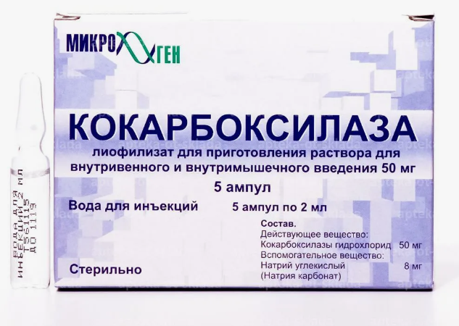
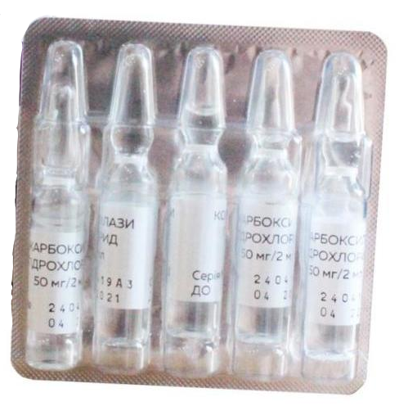
Cocarboxylase hydrochloride

Slide 25
Cocarboxylase hydrochloride
Obtaining
Synthesis of the pyrimidine cycle is based on condensation of acetamidine and cis-α-acetoxymethylene-β-ethoxypropionitrile:

Slide 26
Cocarboxylase hydrochloride
Obtaining
The thiazole cycle is synthesized by condensation of thioformamide and bromacetopropylacetate:

Slide 27
Cocarboxylase hydrochloride
Obtaining
The pyrimidine and thiazole parts are linked into one molecule by fusion of the resulting products at 100-120 °C, or by heating in an organic solvent, such as butyl alcohol, and then treated with two moles of phosphoric acid:
Physical properties
Cocarboxylase is characterized by high hygroscopicity. The drug is easily soluble in water, insoluble in ethyl alcohol and practically insoluble in other organic solvents. Aqueous solutions (5-6%) of the drug have pH 2.7 - 3.4.

Slide 28
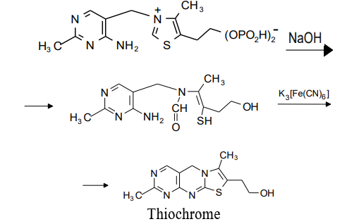
Cocarboxylase hydrochloride
Identification
Infrared spectroscopy
Thiochrome test

Slide 29
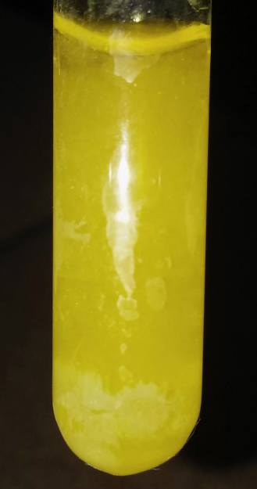
Cocarboxylase hydrochloride
Identification
Reaction for phosphate ions after dissolving the drug in dilute nitric acid.
Chloride detection reaction.

Slide 30
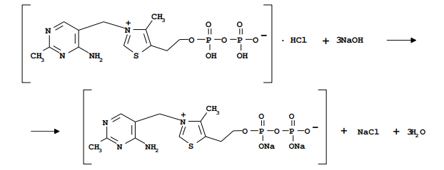
Cocarboxylase hydrochloride
Quantification
Neutralization method
The content of cocarboxylase hydrochloride is determined by neutralization of the drug suspension with sodium hydroxide solution using thymolphthalein as indicator.

Slide 31
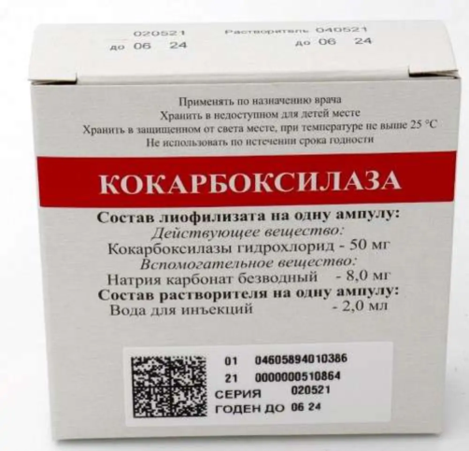
Cocarboxylase hydrochloride
Storage
Store in a dry place protected from light at room temperature.
Medical use
Cocarboxylase hydrochloride for injection is administered intramuscularly and intravenously for disorders of cardiovascular system and coronary circulation.

Slide 32
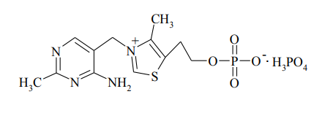
Phosphothiamine
Physical properties
Crystalline powder of sour taste-white color with weak characteristic odor. Phosphothiamine is easily soluble in water, insoluble in ethyl alcohol and practically insoluble in other organic solvents. Aqueous solutions of the drug are slightly acidic.

Slide 33
Phosphothiamine
Obtaining
Synthesis of the pyrimidine cycle is based on condensation of acetamidine and cis-α-acetoxymethylene-β-ethoxypropionitrile:

Slide 34
Phosphothiamine
Obtaining
The thiazole cycle is synthesized by condensation of thioformamide and bromoacetopropylacetate:

Slide 35
Phosphothiamine
Obtaining
The pyrimidine and thiazole parts are linked into one molecule by fusion of the resulting products at 100-120 oC, or by heating in an organic solvent, such as butyl alcohol, and then treated with two moles of phosphoric acid:

Slide 36
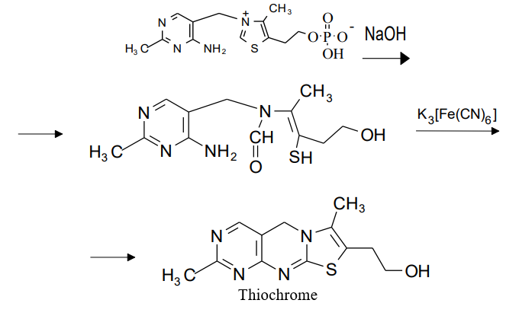
Phosphothiamine
Identification
Infrared spectroscopy.
Thiochrome test:

Slide 37
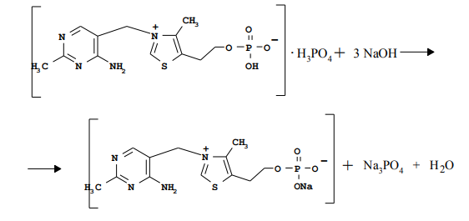
Phosphothiamine
Identification
Determination of phosphorus
Quantification
Neutralization method.

Slide 38
Phosphothiamine
Storage
Store in a dry place protected from light at room temperature.
Medical use
Compared to thiamine chloride and thiamine bromide, phosphothiamine is more deposited in the tissues of the body, less destroyed by the enzyme thiaminase, more easily converted to the active form - cocarboxylase, less toxic.
Used in neuritis, polyneuritis, as an additional remedy for chronic circulatory failure, chronic gastritis, accompanied by impaired motor and secretory (secretion of digestive juices) functions of the stomach.

Slide 39
Benfotiamine
Physical properties
White crystalline powder with weak characteristic odor. Benfotiamine is practically insoluble in water and ethanol, but soluble in 1% sodium hydroxide solution.

Slide 40
Benfotiamine
Identification
IR spectroscopy.
UV spectrometry
Thiochrome test
The reaction is performed after preheating the solution for 20 min on a boiling water bath.
Determination of phosphate after hydrolysis
Quantification
Medical use
Spectrophotometry
Benfotiamine is used as an analog of thiamine, more resistant than it to the action of thiaminase. It is available in the form of tablets.
Storage
Benfotiamine is stored in a dry place protected from light at room temperature.

Slide 41
Thank you for attention!

