Slide 1
«General pharmaceutical chemistry »
Impurities in medicines and their sources
Associate Professor Gureeva E.S.

Slide 2
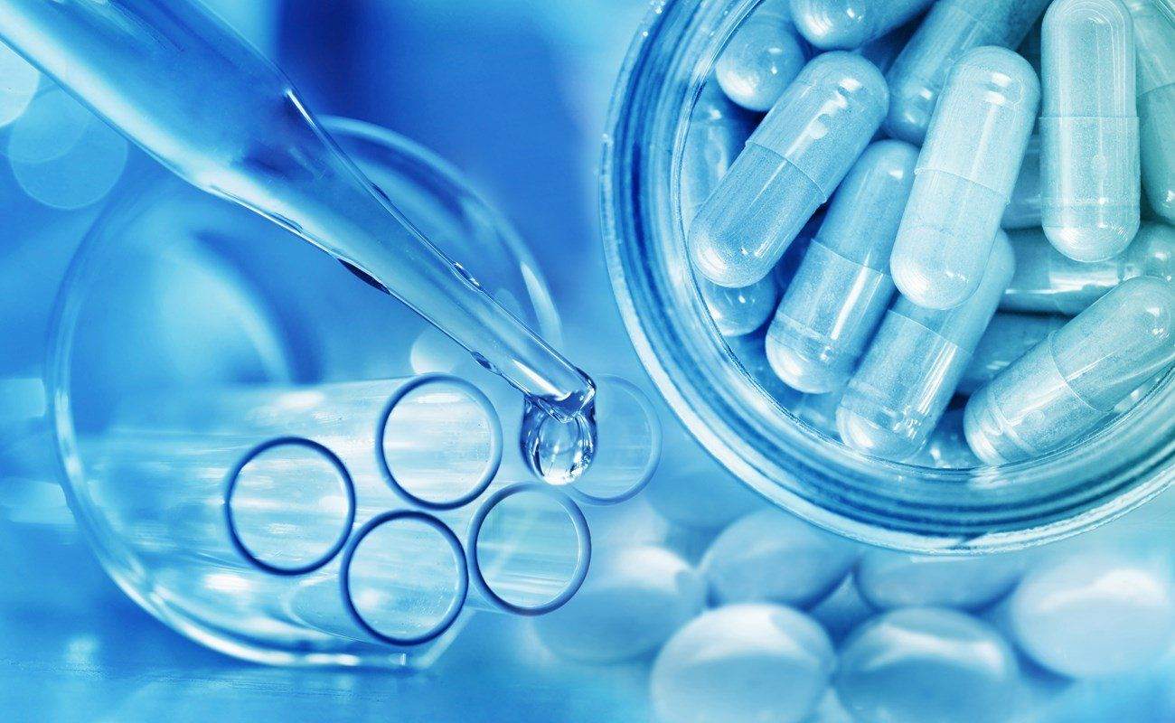
What is an impurity?
Impurity is the unwanted or undesired compound or component in desired product

Slide 3
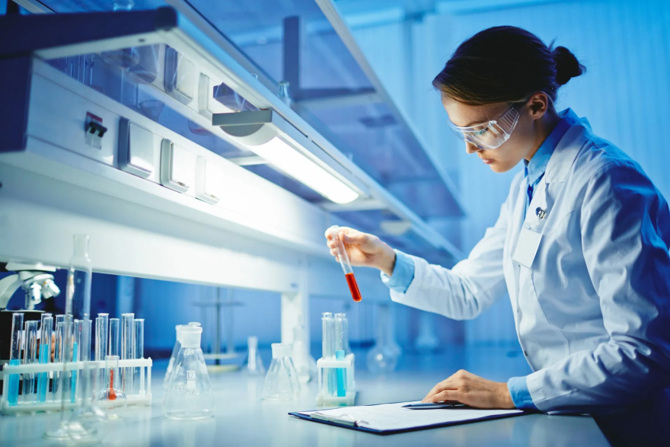
What is an impurity?
International Conference on Harmonization (ICH) defines it for drug substance and drug product as
«Any component of the new drug substance which is not the chemical entity defined as the new drug substance and any component of the new drug product which is not the chemical entity defined as the drug substance or an excipient in the drug product».

Slide 4
Importance of research and control of impurities in pharmaceutical substances
The ICH has published the guidelines for the analysis of impurities in new drug substances and drug products. It has also published the guideline for the analytical method validation for the impurity identification and quantification to check the quality of the products.
The sources of impurities are the major concern for any drug manufacturer. Hence the control of these impurities is very critical at the same time very essential too as some times the effect caused by these impurities can be teratogenic, mutagenic or carcinogenic.

Slide 5
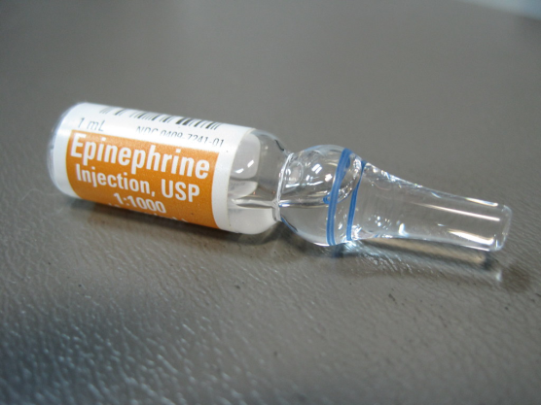
Common terms
Degradation product
A molecule produced by a chemical change in the drug molecule over a period of time and/or by the action of different parameters such as light, temperature, pH, water quality or by reaction with an excipient and/or the immediate container system. It is also called decomposition product.
Enantiomeric impurity
A compound with the same molecular formula as the drug substance that differs in the spatial arrangement of atoms within the molecule and is a non-superimposable mirror image.
Enantiomeric impurity

Slide 6
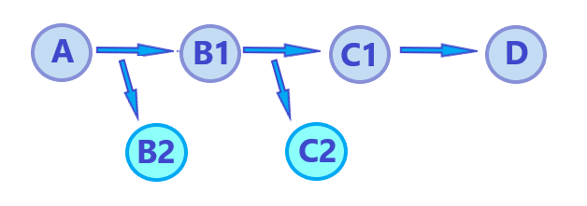
Common terms
Starting material - A material used in the synthesis of a new drug substance that is incorporated as an element into the structure of an intermediate and/or of the new drug substance. Starting materials are normally commercially available and of defined chemical and physical properties and structure.
Interaction product - It is a product formed by the interaction of chemicals in reaction mixture either intentionally or unintentionally.
Intermediate - It is a compounds formed during the synthesis of desired product or as a part of synthetic route.
Penultimate intermediate - the second last compound in the route of synthesis prior to the production of the final desired product.
A - Starting material
B1,B2,C1,C2 - Interaction products
B1,C1- Intermediate
C1- Penultimate intermediate
D - Drug substance

Slide 7
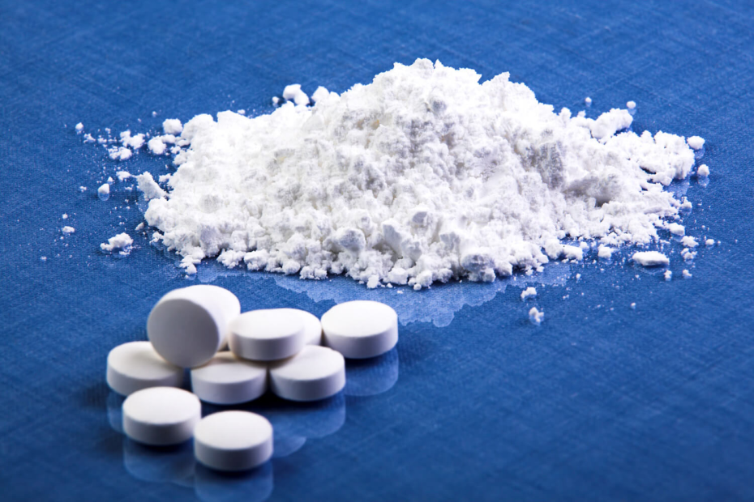
Common terms
New drug product
It is a compounds formed during the synthesis of desired product or as a part of synthetic route.
New drug substance
The designated therapeutic moiety that has not been previously registered in a region or member state (also referred to as a new molecular entity or new chemical entity). It can be a complex, simple ester, or salt of a previously approved drug substance.

Slide 8
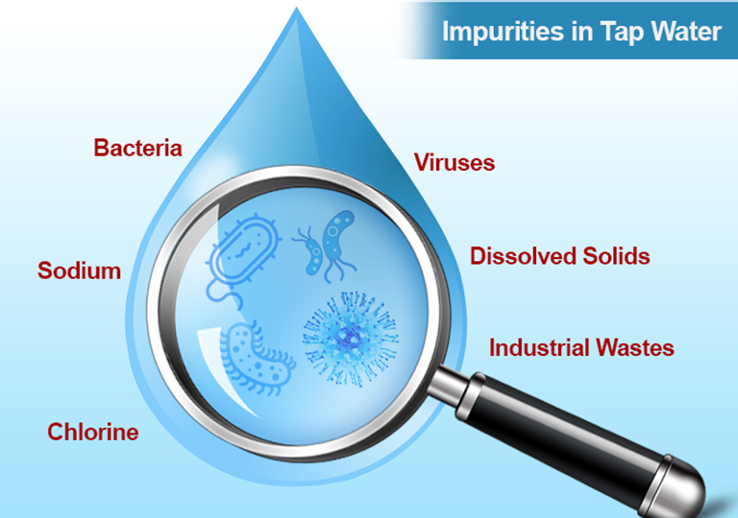
Common terms
Identified impurity
An impurity for which; impurity profiling has been performed and the exact structure of the impurity has been explicated.
Potential impurity
An impurity that theoretically can arise during manufacture or storage. It may or may not actually appear in the new drug substance that may or may not be harmful.
Total impurity
It is a sum of all type of impurities and it is very important for the quality measurement of drug substance and drug product.

Slide 9
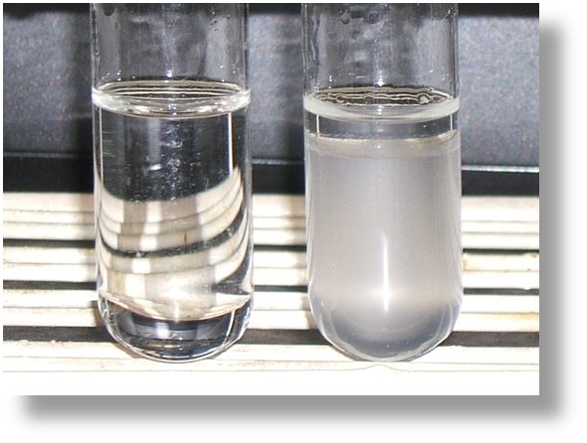
Common terms
Qualification threshold
A limit above which an impurity should be qualified.
Specification
It is a list of tests with references to their analytical procedures and suitable acceptance criteria. According to the specification a drug substance or drug product should pass the acceptance criteria for its intended use.

Slide 10
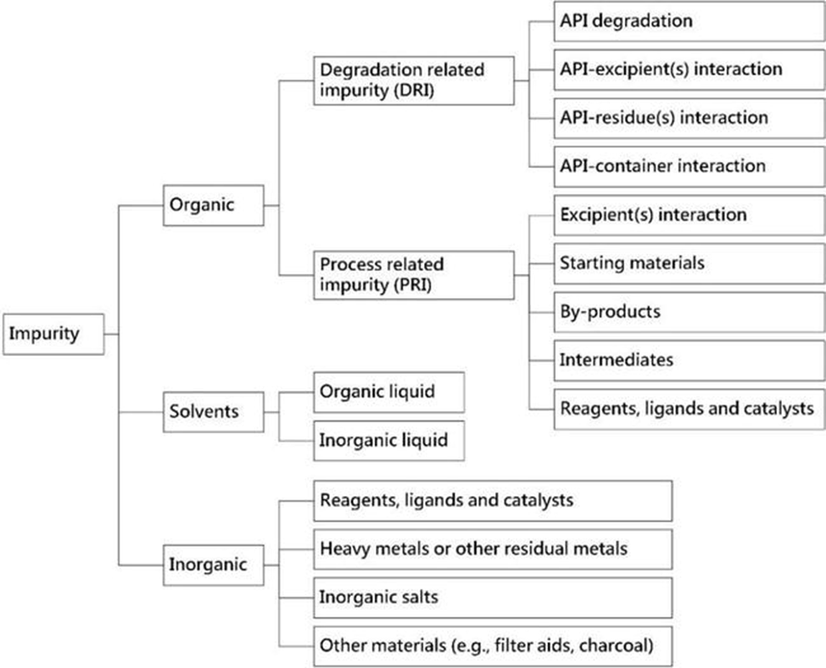
Classification of impurities
According to the definitions of International Council for Harmonization (ICH)

Slide 11
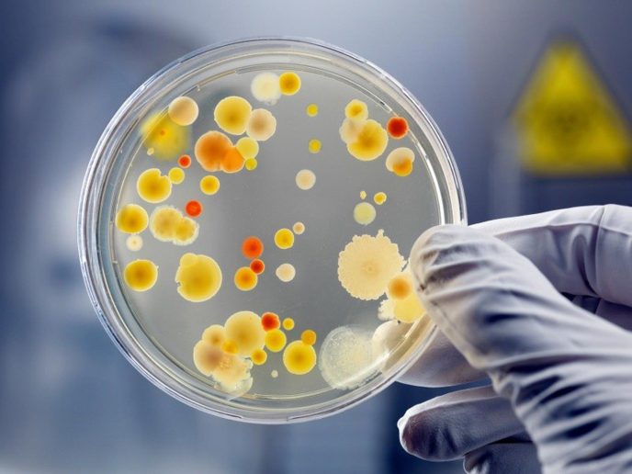
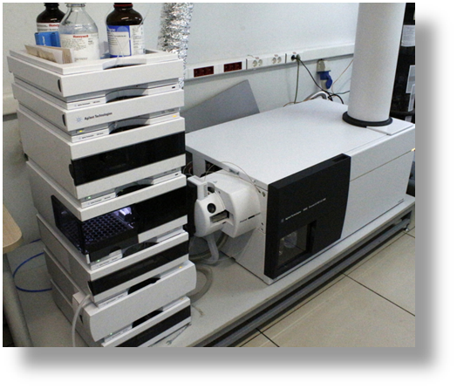
Classification of impurities
Even microbiological impurities are also of great importance in especially parental drug formulation and injectables.
On the basis of their identification
Enantiomeric impurity
Inorganic impurity
Organic impurity
Polymorphic impurity
Residual solvents

Slide 12
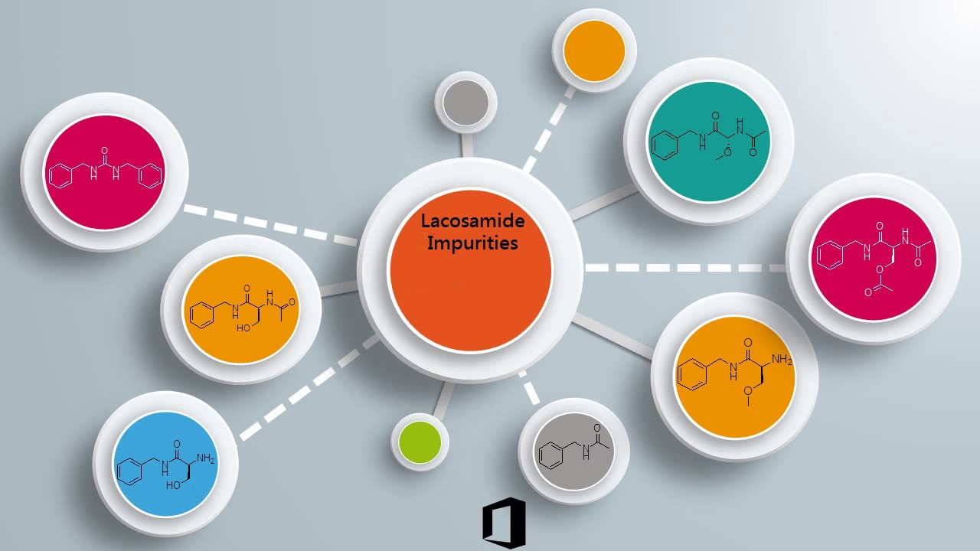
Sources of impurities
The various sources of impurities in pharmaceutical drug substance and drug product are given below:
Chemical related impurity
By products
Degradation products
Excipient degradation
Intermediates
Residual solvents
Starting material or raw material

Slide 13
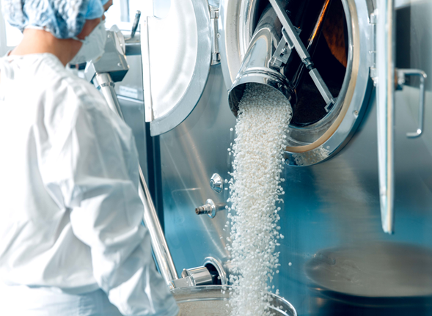
Sources of impurities
Operation related impurity
Centrifuging
Crystallization
Filtration
Glassware contamination
Human operation contamination
In-process operations
Isolation of products and by products
Machinery contamination
Reactor contamination
Solvent extraction
Resolution and racemization of chiral molecules
Drying of the product by different drying methods
Stirring
Transportation of the product

Slide 14
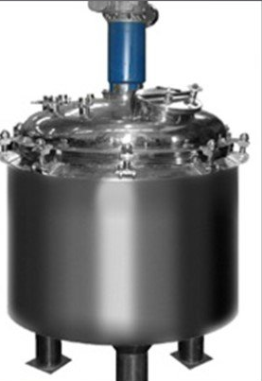
Sources of impurities
Method parameters related impurity
Density
Humidity
Light intensity especially in the case of light sensitive products
pH of the reaction mixture
Pressure of the reactor
Product contact time
Stirring time
Temperature
Viscosity

Slide 15
Sources of impurities
Storage and aging related impurity Contamination by
microbes on long storage
Different storage condition
Interaction amongst the components and packaging
material Light exposure
Packaging material
Transportation environment
Functional group related impurity
Decarboxylation
Ester hydrolysis
Hydrolysis
Oxidative degradation
Photolytic cleavage

Slide 16
Factors affecting the presence of impurities
Various factors affecting the presence of impurities in a drug can be divided into:
Technological factors: the degree of purity of the starting products, temperature, pressure, pH of the medium, solvents, mode and temperature of drying - all these factors can lead to the appearance of impurities that accumulate from one stage to another.
The second group of factors affecting the purity is a violation of the conditions and duration of storage, drying, grinding, transportation.
The third group of factors is the dust and gas contamination of production facilities of chemical and pharmaceutical enterprises (cross contamination).
The fourth group of factors is the contamination of drugs obtained from plant materials with associated natural compounds.
Thus, all pollution factors are divided into
technological (1 and 4 hours)
acquired (2. 3.).

Slide 17
Acquired impurities
Prevention of cross-contamination during production
The possibility of contamination of raw materials must be eliminated. The risk of accidental cross-contamination is increased by the uncontrolled spread of dust, gases, vapours, aerosols or microorganisms present on materials and products, equipment, clothing and human skin and introduced by insects.
The degree of risk depends on the type of contamination and the product affected. The most dangerous contaminants include
sensitizers,
biological preparations containing live microorganisms,
certain hormones,
cytotoxins,
and potent substances.
Contamination is especially dangerous for medicines used for injection or to treat open wounds, as well as those intended for long-term use or high doses.

Slide 18
Acquired impurities
To prevent cross-contamination, considering the conditions of production, the following measures should be taken:
reducing the risk of pollution caused by recirculation or re-entry of untreated or insufficiently treated air;
taking special measures to prevent the formation and spread of dust in case of use in the production of dry materials and products;
use of specially equipped rooms for weighing raw materials;
personnel wearing appropriate process clothing and storing protective clothing within product manufacturing areas with a high risk of cross-contamination;
use of highly effective certified (validated) methods for cleaning equipment and premises;
control of the absence of residues of the previous product or detergent and marking of equipment indicate the status of cleanliness.

Slide 19
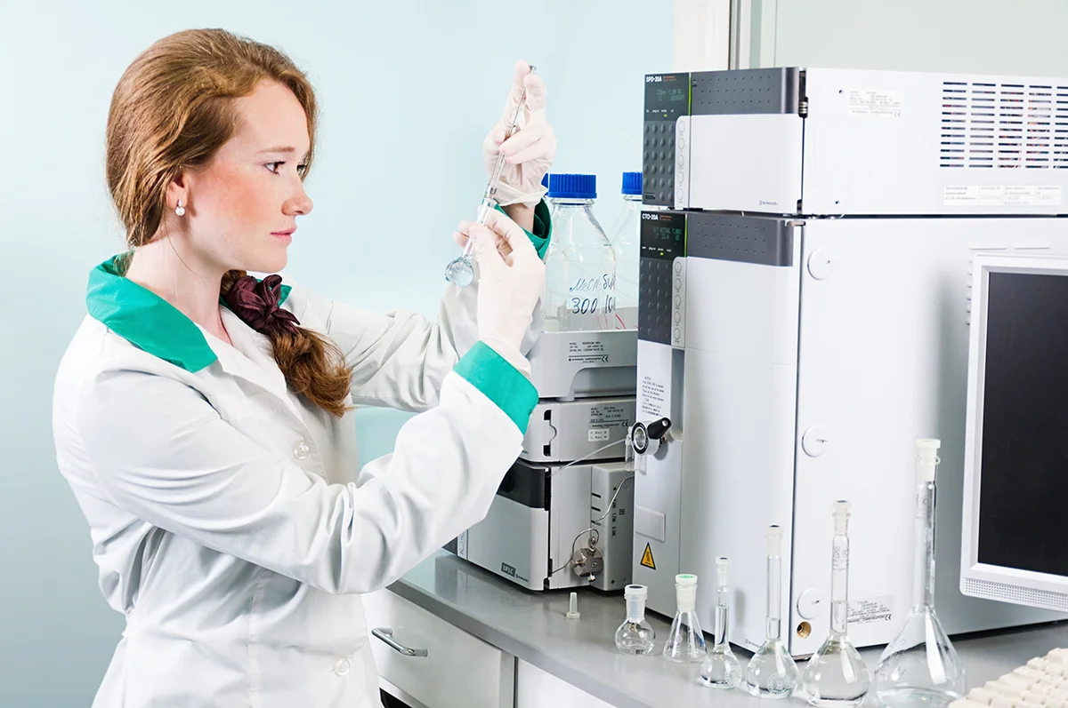
Technological impurities
Any material that may affect the purity of a pharmaceutical substance or finished drug product, is considered an impurity. Impurities occur from a variety of sources, which typically include:
raw material itself
intermediate products;
by-products;
decomposition products;
tautomers

Slide 20
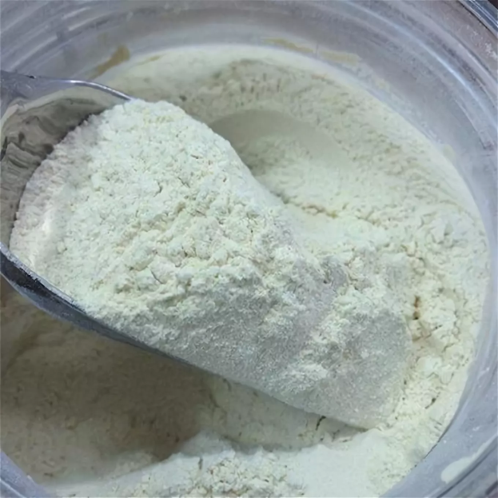
Technological impurities
Raw material
Substance starting materials are raw materials, intermediates that are used to produce other APIs, and those that are included as an important building block in the formulation. API starting materials are usually described by chemical properties and structure.
System or approach for selecting raw materials:
A starting material is a compound whose name, chemical structure, chemical and physical characteristics and properties, and impurity profile are clearly defined in the chemical literature.
The influence of the quality of the starting material on the quality of the pharmaceutical substance has been studied and controlled.
The starting material is commercially available and is included in the new drug substance as an important structural element.
The starting material has been characterized, and the stability has been well studied.

Slide 21
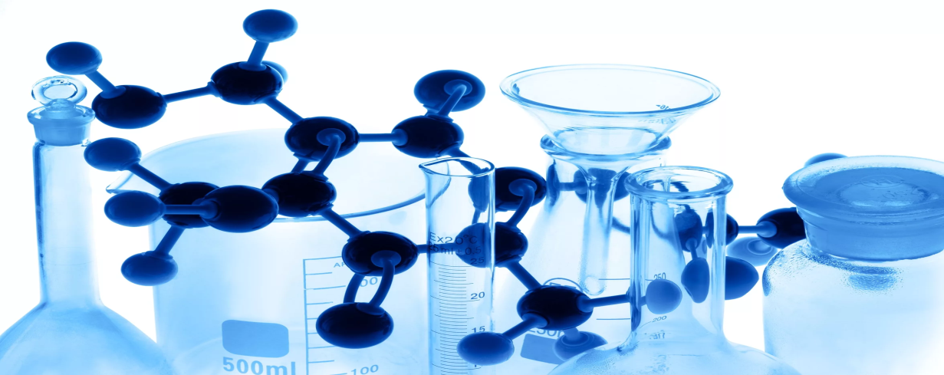
Technological impurities
Intermediates:
Organic compounds formed during the synthesis of a pharmaceutical substance are called intermediates.
Non-reactive intermediates
Non-reactive intermediates are impurities that are formed at some intermediate stage of the reaction because of the interaction of reagents. Such impurities remain inactive in later stages.
Reactive intermediates
Reactive intermediates are by-products or impurities resulting from intermediate steps of a reaction that may react with reactants or catalysts used in later steps. They pass to every stage up to the final pharmaceutical substance as reactive intermediates.

Slide 22
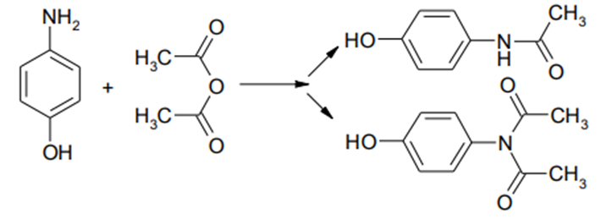
Technological impurities
By-products
In synthetic organic chemistry, obtaining one 100% pure final product is a rather rare phenomenon. This is because of the conversion of the parent material into by-products, which may result from various side reactions such as incomplete reactions, reaction continuation, isomerization, or undesired reactions between starting materials, intermediates, chemicals or catalysts.
For example, in the mass production of paracetamol, it can be formed as a by-product diacetylated paracetamol.

Slide 23
Technological impurities
Decomposition products
During the production of drugs, the substance is subjected to various influences, as a result of which decay processes are possible. For example, if heat is used during drying or other steps, it can contribute to the breakdown of thermally labile substances. In solutions and suspensions, the decomposition of a substance is more likely because of hydrolysis or solvolysis processes.
Impurities formed during the decomposition or breakdown of the final product during the manufacture of a medicinal product are also called degradation products.
This term also includes degradation products resulting from storage, formulation, or aging.

Slide 24
Technological impurities
Tautomeric impurities
Tautomers are isomers that coexist in equilibrium. If the tautomer is thermodynamically stable and is the basic form, the other tautomers should be considered as impurities. Tautomers differ in their kinetic and thermodynamic stability, which makes it difficult to determine them, despite the fact that they can be separated, isolated or analyzed.
Therefore, the term “tautomer admixture” is used.

Slide 25
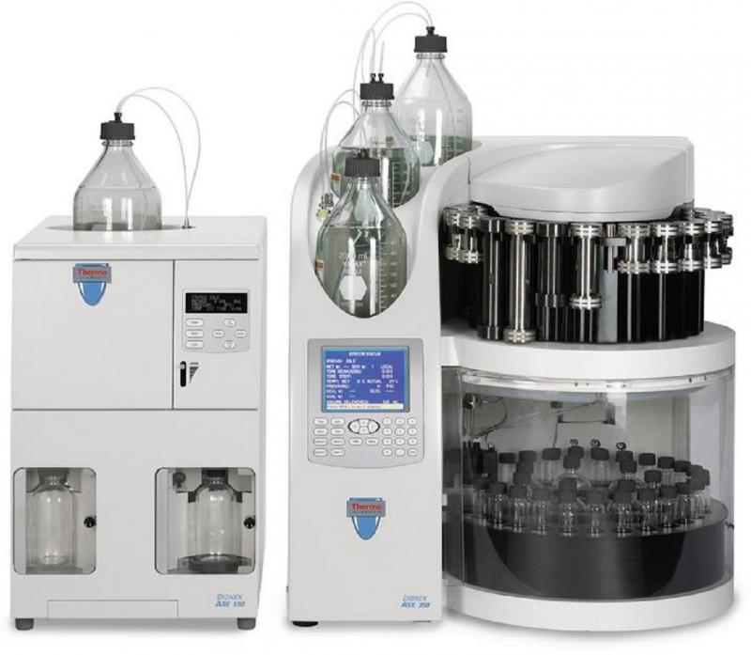
Impurity isolation methods
Accelerated solvent extraction

Slide 26
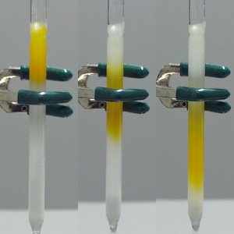
Impurity isolation methods
Column chromatography

Slide 27
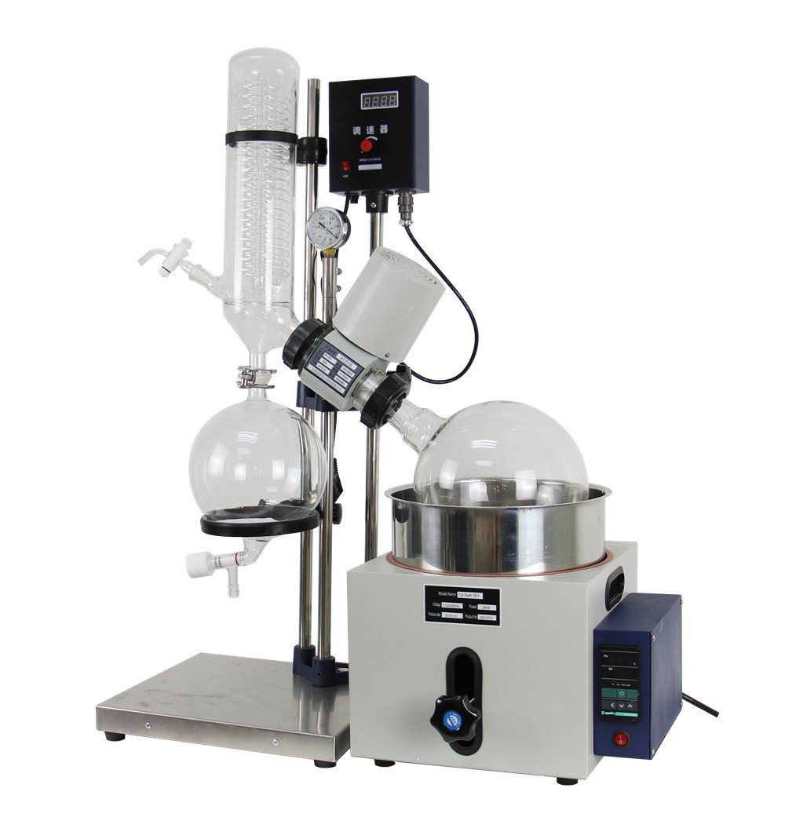
Impurity isolation methods
Different types of drying methods like microwave drying, freeze drying, rotary drying, fluid bed drying (FBD), Tray drying, vacuum tray drying, belt drying etc.

Slide 28
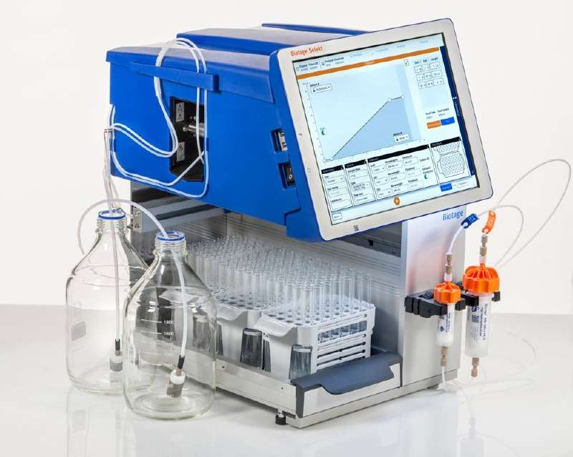
Impurity isolation methods
Flash chromatography

Slide 29
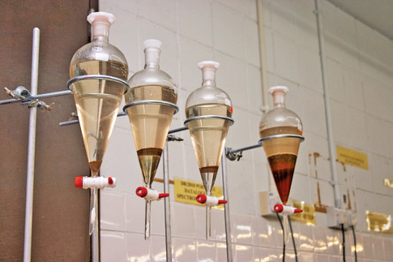
Impurity isolation methods
Liquid-liquid extraction

Slide 30
Impurity isolation methods
Preparative liquid chromatography

Slide 31
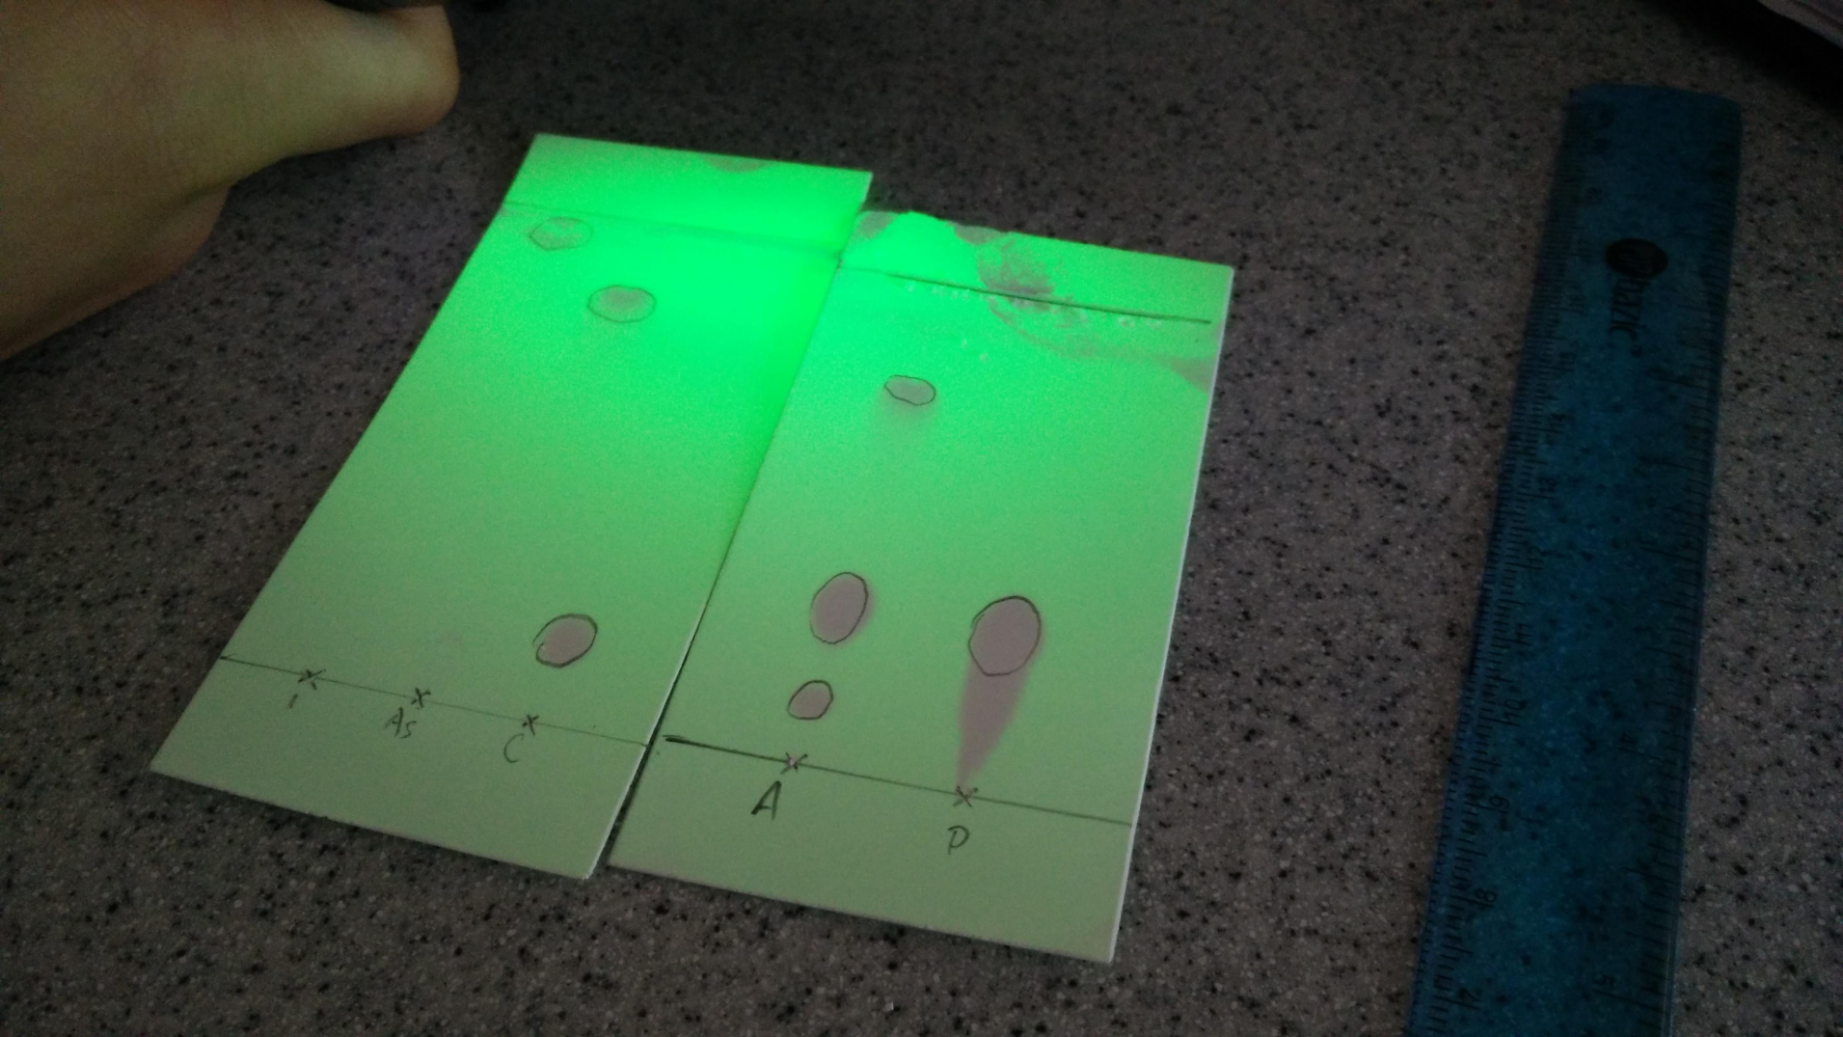
Impurity isolation methods
Preparative thin layer chromatography (TLC)

Slide 32
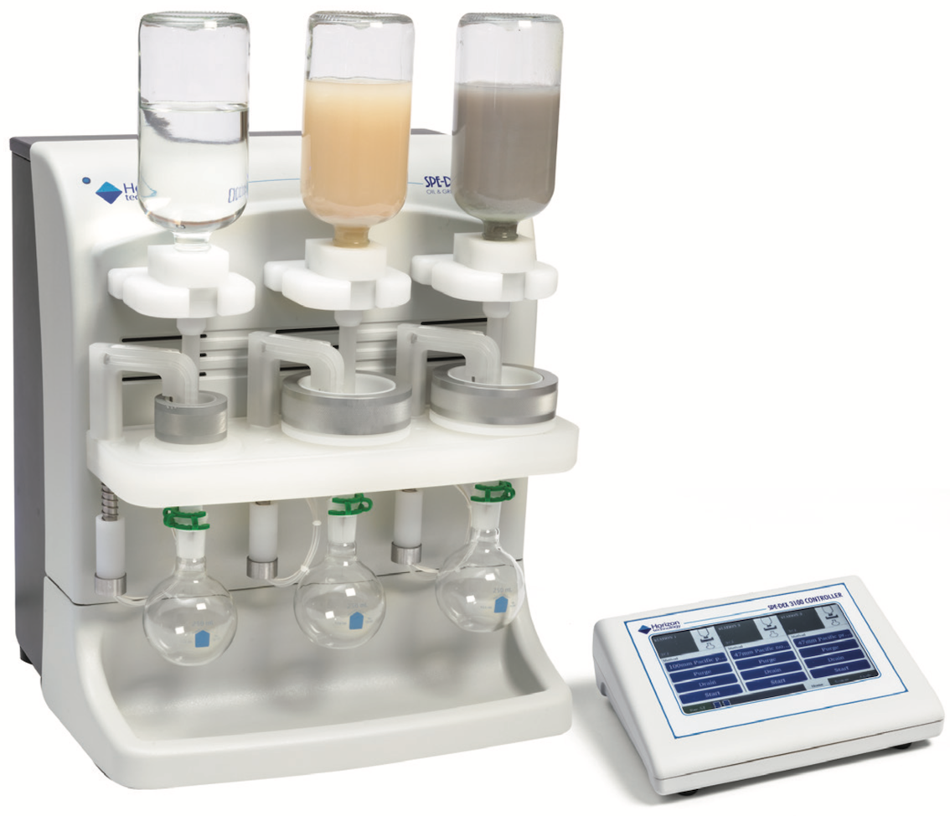
Impurity isolation methods
Solid phase extraction

Slide 33
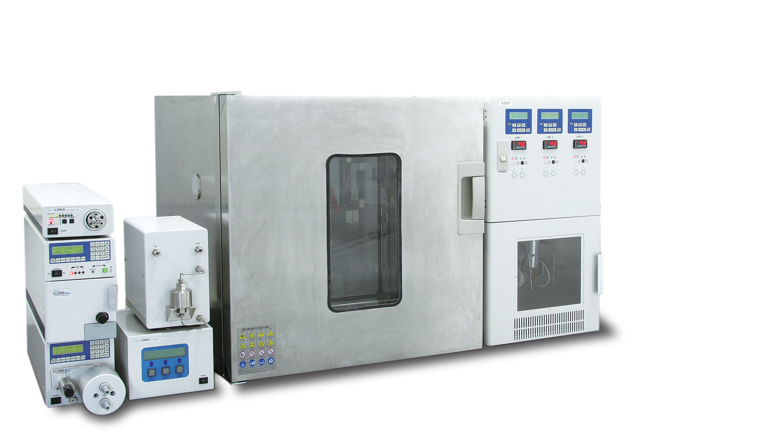
Impurity isolation methods
Supercritical fluid extraction (SFE)

Slide 34
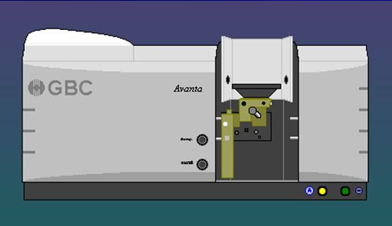
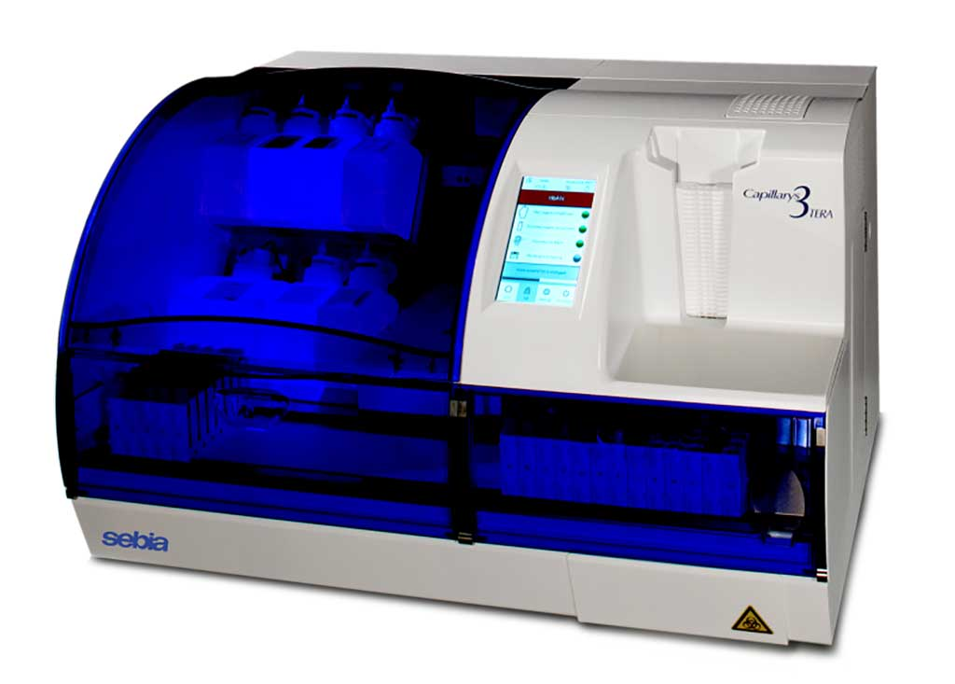
Analytical methods
Once an impurity has been isolated, it is identified (I) and quantified (Q) using the following methods:
Atomic absorption spectroscopy (AAS) (I/Q)
Capillary electrophoresis (CE) (I/Q)

Slide 35
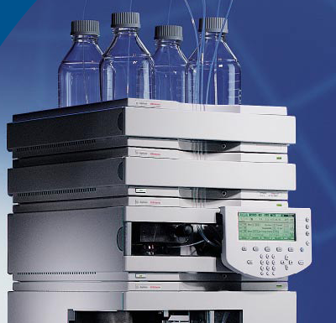
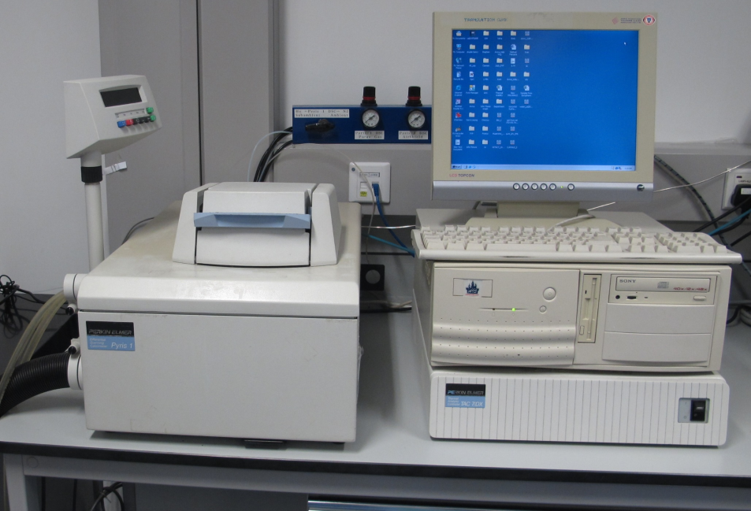
Analytical methods
Chiral High performance liquid chromatography (C-HPLC) (I/Q)
Differential scanning calorimeter (DSC) (I/Q)

Slide 36
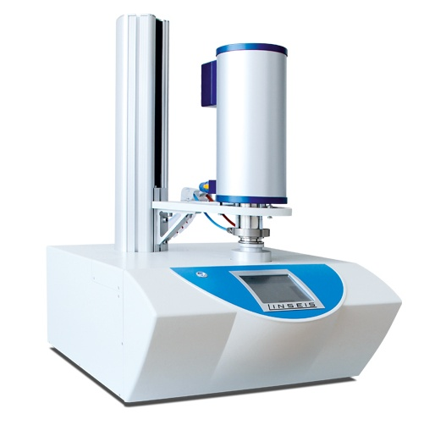
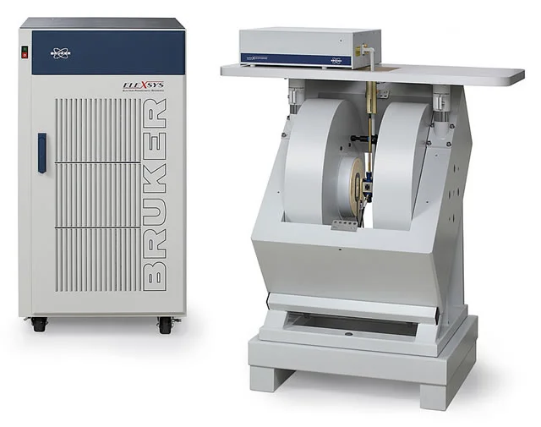
Analytical methods
Differential thermal analysis (DTA) (I/Q)
Electron paramagnetic resonance spectroscopy (EPR) (I)

Slide 37
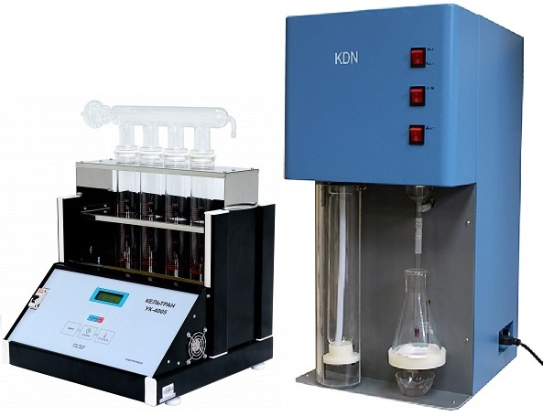
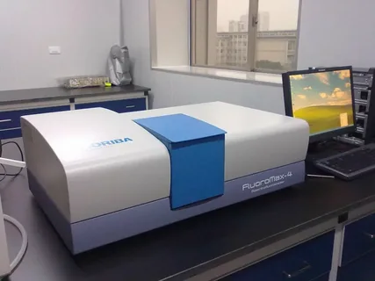
Analytical methods
Elemental analysis (C, H, N, S, O) (I/Q)
Fluorescence spectroscopy (I)

Slide 38
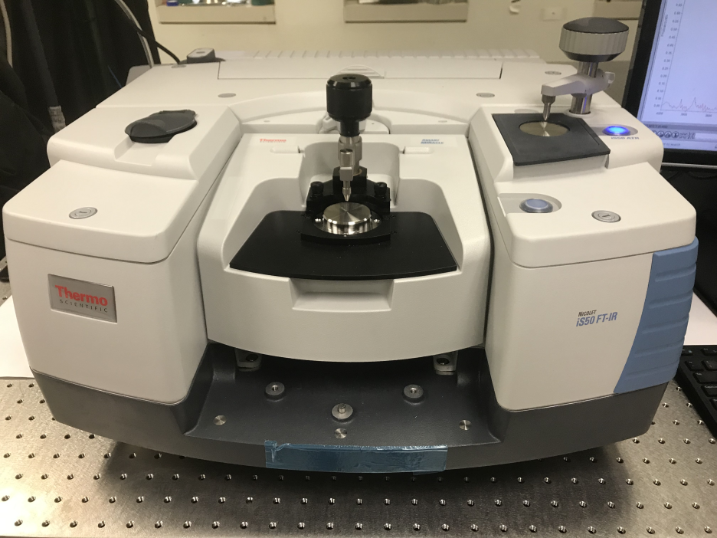
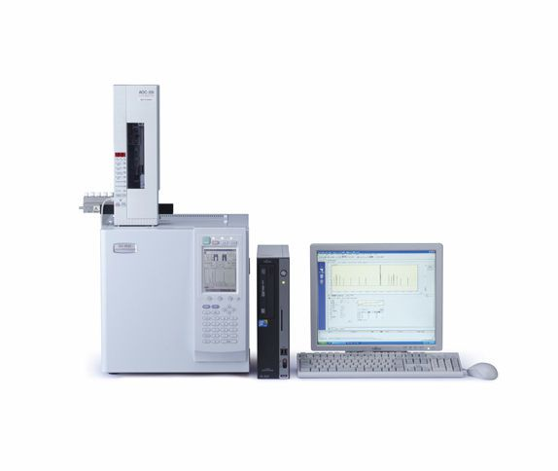
Analytical methods
Fourier transform infrared spectroscopy (FT-IR) (I)
Gas chromatography (GC) (I/Q)

Slide 39
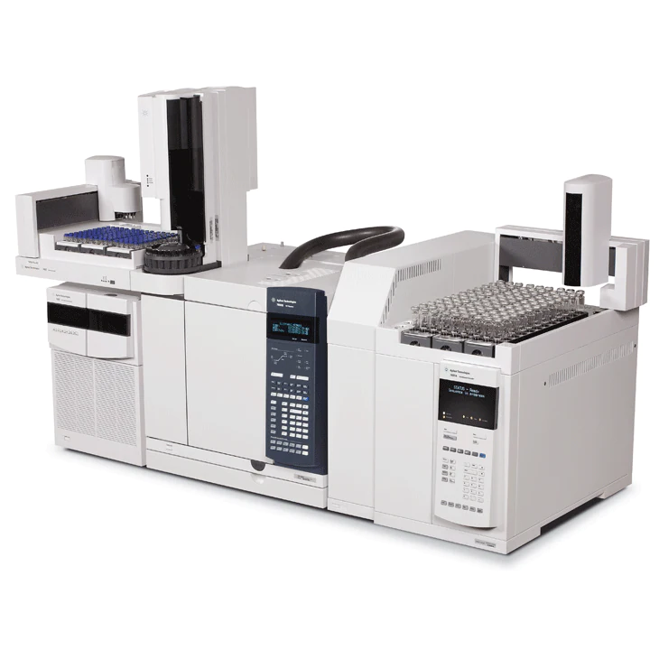
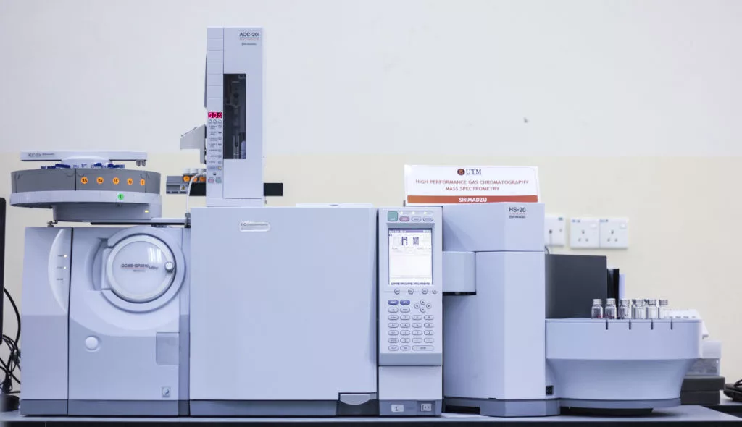
Analytical methods
Gas chromatography-Head space analyzer (GC-HS) (I/Q)
Gas chromatography-Mass spectroscopy (GC-MS) (I/Q)

Slide 40
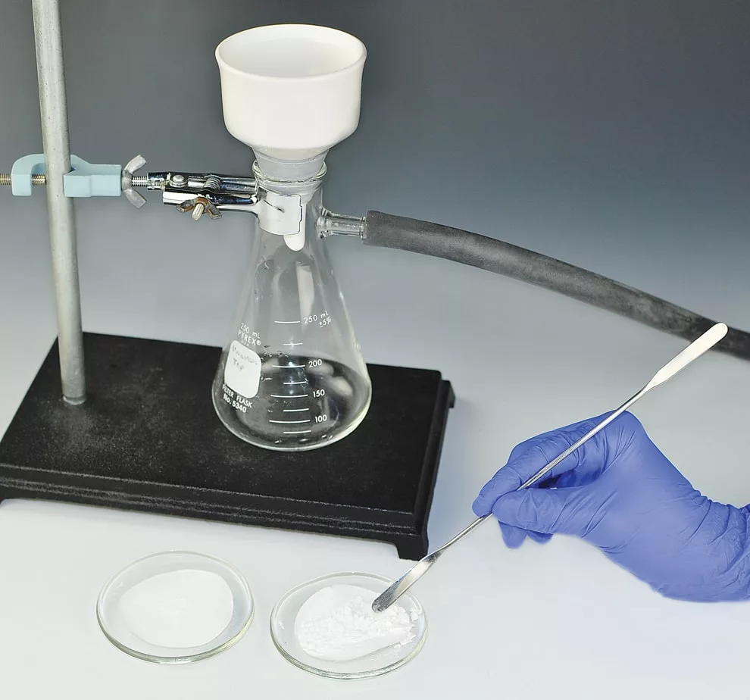
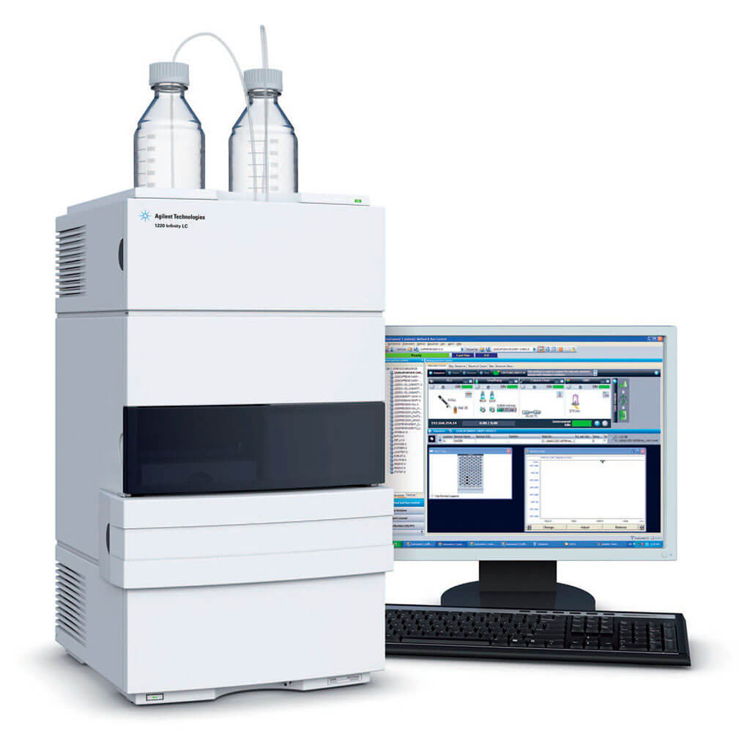
Analytical methods
Gravimetric analysis (Q)
High performance liquid chromatography (HPLC) (I/Q)

Slide 41
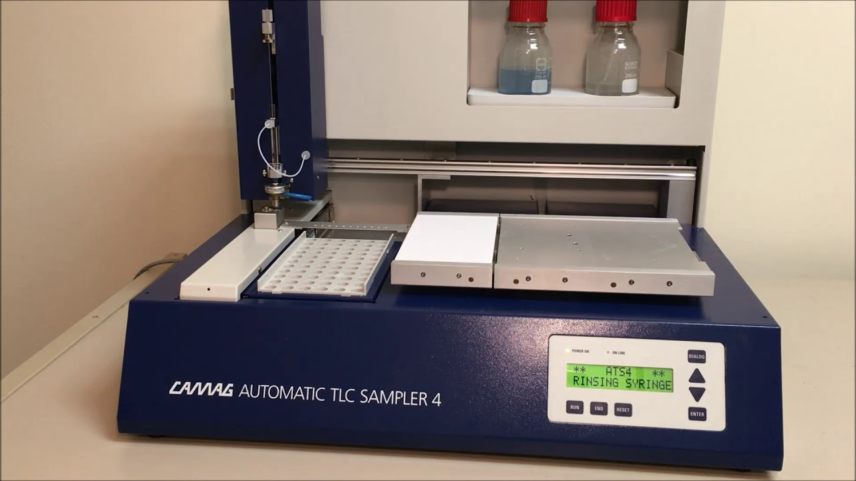
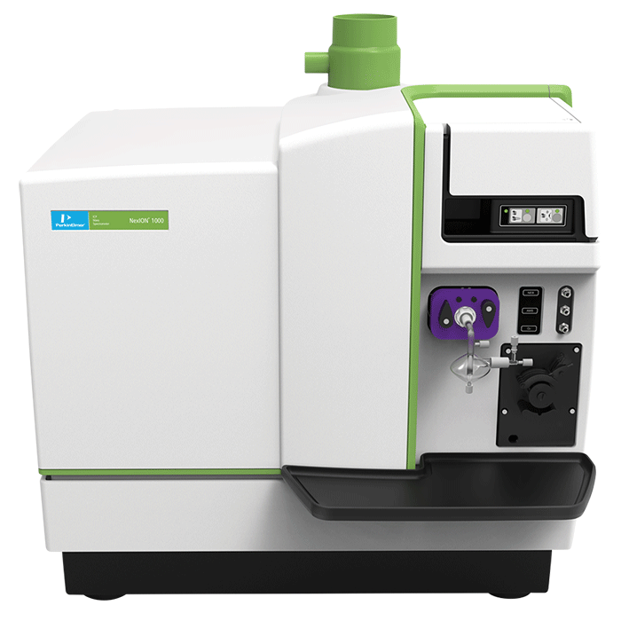
Analytical methods
High performance thin layer chromatography (HPTLC) (I/Q)
Inductive coupled plasma (ICP) (I/Q)

Slide 42
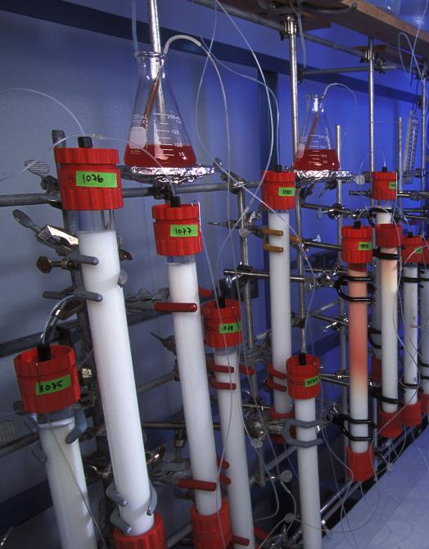
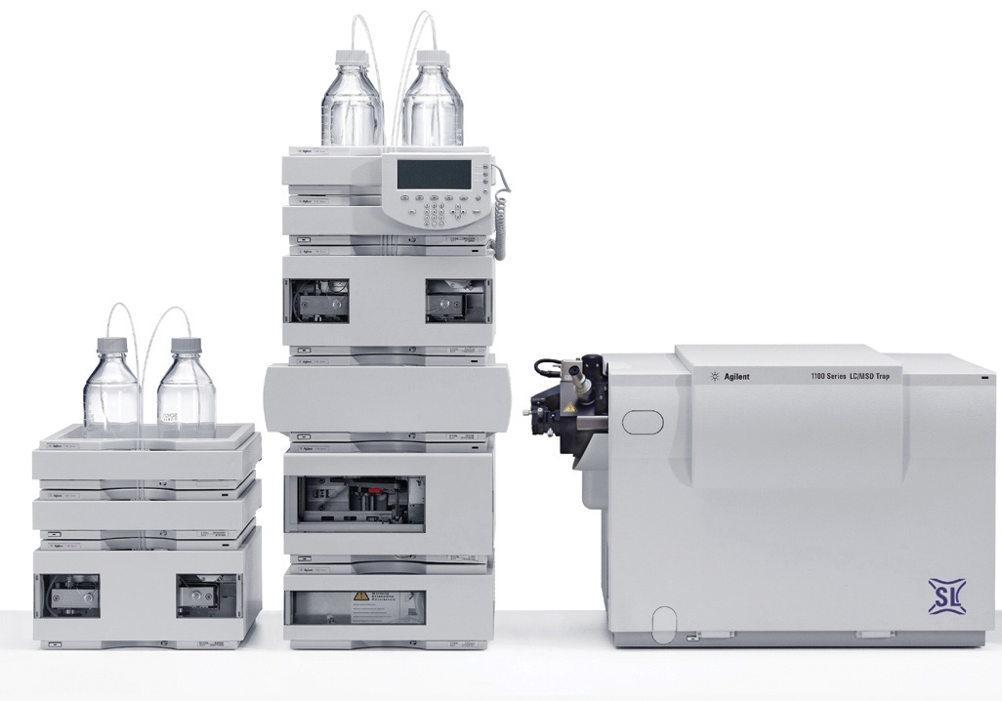
Analytical methods
Ion chromatography (IC) (I/Q)
Liquid chromatography-Mass spectroscopy (LC-MS) (I/Q)

Slide 43
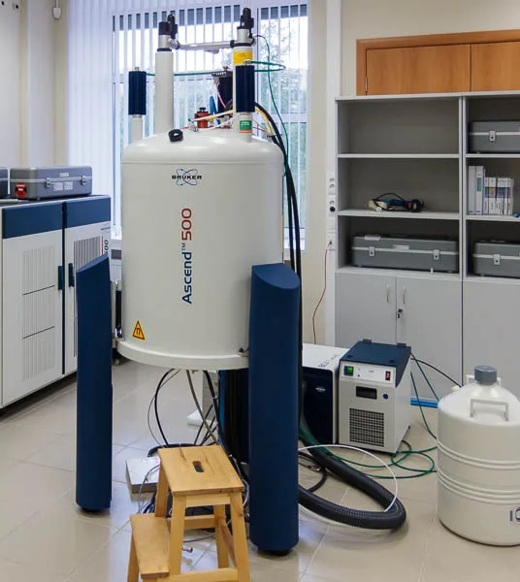
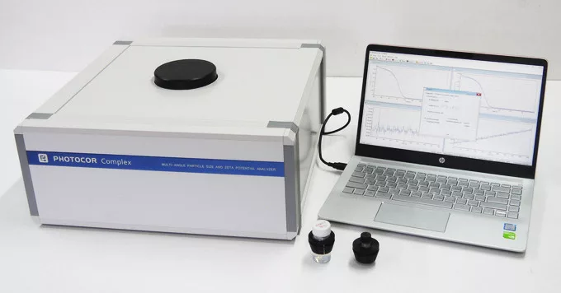
Analytical methods
Nuclear magnetic resonance spectroscopy (NMR) (I)
Particle size analysis (I/Q)

Slide 44
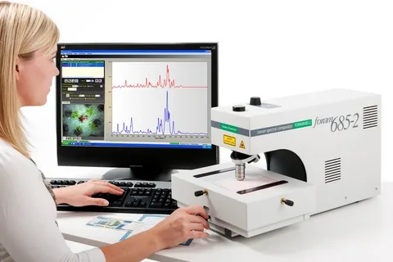
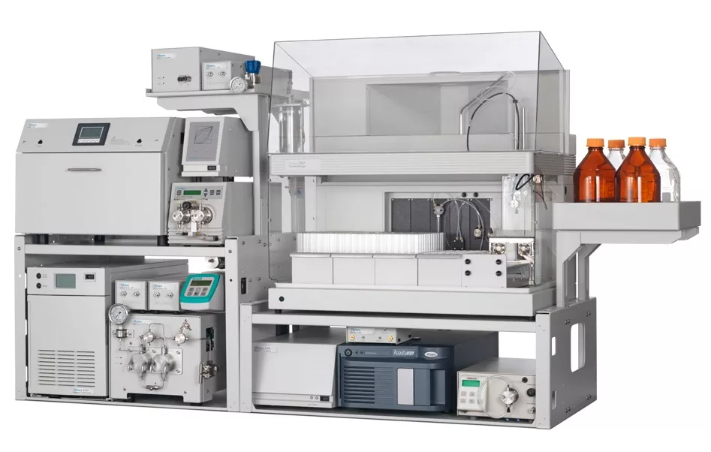
Analytical methods
Raman spectroscopy (I)
Supercritical fluid chromatography (SFC) (I/Q)

Slide 45
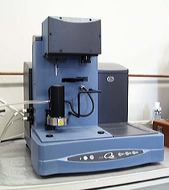
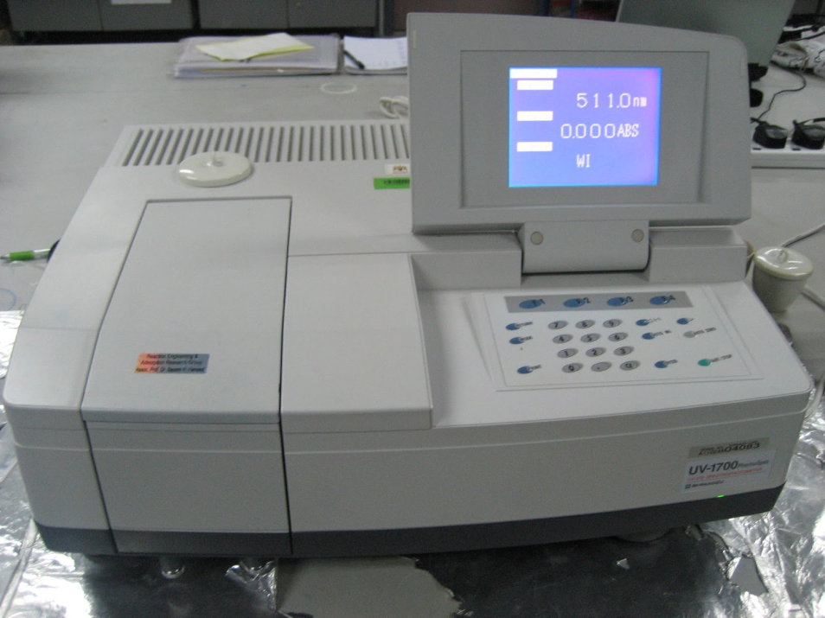
Analytical methods
Thermo gravimetric analysis (TGA) (Q)
Ultraviolet visible spectroscopy (UV-Vis) (I/Q)

Slide 46
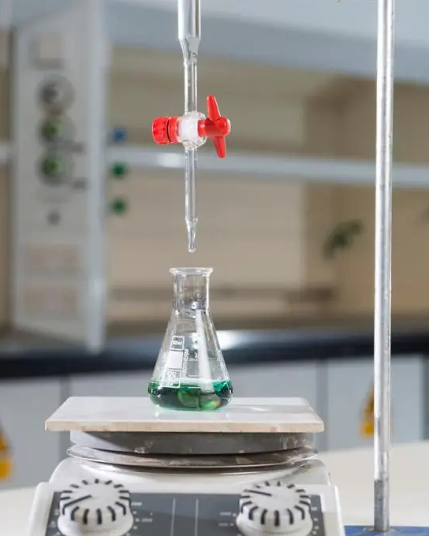
Analytical methods
Qualitative and volumetric analysis (I/Q)
X-Ray diffraction (XRD)

Slide 47
Remedies to prevent the impurities in pharmaceutical products
Control of critical factors during the manufacturing of any product; which affect the product.
Extreme operational care should be taken while handling the equipments, machineries, reactors and other tools that by any mean due to the operational activity, impurity should not be entered into the product.
The wet cake should be thoroughly washed to remove all unwanted chemical including the residual solvents.
In the specification, maximum possible impurities should be specified with stringent limits for the better quality products.
Time to time the specifications of drug substances and drug products should be studied and revised for specific impurity profiling and should be made strict for impurity acceptance criteria.

Slide 48
Remedies to prevent the impurities in pharmaceutical products
During analytical method development and validation study of any drug substance and drug product, the method parameters should be optimized in such a way that the method can resolve maximum number of impurities which will help the synthetic chemist to improve the synthetic process.
Stability study should be carried out methodically and meticulously for the identification of degradation products and to fix the shelf life of drug substances and drug products.
Stress study should be performed for any drug substance or drug product to handle the transportation related issues properly.
Packaging care should be taken for the moisture/light/environment/stress sensitive materials.

Slide 49
Remedies to prevent the impurities in pharmaceutical products
Regulatory authorities should become stricter before giving any license or permission for any product to be sold in any regulated market.
Before giving any approval for any pharmaceutical product to any company, the authorities should ensure the total compliance of the manufacturing site and product, as this is the matter related to human health and it can not be taken in very casual way.
If some of the listed remedies are implemented seriously and strictly, then the pharmaceutical industries can get rid of this burning issue of impurities at major extent.

Slide 50
Thank you for attention!

