Slide 1
«Special pharmaceutical chemistry»
Purine alkaloids
Associate Professor Gureeva E.S.

Slide 2
General characteristic
9H-purine 7H-purine
xanthine

Slide 3
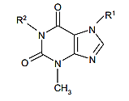
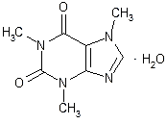
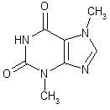
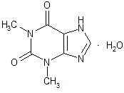
General characteristic
Where R¹ and R² = H or CH₃
caffeine
theobromine
theophylline

Slide 4
General characteristic
Coffea arabica Family Rubiaceae
Chemical Constituents
• 1-2% caffeine
• 0.25% Trigonelline
• Tannins
• Caffiotanic acid
• Chlorogenic acid (responsible for allergic reaction in some individuals)
Characteristic aroma of Roosted coffee is due to an oil called caffeol
1 cup of coffee contain approximately 100mg of caffeine

Slide 5
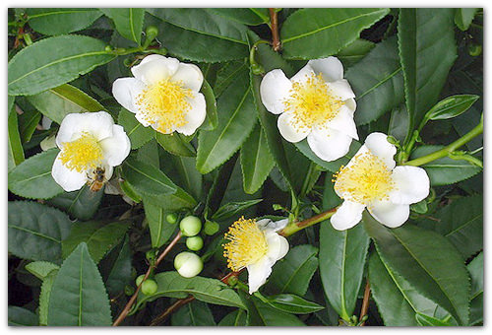
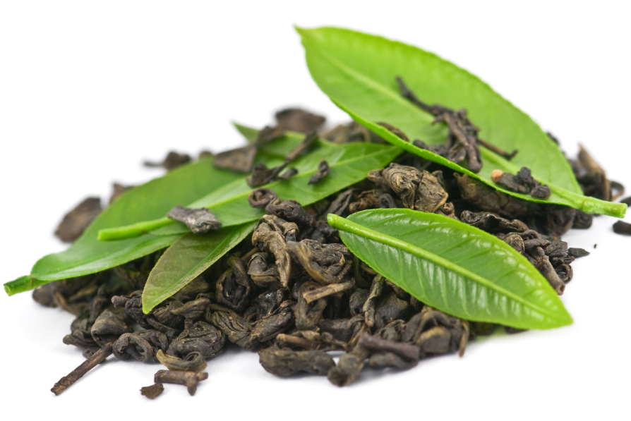
General characteristic
Tea consists of dried leaves of Camellia sinensis or Thea sinensis Family Theaceae
Chemical Constituents
Caffeine
Theophylline
Theobromine
Tannins

Slide 6
History
Humans have consumed caffeine since the Stone Age.
Early peoples found that chewing the seeds , bark, or leaves of certain plants had the effects of easing fatigue, stimulating awareness, and elevating one's mood.
Only much later was it found that the effect of caffeine was increased by steeping such plants in hot water.
Many cultures have legends that attribute the discovery of such plants to people living many thousands of years ago.

Slide 7
History
According to one popular Chinese legend, the Emperor of China Shennong, reputed to have reigned in about 3000 BC, accidentally discovered that when some leaves fell into boiling water, a fragrant and restorative drink resulted.

Slide 8
History
The history of coffee has been recorded as far back as the ninth century. During that time, coffee beans were available only in their native habitat, Ethiopia.
A popular legend traces its discovery to a goatherder named Kaldi, who apparently observed goats that became elated and sleepless at night after grazing on coffee shrubs and, upon trying the berries that the goats had been eating, experienced the same vitality.

Slide 9
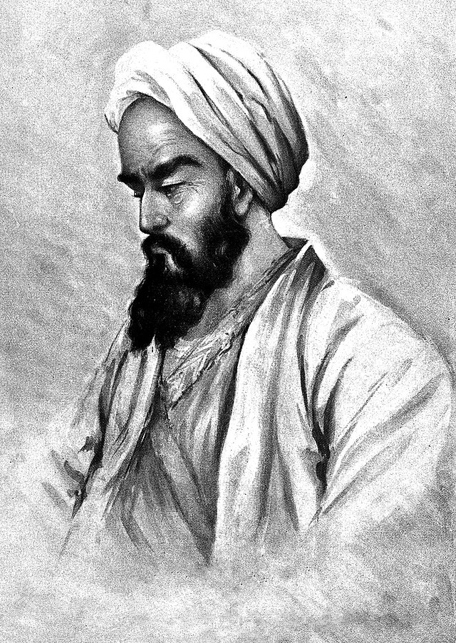
History
The earliest literary mention of coffee may be a reference to Bunchum in the works of the 9th century Persian physician al - Razi.
In 1587, Malaye Jaziri compiled a work tracing the history and legal controversies of coffee, entitled " Undat al safwa fi hill al - qahwa ". In this work, Jaziri recorded that one Sheikh, Jamal – al- Din al–Dhabhani, mufti of Aden, was the first to adopt the use of coffee in 1454, and that in the 15th century the Sufis of Yemen routinely used coffee to stay awake during prayers.

Slide 10
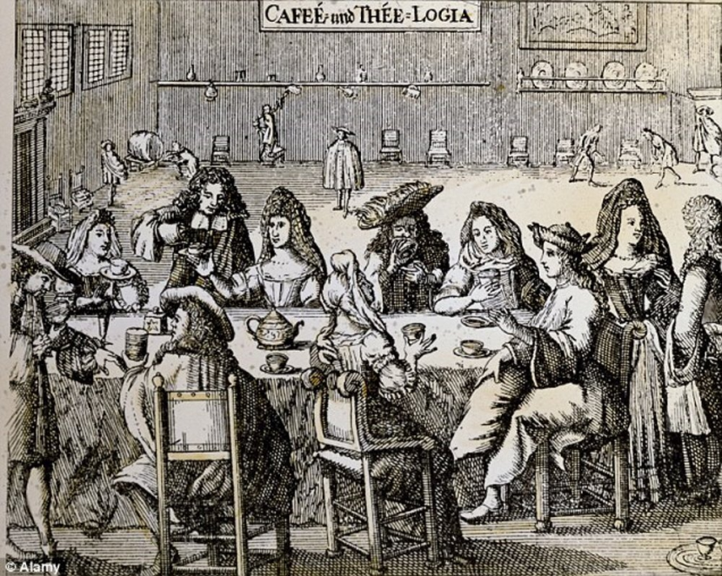
History
Towards the close of the 16th century , the use of coffee was recorded by a European resident in Egypt , and about this time it came into general use in the Near East . The appreciation of coffee as a beverage in Europe, where it was first known as "Arabian wine," dates from the 17th century . During this time " coffee houses " were established , the first being opened in Constantinople and Venice . In Britain , the first coffee houses were opened in London in 1652. They soon became popular throughout Western Europe, and played a significant role in social relations in the 17th and 18th centuries .

Slide 11
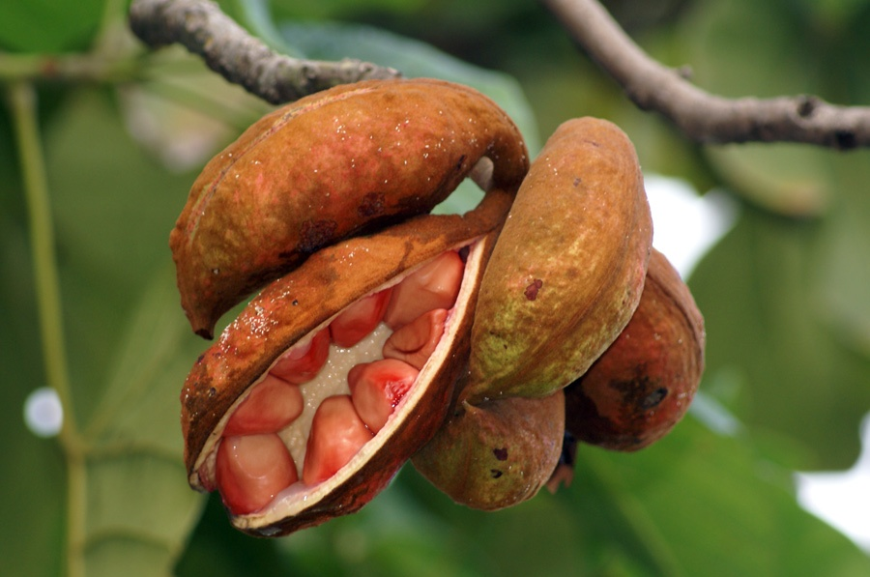
History
The kola nut , like the coffee berry and tea leaf , appears to have ancient origins . It is chewed in many West African cultures, individually or in a social setting, to restore vitality and ease hunger pangs . In 1911 , kola became the focus of one of the earliest documented health scares when the US government seized 40 barrels and 20 kegs of Coca - Cola syrup in Chattanooga , Tennessee , lleging that the caffeine in its drink was " injurious to health ".

Slide 12
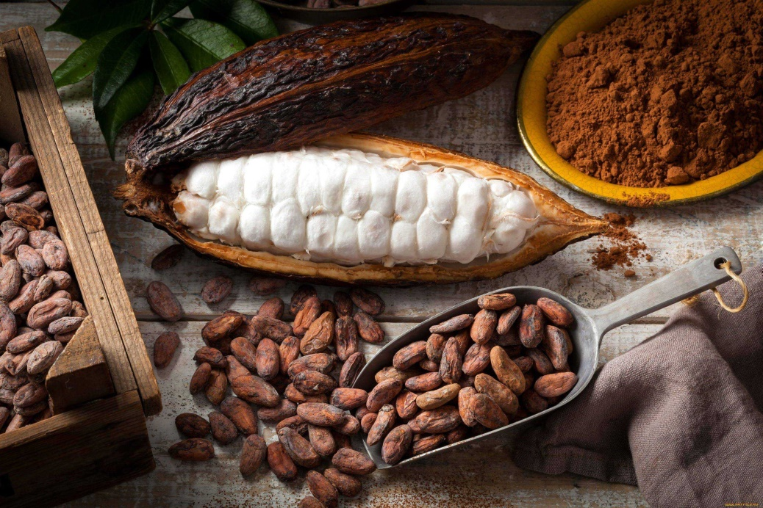
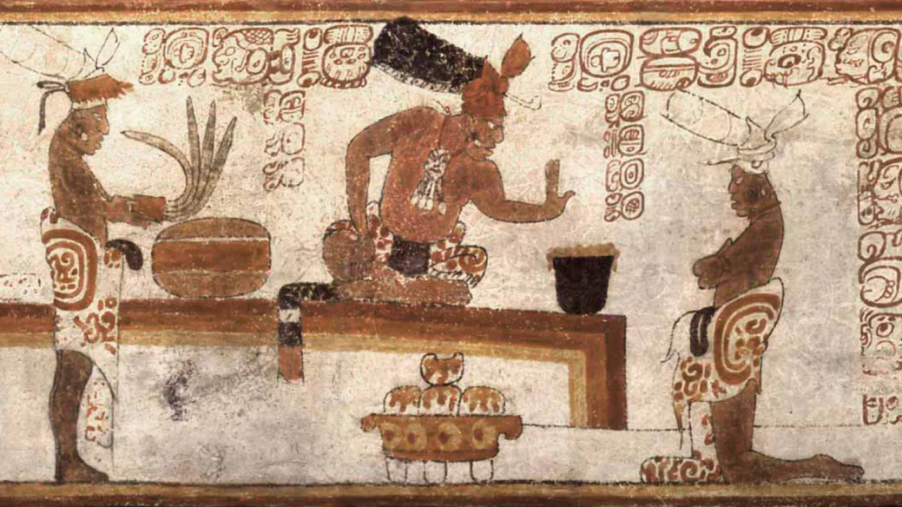
History
The earliest evidence of cocoa use comes from residue found in an ancient Mayan pot dated to 600 BC. In the New World, chocolate was consumed in a bitter and spicy drink called xocoatl, often seasoned with vanilla, chile pepper, and achiote. Xocoatl was believed to fight fatigue , a belief that is probably attributable to the theobromine and caffeine content . Chocolate was an important luxury good throughout pre - Columbian Mesoamerica, and cocoa beans were often used as currency .

Slide 13
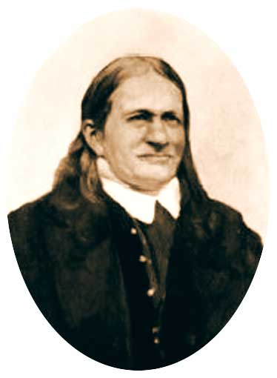
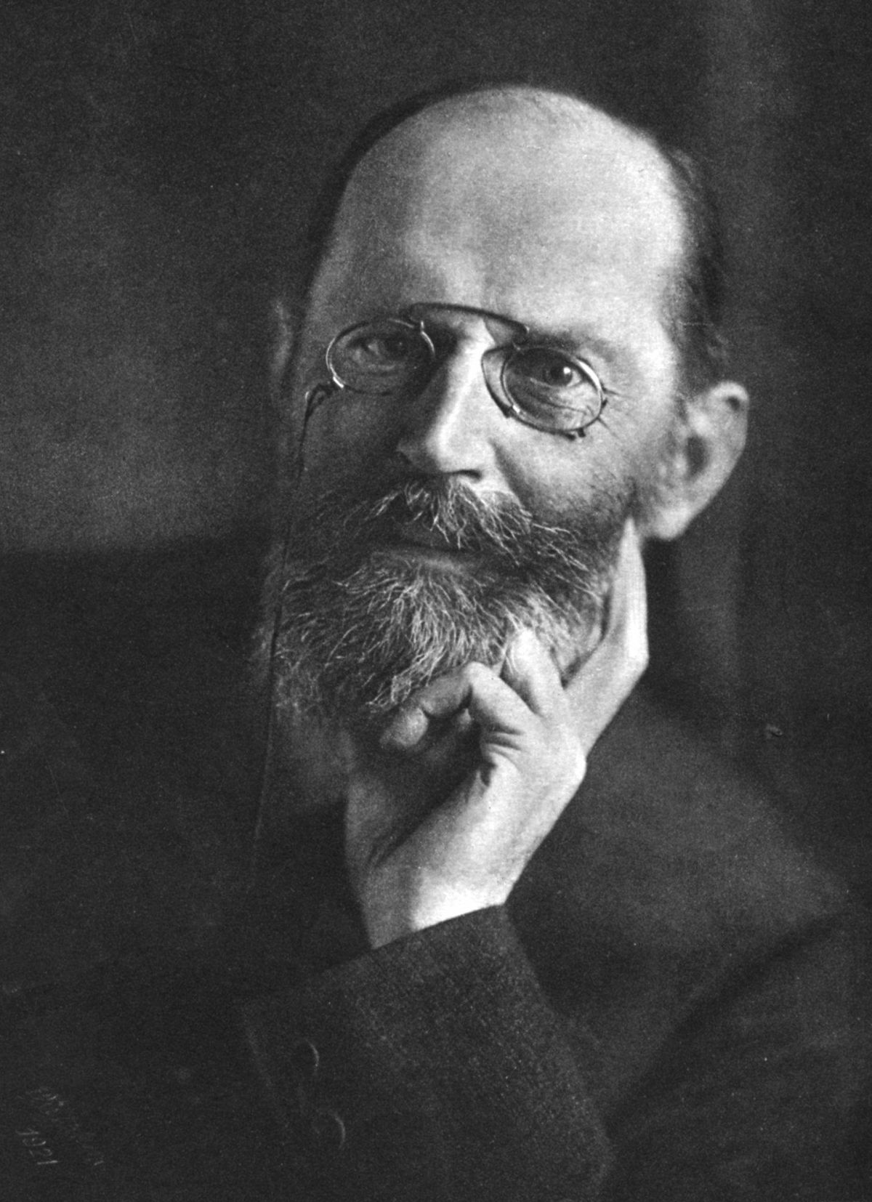
History
Friedrich Ferdinand Runge
Hermann Emil Fischer
Caffeine was discovered by a Germanchemist, Friedrich Ferdinand Runge, in 1819. He coined the term kaffein, a chemical compound in coffee, which in English became caffeine .
The structure of caffeine was elucidated near the end of the 19th century by Hermann Emil Fischer, who was also the first to achieve its total synthesis.

Slide 14
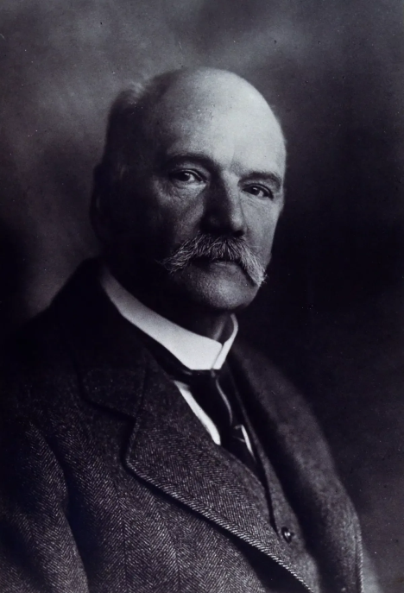
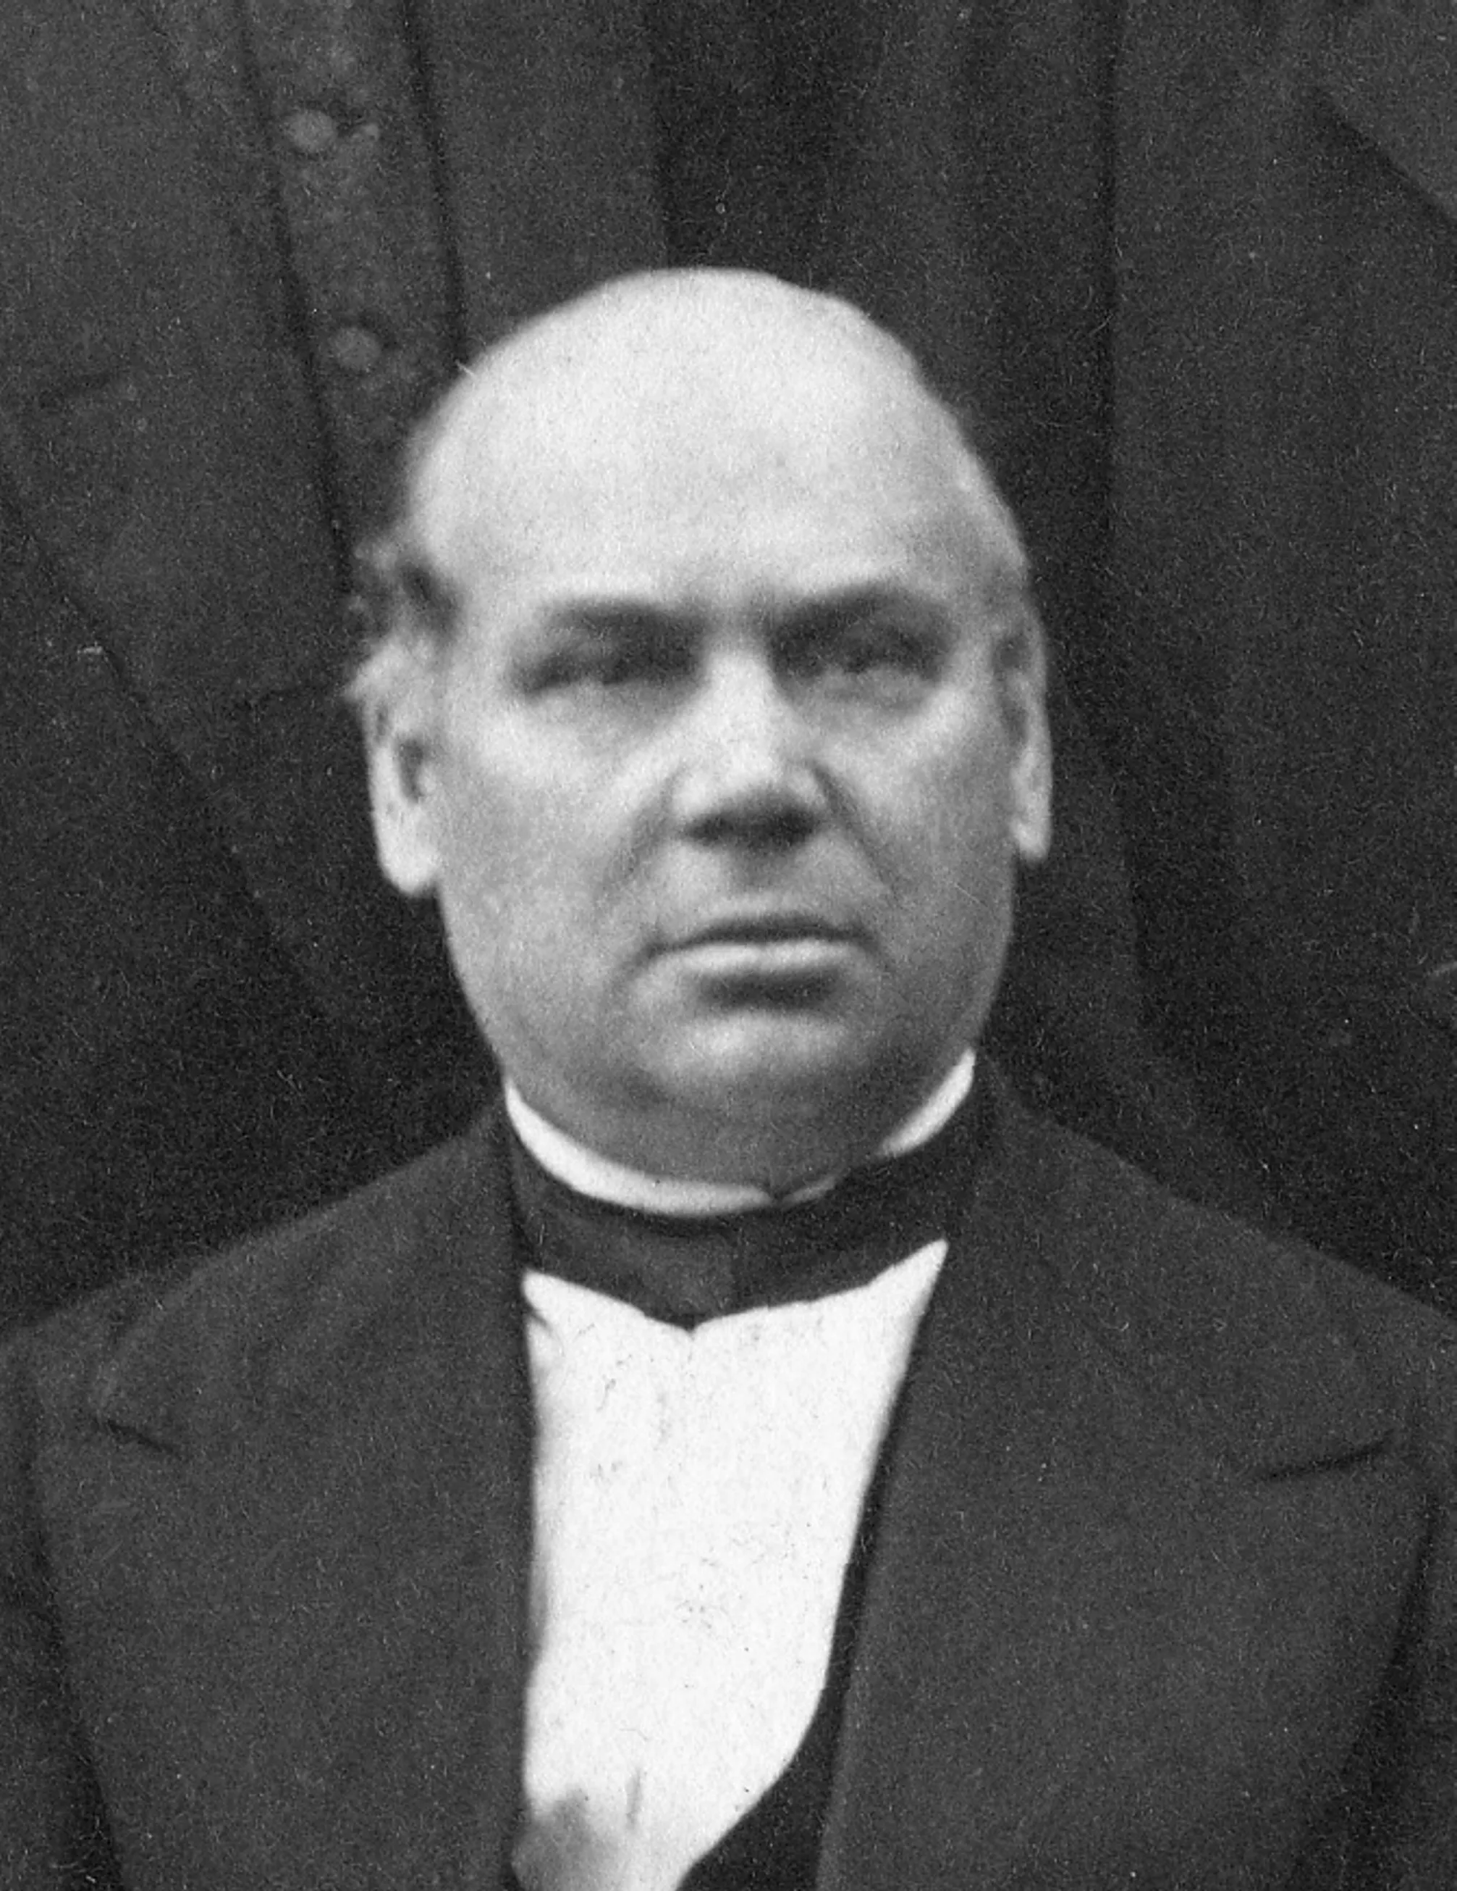
History
Albrecht Kossel
Alexander Abramovich Voskresensky
Theophylline was discovered by Kossel in 1889г.
Theobromine was first isolated and studied by the Russian scientist A.A. Voskresensky in 1842.

Slide 15
Obtaining purine alkaloids
Caffeine extraction from natural material (tea dust, branches, tea leaf trimmings)
Tea production waste is extracted with hot water and filtered.
Ca(OH)2 is added to the filtrate to precipitate ballast substances and further filtered.
The aqueous extract is re-extracted with chloroform and the chloroform extract is evaporated to dryness.
The dry residue is crystallised from water.
Disadvantages of the method: large volumes of processed raw materials with low yield of the finished product, lack of own resource base in the Russian Federation, insufficient purity of caffeine (impurities of theophylline and other compounds).

Slide 16
Obtaining purine alkaloids
Synthetic methods of obtaining purine alkaloids
In order to obtain caffeine and theobromine, xanthine is synthesised from uric acid using formamide:
Xanthine is then methylated with dimethyl sulphate. Depending on the methylation conditions, caffeine or theobromine is obtained:

Slide 17
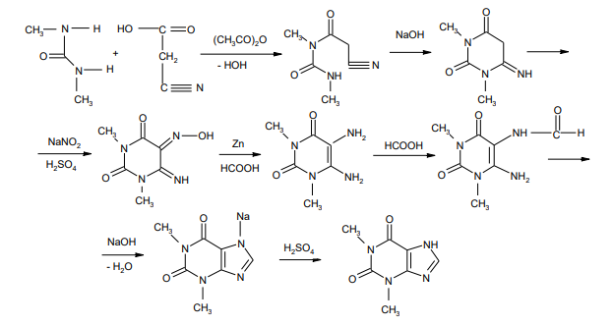
Obtaining purine alkaloids
Synthetic methods of obtaining purine alkaloids
A method based on cyanoacetic acid was developed by Traube and involves the complete synthesis of purine alkaloids. The scheme for the synthesis of theophylline is as follows:

Slide 18
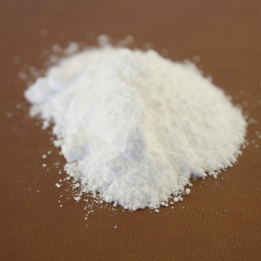
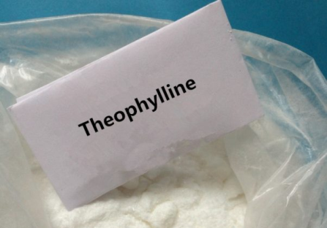
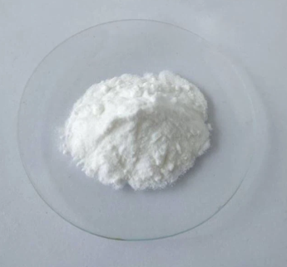
Purine alkaloids
Physical properties
Caffeine
Silky, colourless crystals or a white, crystalline powder; odourless. Soluble in 60 parts of water and in 100 parts of ethanol; slightly soluble in ether.
Theophylline
White crystalline odourless powder. Slightly soluble in cold water, easily soluble in hot water, slightly soluble in ethanol, chloroform, soluble in dilute solutions of acids and alkalis.
Theobromine
White crystalline odourless powder. Practically insoluble in cold water, practically insoluble in hot water, practically insoluble in ethanol, chloroform, soluble in dilute solutions of acids and alkalis.

Slide 19
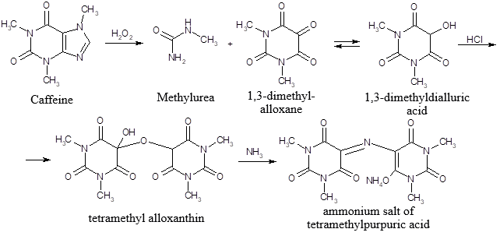
Purine alkaloids
Identification
IR and UV spectrophotometry
2. Murexide test
purplish-red

Slide 20
Purine alkaloids
Identification
3. Interaction with common alkaloid reagents
yellow precipitate
4. Formation of polyiodides
brown precipitate

Slide 21
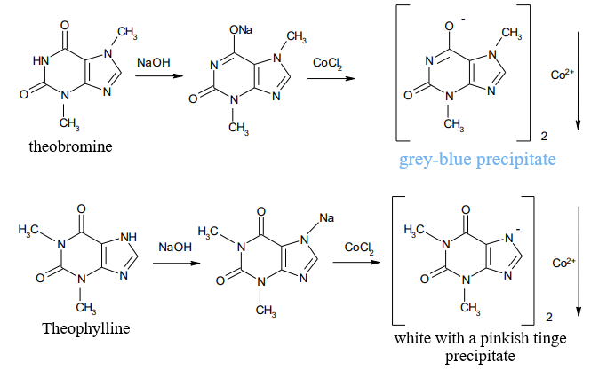
Purine alkaloids
Identification
5. Formation of heavy metal salts

Slide 22
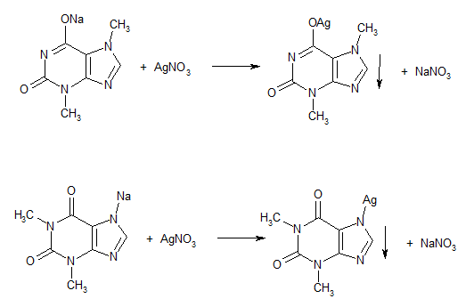
Purine alkaloids
Identification
5. Formation of heavy metal salts

Slide 23
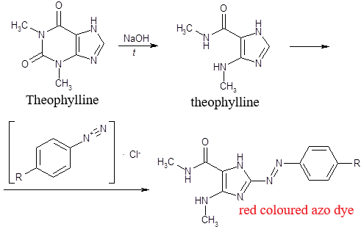
Purine alkaloids
Identification
6. Formation of azo dye
Theophylline, after alkaline hydrolysis, forms theophylline, which reacts with a diazonium salt to form a red coloured azo dye:

Slide 24
Purine alkaloids
Identification
7. Reaction with mercury chloride
Common to caffeine, theophylline and theobromine is the reaction with mercuric (II) chloride. A white crystalline precipitate is formed.
Purity test
The purity of drugs is checked by setting permissible limits for impurities of extraneous alkaloids.
When testing caffeine, impurities of alkaloids are detected using Meyer's reagent, which does not react positively with the drug itself.
Other purine bases are regulated in theophylline and impurities of caffeine in theobromine.
Thin-layer chromatography is used to detect impurities.

Slide 25
Purine alkaloids
Assay
1. Non-aqueous titration in glacial acetic acid
2. Iodometric titration

Slide 26
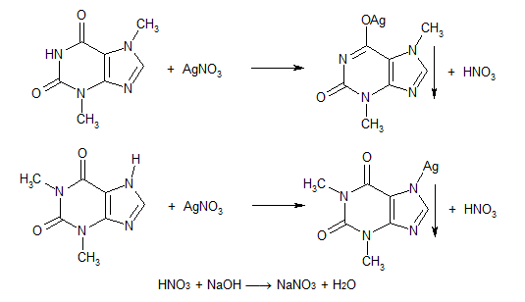
Purine alkaloids
Assay
3. Indirect neutralization

Slide 27
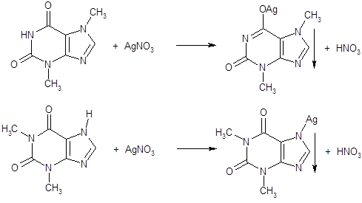
Purine alkaloids
Assay
4. Argentometry (reverse method)

Slide 28
Purine alkaloids
Assay
5. Cerimetric method

Slide 29
Purine alkaloids
Assay
6. Gravimetry
This method is sometimes used for the determination of caffeine in factory-produced dosage forms (caffeine is extracted from the mixture in an alkaline environment with chloroform; the chloroform is then distilled off, the residue is dried and weighed).
7. Physico-chemical methods
Physico-chemical methods (UV spectrophotometry, HPLC) are used for quantitative determination of purine group compounds in factory-produced dosage forms.

Slide 30
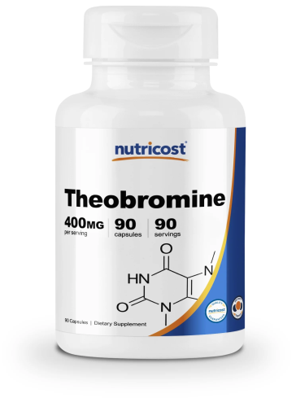
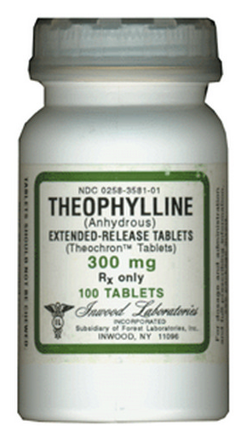
Purine alkaloids
Storage
Purine derivatives are stored in well sealed containers. Theophylline should be protected from light.
Medical use
Caffeine is used as a stimulant of the central nervous system (to increase mental and physical performance, to eliminate drowsiness), cardiotonic agent, for vasospasms (migraine, etc.).
Theobromine and theophylline are used as antispasmodics (vasodilators, bronchodilators) and diuretics.

Slide 31
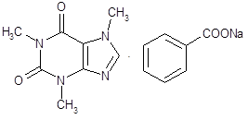
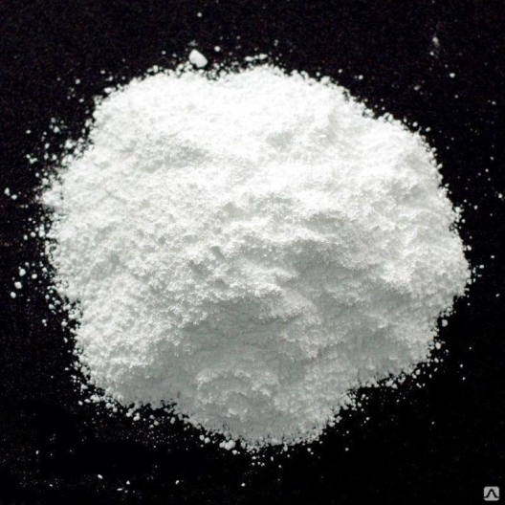
Drugs of double salts of purine alkaloids
Caffeine sodium benzoate
White, odourless powder, faintly bitter flavor.
Sodium caffeine benzoate is easily soluble in water. Aqueous solution of the drug has alkaline reaction. Sodium caffeine benzoate is hardly soluble in ethanol, practically insoluble in ether and chloroform.
Obtaining
Sodium caffeine-benzoate is obtained by mixing aqueous solutions containing 40% caffeine and 60% benzoate. The solution is then evaporated to dryness.

Slide 32
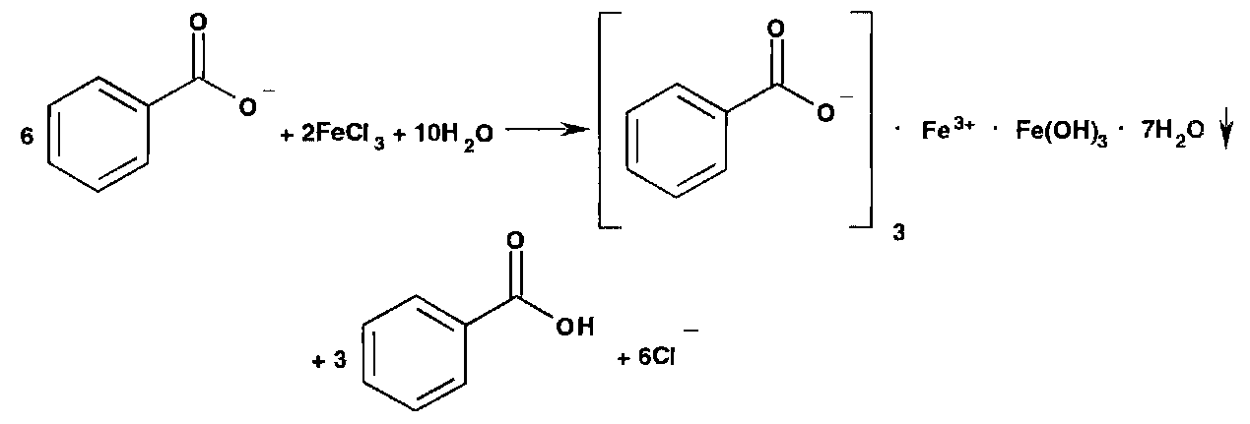
Drugs of double salts of purine alkaloids
Caffeine sodium benzoate
Identification (Specific reactions)
Detection of sodium cation
2. Benzoate detection

Slide 33
Drugs of double salts of purine alkaloids
Caffeine sodium benzoate
Assay
Neutralisation
Sodium benzoate in sodium caffeine-benzoate is determined by neutralisation with 0.5 M hydrochloric acid solution in the presence of a mixed indicator (solutions of methyl orange and methylene blue in the ratio 1 : 1):
To extract the released benzoic acid, the determination is carried out in the presence of ether.
Gravimetric method
For the quantitative determination of caffeine in mixtures, a gravimetric method based on its extraction with chloroform is used.

Slide 34
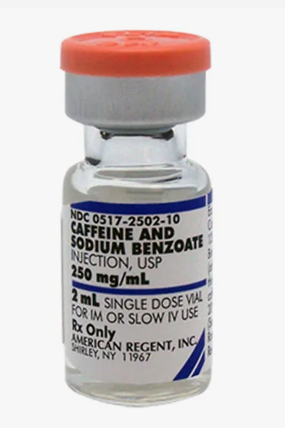
Drugs of double salts of purine alkaloids
Caffeine sodium benzoate
Storage
Sodium caffeine benzoate is stored in a dry place protected from light at temperatures not exceeding +25°C.
Medical use
Caffeine-benzoate sodium is used as a central nervous system stimulant, cardiotonic agent, in vasospasm. Caffeine sodium benzoate is better soluble in water, so it can be used in the form of solutions for injection.

Slide 35
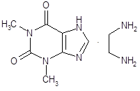
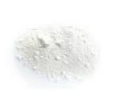
Drugs of double salts of purine alkaloids
Aminophylline
White or white with a yellowish tinge crystalline powder with a faint ammonia odour. Aminophylline in air is capable of carbon dioxide.
Soluble in water. Aqueous solution of the drug has alkaline reaction.
Obtaining
Aminophylline (Eufylline) is obtained by mixing theophylline with 1,2-ethylene diamine.

Slide 36
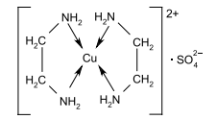
Drugs of double salts of purine alkaloids
Aminophylline
Identification (Specific reactions)
Interaction with benzoyl chloride
The precipitate is filtered off, washed with water, precrystallised from ethanol, filtered and dried. Its melting point should be 250-251 °C.
2. Interaction with copper sulphate solution
A purple colouration appears

Slide 37
Drugs of double salts of purine alkaloids
Aminophylline
Assay
Indirect neutralisation
Ethylenediamine in a separate suspension is titrated with 0.1 M hydrochloric acid solution in the presence of methyl orange indicator:
Argentometric method

Slide 38
Drugs of double salts of purine alkaloids
Aminophylline
Storage
Given the ability of Aminophylline to absorb carbon dioxide from the air, it should be stored in a container filled to the top, protected from light and moisture.
Medical use
Aminophylline is administered for the same indications as theophylline. Good water solubility allows its administration not only intravenously, but also intramuscularly and intravenously.

Slide 39
Thank you for attention!

