Slide 1
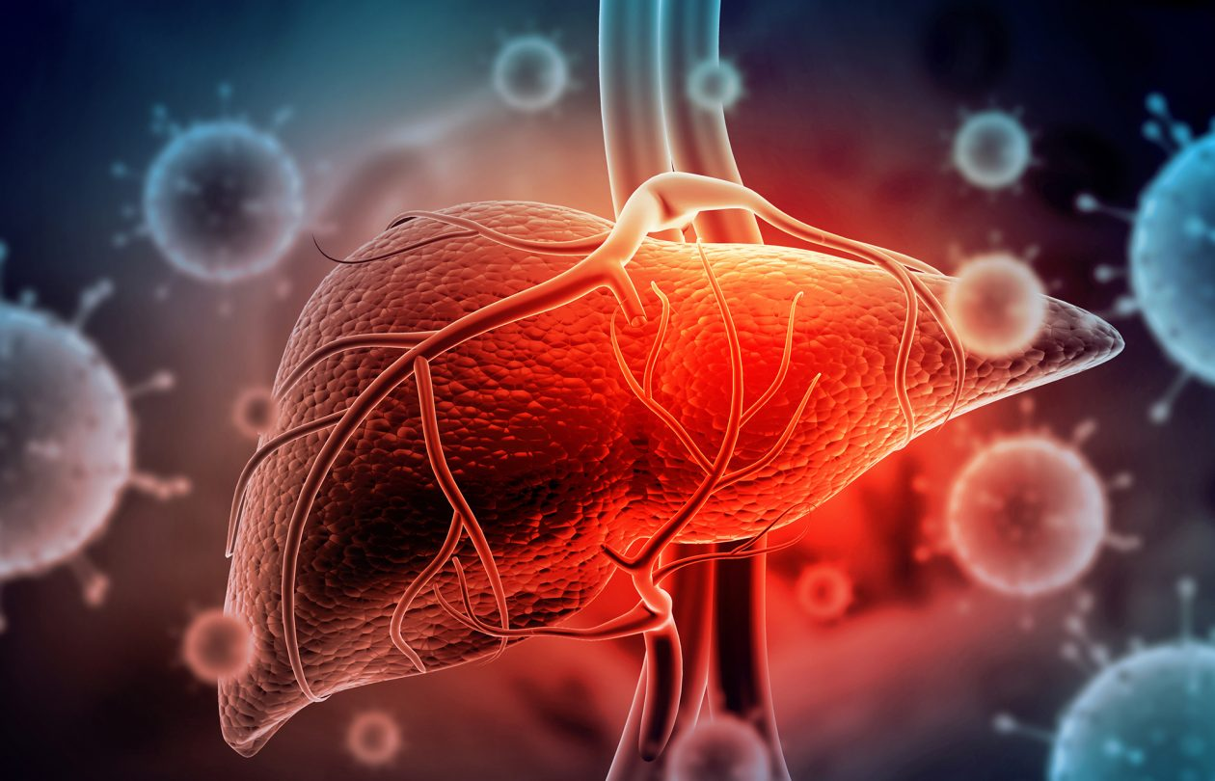
«General pharmaceutical chemistry»
Anti-hepatitis B drugs
Associate Professor Gureeva E.S.

Slide 2
Drugs to treat infection caused by the hepatitis B virus
Characteristics of the hepatitis B virus
Hepatitis B virus (HBV) is a DNA-containing virus in the family Hepadnaviridae and is a member of the genus Orthohepadnavirus.
Eight genotypes are distinguished for HBV: A, B, C, D, E, F, G and H.

Slide 3
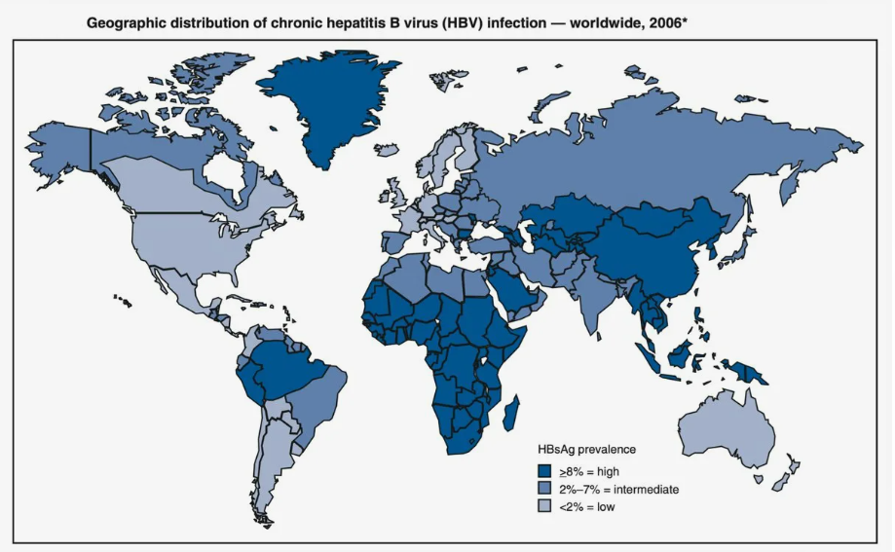
Drugs to treat infection caused by the hepatitis B virus
Characteristics of the hepatitis B virus

Slide 4
Drugs to treat infection caused by the hepatitis B virus
Characteristics of the hepatitis B virus

Slide 5
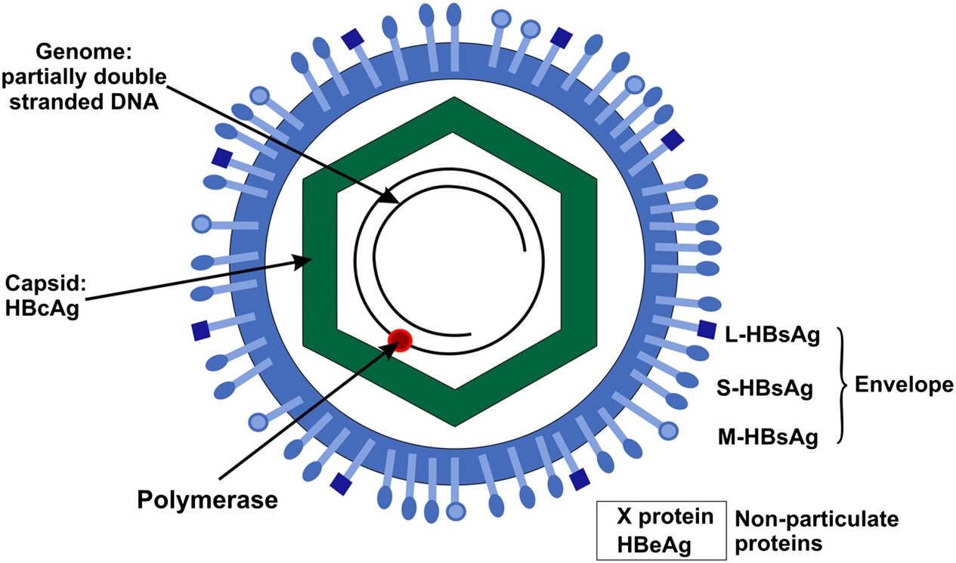
Drugs to treat infection caused by the hepatitis B virus
Characteristics of the hepatitis B virus

Slide 6
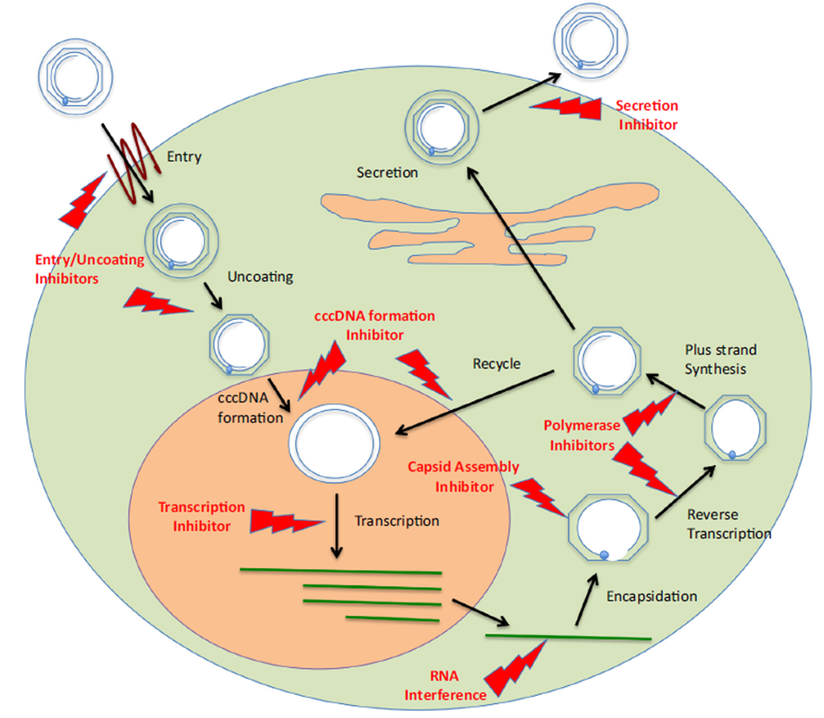
Drugs to treat infection caused by the hepatitis B virus
The HBV life cycle

Slide 7
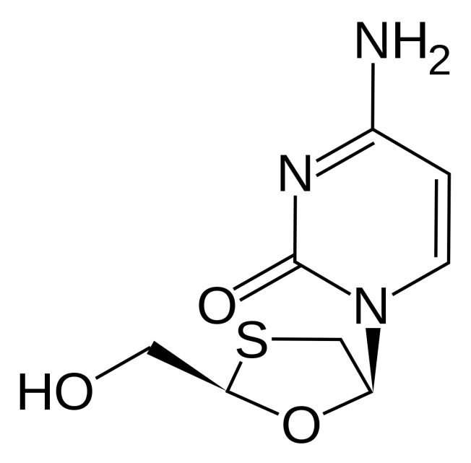
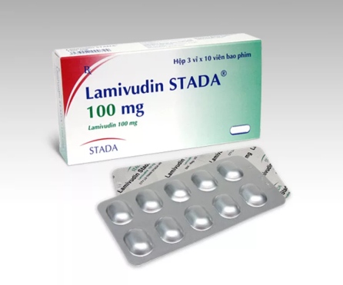
Drugs to treat infection caused by the hepatitis B virus
Therapy for HBV infection
In 1998, the first nucleoside analogue, lamivudine, was approved for the treatment of chronic HBV infection. Clinical studies have shown histological improvements in cells and suppression of HBV DNA replication. However, resistance to lamivudine was found in 70% of patients after 5 years of therapy.

Slide 8
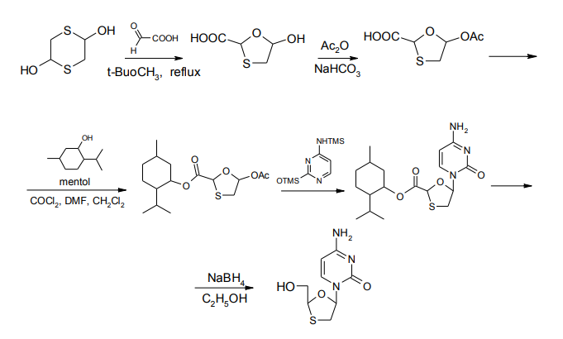
Drugs to treat infection caused by the hepatitis B virus
Lamivudine synthesis

Slide 9
Drugs to treat infection caused by the hepatitis B virus
Lamivudine physical properties
A white or whitish crystalline powder. Soluble in water, very slightly soluble in chloroform and ether
Lamivudine identification
Spectrophotometry in the infrared region. The infrared absorption spectrum is concordant with the spectrum obtained from Lamivudine RS or with the reference spectrum of Lamivudine.
Chromatography. TLC, GC, HPLC methods are used for the authentication. Rf (Rs) and retention times are determined (the difference between the test substance and the standard sample should not exceed 2%).
NMR1H spectroscopy (compare the obtained spectra with the spectrum pattern in the pharma-study),
derivatography,
X-ray diffractography are also used.

Slide 10
Drugs to treat infection caused by the hepatitis B virus
Lamivudine purity
In lamivudine the presence of impurities is determined by TLC and HPLC methods. Residual solvents (methanol, chloroform, toluene, diethylamine, dimethylforamide) are detected by GC.
Lamivudine quantification
For quantification the HPLC method is used. Calculations are made by simple normalisation using the peak area of the main substance and the standard sample.
Lamivudine storage
lamivudine store in a tightly closed container, in a dry, light-protected place at a temperature not exceeding 20ºC.

Slide 11
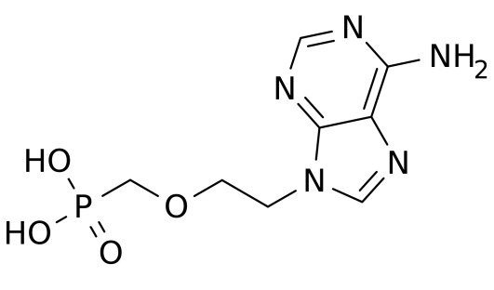
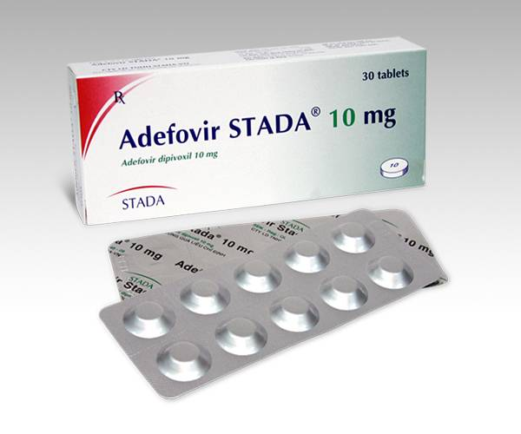
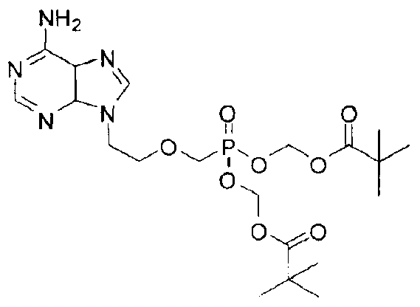
Drugs to treat infection caused by the hepatitis B virus
Therapy for HBV infection
Adefovir was approved in 2002 for the treatment of patients with chronic HBV infection. Resistance to adefovir develops more slowly than to lamivudine. After five years of therapy, resistance has been observed in 29% of patients with chronic HBV infection.
Adefovir
Adefovira dipivoxil

Slide 12
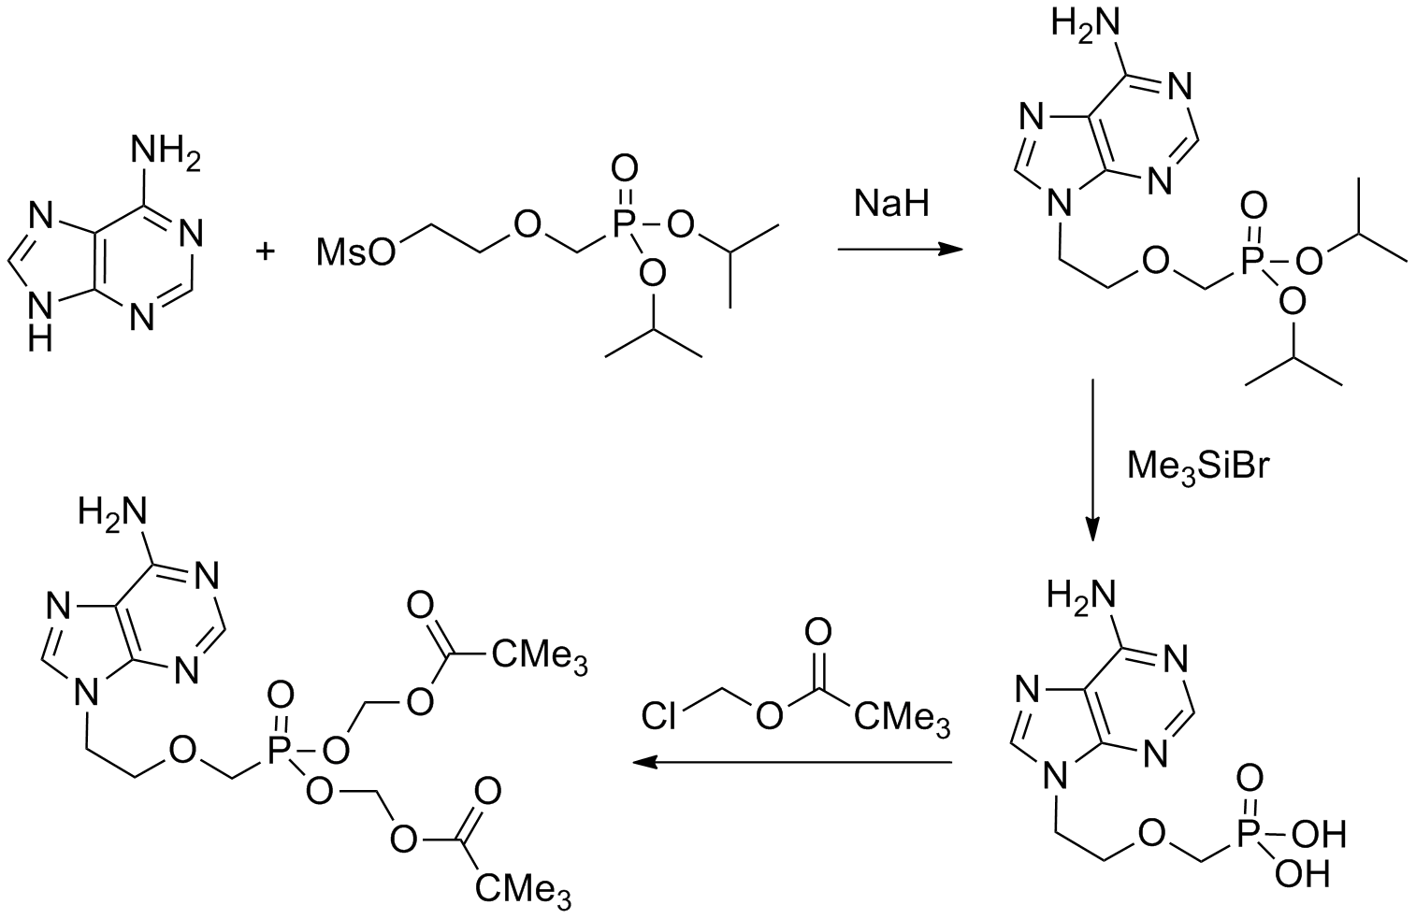
Drugs to treat infection caused by the hepatitis B virus
Adefovir synthesis
Adefovira dipivoxil
Adefovir

Slide 13
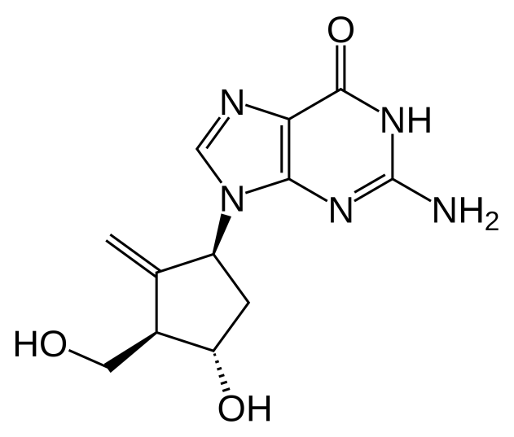
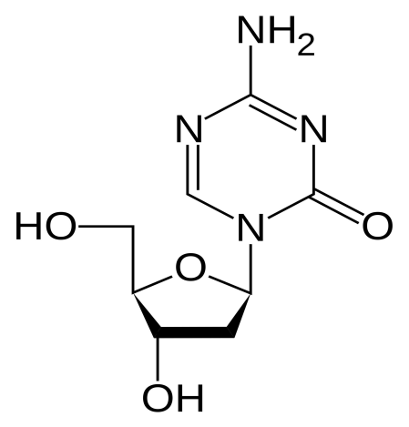
Drugs to treat infection caused by the hepatitis B virus
Therapy for HBV infection
Entecavir
Telbivudine

Slide 14
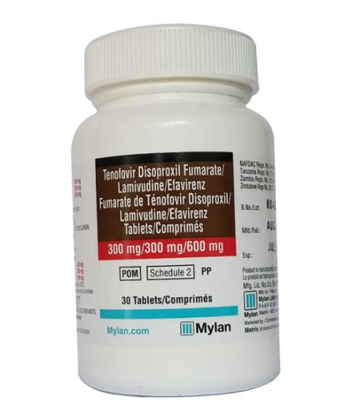
Drugs to treat infection caused by the hepatitis B virus
Therapy for HBV infection
Tenofovir disoproxil fumarate (Tenofoviri disoproxili fumaras)
Description. White to almost-white, crystalline powder.
Solubility. Slightly soluble in water, soluble in methanol, very slightly soluble in dichloromethane.

Slide 15
Drugs to treat infection caused by the hepatitis B virus
Therapy for HBV infection
Tenofovir disoproxil fumarate (Tenofoviri disoproxili fumaras)
Identity tests
Spectrophotometry in the infrared region. The infrared absorption spectrum is concordant with the spectrum obtained from tenofovir disoproxil fumarate RS or with the reference spectrum of tenofovir disoproxil fumarate.
Thin-layer chromatography
Determine the specific optical rotation
High-performance liquid chromatography,
The absorption spectrum of a 25 µg/mL solution of the test substance in water R, when observed between 220 nm and 320 nm, exhibits a maximum at about 261 nm.

Slide 16
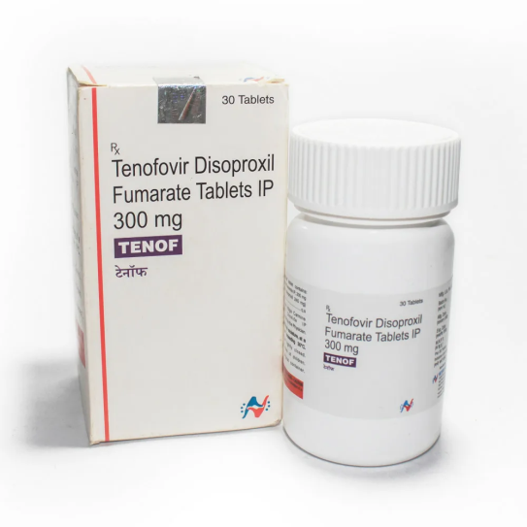
Drugs to treat infection caused by the hepatitis B virus
Therapy for HBV infection
Tenofovir disoproxil fumarate (Tenofoviri disoproxili fumaras)
Purity test
Water
Heavy metals.
Sulfated ash
Related substances
Assay.
Non-aqueous titration. Dissolve in glacial acetic acid and titrate with perchloric acid, and determine the end-point potentiometrically.
Storage. Tenofovir disoproxil fumarate should be kept in a tightly closed container, protected from light and stored at a temperature between 2–8 °C.

Slide 17
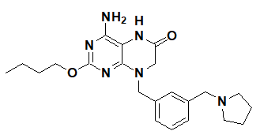
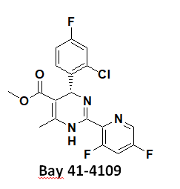
Drugs to treat infection caused by the hepatitis B virus
Therapy for HBV infection
Vezatolimod

Slide 18
Drugs to treat infection caused by the hepatitis B virus
Therapy for HBV infection
Many new drugs that target different stages of the HBV life cycle are currently in various stages of development. These include:
inhibitors of HBV binding to the NTCP receptor (cell entry inhibitor)
inhibitors of HBV DNA replication,
inhibitors of nucleocapsid assembly,
genome editing technologies (TALEN, CRISPR/Cas, etc.) and RNA interference.
In addition to drugs with direct antiviral action, approaches that enhance innate and adaptive immune response are being developed.

Slide 19
Thank you for attention!

