Slide 1
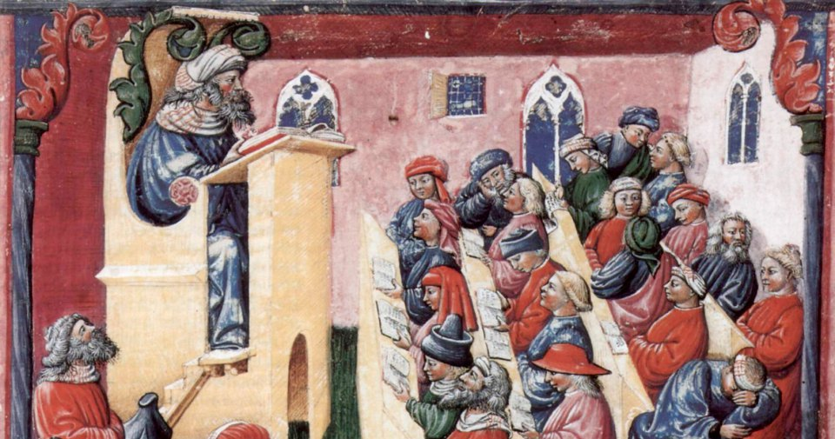
Theme: Theologic philosophy.

Slide 2
Theologic philosophy appeared in the Middle Ages as the result of peculiar union between philosophy and religion. The grand total of such union were first, preservation of the main ideas of ancient philosophy and ancient erudition, secondly, theology (in its medieval interpretation as the theory about God and its attitude to world and human being) became philosophic and rational characteristic peculiarities of medieval thought are retrospectivism and traditionalism that is appeal to the past. Antiquity of source book is the criterion of authenticity and truth.

Slide 3
Quotation became the method of proof and exegesis (interpretation of text) became the way philosophic reflection. Exegesis is the search of symbolism of individual words and sentences, the search of hidden, secret meanings and analysis of thoughts, which set forth the author of commenting text Authoritative text became the basis for development of new ideas and philosophic constructions.
In contradistinction to Ancient philosophy, the style of thinking in middle ages is theocentric, that is God is in the basis of universe. Philosophers of the Middle Ages used theologic idea. It fulfilled regulating function as idea of space fulfilled in Ancient philosophy.

Slide 4
Theologic philosophy based on two main ideas:
Teocentrism is the belief that God is the central aspect to our existence.
Creationism - creation of everything by God.
Providentialism is the belief that all events on earth are controlled by God.
Didacticism, edification, teaching were important features of Theologic philosophy. Dogma about creation of everything told about domination of the supernatural: there is only God. He is the absolute beginning.
All world and human being are results of his creation. Theologic philosophy had scholastic character. The main problem, which was considered in scholasticism, was the problem about correlation knowledge and faith.

Slide 5
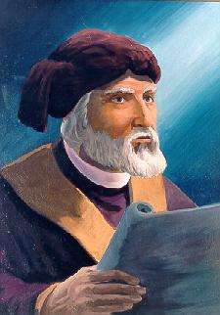
Patristics and scholasticism: the main authorities.
The word «patristics» means the study of early cristian writers, known as the Church Fathers. It is synthesis of religion values and Greek philosophy (philosophy of Plato).
One of the first authorities was Tertullian. He separated knowledge philosophy from faith, from religion. Religion is not based on mind. Divine truths contradict human Tertullian asserted:
«Believe, because it is absurdly».
Tertullian (160-220 A.D.)

Slide 6
Tertullian strictly differentiated between mind and religious consciousness.
Mind is connected with nature and human being. Faith is out these limits.
Faith, revelation aim at cognition of God.
Tertullian censures philosophic knowledge, because it weakens faith brings doubt, makes weaker power of Church. God, according to Tertullian, never reveals himself completely, but only in accordance with human ability of comprehension as human God, revealed himself in son.

Slide 7
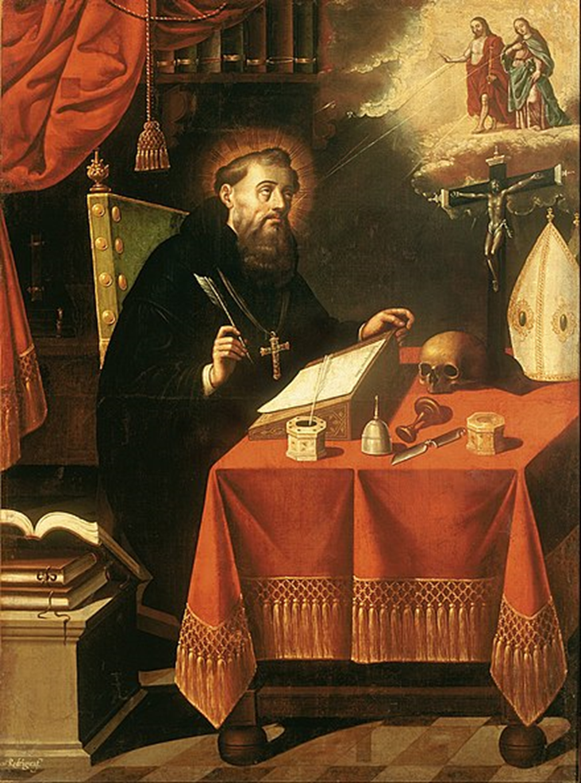
The second great authority of theologic philosophy is Augustine (354-430 A.D). The world outlook of Augustine is deeply theocentric. God is the source of being, clear form, the greatest beauty, the source of good. God constantly creates world once again in order to keep up being of the world.
The world would have return in nothing if the creative power of God had ceased. Augustine interpreted God as personality, created everything that exists.

Slide 8
Augustine analyzed the idea of God in correlation with human being and human being correlation with God.
Human soul, according to Augustine, is immaterial substance, different from body, but is not simple characteristic of body.
The soul is immortal. The mind is gaze of soul with which it independently, without help of body, contemplates true. Augustine regarded mind as very important, function of soul. He has not as Tertullian, hard contrast of mind and faith. But faith is better, more practical.

Slide 9
During the late patristic period, Boethius and John Scott Eriugena became famous for commentaries on Bible translations and translations themselves. John Scott Eriugena was engaged in translations and commentaries of Greek and Byzantine philosophers, developed dialectics, understanding it as logic - the science of right thinking, and as a doctrine of the most general principles and properties of life.

Slide 10
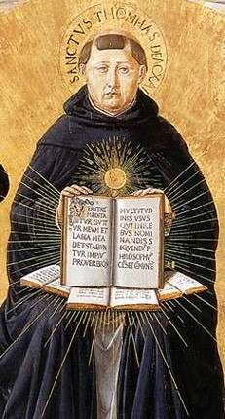
The term "scholasticism" means the systematization of learning in schools and universities, mainly in philosophy and theology, occasionally extending to law and medicine.
The third authority, central figure of medieval philosophy, of late period, outstanding philosopher and theologian, systematizator of orthodox scholasticism was Thomas Aquinas.
Thomas Aquinas
1225-1274 A.D.

Slide 11
Aquinas differentiated between spheres of philosophy and theology: the subject of philosophy is “truths of mind”, but the subject of theology is “truths of revelation”. As, according to Aquinas, God is the ultimate object of philosophy and theology and origin of any truth, there is no principled contradiction between revelation and correctly acting mind, between theology and philosophy. However, not all the “truths of revelation” can be proved rationally.

Slide 12
Philosophy is the servant of theology and as lower the latter, as limited human mind lower divine wisdom. Proceeding in many aspects from philosophy of Aristotle, Aquinas regarded God as the ultimate cause and ultimate aim of being, as pure being, or the act of existing.
Aquinas argued that mind can prove God’s being rationally, and can reject arguments against religious truths.

Slide 13
Aquinas gave ontological proof of God’s being:
All moving things have the cause of movement. It cause is God.
All things, that we can see, are the result of something. All things have its cause. And this cause has its cause. This process is infinite. And the first cause is God.
We can perceive all change around us as necessity or accidental. But the accidental is the necessity that we can not cognize. Аccidentality doesn’t exist for God, and we must recognize God, in order to comprehend reality.
Different things possess different degree of beauty and perfection. But there must be the model, absolute measure of this quality. This model is God.
All things develop and change. Where to? Only God can define the aim for everything.

Slide 14
By Aquinas, essence of all corporal is in the unity of form and matter. They are supersensible inner principles, forming any real thing. Matter only takes forms, changing each other. It is “pure potentiality”, because only owing to form thing is thing of definite kind.
In the interpretation of Aquinas, individuality of human being is the personal unity of soul and body, but soul is invigorating force of human organism.

Slide 15
The soul is the immaterial substance, finding its fullness only in the unity with body. That is why corporality is of great significance: through it the soul can only form human being. The soul always has uniquely-personal character. Corporal beginning of man organically takes part in spiritual activity of personality.
One of the important features of the medieval philosophy showed in celebrated dispute about Universals, that is about the nature of general concepts.
In this dispute Aquinas was supporter of realism, according to which universals exist in three aspects: “before things” in divine mind, “in things” as their essence or form and “after things” that is in human mind as the result of generalization (abstractions).

Slide 16
Nominalism stood in opposition to realism - from the word nomen - name. According to nominalism, things exist objectively and really, and general concepts are only names, that exist only in the human mind, in thinking as a product of generalization. The wellknown representative of this direction was Roscelin.

Slide 17
In the time of the late scholasticism, under the influence of science developing in England, philosophical elements dominate over theological. Philosophy is declared a theoretical discipline, and theology is considered as a sphere of practical knowledge, necessary for a person only to act in accordance with the norms of Holy Books.

Slide 18
Peculiarity of Arabian philosophy.
In X-XI centuries Golden age of Arabian culture took place: it was blossoming forth of science, art, technology, medicine and philosophy. The most brilliant representatives of Arabian philosophy were physician and philosopher
Ibn-Sena (Avicenna) and philosopher
Ibn-Rochd (Averroes). Both thinkers are representatives of eastern aristotelianism. Ibn-Sena regarded world as emanation of God that is world is the result of flow universe from God. Eternal God corresponds to world as eternal duration in time.

Slide 19
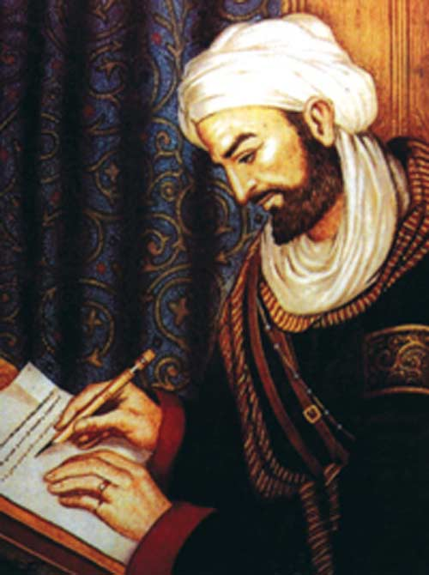
According to Avicenna, any being must be either necessary or accidentally, but if it is by accident, it requires a cause; since no infinite causal regress is possible, there must be a Necessary Being, which is therefore simple, the ultimate cause of all other things. This absolute cause is God.
The human soul is immortal and it is spiritual form of body (in Aristotle’s meaning). In the dispute about universals, Avicenna stood on positions of realism. Medical ideas of Ibn-Sena and refined practice of treatment are very valuable.
Avicenna 980-1037 A.D.

Slide 20
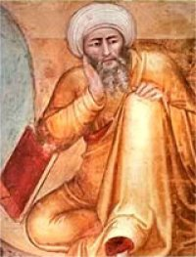
Ibn-Rochd (Averroes) - thought that matter was not created and it can not disappear.
Recognizing the being of God he considered, that God does not precede matter (it is the same eternal as God) and that the function of God is to turn potential, inner, intrinsic in matter forms into actual.
Ibn-Rochd denied the idea of immortality of individual soul.
Averroes
1126-1198 A.D.

