Slide 1
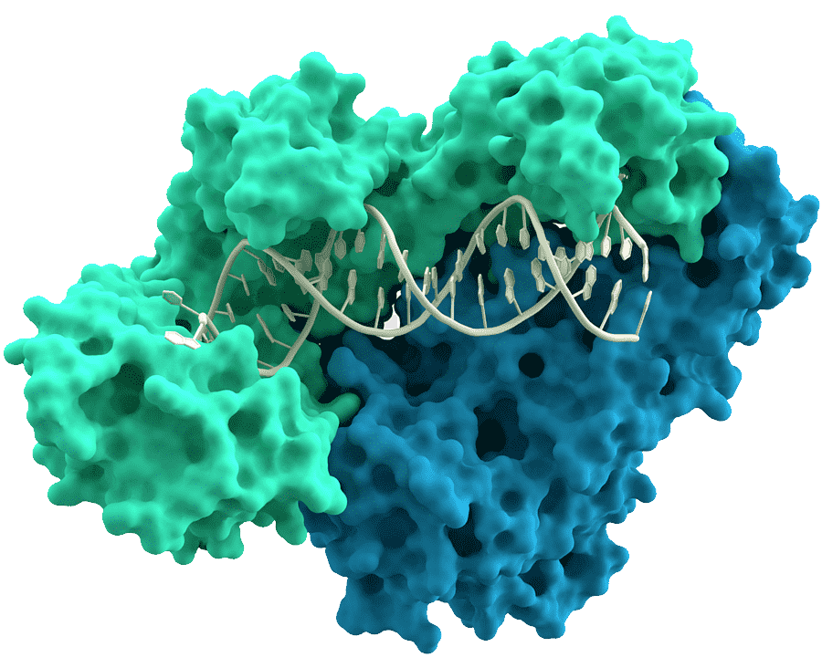
«General pharmaceutical chemistry»
Anti-HIV drugs
(part 2)
Associate Professor Gureeva E.S.

Slide 2
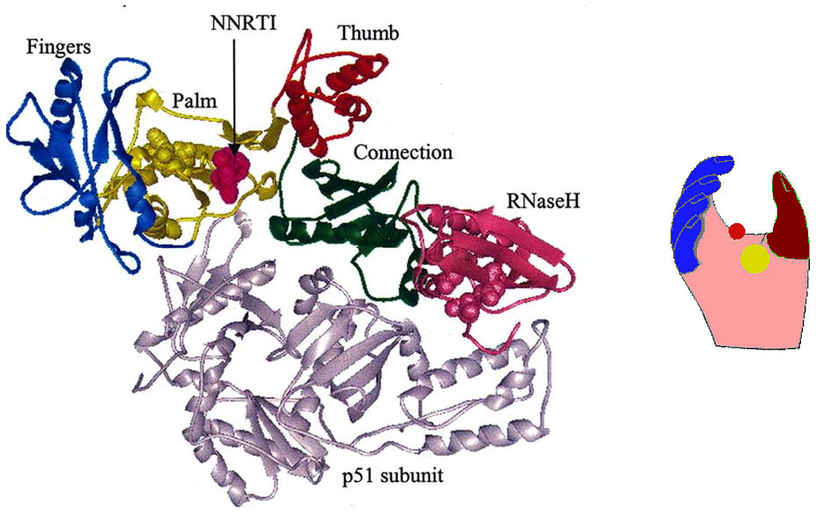
HIV-1 reverse transcriptase inhibitors
Structure of the HIV-1 reverse transcriptase

Slide 3
HIV-1 reverse transcriptase inhibitors
Four classes of HIV-1 reverse transcriptase inhibitors are currently known:
Nucleoside reverse transcriptase inhibitors (NRTIs) - bind to the active centre of reverse transcriptase;
Non-nucleoside reverse transcriptase inhibitors (NNRTIs) - bind to the allosteric centre of the enzyme;
Non-nucleoside inhibitors, but bind to the active site of reverse transcriptase;
RNAase inhibitors - bind to the joint domain and inhibit dissociation of the RNA-DNA complex.
However, only the first two classes of reverse transcriptase inhibitors, NRTIs and NNRTIs, are of therapeutic value.

Slide 4
HIV-1 reverse transcriptase inhibitors
Nucleoside reverse transcriptase inhibitors (NRTIs) of HIV-1
All nucleoside reverse transcriptase inhibitors can be classified into derivatives of their corresponding nucleotide bases:
Thymidine analogues - zidovudine, phosphazid, stavudine, telbivudine, clevudine
Adenine analogues - didanosine, adefovir
Cytidine analogues - zalcitabine, lamivudine, emtricitabine
Guanine analogues - abacavir
Adenosine analogues - tenofovir
Guanosine analogues - entecavir

Slide 5
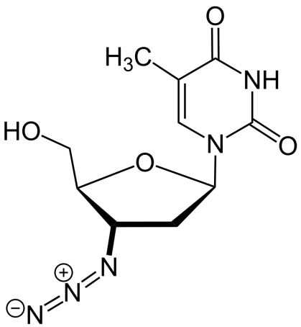
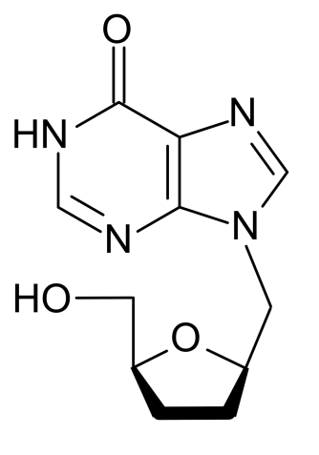
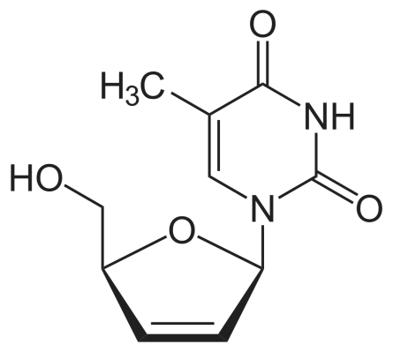
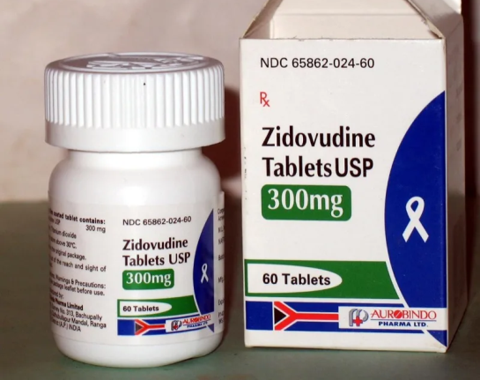
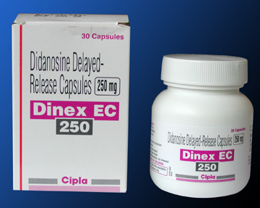
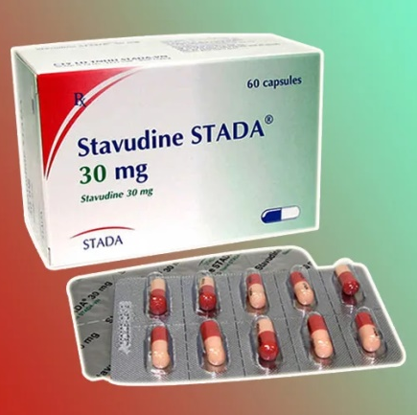
HIV-1 reverse transcriptase inhibitors
Nucleoside reverse transcriptase inhibitors (NRTIs) of HIV-1
Azidothymidine
(Zidovudine, AZT)
Didanosine
Stavudine

Slide 6
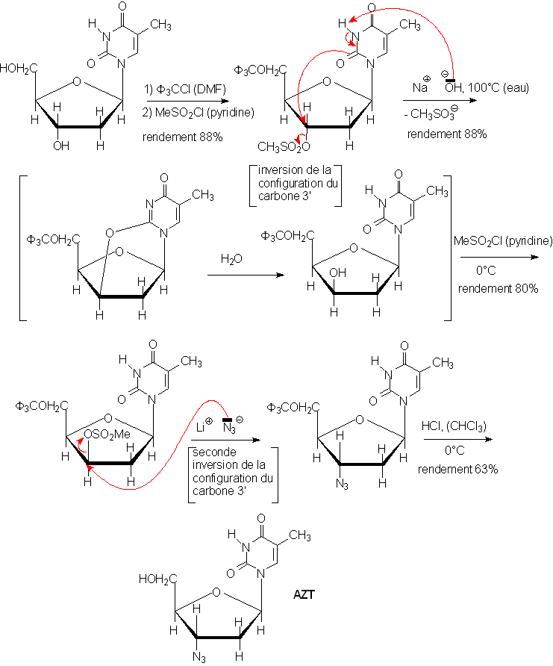
HIV-1 reverse transcriptase inhibitors
Azidothymidine (Zidovudine, AZT)

Slide 7
HIV-1 reverse transcriptase inhibitors
Azidothymidine (Zidovudine, AZT)
Physical properties
A white or brownish powder.
Solubility. Soluble in ethanol, sparingly soluble in water.
Identity tests
1. Thin-layer chromatography
2. Spectrophotometry in the visible and ultraviolet regions
3. Spectrophotometry in the infrared region
4. Determine the specific optical rotation

Slide 8
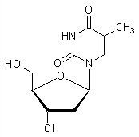
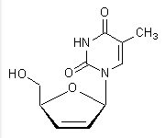
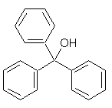
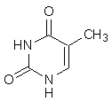
HIV-1 reverse transcriptase inhibitors
Azidothymidine (Zidovudine, AZT)
Purity test
1. Heavy metals
2. Sulfated ash
3. Loss on drying
4. Related substances:
thymine
Stavudine
3'-chloro-3'-deoxythimidine
Triphenyl-methanol
Assay (Quantification)
Spectrophotometry in the visible and ultraviolet regions

Slide 9
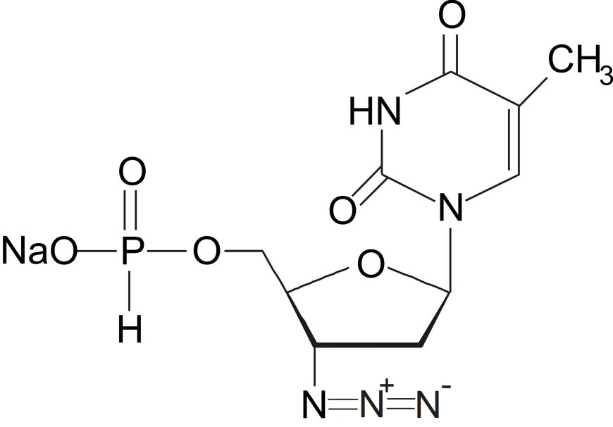
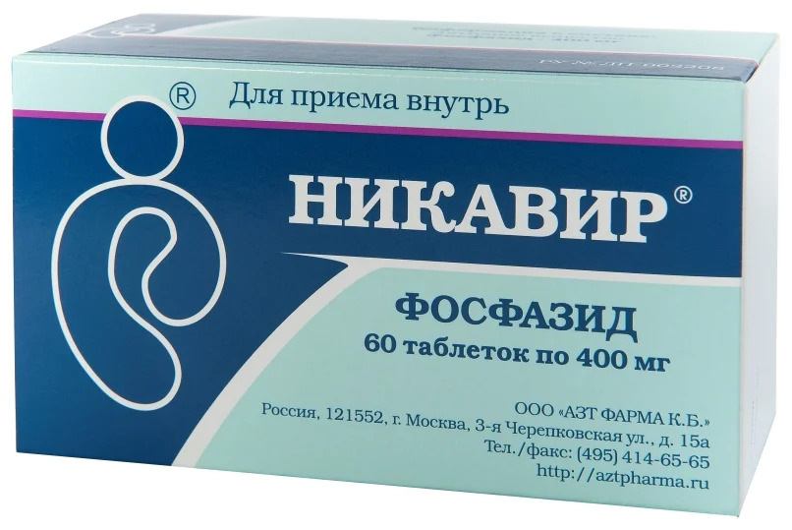
HIV-1 reverse transcriptase inhibitors
Nucleoside reverse transcriptase inhibitors (NRTIs) of HIV-1
Nicavir (sodium salt of 5'-H-phosphonate AZT, phosphazide) is the first success in the creation of depot-formulations of AZT. Nicavir was licensed in the Russian Federation in 1999 as a drug for the treatment and prevention of HIV infection.

Slide 10
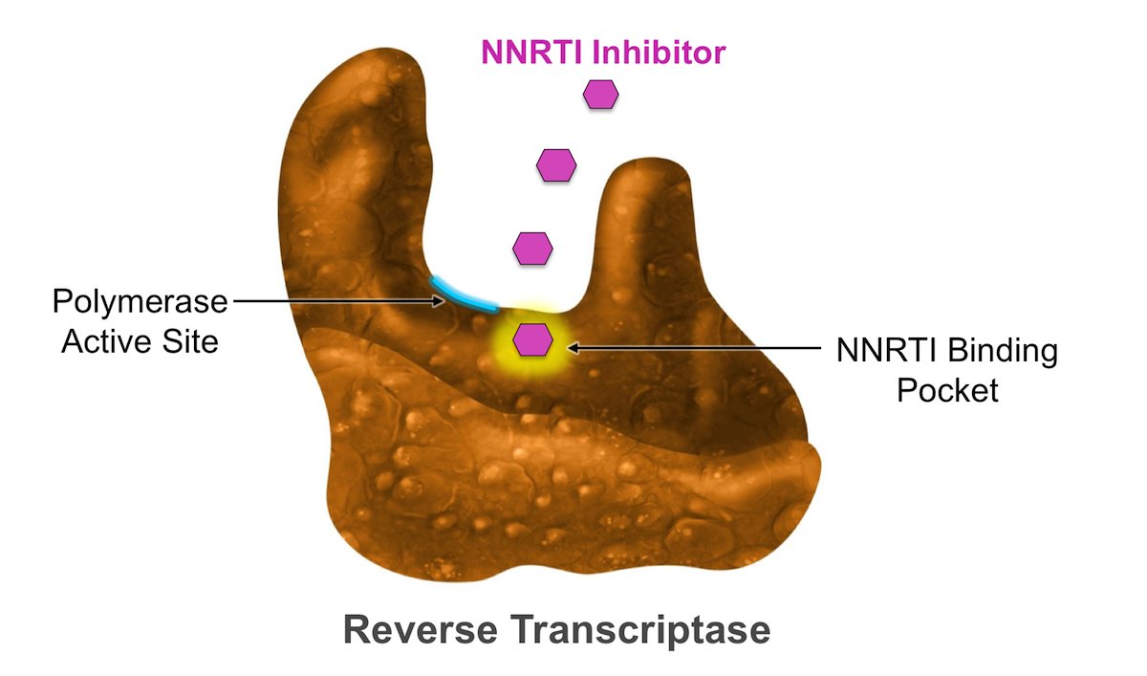
HIV-1 reverse transcriptase inhibitors
Non-nucleoside reverse transcriptase inhibitors (NNOTIs) of HIV-1
HIV-1 NNRTIs bind to the hydrophobic "pocket" of the RT of HIV-1, located 10 Å from the active centre of the enzyme and block its activity.
The hydrophobic pocket is located in the "palm" region of the p66 subunit. Once in the hydrophobic pocket, NNRTIs block the polymerisation process or reverse transcriptase conformational changes required for the catalytic process.

Slide 11
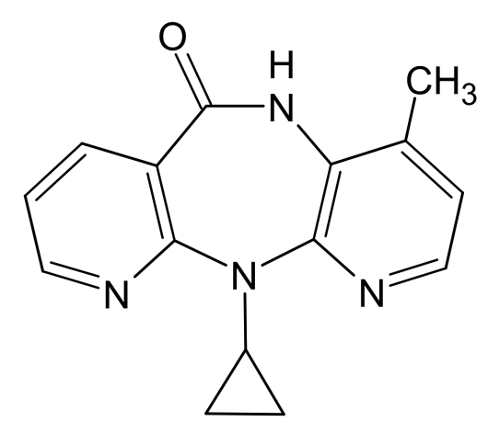
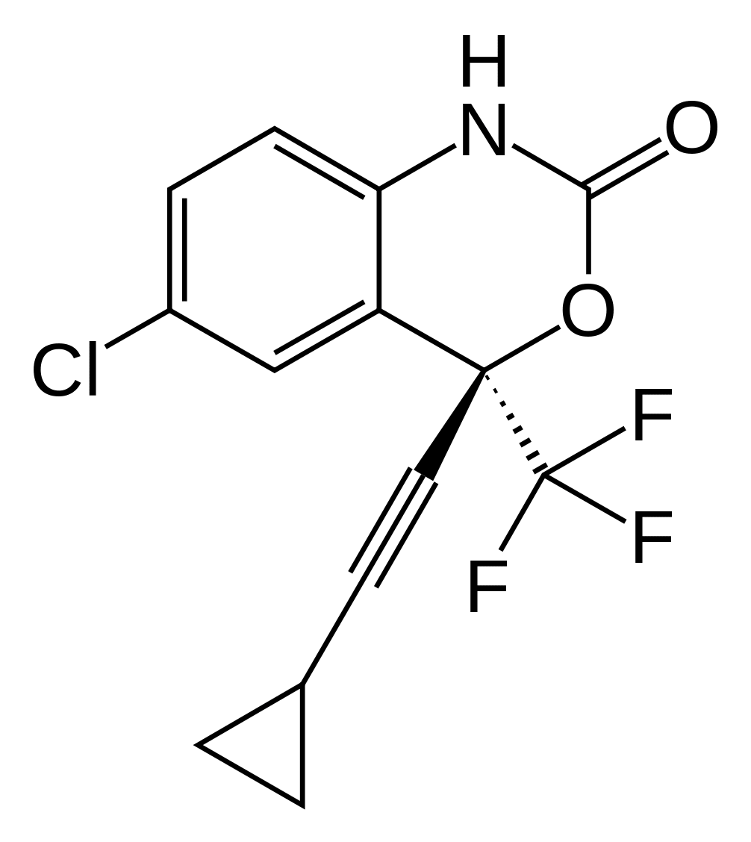
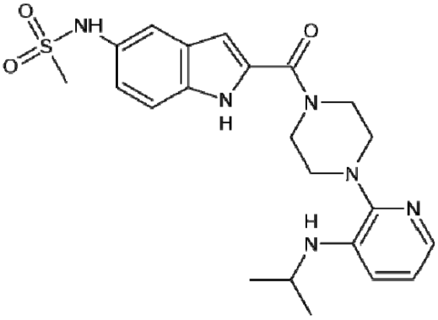
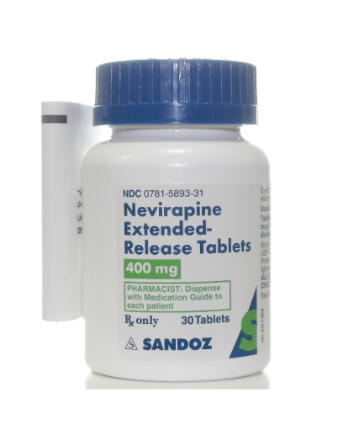
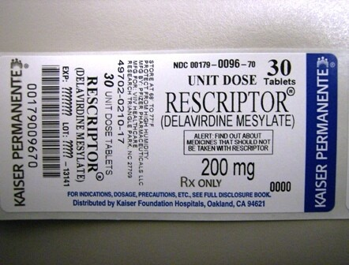
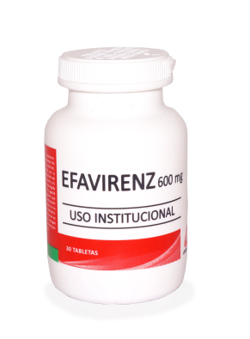
HIV-1 reverse transcriptase inhibitors
Non-nucleoside reverse transcriptase inhibitors (NNOTIs) of HIV-1
First-generation NNRTIs:
nevirapine
delavirdine
efavirenz

Slide 12
HIV-1 reverse transcriptase inhibitors
Non-nucleoside reverse transcriptase inhibitors (NNOTIs) of HIV-1
Nevirapine
Description. A white to almost white powder.
Solubility. Practically insoluble in water, sparingly to slightly soluble in dichloromethane, slightly soluble in methanol.
Identity tests
1. Thin-layer chromatography
2. Spectrophotometry in the visible and ultraviolet regions
3. Spectrophotometry in the infrared region

Slide 13
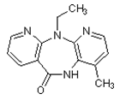
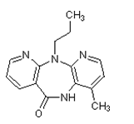
HIV-1 reverse transcriptase inhibitors
Non-nucleoside reverse transcriptase inhibitors (NNOTIs) of HIV-1
Nevirapine
Purity test
Assay (Quantification)
High-performance liquid chromatography
Storage
Nevirapine should be kept in a well-closed container.

Slide 14
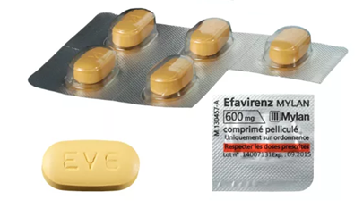
HIV-1 reverse transcriptase inhibitors
Non-nucleoside reverse transcriptase inhibitors (NNOTIs) of HIV-1
Efavirenz
Description. White to slightly pink powder.
Solubility. Practically insoluble in water, freely soluble in methanol.
Identity test
1. Thin-layer chromatography
2. Spectrophotometry in the visible and ultraviolet regions
3. Spectrophotometry in the infrared region
4. Determine the specific optical rotation

Slide 15
HIV-1 reverse transcriptase inhibitors
Non-nucleoside reverse transcriptase inhibitors (NNOTIs) of HIV-1
Efavirenz
Purity test
1. Sulfated ash
2. Loss on drying
3. Related substances. (High-performance liquid chromatography)
Assay (Quantification)
Spectrophotometry in the visible and ultraviolet regions
Storage
Efavirenz should be kept in a well-closed container, protected from light.

Slide 16
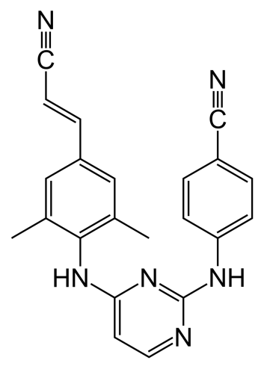
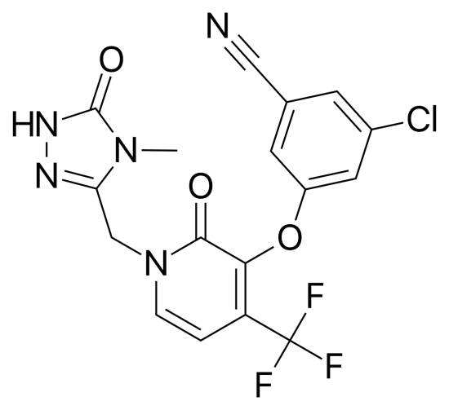
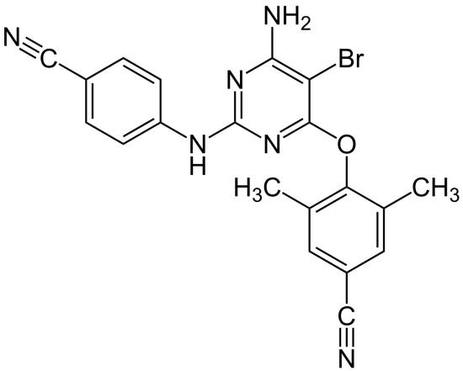
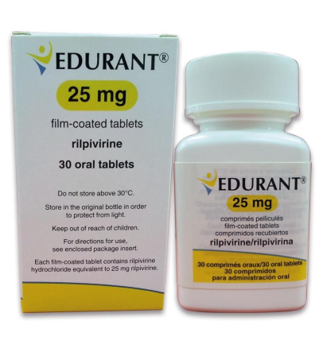
HIV-1 reverse transcriptase inhibitors
Non-nucleoside reverse transcriptase inhibitors (NNOTIs) of HIV-1
Second-generation NNRTIs:
etravirine
rilpivirine
doravirine

Slide 17
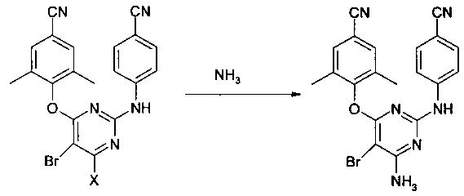
HIV-1 reverse transcriptase inhibitors
Non-nucleoside reverse transcriptase inhibitors (NNOTIs) of HIV-1
Synthesis of etravirine:
Etravirine is marketed by Janssen, a subsidiary of Johnson & Johnson.

Slide 18
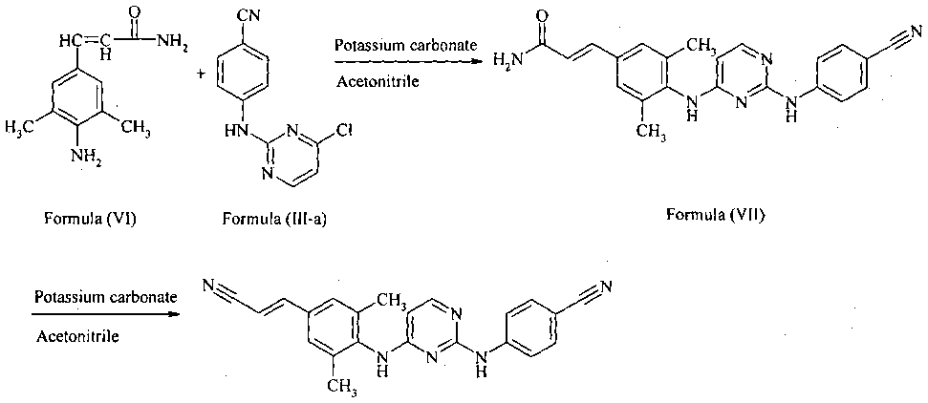
HIV-1 reverse transcriptase inhibitors
Non-nucleoside OT inhibitors (NNOTIs) of HIV-1
Rilpivirine synthesis:

Slide 19
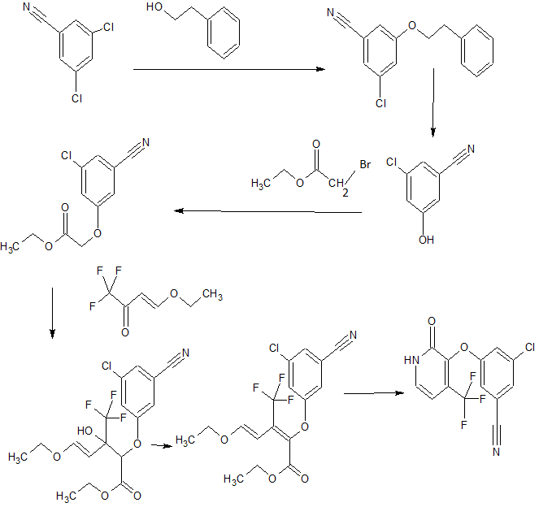
HIV-1 reverse transcriptase inhibitors
Non-nucleoside reverse transcriptase inhibitors (NNOTIs) of HIV-1
Synthesis of doravirin:
Obtaining phenoxypyridone:

Slide 20
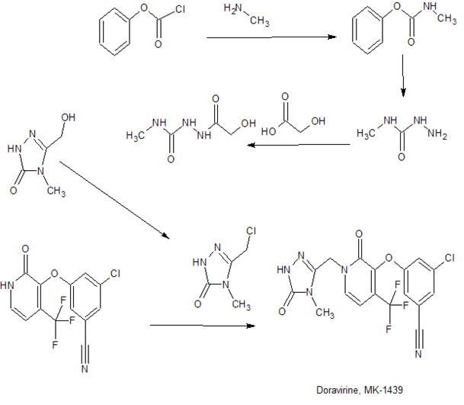
HIV-1 reverse transcriptase inhibitors
Non-nucleoside reverse transcriptase inhibitors (NNOTIs) of HIV-1
Synthesis of doravirine:
Obtaining doravirine:

Slide 21
HAART
The availability of a large number of anti-HIV-1 drugs with different mechanisms of action in the clinic has allowed a new principle for the treatment of HIV infection and AIDS, called Highly Active Antiretroviral Therapy (HAART), to be developed as early as the mid-1990s. This method consists of taking three or four drugs, with different mechanisms of action, at the same time.
Disadvantages:
HAART does not remove the virus from the body, it only prolongs the patient's life.
The body eventually develops multidrug-resistant strains of HIV-1.
Has side effects.
High cost of treatment.
However, the use of HAART delays the onset of AIDS by an average of 15-20 years.

Slide 22
Thank you for attention!

