Slide 1
Lecture № 2
Cell Cycle
Mitosis

Slide 2
Cell Cycle
Is the life of a cell from the time it is first formed from a dividing parent cell until its own division into two daughter cells.

Slide 3
Phases of the Cell Cycle
Interphase
Mitosis (M phase, nuclear division)
Cytokinesis (cytoplasmic division)

Slide 4
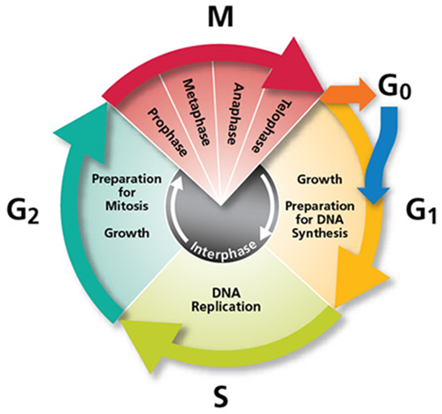

Slide 5
Interphase ("resting stage)
G 1 (gap 1)
S (synthesis)
G 2 (gap 2)

Slide 6
G1 ("Gap One")
The cell grows and enlarges
Synthesis of DNA precursors
Synthesis of histones proteins
Synthesis of enzymes
Synthesis of ATP

Slide 7
DNA precursors
DNA is composed of a series of smaller molecules called nucleotides. In turn, each nucleotide is made up of three primary components:
a nitrogen-containing (nitrogenous) base;
a carbon-based ( pentose) sugar molecule called deoxyribose;
a phosphate group attached to the sugar molecule.

Slide 8
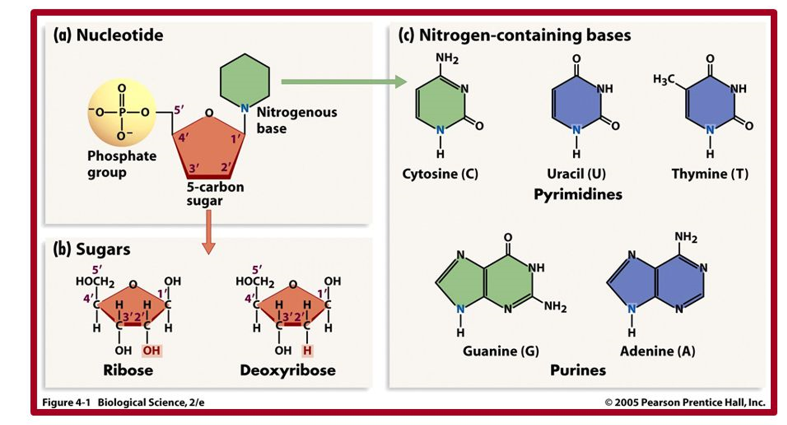
DNA precursors

Slide 9
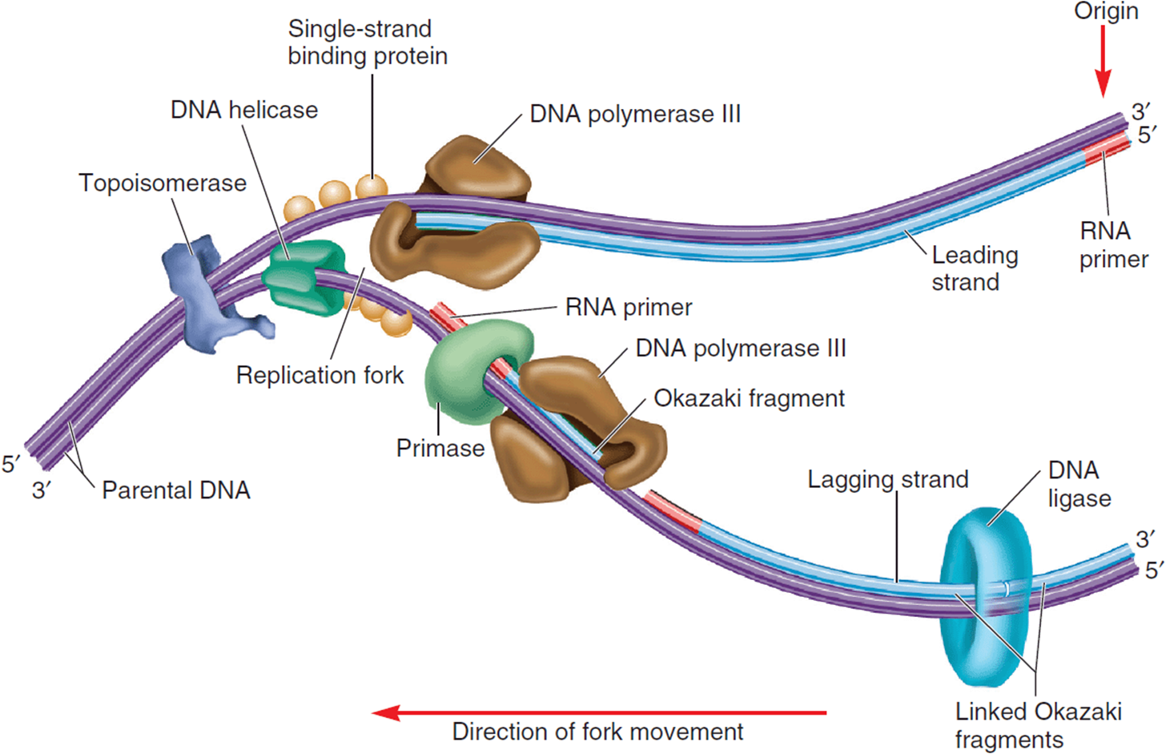
Enzymes of DNA replication
DNA helicase breaks the hydrogen bonds between the DNA strands.
Topoisomerase alleviates positive supercoiling.
Single-strand binding proteins keep the parental strands apart.
Primase synthesizes an RNA primer.
DNA polymerase III (DNA polymerase delta In Eukaryotes) synthesizes adaughter strand of DNA.
DNA polymerase I (Flap exonuclease In Eukaryotes) excises the RNA primers and fills in with DNA
DNA ligase covalently links the Okazaki fragments together.

Slide 10
Synthesis of histones proteins

Slide 11
S ("synthesis")
The genetic material is copied during process, known as DNA replication by semiconservative DNA synthesis.

Slide 12
Models of DNA replication
There are three possible models of DNA replication:
Semiconservative
Conservative
Dispersive

Slide 13
Semiconservative model Conservative model Dispersive model

Slide 14
G2 ("Gap Two")
Proteins that will act as spindle fibers are synthesized
Many organelles grow and divide, increasing in number
Synthesis of ATP
The cell gets ready for the M phase.

Slide 15
Mitosis (M phase)
Prophase
Metaphase
Anaphase
Telophase

Slide 16
Prophase
The chromatin fibers condense
Nuclear envelope breaks down
The nucleoli disappear
The mitotic spindle forms
The centrosomes move apart toward opposite poles.

Slide 17
Metaphase
The chromosomes align on the metaphase plate

Slide 18
Anaphase
The two daughter chromosomes begin moving toward opposite poles.

Slide 19
Telophase
Nuclear membranes and nucleoli re-form.
Spindle fibers disappear.
Chromosomes uncoil and become a tangle of chromatin.

Slide 20
Cytokinesis
In animal cells, cytokinesis involves the formation of a cleavage furrow, which divides the cell in two.
In plant cells, cytokinesis is accomplished by the formation of a membranous cell plate between the daughter cells; eventually, walls composed of cellulose are built.

Slide 21
The outcomes of and biological significance of Mitosis
Mitosis produces two cells that are genetically identical to each other and the original cell.
Cell division plays several important roles in life:
1. Reproduction
2. Growth and development
3. Tissue renewal

Slide 22
Meiosis
is the way to form haploid cells.
Like mitosis, meiosis begins after a cell has progressed through the G1, S, and G2 phases of the cell cycle. However, meiosis involves two successive divisions rather than one (as in mitosis).

Slide 23
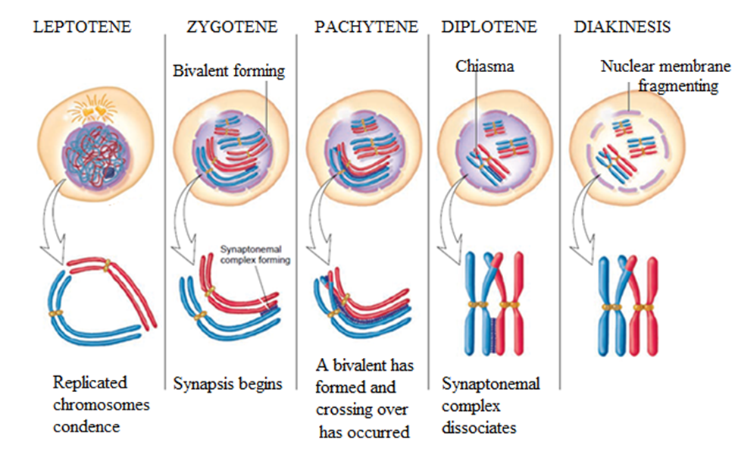
Prophase of meiosis I
is subdivided into stages known as leptotene, zygotene, pachytene, diplotene, and diakinesis.
Leptotene. The replicated threadlike chromosomes begin to condense.
Zygotene. A recognition process known as synapsis, in which the homologous chromosomes recognize each other and begin to align themselves.
Pachytene. Structures known as bivalents are formed. Crossing over occurs. .
Diplotene. The bivalent complex has largely disappeared. The bivalent pulls apart.
Diakinesis. The bivalent complex completely disappears.

Slide 24
The meiosis I is a reduction division.
Prophase I
The spindle apparatus is complete, and the chromatids are attached via kinetochore microtubules.
Metaphase I
The bivalents are organized along the metaphase plate. The paired chromosomes orient toward opposite poles of the spindle.
Anaphase I
The two pairs of sister chromatids within a bivalent separate from each other. However, the connection that holds sister chromatids together does not break. Instead, each joined pair of chromatids migrates to one pole, and the homologous pair of chromatids moves to the opposite pole.
Telophase I
The sister chromatids have reached their respective poles, and decondensation occurs (in many, but not all, species). The nuclear membrane may re-form to produce two separate nuclei.
The meiosis I is a reduction division.

Slide 25
The meiosis II is a equational division.
Prophase II
The chromosomes condense and become attached to a new spindle apparatus.
Metaphase II
The chromosomes move to positions in the equatorial plane of the cell.
Anaphase II
The centromeres of chromosomes split to allow the constituent sister chromatids to move to opposite poles (a phenomenon is called chromatid disjunction).
Telophase II
The separated chromatids — now called chromosomes — gather at the poles and daughter nuclei form around them. Each daughter nucleus contains a haploid set of chromosomes.

Slide 26
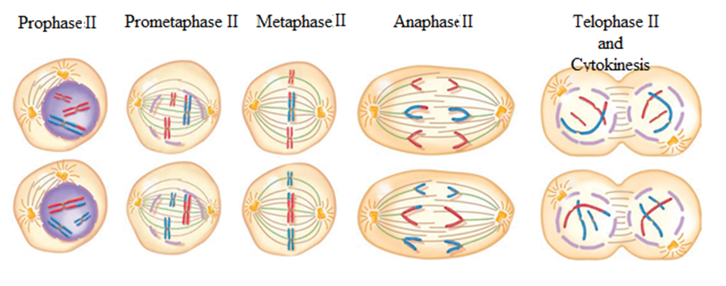

Slide 28
The outcomes and biological significance of Meiosis:
To ensure the production of haploid cells (gamets).
To maintain diploid number of chromosome in each generation.
Through the shuffling of chromosomes (independent assortment) and chromosomal recombination (by means of crossing over), new sets of chromosomes with a mix of paternal and maternal chromosomes are created, generating diversity in gametes.

