Slide 1
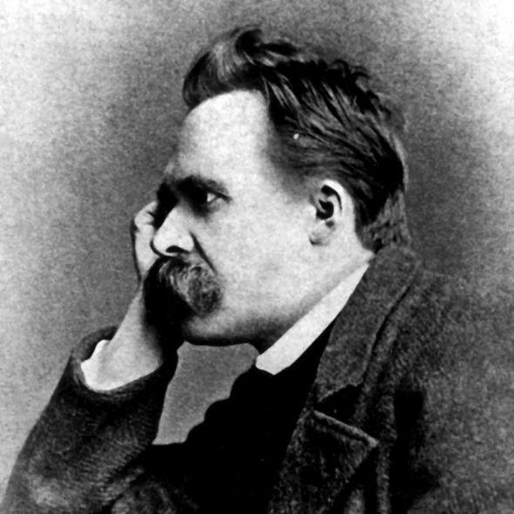
Theme: Western irrationalism (of XIX-XX centuries).
“Philosophy of life” (F. Nietzsche, H. Bergson).
The founder of the “philosophy of life” great philosopher F. Nietzsche. According to him, to live means to be another, than nature, not to obey neither natural, nor human necessity. Therefore, “life” is the symbol of freedom, creation, struggle. For the characteristic of the state of modern culture (end of 19-th century) Nietzsche introduces the concept “nihilism”.
F. Nietzsche
1844—1900

Slide 2
In its outward manifestation nihilism means: “The highest values lose their value”. There is no truth, no morality and the great thing, no God, for, according to Nietzsche, “God is dead”. God died in the souls of people – such the conclusion of German philosopher. But appearing hence nihilism has two aspects. Nihilism of weak is decay and demoralization. But radical nihilism, nihilism of strong is the way of absolute creation – creation of new morality, new man.

Slide 3
It is necessary, says Nietzsche, to enter the path of the “revaluation of values” path of “immoralism”. Revaluation of values supposes the transition from the “love of near” to the “love of distant”. Hypocritical daily morality is based upon “love to near”. This morality treats human weakness indulgently. Love of distant is the creative love, change of the principles of life. Revaluation of values supposes the denial of compassion, kindness, duty. Revaluation of values includes and revision of attitude to human happiness. Man is not bound to be happy; he is bound to be free.
In the context of the revaluation of values Nietzsche tells about religious values. According to him, сhristianity is faulty, because it weakens the will for creation in man. But only image of Christ discovers the way to superman, the long way of human improvement.

Slide 4
The idea of superman is the central in Nietzsche’s philosophy. Superman must replace dead God. Superman creates his life himself, without prompt. He is free in all.
The idea of superman is inseparable from the idea of eternal recurrence. The latter helps to understand the essence of man, going at the way of superhuman. Man must constantly pass the way from the state of “camel”, carrying the load of knowledge, through the state of “lion” – total criticism, to the state of “baby” – creator.

Slide 5
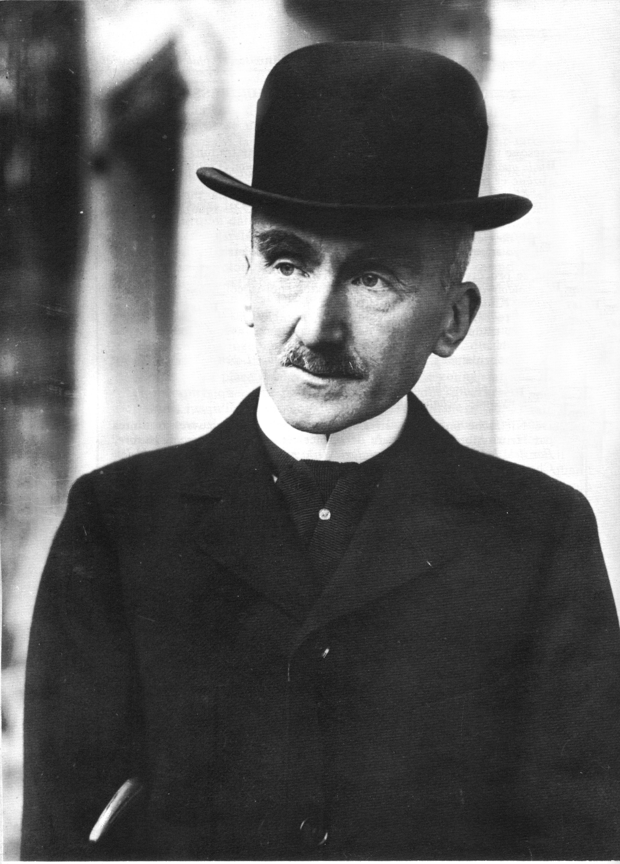
Another celebrated representative of the philosophy of life was Henri Bergson.
Criticizing mechanism and dogmatic rationalism, Bergson said that life is the substance, a certain wholeness, different from matter and spirit.
In this metaphysical constructions, Bergson interpreted life as a certain metaphysical, cosmic process, as “vital impulse” (burst), as powerful stream of creative forming.
Henri Bergson
1859 — 1941

Slide 6
But when this impulse becomes weaker, life fades and disintegrates, transforming in matter. Bergson regarded matter as inanimate mass – substance. But man is the creative being and through him passes the way of vital impulse.
The essence of life, according to Bergson, is comprehended only with the aid of intuition, which as if directly penetrates object, merging with its individual nature. Intuition does not assume any contrast. It is comprehension by life of itself.
It is impossible to understand, intuition, but one can feel it. Will must help to man in this process, for intuition contradicts all usual activity of consciousness.

Slide 7
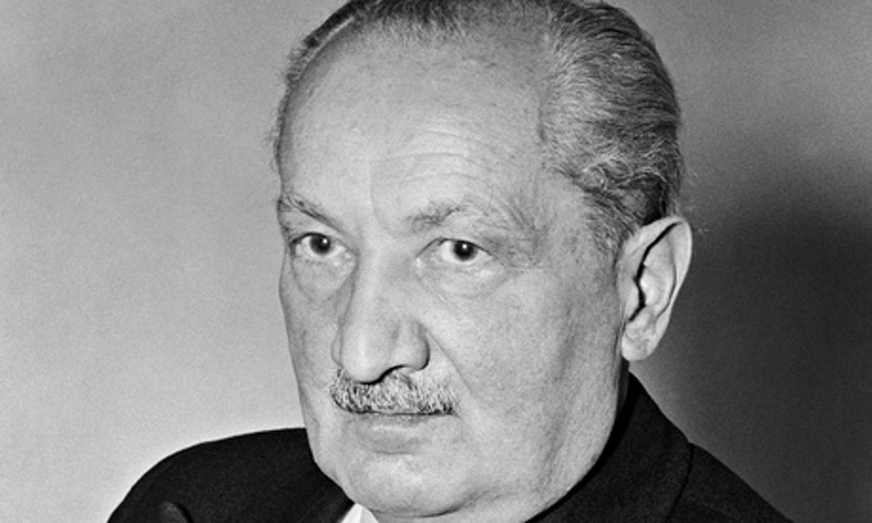
Existentialism: the main features.
Existentialism or philosophy of existence is one of the leading trends in irrational philosophy of 20-th century. The problem of human personality is in the centre of attention of existentialism. The representatives of existentialism are Martin Heidegger and Karl Jaspers, Gabriel Marcel and Jean-Paul Sartre, Maurice Merleau-Ponty, Albert Camus, Jose Ortega-y-Gasset, Nicolai Berdyaev, Leon Shestov and other.
Martin Heidegger
1889 — 1976

Slide 8
Existentialism considers existence as the unity of man and being. Existence is true, internal, personal being of man, the stream of his feelings, it can’t be reduced to external objective forms.
This true “self” can’t be cognized in rational methods. For meaning of feelings that consist existence, Heidegger introduces the concept “existentials”. The main existential are: care, fear, worry, horror. Existentials are ways of man’s existence in “border-situations” (situations between life and death, being and nothing).

Slide 9
The main feature of existence is temporary, ending. Man always stands in opposite to death. Therefore, existential time is fate. Man can die and this feel is the basis of man’s – life-construction. Therefore a sensible life of man Heidegger called “being to death”. In this time existence as true being of man are connected with transcendence. It is way out of human limits. For atheistic existentialists this is a way to nothing, for religious existentialists is a way to God.
The main aspect of existence is freedom. It can not be cognized, but man can be free.

Slide 10
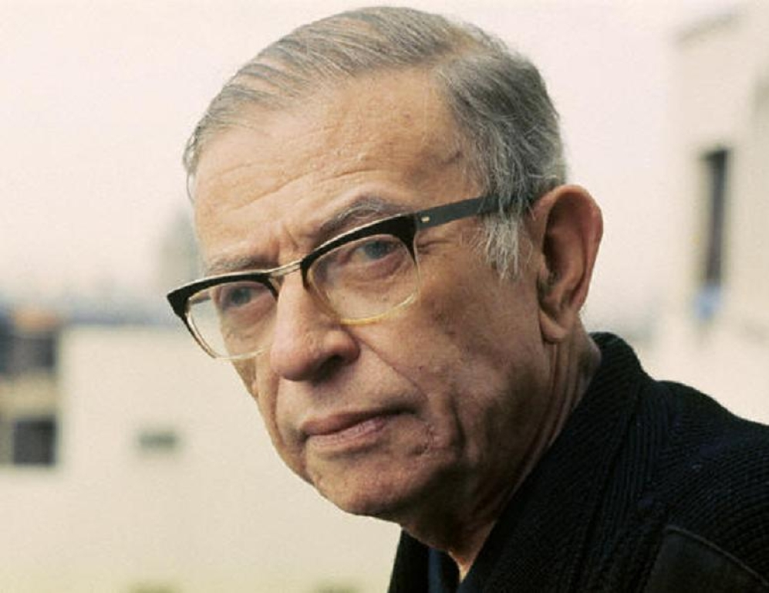
According to Sartre, freedom is the cross, that personality carries all your life. If the man refuses from freedom he loses yourself as personality and sinks into the “world of objectivity”. “World of objectivity” is the world of social commonness. In this world man becomes to be as all people. In this world life of people is not true being. People lives and communicates for lie but not for truth. This life leads to internal and external crisis of man.
Jean-Paul Sartre
1905-1980

Slide 11
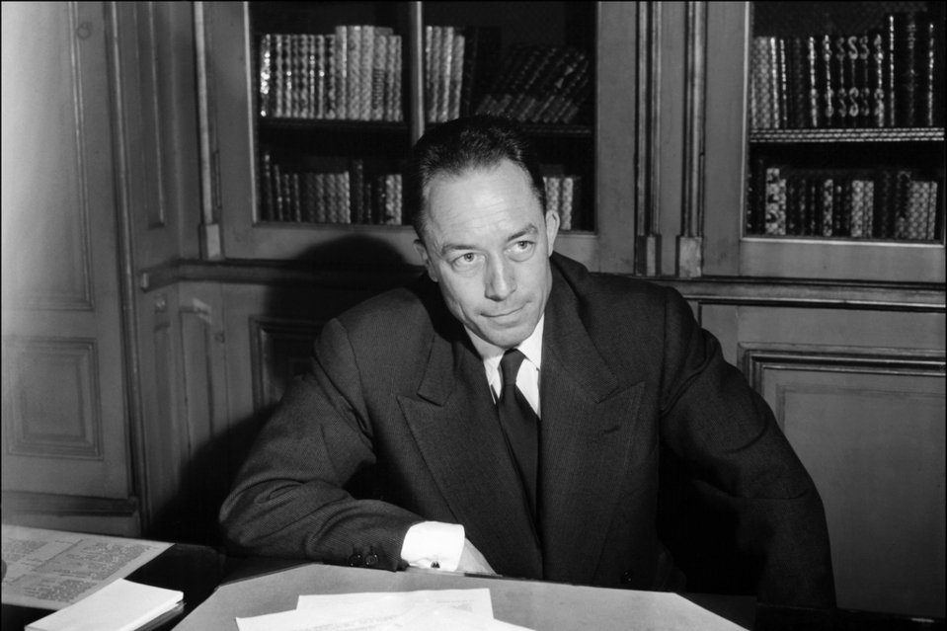
Sartre and Camus saw the exit from crisis in conflict and struggle of absolutely lonely man against the objective world. Marcel and Jaspers saw this exit from crisis in transcendence of personality in existential communication.
Albert Camus
1913 –1960

Slide 12
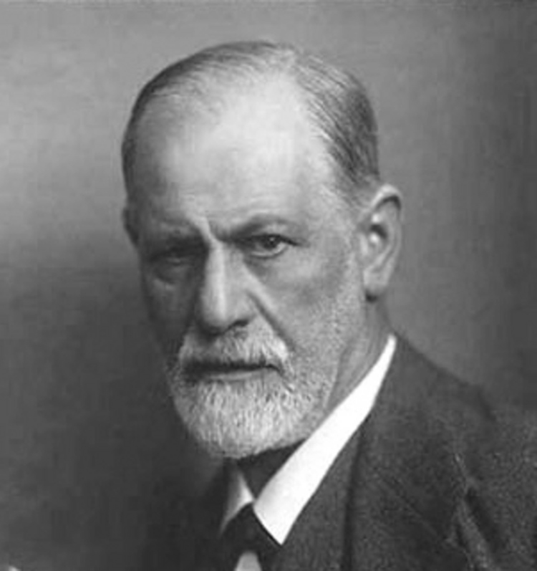
Psychoanalysis or philosophy of unconsciousness is another influential direction of Western irrational philosophy of XX century. The origin of this philosophy is connected with names of doctors-psychiatrists – S. Freud, C.G. Jung, E. Fromm.
Beginning as a theory of neurosis treatment the theory of Freud turns into philosophic-anthropological conception.
S. Freud
1856—1939

Slide 13
Freud first coined and substantiated the new principle of unconscious activity. Human consciousness is under pressure of unconsciousness and superego constantly. This leads to neurosis and other psychical diseases. Investigated neurosis, Freud created method of treatment, which based on his comprehension of human psyche (hypnosis). Freud supposed that except conscious ego and superego in the deep of human psyche hides unconscious (id). That is biological source of man.
Analyzing unconscious deep experience Freud came to a conclusion that the first source of human activity is the repressed energy (libido) attached to sexuality.

Slide 14
The id is the unconscious reservoir of drives and impulses derived from the genetic background and concerned with the preservation and propagation of life. The ego operates in conscious and preconscious levels of awareness. It is the portion of the personality concerned with the tasks of reality: perception, cognition, and executive actions. In the superego lie the individual's environmentally derived ideals and values and the mores of his family and society; the superego serves as a censor on the ego functions.
The existence of mysterious id or unconsciousness helps to explain peculiarity of human behavior. Unconsciousness and its content Freud regarded as a source of neurosis and personal conflicts (conflicts of personality).

Slide 15
Freud used the results of his investigations to speculate about the origins of morality, religion, and political authority. He tended to find their historical and psychological roots in early stages of the development of the individual. Morality in particular he traced to the internalization of parental prohibitions and demands, producing a conscience or superego. Such identification plays an important role in character formation in general. The instinctual renunciation demanded by morality and often achieved by repression Freud regarded as essential to the order society needs to conduct its business. Civilization gets the energy for the achievements of art and science by sublimation of the instinctual drives. But the costs of society and civilization to the individual in frustration, unhappiness, and neurosis can be too high.

Slide 16
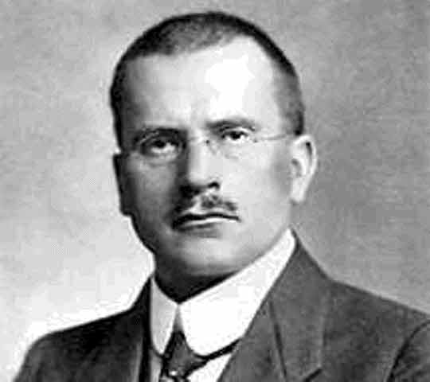
C.G. Jung created the theory of «collective unconsciousness» that consists of archetypes combination (prototypes) of ancient way of view, comprehension and experience of world. Archetypes are instincts, that show its existence by means of symbols images.
C.G. Jung
1875 - 1961

Slide 17
When unconsciousness assimilates with consciousness. This images manifest itself in dreams, impulses, visions in a works of art and forms of human behavior and myths. With help of symbols, archetypes appear yourself in a man enigmatically and mystically.
Archetypes are system of attitudes of ancient man that make possible to survive in complex environment. Due to archetypes can be created myths, religion and philosophical systems that influence on nations in different historical periods.

Slide 18
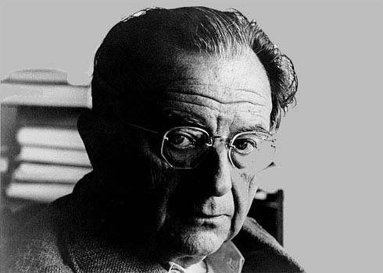
The follower of Jung was E. Fromm.
E. Fromm is the main representative of neo-Freudism.
His theory is synthesis of psychoanalysis, Marxism and existentialism.
E. Fromm
1900—1980

Slide 19
According to Fromm, man, at first is a social creature. Social structure forms human needs and his anthropological basis defines a way of his existence. Fromm introduced the concept about types of social characters. Social character expresses the connection between human psyche and social structure. This character forms under influence of fear. Fear represses and displaces to unconsciousness images and features that is incompatible with leading social norms. Form of social pathology E. Fromm connects with estrangement that leads social life in the modern time.

Slide 20
Estrangement demoralizes and misinterprets all human values. Estrangement in the modern time achieves to limit under which, according to Fromm, it borders with madness, because there is termination of spiritual cultural tradition and creation of global destruction.

