Slide 1
«General pharmaceutical chemistry »
Alkalimetry. Acidimetry.
Titration in non-aqueous solution.
Associate Professor Gureeva E.S.

Slide 2
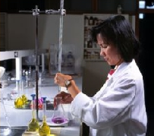
Neutralisation
The neutralisation method is based on the protolytic reaction:
SH₂⁺ + S⁻ 2SH
Particularly in aqueous solutions:
H₃O⁺ + OH⁻ 2H₂O
This method is used to quantify:
acids,
bases,
salts hydrolysed by cation or anion,
nitrogen and sulphur in organic compounds.

Slide 3
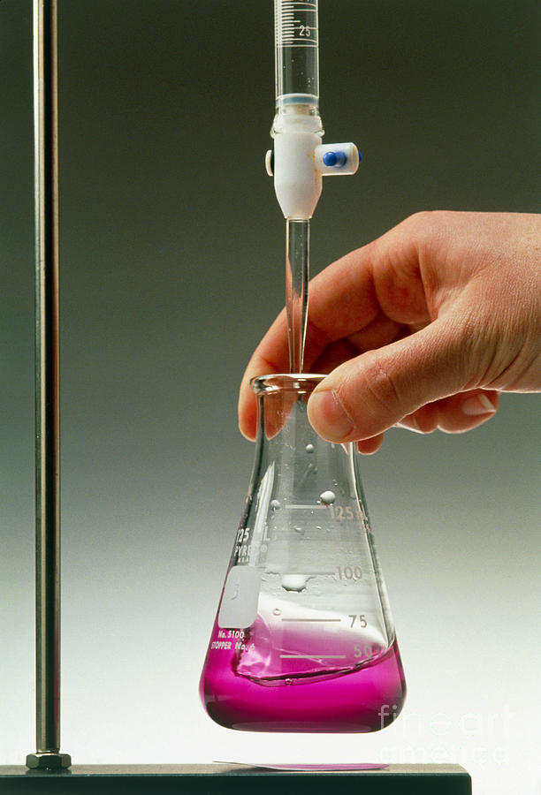
Acid-base titration in aqueous medium
Classification of acid-base titration methods in aqueous media
Depending on the working solution, this method gets its specific name:
Alkalimetry, where the working solution is alkali,
Acidimetry, which uses an acid solution as the working solution.
II. According to the technique of quantitative analysis , there are:
direct titration,
Reverse titration,
Substitution titration.

Slide 4
Acid-base titration in aqueous medium
Working solutions and standard substances
of the acid-base titration method
The main working solutions in this method are strong acid solutions or alkaline solutions. These substances do not meet the requirements for standard substances and therefore titrated solutions cannot be prepared from an exact sample weight.
As standard substances for the standardisation of acid solutions are used:
sodium tetraborate
Na₂B₄O₇ ×10H₂O,
anhydrous sodium carbonate
Na₂CO₃,
mercury oxide HgO,
potassium iodate KJO₃ and others.
To standardise alkaline solutions, the following are used
oxalic acid H₂C₂O₄×2H₂O,
succinic acid H₂C₄H₄O₄,
benzoic acid С₆H₅COOH (primary standards),
as well as standardised solutions of hydrochloric or nitric acid (secondary standards).

Slide 5
Acid-base titration in aqueous medium
Acid-base indicators
Acid-base indicators are organic compounds whose colouring changes according to the concentration of H+ ions in the solution.
The range of pH values of a solution in which there is a noticeable change in indicator colouration is called the transition range of the indicator.

Slide 6
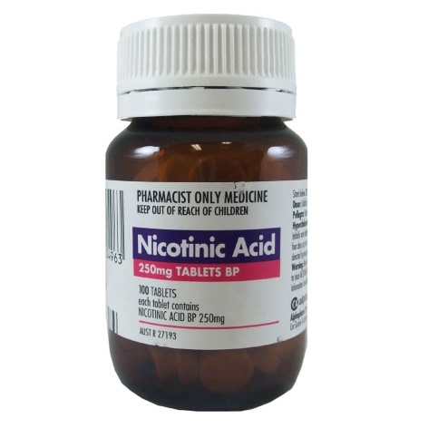
Acid-base titration in aqueous medium
Application of acid-base titration in drug analysis
Titration of inorganic and organic acids
Nicotinic acid
Titrant: NaOH
Indicator: phenolphthalein

Slide 7
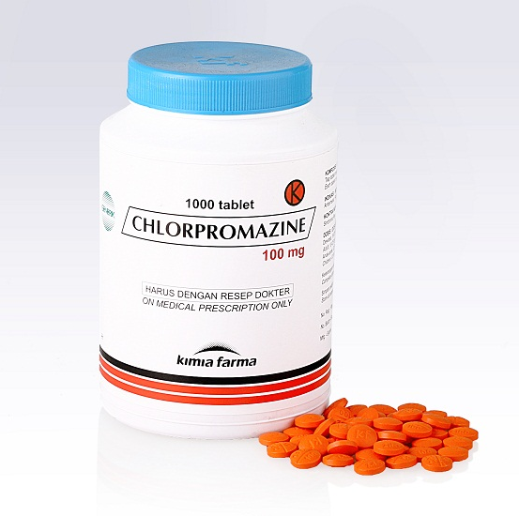
Acid-base titration in aqueous medium
Application of acid-base titration in drug analysis
Titration of organic base salts
Chlorpromazine
Titrant: NaOH
Indicator: phenolphthalein

Slide 8
Acid-base titration in aqueous medium
Application of acid-base titration in drug analysis
Titration of salts of weak inorganic and organic acids
Sodium hydrogen carbonate
Titrant: Hydrochloric acid
Indicator: Methyl orange

Slide 9
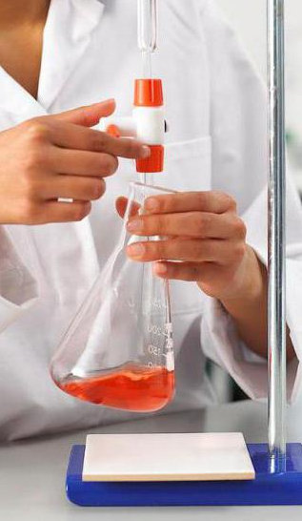
Acid-base titration in aqueous medium
Advantages and disadvantages of the acid-base titration method in aqueous medium
Advantages of the acid-base titration method:
High accuracy (0.1-0.2%),
The stability of the working solutions,
Wide choice of indicators for fixing the titration endpoint,
Large area of practical application.
Disadvantages of the method:
non-selectivity when titrating mixtures of analytes,
Insufficiently high value of the equilibrium constant when titrating very weak acids and bases.

Slide 10
Acid-base titration in aqueous medium
Acid-base titration in an aqueous medium has a number of limitations:
Weak acids and bases whose dissociation constants are < 10-7 cannot be titrated;
Substances insoluble in water cannot be titrated;
Strong acids or bases in mixtures as well as weak acids and bases with close dissociation constants cannot be titrated separately
In such cases, titrations in organic solvents, i.e. non-aqueous media, are resorted to.

Slide 11
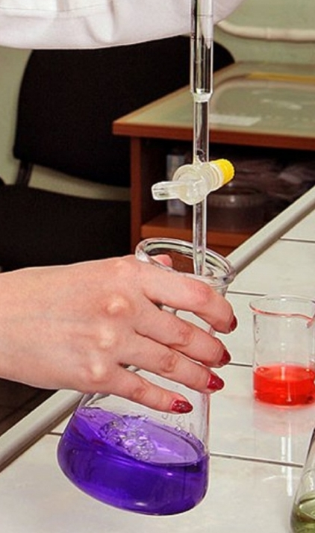
Acid-base titration in a non-aqueous medium
A titration in which the medium is an organic solvent with little dissolved water (less than 0.5%) is called a non-aqueous titration (non-aqueous titrimetry).

Slide 12
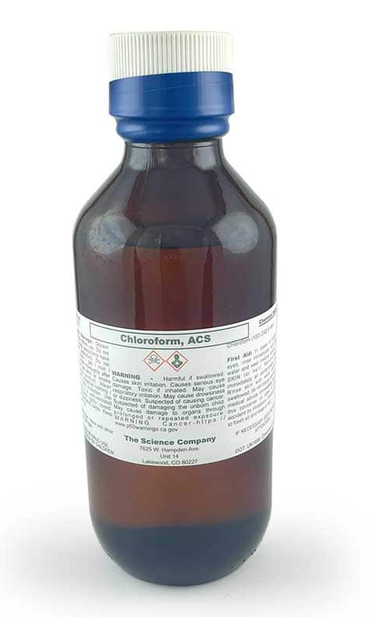
Acid-base titration in a non-aqueous medium
Classification of solvents used in non-aqueous titration
In terms of acid-base properties, solvents can be divided into two groups:
Aprotonic solvents that exhibit neither acidic nor basic properties (benzene, hexane, chloroform, etc.),
Protolytic solvents, which exhibit acidic and basic properties.

Slide 13
Acid-base titration in a non-aqueous medium
Classification of solvents used in non-aqueous titration
Protolytic solvents are in turn divided into 3 types:
Protogenic solvents which exhibit acidic properties, i.e. which are proton donors. These are anhydrous carboxylic acids (acetic, formic, oily, etc.), acetic anhydride and phenol.
Protophilic solvents that have basic properties, i.e. that can act as proton acceptors. These include ketones (acetone), esters (dioxane, diethyl ether), tertiary amines (pyridine);
Amphiprotic solvents with both acidic and basic properties, of which water, alcohols, primary and secondary amines are typical representatives.

Slide 14
Acid-base titration in a non-aqueous medium
TITRANTS AND SOLVENTS USED FOR NON-AQUEOUS TITRATION
For titration of weak acids the basic solvents recommended are ethylenediamine, butylamine, pyridine, dimethylformamide, a mixture of methanol and benzene, and tertiary butanol. Sodium methylate in methanol, for example, is used as a titrant.
For titration of weak bases, solvents with acidic properties are used. The most commonly used solvent is glacial (anhydrous) acetic acid. Chloric acid in acetic acid or dioxane is the titrant.
Both acids and bases can be titrated in universal inert solvents such as methyl isobutyl ketone and methyl ethyl ketone, nitriles and nitromethane. In the inert solvents a differentiation effect can be seen, which makes it possible to titrate separately substances with similar constants. The titrants are tetrabutylammonium hydroxide, sodium methylate etc.

Slide 15
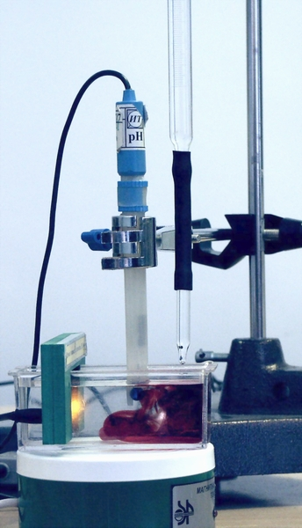
Acid-base titration in a non-aqueous medium
FIXING THE TITRATION END POINT
Indicators are used to fix the titration end-point, but mainly potentiometric titration.
Indicators
In acidic solvents:
Crystal violet,
Tropeolin 00,
Malachite green, etc.
In basic solvents:
Thymol blue,
Bromothymol blue, etc.
In inert solvents:
Methyl orange,
Thymol blue, etc.

Slide 16
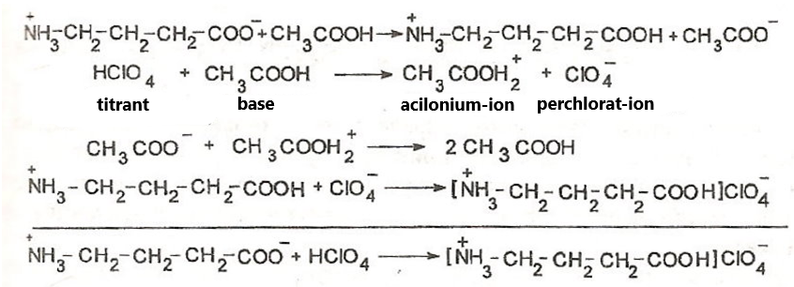
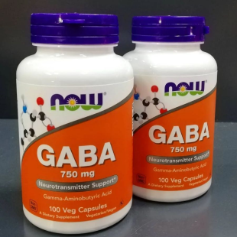
Acid-base titration in a non-aqueous medium
APPLICATION OF NON-AQUEOUS TITRATION IN PHARMACEUTICAL ANALYSIS
Titration of amino acid salts
GABA
Solvent: glacial acetic acid
Titrant: HClO₄
Indicator: crystal violet

Slide 17
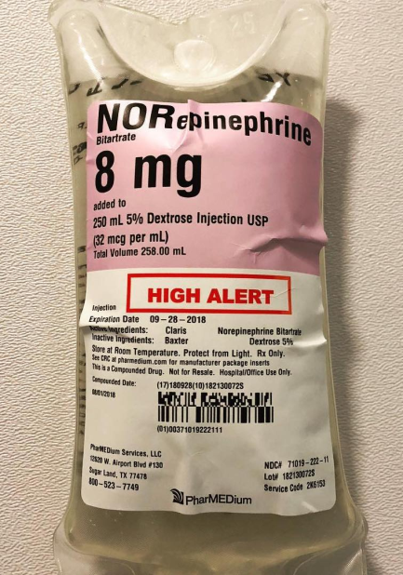
Acid-base titration in a non-aqueous medium
APPLICATION OF NON-AQUEOUS TITRATION IN PHARMACEUTICAL ANALYSIS
Titration of salts of nitrogen-containing organic bases
Norepinephrine hydrotartrate
Solvent: glacial acetic acid
Titrant: chloric acid
Indicator: crystal violet

Slide 18
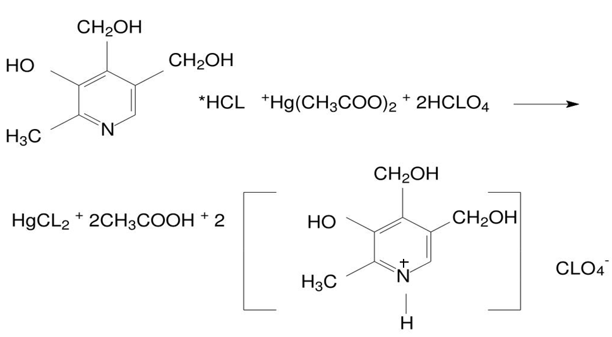
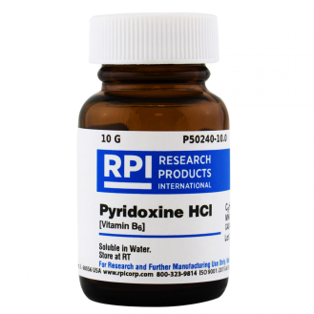
Acid-base titration in a non-aqueous medium
APPLICATION OF NON-AQUEOUS TITRATION IN PHARMACEUTICAL ANALYSIS
Titration of nitrogen-containing organic base hydrohalides
Pyridoxine hydrochloride
Solvent: glacial acetic acid
Titrant: HClO4
Indicator: crystal violet

Slide 19
Acid-base titration in a non-aqueous medium
APPLICATION OF NON-AQUEOUS TITRATION IN PHARMACEUTICAL ANALYSIS
Titration of nitrogen-containing organic base hydrohalides
Pyridoxine Hydrochloride
Solvent: formic acid with acetic anhydride
Titrant: HClO₄
Indicator: Crystal violet

Slide 20
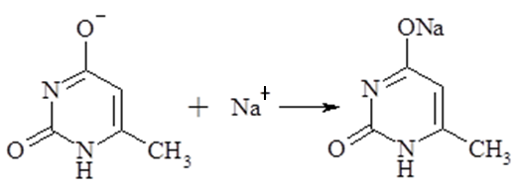
Acid-base titration in a non-aqueous medium
APPLICATION OF NON-AQUEOUS TITRATION IN PHARMACEUTICAL ANALYSIS
Titration of acidic medicinal substances
Methyluracilum
Solvent: DMFA
Titrant: NaOH in a mixture of methanol and benzene
Indicator: Bromothymol blue

Slide 21
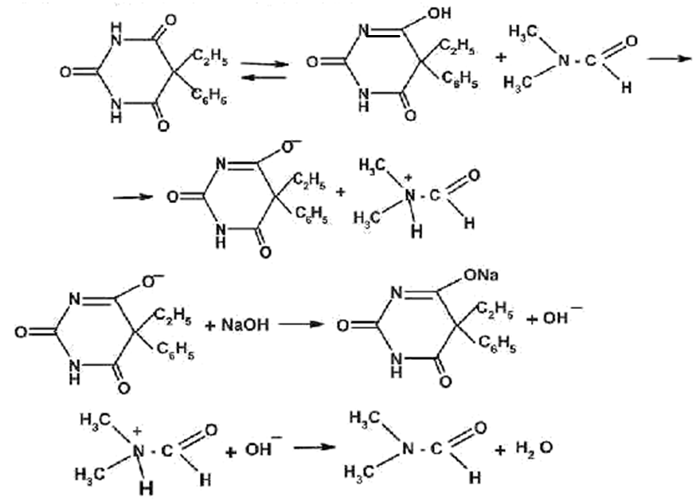
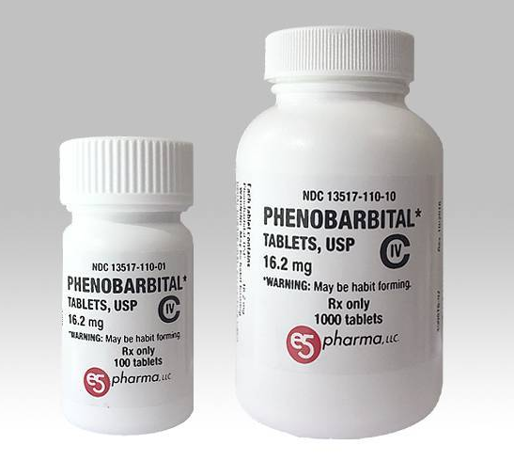
Acid-base titration in a non-aqueous medium
APPLICATION OF NON-AQUEOUS TITRATION IN PHARMACEUTICAL ANALYSIS
Titration of acidic medicinal substances
Phenobarbital
Solvent: DMF
Titrant: NaOH
Indicator: Thymol blue

Slide 22
Acid-base titration in a non-aqueous medium
ADVANTAGES AND DISADVANTAGES OF NON-AQUEOUS TITRATION
Advantages of non-aqueous titration:
Ability to analyse weak and very weak acids and bases, including those insoluble in water;
The possibility of unifying quantification methods for large groups of drugs;
Specificity of the method, as the determination is carried out on the pharmacologically active fragment of the structure of the molecule;
The possibility of separate titration of mixtures of substances with the same properties (acidic or basic).

Slide 23
Acid-base titration in a non-aqueous medium
ADVANTAGES AND DISADVANTAGES OF NON-AQUEOUS TITRATION
Main disadvantages of non-aqueous titration :
Negative effects of organic solvents and mercury acetate on the human body;
Chloric acid is explosive;
Careful preparation of solvents, protection of titrants (especially of basic nature) from atmospheric exposure is necessary;
Organic solvents are more expensive than purified water;
The possibilities of the method are noticeably narrowed when analysing dosage forms prepared on water (solutions, mixtures, solutions for injections).
The method does not provide objective information on the quality of substances which undergo hydrolytic decomposition (e.g. substances with ester groups) or other types of degradation during storage of aqueous dosage forms or sterilization process.

Slide 24
Thank you for attention!

