Slide 1
Lecture
Bases of molecular genetics

Slide 2
Structure of DNA
DNA molecule contains two chains of polynucleotides.
These two chains are helically wrapped around each other forming DNA double helix

Slide 3
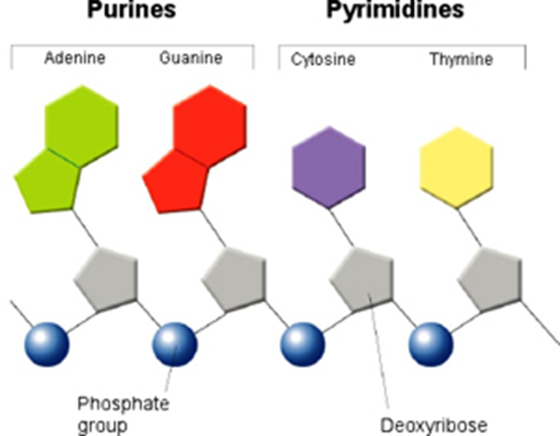
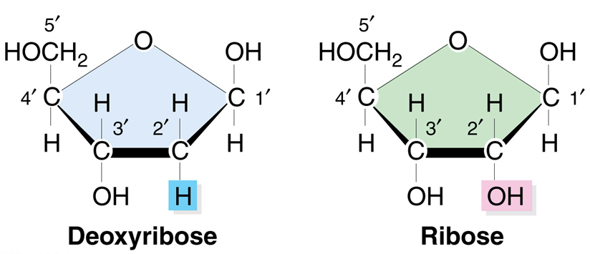
Each nucleotide is made up of three components:
nitrogen-containing base (two purines: A,G and two pyrimidines: T, C;
pentose sugar (deoxyribose);
phosphate group

Slide 4
The number of A equals the number of T, and the number of G equals the number of C. It’s The Chargaff’s rule.
The two strands run in opposite directions i.e. they are antiparallel.
They are complementary to each other.

Slide 5
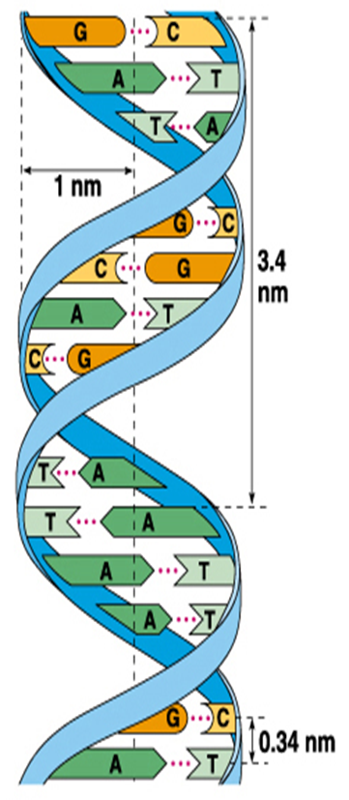

Slide 6
DNA packaging
Complex of DNA histone proteins are called chromatin.
There are up to six levels of chromatin packaging:
Nucleosome (11nm)
Solenoid (30 nm)
Loop Domains (300nm)
Interphase Chromosome (700nm)
Metaphase Chromosome (1400nm)

Slide 7
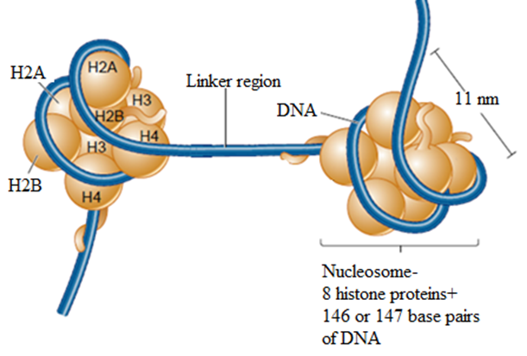
Nucleosome

Slide 8
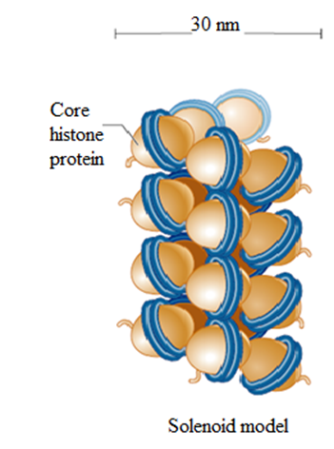
Solenoid

Slide 9
Loop Domains

Slide 10
Interphase Chromosome
Euchromatin is the lightly packed material. It is less intense stained than heterochromatin.
Heterochromatin is the tightly compacted regions of chromosomes. In general, these regions of the chromosome are transcriptionally inactive.

Slide 11
Metaphase Chromosome

Slide 12
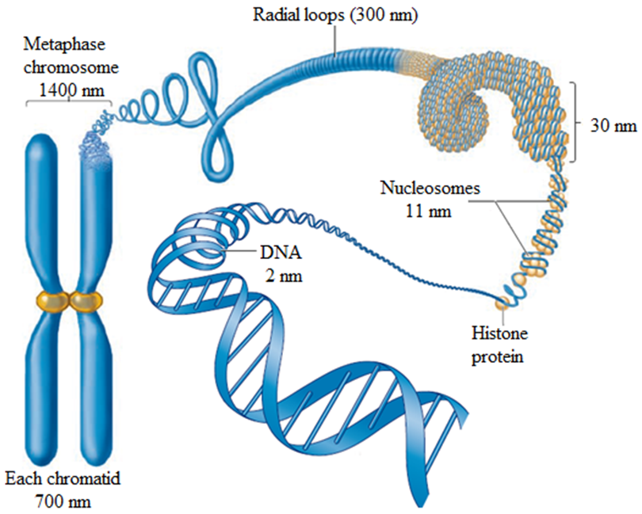

Slide 13
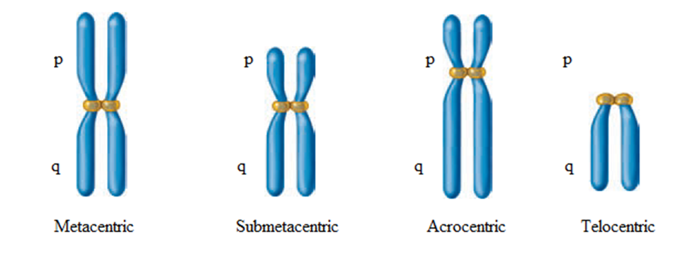
Types of chromosomes
Metacentric chromosomes have equal arms; the centromere in the middle.
Submetacentric chromosomes have arms of unequal length with the centromere more towards one end.
Acrocentric chromosomes have a centromere very near to one end and have very small short arm and very long arm.
Telocentric chromosomes have centromere located at the terminal end. Humans do not possess telocentric chromosomes.

Slide 14
DNA Replication
DNA Replication occurs by means semiconservative model.
Two complementary strands of DNA come apart and serve as template strands for the synthesis of two new strands of DNA.

Slide 15
Enzymes of DNA Replication
DNA helicase breaks the hydrogen bonds between the DNA strands.
Topoisomerase alleviates positive supercoiling.
Primase synthesizes an RNA primer.
DNA polymerase III synthesizes a daughter strand of DNA.
Endonuclease cuts off the RNA primers and fills in with DNA
DNA ligase covalently links the Okazaki fragments together.
Telomerase replicats the ends of eukaryotic chromosomes.
Set of single-stranded binding proteins (SSB proteins) binds to the strands of parental DNA and prevent them from re-forming a double helix.

Slide 16
DNA replication proceeds in three steps:
initiation
elongation
termination

Slide 17
Initiation
Replication starts at the origin of replication.
DNA helicase breaks the hydrogen bonds between base pairs.
Two replication forks are formed.
Topoisomerase alleviates positive supercoiling.
The synthesis proceeds in both directions.

Slide 18
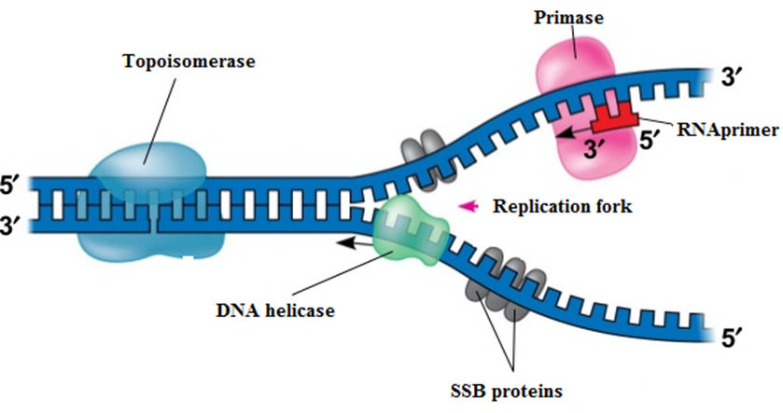
DNA polymerase builds new strand in 5'-3' direction.
DNA polymerase requires a primer.
Primers help to start replication.
The synthesis of primers occurs with help of primase.

Slide 19
Elongation
DNA polymerase is responsible for elongation.
Synthesis of two strands of DNA occurs, one from them is the leading strand and another is the lagging strand.
The leading strand is very long continuous fragment.
A lagging strand is formed in a series of short Okazaki fragments.

Slide 20
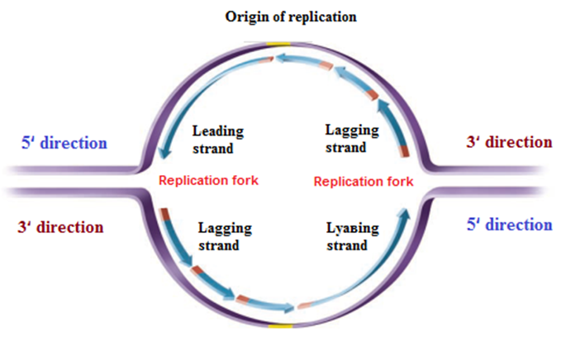

Slide 21
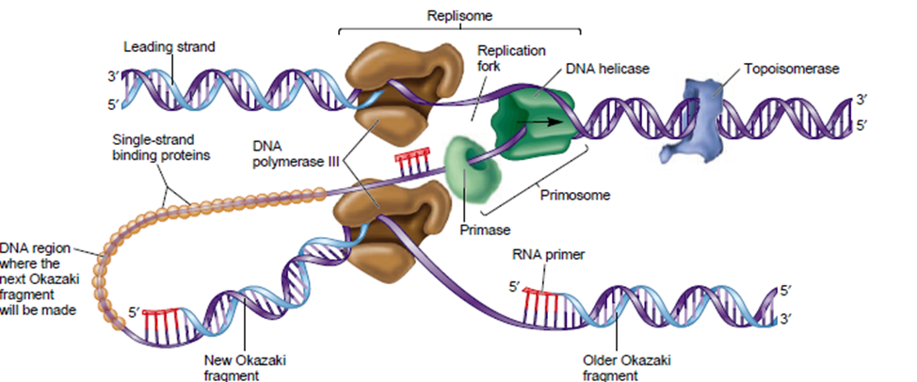

Slide 23
To complete the synthesis of Okazaki fragments two events must occur:
removal of the RNA primers,
synthesis of DNA in the area where the primers have been removed.
Primers are removed by endonuclease.
DNA ligase joins fragments.

Slide 24
Termination
DNA replication ends at the telomere regions which are at both ends of linear eukaryotic chromosomes.

Slide 25
RNA RNA is made up
a nitrogen-containing base
a pentose sugar molecule called ribose
a phosphate group
N-base thymine is replaced by uracil

Slide 26
Types of RNA
m-RNA – messenger RNA
rRNA – ribosomal RNA
t-RNA – transfer RNA

Slide 27
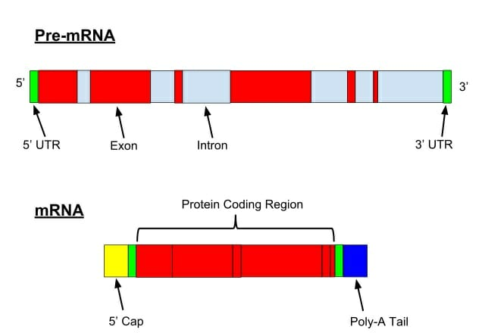
Messenger RNA (m-RNA)
pre-m-RNA is composed of exons and introns
mature m-RNA is composed of only exons

Slide 28
Ribosomal RNA (r-RNA)
In combination with r-RNA ribosomal proteins forms the ribosome

Slide 29
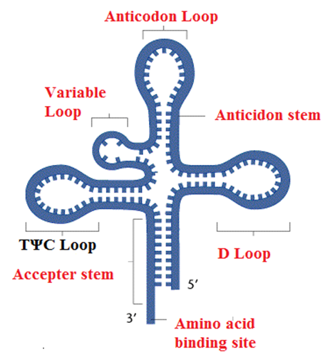
t-RNA
Clover Leaf Model:
✓ Acceptor arm (connected with aminoacid)
✓ Anticodon arm
(complemantory to codon of m-RNA)

Slide 30
Genetic code
helps to translate genetic information from a nucleotide chain to a sequence of amino acids

Slide 31
The main features of genetic code:
consists of triplets known as codons
degenerate
nonoverlapping (GAA-GUU-GAA)
three stop codons (nonsense codon): UAA, UAG, and UGA
universal

Slide 32
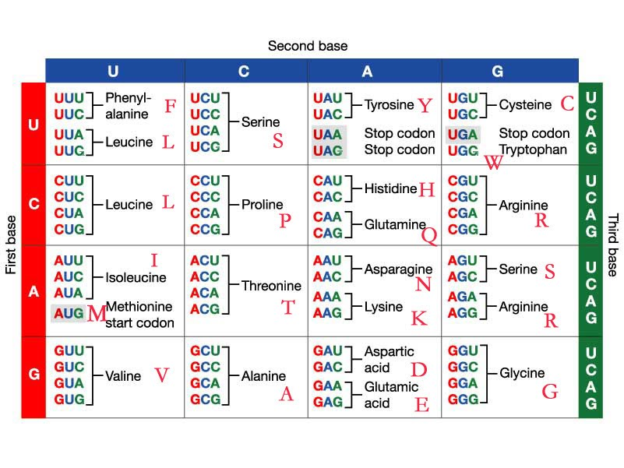

Slide 33
Transcription
is the process of synthesis of molecule of m-RNA from a DNA template
Three steps:
Initiation
Elongation
Termination

Slide 34
Initiation
Transcription does not need a primer to start; it requires a promoter like sequence.
Transcription begins at a specific site called as promoter (In Eukaryotes, a TATA box, a nucleotide sequence like TATAAAA…, is typically present in the promoter.) The TATA box aids in the recognition of the promoter.
To realize transcription:
DNA chain
Factors of transcription (GTFs -general transcription factors): TFIIA, TFIIB, TFIID
polymerase II

Slide 35
Elongation and Termination
RNA polymerase II begins moving down the DNA template strand in the 3' to 5' direction, and as it does so, it strings together complementary nucleotides.
RNA chain is terminated when a sequence of nucleotides terminator appears.
In Eukaryotes, structural genes include regulatory elements:
enhancers, are needed to stimulate transcription
silencers that inhibit transcription.

Slide 36
Transcription

Slide 37
RNA processing
The result of transcription is a long transcript known as pre-m-RNA (precursor m-RNA) which contains exons and introns.
Subsequently, as pre-m-RNA matures, the introns are removed and the exons are connected, or spliced, together. The pre-m-RNA is modified into m-RNA. This process is called RNA splicing.
In Eukaryotes, in addition to splicing, pre-m-RNAs both ends of m-RNA are protected by two different ways:
5’ end – the 5’end is capped with a methylated guanosine during the early stages of transcription. The process is known as capping. This cap protects the m-RNA from degradation in cytoplasm and helps in recognition by the ribosome.
3’ end - a sequence of adenine nucleotides called a poly-A tail is added to the 3' end of the m-RNA molecule. The process is called as polyadenylation.

Slide 38
Ribosome
Ribosomes are a complex of proteins and specialized RNA molecules called ribosomal RNA (r-RNA).
Ribosomes are composed of two subunits, one large (LSU) and one small (SSU).
They only bind together during protein synthesis.

Slide 39
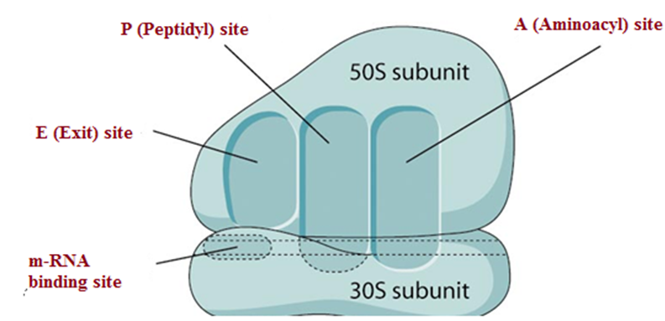
They have three binding sites
A site (Aminoacyl site) - the binding site for t-RNA, which holds the aminoacyl-t-RNA complex;
P site (Peptidyl site), which binds to the t-RNA attached to the growing polypeptide chain;
E (exit) site, which are occupied by tRNA molecules.

Slide 40
Translation
is the process of synthesis of polypeptide from a mRNA template
Three steps:
Initiation
Elongation
Termination

Slide 41
To realize translation:
m-RNA
Ribosomes
t-RNA for each aminoacid
20 aminoacids
Energy (GTF)

Slide 42
Initiation
1 step: small subunit of ribosome attaches to the mRNA strand
2 step: it finds the beginning of the genetic message, called the start codon. This codon is almost always AUG, which corresponds to the amino acid methionine.
But an RNA contains more than one AUG. Prokaryotes use a recognition sequence that is near the AUG initiation codon - the Shine-Dalgarno sequence. Usually this sequence is AGGAGG.
Eukaryotes use a recognition sequence called Kozak box - ACCATGG

Slide 43
Elongation
During the elongation stage of translation, amino acids are added, one at a time, to the polypeptide chain.
1 step: t-RNA brings a new amino acid to the ribosome to the A site. This binding occurs because the anticodon in the t-RNA is complementary to the codon in the m-RNA.
2 step: the peptidyl transfer reaction — the polypeptide is removed from the – t-RNA in the P site and transferred to the amino acid at the A site. This transfer is accompanied by the formation of a peptide bond between the amino acid at the A site and the polypeptide chain.
3 step: the discharged t-RNAs are released from the E site. The ribosome shifts to the next codon.
This process is repeated along the entire length of the mRNA.

Slide 44
Termination
Eventually, after elongation has proceeded for some time, the ribosome comes to a stop codon, which signals the end of the genetic message.
As a result, the ribosome detaches from the mRNA and releases the amino acid chain.

Slide 45
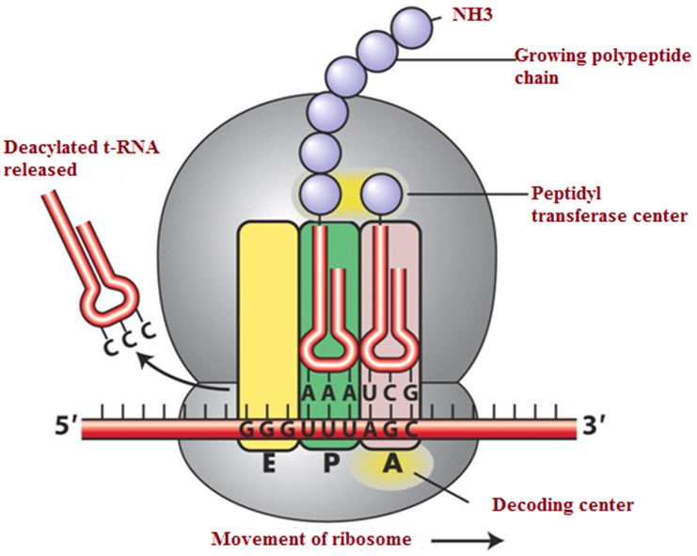

Slide 46
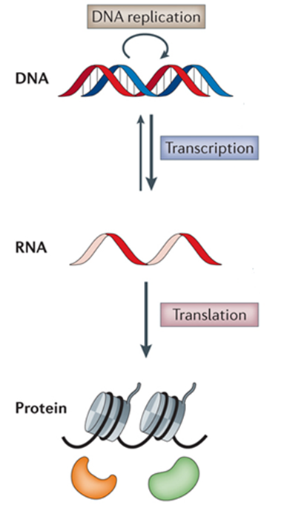
The central dogma of genetics (The Central Dogma of molecular biology)

Slide 47
Regulation of gene expression in prokaryotes
The model of the lac operon:
structural genes
operator
Promoter
regulatory gene

Slide 48
