Slide 1
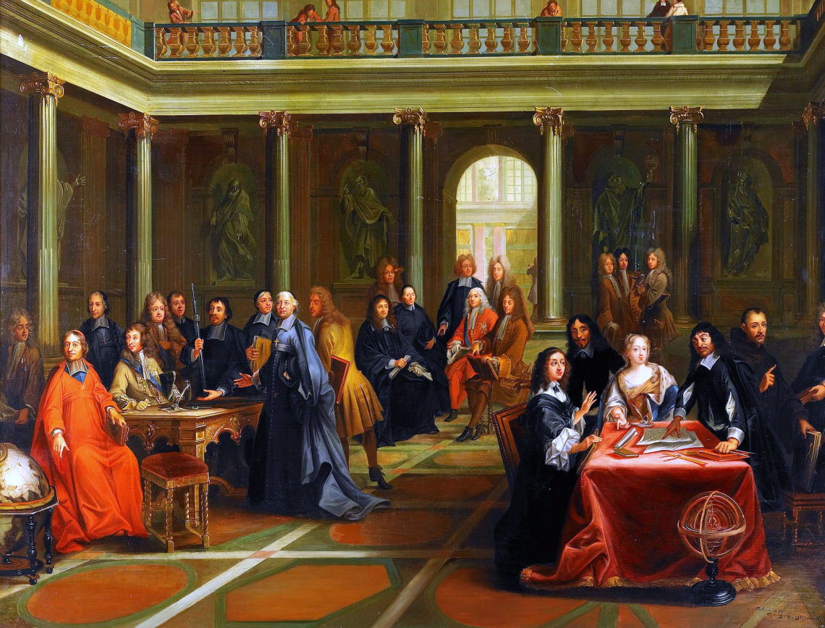
Theme: Philosophy of New Time.

Slide 2
In period from 1660 to 1750 in Europe took place industrial revolution. Machines were invented – machines automatically producing consumer goods. Technology and science were existing in close connection at this time. Science was orientated towards technology and became important social institute.
European philosophy 17-18 centuries conditionally is called the philosophy of New Time. In this period consciousness of people and world outlook as a whole changed. Scientific knowledge began to fulfil regulative function in New Time. The consequence was that aspiration appeared for all to conclude from mind and all to make in conformity with the reasons of mind. The sincere sureness in realization of reasonable ideas appeared.

Slide 3
Assurance in the might of mind caused the faith in progress and accordingly optimistic world outlook.
The principles and methods of naturally-scientific cognition appeared: analytics, mechanism, mechanistic metaphysics, the desire to learn man and world structure, their components and the causes of their functioning.
Thus, object of study was changed: now this object is nature. G. Galilei realized “mathematization of nature”. And human being as natural creature is exposed to the same analytical research. The centre of gravity in philosophy changed from question “why?” to question “how?”

Slide 4
The problem of human mind as itself appeared. It is considered as something special, regarding mechanics of the universe and own device as if in a detached spirit. The old philosophic problem of correlation of spirit and body showed itself again but in new aspects: the problem of receiving of information in mind; correlation of knowledge about world with the world as itself; the role of human being in the world.

Slide 5
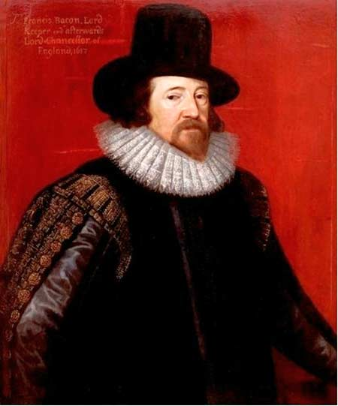
English philosopher Francis Bacon was the first great researcher of nature in New Time. In his studies he noted exceptional importance of experience and drew attention to significance and necessity of observations and experiments for the discovery of the truth. Bacon considered, that philosophy must have, first of whole, practical character. He thought, that superior aim of science is domination of man over nature, but “to dominate over nature one may only obeying its laws”. Bacon proclaimed motto, which became celebrated: “Knowledge is power”. The way, leading to knowledge, is observation, analysis, comparison and experiment.
Francis Bacon (1561-1626)

Slide 6
There are impediments on the way of cognition, which Bacon called “idols” or “phantoms”. Researchers must avoid or overcome them, in order to get true knowledge. According to Bacon, there are four types of “idols”: “idols of tribe”, “idols of cave”, “idols of the market-place”, “idols of the theatre”.
“Idols of tribe” are mistakes, which appear, when man judges about nature by analogy with human life; “idols of cave” are mistakes of individual character, depending on education, tastes, habits of some individuals; “idols of the market-place” are habits to use in the statement about universe prevailing ideas and opinions without critical attitude to them; “idols of the theatre” are connected with the blind faith in authorities.

Slide 7
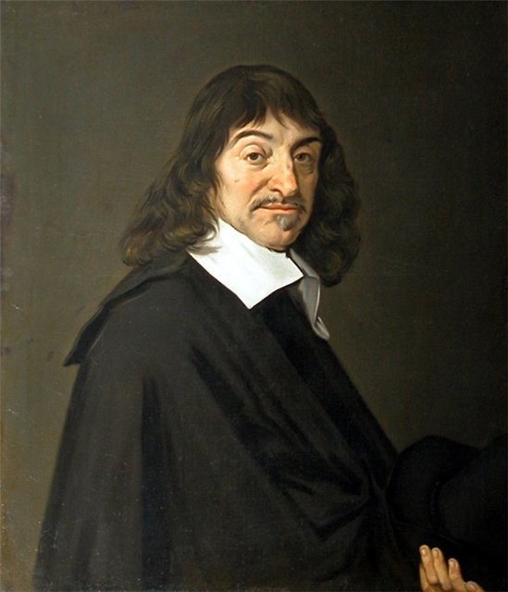
Experience, according to Descartes, can not be reliable beginning of cognition. Key question was, what concrete truths possess sign of lucidity (clearness) and distinction and therefore can be taken as a basis of science. According to Descartes, conviction that as thinking being “I am” forms such concrete basis.
Descartes introduced principle of radical doubt, according to which we can and must doubt in reliability of all sense evidences. But in spite of all my doubt, there is one point on which it can not spread: I don’t know, the objects of perception exist or don’t exist, but I know exactly, that itself my doubt exists. But doubt is one of the acts of thinking. I doubt, since I think.
Hence it follows: “I think, therefore I am”.
French philosopher and scientists
Rene Descartes (1596-1650)
put mind on first place.

Slide 8
Descartes methodology is deduction.
Investigating things, revealing their essential features, which may be attributed to fundamental (substantial), Descartes came to a conclusion, that from multitude of qualities, intrinsic in things, only one is general for all and indispensable: this is extension in space. But mind, consciousness, hasn’t this characteristic; therefore, it is substance of another kind than material things.
Thus, doctrine about two substances – dualism - appeared: material, which has attribute – extension and spiritual, which has attribute – mentality.

Slide 9
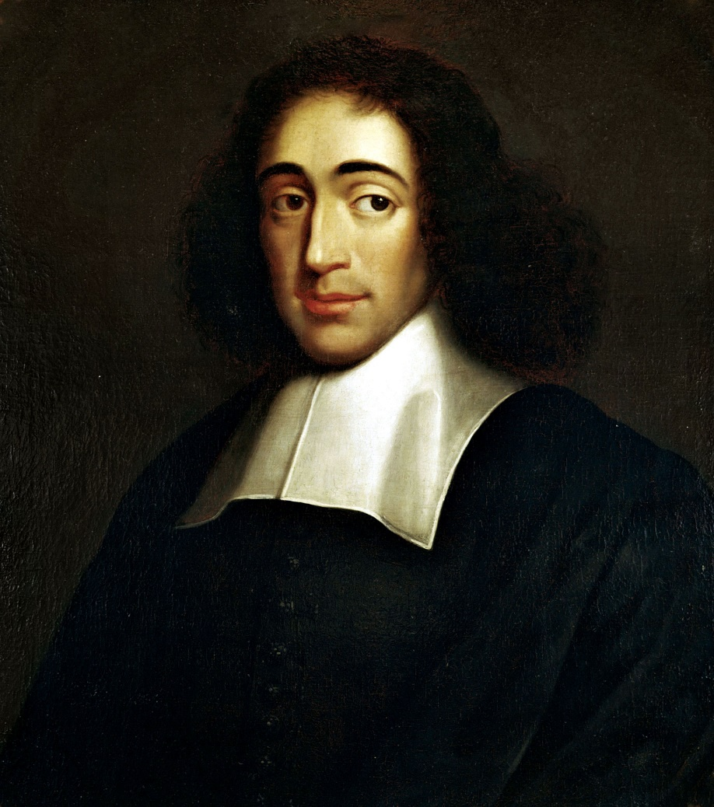
Descartes philosophy became in some aspects basis for ideas of Dutch thinker Benedict Spinoza, who opposed his own principle of monism to Descartes dualism. Monism is philosophic view, according to which all diversity of the universe is explained with the aid of single substance. Spinoza repudiated the idea about soul as special substance. Monism of Spinoza is in the nature of pantheism: God is identified with nature (pantheism)
Benedict Spinoza
(1632-1677)

Slide 10
Spinoza affirmed, there is single substance, which is the cause of itself “causa sui" and has infinite multitude of attributes. The necessity of causes and consequences, following from inner laws of the single substance is the only principle of world order. Single substance has two knowable attributes – extension and mentality.
According to Spinoza, matter, from stone to human brain, can think, though to a different degree: human mentality is only special case of mentality in general.

Slide 11
Man can comprehend the course of world process, so as to coordinate his life, his desires and acts with it. To comprehend thing – signify to see universal element behind its individuality. There is dialectical comprehension of the world in Spinoza’s philosophy: unity of finite and infinite, single and plural, necessity and freedom.
Well-known formulation belongs to Spinoza: “Freedom is cognized necessity”.

Slide 12
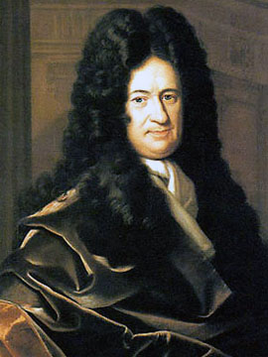
German philosopher G. V. Leibniz considered, that world consists of the smallest elements, which he called “monads” – spiritual substances of being, each different, each a percipient of the universe around it, and each mirroring that universe from its own point of view. The world of monads is strictly hierarchical. Оne substance that expresses plurality –this philosophy is pluralism. Pluralism is a term used in philosophy, meaning "doctrine of multiplicity“. They are arranged from the lowest to the highest and crowning them all – God. Only God has exhaustive completeness of notion, clear knowledge of all and as result of that, maximum of action, activity.
G. V. Leibniz
(1646-1716)

Slide 13
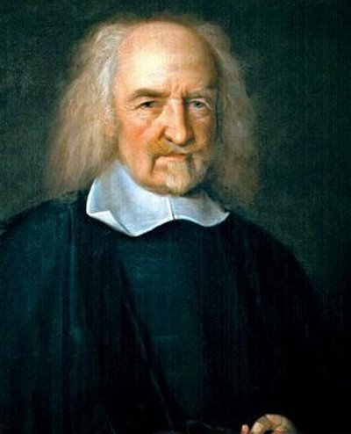
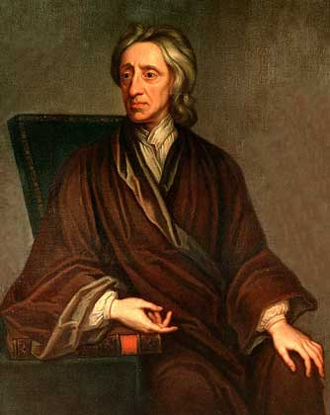
Ideas of Bacon inspired two English philosophers T. Hobbes (1588-1679) and J. Locke (1632-1704). They created critical empiricism. Hobbes considered, that all conceptions are generated not in human mind originally, but in organs of sensation. But scheme of world perception is insufficient for scientific knowledge, if to proceed only from knowledge of facts. Hobbes thought mathematics as the basis of theoretical knowledge. He connected truths of mathematics with language, words-symbols, taking part in exchange of thoughts with regard to immediate sense experience.

Slide 14
J. Locke thought, that we get all our knowledge from experience, sensations. People are not born with prepared ideas. The head of new-born child is tabula rasa (clean slate) on which life draws its patterns-knowledge.
Locke gave proof of sensationalism (view, deducing all content of knowledge from action of sense organs and reducing it to the sum of elements of sense cognition) contrary to Descartes rationalism.
Locke shared the medieval Scholastics’ maxim that “there is nothing in the mind but what was previously in the senses”. Sensations arise as a result of effect of outward things on our sense organs.

Slide 15
The ideas of George Berkeley and David Hume.
Berkeley make analysis of the concept of matter. He finds arguments that this concept is contradictory, meaningless and does not express anything real, matter does not exist at all.
Berkeley argued that human knowledge of the world consists in describing various combinations of sensations. There is only what can be perceived.
His wellknown thesis: "To be - means to be in perception."
George Berkeley
(1685–1753)

Slide 16
Reducing the qualities of things and their properties to sensations led Berkeley's concept to solipsism. Solipsism is an form of subjective idealism, recognizing as self-evident reality only its own "I", the subject. It is the philosophical idea that only one's mind is sure to exist. Everything else became dependent on him.
David Hume developing the views of Berkeley, gave them the form of agnosticism. Agnosticism is a philosophical conception that means - world is not cognizable. It denies knowledge of the world. No idea can come without impression. But what is the reasons causing these impressions, we can't know.
David Hume
(1711-1776)

