Slide 1
«Special pharmaceutical chemistry»
Steroids. Classification.
Cardiac glycosides
Associate Professor Gureeva E.S.

Slide 2
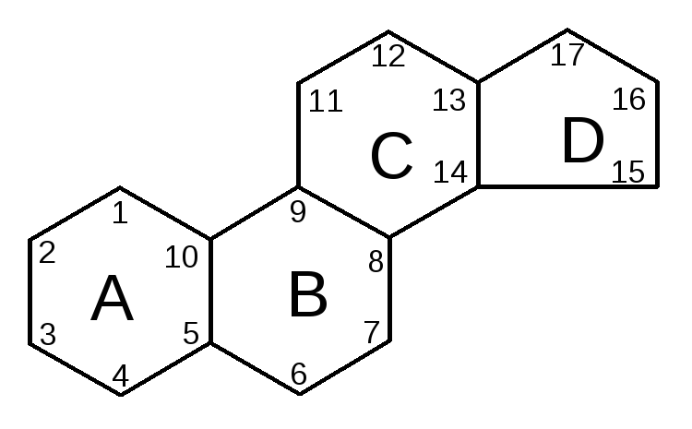
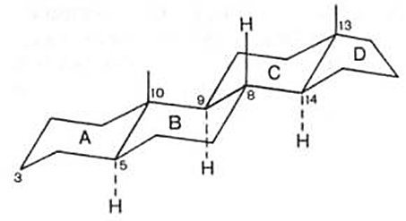
Steroids. Features of structure.
Steroids are a group of natural and synthesised chemical compounds - derivatives of partially or fully hydrogenated 1,2-cyclopentenophenanthrene, in the molecular skeleton of which 17 carbon atoms form 4 articulated rings A, B, C, D.
In natural steroids, including cholesterol, all rings are in the form of ‘armchair’, which is a more stable conformation. In turn, in relation to each other, the rings can be in cis- or trans-positions.

Slide 3
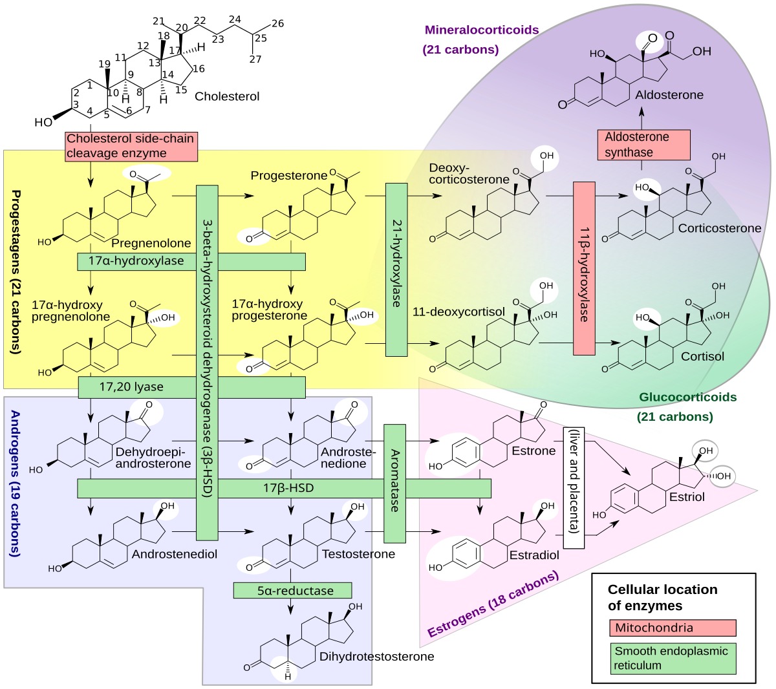
Steroids. Biochemical role of steroids.

Slide 4
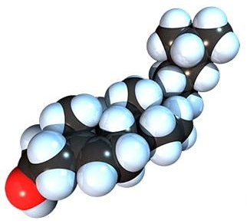
Steroids. Classification of steroids.
Depending on the structure of the A and B cycles, the placement and nature of the substituents in the molecule and the nature of the side chain, as well as the properties and biological action, steroids are divided into
Sterols,
D-vitamins,
Bile acids and alcohols,
Hormones,
Steroidal saponins,
Steroidal glycoalkaloids and alkaloids,
Cardiac glycosides.

Slide 5
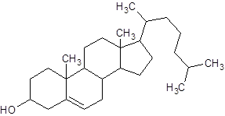
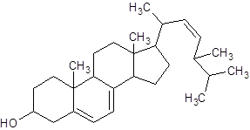
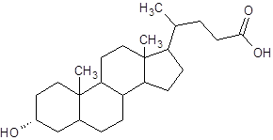
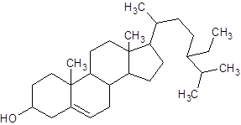
Steroids. Classification of steroids.
Sterols are steroidal alcohols. All sterols contain a β-hydroxyl group at C-3 and one or more double bonds in the B ring and side chain. Sterol molecules lack carboxyl and carbonyl groups.
Basic sterols
Ergosterol
Cholesterol
Stigmasterin
β-Sitosterol

Slide 6
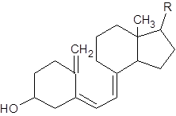
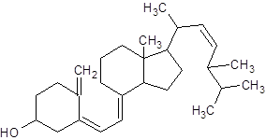
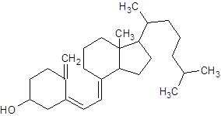
Steroids. Classification of steroids.
D vitamins. Several D vitamins have been discovered to date: D2, D3, D4, D5, D6, D7. Natural vitamins D2 (ergocalciferol) and D3 (cholecalciferol) are found in small amounts in egg yolk, caviar, butter, and milk. Significant amounts of these vitamins accompany retinol in the liver and adipose tissue of fish (mainly cod) and marine animals. Under ultraviolet irradiation (in certain doses), the content of D vitamins in these products increases.
The structure of calciferols is genetically related to that of sterols. The two groups of compounds differ in that calciferols have an open B cycle:
General formula of calciferols
Ergocalciferol
Cholecalciferol

Slide 7
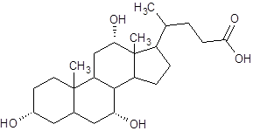
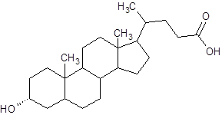
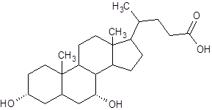
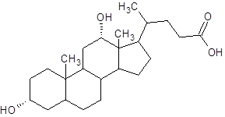
Steroids. Classification of steroids.
Bile acids and alcohols. Bile acids are made from cholesterol in the liver. They are chemically similar to cholesterol. Bile acids are characterised by the presence of a shortened, branched side chain with a carboxyl group at the end. There is no double bond in the B ring and the A and B rings are joined in the cis position. The steroid backbone contains one to three β-hydroxyl groups at positions 3, 7 and 12.
Cholic acid
Lithocholic acid
Chenodeoxycholic acid
Deoxycholic acid
Bile acids ensure solubility of cholesterol in bile and contribute to lipid digestion. In the liver, primary bile acids - cholic and chenodeoxycholic (anthropodeoxycholic) - are formed first. Dehydroxylation of these compounds by C-7 by intestinal microflora leads to the formation of secondary bile acids - lithocholic and deoxycholic.

Slide 8
Steroids. Classification of steroids.
Steroid hormones are a group of lipophilic signalling substances that regulate the metabolism, growth and reproductive functions of the organism.
Steroid hormones are derivatives of a number of hydrocarbons, mainly pregnane, androstane and estran:
pregnane androstane estran

Slide 9
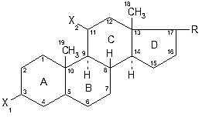
Steroids. Classification of steroids.
The general formula of steroid hormones is as follows:
hormone group | Double bond | Substitutes
 |  | X₁ | X₂ | R
Corticosteroids | en-4 dien-1,4 | =O | -H -OH =0
Gestagens | en-4 | =O | -H
Androgens | en-4 | =O | -H | -OH
Estrogens | trien-1,3,5 (no С-19) | –OH | -H | -OH =O

Slide 10
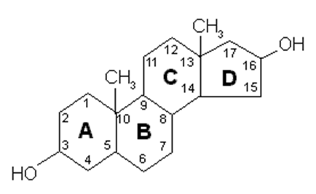
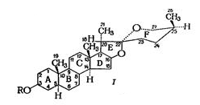
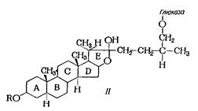
Steroids. Classification of steroids.
Steroidal saponins. Saponins are a group of natural compounds of plant or animal origin that have surface activity and can cause haemolysis of erythrocytes.
Steroidal saponins are subdivided into spirostenol glycosides with 6 cycles in the steroid part of the molecule (I) and furostenol glycosides in which one of their rings is opened and the side chain contains glucose (II):

Slide 11
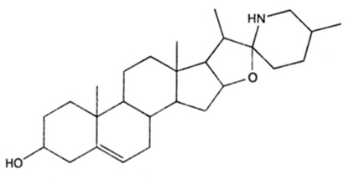
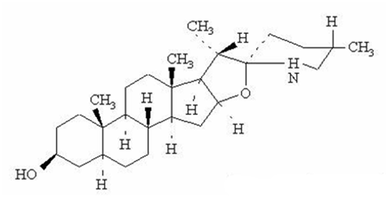
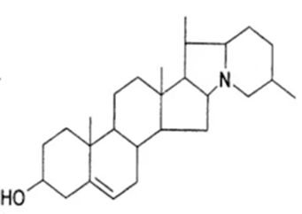
Steroids. Classification of steroids.
Steroidal glycoalkaloids. A relatively large group of alkaloids belonging to the pseudoalkaloids. Includes about 350 representatives found in only 5 families: nightshade, lily, boxwood, coutre, simarubic. They combine the properties of steroidal saponins and alkaloids. The structure of the steroidal alkaloids is based on a cyclopentano-perhydrophenanthrene skeleton linked to a heterocyclic system.
Solasodin
Tomatidine (tomatanin)
Solanidine

Slide 12
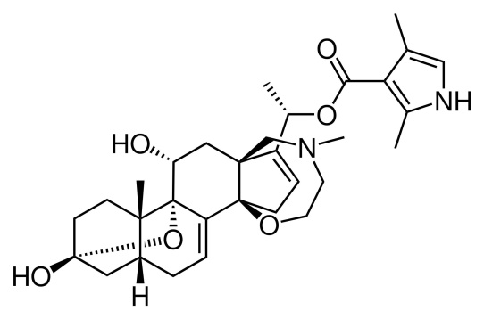
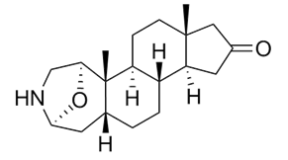
Steroids. Classification of steroids.
Steroid alkaloids. They include the following groups of compounds: C27-alkaloids with modified steroid skeleton, stimulating contraction of transverse striated muscles; plant C21-alkaloids with bactericidal and amoebocidal action, and modified C21-alkaloids from amphibian glands (samandarone, batrachotoxin, etc.), which are strong poisons of the central nervous system and cardiotoxins.
Batrachotoxin
Samandaron

Slide 13
Steroids. Classification of steroids.
Cardiac glycosides. A group of natural biologically active substances with selective cardiotonic action on the heart muscle. The aglycon of these compounds is a derivative of cyclopentaneperhydrophenanthrene containing an unsaturated five- or six-membered lactone ring at the 17th position. Depending on the structure of the unsaturated lactone ring, all cardiac glycosides are divided into two groups with a five-membered - cardenolides (glycosides from foxglove, strophanthus, lily of the valley, hollyflower) and six-membered - bufadienolides (frost glycosides) lactone ring.
cardenolides
bufadienolides

Slide 14
Methods for the analysis of steroid structure compounds
1. In identification tests, the reaction of the formation of coloured and fluorescent substances by the action of concentrated sulphuric acid is widely used to confirm the steroid cycle in molecules.
2. The α-ketol group is discovered by showing reducing properties.
3. The keto group is discovered by the reaction of the formation of ketoximes by interaction with hydroxylamine, and of hydrazones with phenylhydrazine and other hydrazines and hydrazides.
4. The presence of alcohol and phenolic hydroxyls in the molecules is confirmed by the esterification reaction followed by the determination of the melting point of the esters formed.
5. The presence of ester groups (in acetates, propionates, enanthates, etc.) is confirmed either by the formation of coloured salts of hydroxamic acids or by hydrolysis reactions in alkaline or acid medium.
6. In the presence of phenolic hydroxyl in the molecule (natural and synthetic oestrogens), halogenation reactions and formation of azo compounds are also used.
7. Identity tests are also carried out using UV and IR spectrophotometry.

Slide 15
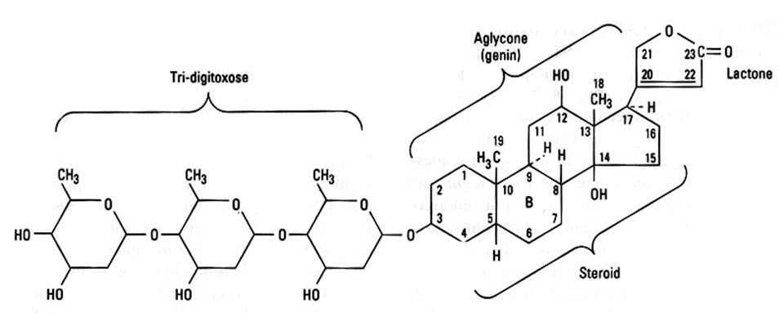
Cardiac glycosides
Cardiac glycosides are biologically active substances contained in some plant species and have the ability in very small doses to have a specific effect on the heart muscle.

Slide 16
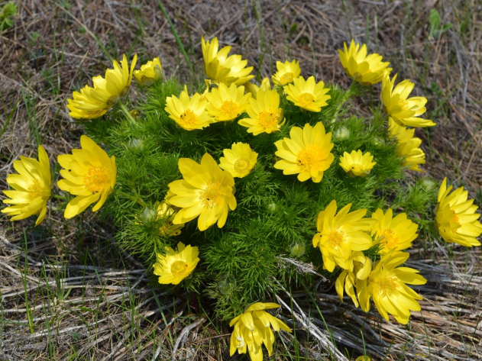
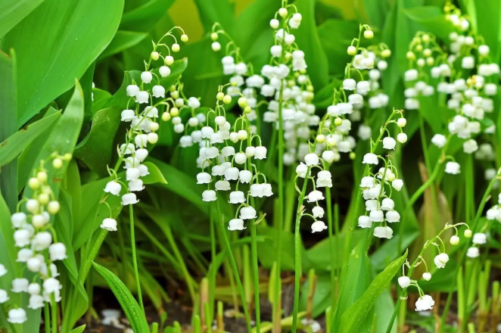
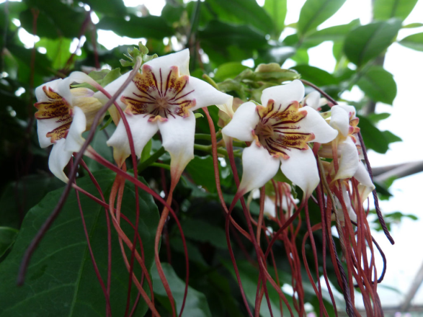
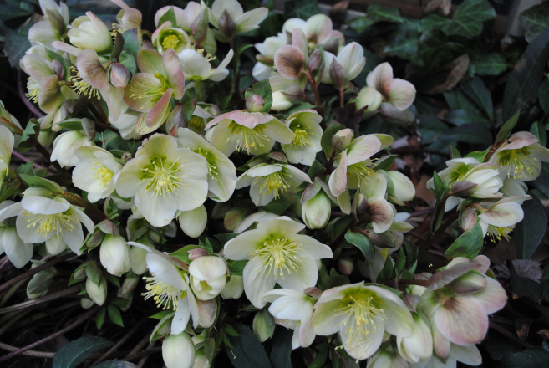
Sources of cardiac glycosides
foxglove large-flowered
spring gentian
oleander
lily of the valley
strophanthus
helléborus

Slide 17
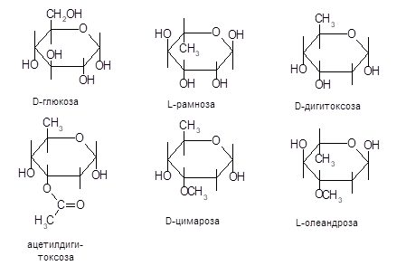
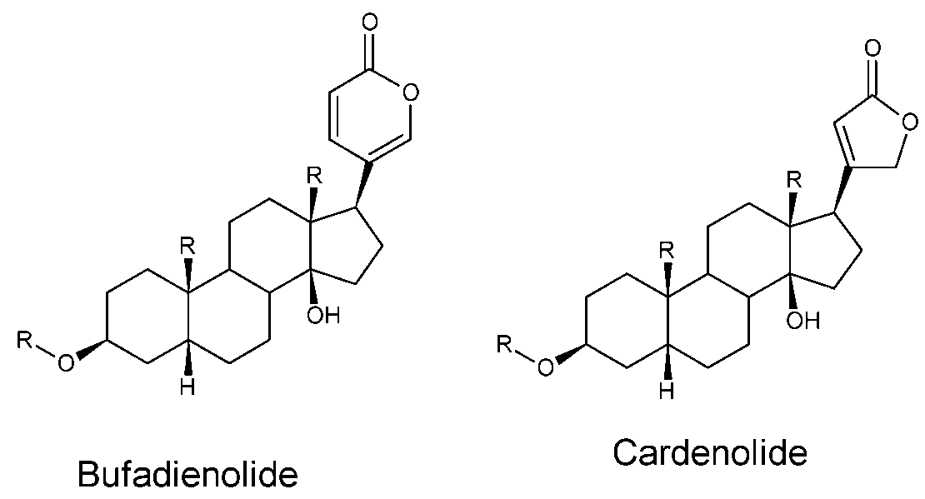
Cardiac glycosides
The sugars in cardiac glycosides
The aglycones (genines)

Slide 18
Relationship between structure and pharmacological action
The carrier of the biological activity is the aglycone.
The sugar moiety attached to the aglycone at position 3 influences the rate of absorption and therefore the duration of action. The more monosaccharide residues in the glycoside molecule, the more active it is.
The specific action of the glycoside on the heart is due to the presence in the aglycone molecule of a five- or six-membered lactone cycle attached at position 17 and hydroxyl at position 14.
The cardiotonic effect is strongly influenced by the substituent at position 10. Most aglycones at this position have a methyl or aldehyde group.
Replacement of the steroid cycle of aglycones, as well as replacement of the lactone cycle by other radicals, and even changing the nature of the bond between the steroid nucleus and the lactone, leads to a loss of pharmacological activity.

Slide 19
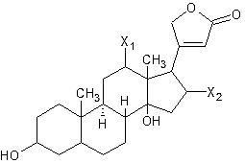
Glycosides of the foxglove subgroup: digitoxin, acetyl digitoxin, digoxin
Aglycones | Radicals
 | X₂ | X₁
Digitoxigenin | – | –
Hytoxigenin | –OH – | –
Digoxigenin |  | –OH –

Slide 20
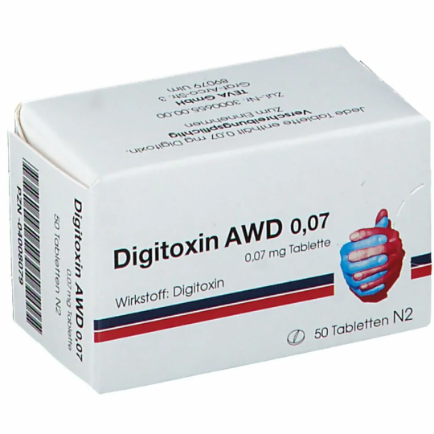
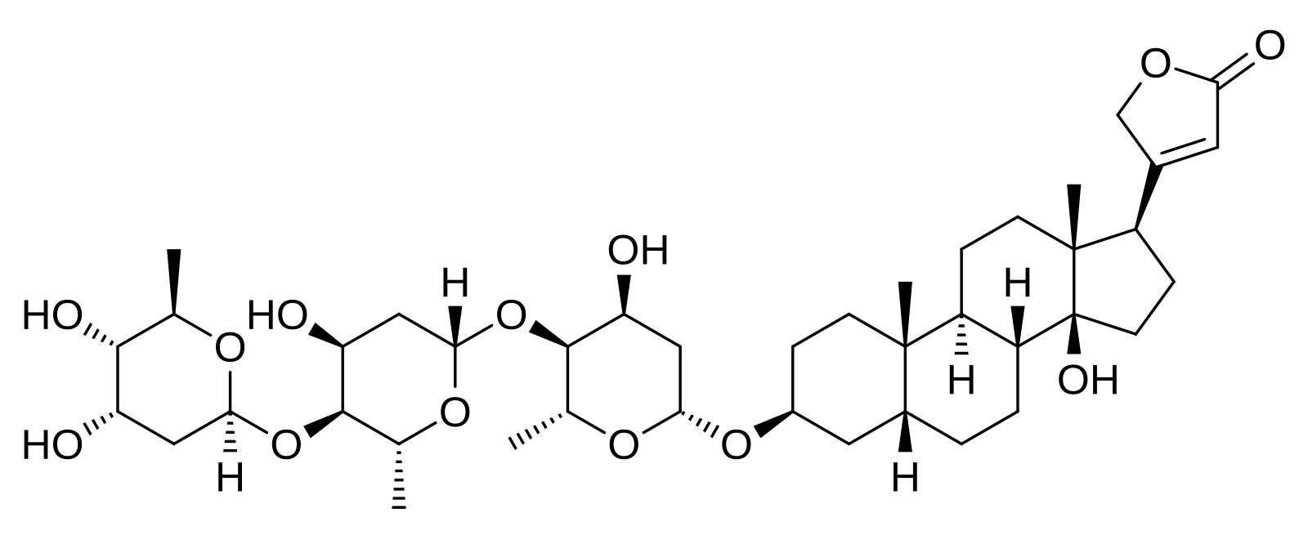
Glycosides of the foxglove subgroup: digitoxin, acetyl digitoxin, digoxin
Digitoxin is a white crystalline powder. Practically insoluble in water, slightly soluble in ethanol, difficult in chloroform. Specific rotation from +16 to +19° (1% solution in chloroform).

Slide 21
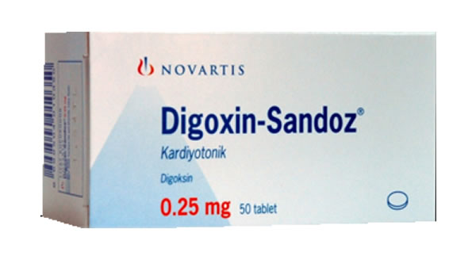
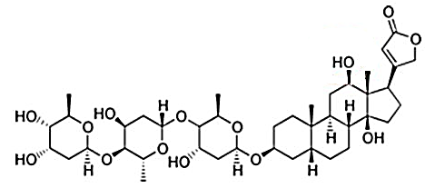
Glycosides of the foxglove subgroup: digitoxin, acetyl digitoxin, digoxin
Digoxin is a white crystalline powder. It is practically insoluble in water, very insoluble in ethanol and chloroform, and soluble in methanol.

Slide 22
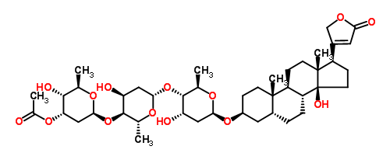
Glycosides of the foxglove subgroup: digitoxin, acetyl digitoxin, digoxin
Acetyldigitoxin - white lamellar crystals or white crystalline powder. Melting point is 218-227°C. Specific rotation from +24.6° (1% solution in methanol).

Slide 23
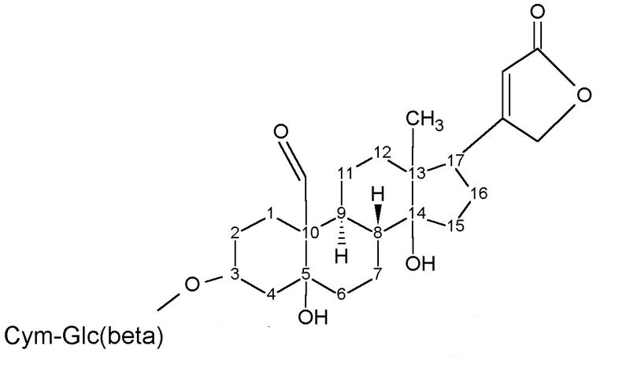
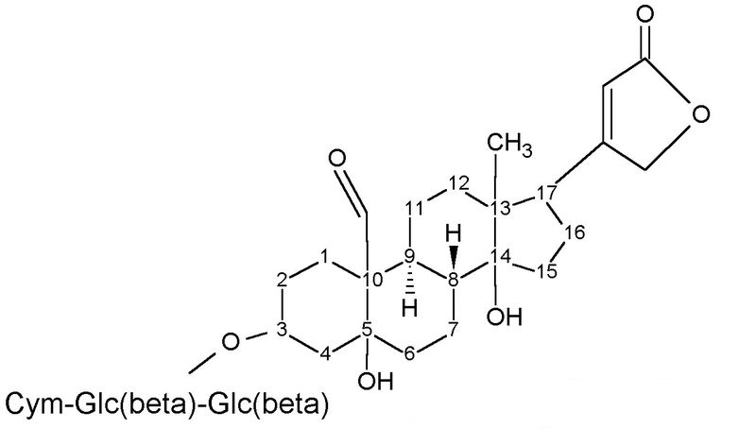
Glycosides of the subgroup Strophanthus
Strophanthin K (Strophanthinum K) is a white or white powder with slightly yellowish tinge. Hardly soluble in water and alcohol, practically insoluble in chloroform and ether.
K-strophanthin-β
K-strophantoside

Slide 24
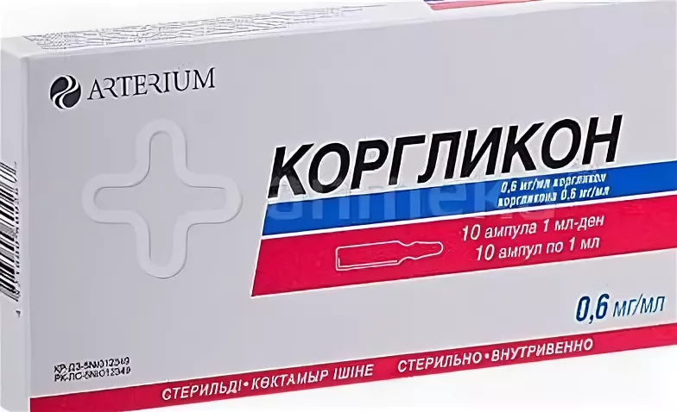
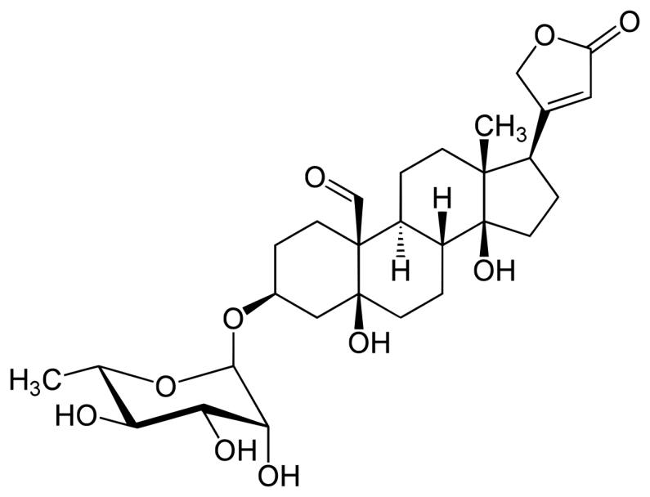
Glycosides of the subgroup Strophanthus
Corglycon (Corglyconum) is a slightly yellowish amorphous powder, odourless, bitter tasting, easily soluble in alcohol, difficult in water.

Slide 25
Obtaining cardiac glycosides
The general scheme for obtaining cardiac glycosides consists of preliminary degreasing of the plant raw materials with ether or naphtha.
Depending on their solubility, acetone, alcohols, ethyl acetate, often with the addition of water, are used to extract the glycosides from the plants.
The raw material is then infused with 70% ethyl alcohol to remove chlorophyll.
Adsorption of impurities on aluminium oxide is also used for this purpose.
Glycosides are precipitated by saturating the mixture with an aqueous solution of ammonium sulphate.
The separation of the mixture of glycosides is based on the difference in their solubility in organic solvents. Chromatographic methods or countercurrent distribution of substances in specially selected solvent systems are used for separation.

Slide 26
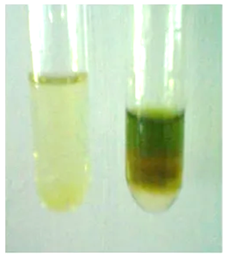
Identification of cardiac glycosides
1. Reactions for the detection of the steroid cycle:
Liebermann-Burchardt reaction
The process is dependent upon the ability of steroids to undergo dehydration when subjected to the action of acetic anhydride and concentrated sulfuric acid. The reaction results in the formation of a pink-coloured layer of acetic anhydride, which gradually undergoes a change in colouration to green or blue.

Slide 27
Identification of cardiac glycosides
1. Reactions for the detection of the steroid cycle:
Fluorimetry
A mixture of phosphoric and sulphuric acids with iron (III) chloride, a solution of iron perchlorate in sulphuric acid, and so forth, is employed as a reagent. Reactions are deemed acceptable when the glycoside to be analysed forms coloured mono- or dianhydride derivatives as a consequence of dehydrogenation.
Reaction with concentrated sulphuric acid
A green colouration is observed.
Heating a solution of glycoside in acetic anhydride with a 20-25% solution of antimony (III) chloride to 100°C results in purple colouring.

Slide 28
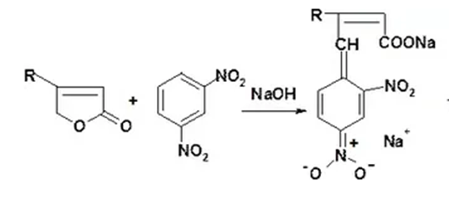
Identification of cardiac glycosides
2. Reactions on the detection of a five-membered lactone cycle with a double bond at the α,β-position in the cardenolide molecule:
The Legall reaction
The formation of a red-coloured product when a cardiac glycoside interacts with a solution of sodium nitroprusside in an alkaline medium.
The Raymond reaction
Formation of red-purple coloured products.

Slide 29
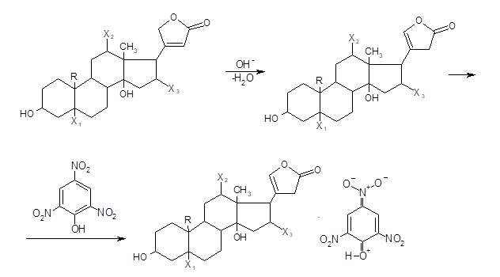
Identification of cardiac glycosides
2. Reactions on the detection of a five-membered lactone cycle with a double bond at the α,β-position in the cardenolide molecule:
Balier reaction
In the presence of alkali, cardiac glycosides produce an orange colour reaction with picric acid.

Slide 30
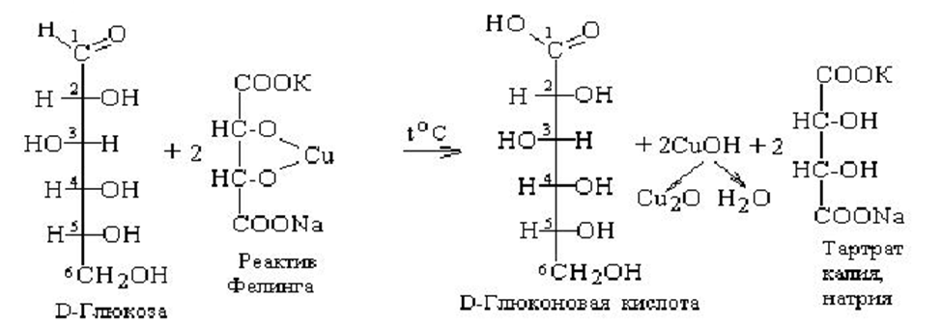
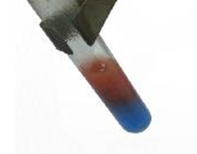
Identification of cardiac glycosides
3. Reactions to detect the sugar component in cardiac glycosides:
Reaction with Fehling's reagent
Recovery of Fehling's reagent and formation of brick-red precipitate Cu₂O.

Slide 31
Identification of cardiac glycosides
3. Reactions to detect the sugar component in cardiac glycosides:
Silver mirror reaction
When interacting with ammonia solution of silver nitrate, silver is reduced.

Slide 32
Identification of cardiac glycosides
3. Reactions to detect the sugar component in cardiac glycosides:
Keller-Kiliani reaction
Pre-dissolving 1-2 mg of glycoside in glacial acetic acid containing 0.05% iron (III) chloride.
The solution is then carefully poured into a test tube containing concentrated sulfuric acid, and the colouring of the upper layer is observed.
This confirms the presence of sugar in the molecule, specifically digitoxose, which produces a blue-green colouration.
Additionally, the presence of the aglycone, di-hitoxigenin, is indicated by the colouration observed at the border between the two layers, which may appear purple-red or brown. This method serves to authenticate the presence of digitoxin.

Slide 33
Identification of cardiac glycosides
3. Reactions to detect the sugar component in cardiac glycosides:
Pezetz reaction

Slide 34
Identification of cardiac glycosides
4. Infrared spectrometry
The spectrum should be identical to that of a standard digoxin sample taken under the same conditions.
5. UV spectrometry is possible due to the selective absorption in the UV region of the spectrum (215-220 nm) due to the presence of α,β-unsaturated lactone cycle in the aglycones.
6. The identity of cardiac glycosides can be confirmed by specific rotation.
7. The identity of the corglycone is established by TLC.
8. The HPLC method is highly sensitive and allows the determination of not only the major glycosides but also the associated glycosides.

Slide 35
Quantification of cardiac glycosides
1. UV spectrophotometry. Digitoxin is quantified at wavelengths of 215 and 219 nm.
2. Photometry in alkaline medium of coloured products of interaction of cardiac glycosides with nitro derivatives of the aromatic series. The most widely used reagent is picric acid or sodium picrate (Balier reaction) for the determination of digitoxin, digoxin, strophanthin G, etc.
3. HPLC method.
4. By biological method activity is established by comparison with standard drugs and expressed in FUA (frog), CUA (cat) or PUA (pigeon) units of action. The disadvantage of biological control is labour-intensive, time-consuming and low accuracy. It is often combined with the use of physicochemical methods.
5. A number of cardiac glycosides and their dosage forms can be determined by polarographic method.

Slide 36
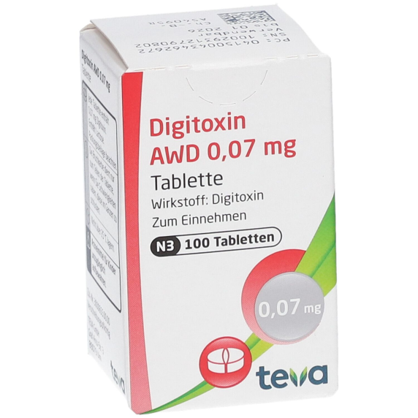
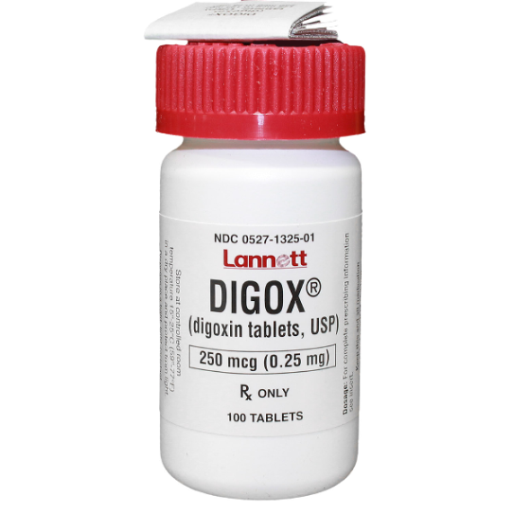
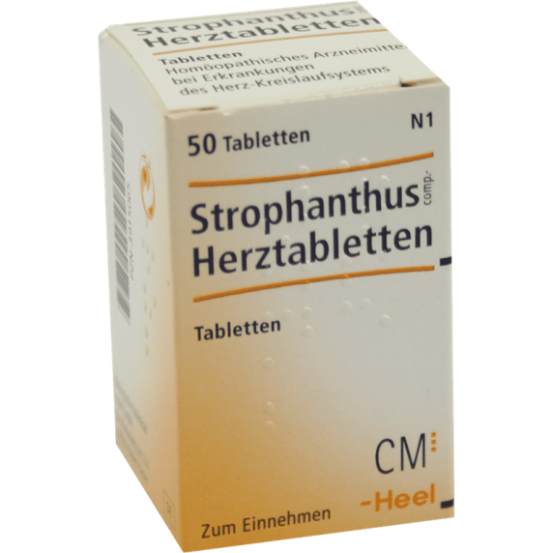
Storage of cardiac glycosides
Medicinal preparations of cardiac glycosides are stored in well-sealed containers to protect them from light and moisture (corglycone at a temperature not exceeding +5°C). Such conditions permit the prevention of their hydrolytic cleavage.

Slide 37
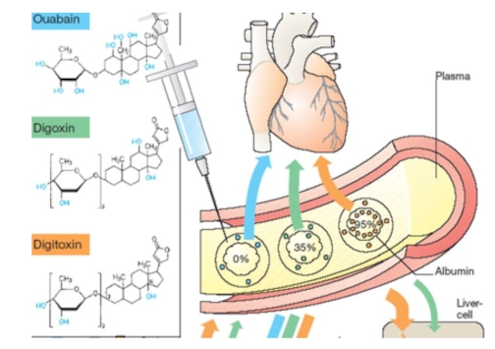
Medical use of cardiac glycosides
Cardiac glycosides are employed as cardiotonic agents in the treatment of acute and chronic circulatory or cardiovascular insufficiency. They differ in terms of their potency, duration of action, and the speed of their effect, as well as their impact on the central nervous system.
An overdose results in a pronounced disruption to cardiac function. It is important to consider the capacity of cardiac glycosides to gradually accumulate in the body, a process known as degree of accumulation.

Slide 38
Thank you for attention!

