Slide 1
«General pharmaceutical chemistry »
METROLOGY in pharmacy. BASIC CONCEPTS OF METROLOGY.
Associate Professor Gureeva E.S.

Slide 2
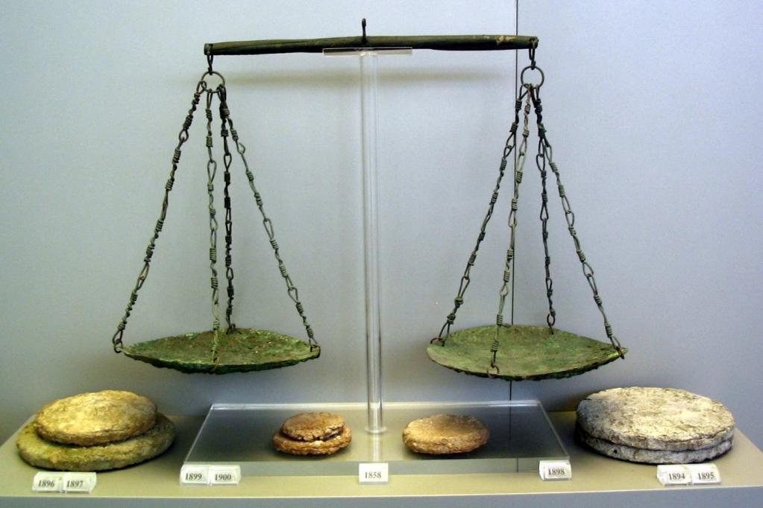
Metrology History
Metrology dates back to ancient times. Ancient forms of metrology comprised local authorities setting simple, arbitrary standards, often based on simple practical measurements, such as arm length.
The earliest standards were introduced for quantities such as length, weight and time. This simplified commercial transactions and the recording of human activity.
Bronze scales of Ancient Greece

Slide 3
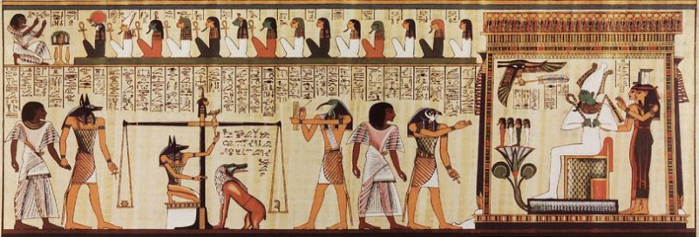
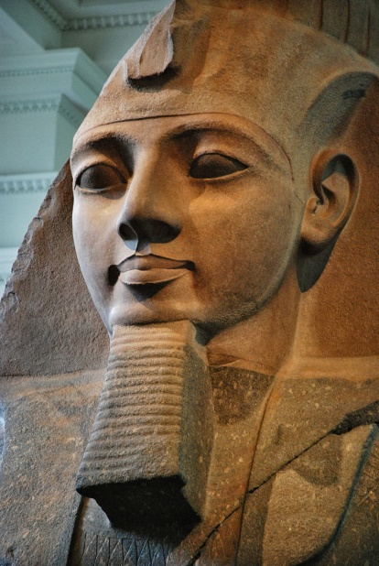
Metrology in Ancient Egypt
Ramses II distributed to all the citizens identical square pieces of land, such that all would pay the same taxes.
But the Nile floods changed their shapes. The scribers measured the new complex surfaces shapes in order to adjust the taxes.

Slide 4
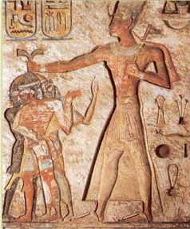
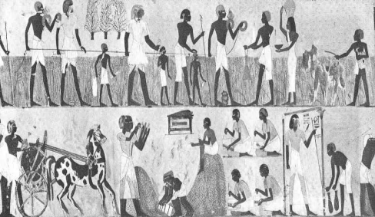
Measuring and Counting in Ancient Egypt
Land surveying for purposes of taxation and administration led to measuring and counting.
Ramses II ~ 1300 B.C.

Slide 5
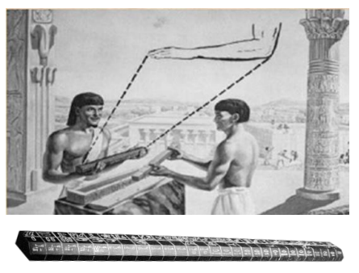
Calibration and Traceability in
Ancient Egypt
The Egyptians Laid the Foundation for Modern Dimensional Measurements.
5,000 years ago they produced a standard of linear measurement, the cubit "Length Of The Royal Forearm".
The “Royal Cubit” Primary standard was made from granite.
The “Royal Cubit” Primary standard, Realization of Reference.
A stick of wood as Working Standard.
Re-calibration of cubit stick on each full moon.
Severe penalty for non-compliance
Calibration / Traceability

Slide 6
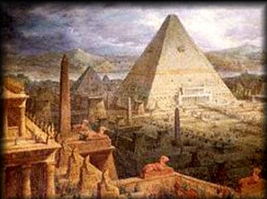
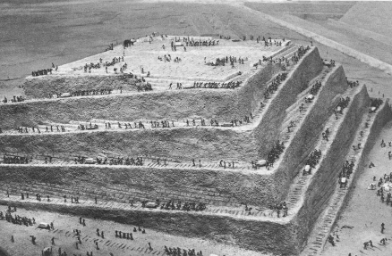
Errors In Pyramid Construction
236.22 m wide width, 146.3 m height and the error less than 15 mm, (6 X 10⁻⁵)
Perpendicular angel with error less than 12 second (4 X 10⁻⁶).

Slide 7
Other Measurement Standards in Ancient Egypt

Slide 8
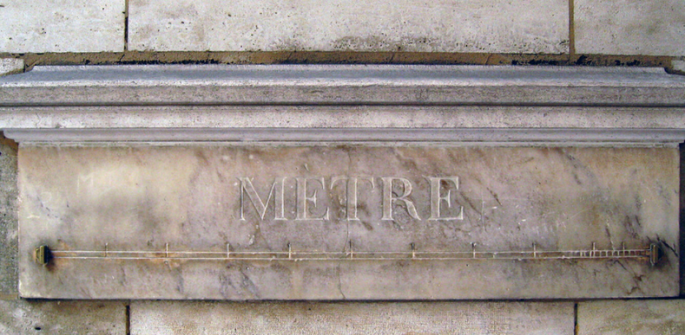
Historically important stages in the development of metrology
18th century - establishment of the meter standard (the standard is kept in France, at the Museum of Weights and Measures; nowadays it is more of a historical exhibit than a scientific instrument.);
1832 - Karl Gauss's creation of absolute systems of units;
1875 - 20 May 1875, the Meter Convention (second oldest intergovernmental treaty) was signed, by 17 industrial nations, in Paris with the aim of world-wide uniformity of measurement; measurement standards improvement, international equivalence, establishment of a global infrastructure for precise, accurate and traceable measurement.
1960 - development and establishment of the International System of Units (SI);
20th century - International Metrology Organizations coordinate metrological studies of individual countries.
New type of institute dedicated, the National Metrology Institute(NMIs).
Meter standard in Paris

Slide 9
National Metrology Institutes(NMIs)
In 1887 the first institute for metrological research was founded, in Germany (PTB). Soon in other countries similar institutes were created, first in the UK (NPL), then in the USA (NIST) and in Japan (NMIJ).
In Egypt National Institute for Standards (NIS) was established in 1963 just after Egypt became signatory to the Meter Convention in 1962.
Tasks of NMIs
Realisation and dissemination of units
Development and validation of measurement procedures
Knowledge transfer
Consultation

Slide 10
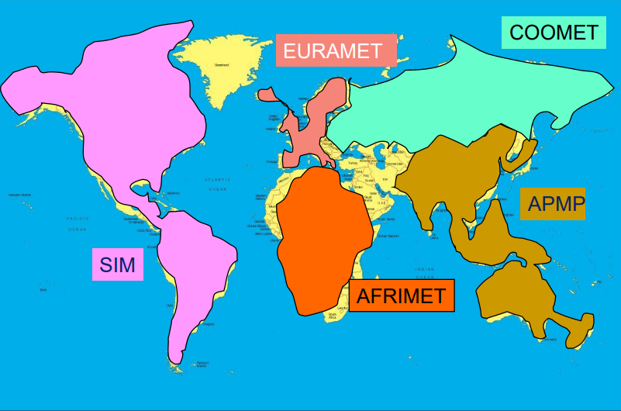
Regional Metrology Organisations (RMO)

Slide 11
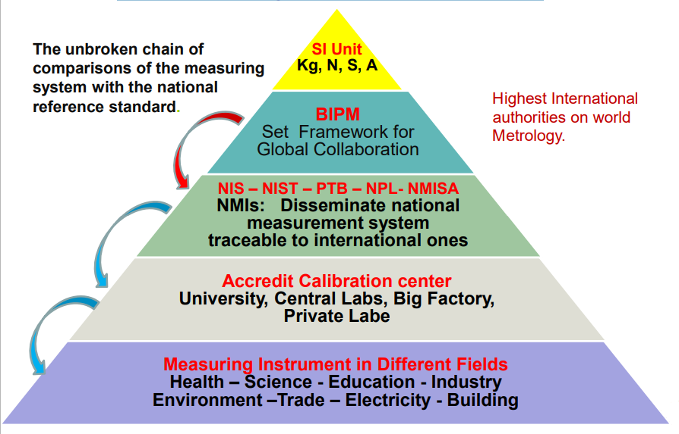
Traceability in Measurement

Slide 12
International Bureau of Weights and Measures
International Bureau of Weights and Measures (BIPM) is a permanent organisation headquartered in Sèvres, near Paris, France. Its principal task is to ensure that a uniform system of measurements exists in all the countries that are party to the metric convention. It does this by comparing national measurement standards and by carrying out research in metrology with a view of improving accuracy. The member countries of the Metrology Convention finance the Bureau.

Slide 13
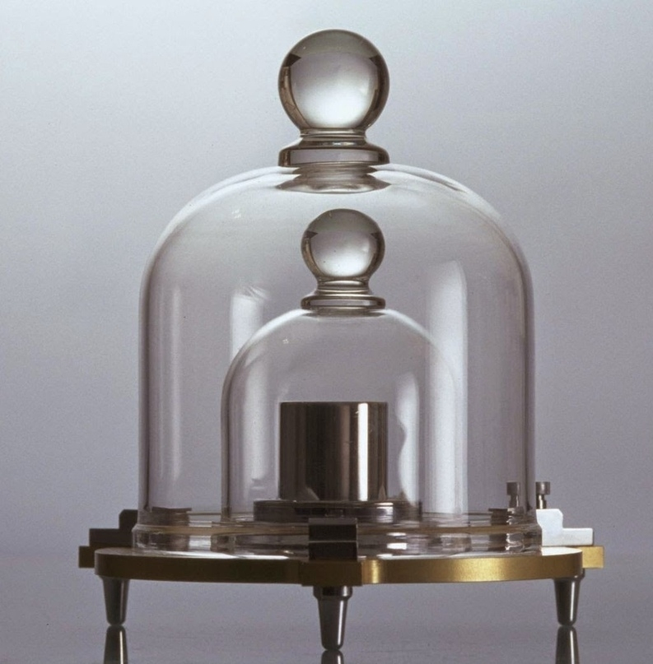
International Committee of Weights and Measures
International Committee of Weights and Measures comprises 18 members, each representing one member country. It meets annually at the headquarters of the International Bureau of Weights and Measures. The Committee oversees the work of the International Bureau of Weights and Measures, co-ordinates metrological research in the Member countries and drafts. It advises the General Conferences on Weights and Measures.

Slide 14
General Conferences on Weights and Measures
General Conferences on Weights and Measures are convened every four years. Representatives of all countries taking part in the metric convention and observers from associate members take part in them. The Conference hears the report of the International Committee of Weights and Measures, decides aimed at improving and spreading the International System of Units (SI), approves the budget of the International Bureau of Weights and Measures for the next four years.

Slide 15
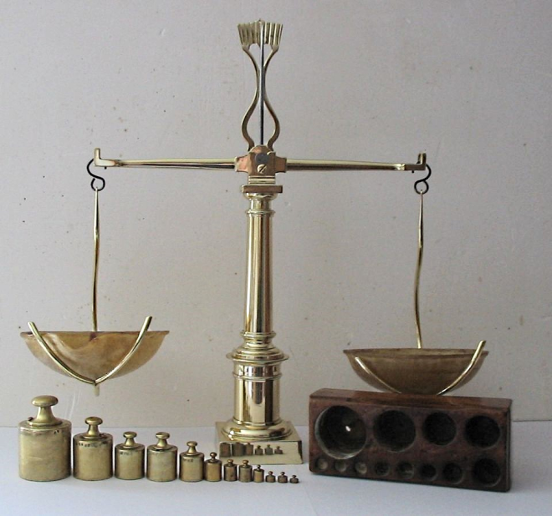
Metrology
Metrology is the science of measurements, methods and means of ensuring their unity and ways to achieve the required accuracy.
Metrology is the science of measurement and its application.
Why Metrology is Essential?
The Logic Chain of Quality
no quality without quality control,
no quality control without measurements,
no measurements without calibration,
no calibration without calibration laboratories,
no calibration laboratories without traceability,
no traceability without measurement standards,
no measurement standards without metrology

Slide 16
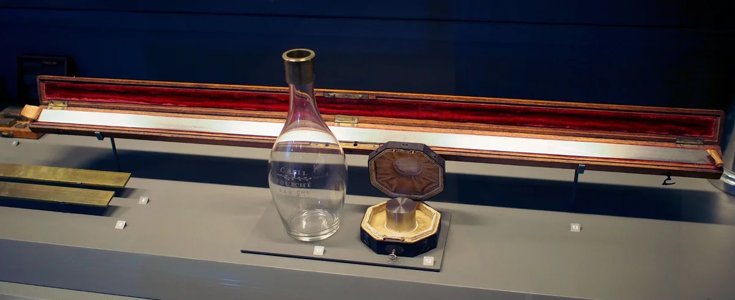
Goals and objectives of metrology
creation of a general theory of measurements;
establishment of units of physical quantities and systems of units;
development and standardization of methods and measuring instruments, methods for determining the accuracy of measurements, the foundations for ensuring the uniformity of measurements and the uniformity of measuring instruments (the so-called "legal metrology");
creation of standards and exemplary measuring instruments, verification of measures and measuring instruments. The priority subtask of this direction is the development of a system of standards based on physical constants.
development of the system of measures, monetary units and accounts in the historical perspective.

Slide 17
Sections of metrology
Theoretical or fundamental metrology - considers general theoretical problems (development of the theory and problems of measuring physical quantities, their units, measurement methods).
Applied metrology – studies the issues of practical application of developments in theoretical metrology. She is in charge of all issues of metrological support.
Legal metrology - establishes mandatory technical and legal requirements for the use of units of physical quantity, methods and measuring instruments.

Slide 18
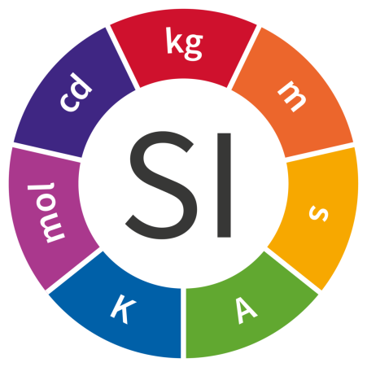
Terms and definitions of metrology
Unity of measurement is the condition of measurement in which the results are expressed in legal units whose dimensions within prescribed limits are equal to those of the units reproduced by the primary standards, and in which the errors of measurement are known and, with a given probability, are within prescribed limits.
International System of Units SI - system of units, based on the International System of Quantities (ISQ), their names and symbols, including a series of prefixes and their names and symbols, together with rules for their use, adopted by the General Conference on Weights and Measures (CGPM).
Measurement - a set of operations for the use of a technical means that stores a unit of a physical quantity, providing a ratio of the measured quantity with its unit and getting the value of this quantity.
Measuring instrument is device used for making measurements, alone or in conjunction with one supplementary devices.

Slide 19
Medical metrology
Medical metrology is a field of metrology, the principal task of which is to ensure the unity and reliability of measurements in medicine. Medical metrology data are used in medical information systems.
Medical measuring instruments, mainly measuring instruments, can be divided into three groups according to the method of normalizing their measurement ranges and accuracy characteristics
The first group is devices calibrated directly in units of those physical quantities, the values of which are the final measurement information that allows making a medical conclusion (thermometer, dynamometer).
The second group are devices in intermediate values, the measured values of which still need to be converted into final information using another device or by calculation (photoelectric colorimeters).
The third group is devices that are characterized by the representation of their metrological properties using auxiliary quantities and parameters (electrocardiograph).

Slide 20
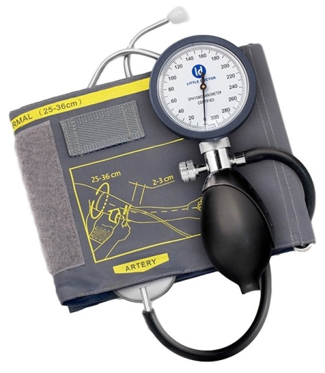
Medical equipment products
All medical equipment products can only be approved for use by order of the Ministry of Health. For the use of medical measuring instruments, besides the order of the Ministry of Health, a positive decision of the State Committee of Standards is required.
Medical devices (electrophoresis, UHF, magnetic and laser therapy, laser cameras, defibrillators, etc.), which are used for physiotherapy procedures, must pass the control of output parameters and have a valid certificate of suitability for use.
Test equipment (drying cabinets, sieves, thermostats, ovens, etc.), which is used to reproduce normalized external influencing factors (loads), must be certified and have a valid certificate.
Measuring equipment (diagnostic equipment, scales, blood pressure monitors, etc.), which are used to obtain data about the patient’s condition, must be verified (state metrological certification) and have a valid certificate of verification (state metrological certification).

Slide 21
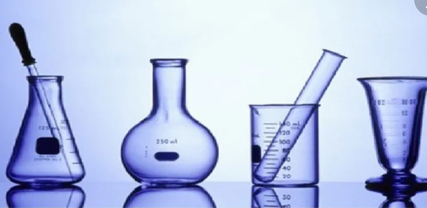
Metrology in pharmacy
Measurements are carried out both in order to establish the actual parameters of medicines and medical equipment and their compliance with the requirements of regulatory documentation, and to check the accuracy of the technological process and improve it to prevent the occurrence of defects.
When controlling finished dosage forms, they check the compliance of the actual values of chemical, mechanical, physical and other parameters with the permissible values of these parameters established in the pharmacopoeia.

Slide 22
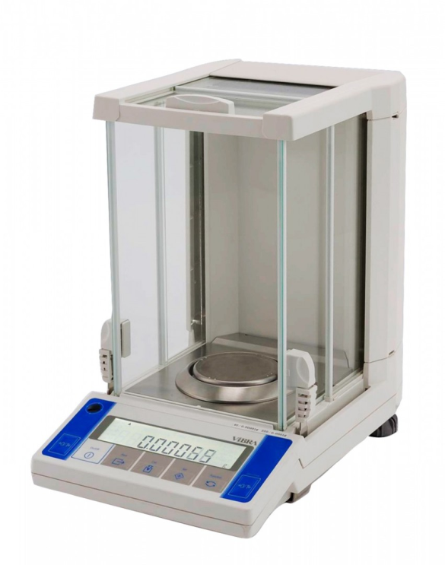
Measuring instruments
Measuring instruments - technical means, devices and equipment having normalized metrological properties.
Measuring instruments are divided into 2 classes:
Exemplary measuring instruments are measures, measuring instruments or transducers approved as exemplary.
Working measuring instruments are measures, devices, or devices used for measurements during working hours.
Depending on the physical measurement principles used, there are:
electrical;
pneumatic;
optical;
photoelectric and other measuring instruments.

Slide 23
Measurement methods
In direct measurements, the value of the measured quantity is found directly from experimental data. Most measuring instruments are based on direct measurements, such as temperature measurement with a thermometer, tablet diameter with a caliper, etc.
In indirect measurements, the desired value of the value is found by calculating the known relationship between this value and the values subjected to direct measurements, for example, measuring the concentration of the active substance - according to the consumption of the reagent used for titration.
A variation of the indirect method is the comparison method.
Comparison method - a measurement method based on the use of a working standard and a measuring device for comparison. In this case, the obtained measurement result is compared with a test under the same conditions as a working standard sample. For example, the measurement of the optical density of the test solution and the RSO solution in a quantitative analysis by spectrophotometry.

Slide 24
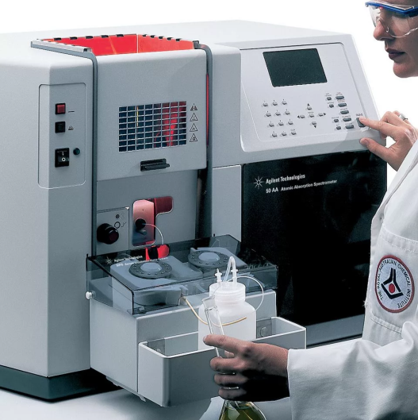
Statistical processing of the results of quantitative analysis
Accuracy (correctness) of analysis results is the closeness of the results of the analysis to the actual value of the measured value.
Accuracy depends on the magnitude of the systematic error inherent in this method of analysis.
Reproducibility of the analysis is the degree of closeness to each other of the results of parallel measurements performed using the same technique and on the same device. Reproducibility is determined by the magnitude of random errors (errors) and can be characterized by the reciprocal of the relative standard deviation. Methods for estimating random errors are very diverse, although most of them are based on methods of mathematical statistics.

Slide 25
Thank you for attention!

