Slide 1
MINISTRY OF HEALTH OF THE RUSSIAN FEDERATION VOLGOGRAD STATE MEDICAL UNIVERSITY DEPARTMENT OF PHARMACEUTICAL AND TOXICOLOGICAL CHEMISTRY LECTURE 6 TOXICOLOGIKAL CHEMISTRY
Characteristics of groups of xenobiotics that cause intoxication. Chemical-toxicological analysis of derivatives of opiates.
Maria Petrovna Paramonova
Assistant professor, PHD

Slide 4
MAIN OPIATE
MORPHINE CODEINE HEROIN

Slide 8
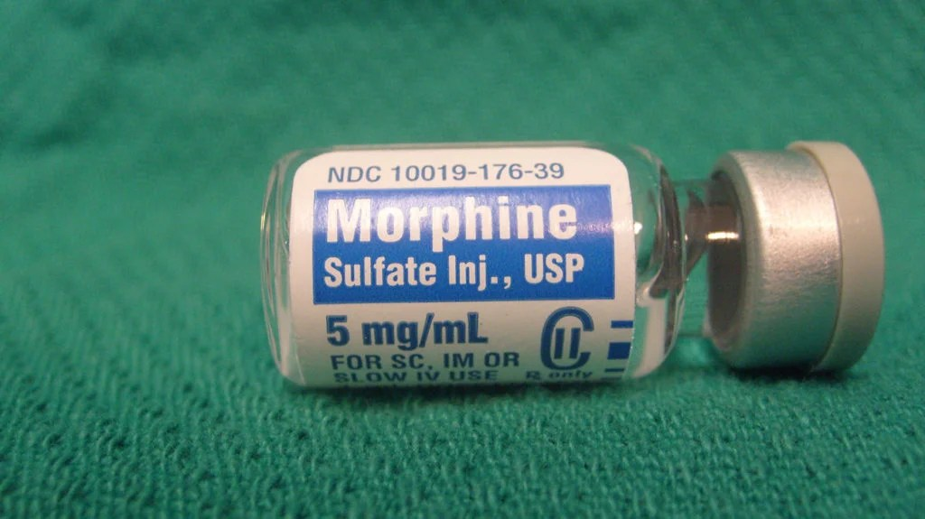
Morphine is a strong opiate that is found naturally in opium, a dark brown resin produced by drying the latex of opium poppies (Papaver somniferum). It is mainly used as an analgesic (pain medication). There are numerous methods used to administer morphine: oral; sublingual; via inhalation; injection into a muscle, injection under the skin, or injection into the spinal cord area; transdermal; or via rectal suppository.^{[10][12]} It acts directly on the central nervous system (CNS) to induce analgesia and alter perception and emotional response to pain. Physical and psychological dependence and tolerance may develop with repeated administration

Slide 9
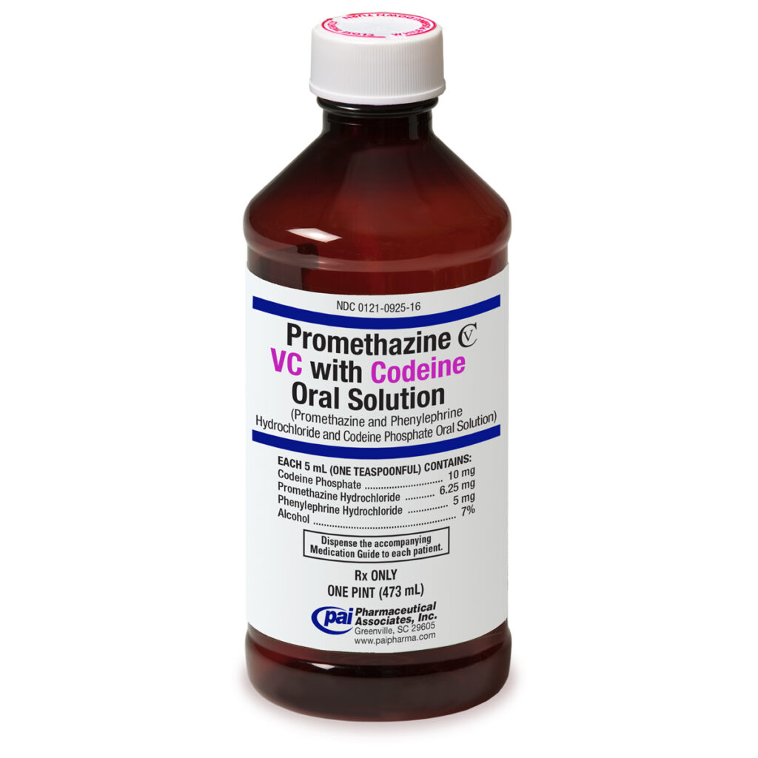
Codeine is an opiate and prodrug of morphine mainly used to treat pain, coughing, and diarrhea. It is also commonly used as a recreational drug. It is found naturally in the sap of the opium poppy, Papaver somniferum.
It is typically used to treat mild to moderate degrees of pain.
Codeine exhibits abuse potential similar to other opioid medications, including a risk of habituation and overdose.

Slide 10
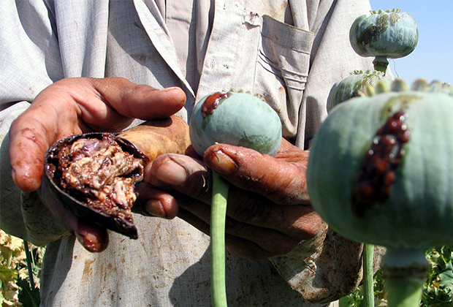
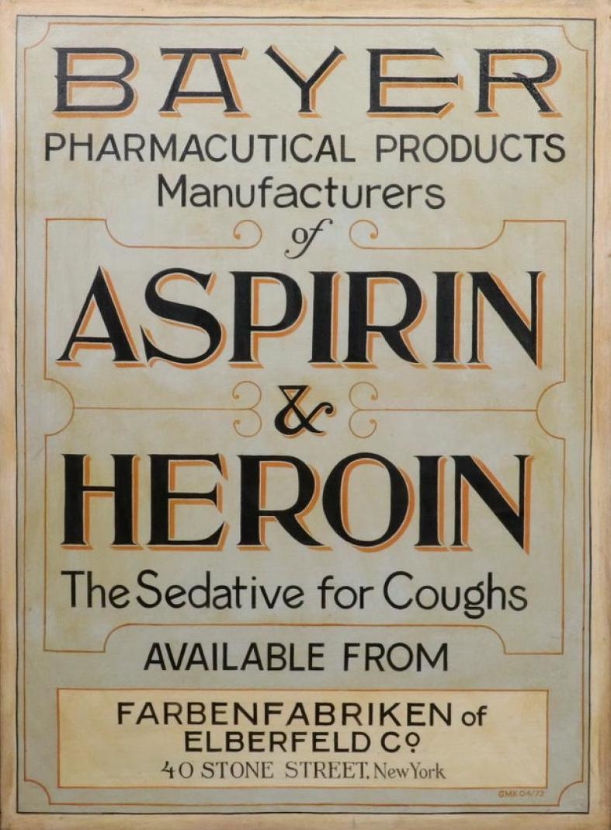
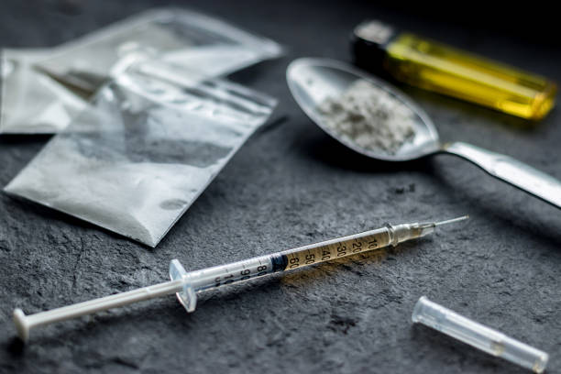
Heroin, also known as diacetylmorphine and diamorphine among other names,^{[1]} is a morphinan opioid substance synthesized from the dried latex of the Papaver somniferum plant; it is mainly used as a recreational drug for its euphoric effects. Medical-grade diamorphine is used as a pure hydrochloride salt. Various white and brown powders sold illegally around the world as heroin are routinely diluted with cutting agents. Black tar heroin is a variable admixture of morphine derivatives—predominantly 6-MAM (6-monoacetylmorphine), which is the result of crude acetylation during clandestine production of street heroin

Slide 11
Morphine

Slide 12
Codeine

Slide 13
Heroin

Slide 14
Objects of study:
Corpse material: 1/3 liver, 1 kidney, 1 meter intestin, stomach with contents, brain; blood, urine
Acute poisoning: gastric lavage water, dialysis water, vomit, blood, urine.
Narcological research : blood, urine, hair, nails, saliva, sweat and fat washes

Slide 15
Methods for isolating opiates:
General methods: morphine loss 97-98,5%
• Stass-Otto method (isolation with acidified alcohol) • Shvaikova-Vasilieva method (isolation with acidified water)
2. Specific methods:
Kramarenko method (for alkaloids)
Specific method (for morphine pH=9
CHCl₃: isopropyl alcohol 9:1)
Specific method (for morphine pH=8,5-9,5 with amyl alcohol)

Slide 16
Isolation with acidified alcohol (Stass-Otto method)
Stage 1
• Infusion of the crushed object 100 g with ethyl alcohol 96%, acidified with oxalic acid to pH = 2.5-3, three times during the day.
• Evaporation of the combined alcohol extracts at a temperature of 40-50°C to a thick residue, to which absolute ethanol is added drop by drop to coagulate proteins.
• Evaporation of the filtrate at the same temperature to a thick residue and dilution with hot water to remove resinous substances, fats and pigments.
Stage 2
• Extraction of acidic, neutral and weakly basic substances from an aqueous filtrate with chloroform at pH = 2 (three-fold extraction), separation of the organic phase and concentration of the resulting extract by evaporation (fraction A, “acidic” extract).
• Alkalinization of the aqueous layer remaining after phase separation to pH = 9-10, extraction of strongly basic substances (three-fold extraction) with chloroform, separation of the organic phase and concentration by evaporation (fraction B, “alkaline” extraction).

Slide 17
Isolation with water acidified with oxalic acid Shvaikova-Vasileva
• Infusion of the crushed object 100 g with water acidified with oxalic acid to pH = 2-3 (1:2), for two hours, then 1 hour.
•Centrifugation 30 min at 3000 rpm.
• Extraction of acidic, neutral and weakly basic substances from aqueous filtrate (centrifugate) with chloroform at pH = 2 (three times extraction), separation of the organic phase and concentration of the resulting extract by evaporation (fraction A, “acidic” extract).
• Alkalinization of the aqueous layer remaining after phase separation with a 25% ammonia solution to pH = 9-10, extraction of basic substances by three-fold extraction with chloroform, separation of the organic phase and concentration by evaporation (fraction B, “alkaline” extraction).

Slide 18
Method of isolating alkaloids with water acidified with sulfur acid (according to V.F. Kramarenko)
• Infusion of the crushed object 100 g with water, acidified with a 20% sulfuric acid solution to pH 2-3, for two hours, then 1 hour. Combination, centrifugation.
• Purification of the aqueous extract from protein compounds by saturating it with ammonium sulfate, infusing for an hour and filtering or centrifuging the resulting precipitate.
•Cleaning the filtrate from fats, resins, pigments by extraction with ether. The ethereal extract is discarded.
•Alkalinization of the aqueous extract with a 20% sodium hydroxide solution and extraction of basic substances with chloroform at pH 8.5-9 (fourfold extraction), separation of the organic phase and concentration of the resulting extract by evaporation.
Advantages of the method:
Speed
Good purification of extracts from co-extractives
Disadvantage of the method:
Loss of desired substances due to co-extraction at the purification stage

Slide 19
Morphine DETECTION
1. Thin layer chromatography method.
solvent (ether-acetone-25% ammonia in a ratio of 20:10:1).
detection with Dragendorff reagent.
pink or brown spots
2. UV and IR spectra
3. GLC
4. HPLC
5. Chemical reactions:
Bouchard, Dragendorff, Mayer, Sonnenschein,
Erdmann's and Frede's reagent
Pellagri reaction.
Reaction with iron (III) chloride
Reaction with potassium hexacyanoferrate (III) and iron (III) chloride.

Slide 20
Codeine DETECTION
1. Thin layer chromatography method.
solvent (chloroform-acetone-diethylamine in the ratio 25:15:1).
detection with Dragendorff reagent.
pink or brown spots
2. UV and IR spectra
3. GLC
4. HPLC
5. Chemical reactions:
Bouchard, Dragendorff, Mayer, Sonnenschein,
Erdmann's and Frede's reagent
Pellagri reaction.

Slide 21
Heroin DETECTION
Substance!!!
Chemical methods for the determination of heroin.
• When concentrated sulfuric acid is added to a drug, the formation of a blue color is observed.
• When concentrated nitric acid is added to the drug, the formation of a yellow color is observed.
• Esterification reaction. 1 ml of concentrated sulfuric acid, a few drops of ethyl alcohol are added to part of the drug under study and heated. There is a characteristic odor of ethyl acetate.

Slide 22
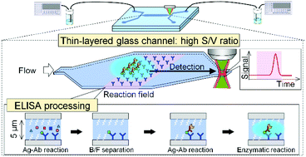
Heroin DETECTION
in extract
detection is based on morphine!!!!!!
It is necessary to determine 6-monoacetylmorphine!!!!!!!
1. Thin layer chromatography method.
solvent (ether-acetone-25% ammonia in a ratio of 20:10:1).
detection with Dragendorff reagent. pink or brown spots
2. GL-MS
3. ELISA (enzyme-linked immunosorbent assay)
is a plate-based assay technique designed for
detecting and quantifying soluble substances
such as peptides, proteins, antibodies,
and hormones. Other names,
such as enzyme immunoassay (EIA),
are also used to describe the same technology.
4. HPLC

Slide 23
QUANTITATIVE ASSESSMENT:
PHOTOCOLORIMETRY
2. HPLC
3. GLC
4. UV SPECTROMETRY

