Slide 1
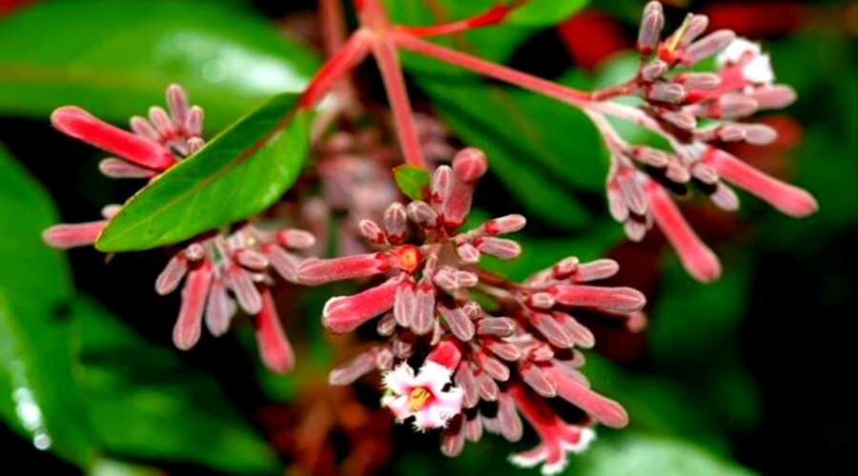
«Special pharmaceutical chemistry»
Alkaloids derivatives of quinoline, benzylisoquinoline
Associate Professor Gureeva E.S.

Slide 2
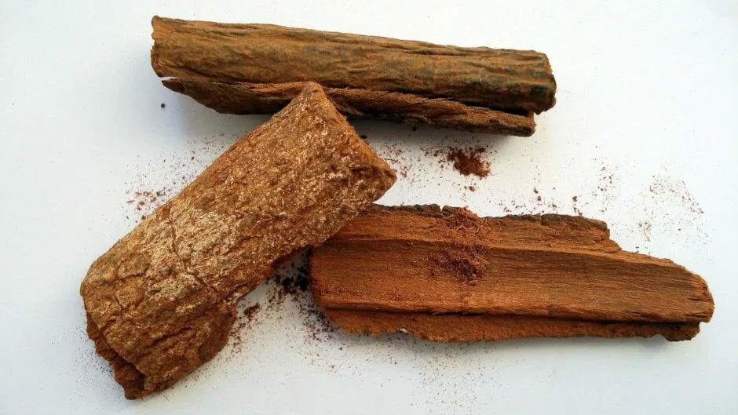
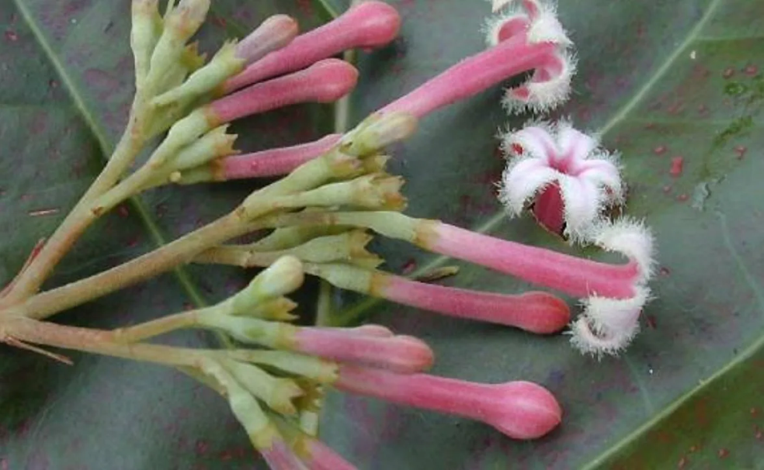
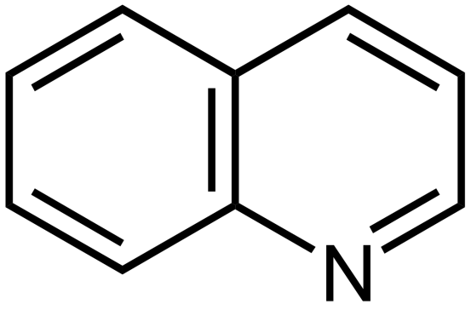
Alkaloids derivatives of quinoline

Slide 3
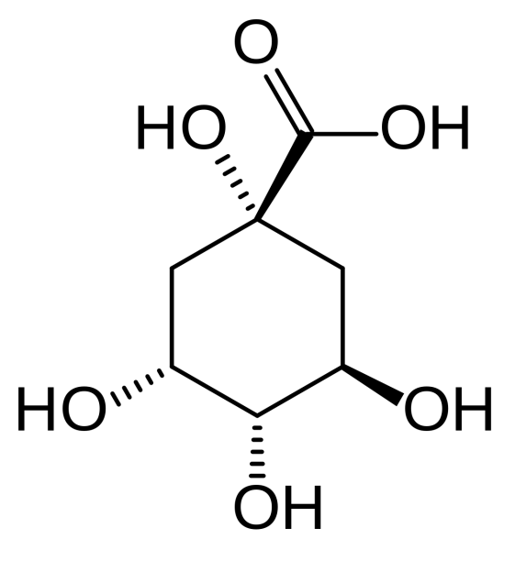
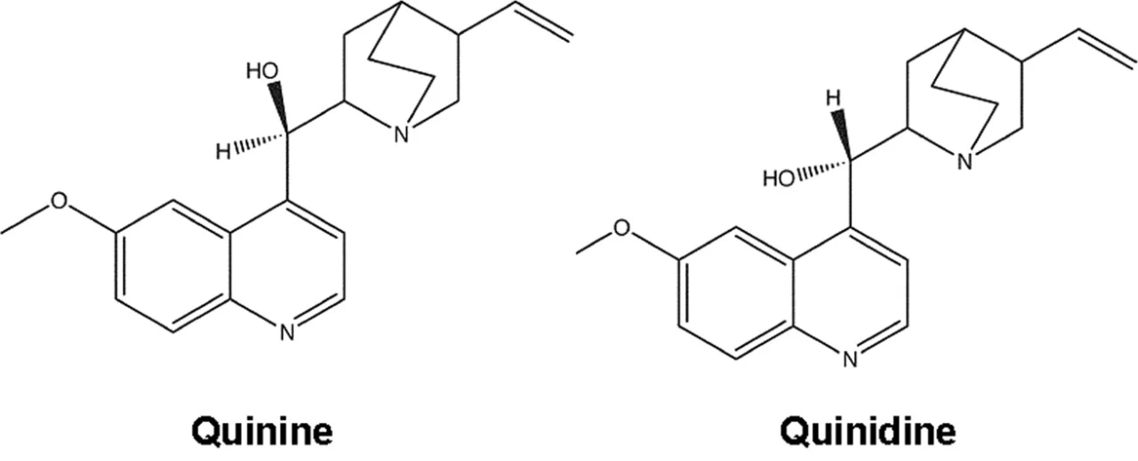
Alkaloids derivatives of quinoline
quinic acid

Slide 4
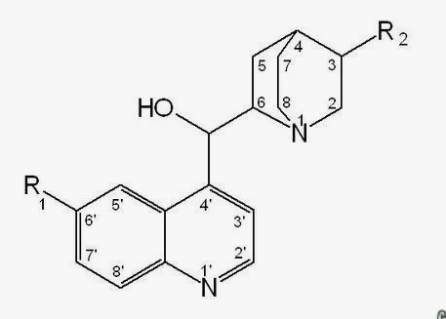
Alkaloids derivatives of quinoline
R₁ | R₂ | Alkaloids
 |  | l-isomer | d-isomer
CH₃O- | CH₂=CH- | quinine | quinidine
H- | CH₂=CH- | cinchonidine | cinchonine
CH₃O- | CH₃CH₂- | hydroquinine | hydroquinidine
H- | CH₃CH₂- | hydrocinhonidine | hydrocinchonine
HO- | CH₂=CH- | cuprein | -

Slide 5
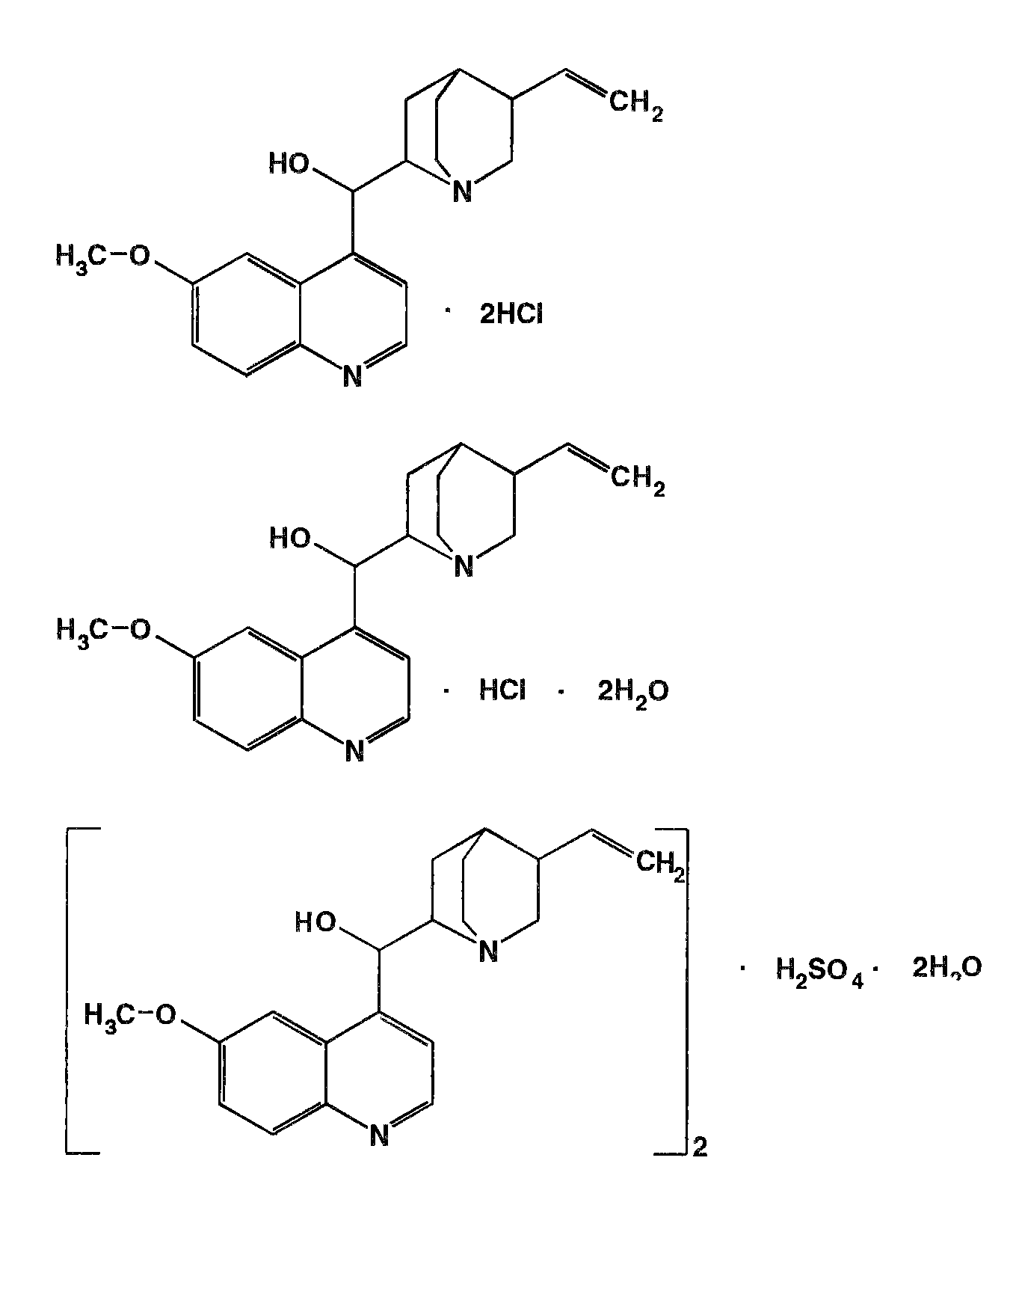
Quinine
quinine dihydrochloride
quinine hydrochloride
quinine sulphate

Slide 6
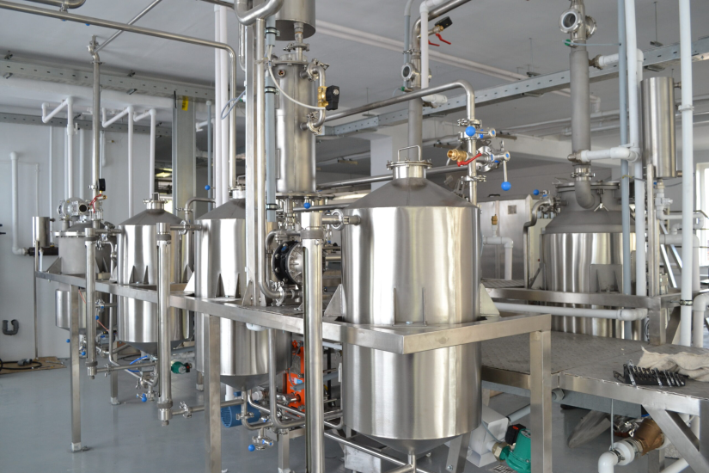
Quinine
Obtaining
Since the alkaloids in the plant material are present in the form of salts of cinnamic acid, crushed cinnamon bark is treated with milk of lime mixed with alkali. The resulting bases are extracted with benzene, yielding the sum of the alkaloids. Quinine is separated as a slightly soluble sulphate. The remaining alkaloids are separated by ion exchange chromatography. The quinine sulphate is purified by recrystallisation and converted back to base. From the base, quinine dihydrochloride and quinine hydrochloride.

Slide 7
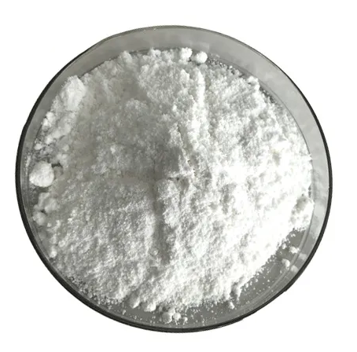
Quinine
Physical properties
Chinine (Quinine) Dihydrochloride
Colourless crystals or white crystalline powder without odour. Specific rotation of a 3% solution in 0.1 M hydrochloric acid solution is about -225°. Very readily soluble in water.
Chinine (Quinine) Hydrochloride
Colourless shiny silky lustrous needles or white fine crystalline odourless powder. Weathered. Specific rotation of a 3% solution in 0.1 M hydrochloric acid solution is about -245°. Soluble in water.
Chinine (Quinine) Sulfate
Colourless lustrous silky silky needle-like crystals or white fine crystalline powder without odour. Specific rotation of a 3% solution in 0.1 M hydrochloric acid solution is about -240°. Slightly soluble in water.

Slide 8
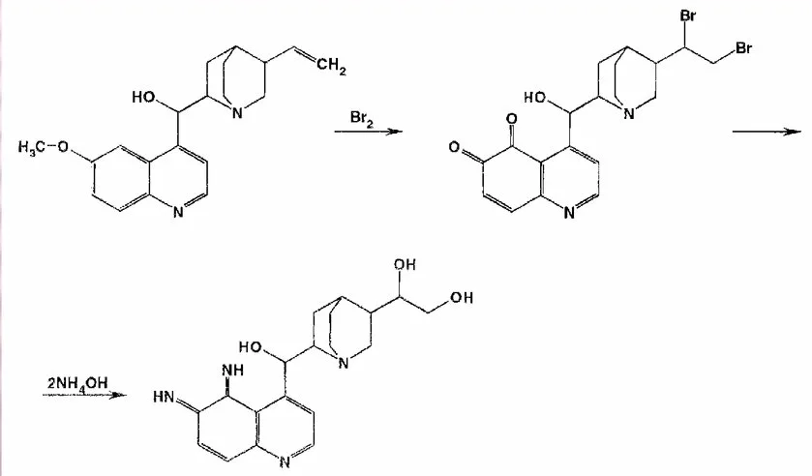
Quinine
Identification
IR and UV spectrophotometry
2. Taleiochin test

Slide 9
Quinine
Identification
3. Interaction with sulphuric acid
Blue fluorescence appears.
In the presence of oxidants, the colour of the fluorescence changes. For example, exposure to a saturated solution of bromine water produces a yellow-green fluorescence.
4. Interaction with common alkaloid reagents

Slide 10
Quinine
Identification
5. Interaction with alcoholic iodine solution
green crystals
6. Determination of chloride and sulphate

Slide 11
Quinine
Identification
7. Detection of formaldehyde after fusion with benzoyl peroxide

Slide 12
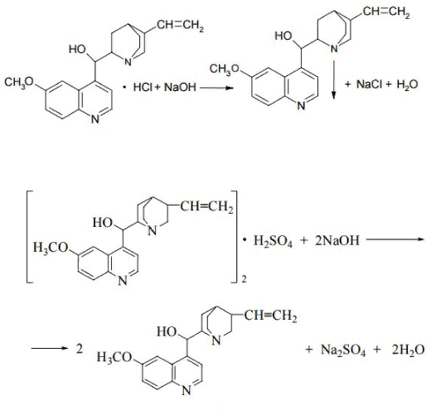
Quinine
Quantificification
1. Gravimetry
2. Alkalimetry

Slide 13
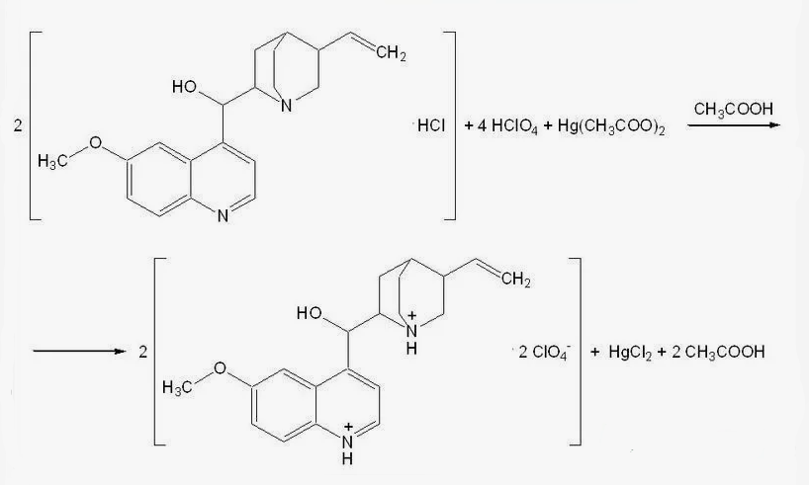
Quinine
Quantificification
Non-aqueous titration

Slide 14
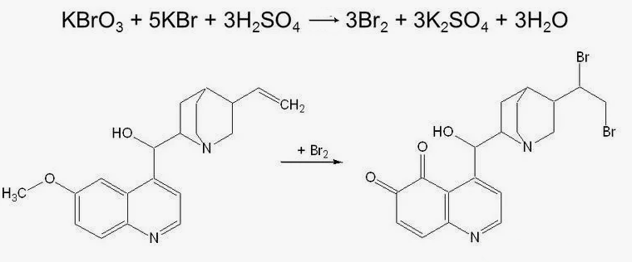
Quinine
Quantificification
Bromatometry
5. Spetrophotometry
6. Gas-liquid chromatography

Slide 15
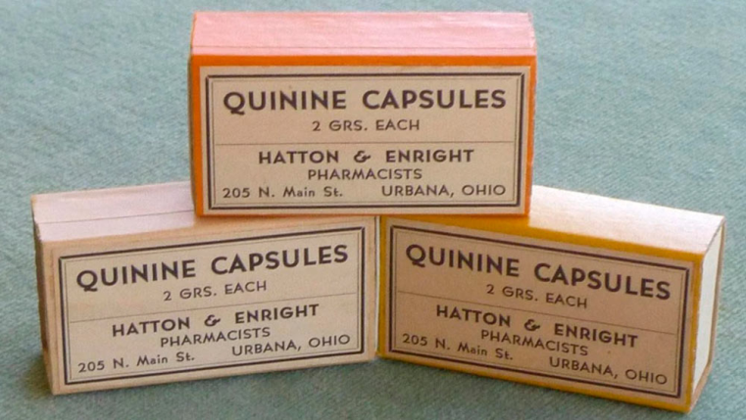
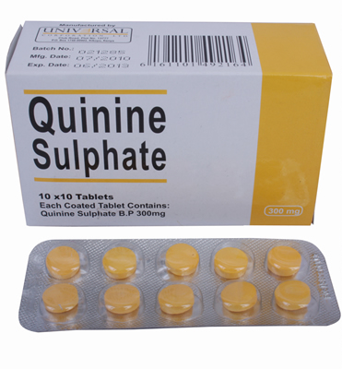
Quinine
Storage
Quinine salts should be kept in well-corked containers, away from light, which gradually causes quinine to decompose and turn yellow.
Medical use
Quinine is recommended for the treatment of malaria; correction of weakness of labour activity and uterine hypotonia in the early postpartum period as part of combined therapy.

Slide 16
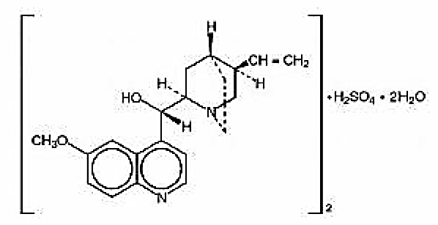
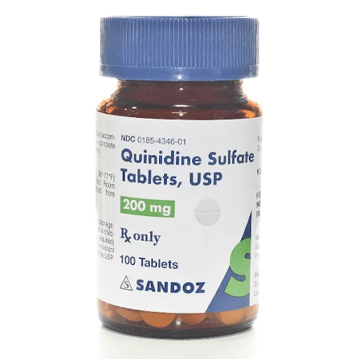
Quinidine sulphate
Colour reactions are known to distinguish quinine from quinidine. Thus, if one drop of alcohol solution acidified with sulphuric acid is applied to filter paper and treated with iodine vapour for 30 seconds, a greyish-blue spot with a dark yellow rim appears in the presence of quinine, and a dark yellow spot appears in the presence of quinidine.
Quinidine sulphate is stored in well-corked containers protected from light.
It is prescribed for various types of arrhythmias as a prolonged-acting antiarrhythmic agent.

Slide 17
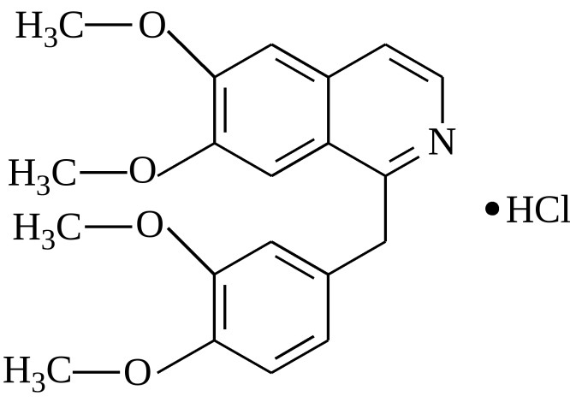
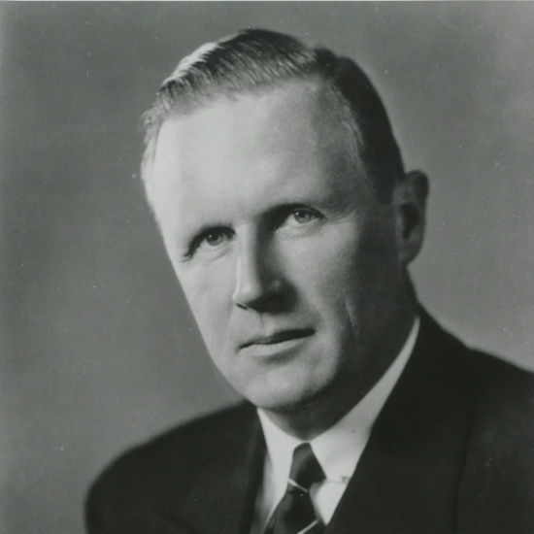
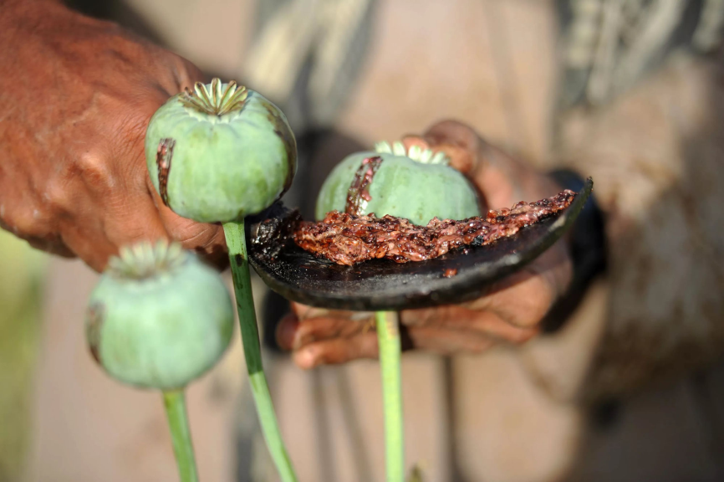
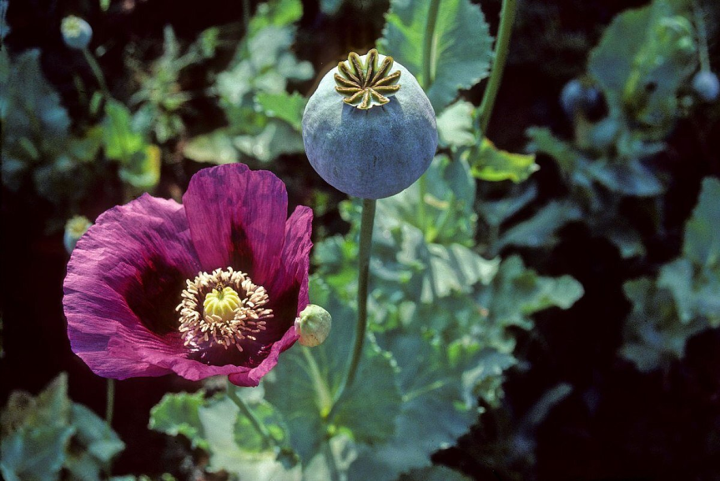
Alkaloids derivatives of benzylisoquinoline
Papaverine Hydrochloride

Slide 18
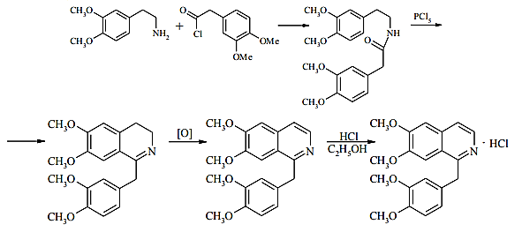
Papaverine Hydrochloride
Obtaining
Papaverine hydrochloride is a white crystalline powder of bitter taste.
Moderately soluble in water, slightly soluble in ethanol, soluble in chloroform, practically insoluble in ether.

Slide 19
Papaverine Hydrochloride
Identification
IR and UV spectrophotometry
2. Interaction with nitric acid
When the drug is exposed to concentrated nitric acid, a yellow colour appears which turns orange when heated.
3. Interaction with bromine water
When the drug solution is exposed to bromine water, a yellow precipitate is formed.
4. Interaction with concentrated sulphuric acid
The action of concentrated sulphuric acid produces purple oxidation products.

Slide 20
Papaverine Hydrochloride
Identification
4. Interaction reaction with common alkaloid reagents
For example, a yellow precipitate is formed with picric acid. The melting point of papaverine picrate is 220ºC.

Slide 21
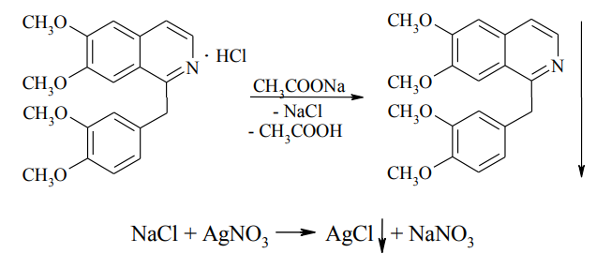
Papaverine Hydrochloride
Identification
5. Interaction with sodium acetate solution

Slide 22
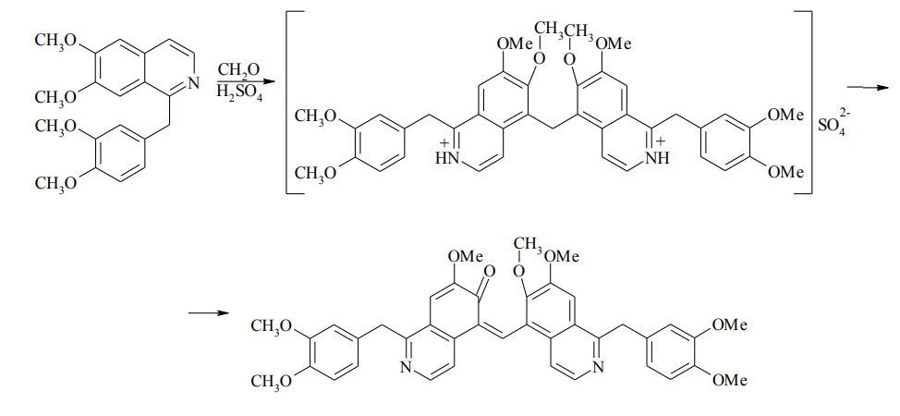
Papaverine Hydrochloride
Identification
6. Interaction with Marquis’ reagent
red-violet colour

Slide 23
Papaverine Hydrochloride
Quantificification
1. Non-aqueous titration
2. Argentometry

Slide 24
Papaverine Hydrochloride
Quantificification
3. Neutralisation
Storage
The drug should be stored in a well-sealed container, protected from light.

Slide 25
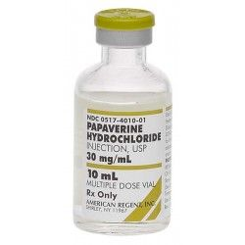
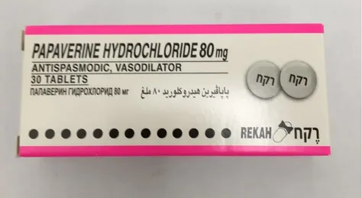
Papaverine Hydrochloride
Medical use
Papaverine has almost no analgesic effect, but has a strong antispasmodic effect. It relaxes smooth muscles, which is important during surgery.

Slide 26
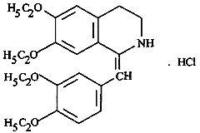
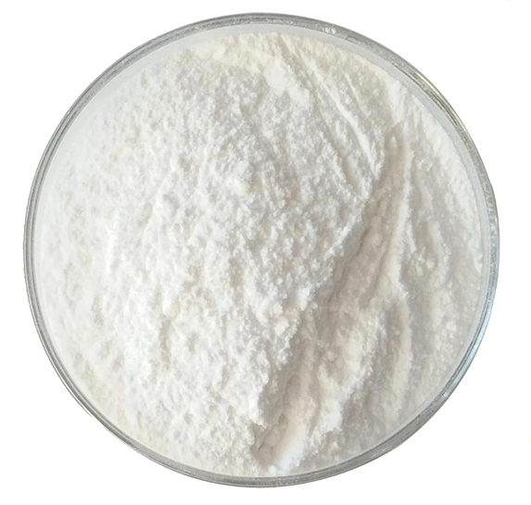
Drotaverine Hydrochloride
Pale yellow or greenish yellow crystalline powder with no or almost no odour. Melting point 208-211°C.
Moderately soluble in water, soluble in ethanol, slightly soluble in chloroform, slightly soluble in acetone.

Slide 27
Drotaverine Hydrochloride
Identification
1. IR- and UV-spectrophotometry
2. Interaction with common alkaloid reagents
3. Interaction with concentrated sulphuric acid in the presence of iron(III) chloride
Heating drotaverine hydrochloride with concentrated sulphuric acid in the presence of traces of iron (III) chloride results in green colouring, which changes to brownish-red on addition of nitric acid.

Slide 28
Drotaverine Hydrochloride
Identification
4. Chloride determination
5. Precipitation of drotaverine base

Slide 29
Drotaverine Hydrochloride
Quantificification
1. Non-aqueous titration
Titrated with perchloric acid in glacial acetic acid and mercury (II) acetate. The indicator is crystal violet
2. Neutralisation

Slide 30
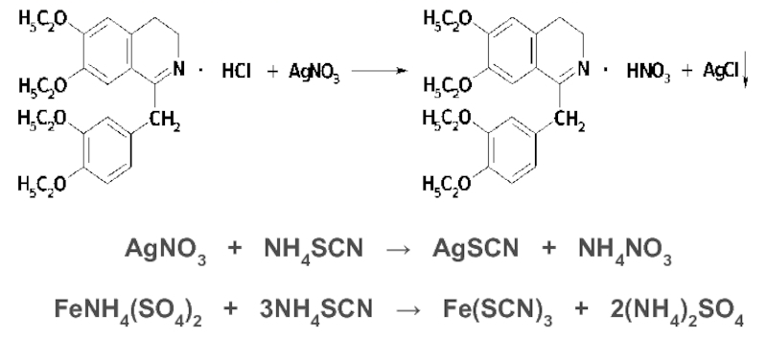
Drotaverine Hydrochloride
Quantificification
3. Reverse Argentometry
4. Photometry

Slide 31
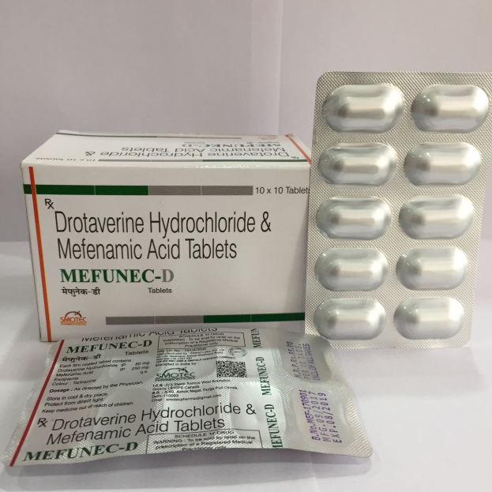
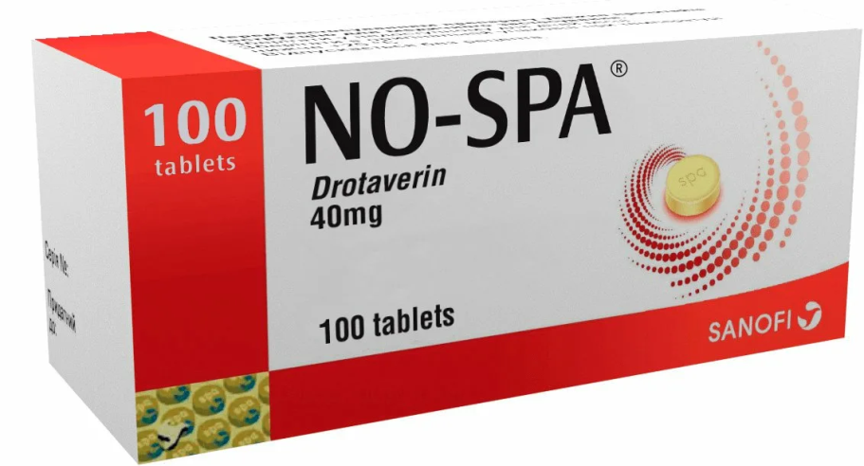
Drotaverine Hydrochloride
Storage
Store drotaverine hydrochloride in tightly closed containers away from light to avoid oxidation.
Medical use
Drotaverine hydrochloride is used as an antispasmodic agent in spasms of blood vessels and smooth muscles of the abdominal organs and in bronchial asthma.

Slide 32
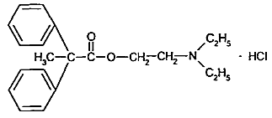
Papaverine analogues in action
spasmolytin
aprofene
thiphen
diprophen

Slide 33
Aprofene
Obtaining
Physical properties
Aprofen is a white crystalline powder, easily soluble in water, alcohol, chloroform, difficult in acetone and benzene. Insoluble in ether. Melting point is 161-165 °C.

Slide 34
Aprofene
Identification
1. IR- and UV-spectrophotometry
2. Interaction with concentrated sulphuric acid
When the drug is dissolved in a small amount of concentrated sulphuric acid, a greenish-yellow colouring occurs.
3. Interaction with potassium bichromate
After oxidation of the drug with potassium bichromate in the presence of sulphuric acid, the reaction products formed stain the filter paper moistened with sodium nitroprusside and piperidine solution blue..
4. Chloride determination
5. Interaction with Markey reagent
A yellow-orange colouration is formed

Slide 35
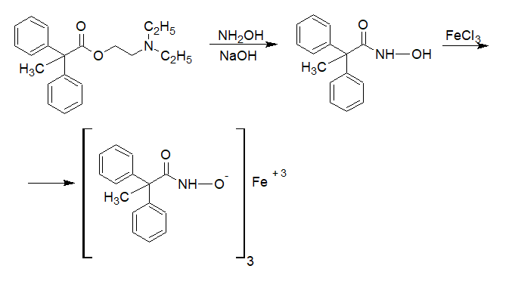
Aprofene
Identification
5. Hydroxamic reaction
The iron hydroxamate formed has a red-violet colour

Slide 36
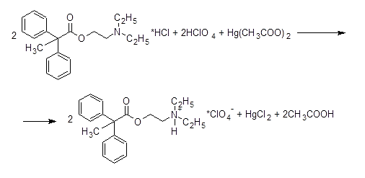
Aprofene
Quantificification
1. Non-aqueous titration

Slide 37
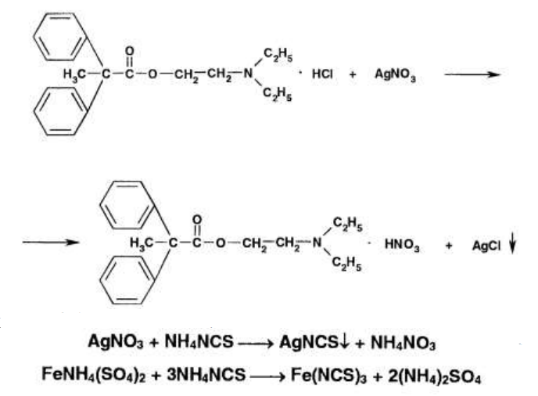
Aprofene
Quantificification
2. Argentometry

Slide 38
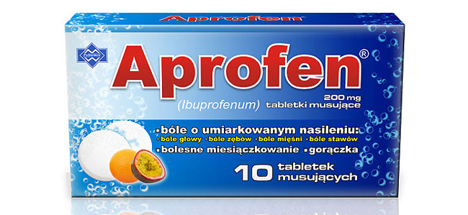
Aprofene
Storage
The medicine should be stored in tightly closed containers away from light. If the storage conditions are not observed, it will gradually hydrolyse.
Medical use
Aprofen is used to treat spasticity of the abdominal organs and diseases caused by spasms of the blood vessels (angina pectoris, endarteritis, etc.).

Slide 39
Thank you for attention!

