Slide 1
Lecture
MENDELIAN INHERITANCE
Patterns of inheritance

Slide 2
Genetics is a branch of biology, which studies heredity and variability

Slide 3
Heredity - the sum of all biological processes by which particular characteristics are transmitted from parents to their offspring.
Variability –the property of living organisms to change hereditary traits from generation to generation.

Slide 4
Terms of Genetics
trait - any characteristic that an organism displays
allele - an alternative form of a specific gene
dominant - an allele that determines the phenotype in the heterozygous condition
recessive - a trait or gene that is masked by the presence of a dominant trait or gene
genotype - the genetic composition of organism
phenotype - the observable traits of an organism
homozygote - has two identical alleles of a gene
heterozygote - has two different alleles of a gene

Slide 5
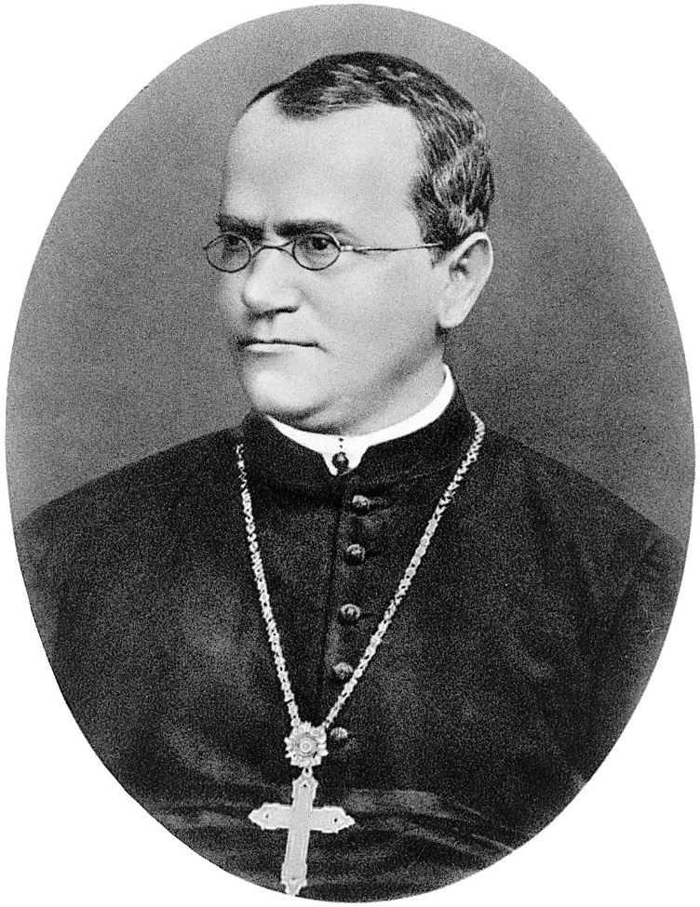
Gregor Johann Mendel, born in 1822, is now remembered as the father of genetics. In 1856, Mendel began his historic studies on pea plants.

Slide 6
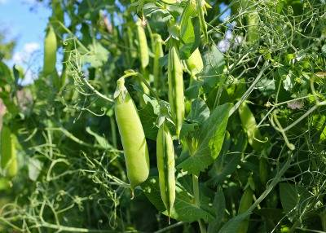
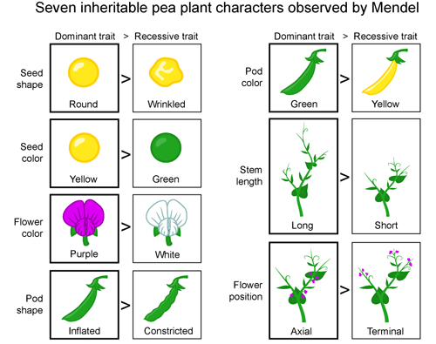
Garden pee
This is a very convenient object for research:
It has a few contrasting characters;
Easy to cultivate;
Short duration of life cycle;
Every pea plant produces a large number of seeds.

Slide 7
For 8 years, G. Mendel grew and crossed thousands of pea plants. Mendel made innovations. It is known as the hybridological method
He developed pure lines;
He counted his results and kept statistical notes.

Slide 8
Mendel's Laws
Mendel was the first to formulate the basic patterns inheritance.
Law of dominance
Law of segregation
Law of independent assortment

Slide 9
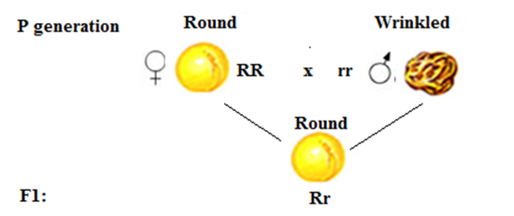
Law of dominance

Slide 10
Law of dominance
in a cross-involving two contrasting characters, only one character (dominant) expresses itself in the next generation

Slide 11
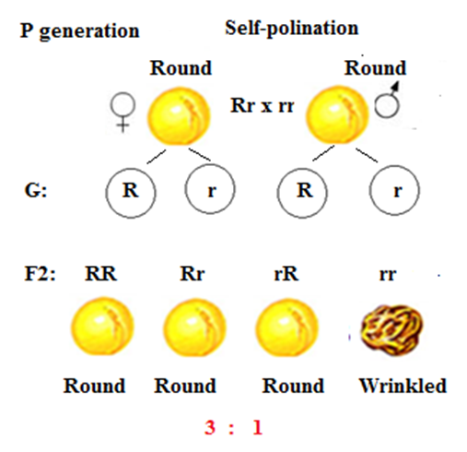
Law of segregation

Slide 12
Law of segregation
The two copies of a gene segregate (or separate) from each other during transmission from parent to offspring

Slide 13
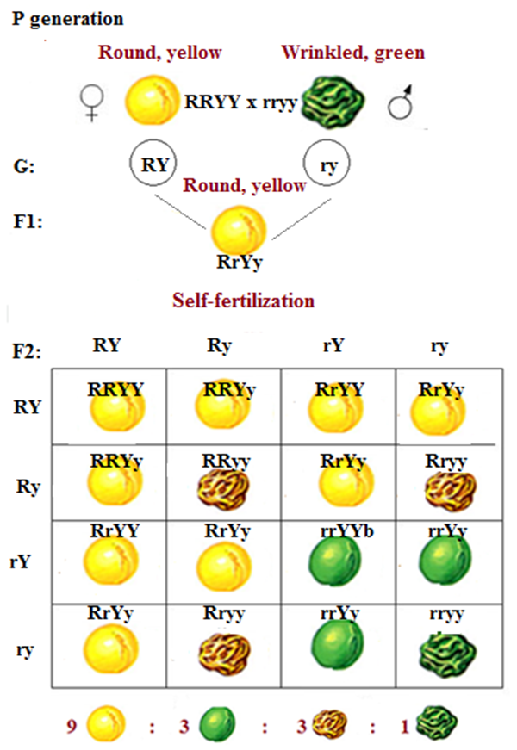
Law of independent assortment

Slide 14
Law of independent assortment
Two different genes will randomly assort their alleles during the formation of haploid cells

Slide 15
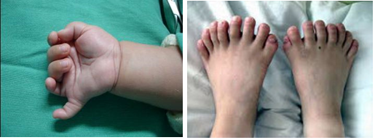
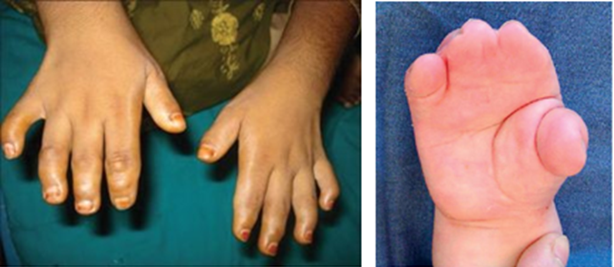
Mendelian inheritance in Humans
Dominant:
Polydacthily
(extra fingers)
Brachidacthily
(short fingers)

Slide 16
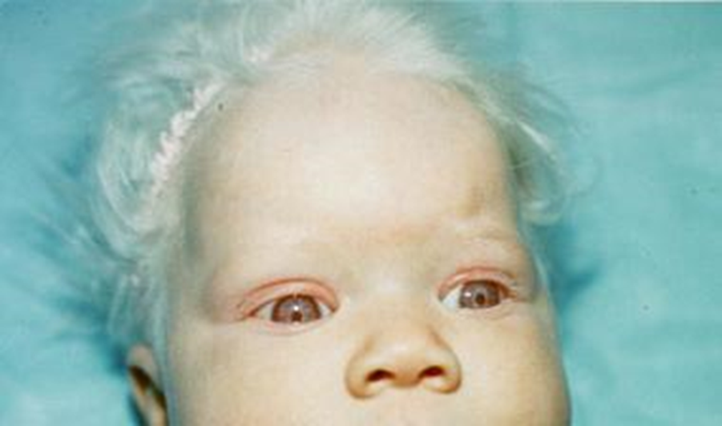
Mendelian inheritance in Humans
Recessive:
Phenylketonuria (PKU) (mental deficiency)
Albinism (failure the production of melanin)

Slide 17
Allelic Genes Interaction
Complete dominance
Incomplete dominance
Codominance
Overdominance

Slide 18
Complete dominance
a strict dominant/recessive relationship
Example:
The Rhesus factor
Polydacthily
(extra fingers)
Brachidacthily
(short fingers)

Slide 19
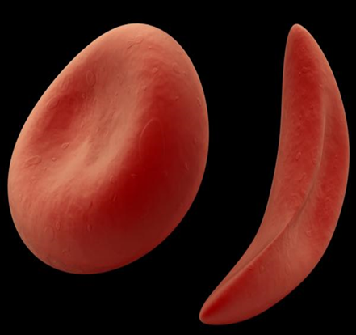
Incomplete dominance
occurs when the heterozygote has a phenotype that is intermediate between either corresponding homozygote
Example: The Sickle cell anemia
aa – hard form
AA – healthy
Aa – mild form

Slide 20
Codominance
occurs when the heterozygote expresses both alleles simultaneously
Example: AB blood type.

Slide 21
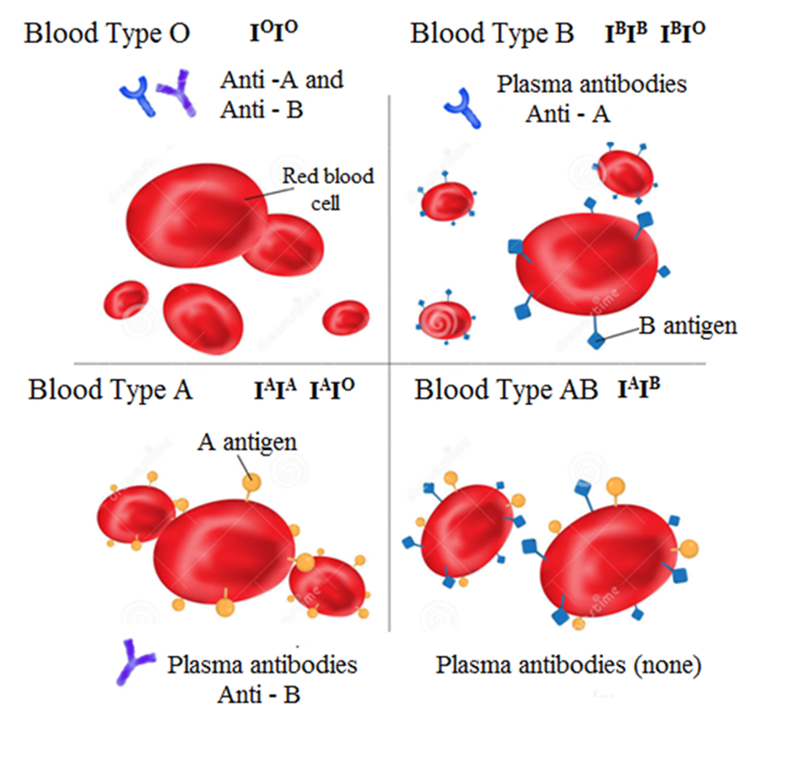

Slide 22
Overdominance
occurs when the heterozygote may display characteristics that are more beneficial for their survival

Slide 23
Non-Allelic Gene Interaction
Complementation
Epistasis
Polygenic inheritance

Slide 24
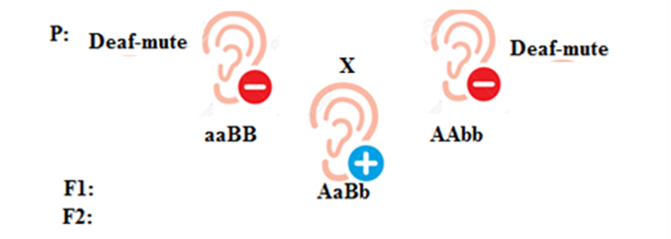
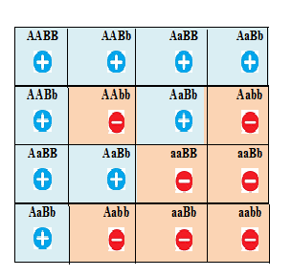
Complementation -
the manifestation of a character is determined by presence of both dominant alleles of non-allelic genes simultaneously
Example: The Deaf-mutism in human

Slide 25
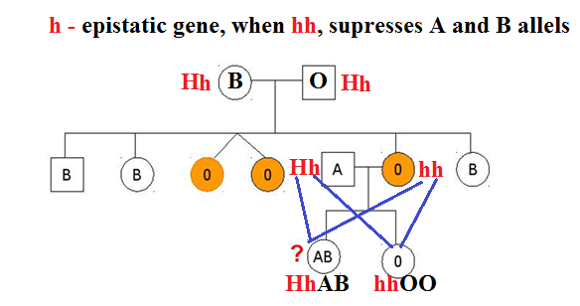
Epistasis -
two pairs of non-allelic genes interact in such a way when one gene suppresses or masks the expression of the other gene
Epistasis may be dominant and recessive
Example: Bombay phenomenon

Slide 26
Polygenic inheritance
the transmission of a trait governed by two or more different genes
It may be cumulative and non-cumulative
Examples in human: height, weight, skin color, IQ

Slide 27
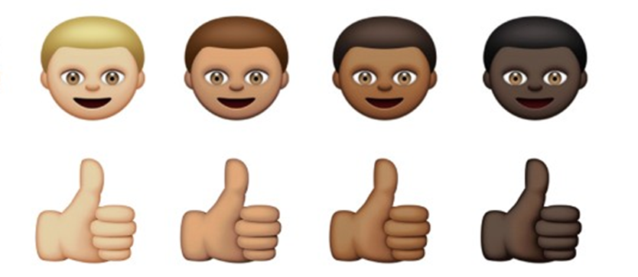
Human Skin Color Variation

Slide 28
Pleiotropy
the expression of a single gene may have multiple effects
Example: Marfan syndrome

Slide 29
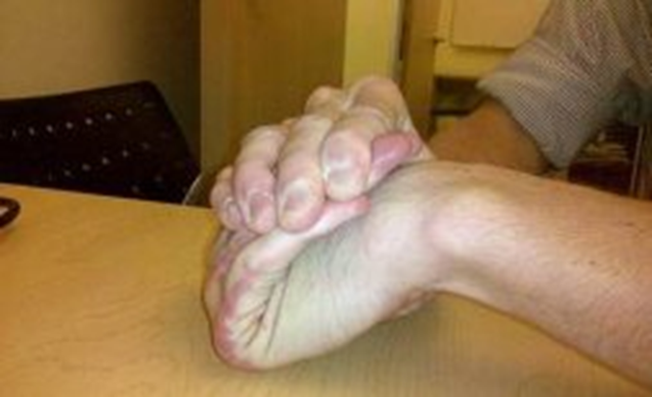
Marfan syndrome

Slide 30
Genetic linkage
Genetic linkage is the phenomenon in which genes that are close together on the same chromosome tend to be transmitted as a unit.
Linked genes - genes located on the same chromosome that tend to be inherited together in genetic crosses
Linkage groups – each chromosome contains a group of genes that are physically linked together.
The number of linkage groups equals the number of chromosome types.
Human‘s genome – 46 chromosomes; 23 linkage groups

Slide 31
To see how linkage between genes affects the inheritance of two different characters, let’s examine Morgan’s Drosophila experiments.
In Drosophila fly two characters - body color and wing size, each with two different phenotypes.
gray body and normal-sized wings – dominant traits
black body and reduced wings – recessive traits

Slide 32
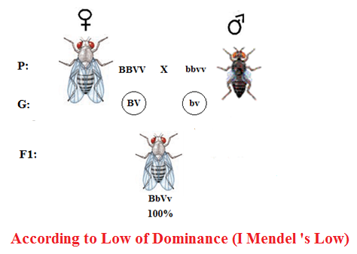
1-st experiment

Slide 33
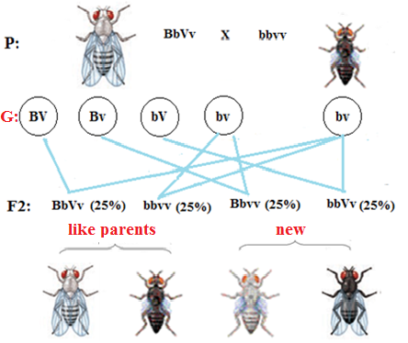
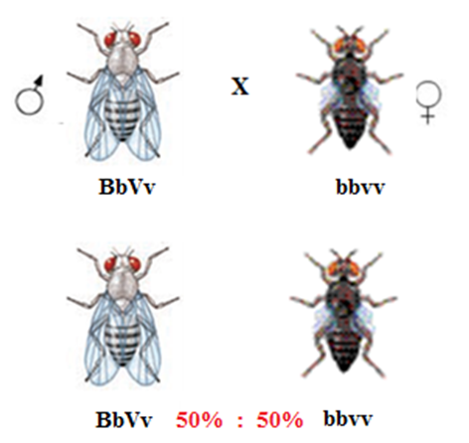
2-d experiment
Morgan crossed male –hybrid of 1 generation and homozygous female
Morgan expected to receive: Real results:

Slide 34
Morgan suggested:
two different genes are responsible for two traits, but these genes are located on the same chromosome, therefore, they are inherited jointly.

Slide 35
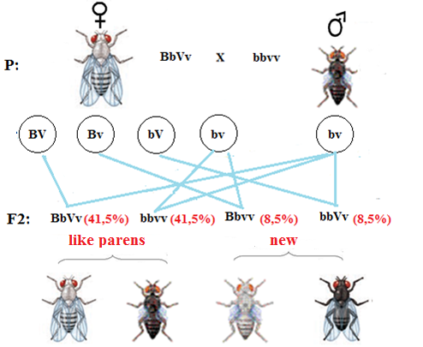
3-d experiment
Morgan crossed female –hybrid of 1 generation and homozygous male
Morgan received:

Slide 36
Morgan suggested:
two different genes are responsible for two traits, but these genes are located on the same chromosome, therefore, they are inherited jointly. But the linkage may be complete and incomplete. The reason for incomplete linkage is a crossing over.

Slide 37
The main statements of chromosome theory of inheritance (Morgan’s Theory)
A specific gene is carried on a specific chromosome.
The chromosomes are linkage groups, because a chromosome contains a group of genes that are physically linked together; the number of linkage groups equals the haploid number of chromosomes.
Each gene has its own unique locus — the site where the gene is found within a particular chromosome.
All genes in chromosome are located in Linear arrangement.
The crossing over may occur between homologous chromosomes; the likelihood of crossing over depends on the distance between genes.
Each species has own unique number of chromosomes.

Slide 38
GENETIC BASIS OF SEX.
SEX-LINKED INHERITANCE

Slide 39
Types of sex determination
In relation to the time of fertilization, there are four types of sex determination:
Progamy
Epigamy
Syngamy
Eusyngamy

Slide 40
Progamy – sex is determined during the maturation of eggs
the males develop from small eggs,
the females develop from large eggs

Slide 41
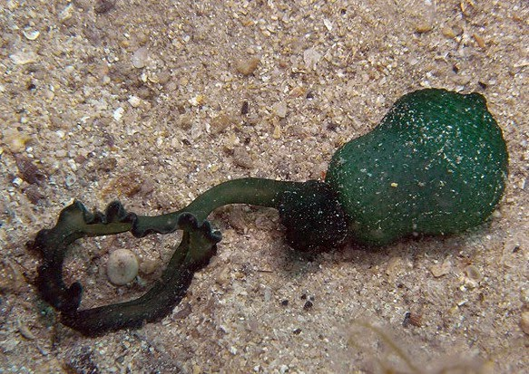
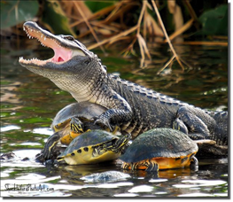
Epigamy - sex determination occurs after fertilization under the influence of a wide variety of external conditions (occurs in a limited number of species)
Example1: (sex is defined by active metabolic products – hormones)
Sea worm Bonellia viridis, females or males develop depending on whether or not the larva attaches to the body of the mother organism. If the larva settles on the body of the female mother, it differentiates into a male, if it settles on the ground, it becomes a female.
Example 2: (Temperature Dependent Sex-Determination)
In some species like the turtles, alligators the sex of the organisms is determined by the incubation temperature of the egg during the temperature sensitive period of the egg.

Slide 42
Singamy - the sex of the zygote is determined at the moment of fertilization.
Gametes of the same type formed in individuals of the homogamete sex can be fertilized by two different types of gametes formed in individuals of the heterogamete sex.
It is typical of most mammals, including humans.

Slide 43
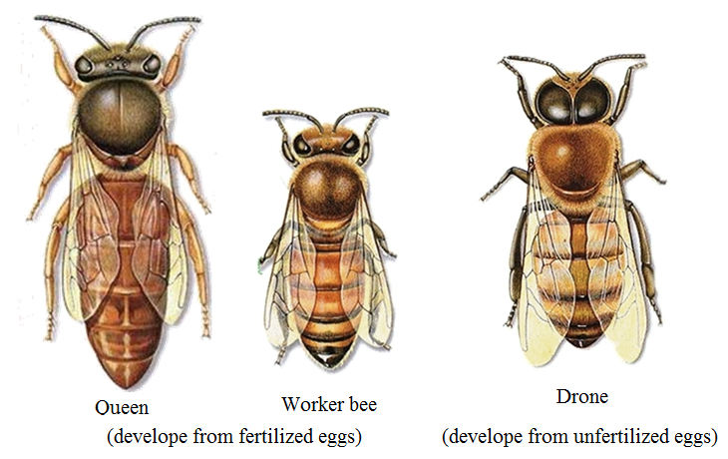
Eusingamy – sex depends on the ratio of sex chromosomes and autosomes
females with a diploid set of chromosomes develop from fertilized eggs,
males drones develop from unfertilized eggs, parthenogenetically.

Slide 44
Sex determination by means chromosomal apparatus
Depending on the number and composition of sex chromosomes, there are three main types of chromosomal sex determination:
The X-Y system
The X-0 system
The Z-W system

Slide 45
The X-Y system
Female - homogametic XX
Male -heterogametic XY
It is typical for mammals including human

Slide 46
The X-O system
Female - homogametic XX
Male –has only one X
This system of sex-determination is seen in insects like grasshoppers, crickets, cockroaches.

Slide 47
The Z-W system
Female – heterogametic ZW
Male - homogametic ZZ
This type of system is found in birds, some reptiles and some insects

Slide 48
Sex Linkage
genes that are located in the sex chromosomes are inherited together with a sex trait.
There are three ways of Sex Linkage:
X-Linked Dominant Inheritance
X-Linked Recessive Inheritance
Y-Linked Inheritance (Holandric inheritance)

Slide 49
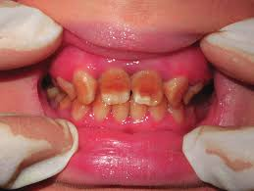
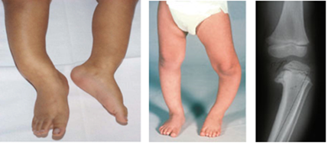
X-Linked Dominant Inheritance inherited by men and women equally often
Dark tooth enamel
(lack of enamel on the teeth)
Vitamin D-resistant rickets
Defects in bone mineralization at the sites of bone growth, leading to bone deformity and stunted growth in children.

Slide 50
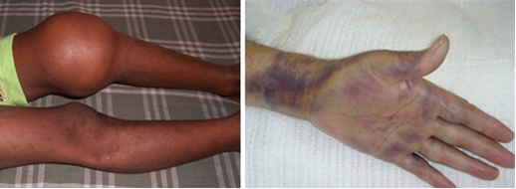
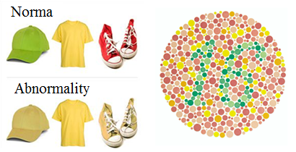
X-Linked Recessive Inheritance Males are much more likely to exhibit the trait
Hemophilia
(Defect in blood clotting); hemorrhages occur in the joints, muscles and internal organs
Red-green color blindness
An inability or decreased ability to see color (more often green and red)

Slide 51
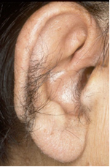
Y-Linked Inheritance (Holandric inheritance) Only Males exhibit the trait
Hairy ears (hypertrichosis)

