Slide 1
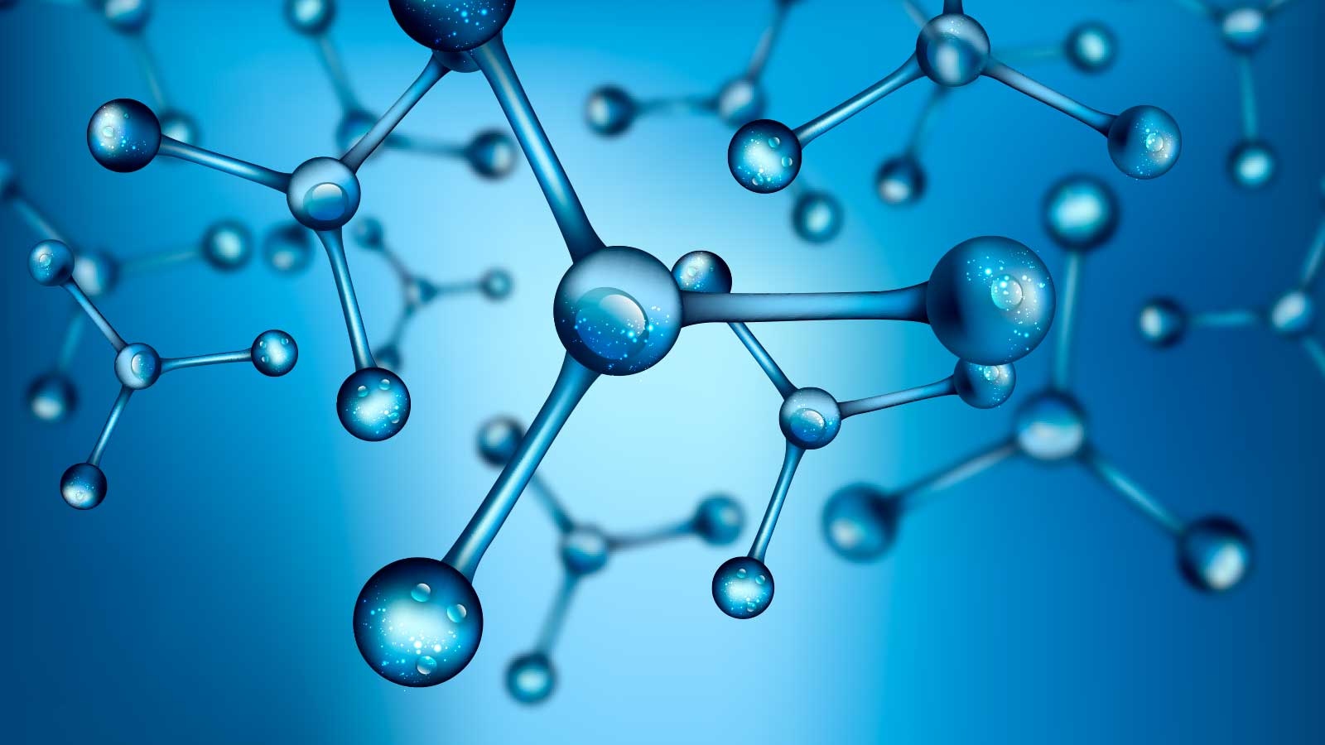
«Special pharmaceutical chemistry»
Hormones. Concept, biological role and classification of hormones. Thyroid hormones.
Associate Professor Gureeva E.S.

Slide 2
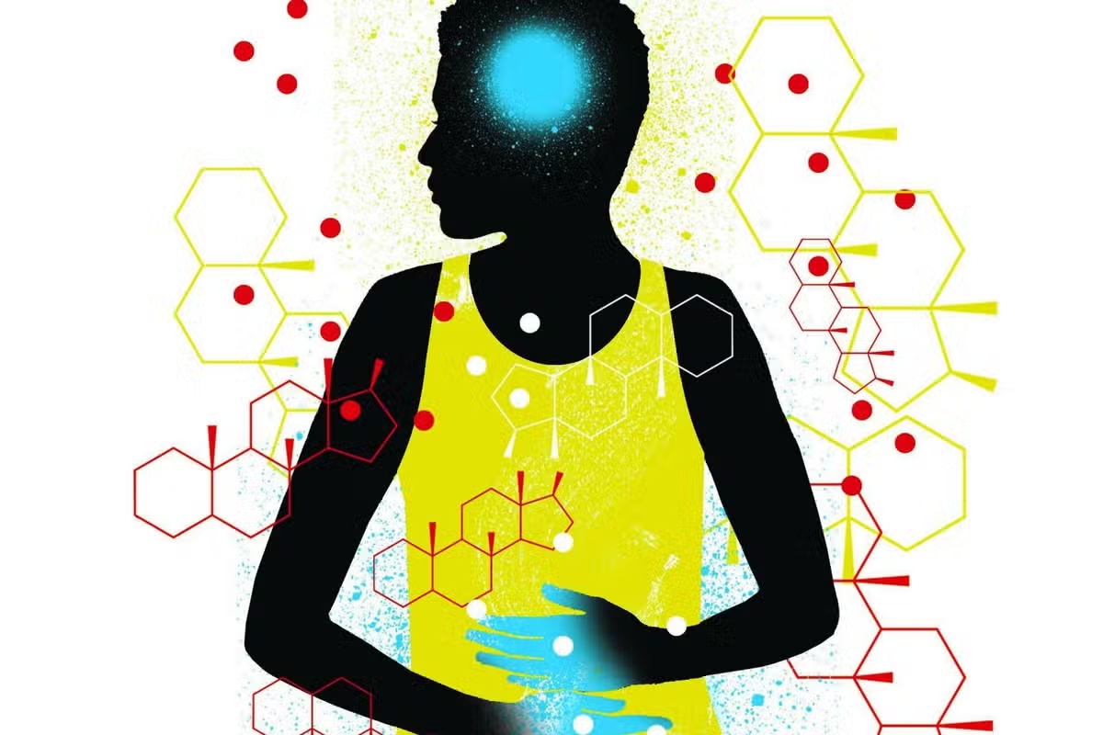
Hormones
Hormones (from the Greek hormaino - to induce) are biologically active substances secreted by endocrine cells into the blood or lymph to regulate biochemical and physiological processes in target cells.

Slide 3
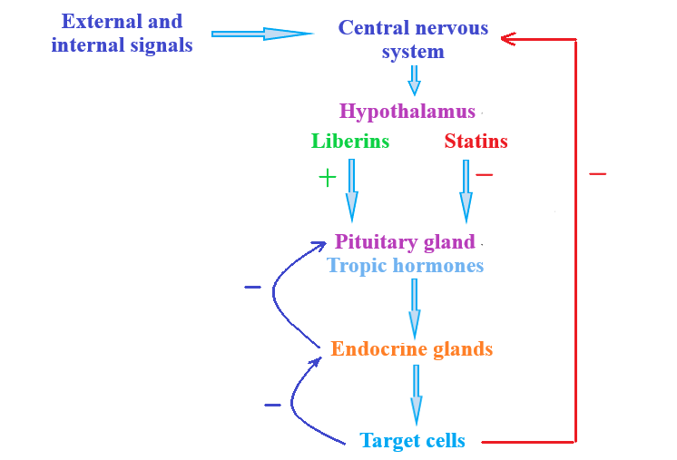
Hormones

Slide 4
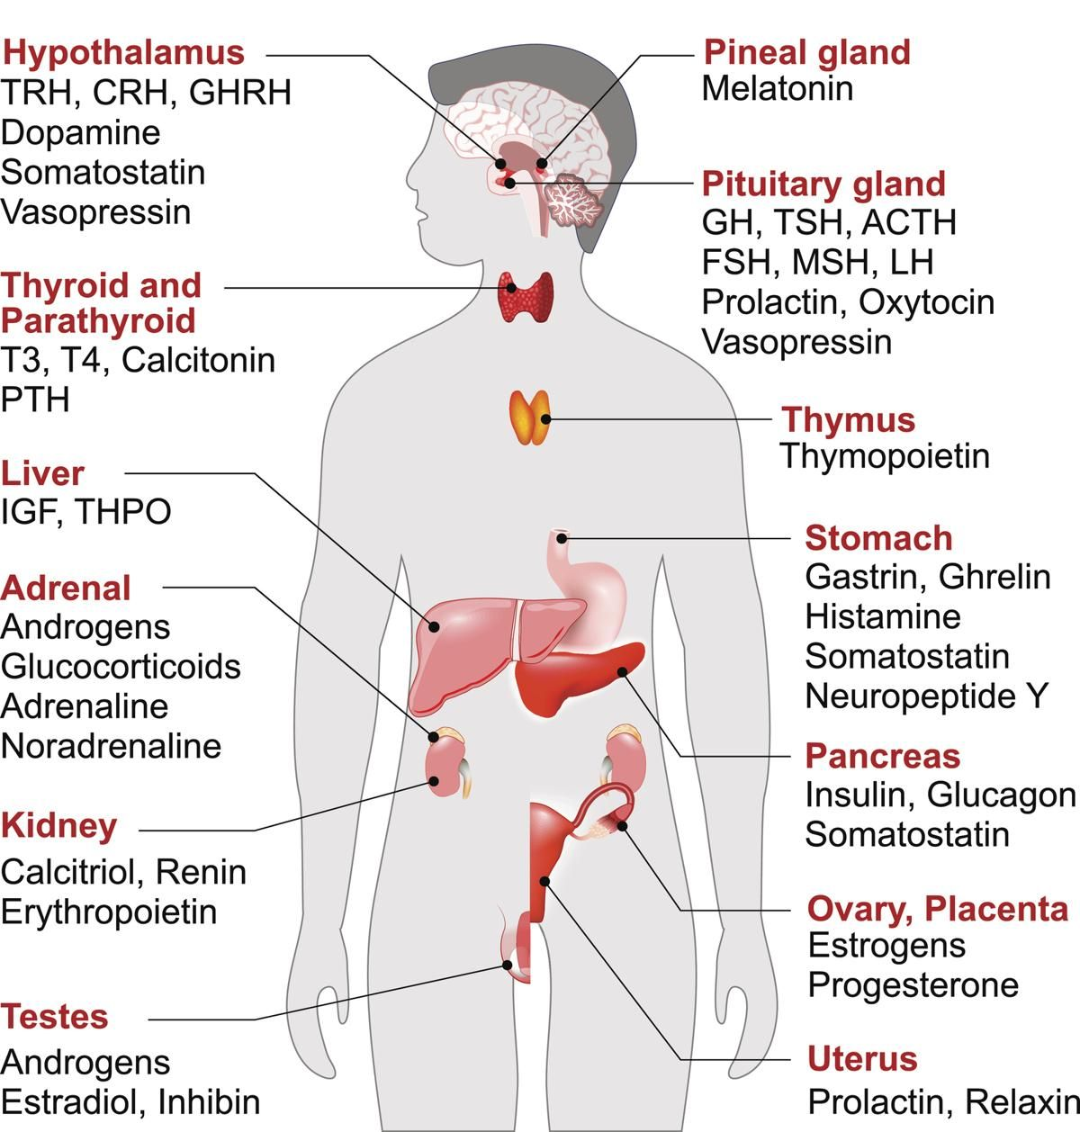
Hormones
Hormones are characterised by:
specificity of action;
high biological activity;
local and remote action;
relatively short half-life (less than 1 h).

Slide 5
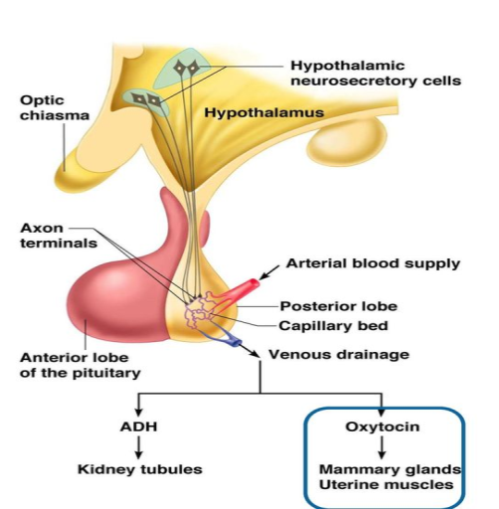
Hormones
Classification of hormones
Hormones are classified according to where they are produced
hypothalamus (corticoliberin, thyreoliberin, gonadoliberin, somatoliberin, melanoliberin, prolactostatin, somatostatin, melanostatin)
pituitary (somatotropic, lactotropic, adrenocorticotropic, thyrotropic hormones, melanocyte stimulating, vasopressin, oxytocin, follicle stimulating, luteinising)
pineal gland (melatonin);
peripheral endocrine glands (insulin, glucagon, cortisol, thyroxine, adrenaline, aldosterone, estradiol, estriol, testosterone, calcitonin, parathormone, calcitriol).

Slide 6
Hormones
Classification of hormones
Hormones can be divided into 3 groups according to their mechanism of action
Hormones that do not penetrate the cell and interact with membrane receptors (peptides, protein hormones, adrenaline). The signal is transmitted within the cell by intracellular mediators (secondary messengers). The main end effect is a change in enzyme activity;
Hormones that enter the cell (steroid hormones, thyroid hormones). Their receptors are located inside the cells. The main end effect is a change in the amount of enzyme proteins through gene expression;
Membrane acting hormones (insulin, thyroid hormones). The hormone is an allosteric effector of membrane transport systems. Binding of a hormone to a membrane receptor leads to a change in the conductance of membrane ion channels.

Slide 7
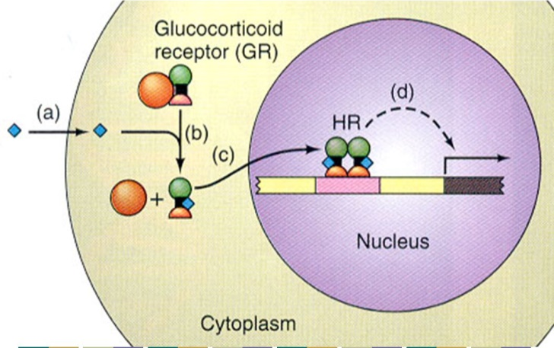
Hormones
Classification of hormones
By localisation of hormone receptors
inside or on the surface of the plasma membrane (receptors for peptide hormones, catecholamines, eicosanoids);
in the cell cytoplasm and nucleus (steroid hormone receptors, thyroid hormone receptors).

Slide 8
Hormones
Classification of hormones
By affecting metabolism and physiological functions
protein metabolism (somatotropin, adrenocorticotropic, thyrotropic hormone, insulin, thyroxine)
carbohydrate and lipid metabolism (somatotropin, adrenocorticotropic, thyrotropic hormones, insulin, thyroxine, epinephrine, glucagon);
water and salt metabolism; calcium and phosphorus metabolism (aldosterone, vasopressin; calcitonin, parathormone, calcitriol);
reproductive function (gonadotropic hormones, estradiol, estriol, progesterone, testosterone, prolactin, oxytocin).
By solubility
hydrophilic (peptide hormones, amino acid derivatives);
hydrophobic (steroid hormones).

Slide 9
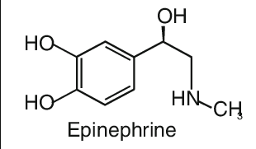
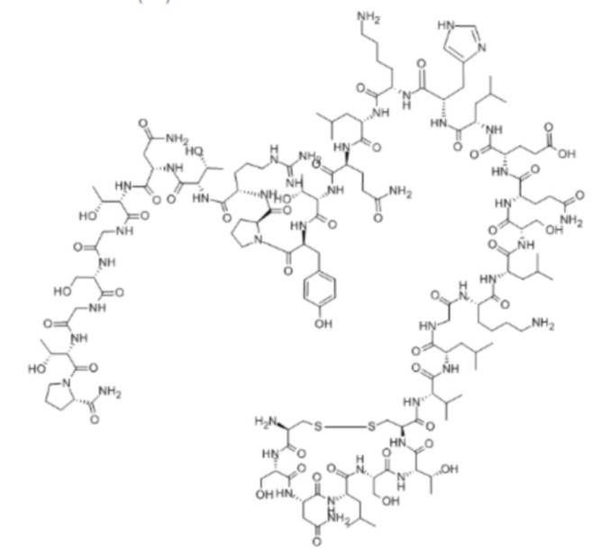
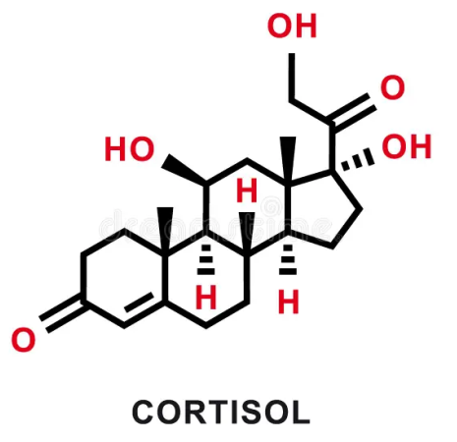
Hormones
Classification of hormones
according to their chemical structure
Amino acid derivatives (epinephrine, norepinephrine, thyroxine, triiodothyronine);
Peptide hormones (pituitary hormones, calcitonin, parathormone, insulin, glucagon);
Steroid hormones (cortisol, aldosterone, estradiol, progesterone, testosterone, calcitriol).
calcitonin

Slide 10
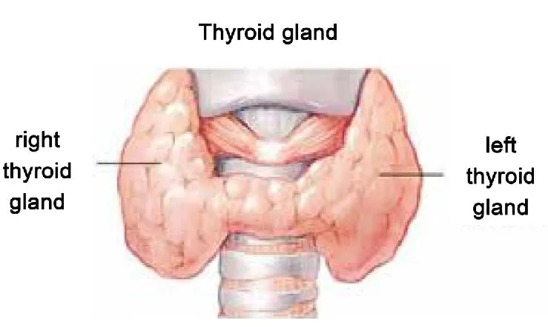
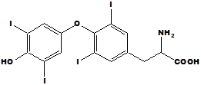
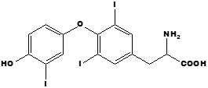
Thyroid hormones
L-thyroxine
In 1914 Kendall isolated a single compound from the thyroid glands of cattle, which he named thyroxine. The chemical structure of thyroxine was determined in 1926-1927. Harington and Barcher, who proved that it was l- 3,5,3',3'-tetraiodothyronine.
3,5,3'-triiodothyronine
In 1951-53, a number of scientists isolated another hormone, l-3,5,3'-triodothyronine, which is 5 times more active than thyroxine, from human blood and bovine thyroid glands: 3,5,3'-triiodothyronine.

Slide 11
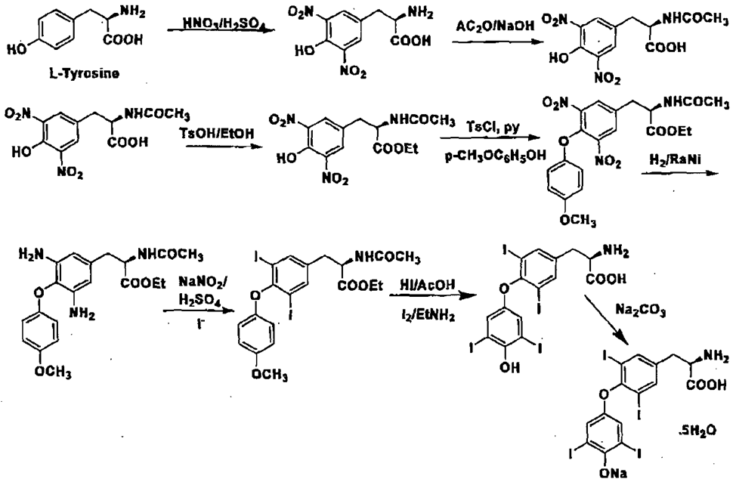
Levothyroxine sodium
Obtaining

Slide 12
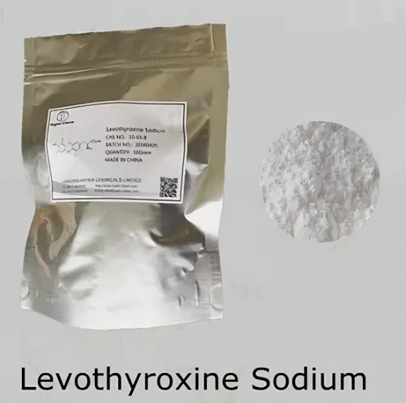
Levothyroxine sodium
Physical properties
An almost white or slightly coloured powder, or a fine, slightly coloured, crystalline powder; odourless. Levothyroxine sodium may contain a variable quantity of water of crystallization; anhydrous levothyroxine sodium is hygroscopic.
Very slightly soluble in water; slightly soluble in ethanol; practically insoluble in acetone and ether. It dissolves in solutions of alkali hydroxides.

Slide 13
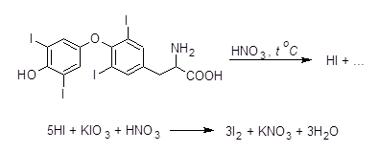
Levothyroxine sodium
Identification
Detection of organically bound iodine
2. Interaction with sodium nitrite in the presence of hydrochloric acid
Dissolve in a mixture of ethanol and about hydrochloric acid, add sodium nitrite and allow to stand for 15 minutes or heat for 2–3 minutes in a water-bath; a yellow solution is produced. Cool and add ammonia to make the solution alkaline; the colour changes to red.

Slide 14
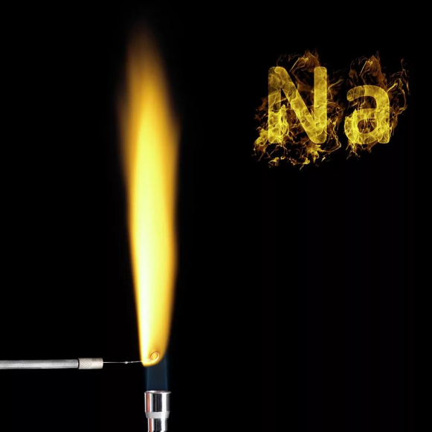
Levothyroxine sodium
Identification
3. HPLC
Identity in tablets is established by HPLC by comparing the retention times of the two peaks of the test and standard solutions. They should agree to within +2%.
4. Determination of sodium
The sodium cation forms a yellow crystalline precipitate with zincuranyl acetate

Slide 15
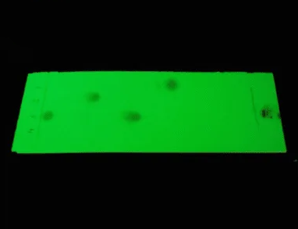
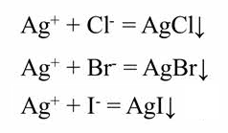
Levothyroxine sodium
Purity test
1. Specific optical rotation
= +16.0° to +20.0°.
2. Loss on drying
Dry to constant weight at 105 °C; it loses not less than 60 mg/g and not more than 120 mg/g.
3. Liothyronine
Used Thin-layer chromatography
4. Soluble halides

Slide 16
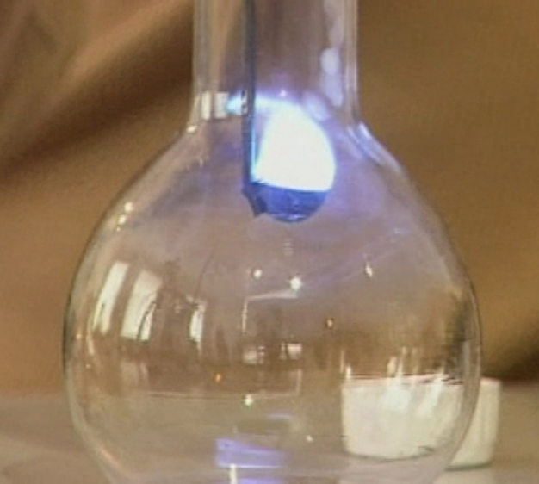
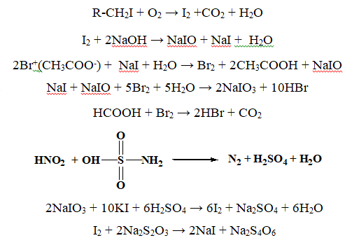
Levothyroxine sodium
Assay
The iodine content is quantified by burning in a flask with oxygen, as in the identity test. Iodine bound to the organic part of the molecule is oxidised by oxygen:

Slide 17
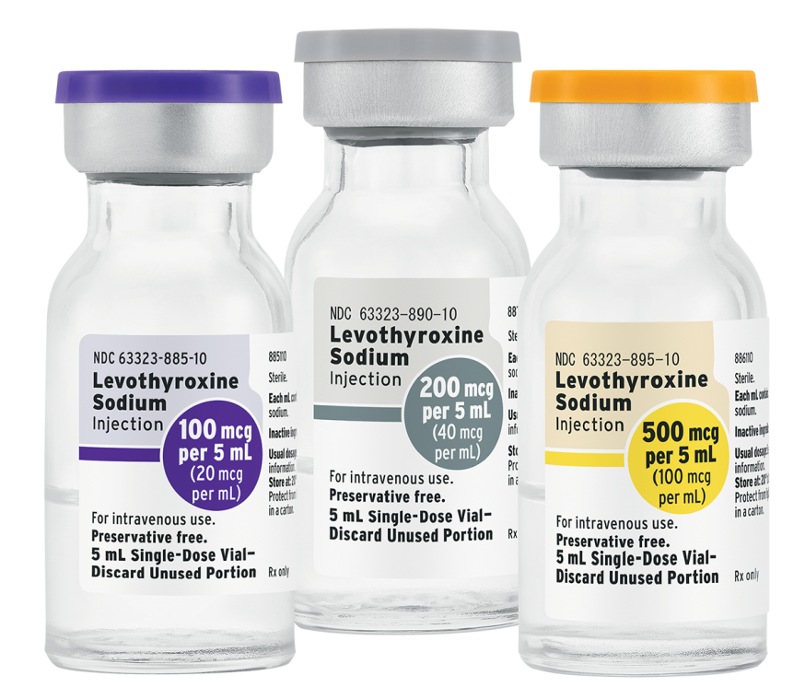
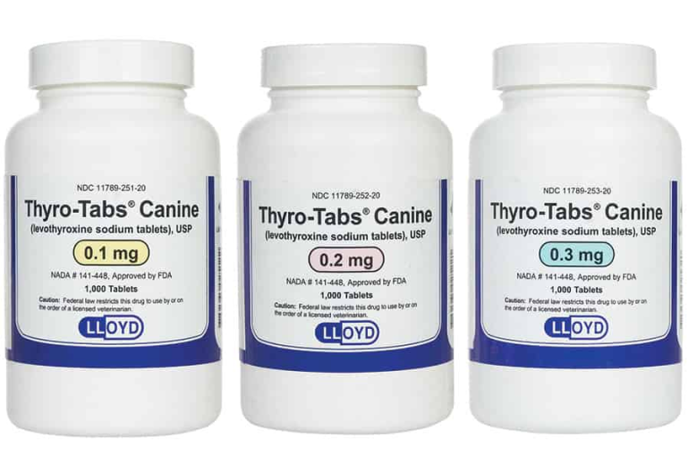
Levothyroxine sodium
Storage
Levothyroxine sodium should be kept in a tightly closed container, protected from light.
Medical use
Hypothyroidism of various genesis deficiency of thyroid hormones, benign goitre. Thyroid cancer (after removal of the thyroid gland). As part of complex therapy: Graves' disease, autoimmune thyroiditis, thyroid function suppression test.

Slide 18
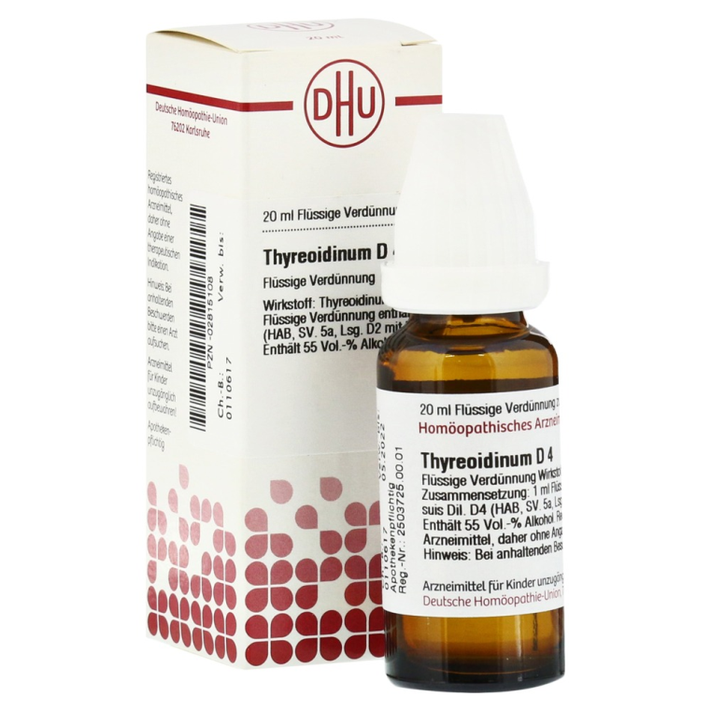
Thyroidine
Obtaining
Thyroidine is obtained by grinding the defatted and dried thyroid glands of slaughtered cattle. It is a substance insoluble in water and other solvents and contains mainly the hormones l-thyroxine and l-3,5,3'-triiodothyronine.
Physical properties
Thyroidine (Thyreoidinum) is a yellowish grey powder with a faint odour characteristic of dried animal tissues. It is insoluble in water, alcohol and other solvents. The content of bound iodine in the medicinal product is 0.17 - 0.23%.

Slide 19
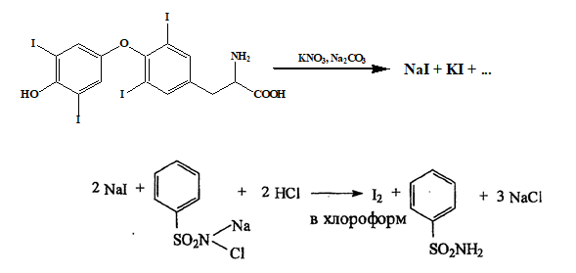
Thyroidine
Identification
Detection of protein in thyroidin
Protein is detected by the formation of a yellow colour after boiling thyroidine in sodium hydroxide solution. Subsequent addition of dilute sulphuric acid discolours the solution and a colloidal precipitate falls out.
2. Detection of organically bound iodine

Slide 20
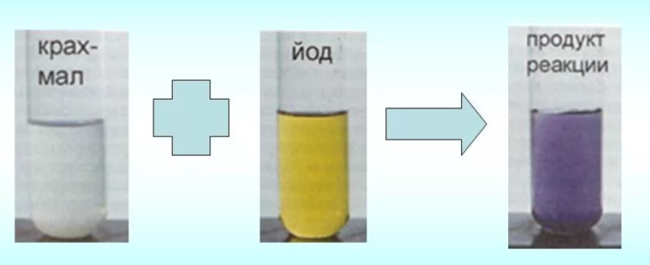
Thyroidine
Identification
3. Oxygen flask method
A starch solution with added sulphamic acid is used as the absorbent liquid. Sulphamic acid binds nitrites formed during the combustion of the protein part of the molecule:
The iodine released when the drug burns gives the starch a characteristic blue colour. This method can detect not only iodine but also nitrogen and sulphur in thyroidine, elements that are part of the thyroglobulin protein.
4. HPLC
Identity in tablets is established by HPLC by comparing the retention times of the two peaks of the test and standard solutions. They should agree to within +2%.

Slide 21
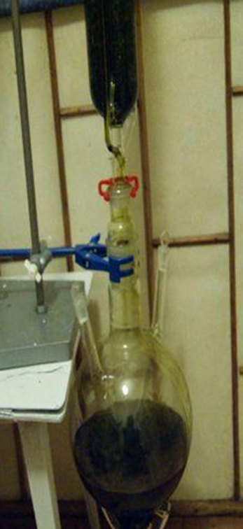
Thyroidine
Purity test
Fat impurities (not more than 2 %) are determined in thyroidine. The determination is carried out in a Zaichenko apparatus which allows quantitative extraction of fat from a thyroidine suspension placed in an extraction tube.
The iodide impurity is extracted with saturated zinc sulphate solution, then starch solution, 10% sodium nitrite solution and dilute sulphuric acid are added to the filtrate. No blue colour should appear.

Slide 22
Thyroidine
Assay
1. Oxygen flask method

Slide 23
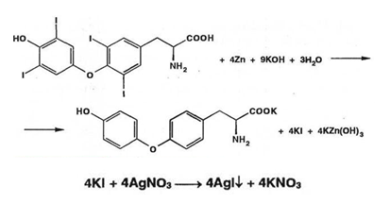
Thyroidine
Assay
2. Argentometry

Slide 24
Thyroidine
Assay
3. Determination of iodine after mineralisation with potassium permanganate

Slide 25
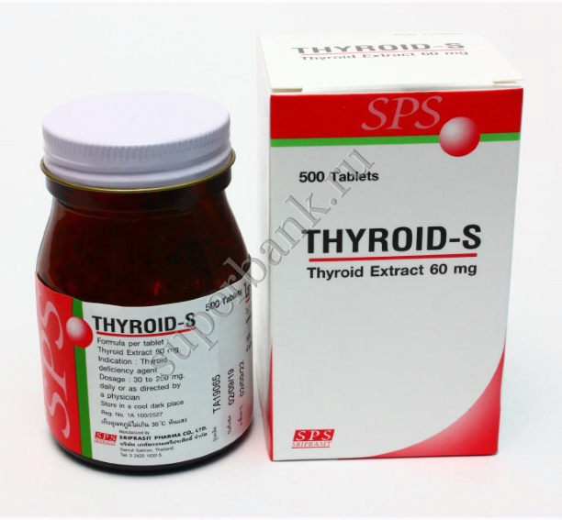
Thyroidine
Storage
In well-corked jars of dark glass, in a dry, cool place to prevent decomposition with the formation of iodides.
Medical use
Thyroidine is an anti-hypothyroid drug. It is used to treat hypothyroidism leading to conditions such as myxedema, hypothyroidism, cretinism, obesity, sporadic or endemic goiter, etc.

Slide 26
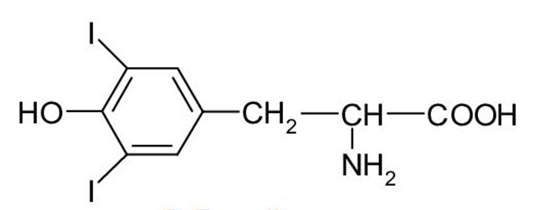
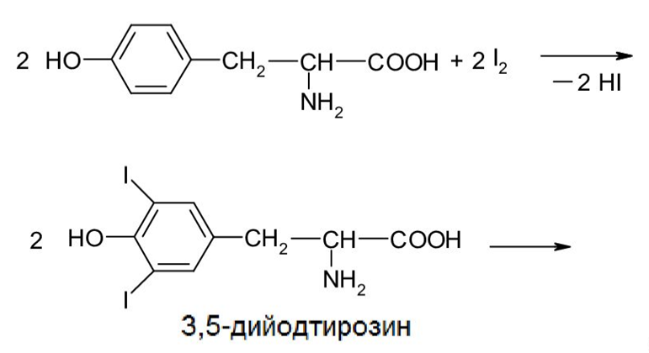
Antithyroid agents: diiodotyrosine
White or white with a slight greyish tinge, crystalline powder, odourless, slightly bitter taste, melting point 196-202 ° (with decomposition), slightly soluble in water and alcohol, practically insoluble in ether, benzene and chloroform, freely soluble in dilute alkalis and acids.
In the body, the biosynthesis of this hormone is from tyrosine and iodine:

Slide 27
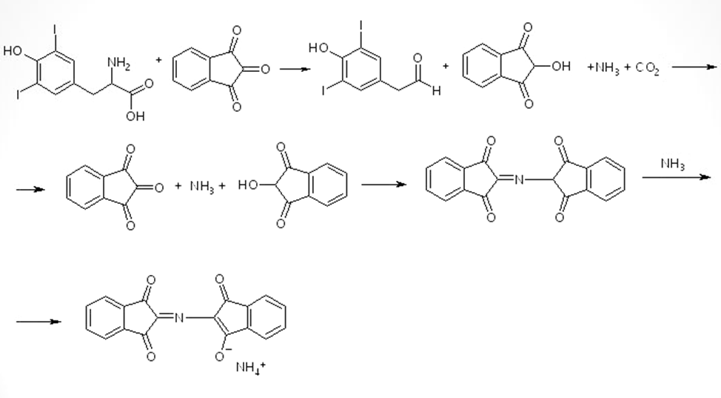
Antithyroid agents: diiodotyrosine
Identification
IR and UV spectrophotometry
2. Reaction with ninhydrin

Slide 28
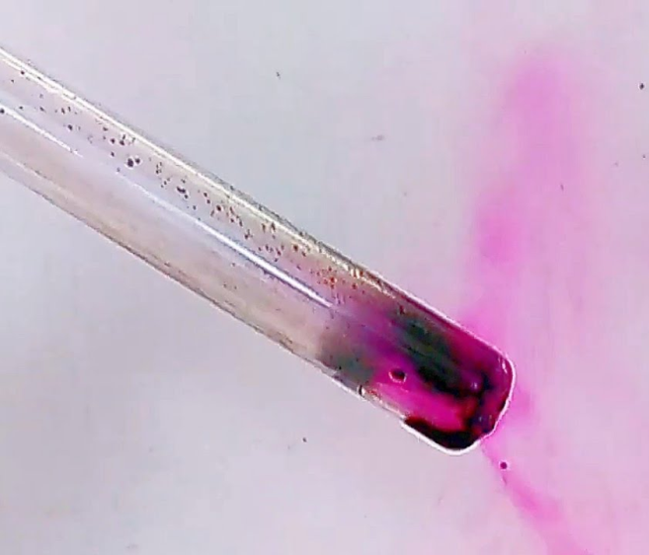
Antithyroid agents: diiodotyrosine
Identification
3. Interaction with concentrated nitric acid in the presence of sulphuric acid
If a few drops of concentrated nitric acid are added to a solution of the drug in dilute sulphuric acid, an orange colour appears.
4. Heating
When the drug is heated, violet iodine vapours are released.

Slide 29
Antithyroid agents: diiodotyrosine
Purity test
1. Free iodine is detected. The drug is shaken with chloroform. The latter should not be coloured violet.
The drug must be free from tyrosine. Dissolve the drug in caustic soda solution, add Millon's reagent (a solution of HgNO₃ and Hg(NO₃)₂ in dilute HNO₃ with an admixture of HNO₂) dropwise until the precipitate formed dissolves and heat for a few minutes; no red colour should appear.
3. Halogens, sulphates and heavy metals must be within the reference standard.
4. The loss in mass on drying and sulphate ash are determined.

Slide 30
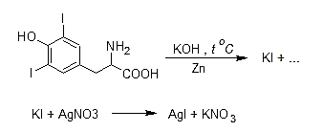
Antithyroid agents: diiodotyrosine
Assay
Argentometry

Slide 31
Antithyroid agents: diiodotyrosine
Storage
In tightly closed containers, away from light, in a dry place.
Medical use
Inhibits the synthesis of thyroid hormone by the pituitary gland according to the feedback principle. Combined treatment of hyperthyroidism (thyrotoxicosis) and basalgia, together with methylthiouracil. Methylthiouracil directly inhibits the production of thyroid hormone, and the thyroid function of the pituitary gland enhanced by methylthiouracil is inhibited by diiodotyrosine, which eliminates the hyperemia, hyperplasia and hypertrophy of the thyroid gland associated with treatment with methylthiouracil (strumogenic effect of methylthiouracil). Treatment of dermatoses in patients with hyperthyroidism.

Slide 32
Thank you for attention!

