Slide 1
«Special pharmaceutical chemistry»
Chromane and phenylchromane vitamins
Associate Professor Gureeva E.S.

Slide 2
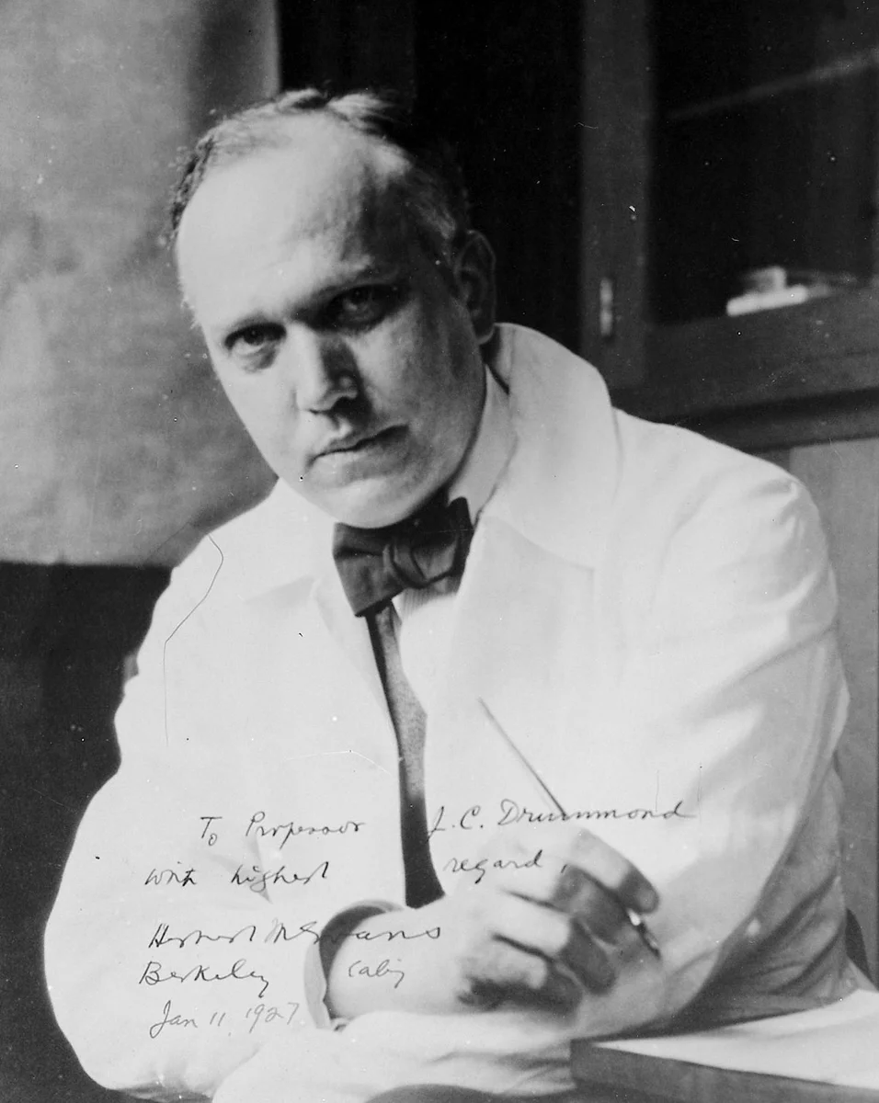
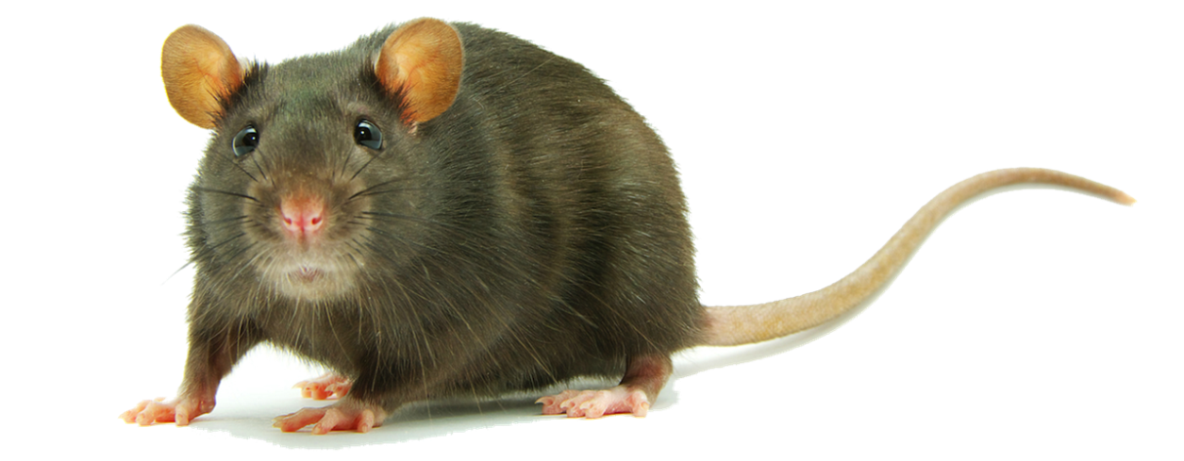
Chromane vitamins. Tocopherols
History of discovery
The discovery of vitamin E in 1922 was made quite by accident by Herbert Evans and Catherine Scott Bishop.

Slide 3
Chromane vitamins. Tocopherols
History of discovery
In 1931, Mattill and Olcott described the antioxidant function of vitamin E.
In the same year, it was discovered that vitamin E deficiency causes muscle failure and encephalomalacia.
In 1936, α-tocopherol was first isolated by Evans. The name tocopherol (from the Greek τόκος "offspring, procreation" and φέρω "bearing") was proposed by J. Calhoun.
In 1938, the chemical structure of α-tocopherol was described and Paul Karrer was able to synthesize it.
The first therapeutic use of vitamin E was conducted in 1938 by Wiedenbauer, who used wheat germ oil as a supplement for 17 premature newborn infants suffering from growth disorders. Eleven of them recovered and were able to resume normal growth rates.

Slide 4
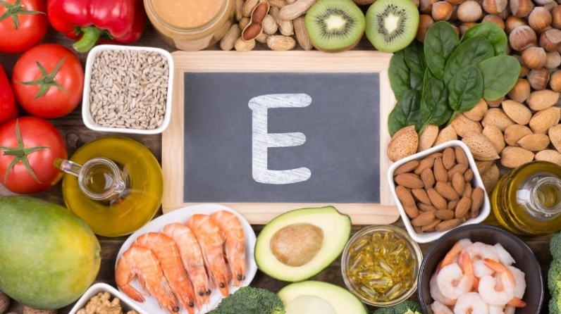
Chromane vitamins. Tocopherols
Sources of vitamin E
The best plant sources of vitamin E include: green peas, wheat and rye germ, soybeans, beans, green salad, lentils, oats, corn, soybean, olive oil.
Animal products also contain some vitamin: animal fat, meat, beef liver.

Slide 5
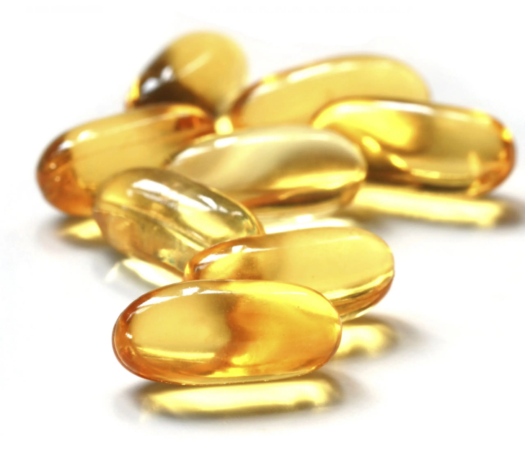
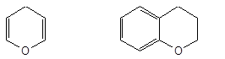
Chromane vitamins. Tocopherols
Structure of vitamin E
Chromane
(benzo-γ-dihydropyran)
γ-pyran
2-methyl-2-(4', 8', 12'-trimethyltridecyl)-6-oxychromane

Slide 6
Chromane vitamins. Tocopherols
Structure of vitamin E
5
7
8
Tocopherols | Position
 | 5 | 7 | 8
α-Tocopherol | –CH₃ | –CH₃ | –CH₃
β-Tocopherol | –CH₃ | – | –CH₃
γ-Tocopherol | – | –CH₃ | –CH₃
ζ-Tocopherols | –CH₃ | –CH₃ | –
8-Methyltocol (δ-Tocopherol) | – | – | –CH₃
5-Methyltocol (ε-Tocopherol) | –CH₃ | – | –
7-Methyltocol (η-Tocopherol) | – | –CH₃ | –

Slide 7
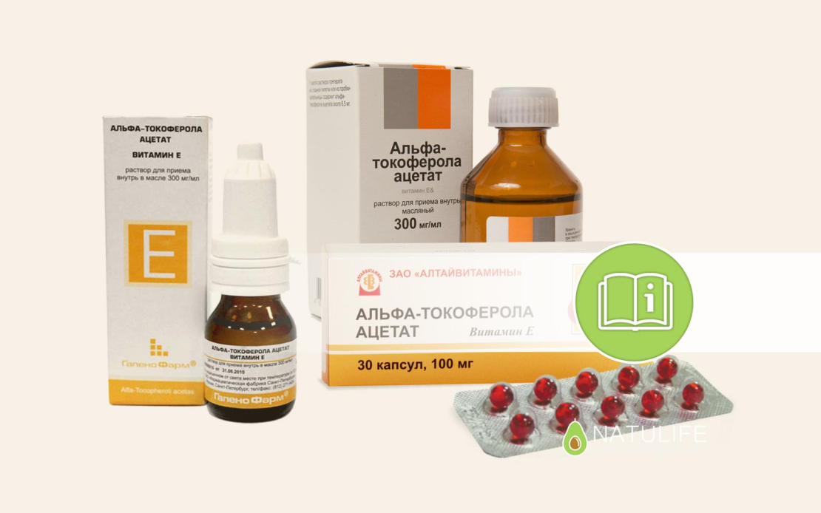
Chromane vitamins. Tocopherols
Tocopherol acetate

Slide 8
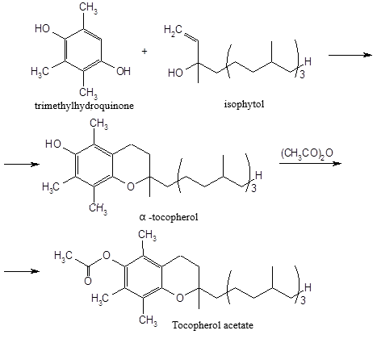
Chromane vitamins. Tocopherols
Tocopherol acetate
Obtaining
Physical properties
Colorless or light yellow transparent, viscous, oily liquid with a faint odor. Under the influence of light and air it turns yellow. Refractive index 1.4950-1.4985
Practically insoluble in water, easily soluble in ethanol, very easily soluble in ether and vegetable oils.

Slide 9
Chromane vitamins. Tocopherols
Tocopherol acetate
Identification
1. Infrared spectroscopy
2. UV spectrophotometry
3. Alkaline hydrolysis followed by detection of acetic acid
fruity smell

Slide 10
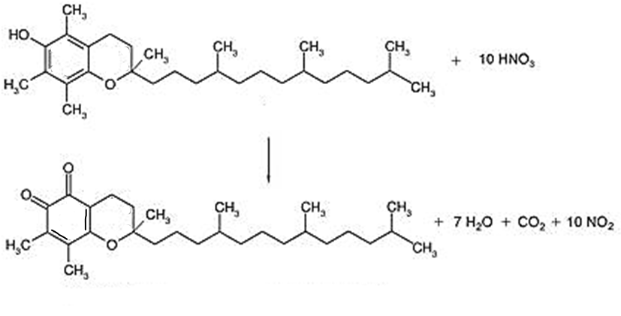
Chromane vitamins. Tocopherols
Tocopherol acetate
Identification
4. Interaction with concentrated nitric acid on heating
red-orange colored o-tocopherylquinone

Slide 11
Chromane vitamins. Tocopherols
Tocopherol acetate
Identification
5. Interaction with ferric chloride.
yellow

Slide 12
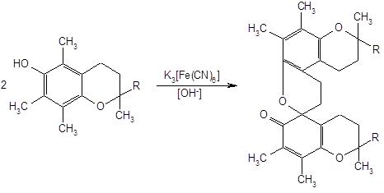
Chromane vitamins. Tocopherols
Tocopherol acetate
Identification
6. Interaction with potassium hexacyanoferrate in alkaline medium
7. Interaction with a reagent containing iron (III) chloride and α,α-dipyridyl in a mixture of ethanol and benzene.
A red coloration appears, having a maximum of light absorption at a wavelength of 500 nm.

Slide 13
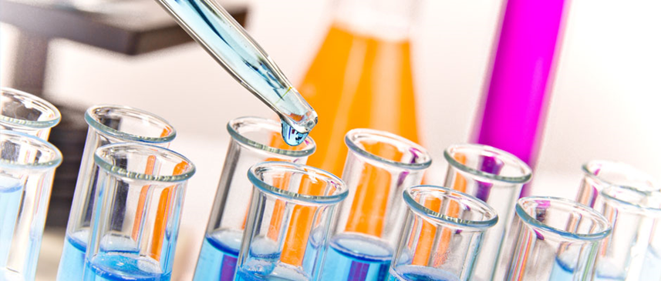
Chromane vitamins. Tocopherols
Tocopherol acetate
Purity test
When testing for purity determine the transparency, color of the solution, acid number (not more than 0.5 from a sample of 2.0 g).
Determine the sum of extraneous impurities (up to 1%) and impurity α-tocopherol (not more than 4%) by HPLC.
Detection of the total content of impurities is performed at a wavelength of 210 nm, and α-tocopherol - at 292 nm. Calculations are made by comparing the peak areas of the test substance and the state standard sample of tocopherol acetate.

Slide 14
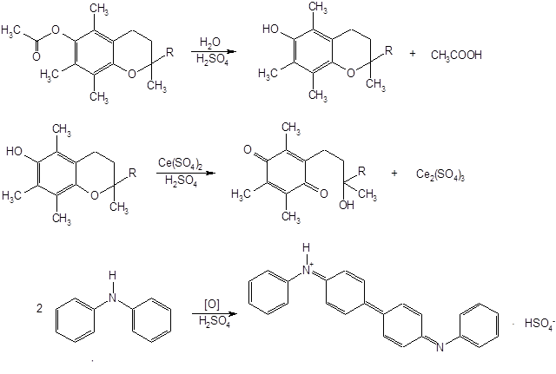
Chromane vitamins. Tocopherols
Tocopherol acetate
Quantification
1. Cerimetry

Slide 15
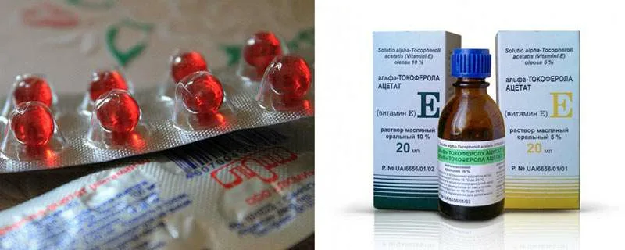
Chromane vitamins. Tocopherols
Tocopherol acetate
Quantification
2. Gas-liquid chromatography
This method is used to quantify tocopherol oil solutions
3. HPLC
Storage
During storage it is necessary to take into account the influence of UV radiation. Tocopherol acetate is stored in hermetically sealed, filled to the top in dark glass jars in a cool place protected from light (at a temperature not exceeding +10°C).

Slide 16
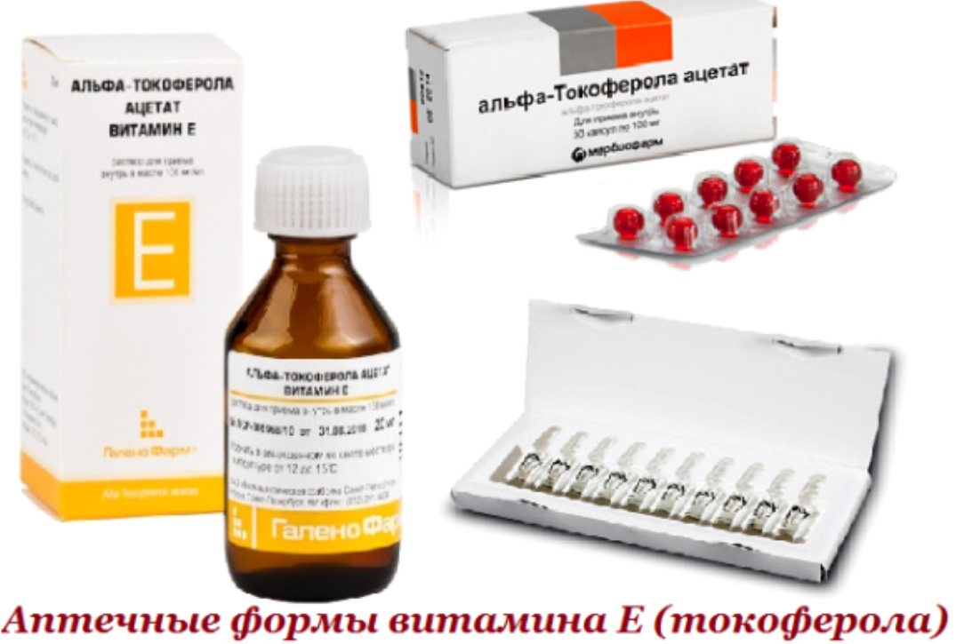
Chromane vitamins. Tocopherols
Tocopherol acetate
Medical use
Tocopherol acetate is used in the form of solutions in oil 5, 10 and 30% for ingestion and intramuscular injection. It is prescribed for diseases of the neuromuscular system, peripheral vessels, atherosclerosis, threatened abortion, dysfunction of the sex glands in men and other diseases.

Slide 17
Phenylchroman vitamins.
Bioflavonoids (P vitamins).
In 1936, Saint-Georgie, studying natural extracts of vitamin C (lemons, red pepper), found that in the treatment of patients with scurvy, they are much more effective than synthetic ascorbic acid. Hence it was concluded that natural preparations of vitamin C contain some other substance, the presence of which is necessary to manifest the full effect of ascorbic acid.
This substance affects the state of capillary blood vessels, their fragility, permeability, in connection with which it was called "vitamin permeability", or vitamin P, from the Latin word permeabilitus, which means "to penetrate". Lack of vitamin P in the body causes painful phenomena - pitting hemorrhages. From red pepper and citrus fruits, a yellow crystalline substance, citrine, which has the effect of vitamin P, has been isolated.

Slide 18
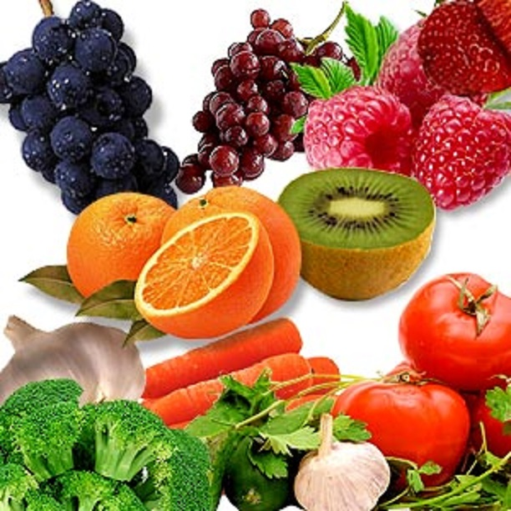
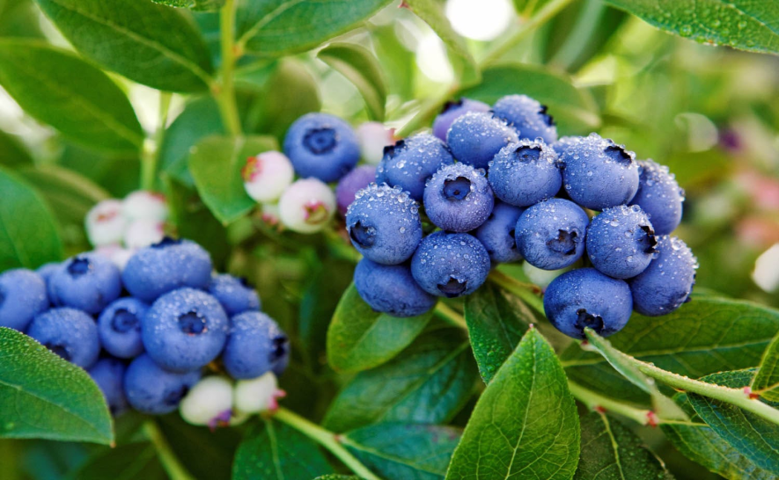
Phenylchroman vitamins.
Bioflavonoids (P vitamins).
Structure of flavanoids
flavan

Slide 19
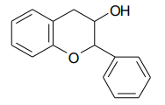
Phenylchroman vitamins.
Bioflavonoids (P vitamins).
Groups of flavan derivatives are of interest for medicine
1. 3-Oxy derivatives of flavan (2 - phenylchroman) are catechins with tannin property:

Slide 20
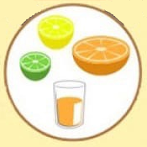
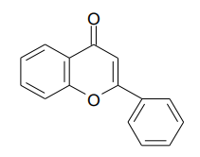
Phenylchroman vitamins.
Bioflavonoids (P vitamins).
Groups of flavan derivatives are of interest for medicine
2. Derivatives of 4 - oxoflavan (4 - oxo - 2 - phenylchroman) - Flavanones, which cause coloration of fruits and berries:

Slide 21
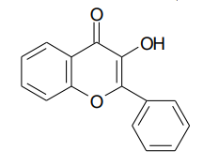
Phenylchroman vitamins.
Bioflavonoids (P vitamins).
Groups of flavan derivatives are of interest for medicine
3. The oxysubstituted flavones are flavonols:

Slide 22
Phenylchroman vitamins.
Bioflavonoids (P vitamins).
Rutin and quercetin

Slide 23
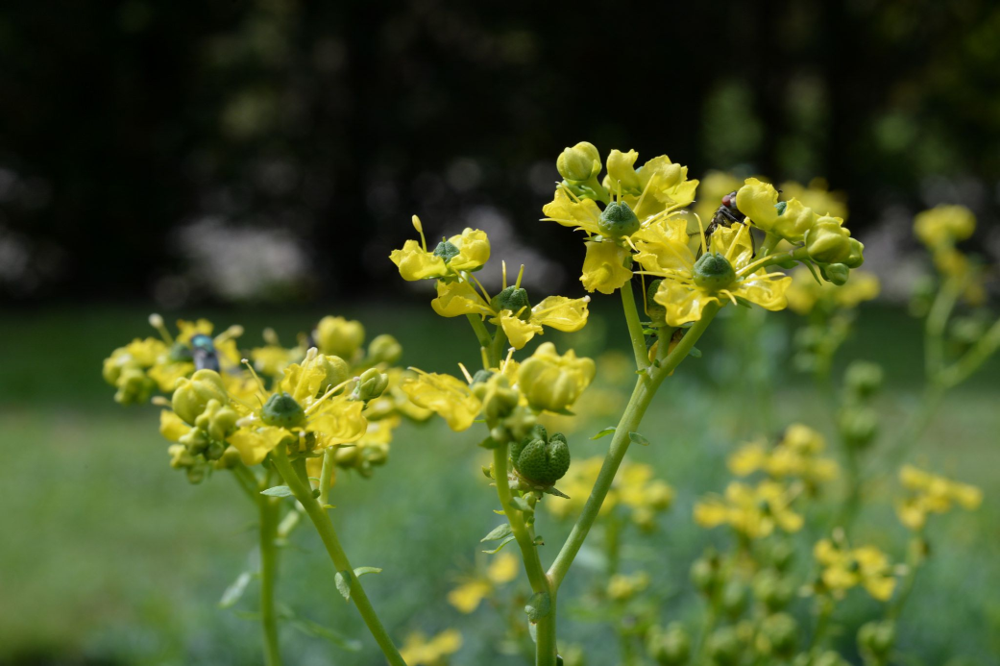
Phenylchroman vitamins.
Bioflavonoids (P vitamins).
Rutin was first isolated by the Nuremberg pharmacologist Weiss (1842) from a semi-shrubby plant of the ruta family (Ruta graveolems). Later, it was isolated from the green mass of buckwheat, where its content, depending on the variety of buckwheat, ranges from 1.5 to 6% of the dry matter. Rutin is also found in the leaves of Eucaliptus nacror (about 24% per dry matter) and in the leaves of the Chinese tree Sophorica japonica with a content of up to 44.5% per dry matter.
As a substance with P - vitamin activity rutin was recognized in medicine in 1944 and is used not only for the treatment of diseases associated with impaired capillary function, but also in the treatment of frostbite.

Slide 24
Phenylchroman vitamins.
Bioflavonoids (P vitamins).
Quercetin
Obtaining
1. Scheme of quercetin synthesis
2. Quercetin can be obtained from rutin by hydrolysis.

Slide 25
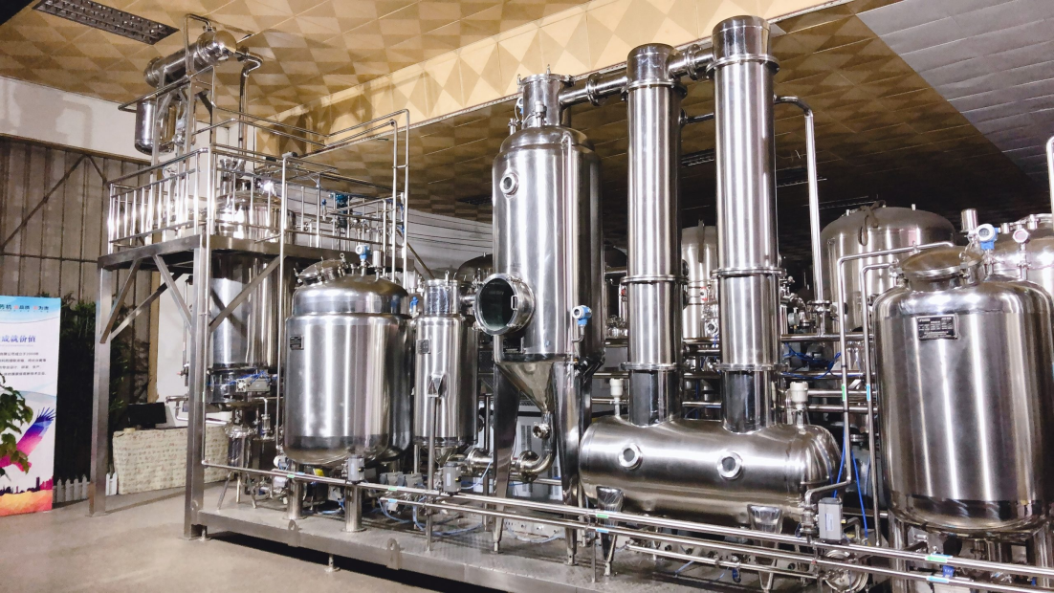
Phenylchroman vitamins.
Bioflavonoids (P vitamins).
Rutin
Obtaining
Rutin is extracted with water from plant material, then separate proteins by precipitation, and rutin recrystallized. When obtaining should be taken into account that rutin in an acidic environment, especially when heated, is easily hydrolyzed to form quercetin, rhamnose and glucose.

Slide 26
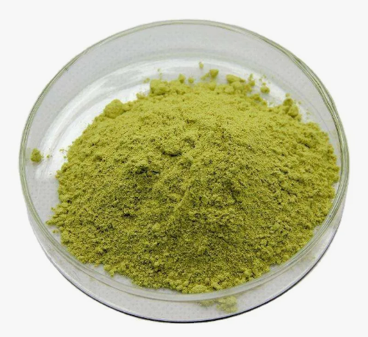
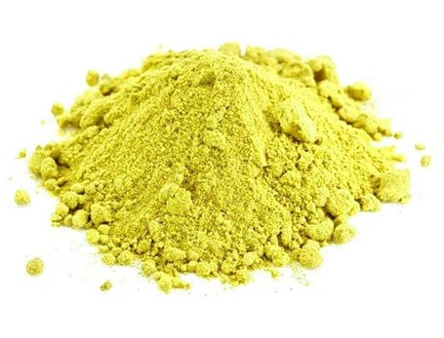
Phenylchroman vitamins.
Bioflavonoids (P vitamins).
Rutin and quercetin
Physical properties
Rutin is a greenish-yellow odorless fine-crystalline powder. Practically insoluble in water and chloroform, soluble in boiling ethanol. Being a polyatomic phenol, rutin is soluble in dilute solutions of caustic alkali.
Quercetin is a yellow, fine-crystalline, odorless powder. Practically insoluble in water and chloroform, slightly soluble in ethanol. Being a polyatomic phenol, quercetin is soluble in dilute solutions of caustic alkali.

Slide 27
Phenylchroman vitamins.
Bioflavonoids (P vitamins).
Rutin and quercetin
Identification
1. IR, UV spectrophotometry, PMR spectroscopy are used to test the authenticity of flavonoids.
2. Alkaline hydrolysis
yellow-orange coloring

Slide 28
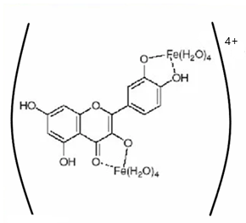
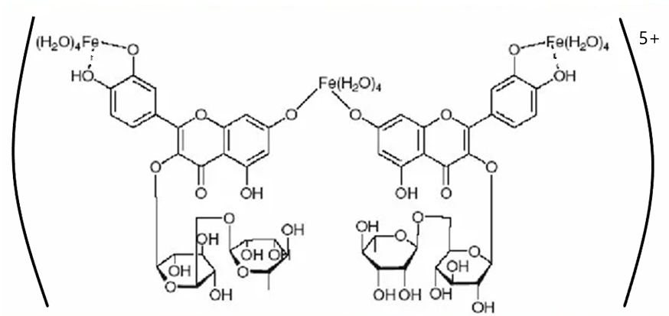
Phenylchroman vitamins.
Bioflavonoids (P vitamins).
Rutin and quercetin
Identification
3. Interaction with iron chloride
dark green coloring is formed, and with the subsequent addition of a few drops of alkali solution, the coloring of the solution changes to red-brown

Slide 29
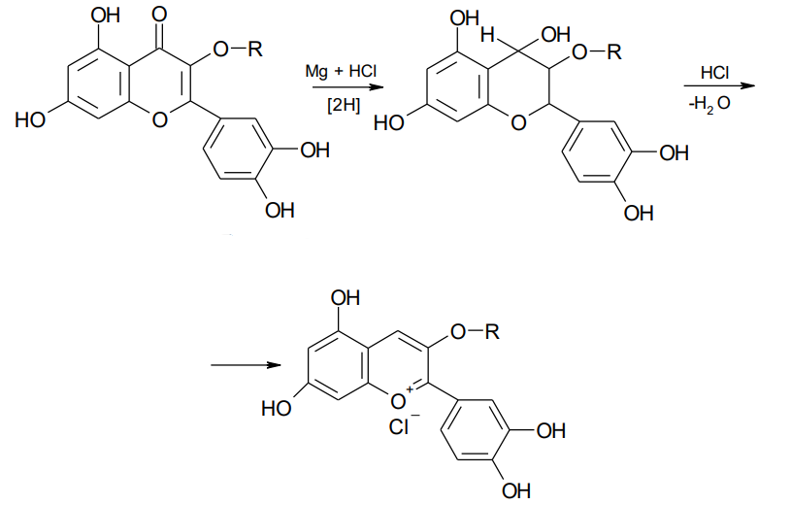
Phenylchroman vitamins.
Bioflavonoids (P vitamins).
Rutin and quercetin
Identification
4. Cyanine reaction
red

Slide 30
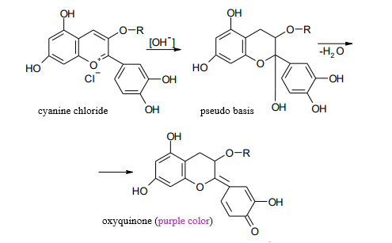
Phenylchroman vitamins.
Bioflavonoids (P vitamins).
Rutin and quercetin
Identification
5. Formation of oxyquinone and its salts

Slide 31
Phenylchroman vitamins.
Bioflavonoids (P vitamins).
Rutin and quercetin
Identification
6. Detection of sugars after hydrolysis
brick-red precipitate

Slide 32
Phenylchroman vitamins.
Bioflavonoids (P vitamins).
Rutin and quercetin
Identification
7. Formation of complex salts
yellow or orange precipitate

Slide 33
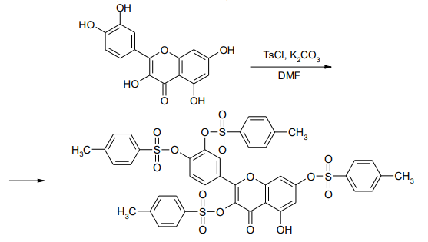
Phenylchroman vitamins.
Bioflavonoids (P vitamins).
Rutin and quercetin
Identification
8. Obtaining a tosyl derivative of quercetin
Yellow crystals of tetratosylflavone have a melting point of 191.5°C.

Slide 34
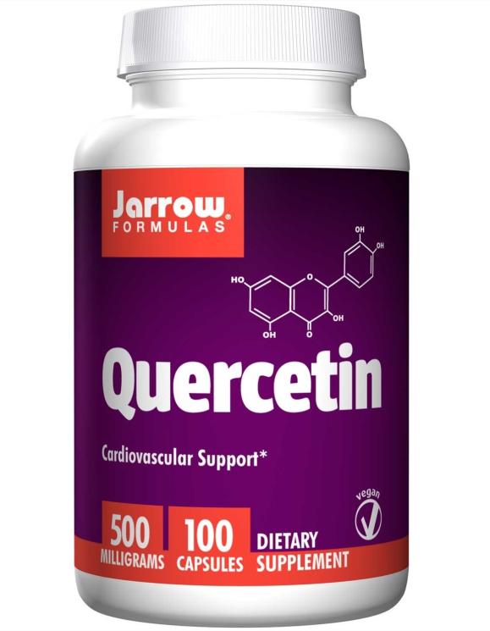
Phenylchroman vitamins.
Bioflavonoids (P vitamins).
Rutin and quercetin
Quantification
1. Spectrophotometric determination
2. Colorimetric determination.
The method is based on the reactions of
with alkali;
formation of colored complex compounds.
Storage
Rutin and quercetin are stored in well sealed containers, in a dry place, protected from light.

Slide 35
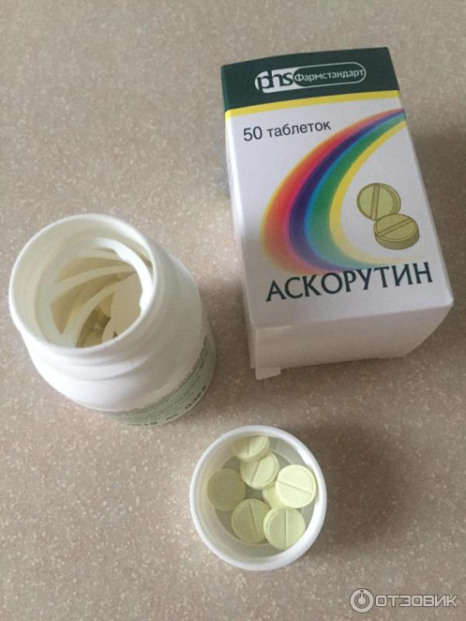
Phenylchroman vitamins.
Bioflavonoids (P vitamins).
Rutin and quercetin
Medical use
The main effect of rutin, especially in combination with ascorbic acid, is to resist capillaries and reduce vascular permeability.
In addition, it takes part in the oxidative-reductive processes of metabolism, normalizes the activity of the thyroid gland, enhances the effect of ascorbic acid and promotes its accumulation in various organs.
There is information about the favorable effect of rutin in radiation sickness. Often rutin is prescribed together with ascorbic acid.

Slide 36
Thank you for attention!

