Slide 1
Theme: Western rationalism (of XIX-XX centuries).
The Marxist philosophy.
The philosophy of Karl Marx formed in the course of German classic philosophy. From the passion to Hegel’s ideas Marx drifted to passion of Feuerbach’s philosophy and then propounded original ideas. He worked out the theory, which was new more high form of materialism.
5 May 1818 – 14 March 1883

Slide 2
Marx realized the joining of materialism and dialectics. Thus materialist dialectics appeared, which, according to Marx, regards ideal «as material that was transplanted in human head and transformed in it».
Marx tried to substantiate the objectivity of the process of development of matter and being. As to human thought, it is the transformation of material. And material object as itself is considered from the point of view, of practically acting concretely-historical man with his needs.

Slide 3
The philosophy of man, philosophic anthropology is a centre around which is built the system of Marx reflections.
According to Marx, the social aspect is the most important in man.
Proceeding from that, Marx formulates his conception of social life and history. He insists on materialistic interpretation of social life and history. Marx explains that society is the system of stable relations between people. The stability of relations in society forms in the process of subject human activity. This activity is connected with the use of articles, which are created by one man for others.

Slide 4
After the study of real history, Marx came to a conclusion that changes of social relations depend on objective laws of human activity. This laws are connected with the character and division of labour between individuals with the development of material forces and means, reproducing human life as itself. Therefore, the essence of social relations, society, history is material and production relations (relations of property and relations of distribution) are most important in them.
Marx formulated his conception of human essence as totality (total combination) of all social relations.

Slide 5
Human creature becomes man only in the process of assimilation by him culture (material and spiritual). The interpretation of human essence as totality of all social relations is methodological principle for clarification of mechanism of human becoming as personality (socialization).
Formational theory of K.Marx:
Primitive society.
Slave-own society.
Feudal society.
Capitalist society.
Communistic society.

Slide 7
Marx investigated the condition of man in the middle of 19-th century and distinguished estrangement as the most characteristic feature of it. There are four aspects of estrangement in capitalist society:
Estrangement from the object of labour. Mechanized production as distinct from the craft industry, demands from worker only separate operations and it separates him from final goal, that is from the product of labour. The meaningless, execution of operations leads to situation, when the product transforms in something alien, inimical. The product of labour holds dominant position over man and gains an influence over him. Thus estrangement appears, which concerns all participants of production.

Slide 8
Estrangement from the process of labour. Mechanized production transforms worker in part, small screw, in executor of certain set of functions (operations). There is no creation in this work. Therefore labour becomes for man not a goal, but means for earnings and appears for worker, as alien, inimical sphere. According to Marx, man can find his essence only in labour. The essence of man is his social, family characteristics. “Family” man is the creative man. All world is potentially object of his transforming activity, his creation.

Slide 9
Estrangement of man from his family essence.
When man hasn’t possibility to work creatively, he tries to find himself in other forms of activity, which are connected with directs needs of man (meal, drinking, amusements). Norms of morals, political ideals, religious dogmas, legal laws becomes alien, demanding submission. The development of human personality as unique individuality is impossible in this conditions.

Slide 10
Estrangement of man from man. Standardization of man in capitalist society leads to the situation, when in respect of other man there is no notion about his value as personality. Another man is regarded either as rival or as subordinate or as boss, that is as means for achievement own goals.

Slide 11
Marx saw the cause of estrangement in private property and considered, that estrangement will disappear after the abolition of private property and man will become free, creative creature. He will pass from the “kingdom of necessity” to the “kingdom of freedom”.
However, achievement of such state is the matter of indefinite future. The modern being is another. In this being, according to Marx, working class, proletariat, the most humiliated and destitute acts. The being of proletariat is the maximum estranged being. Its activity is activity of despair. Capitalism deprived proletariat of all, deprived it of its family essence. But that is why proletariat is able to become liberator of mankind. Although this last idea of Marx now seems the most disputable, it should be borne in mind, that ideas of German thinker exercised and continue to exercise immense influence on philosophic thought.

Slide 12
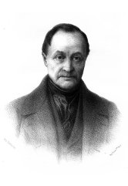
Positivism. Early positivism (O. Comte, H. Spencer, J.S. Mill).
The increase of role of science in the life of society generated new philosophic theory – positivism in the middle of 19-th century. This term was introduced by French philosopher and sociologist O. Comte. According to positivism, only concrete sciences (mathematics, physics, chemistry, biology) and their synthetic combinations can be the source of true, positive knowledge.
O. Comte
1798-1851

Slide 13
Positivism as itself, which rise and evolution are connected with the development of scientific knowledge exists and as independent philosophic theory and as world outlook of researchers in the field of natural and exact sciences and in the field of psychology, history, sociology, ethics and aesthetics too.

Slide 14
There are some main features of positivism.
1. Pretensions of traditional philosophy with its search of beginnings and causes, supernatural substances, standing beyond the limits of possibilities of experimental knowledge are unfounded.
2. Only the world of phenomena must be investigated.

Slide 15
3. Philosophy can preserve status of science, if it will change its subject and become special activity in service of science either as generalization of scientific knowledge or as the logic of science.
4. The process of cognition is the single subject of philosophy as severe science. This process is unified, homogeneous; therefore the employment of scientific methods is possible not only in study of nature, but of society and of human being. Science is not only the model of human cognition, but the main means of reorganization and improvement of life.

Slide 16
O. Comte divided all human history and accordingly philosophy into three stages:
At the first, theological stage, all phenomena were regarded as the objects of influence of supernatural forces.
At the second, metaphysical stage, all in the world was explained through action of some abstract origins.
At third, positive stage, man is not interested in the origin of world; he bases his reasonings only on observations.
Philosophy becomes an instrument for regulation of science, the way of revealing of general laws for all sciences, which can be used in the study of society.

Slide 17
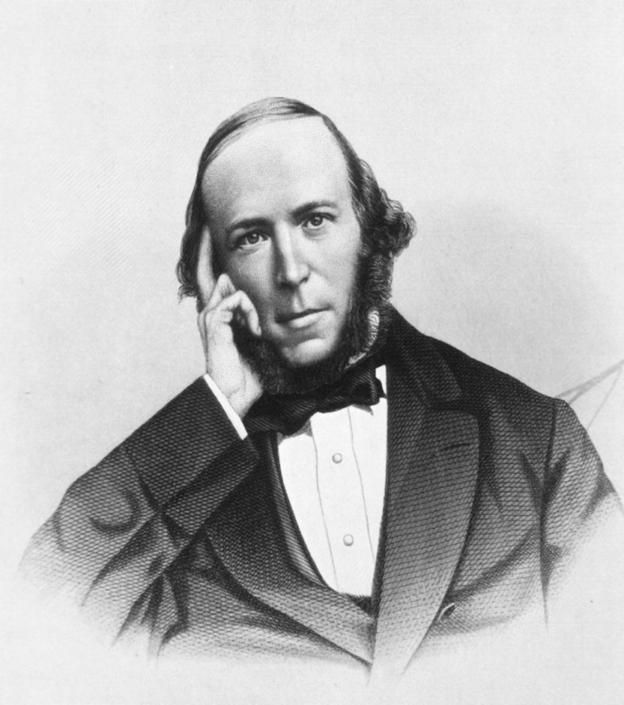
Herbert Spencer saw the tasks of philosophy in unification of knowledge, in revealing general interests, forming the basis of all sciences. Such general principles, in Spencer’s opinion are the principles of eternity of matter and movement power resistance. If to see generalization through, then the most general principle is the principle of changing of everything that exists.
H. Spencer
1820-1903

Slide 18
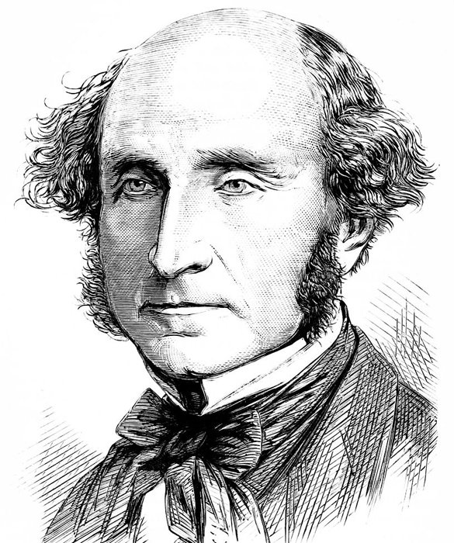
The third philosopher of early positivism John Stuart Mill considered inductive logic as the main instrument of scientific philosophy. English thinker tried to defend original existence of logic, proved absence of close connections between logic and traditional metaphysics. Mill criticized metaphysical interpretation of lucidity and simplicity of theory. The simplicity of scientific theory is not connected with that some “first essence” reveals itself in this theory obviously. The simplicity of theory is its logical characteristic consistency of deducing one statements from other.
J.S. Mill
1806-1873

Slide 19
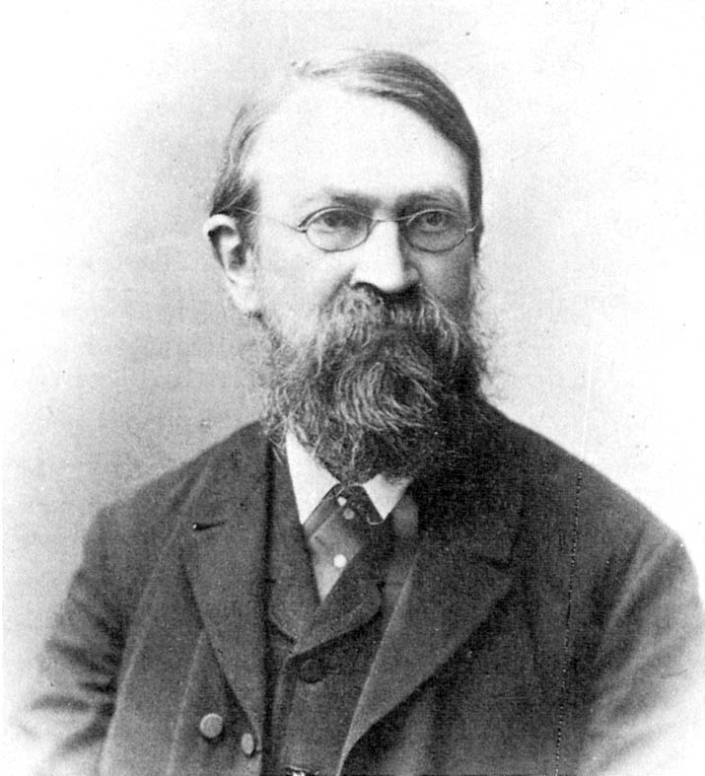
Second positivism (R. Avenarius and E. Mach)
The founders of so-called “second positivism” R. Avenarius and E. Mach approved of the idea about abolition of old metaphysics about change of position of philosophy in culture. But they also saw the task of philosophy in determination of principles of regulation phenomena in the consciousness of researcher.
The term “empiriocriticism” which was introduced by Avenarius, literally means the critique of experience. The latter is the facts of world fixed in human consciousness by means of affirmations statements.
E. Mach
1838-1916

Slide 20
To reveal the features of understanding of experience can so-called “principled co-ordination”. That is the man with his system and environment form real unity of experience.
According to empiriocriticism, philosophy must cleanse experience from fruitless dreams unnecessary products of mental activity (statements about substance and soul).
Experience is a certain fitnessing complex. It must be monolithic. And then its action will be effective. The principle of the least spending of forces is the main principle, which philosophy must use, as the critique of experience, as the activity in purge of experience.

Slide 21
The principle of the least spending of forces directs to cumulative model of the development of scientific knowledge, supposing uninterrupted grown of knowledge its constant increase. Cumulativism is connected with interpretation of scientific knowledge as description of facts. This conclusion was made by Mach, who proposed another name for indicated principal.
Нe called it the principle of economy of mentality.

