Slide 1
Lecture 13
PHYLUM

Slide 2
MEDICAL ARAHNOENTOMOLOGY
is a division of medical parasitology that studies the morphology, ecology of representatives of the type of Arthropods, which have medical significance
Arthropods have medical interest due to the fact that some representatives of this type are:
✓ human ectoparasites;
✓ intermediate hosts of human parasites;
✓ carriers of vector borne pathogens;
✓ poisonous animals.

Slide 3
Medical interest of Arthropods
is due to the fact that some representatives of this type are:
human ectoparasites;
intermediate hosts of human parasites;
vector of causative agents of diseases;
poisonous animals.

Slide 4
General characteristics
Body is triploblastic.
Bilaterally symmetrical.
They have haemocoel. Coelom (i.e. body cavity) is filled with blood or fluid.
Body have jointed legs. (There may be 3 pairs, 4 pairs, 5 pairs, many pairs).
Body is covered with chitinous exoskeleton.

Slide 5
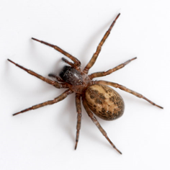
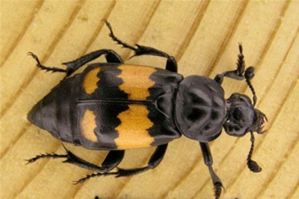
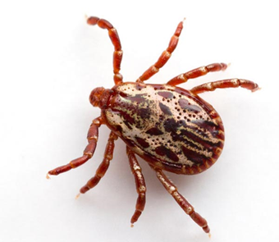
General characteristics
Body is divided into head, thorax and abdomen.
NOTE:
In some (crustacean and arachnida) body is divided into cephalothorax (head and thorax is fused) and abdomen.
Body may be undivided (ticks).

Slide 6
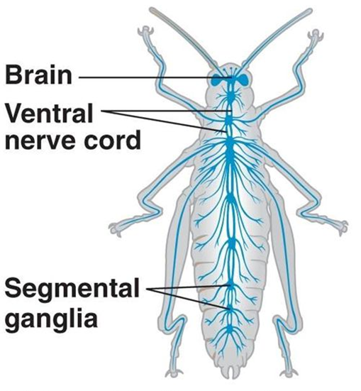
Nervous system consists of brain and ventral nerve cord. Sensory organ include antennae, sensory hairs for touch and chemoreceptor, simple and compound eyes, auditory organs and so on.

Slide 7
Circulatory system is of open type i.e. do not have blood vessels. The blood is colorless.
Respiration takes place by: gills (in Crustaceans) or trachea (in insects) or booklungs (Arachnida).

Slide 8
Digestive system is complete and well developed.
Mouth are modified for chewing, biting, sponging, piercing, siphoning.
Excretion takes place as a rule by means Malphigian tubules (in terrestrial form).
Sexes are separate.
Fertilization is internal or external.

Slide 9
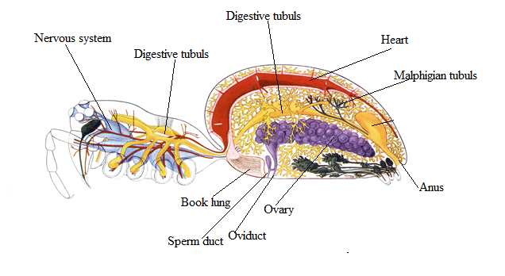
Internal structure of arthropods

Slide 10
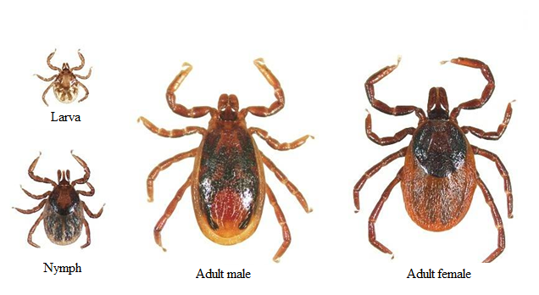
Life cycle (metamorphosis)
Incomplete metamorphosis: the intermediate stage (Nymph) resemble the adult stage (imago).

Slide 11
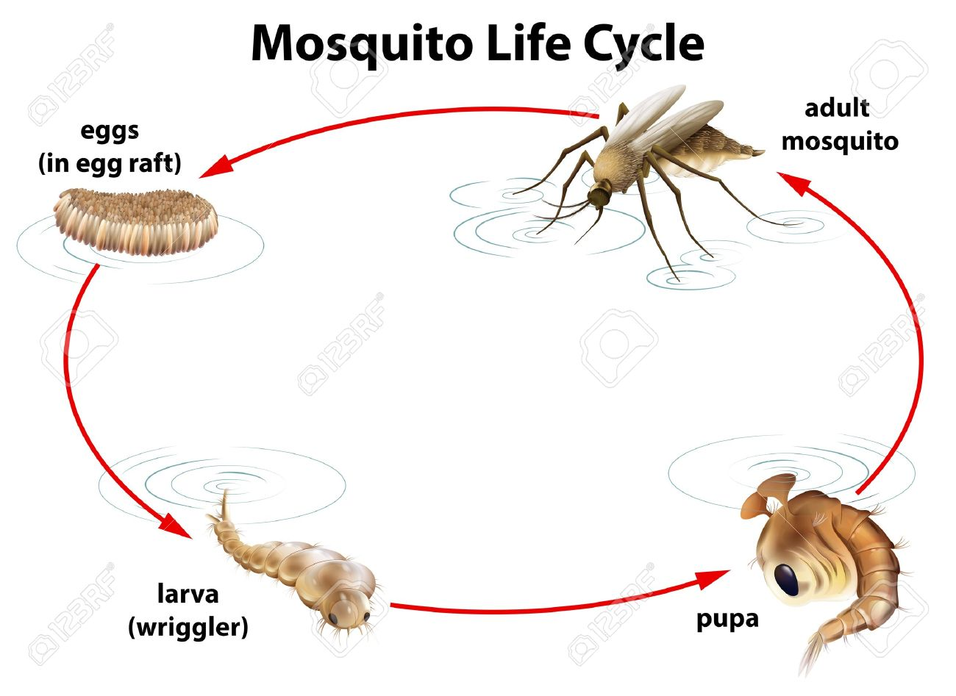
Life cycle (metamorphosis)
Complete metamorphosis: the intermediate stage (Larva and Pupa) differ from the adult stage.

Slide 12
Phylum Arthropoda includes 3 classes of medical importance:
CLASS CRUSTACEA (cyclops, crabs)
CLASS ARACHNIDA (scorpions, spiders, ticks, mites)
CLASS INSECTA (mosquitoes, flies, bugs, lice, fleas)

Slide 13
General characteristic of different classes of arthropods
 | CRUSTACEA | ARACHNIDA | INSECTA
Body | Cephalothorax, abdomen | Cephalothoracs, abdomen | Head, thorax, abdomen
Antennae | Two pairs | absent | One pair
Legs | 4 pairs | 4 pairs | 3 pairs
Wings | absent | absent | 1-2 pairs (sometimes absent)

Slide 14
Thank you for attention

