Slide 1
Lecture 14
PHYLUM Arthropoda
Class Insecta

Slide 2
General characteristics of Insecta
Body is divided into head, thorax (3 segments) and abdomen (8-9 or more segments);
Head carries one pair of antennae;
Thorax carries 3 pairs of legs;
Wings may be present or absent;
Metamorphosis may be complete or incomplete.

Slide 3
Class Insecta
includes 4 orders of medical importance:
Order Anoplura (Lice)
Order Sifonapthera (Fleas)
Order Hemiptera (bugs).
Order Diptera (mosquitoes and flies)

Slide 4
General characteristics of Anoplura
Body is flattened dorso-ventrally
Wingless
Short legs

Slide 5
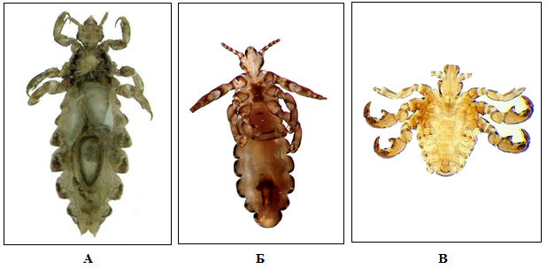
Order Anoplura
Pediculus humanus capitis (Head louse)
Pediculus humanus corporis (Body louse)
Phthirus pubis

Slide 6
Morphology
Size: 2-5 mm, male are smaller body is divided into a head, a thorax and an abdomen;
Head is conical and carries: 2 simple eyes; 2 five-segmented antennae; retractile proboscis lying in a sac.
Mouthpart is of piercing and sucking type in male and female;
Thorax: 3 segments fused together
Legs: 3 pairs of short legs
Abdomen: consists of 8 segments
Eggs (nits): oval, operculated (crown-like); 0. 8 mm; whitish;
Nymph: resembles the adult but smaller and sexually immature.

Slide 7
Differences between Lice
 | Morphology and life cycle |  | Medical importance
P.h.corporis |  | 3-5 mm, body is lighter Incomplete metamorphosis | Bloodsucking ectoparasite Causative agent of pediculosis Vector of causative agent of epidemic typhus
P.h. capitis |  | 2-3mm, body is darker Incomplete metamorphosis
P.pubis |  | 1-1,5 mm Incomplete metamorphosis | Causative agent of pediculosis

Slide 8
Life cycle
undergo incomplete metamorphosis:
egg – nymph - adult

Slide 9
The main mode of transmission of Head and Body lice:
contact with a person who is already infested
contact is common during play (sports activities, playgrounds, at camp, at school and at home.
wearing clothing, such as hats, scarves, coats, sports uniforms, or hair ribbons worn by an infected person;
using infested combs, brushes or towels;
lying on a bed, couch, pillow, carpet, or stuffed animal that has recently been in contact with an infected person may result in transmission.

Slide 10
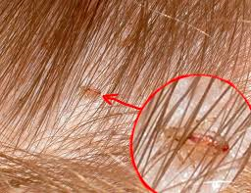
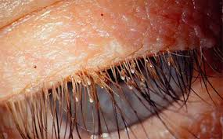
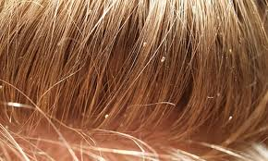
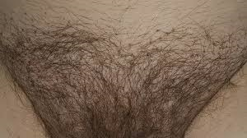
Pediculosis
Pathogenesis:
the majority of lice infestations (pediculosis) are asymptomatic.
itching, caused by an allergic reaction to louse saliva, and irritability.
A secondary bacterial infection may be a complication.

Slide 11
Prevention and control:
head examination among children;
keep your clothes and body clean;
keep public places like: hostels, hospitals, hair dresser’s clean.

Slide 12
Order Sifonapthera (Fleas)
Body is bilaterally compressed;
Body is divided into head, thorax and abdomen;
2-3 mm;
Wingless;
Proboscis is of piercing and sucking type;
Complete metamorphosis.

Slide 13
Order Sifonapthera (Fleas)
Pulex irritans (Humanʼs flea)
Ctenocephalis canis (Dogʼs flea)

Slide 14
Morphology
Size 2-3 mm;
Body is divided into a head, a thorax and an abdomen;
Head is round or angular and carries 2 simple eyes
Proboscis is of piercing and sucking type in male and female;
Thorax composed of 3 segments;
Legs - 3 pairs of strong legs;
Abdomen consists of 10 segments;
Eggs are oval with blunts ends. 0.5 mm. Pearly white;
Larva is worm-like, divided into a head, a thorax (3 segments) and an abdomen (10 segments). All segments carry backwardly-directed hairs.
Pupa is enclosed in a cocoon.

Slide 15
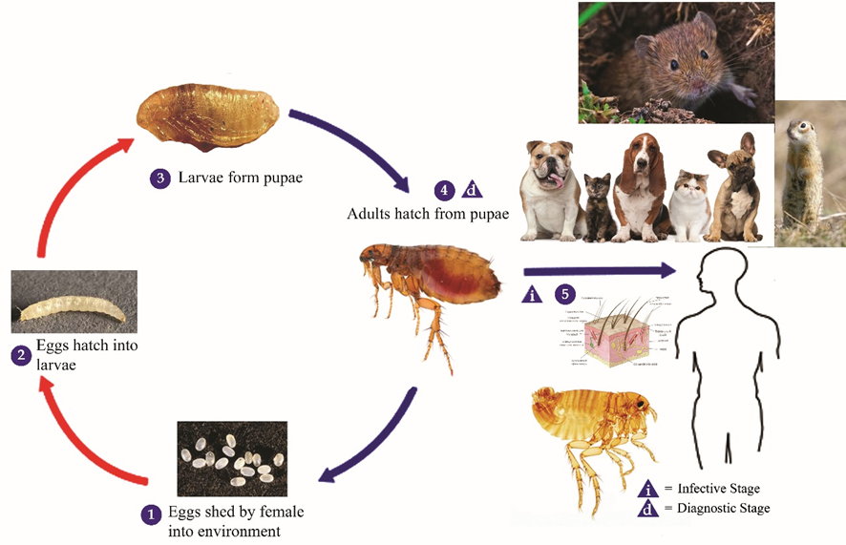
Life Cycle:
undergo complete metamorphosis:
Eggs – larvae – Pupae - Adult

Slide 16
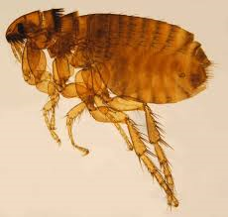
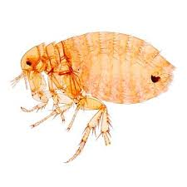
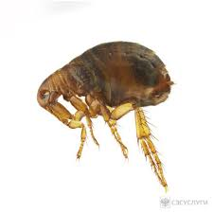
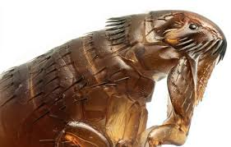
 | Humanʼs flea | Dogʼs flea
Morphology | Ctenidiums are absent | Ctenidiums are present
Medical importance | Vector of plague Vector of tularemia

Slide 17
Pathogenesis: bites of fleas causes itching and scratching with possible development of secondary (bacterial) infection.
Prevention and control:
Human flea: a) cleaning and dusting of dust from floor and carpets, b) application of insecticides and repellents (naphthaline);
Dog and cat flea: animals and their resting-places should be treated with insecticides.

Slide 18
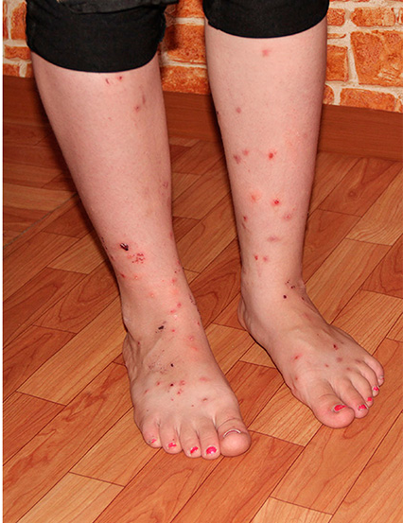
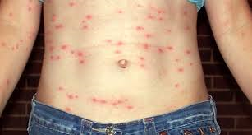

Slide 19
Order Diptera
Body is divided into head, thorax and abdomen;
Mesothorasic pair of wings;
Metathorasic pair of wings is modified into halters or balancers;
Mouthparts are sucking or piercing;
Complete metamorphosis.

Slide 20
Order Diptera
Includes two families of medical importance:
Family Culicidae (mosquitoes)
Family Muscidae (flies)

Slide 21
Family Culicidae (mosquitoes)
Three species:
Anopheles
Culex
Aedes

Slide 22
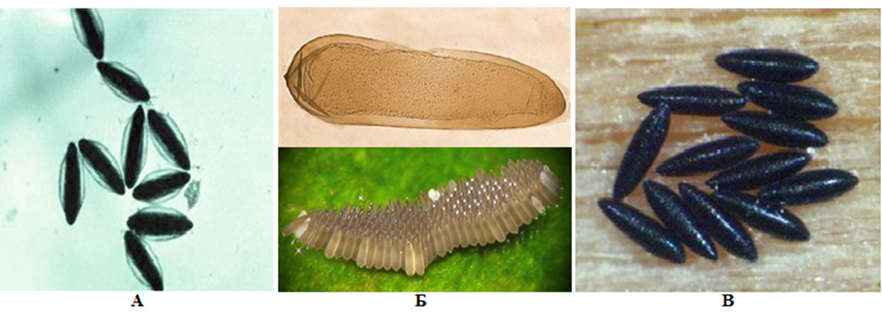
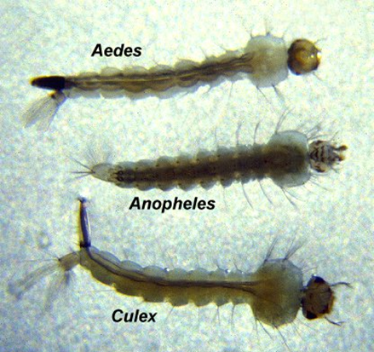
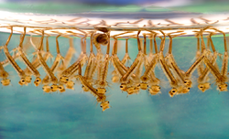
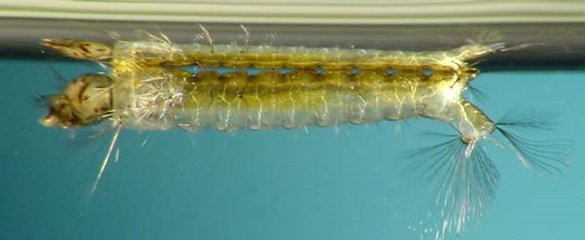
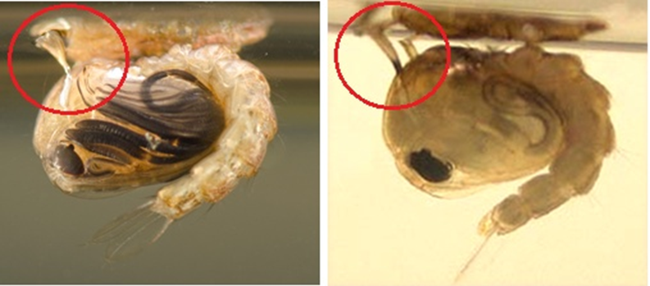
Differences between Anopheles and Culex
 | Anopheles | Culex
Egg | Air bags are present Located singly | Air bags are abesent Form “raft”
Larva | Respiratory syphon is abesent | Respiratory syphon is present
Pupa | Cone shaped respiratory tubules | Cylindrical shaped respiratory tubules

Slide 23
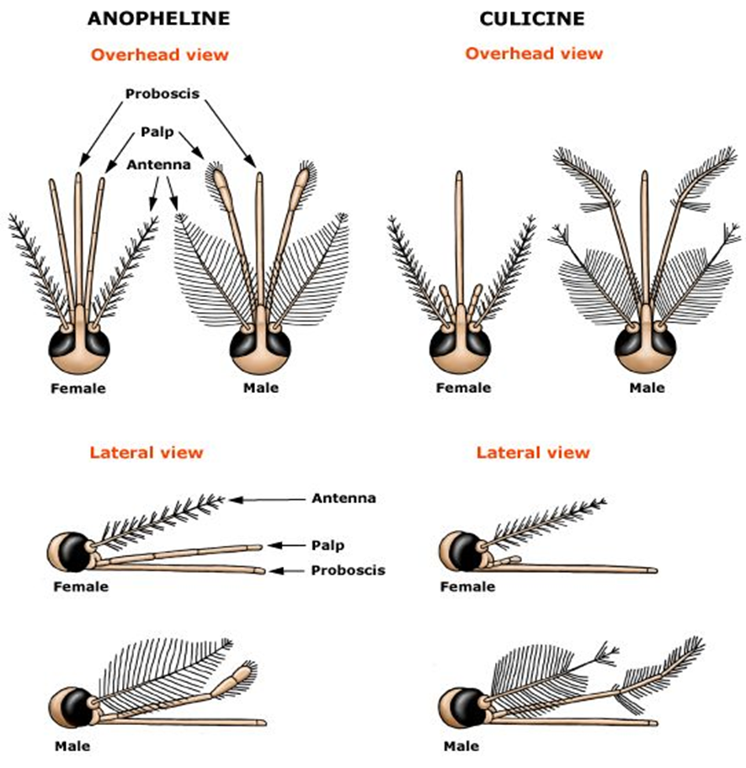

Slide 24
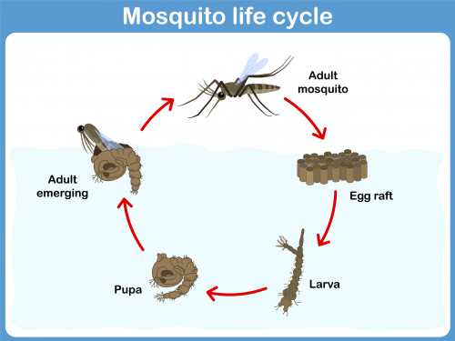
Life Cycle
undergo complete metamorphosis:
Eggs – larvae – Pupae - Adult

Slide 25
Medical importance of mosquitoes
Anopheles | Culex
Host of causative agent of malaria, Vector of microfilaria | Transmit causative agents of: filariasis Yellow fever, Dengue fever

Slide 26
Prevention and control:
Mechanical methods:
mosquito nets;
repellants; certain lotions or creams applied to the skin repel mosquitoes from biting e. g. citrgnella oil, Indalone;
animal barrier: placing farm animals between the breeding places and human habitations would deviate mosquitoes (particularly zoophilic) from biting humans.
Natural or physical methods (ecological interference):
changing the environment so as to become unsuitable for the mosquito e. g. filling or drainage of the breeding place;
changing water level, water current, pH.
Biological methods:
introduction of a natural enemy (predator):
a) fish (Gambusia affinis) feed on larvae and pupae;
b) release of sterilized males (X-ray or chemical agents) which compete with males in nature, mating with females, and resulting in reduction of the forthcoming generation.
Chemical methods (insecticides):
against adults (adulticides);
preventing aquatic stages.

Slide 27
Family Muscidae
Name | Medical importance
House fly | Mechanical vector of eggs of helminthes, cysts of protozoans; Different bacteria:
Tse-tse fly | Vector of trypanosomes
Sand fly | Vector of Leishmania
Wohlfahrtia magnifica | Larva is causative agent of myasis

Slide 28
Thank you for attention

