Slide 1
«General pharmaceutical chemistry »
SUBJECT AND TASKS OF PHARMACEUTICAL CHEMISTRY
SOURCES AND METHODS OF OBTAINING DRUGS
Associate Professor Gureeva E.S.

Slide 2
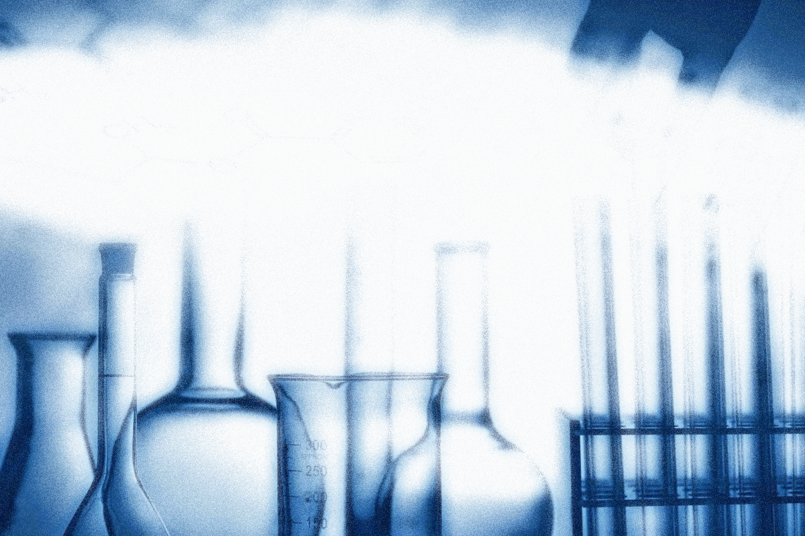
Pharmaceutical chemistry is a science that studies
the methods of obtaining,
structure,
physical and chemical properties of medicinal substances,
the relationship between their chemical structure and effects on the body,
quality control methods,
quantification methods of medicinal substances,
changes that occur during storage.

Slide 3
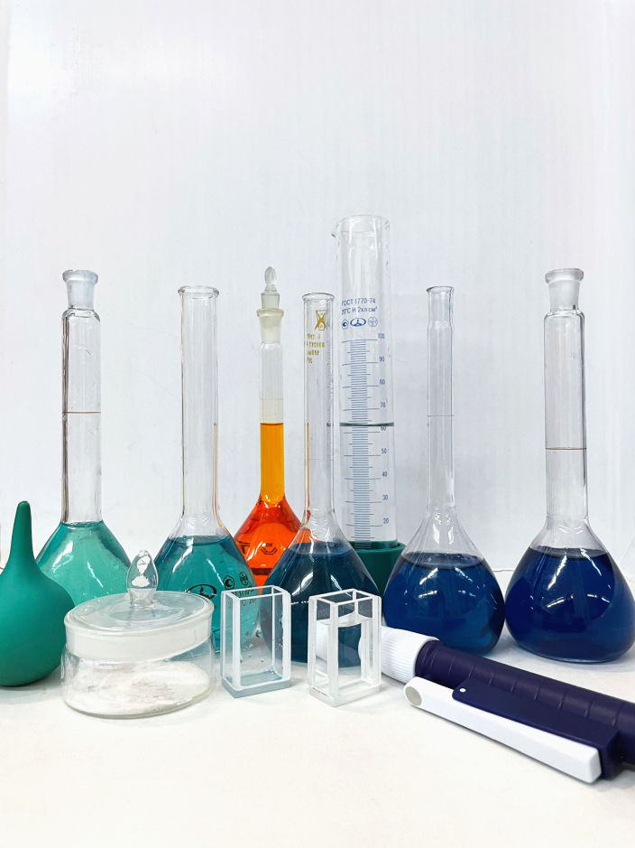
Tasks of pharmaceutical chemistry
1. Study of the chemical nature, composition and structure of medicinal substances.
2. Study of the relationship between the structure of the medicinal substance and its effect on the body.
3. Search and development of new medicinal substances.
4. Study of the physical and chemical properties of medicinal substances.
5. Development and study of drug quality and quantity control methods.
6. Determining the storage conditions for drugs.

Slide 4
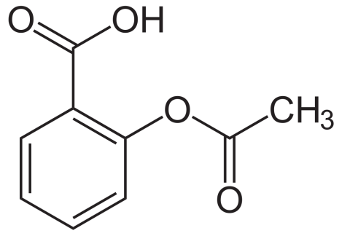
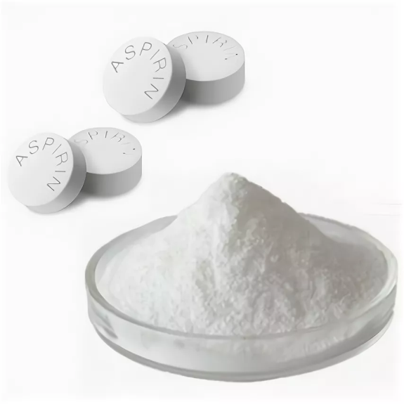
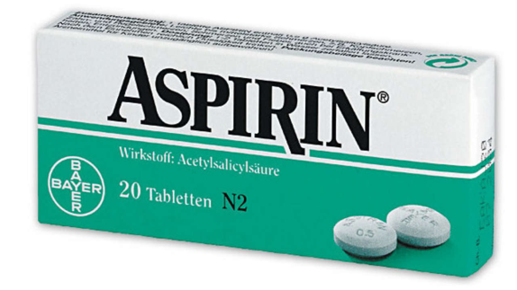
Pharmaceutical chemistry objects
Medicinal substance (MS) is an individual substance of plant, animal, microbial or synthetic origin with pharmacological activity. It is also called the active pharmaceutical ingredient (API). Substances are intended for obtaining medicines.
Dosage form (DF) - the physical manifestation of a product that contains the active ingredient(s) and/or excipient(s) that are intended to be delivered to the patient.
Pharmaceutical preparation (MP) is a dosed medicinal product in a specific dosage form and is ready for use.

Slide 5
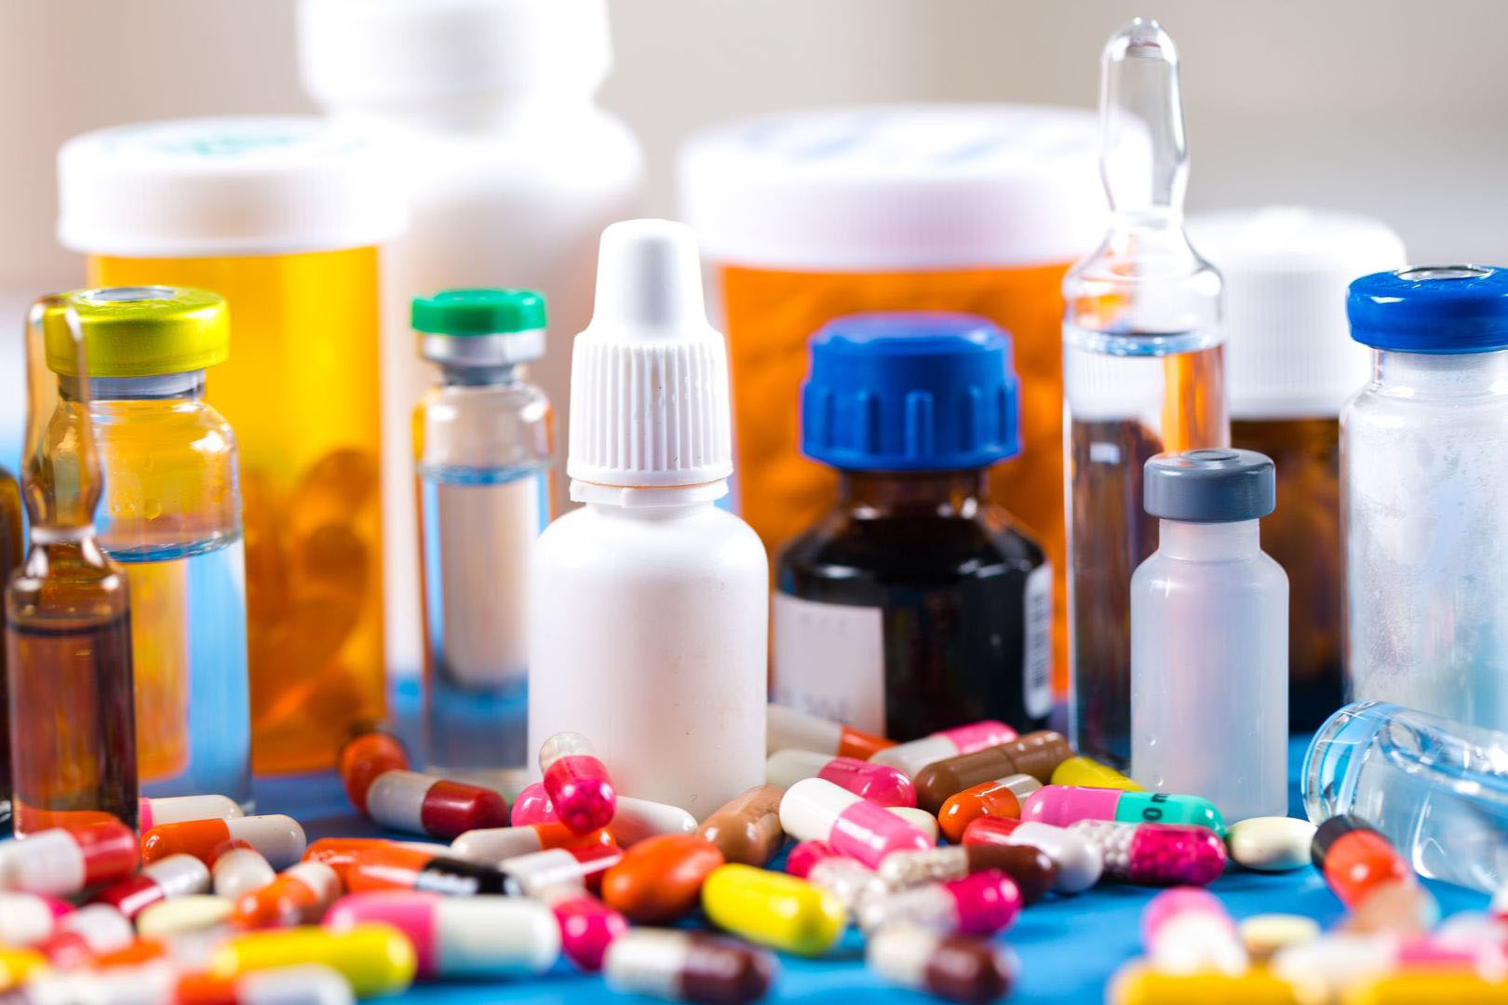
Classification of drugs
Drugs are classified according to
chemical structure,
pharmacological action,
therapeutic use,
anatomic therapeutic chemical structure (ATC),
mechanism of action at the molecular level.

Slide 6
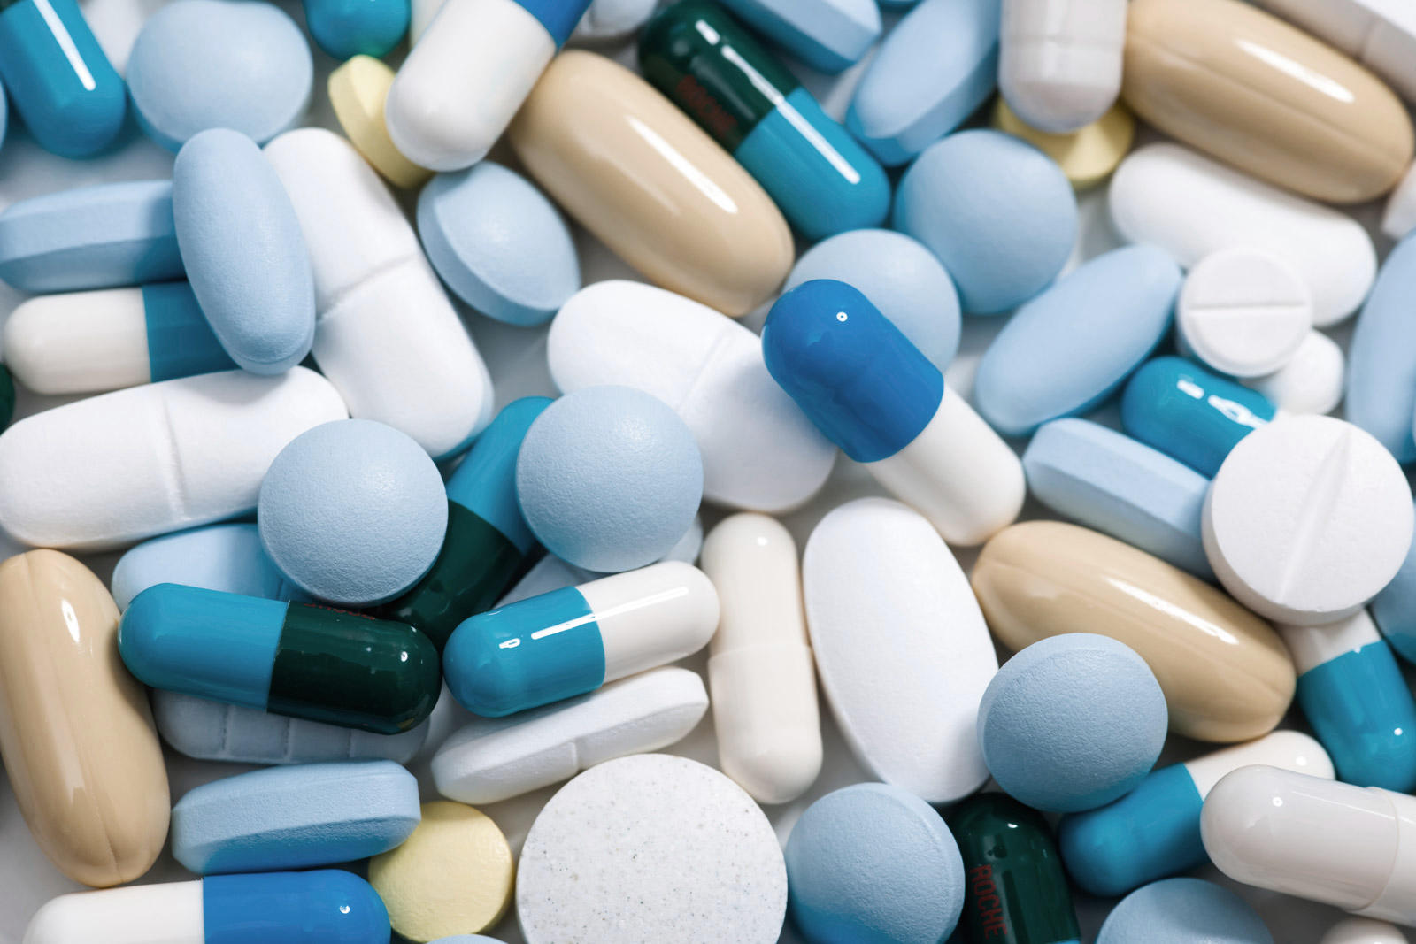
Classification of drugs
Pharmacological classification takes into consideration the mode of action of drugs. According to this criterion, WHO divided the known drugs into the following classes:
central nervous system depressants,
central nervous system stimulants,
peripheral nervous system drugs,
smooth muscle active drugs,
drugs acting at synaptic and neuroeffector junction sites,
histamine and anihistamines,
cardiovascular drugs,
gastrointestinal tract drugs and others.

Slide 7
Classification of drugs
Classification following the therapeutic use. Drugs are divided into the following classes:
central nervous system depressants,
central nervous system stimulants,
psychotropic drugs,
Peripheral nervous system drugs,
muscle relaxants,
spasmolytics,
vitamins,
anti-infectives, and other therapeutic uses.

Slide 8
Classification of drugs
Anatomic therapeutic chemical (ATC) classification is very useful system for clinicians, divides the drugs into 14 main “anatomic groups (first level), distinguished by letters:
A, alimentary tract and metabolism;
B, blood and blood-forming organs;
C, cardiovascular system;
D, dermatologicals;
G, genitourinary system and sex hormones;
H, systemic hormonal preparations, excluding sex hormones;
J, general anti-infectives, systemic;
L, antineoplastic and immunosuppressive drugs;
M, musculoskeletal system;
N, central nervous system;
P, antiparasitic products;
R, respiratory system;
S, sensory organs;
V, various.

Slide 9
Chemical classification of drugs
Chemical classification allows you to very clearly distribute all the drugs into groups and classes of compounds in accordance with their chemical structure. But in the same group there may be drugs with different pharmacological effects.
Drugs
inorganic
organic

Slide 10
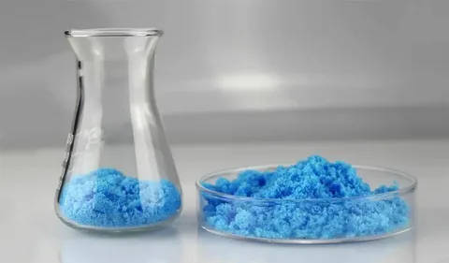
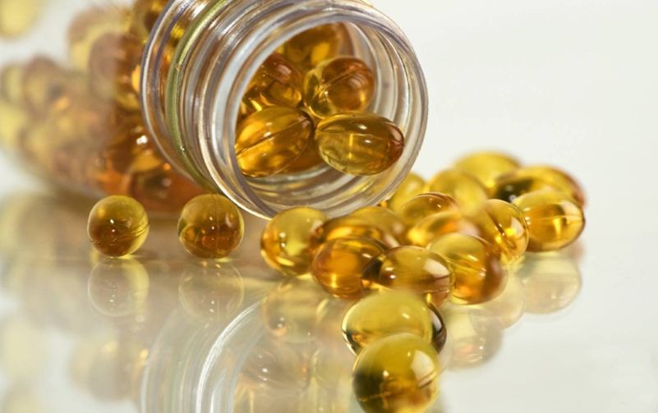
Chemical classification of drugs
Inorganic drugs are divided into main classes:
oxides (MgO, ZnO)
acids (HCl, H₃BO₃)
hydroxides (Mg(OH)₂)
salts (NaCl, Na₂S₂O₃)
complex compounds.
Organic drugs are classified according to two criteria:
the structure of a carbon chain or cycle
the types of the functional groups

Slide 11
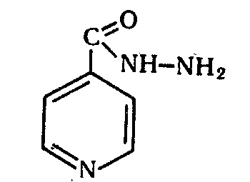
Chemical classification of drugs
Classification according to the types of the functional groups
Organic medicines are divided into:
halogen derivatives
alcohols
phenols
esters
aldehydes:
ketones
sulfonic acids
carboxylic acids and their derivatives
imines
oximes
hydrazones
semicarbazones
thiosemicarbazones.

Slide 12
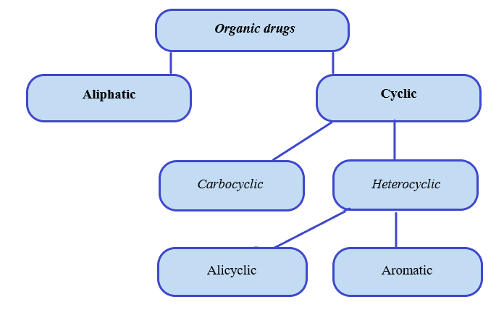
Chemical classification of drugs
Classification based on the structure of the carbon chain or cycle

Slide 13
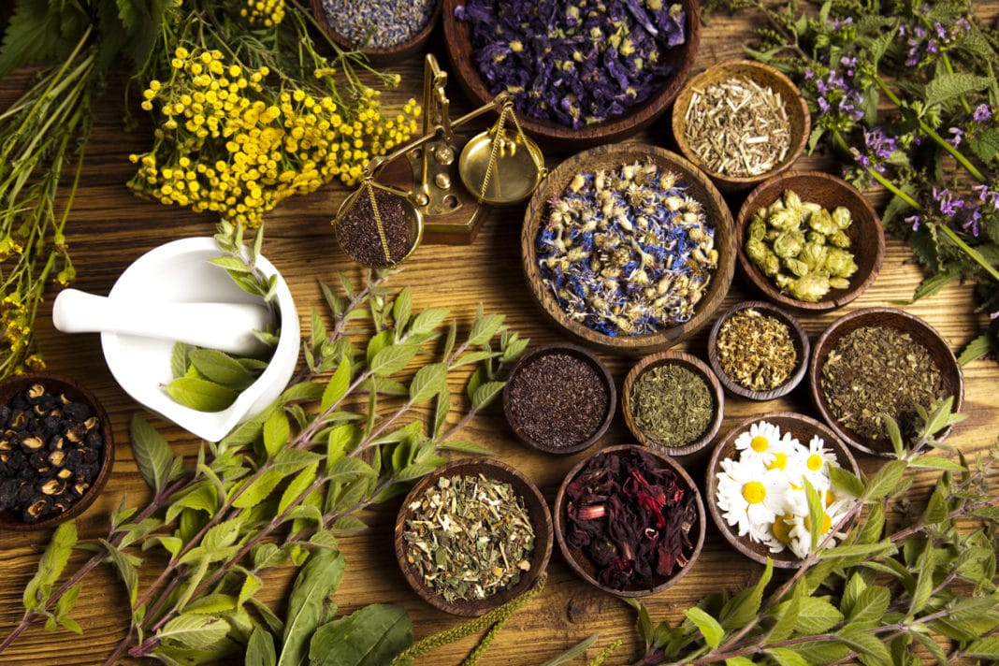
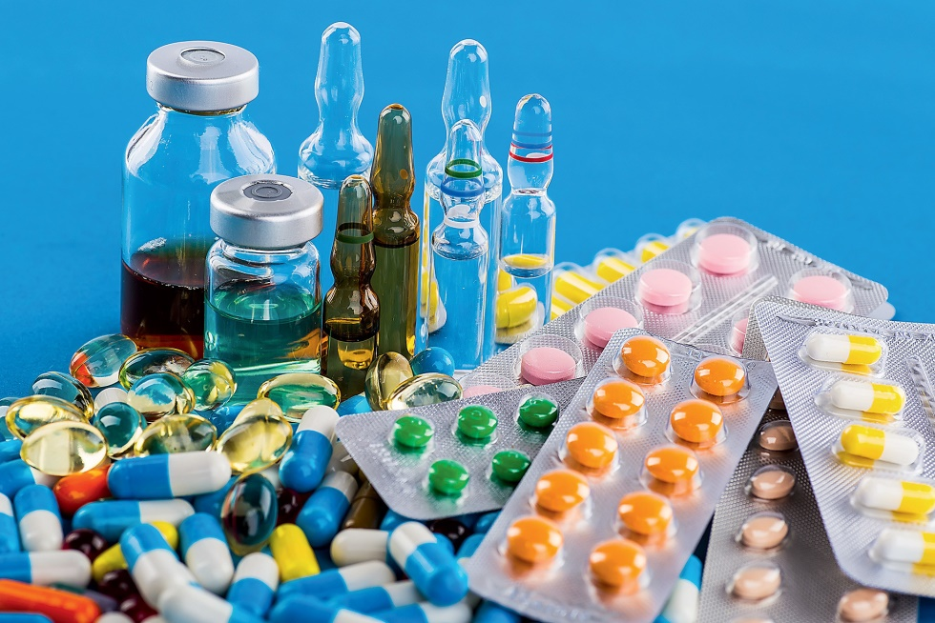
Sources of drugs
Drugs are substances that are used or intended to be used in the diagnosis, prevention, treatment or cure of diseases.
In early times, these substances were derived from natural sources, of which plants took up the major share. With the introduction of technology, most drugs today are manufactured synthetically in the laboratory.

Slide 14
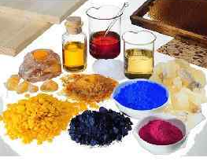
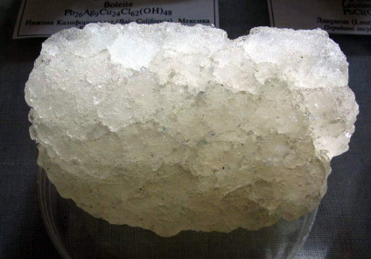
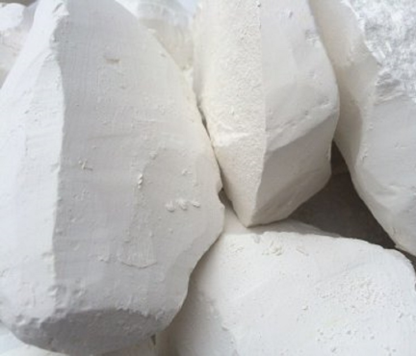
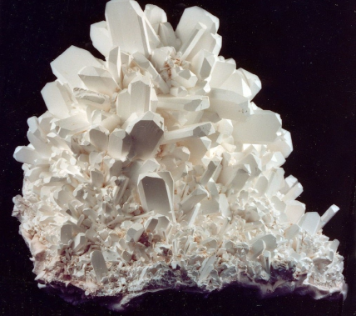
Mineral sources
The source of obtaining inorganic drugs is mineral raw materials. The minerals themselves or individual elements are used.
Examples: for the preparation of
Sodium chloride (Natrii Chloridum) uses natural solutions - water of lakes and seas;
Potassium Chloride (Kalii Chloridum) - minerals: Sylvinitis, Carnallitis;
Calcium chloride (Calcii chloridum) - chalk or marble;
Boric acid (Acidum Boricum) - Sasolin or Borax.

Slide 15
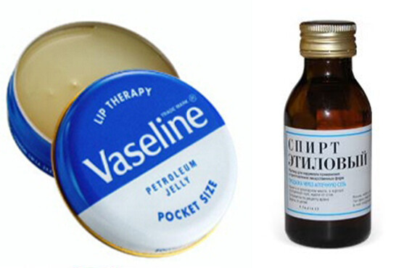
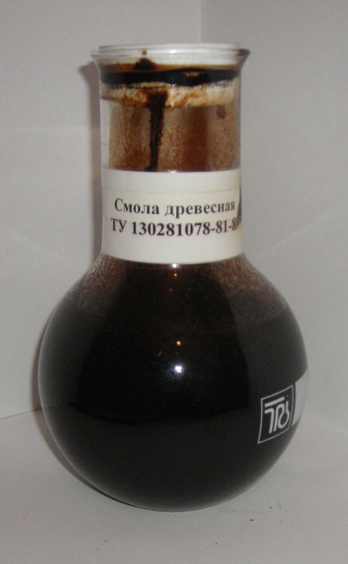
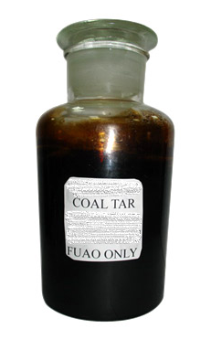
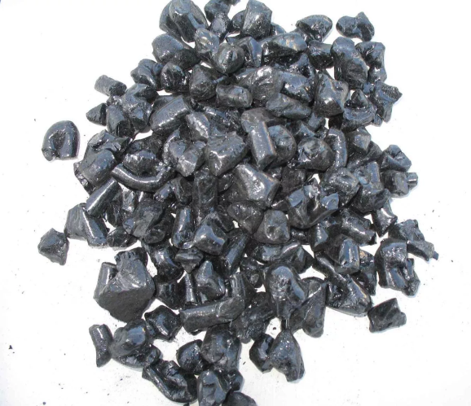
Mineral sources
To obtain synthetic organic drugs, dry distillation products of coal, wood, oil shale, as well as various oil fractions are used.
During the dry distillation of wood, charcoal and two liquid fractions (wood resin) are formed.
Coal tar is a complex mixture that includes over 480 different aromatic and heterocyclic compounds.

Slide 16
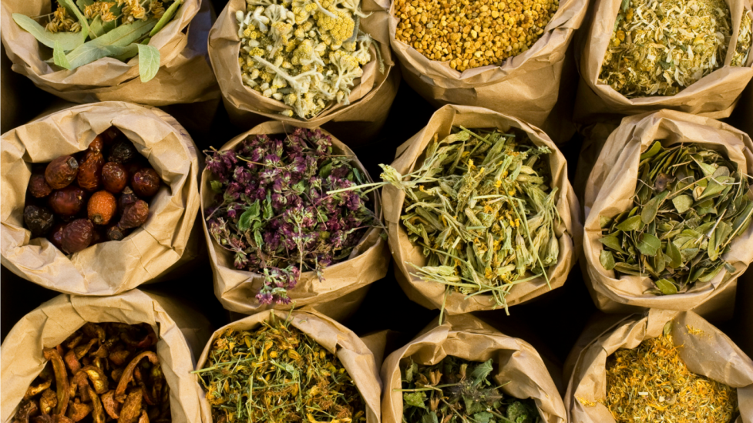
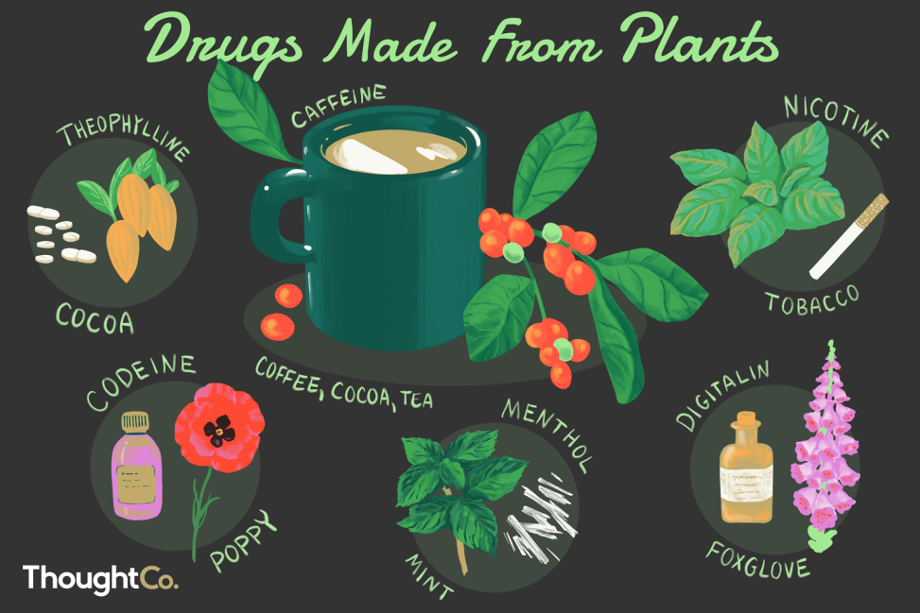
Plant sources
Plant materials - leaves, flowers, peels, seeds, fruits, roots of plants - in themselves can be medicines.
Medicinal plant materials are a source of natural biologically active substances:
alkaloids,
terpenes,
glycosides,
vitamins.

Slide 17
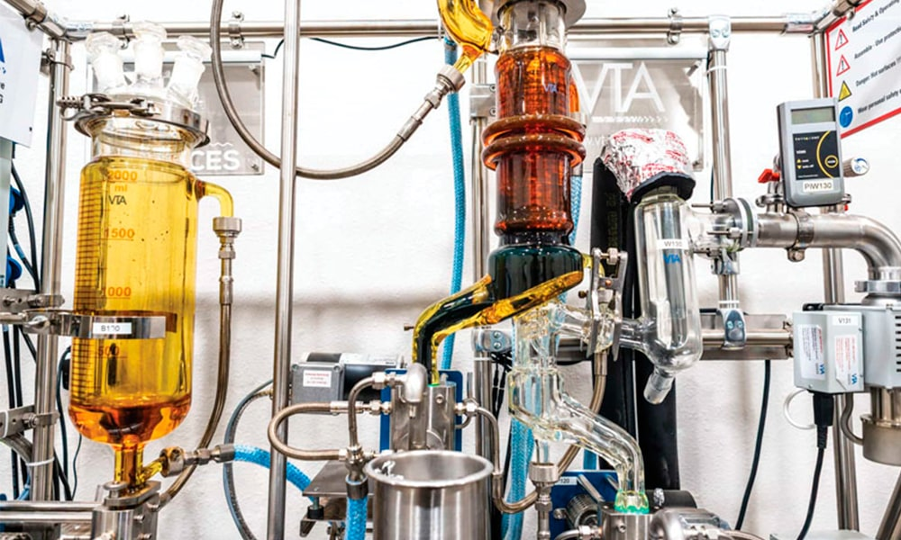
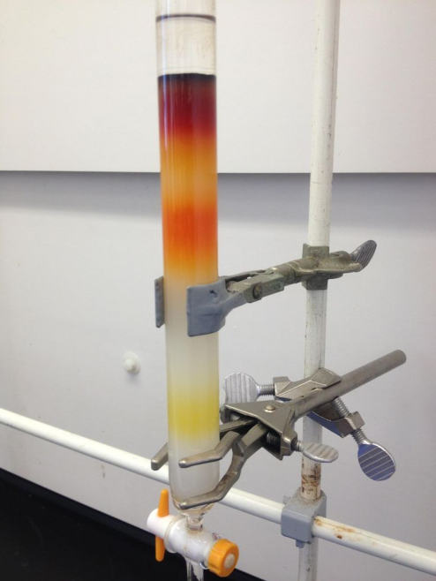
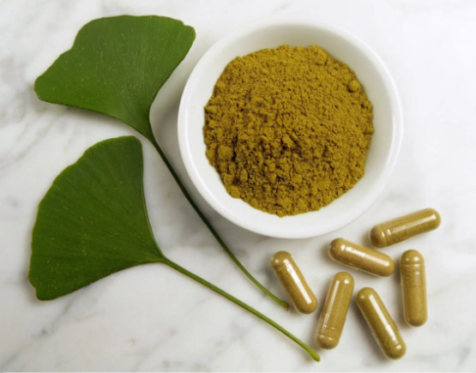
Plant sources
The process of selection of biologically active substances from plant consists of the following steps:
grinding of raw materials,
extraction,
separation of the extract from the raw material,
removal and recovery of the solvent from the extract and feedstock,
isolation and purification of biologically active substances.

Slide 18
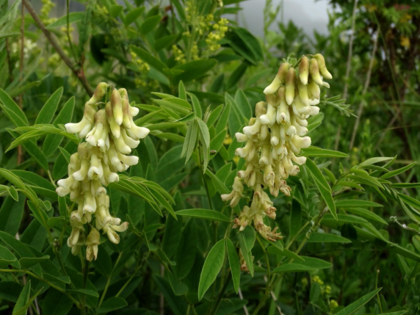
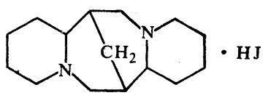
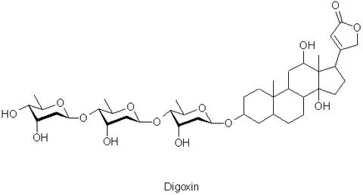
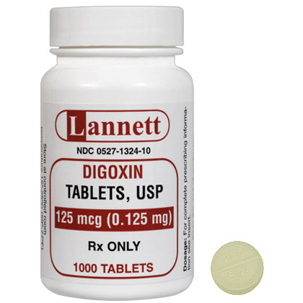
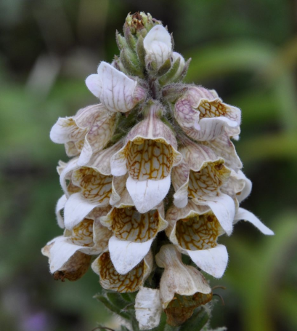
Plant sources
Examples
Pachycarpine hydroiodide is obtained by extraction from the herb Sophora pachycarpa. It is a ganglion blocker.
Digoxin is obtained from the leaves of woolly foxglove (Digitalis lanata). It is a cardiac glycoside and is used in heart failure.

Slide 19
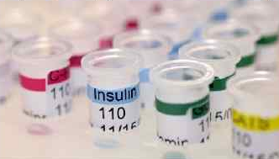
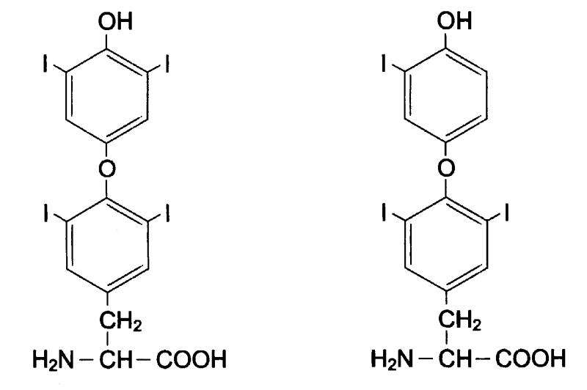
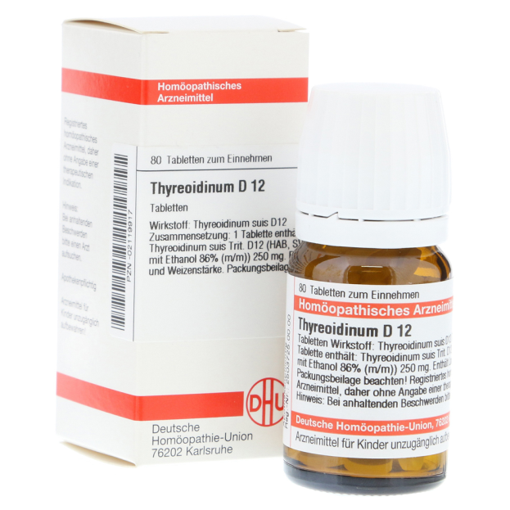
Animal sources
Individual substances are obtained from raw materials of animal origin:
hormonal preparations,
enzymes,
antitoxins sera.
Examples
Thyroidin is obtained from lyophilized thyroid glands of slaughtered cattle. The main components are thyroxine and triiodothyronine. Used for hypothyroidism.

Slide 20
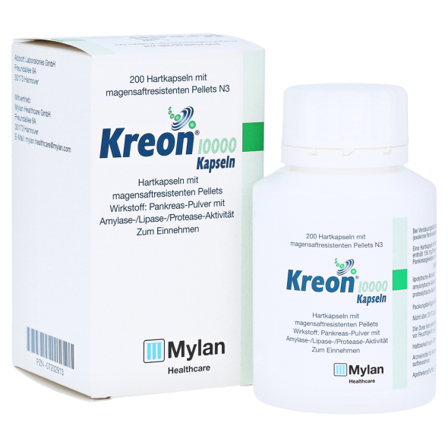
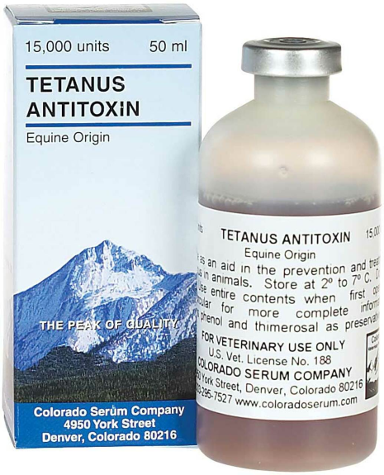
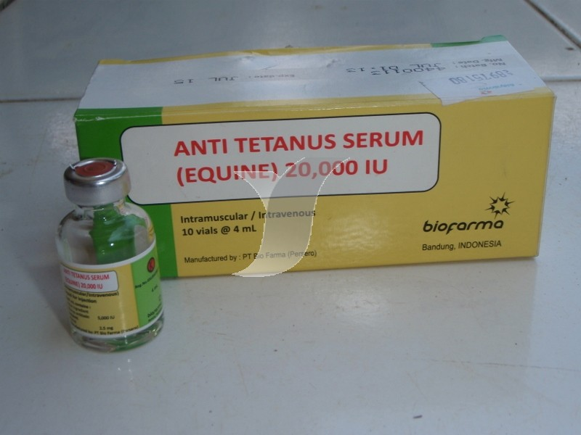
Animal sources
Kreon is an extract of the pancreas. It is used for deficiency of pancreatic enzymes.
Anti-tetanus serum is obtained from the plasma of horses immunized with tetanus toxin

Slide 21
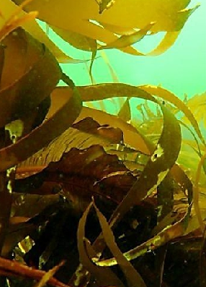
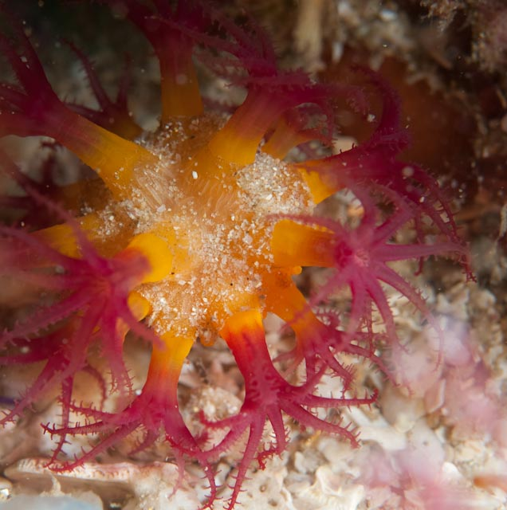
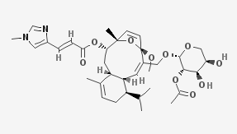
Marine source
Bioactive compounds from marine flora and fauna have extensive past and present use in the prevention, treatment or cure of many diseases. Coral, sponges, fish, and marine microorganisms produce biologically potent chemicals with interesting anti-inflammatory, anti-viral, and anticancer activity.
Example
Eleutherobin is a marine diterpene glycoside with antitumor activity in vitro. It was isolated from the soft coral species Eleutherobia

Slide 22
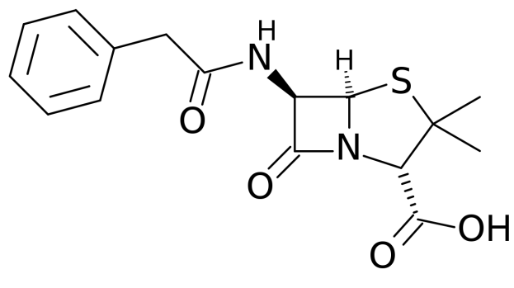
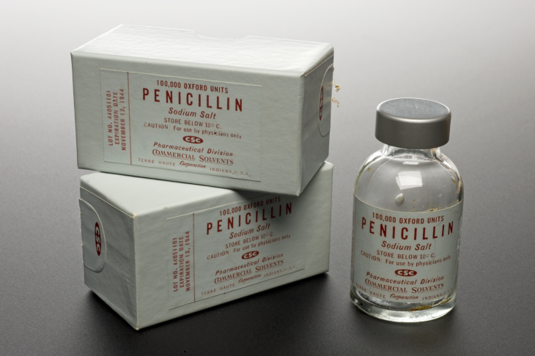
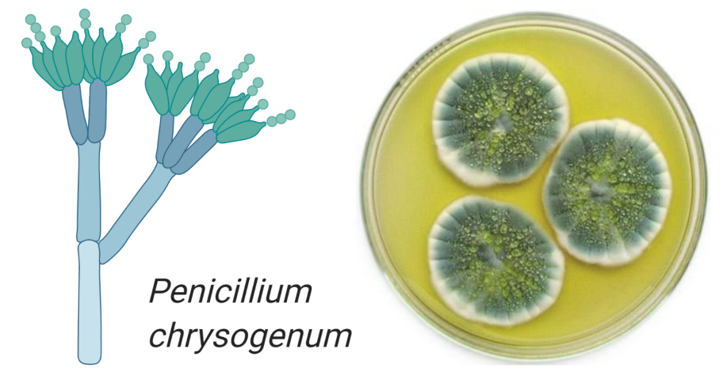
Microbial sources
Several life-saving drugs have been historically derived from microorganisms.
Penicillin produced by Penicillium chrysogenum

Slide 23
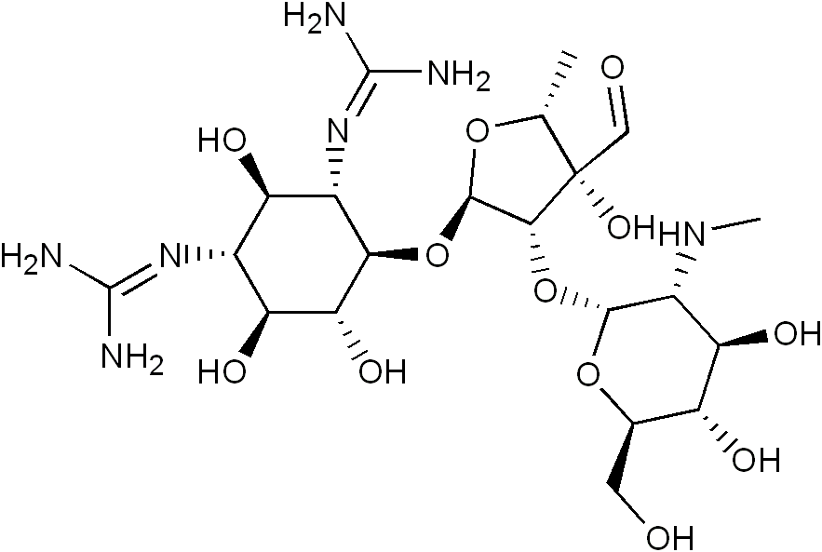
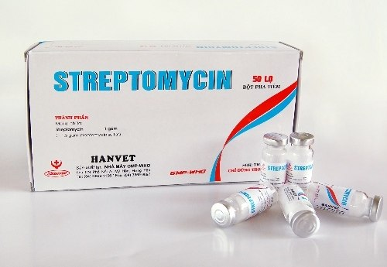
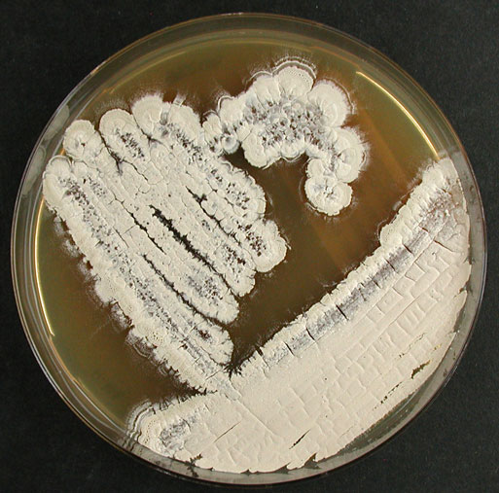
Microbial sources
Streptomycin produced by Streptomyces griseus

Slide 24
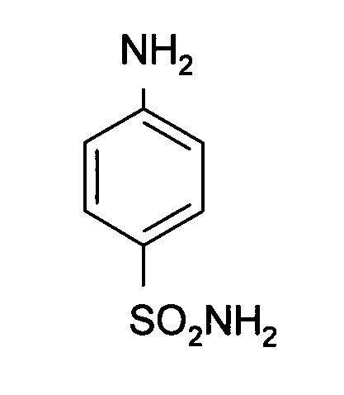
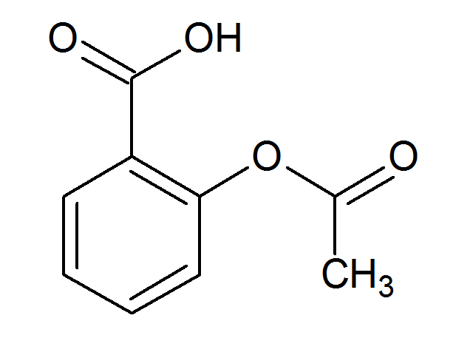
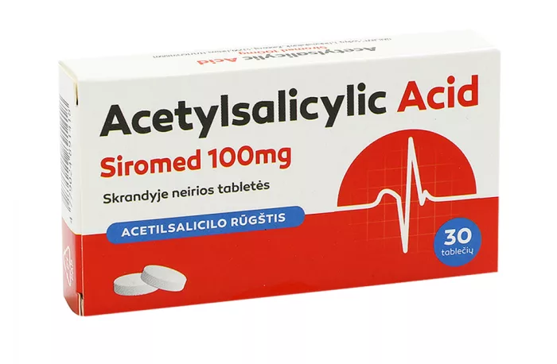
Synthetic/chemical derivative
A synthetic drug is produced using chemical synthesis, which rearranges chemical derivatives to form a new compound. At present, the majority of drugs used in clinical practice are exclusively prepared synthetically in pharmaceutical and chemical laboratories.
Sulphonamide
Acetylsalicylic acid (Aspirin)

Slide 25
The chemical reactions used to synthesize organic drugs
Substitution reactions. These reactions are based on the substitution of hydrogen atoms in the aliphatic chain, aromatic, heterocyclic ring or functional group with various substituents.
Substituent transformation reactions. This group of reactions is based on the chemical transformations of the substituents present in the molecule of the intermediate product to give it new properties or change its reactivity.
Oxidation-reduction reactions. Reduction and oxidation are a single process, as a result of which one group of atoms is reduced, while acquiring electrons, and another group of atoms is oxidized. In redox reactions, not only the degree of oxidation changes but also the composition of the molecule.

Slide 26
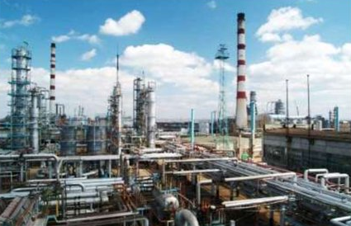
Types of organic synthesis
Basic organic synthesis is the industrial large-scale production of organic compounds. The basic organic synthesis is characterized by a small number of stages. It is carried out at large industrial complexes.
Fine organic synthesis is low-tonnage. As a result of production, organic substances of a complex structure are obtained. Fine organic synthesis is carried out from the products of the main organic synthesis. Fine organic synthesis is characterized by a multistage nature, high energy and labor costs, and sophisticated equipment.

Slide 27
Semi-synthetic sources
Semi-synthetic drugs are neither completely natural nor completely synthetic. They are generally made by chemically modifying substances that are available from a natural source to improve their potency, efficacy, and/or reduce side effects.
In semi-synthetic drugs, the nucleus of the drug obtained from a natural source is kept intact but the chemical structure is altered.
Heroin (Diacetyl morphine) is derived from morphine

Slide 28
Semi-synthetic sources
Ampicillin is derived from penicillin
Ethinylestradiol is derived from estrone

Slide 29
Biosynthetic sources
This is relatively a new field that is being developed by mixing discoveries from molecular biology, recombinant DNA technology, DNA alteration, gene splicing, immunology, and immune pharmacology.
Recombinant insulin
Recombinant Hepatitis B vaccine

Slide 30
Biosynthetic sources

Slide 31
Biosynthetic sources
Advantages:
Huge amounts of drugs.
Drug can be obtained in pure form.
It is less antigenic.
Disadvantages:
Well equipped lab is required.
Highly trained staff is required.
It is a complex and complicated technique.

Slide 32
Thank you for attention!

