Slide 1
«General pharmaceutical chemistry »
Oxidimetry: Permanganatometry. Cerimetry. Iodometry .
Associate Professor Gureeva E.S.

Slide 2
Redox Titration
Redox Titration is mainly based upon the change of the oxidation number or electrons transfer between the reactants, that is, these reactions are mainly based upon the oxidation-reduction reactions.
In oxidation-reduction titration method, a reducing substance is titrated with standard solution of an oxidizing agent or an oxidizing substance is titrated with the standard solution of the reducing agent.

Slide 3
Redox Titration
Reduction Reaction
A substance undergoes a reduction in the following ways:
The addition of hydrogen.
The process of removing oxygen.
Acceptance of electrons.
A reduction in overall oxidation state.
Oxidation Reaction
A substance undergoes oxidation in the following ways:
The addition of oxygen.
The hydrogen that was connected to the species was removed.
Electron donation and loss
An increase in the oxidation state of the material

Slide 4
Classification of redox titration
Permanganometry is a redox titration that uses potassium permanganate as an oxidizing agent.
Cerimetry is a type of redox titration that uses ammonium ceric sulphate as an oxidizing agent.
Dichrometry uses potassium dichromate.
Bromatometry is a redox titration that uses potassium bromate as an oxidizing agent.
Iodimetric titrations use iodine as an oxidizing agent to titrate reducing agents.
Iodometric titrations, on the other hand, uses iodide ion as a weak reducing agent.

Slide 5
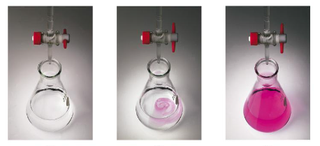
Permanganometry
Titrant is a solution of potassium permanganate
Indicator is KMnO4 solution itself, which has a crimson-purple colour due to the MnO₄¯ ion; the resulting Mn²⁺ cation is colourless after the reaction. The use of potassium permanganate makes it possible to fix the point of equivalence by the appearance of a pink colour from just one extra drop of solution.
The essence of the method is the oxidation of reducing agents with potassium permanganate solution.

Slide 6
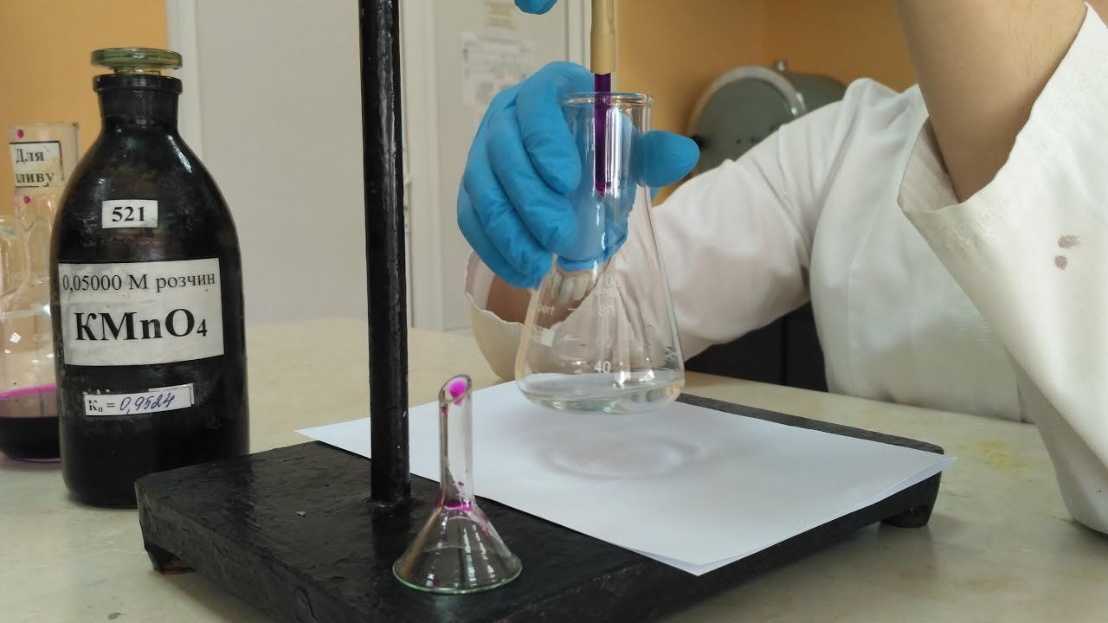
Permanganometry
The permanganatometric method is the most widely used in analytical practice in acidic media:

Slide 7
Permanganometry
Preparation of standard Potassium Permanganate Solution
A standard solution of potassium permanganate cannot be prepared from an exact sample weight, as there are always impurities in the salt and there are organic substances oxidised by the permanganate in the water.
The titer of potassium permanganate can be set by oxalic acid and by ammonium or sodium oxalate.
The oxalic acid standardisation of the solution is carried out in an acidic medium.

Slide 8
Permanganometry
Advantages
In this method the working solution is the indicator - one drop of the working solution stains the solution pink.
The possibility of titration by KMnO4 solution can be carried out both in acidic and alkaline environment.
Permanganate is a cheap and accessible reagent.
Stoichiometricity and fairly high rate of most redox reactions involving permanganate.

Slide 9
Permanganometry
Disadvantages
Potassium permanganate is difficult to obtain in chemically pure form, because it contains many impurities and it is not possible to take an exact sample.
Standard solutions are unstable and the titre must be checked periodically during use.
In hydrochloric acid, the determination cannot be carried out as the chloride ion is oxidised to free chlorine.
Some oxidation reactions are very slow and therefore require heating; but in this case the test substances may decompose.

Slide 10
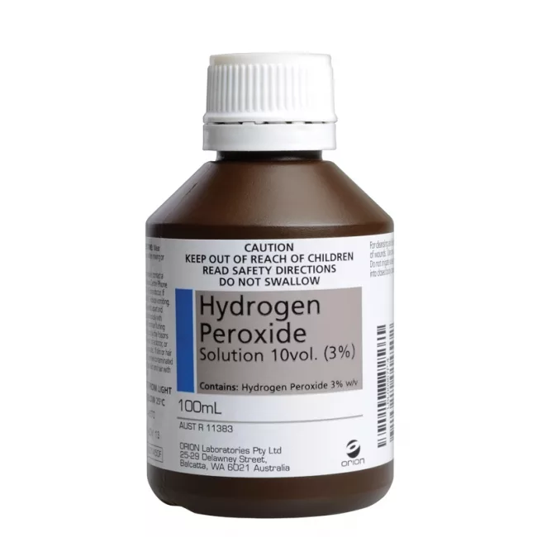
Permanganometry
Applications of permanganatometry in pharmaceutical analysis
Direct Titration Methods
Hydrogen Peroxide Solution
Titrant KMnO₄
Color transition from colourless to pink

Slide 11
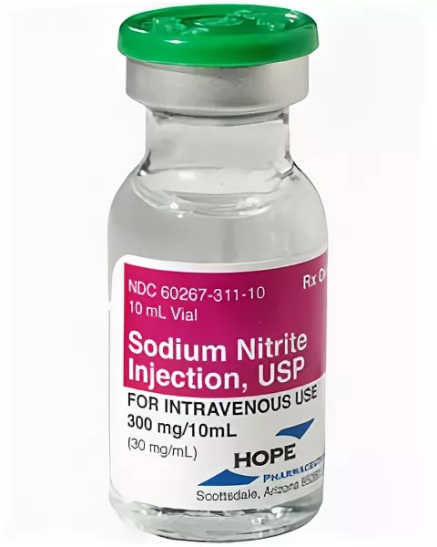
Permanganometry
Applications of permanganatometry in pharmaceutical analysis
Residual Titration Methods
Sodium Nitrite
Titrant KMnO₄
Color transition from colourless to pink

Slide 12
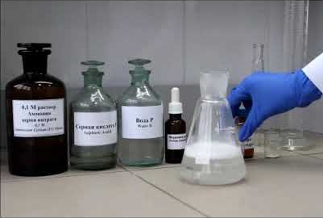
Cerimetry
Cerimetry is a method of titrimetric analysis, based on the use of cerium (IV) compounds as an oxidant. Cerium (IV) compounds. It is based on a half reaction:
The titrants are solutions of
cerium (IV) sulfate Ce(SО4)2 ∙ 4H2O or
cerium (ΙV)-ammonium sulfate [Ce(SО4)2 ∙ 2(NH4)2SО4] ∙ 2H2O
These titrants are secondary standards

Slide 13
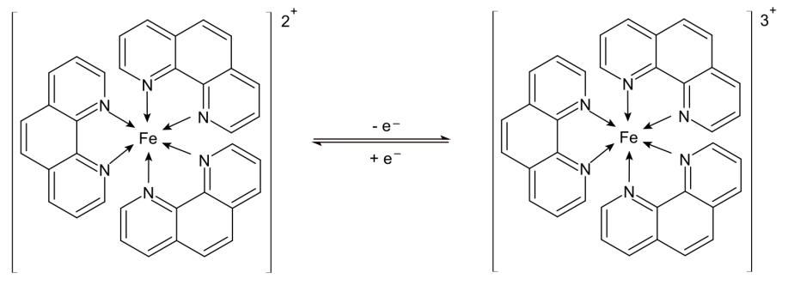
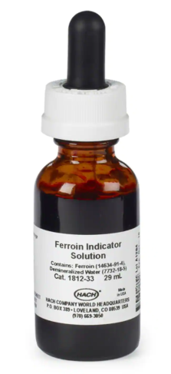
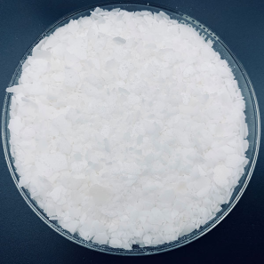
Cerimetry
Fixing the titration end point
without indicator - by the colour change of the titrated mixture. The method is based on visual observation of the colour change of the titrated solution, which turns yellow in the presence of excess titrant.
With the help of redox indicators such as diphenylamine, ferroin, etc;
ferroin
diphenylamine

Slide 14
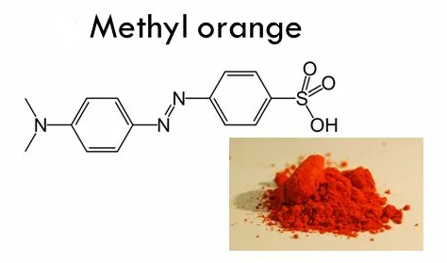
Cerimetry
Fixing the titration end point
with the acid-base indicators methyl orange, methyl red. At the point of equivalence, the indicator is irreversibly oxidised by the titrant and a colour change occurs.
instrumental methods - potentiometric, photometric, amperometric, etc.

Slide 15
Cerimetry
Advantages
Standard solutions retain a constant concentration for a long time and are very resistant to environmental components.
Titration with solutions of cerium (IV) salts can be carried out not only in sulphuric but also in hydrochloric acid media.
The titration with solutions of cerium (IV) salts usually does not produce intermediate products or by-products which reduce accuracy or slow down the titration process.
Cerimetry can be used to determine a wide variety of objects that cannot be determined by other redox methods.

Slide 16
Cerimetry
Disadvantages
In cerimetry, indicators are needed because the titration end-point is difficult to detect by the colour change of the solution when an excess of titrant is added.
Do not use in the presence of phosphates and fluorides, as stable complexes are formed.
Titration with solutions of cerium (IV) salts often has to be carried out when heated to 50-75 C. This leads to difficulties in the case of the determination of volatile organic compounds.

Slide 17
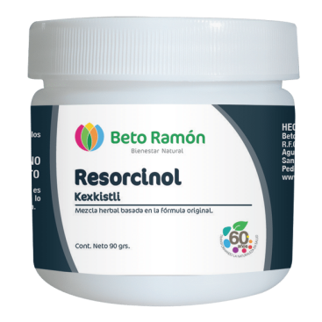
Cerimetry
Applications of permanganatometry in pharmaceutical analysis
Resorcinol
Titrant cerium (IV) sulphate Ce(SO₄)₂
Indicator starch
Color transition from blue to colourless

Slide 18
Iodometry
Iodometry is a redox titration method based on reactions involving oxidation of reducing agents by free iodine I₂ or reduction of oxidants by potassium iodide KI. Both processes can be expressed by the following scheme:

Slide 19
Iodometry
Classification
Direct titration is used to determine substances which are easily oxidised by elemental iodine. The titrant is an iodine solution.
Reverse titration is used to determine substances which are more difficult to oxidize with elemental iodine. In this case the substance to be determined is treated with an excess of iodine and then, after some time, the iodine residue is titrated with a standard solution of sodium thiosulphate (Na₂S₂O₃ ∙ 5H₂O).
Indirect method (substitution method) is used for the determination of oxidants. In this case the sample is treated with excess potassium iodide and the equivalent amount of elemental iodine is titrated with a standard solution of sodium thiosulphate.

Slide 20
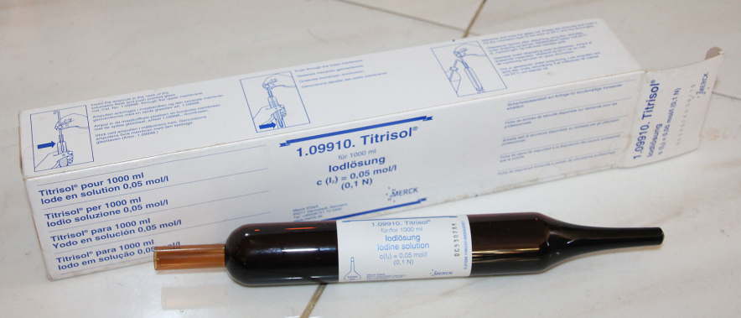
Iodometry
Preparation and standardisation of iodine solution
Standard solutions of iodine can be prepared as a primary standard.
Usually a solution of iodine of approximately the desired concentration (secondary standard) is prepared and then standardised with a suitable primary standard. Iodine solutions are most commonly standardised with sodium thiosulphate or potassium tartrate. Iodine titration with sodium thiosulphate Na₂S₂O₃ ∙ 5H₂O follows the equation of the reaction:

Slide 21
Iodometry
Stability of iodine solution
The stability of iodine solutions is low.
Reasons:
volatility of the dissolved substance
interaction with cortical or rubber plugs
oxidation of iodide ions by atmospheric oxygen
This reaction is accelerated in light, when heated and in the presence of acids.
Consequently, it is advisable to keep the solution cold, in a dark place.

Slide 22
Iodometry
Preparation, stability and standardisation of sodium thiosulphate solutions
Working solutions of sodium thiosulphate are prepared with approximate concentration from crystalline Na₂S₂O₃ ∙ 5H₂O followed by setting the exact concentration (secondary standard).
Potassium bichromate K₂Cr₂O₇ is used for standardisation. First react potassium dichromate with potassium iodide:
The iodine released in an equivalent amount to the dichromate is then titrated with sodium thiosulphate solution:
Sodium thiosulphate solutions are stored in dark or orange vials in diffuse light or in the dark.

Slide 23
Iodometry
Fixing the titration end point
The indication-free method
In the direct method, in cases where iodine is the only coloured substance in the system, the appearance or disappearance of its own yellow-orange colour is a rather sensitive indication for establishing the titration end-point.
Indicators
The most widely used indicator in both direct and indirect titration methods is a starch solution.
In direct titration the titration end-point is indicated by the blue colouring of the iodine-starch complex.
In indirect method the disappearance of the blue colouring indicates that the titration end-point has been reached.

Slide 24
Iodometry
Conditions for iodimetric titration
Titration with an iodine solution should be carried out in the cold to avoid iodine volatilisation.
Iodimetric titration is carried out in slightly acidic, neutral or very slightly alkaline solutions at pH < 8.
Advantages
Accuracy of determination
Can also be carried out without an indicator
The ability to titrate a wide range of compounds in non-aqueous media due to the good solubility of iodine in organic solvents.

Slide 25
Iodometry
Disadvantages
The volatility of the iodine can lead to errors of determination. Therefore in indirect titration an excess of potassium iodide should be added and the titration flasks should be sealed with a stopper;
The need for titration in slightly acidic media
The titration cannot be carried out in alkaline media, as iodine is oxidised to hypoiodide ions;
Adsorption of elemental iodine by the precipitation produced by the reaction;
Changes in the concentration of standard solutions during storage and use, requiring additional periodic standardisation of titrant solutions;
Strict adherence to the reagent discharge sequence.

Slide 26
Iodometry
Application of iodometry in pharmaceutical analysis
Direct iodometry
Sodium thiosulphate
Titrant iodine solution
Indicator starch
Color transition from colourless to blue

Slide 27
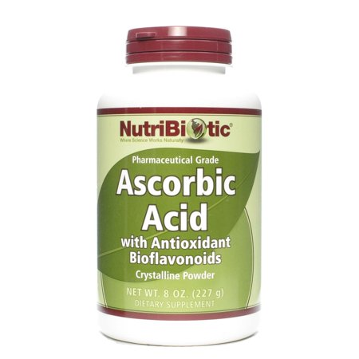
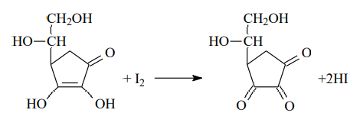
Iodometry
Application of iodometry in pharmaceutical analysis
Direct iodometry
Ascorbic acid
Titrant iodine solution
Indicator starch
Color transition from colourless to blue

Slide 28
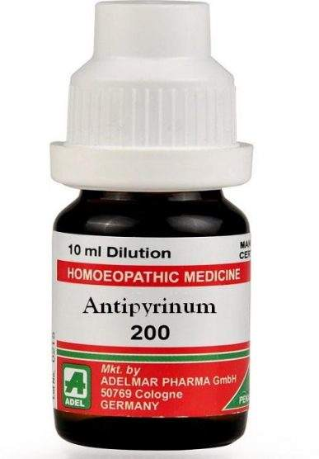
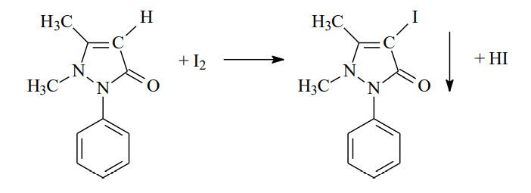
Iodometry
Application of iodometry in pharmaceutical analysis
Reverse iodometry
Antipyrine
Titrant sodium thiosulphate solution
Indicator starch
Color transition from blue to colourless

Slide 29
Thank you for attention!

