Slide 1
Lecture 11
PHYLUM PLATHELMINTHES
CLASS CESTODAE (TAPEWORMS)

Slide 2
General characteristics
Flattened dorsoventrally
Ribbon - shaped body
Length varies from 0.6 millimeter to 30 meters
Bilaterally symmetrical
Body cavity is absent
Outer coating is tegument
Organs of fixation: suckers, hooks, bothriums

Slide 3
Body is segmented. It has three regions: scolex, neck, strobila
The scolex is the head. It has hooks, suckers;
The neck is the region of grouth.
The strobila consists of a segments called proglottids.
Strobila contains three types of proglottids:
- immature proglottids,
- mature proglottids, which contain functioning male and female reproductive organs,
- gravid proglottids, which contain uterus with eggs.

Slide 4
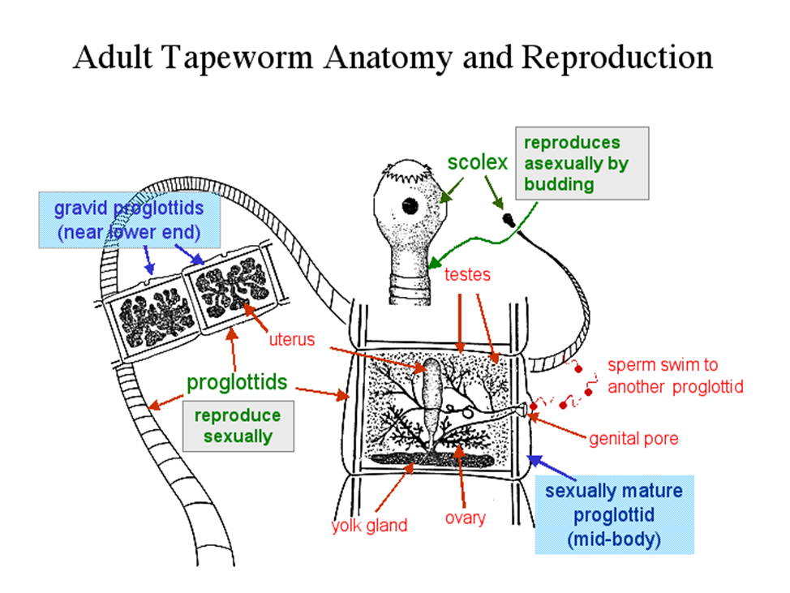

Slide 5
Digestive system: absent
Excretory system: some protonephridia (flame cells)
Nervous system: the main nerve centre of a cestode is a cerebral ganglion in its scolex.
Reproductive system: true tapeworms are hermaphrodites; they have both male and female reproductive systems in their bodies.

Slide 6
Life cycle
The life cycle may consist of 3-4 stages.
In the first stage, the adult worms live in the intestines of the definitive host produce eggs.
In the second stage, the eggs fall into the environment: in soil or in water. On land in the egg is formed the larva or embryo. If eggs develop in water, they becomes a free-floating larva with cilia, and it is the second larval phase.
The third stage is the development of larvae in the intermediate host, where it develops into one from the following forms of larva: plerocercoid, cystecercoid, cystecerk, coenoir, tchinococcus.

Slide 7
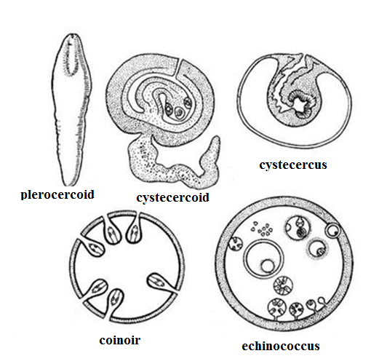

Slide 8
TAENIA SOLIUM (PORK TAPEWORM)
Disease: taeniasis, cysticercosis.
Geographic distribution: Africa, Asia, South America and Southern Europe. Localization in human body: small intestine; in case of cystecercosis – brain, spinal cord, eyes, muscle tissues
Morphology:
- length of adult 2-7m,
- scolex has 4 suckers with crown of hooks;
- mature proglottide includes trilobed ovary,
- gravid proglottide – 7-12 branches of uterus.
- Larva of T.solium called cysticercus.

Slide 9
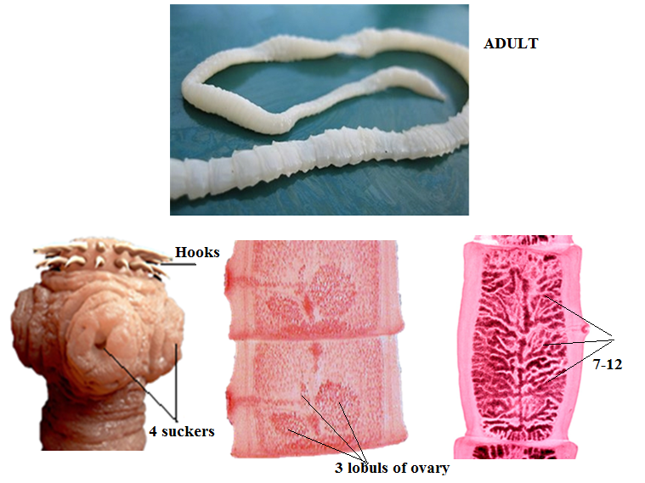
Morphology

Slide 10
Mode of transmission: by eating raw or undercooked pork
Life Cycle:
Definitive host - human
Intermediate host – pig
First larval form – oncosphere
Second larval form - cystecercus

Slide 11
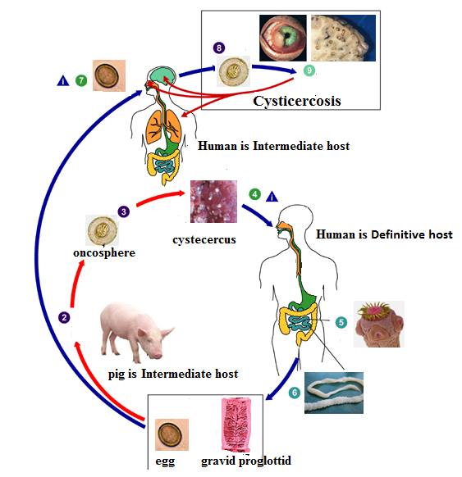
Life cycle

Slide 12
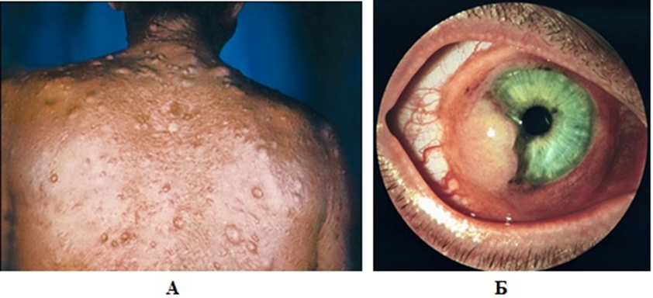
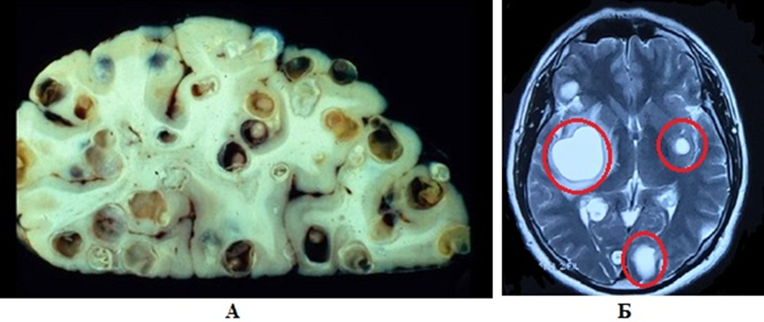
Pathogenesis

Slide 13
Diagnosis:
Taeniasis
microscopic identification of eggs and proglottids (7-12 branches) in feces
Cystecercosis
x-ray
computed tomography scan
Prevention and control:
cooking pork adequately

Slide 14
TAENIA SAGINATA (BEEF TAPEWORM)
Disease: taeniasis
Geographic distribution: worldwide
Localization in human body: small intestine
Morphology:
length of adult 4-6(10)m,
scolex has only 4 suckers
mature proglottide includes two lobules of ovary,
gravid proglottide – 17-35 branches of uterus;
Larva of T.solium called cysticercus.

Slide 15
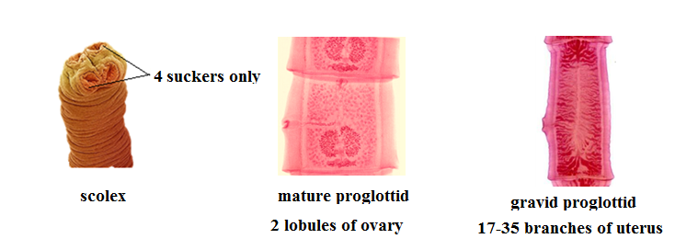
Morphology

Slide 16
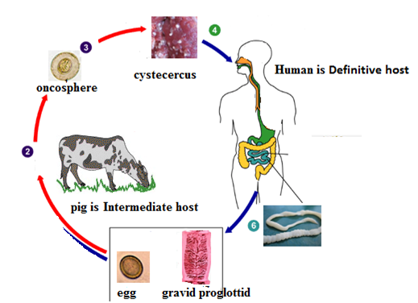
Mode of transmission: by eating raw or undercooked beef
Life Cycle:
Definitive host - human
Intermediate host – cow
First larval form – oncosphere
Second larval form – cystecercus

Slide 17
Pathogenesis: Cystecercosis is not possible
Diagnosis:
Taeniasis
microscopic identification of eggs and proglottids (17-35 branches) in feces
Prevention and control:
cooking beef adequately

Slide 18
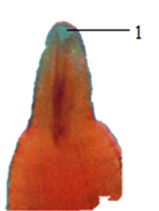
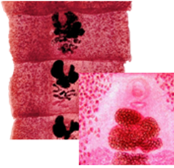
DIPHYLLOBOTHRIUM LATUM (FISH TAPEWORM)
Disease: diphyllobothriasis
Geographic distribution: in areas of rivers and lakes
Localization in human body: small intestine
Morphology: length of adult 10-13m, wide proglottids,
- scolex has two elongated sucking grooves (bothria);
- gravid proglottide has rosette-shaped uterus;
- Larva is called plerocercoid.

Slide 19
Mode of transmission: by eating raw or undercooked fish
Life Cycle:
Definitive host - carnivorous mammals, humans
First intermediate host – freshwater crustacean
Second intermediate host – fish
First larval form – oncosphere (coracidia)
Second larval form – (procercoid) plerocercoid

Slide 20
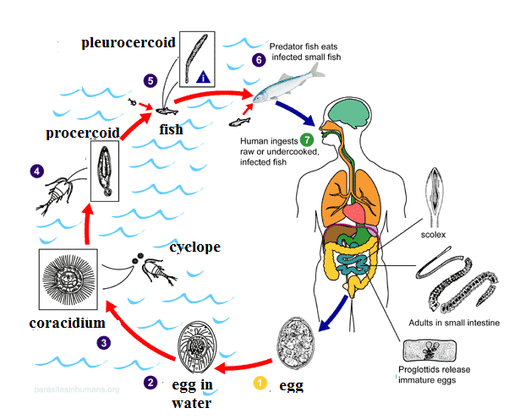
Life Cycle

Slide 21
Pathogenesis:
Diphyllobothriasis is usually asymptomatic.
In some cases it causes severe vitamin B12 deficiency.
Diphyllobothriasis symptoms include: diarrhea, fatigue, obstruction of the bowel,
Diagnosis: microscopic identification of eggs and proglottids in the stool.
Prevention and control:
Cook fish properly.

