Slide 1
«Special pharmaceutical chemistry»
Purine alkaloids synthetic analogues
Associate Professor Gureeva E.S.

Slide 2
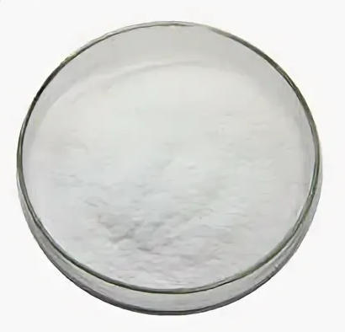
Diprophylline
Obtaining
Physical properties
White fine crystalline powder.
Diprophyllin is slowly soluble in water (1:10), soluble in ethanol (on boiling), practically insoluble in chloroform and acetone.

Slide 3
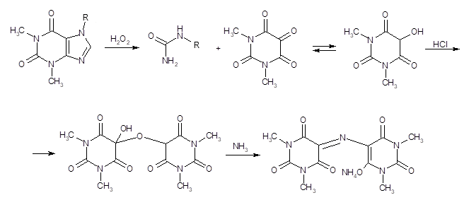
Diprophylline
Identification
IR and UV spectrophotometry
2. Murexide test
A purplish-red colouration appears

Slide 4
Diprophylline
Identification
3. Interaction with common alkaloid reagents
4. Interaction with iodine solution

Slide 5
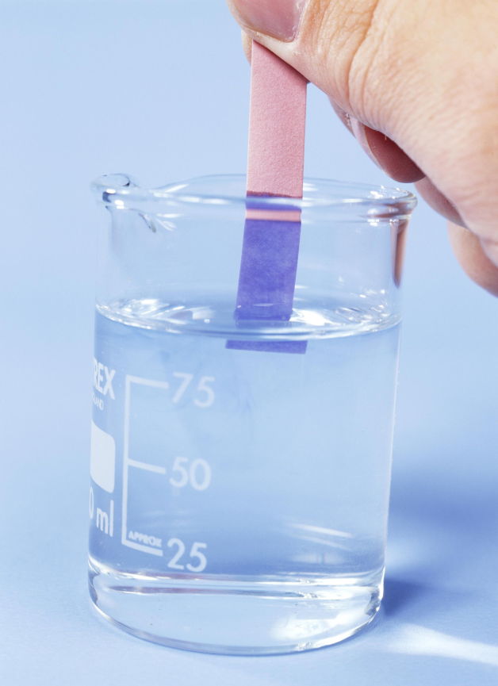
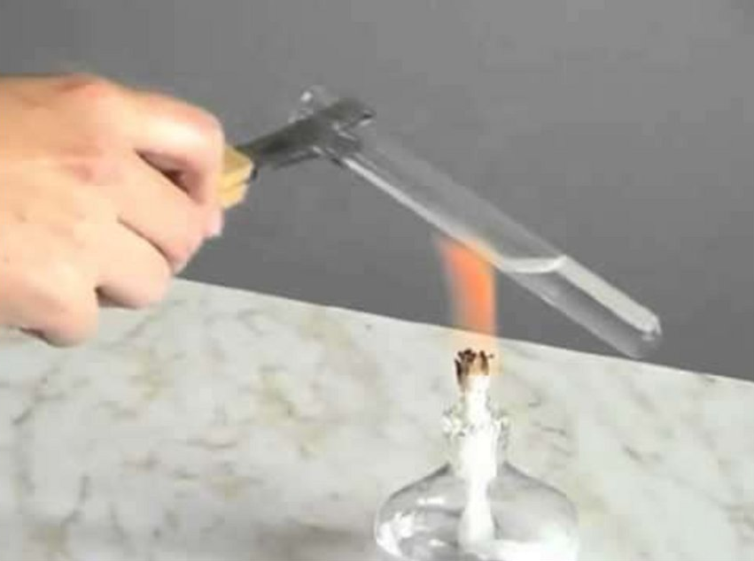
Diprophylline
Identification
5. Boiling with sodium hydroxide solution
Diprophyllin when boiled with sodium hydroxide solution gives off ammonia, which is detected by odour or change in colour of red litmus paper.

Slide 6
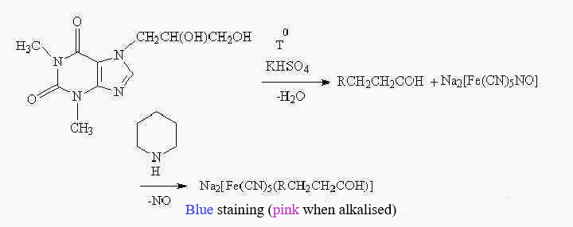
Diprophylline
Identification
6. Interaction with sodium hydrosulphate

Slide 7
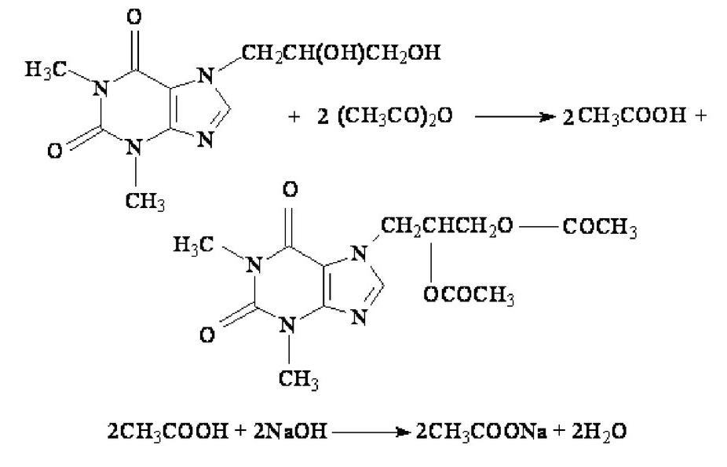
Diprophylline
Assay
1. Kjeldahl method
2. Indirect alkalimetry
3. Spectrophotometry
4. GC
5. HPLC

Slide 8
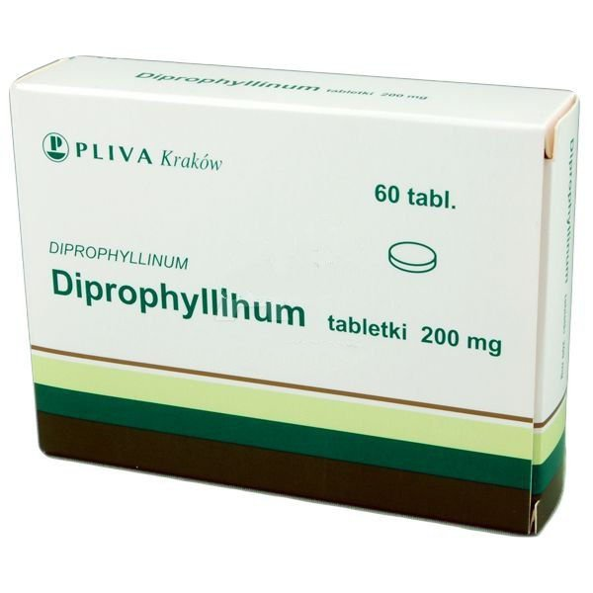
Diprophylline
Storage
Diprophyllin is stored in well sealed containers.
Medical use
Diprophylline's pharmacological properties are similar to those of theophylline and eufylline. It has coronary and bronchodilator effects, increases diuresis. Less toxic than theophylline, does not cause marked excitation of the central nervous system. Diprophyllin is less effective than other theophylline derivatives, but does not irritate the stomach mucosa.
It is used in angina pectoris, cardiac and bronchial asthma, and hypertension.

Slide 9
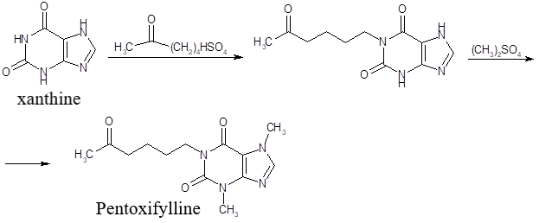
Pentoxiphylline
Obtaining

Slide 10
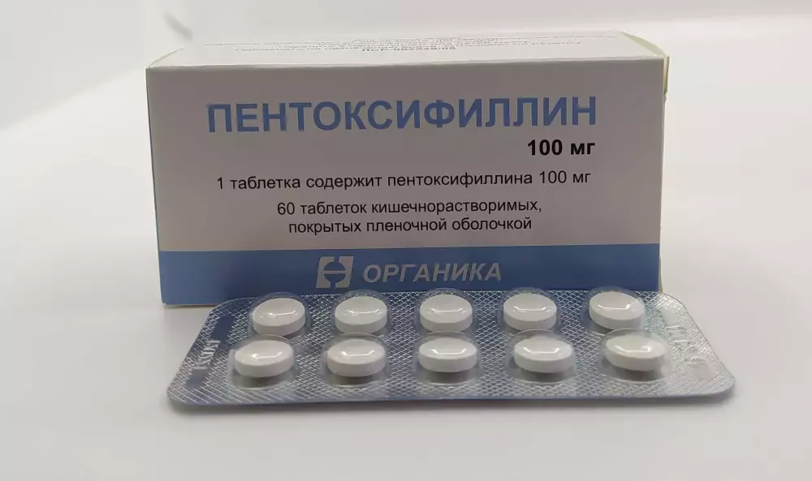
Pentoxiphylline
Physical properties
White or white with a faint yellowish tinge, crystalline powder, practically odourless.
Pentoxifylline is slightly soluble in water and ethanol, easily soluble in chloroform.

Slide 11
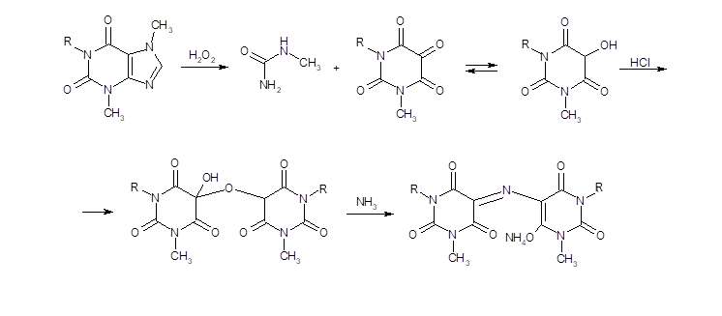
Pentoxiphylline
Identification
IR and UV spectrophotometry
2. Murexide test
A purplish-red colouration appears

Slide 12
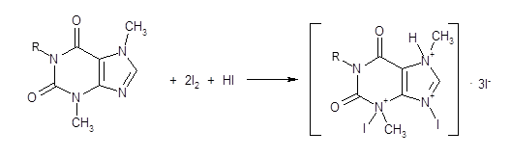
Pentoxiphylline
Identification
3. Interaction with common alkaloid reagents
Aqueous solution of pentoxifylline when added with Sonnenstein's or Scheibler's reagents forms a white precipitate, and with Dragendorf's reagent - a yellow precipitate.
4. Interaction with iodine solution

Slide 13
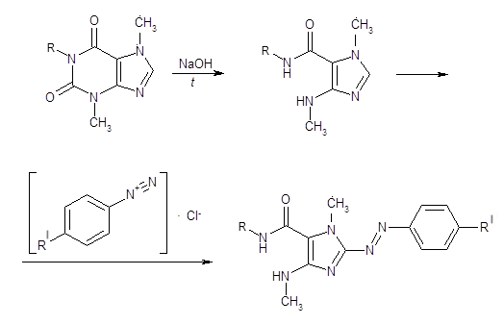
Pentoxiphylline
Identification
5. Formation of azo dye

Slide 14
Pentoxiphylline
Assay
1. Kjeldahl method
2. Non-aqueous titration
3. Spectrophotometry
4. GC
5. HPLC

Slide 15
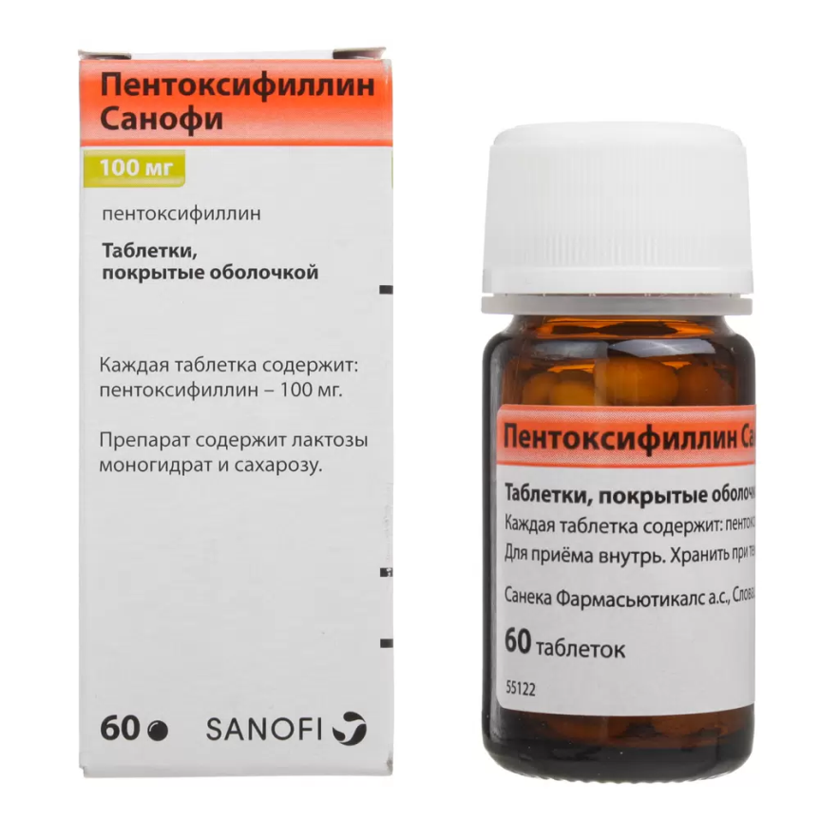
Pentoxiphylline
Storage
Pentoxiphylline is stored in well sealed containers.
Medical use
Pentoxifylline is a vasodilating, angioprotective, antiaggregant, antithrombic agent. It is prescribed for peripheral blood circulation disorders, cerebrovascular pathology, in ophthalmology and otorhinolaryngology.

Slide 16
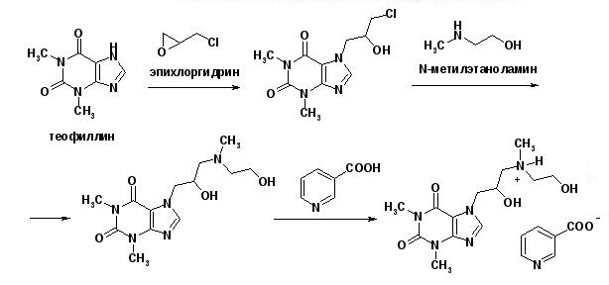
Xantinol Nicotinate
Obtaining

Slide 17
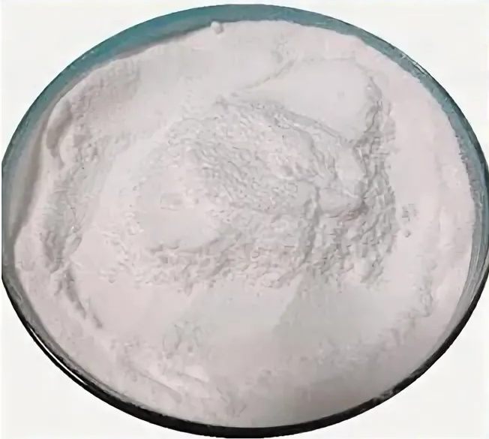
Xantinol Nicotinate
Physical properties
White crystalline, odourless powder.
Xanthinol nicotinate is easily soluble in water. The aqueous solution has an alkaline reaction. Xanthinol nicotinate is very insoluble in ethanol, practically insoluble in ether and chloroform.

Slide 18
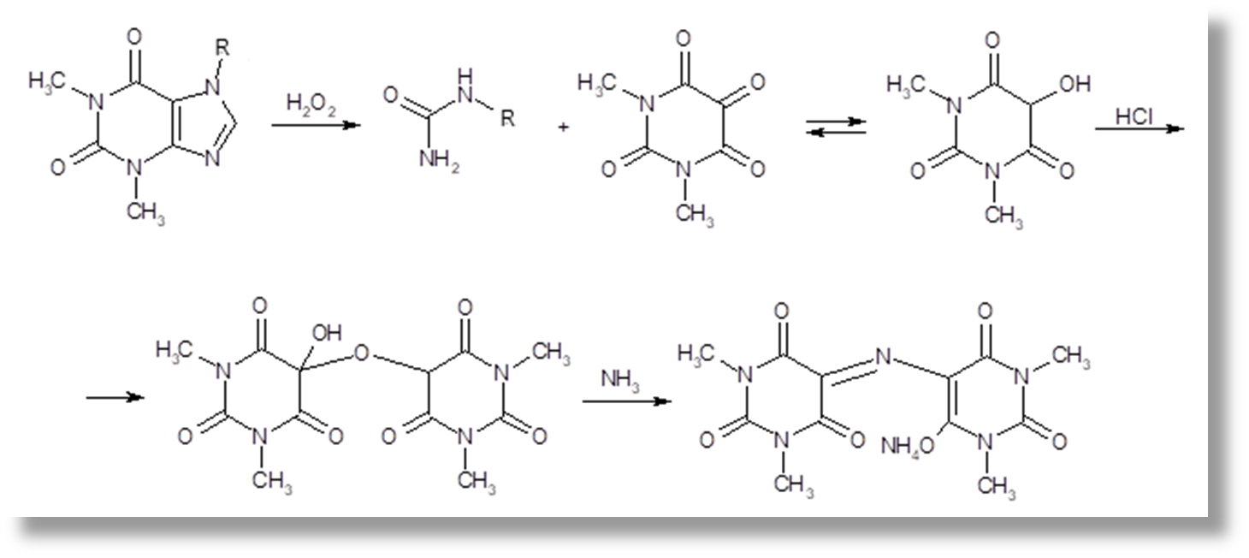
Xantinol Nicotinate
Identification
IR and UV spectrophotometry
2. Murexide test
A purplish-red colouration appears

Slide 19
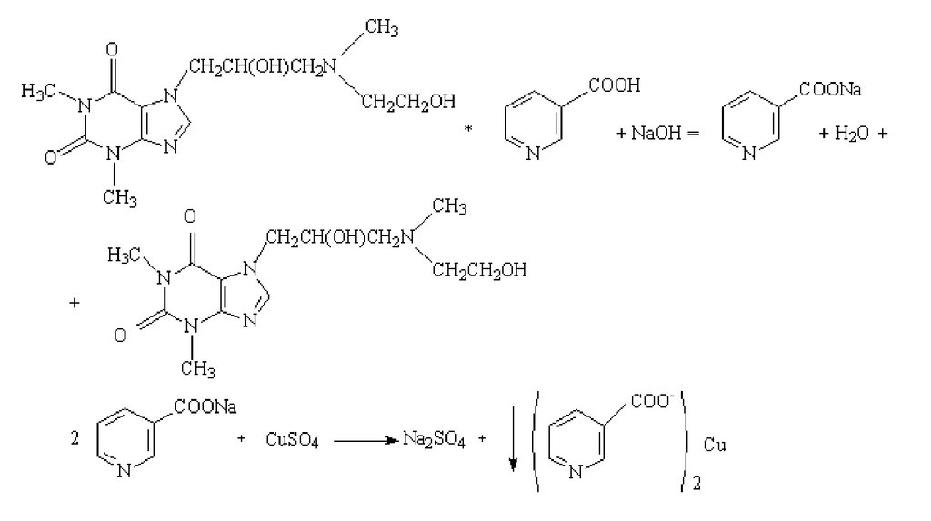
Xantinol Nicotinate
Identification
3. Interaction with common alkaloid reagents
4. Detection of nicotinic acid

Slide 20
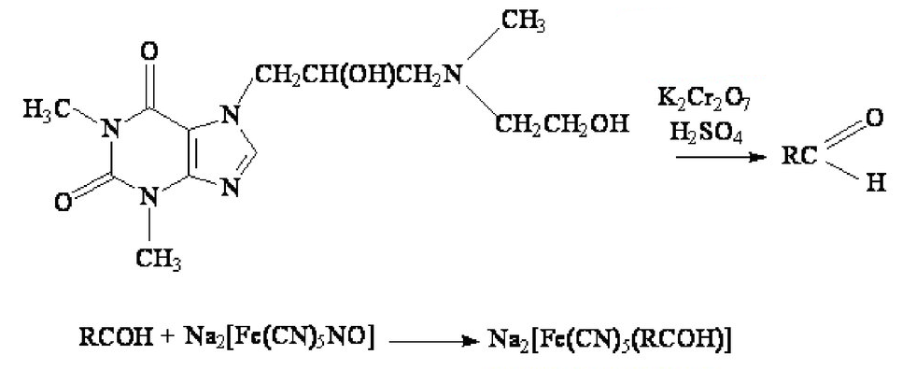
Xantinol Nicotinate
Identification
5. Interaction with potassium bichromate in acidic medium
blue
6. Thin layer chromatography

Slide 21
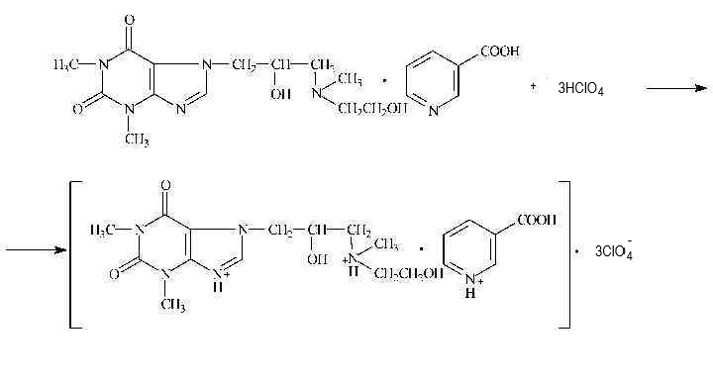
Xantinol Nicotinate
Assay
1. Kjeldahl method
2. Non-aqueous titration

Slide 22
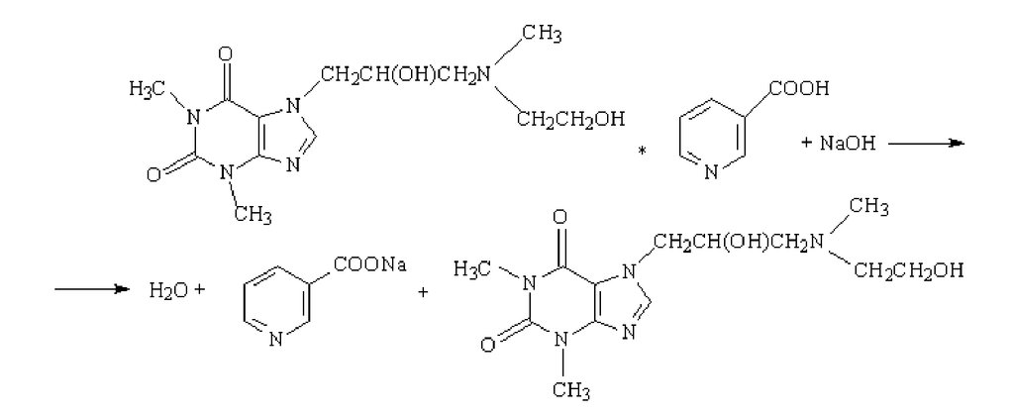
Xantinol Nicotinate
Assay
3. Alkalimetry
4. Spectrophotometry
5. GC
6. HPLC

Slide 23
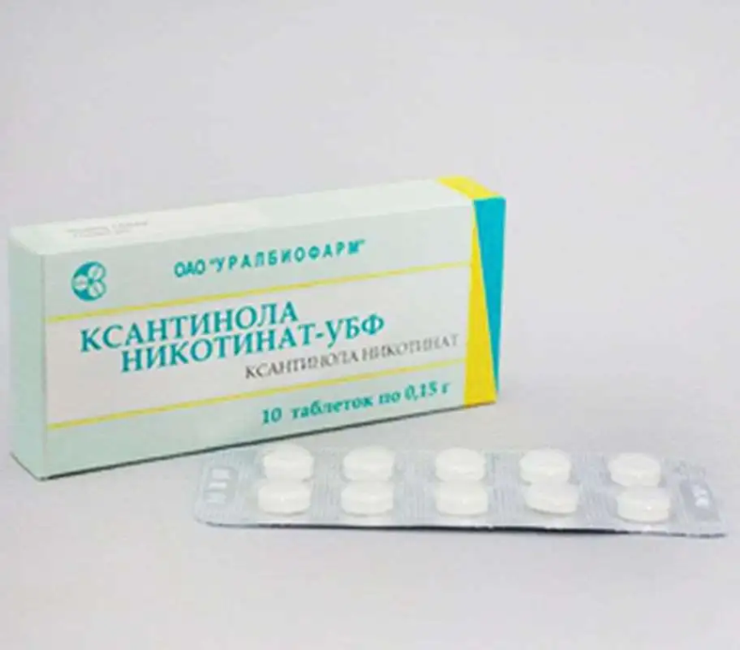
Xantinol Nicotinate
Storage
Xanthinol nicotinate is stored in well sealed containers.
Medical use
An agent improving microcirculation; combines the properties of theophylline and nicotinic acid. Causes dilation of peripheral vessels, improves collateral circulation, improves microcirculation, improves tissue oxygenation and nutrition. It has antiaggregant effect, activates fibrinolysis, improves cerebral circulation, reduces blood viscosity.

Slide 24
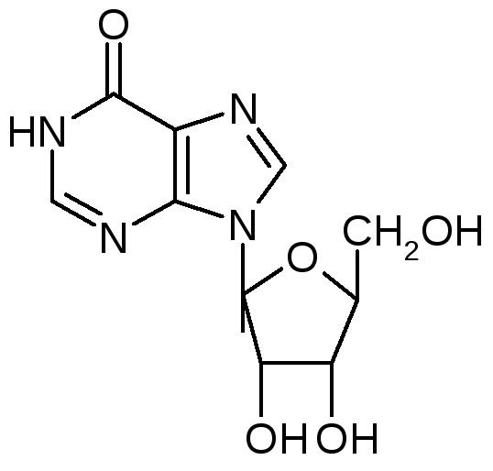
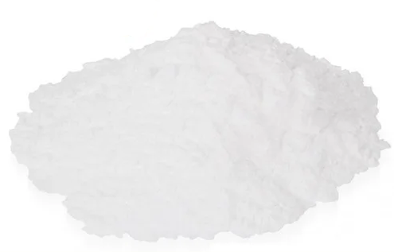
Inosine
Obtaining
Inosine is produced by the microorganism Bacillus subtilis. It is obtained by microbiological synthesis. It is then isolated from native solutions using physicochemical methods.
Physical properties
Inosine is a white powder with a yellowish tinge of colour. Inosine is slowly and moderately soluble in water, very little in ethanol.

Slide 25
Inosine
Identification
1. IR- and UV-spectrophotometry
2. Hydrolysis

Slide 26
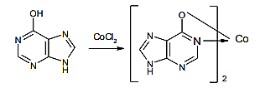
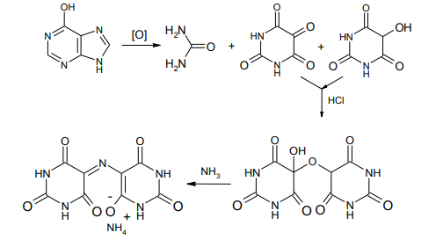
Inosine
Identification
Interaction of hypoxanthine with heavy metal salts
Murexide test

Slide 27
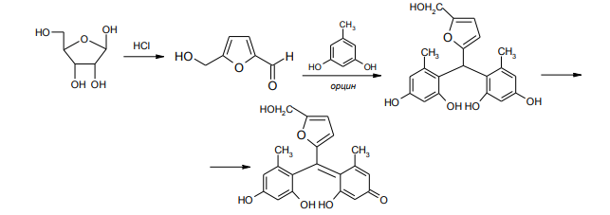
Inosine
Identification
Interaction of a ribose residue with orcin
Condensation reaction with aniline

Slide 28
Inosine
Purity test
The content of hypoxanthine and guanosine in inosine should not exceed 2.5%, and unidentified impurities - 0.5%. Their content is determined by HPLC, using 0.02 M solution of sodium hydrophosphate as a mobile phase. Calculations are made on the basis of peak areas of these impurities.
The pH value of aqueous solution of riboxin should be from 4.5 to 6.0 (potentiometrically),
Water content in riboxin (Fischer method) not more than 1.5 %.

Slide 29
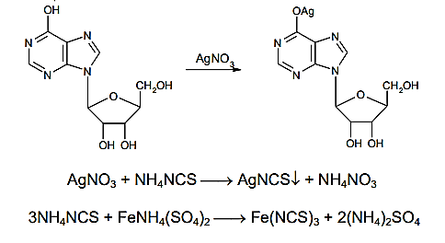
Inosine
Assay
1. Reverse Argentometry

Slide 30
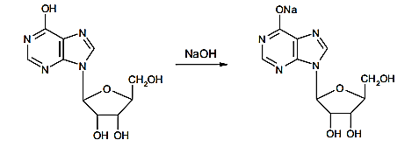
Inosine
Assay
2. Non-aqueous titration
Dimethylformamide is used as solvent. The titrant is 0.1 M sodium hydroxide solution in a mixture of methanol and benzene. The indicator is thymol blue. The end point can be determined potentiometrically.

Slide 31
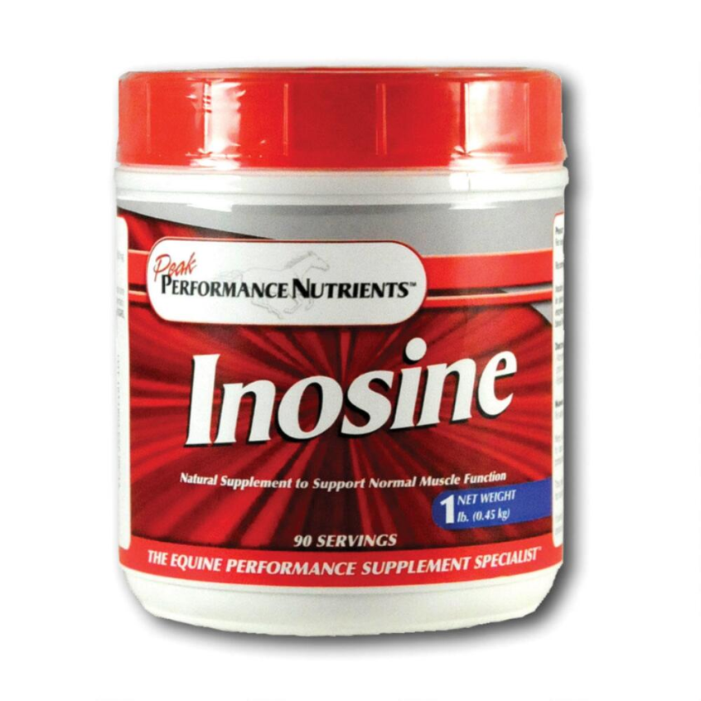
Inosine
Storage
Inosine should be stored in a dry place, protected from light place at room temperature.
Medical use
Inosin is used for the treatment of cardiovascular diseases (ischaemia, myocardial infarction, rhythm disturbance, etc.) in the form of coated tablets of 0.2 g each.

Slide 32
Fopurin
Obtaining
Physical properties
Fopurin is a white with yellowish tinge crystalline powder, Fopurin is soluble in water, ethanol and insoluble in alcohol, ether and chloroform.

Slide 33
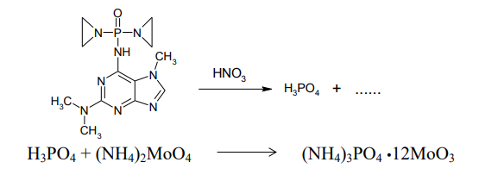
Fopurin
Identification
1. IR- and UV-spectrophotometry
2. Detection of dimethylamine after alkaline hydrolysis
3. Detection of phosphoric acid

Slide 34
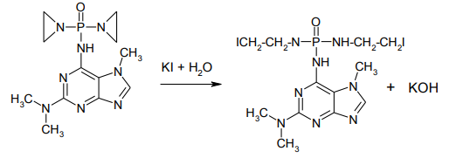
Fopurin
Identification
4. Reaction with ethyleneimino groups

Slide 35
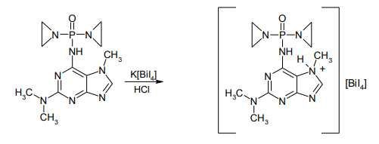
Fopurin
Identification
5. Interaction with common alkaloid reagents

Slide 36
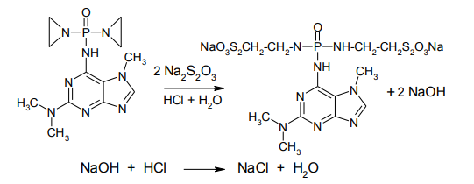
Fopurin
Assay
1. Spectrophotometric determination
2. Indirect neutralisation

Slide 37
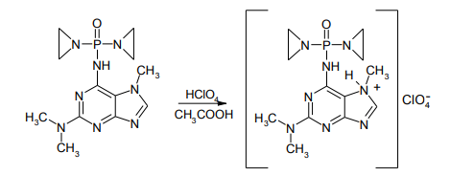
Fopurin
Assay
3. Non-aqueous titration

Slide 38
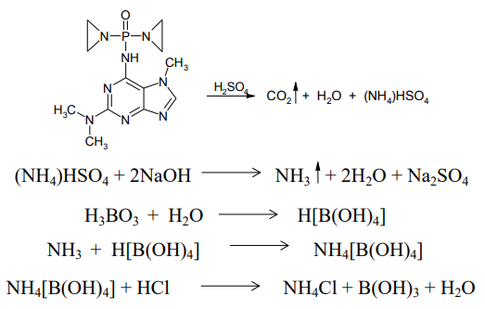
Fopurin
Assay
4. Kjeldahl method

Slide 39
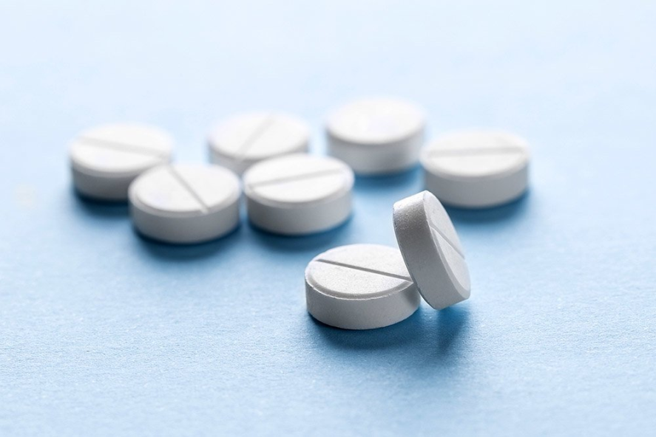
Fopurin
Storage
Fopurin is stored in a dry place, protected from light, at a temperature not exceeding +10 oC, in well-closed containers of dark glass, in a place protected from light, as it is easily oxidised by UV light.
Medical use
Fopurin contains alkylating groups and is structurally similar to purine metabolism antimetabolites. Due to its alkylating and antimetabolite activity, fopurin affects cells at all stages of the cell cycle and is a broad-spectrum antitumour agent. Malotoxic. It is used in acute and chronic leukaemia, cutaneous reticulosis (name given to tumours of the blood system), retinoblastoma (a rare type of eye cancer), psoriasis.

Slide 40
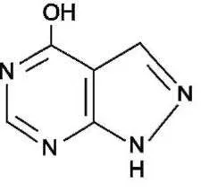
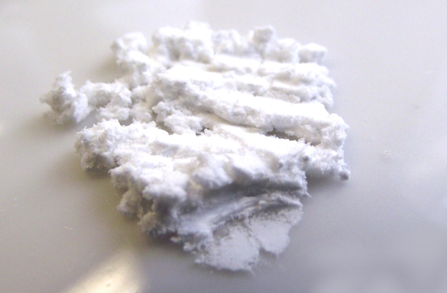
Allopurinol
Physical properties
White or white with a creamy tinge fine crystalline powder.
Allopurinol is very insoluble in water and ethanol, practically insoluble in chloroform and ether, moderately soluble in dimethyl sulfoxide, easily soluble in solutions of alkali metal hydroxides.

Slide 41
Allopurinol
Identification
1. IR- and UV-spectrophotometry
2. Interaction with Nessler's reagent
With Nessler's reagent in alkaline medium, allopurinol forms a yellow flaky precipitate of mercury salt after heating to boiling.
3. Formation of heavy metal salts
4. Murexide test

Slide 42
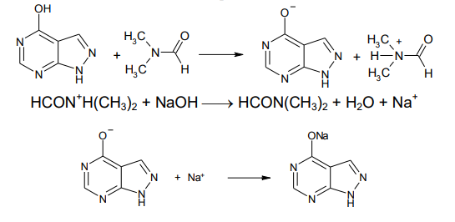
Allopurinol
Assay
Non-aqueous titration

Slide 43
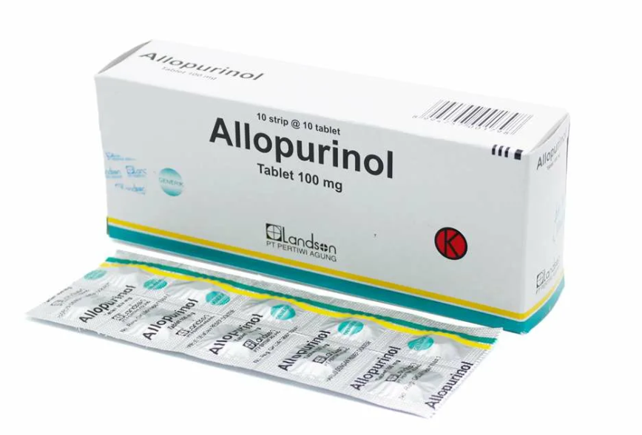
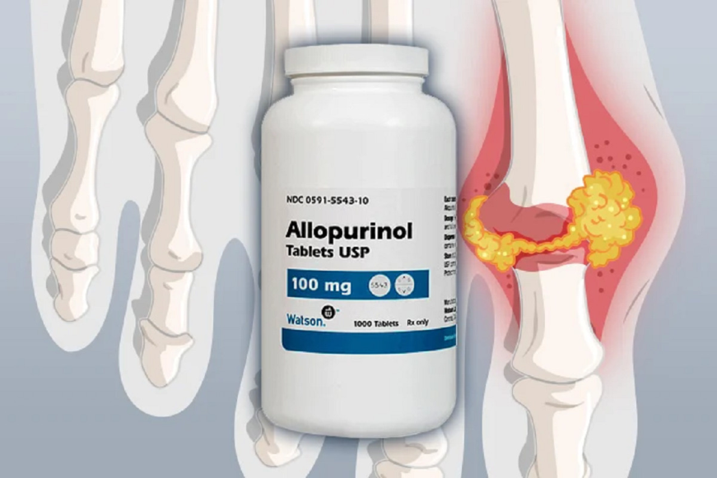
Allopurinol
Storage
Allopurinol is stored in well sealed containers, in the protected from light.
Medical use
Treatment and prevention of gout and hyperuricemia of various aetiologies (including in combination with nephrolithiasis, renal failure, uricosuric nephropathy). Increased urate formation due to enzyme disorders. Prevention of acute nephropathy in cytostatic and radiotherapy of tumours and leukaemia, and in total therapeutic fasting.

Slide 44
Thank you for attention!

