Slide 1
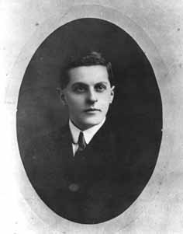
Theme: Western rationalism (of XIX-XX centuries).
Neopositivism (L. Wittgenstein, B. Russell, Vienna Circle)
The third stage of positivism is neopositivism or logical positivism. Its influential trend of western philosophy appeared in Europe in 20-th years of 20 century. Among the representatives of this trend were English philosopher B. Russell, Austrian philosopher L. Wittgenstein and members of so-called Vienna Circle: R. Carnap, M. Schlick, H. Reichenbach and some others.
L. Wittgenstein
1889-1951

Slide 2
Logical positivism tried to supersede traditional philosophy from the sphere of research of scientific cognition. Positivism, in fact, infringed on existence of philosophy as itself, when applied to analysis of “metaphysics” some criteria of science status.
Thinkers of Vienna Circle formulated fundamental principle of logical positivism:
the principle of verification.
According to this principle, concept or statement has meaning if and only if it can be verified, empirically.

Slide 3
L. Wittgenstein, one of the founders of analytical philosophy propounded the idea of construction of “logically perfect”, “ideal”, artificial language. Prototype of this language is the language of mathematical logic. Thinker tried to spread the characteristics of logical formalism at all totality of knowledge about world. Affirmations of formal logic were regarded as the specimen of the expression of the schemes of the formal transformation of the profound affirmations about world.
According to Wittgenstein, the greater part of sentences and questions, which were stated with regard to philosophic problems are simply meaningless. Therefore it shouldn’t be spoken nothing except what is possible to state and it must be the statements of science. Philosophy is possible only as criticism of language, clarifying its logical structure and eliminating indistinctions and errors. “The aim of philosophy is the logical clarification of thoughts”.

Slide 4
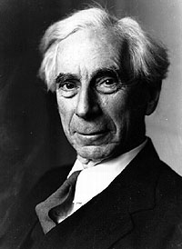
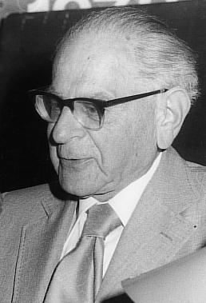
B. Russel, one of very few representatives of positivism, who didn’t reduce philosophy to science, to logic. According to Russel, logic is not all philosophy, but important part of philosophy. Logic must be used in philosophy. The philosophy of K. Popper was called postpositivism. Popper working out the theory of growth of scientific knowledge, opposed to the principle of verification his principle of falsifiability.

Slide 5
According to the latter any principle of science must be subjected to refutation. The real science must not fear refutations: rational criticism and constant correction by facts is the essence of scientific cognition. Constantly propounding new hypotheses and theories must go through strict selection in the process of rational criticism and attempts of refutations. Only the most powerful (strong) theories must survive, but they can’t be regarded as absolute truths (verities).

Slide 6
Pragmatism.
In the second half of 19-th century in the United States new philosophy appeared. It was the philosophy of pragmatism. Pragmatism comes of Greek word “pragmatos” which means “action”, “affair”. Pragmatic philosophy says, that affair, action must be positive and useful.
Pragmatic philosophy based on the principle that the usefulness, workability, and practicality of ideas, policies, and proposals are the criteria of their merit. It stresses the priority of action over doctrine, of experience over fixed principles, and it holds that ideas borrow their meanings from their consequences and their truths from their verification. Thus, ideas are essentially instruments and plans of action.

Slide 7
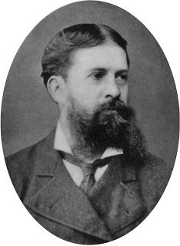
The founders of pragmatism, philosophers
Ch. Peirce, W. James, J. Dewey realized reconstruction of philosophy. The essence of reconstruction is to make philosophy means for good existence of man in society. To transform it in methodology of extraction and achievement of profit. Ideas and theories are called to be necessary instruments.
Ch. Peirce
1839-1914

Slide 8
Knowledge is instrumental - a tool for organizing experience satisfactorily. Concepts are habits of belief or rules of action. Values, which arise in historically specific cultural situations, are intelligently appropriated only to the extent that they satisfactorily resolve problems and are judged worth retaining. Truth is belief that is confirmed in the course of experience and is therefore fallible, subject to further revision.
Hence, the term “instrumentalism” appeared. According to James, mentality is the means of the adaptation of organism to environment for successful action. Function of thought is the choice of means, which need for achievement of purpose. According to Peirce, usefulness defines the meaning of verity, its effectiveness.

Slide 9
Theme: Western irrationalism.
The classical philosophy in 17-19-th centuries firmly believed in power and purposefulness of mind. According to this conception, the improvement of mind, progress must be realized through scientific knowledge, enlightenment of the masses, democracy. For the fulfillment of this purpose knowledge must be distinct, clear, demonstrative and has logically-conceptual structure. Philosophers of classical period believed in possibility of rational cognition of human, humanistic ideals, ideal of freedom, principle of personal dignity. But all this problems worked out in the limits of general which got complete expression in Hegel’s philosophy.

Slide 10
Yet during Hegel’s lifetime philosophers have appeared, who thought that life man with his feelings will intuition, unconscious impulses are inexplicable through rationalism. Thus irrationalism appeared. The study, according to which, decisive factor in cognition, in human behavior, in world outlook, in the course of historical process is something irrational (unreasonable, unconscious).
In general, irrationalism implies either (in ontology) that the world is devoid of rational structure, meaning, and purpose; or (in epistemology) that reason is inherently defective and incapable of knowing the universe without distortion; or (in ethics) that recourse to objective standards is futile; or (in anthropology) that in human nature itself the dominant dimensions are irrational.

Slide 11
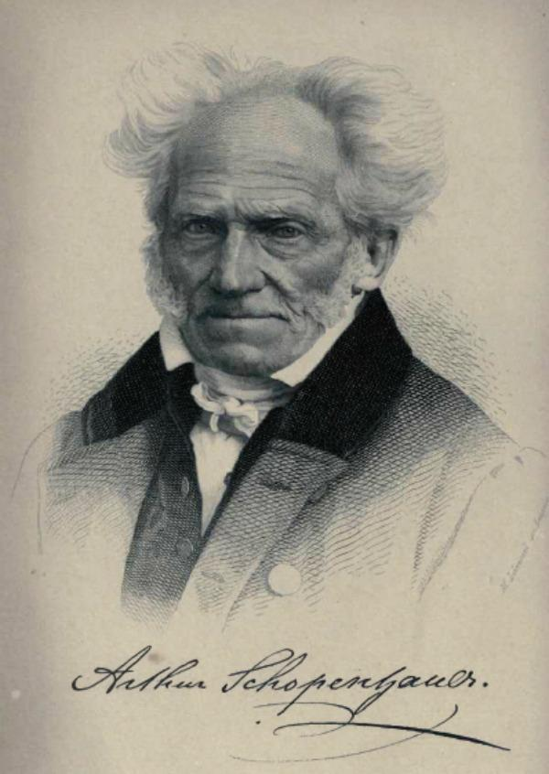
The principles of irrationalism were laid by two great philosophers of 19-th century:
Arthur Schopenhauer
and
Soren Kierkegaard.
Schopenhauer made his philosophy, proceeding from the ideas of Buddhism, of Plato and Kant. He asserted, that the world of human experience is only total combination of ideas, which is like appearance.
Arthur Schopenhauer
1788-1860

Slide 12
Everything around people is the total combination of sensually-intuitive ideas of subjects, that is people, who themselves are only ideas too. All world of phenomena is imagined by certain metaphysical Will, which is behind the world of phenomena. This Will is like “thing in itself” of Kant. It is unitary, unfathomable, and unchangeable, beyond space and time, without causes and purposes. It is impersonal super object, freedom as antimoral reality. This freedom is irrational and acts as eternal formation, aimless desire, which is able to generate any evil.

Slide 13
Will is the irrational power, aspiring to confirmation of life and forcing all living creatures to act in this direction. Will is in the state of the eternal dissatisfaction, it must devour itself, because, there is no anything, except it and it is the hungry Will. Therefore, the life of people is full of torments, alarms and disillusionments, for the people are slaves, instruments of Will to life. However, people are able to direct their vital energy against Will.

Slide 14
It is realized though the action of isolated persons.
There are two stages in this action:
1. Aesthetic contemplation. The purpose of art is bringing by art temporary consolation, lull and oblivion, transforming man to “will-less subject”.
2. Ethical sphere of activity. When man suppresses in himself Will to life and disavows it.

Slide 15
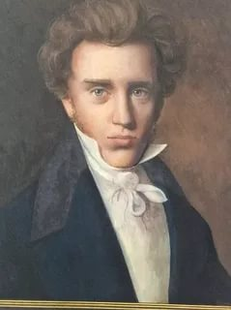
Soren Kierkegaard is the creator of existential dialectics, that is the dialectics of unique individual. The central idea of Kierkegaard is the principle of human individuality. Individual is the spiritual human creature, who opposes himself to all world. Only individual has, what Kierkegaard called “existence”.
S. Kierkegaard
1813-1855

Slide 16
“Existence” is the specifically human category, expressing being of unique individuality in the flood of inner unique experiences. This term was included in philosophy of 20-th century. Kierkegaard describes human existence as an unfinished process, in which “the individual” (a key concept in his thought) must take responsibility for achieving an identity as a self through free choices. In accord with his claim that existence cannot be reduced to intellectual thought, Kierkegaard devotes much attention to emotions and passions.

Slide 17
In opposite to German classic idealism and rational Hegel’s philosophy more, Kierkegaard supposes that the first is clear existence (existentialism) and the second is rationalism. The main parameters of existence are freedom the possibility of choice, fear, anxiety, despair.
The social problem of moral choice was reflected in Kierkegaard’s study about three spheres of individuals being, three stages of his earthy development, three ways (styles) of life:
1. Aesthetic. This is the sense way of vital activity for which sensuality, cynicism, confusion, chance are characteristic. Aesthetic man lives by instant, in pursuit of sense pleasures. More refined aesthetic man aspires for beauty, which is the illusion of freedom. The result of this study is boredom. However man that lives the life of spirit constantly feels disharmony, horror and fear in the face of unknown. Break-through to ethic study is happened through the despair. If man overcomes the despair when he begins to comprehend true essence of life.

Slide 18
2. Ethical. At this stage man sets himself in position “either - or” and decides on act of choice. For ethical man the sense of blame and repentance arises owing to choice.
3. Religious. Now individual selects himself as sinner, guilty in the face of God. According to Kierkegaard, in such way man enters into dialogue with God and in God he finds himself as individual personality, through repentance confirms himself. And breaks to faith. This faith is the paradox, special condition of human being, which is madness for rational point and view. But this madness signifies the possibility of such world in which each man could fulfill his human intention.

Slide 19
In the end of 19-th century appeared “philosophy of life”, which affirms insufficiency of mind for creation of integrated world outlook. The concept “life” is proposed. It is treated as psychology experience.

