Slide 1
«General pharmaceutical chemistry »
Pharmacist-analyst of a pharmacy. equipment of the analytical room
Associate Professor Gureeva E.S.

Slide 2
The role of pharmacies with a prescription-manufacturing department
There are some groups of medicines that cannot be manufactured on an industrial scale.
Therefore, manufacturing pharmacies are needed in the medicinal supply of the population.
In the prescription of manufacturing pharmacies, there are dosage forms containing both single and multiple ingredients.
In the prescription of manufacturing pharmacies, there are dosage forms containing both single and multiple ingredients. The variety of physical and chemical properties of the ingredients allows for the use of multiple identification reactions and quantification methods. However, in the case of multi-component mixtures, their choice is often difficult to select.

Slide 3
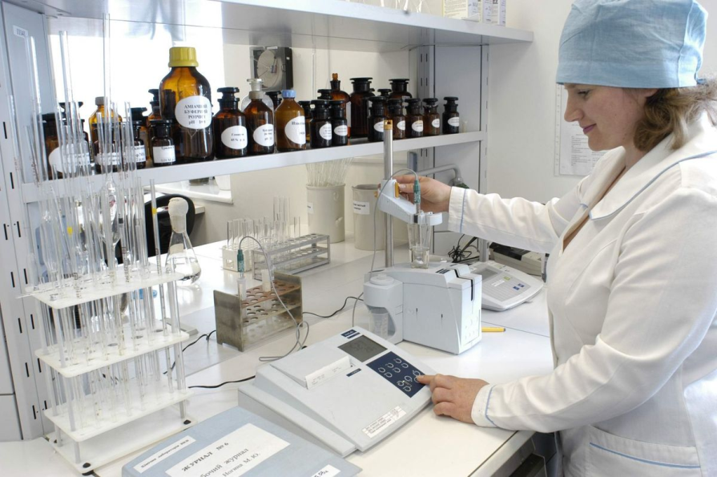
Pharmacist-analyst
Quality control of dosage forms in the pharmacy is carried out by the pharmacist-analyst using express analysis methods.
The pharmacist analyst uses rational quality control schemes for multi-component dosage forms.
A pharmacy analyst is a pharmacy specialist whose functional tasks include carrying out various types of In-pharmacy controls of pharmaceutical substances, water purified/injectable water, concentrates, semi-finished products, pharmaceutical preparations manufactured in a pharmacy.

Slide 4
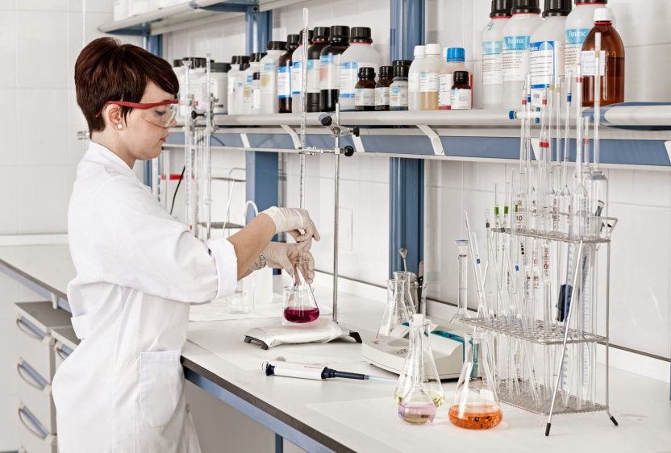
Pharmacist-analyst
The pharmacist-analyst
must have higher pharmaceutical education,
must be accredited,
have a certificate of a specialist confirming the degree of compliance of his/her professional competence with established requirements.
In his /her activity he / she submits to the head of the pharmacy.
The main work of the analytical pharmacist is to provide chemical and physico-chemical quality control of medicines manufactured in the pharmacy and substances used in the production of medicines. Also methodological management of all types of intra-pharmacy control.
The work of the pharmacist-analyst is regulated by orders of the Ministry of Health.

Slide 5
In his work, the pharmacist-analyst is guided by:
regulatory documents on the issues of the work performed;
methodological materials related to relevant issues;
Regulations on pharmacy establishment;
rules of the sanitary regime of pharmacies and labor regulations;
orders and instructions of the director of the enterprise (immediate supervisor);
job description.

Slide 6
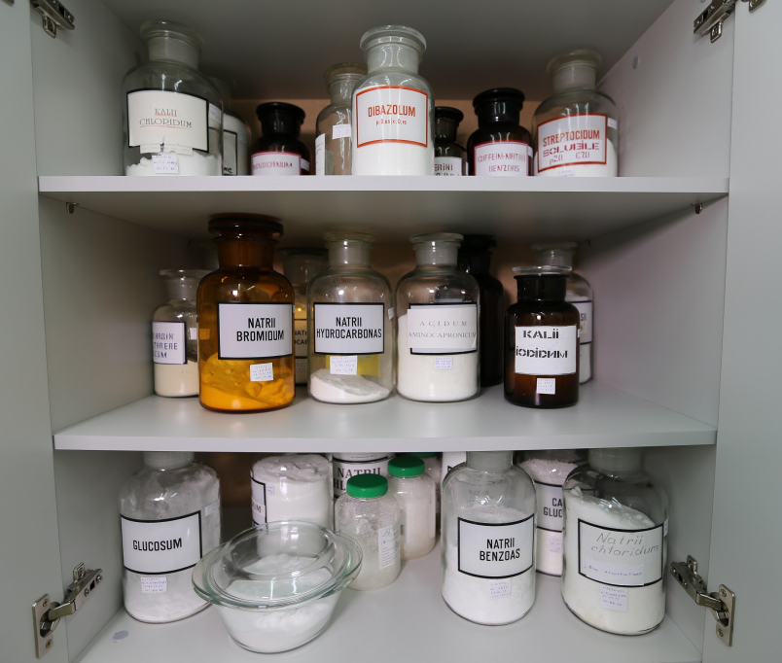
Responsibilities of a Pharmacist Analyst
master all types of chemical and physicochemical methods of analysis;
to exercise control over compliance with the preparation technology and storage conditions of medicines, the expiration date of concentrates and semi-finished products;
in necessary cases, give consultation on storage, manufacturing technology and control of medicines, sanitary regime, etc.;
to conduct a selective qualitative analysis of drugs that are in doubt;

Slide 7
Responsibilities of a Pharmacist Analyst
to conduct a complete chemical analysis of the seized samples of medicines;
to conduct, in accordance with the established procedure, the withdrawal of samples of drugs for re-control;
to supervise the work of the subordinate pharmaceutical personnel;
to report all cases of errors to the head of the pharmacy and take measures to eliminate them.

Slide 8
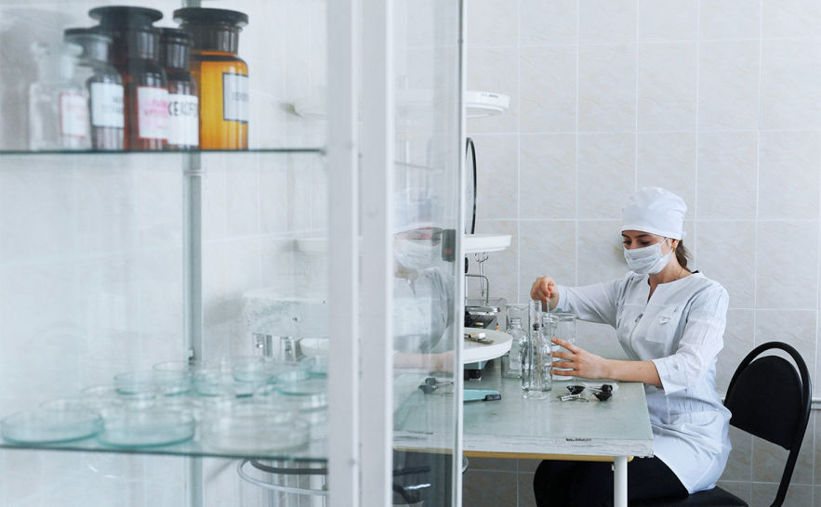
Professional and job requirements for the pharmacy pharmacist-analyst
The professional and job requirements for the pharmacy dispensary analyst include two areas:
contains the requirements for what the pharmacy pharmacist-analyst must know (theoretical training);
contains the requirements for the pharmacist-analyst to be able to do (practical training).
Both of these areas are interconnected. Since it is impossible to master practical skills without appropriate theoretical knowledge.

Slide 9
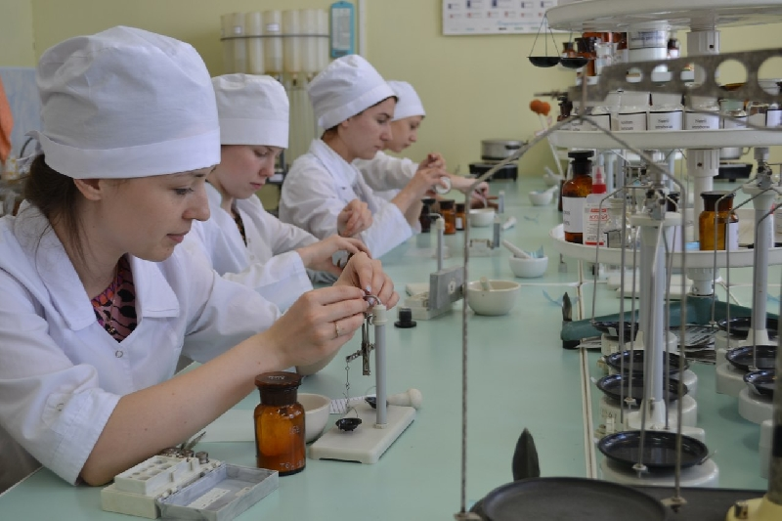
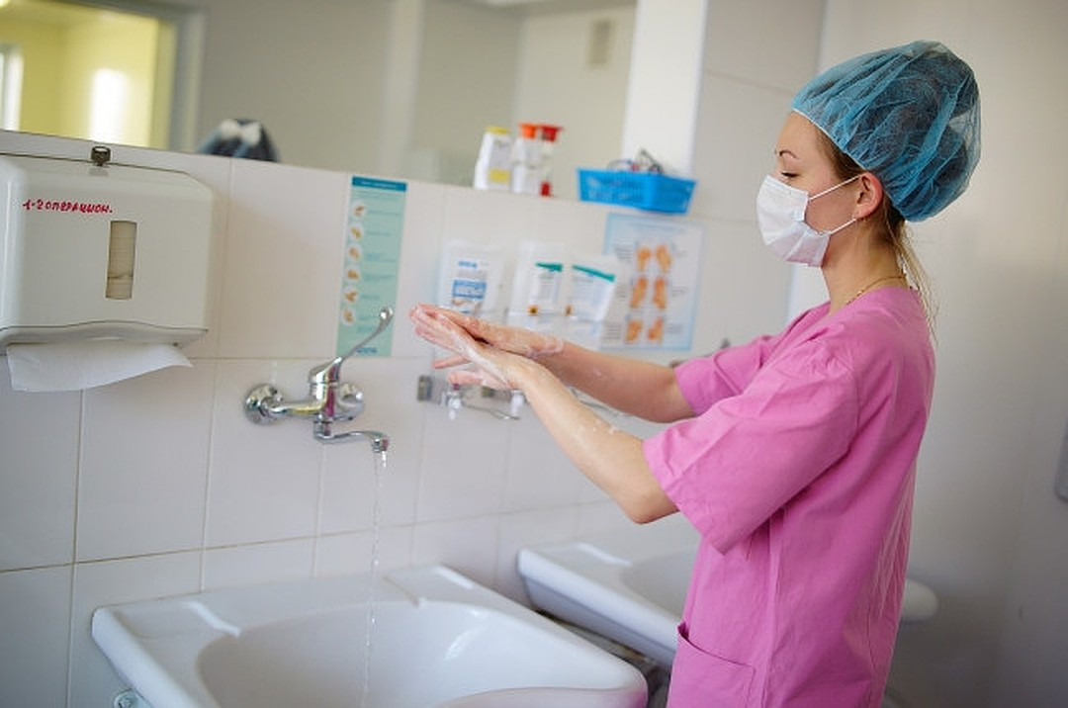
A pharmacist-analyst must know:
the system for organising the quality control service;
the technology of different types of dosage forms;
rules and norms of sanitary-hygienic and anti-epidemic regime, rules of aseptic medicine production, pharmaceutical procedure in accordance with the current regulatory documents, orders, instructions;

Slide 10
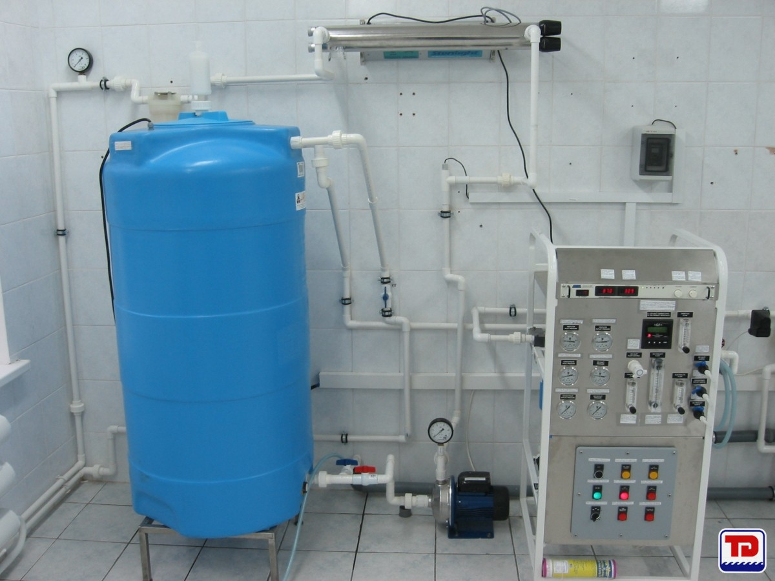
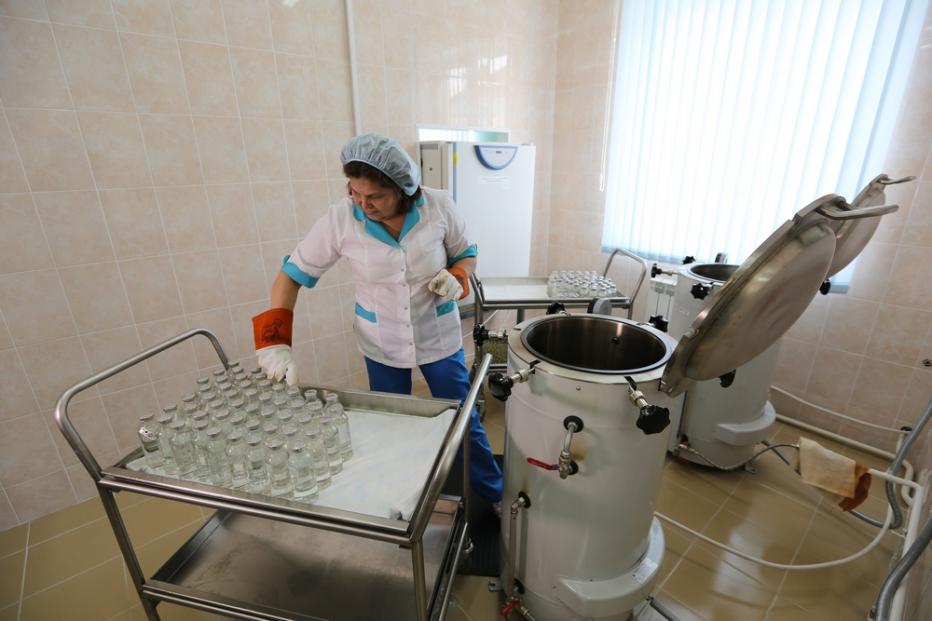
A pharmacist-analyst must know:
rules for obtaining, collecting and storing purified water and water for injections;
rules for storing medicines in the pharmacy, expiration date of medicines made in the pharmacy;
all types of in-pharmacy control of medicinal products as required by the current instructions on quality control of medicinal products manufactured in a pharmacy;

Slide 11
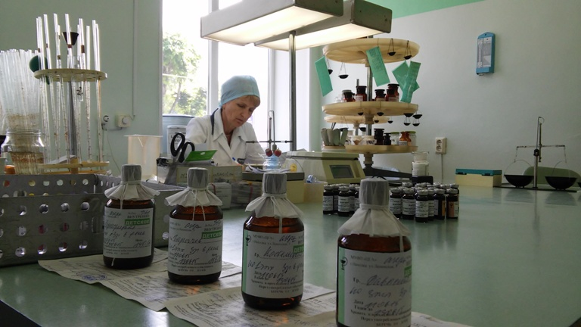
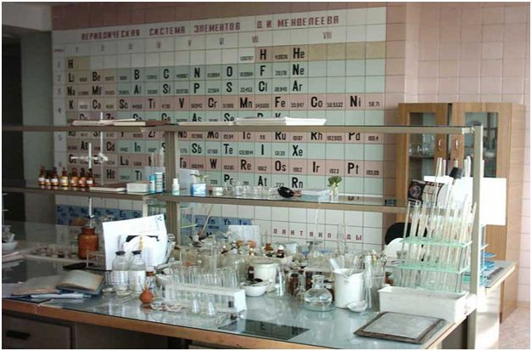
A pharmacist-analyst must know:
express methods of quality control of medicines in the pharmacy;
quantitative analysis of medicinal products using various methods;
standards of deviations allowed during manufacture of medicines and packaging;
health, safety and fire safety rules and regulations;
normative legal acts and other guideline materials of higher authorities on pharmacy issues;

Slide 12
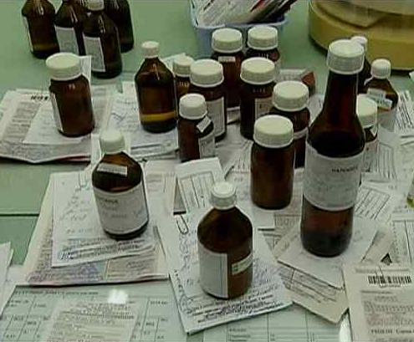
A pharmacist-analyst must know:
the principles of providing pharmaceutical care to the population, and the professional activities of the position held;
organisation and economics of pharmacy;
normative and methodological materials on analysis and quality control of medicines, pharmaceutical order, sanitary regime of pharmacies;
basics of labour legislation;

Slide 13
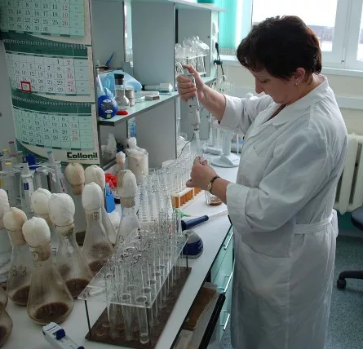
A pharmacist-analyst must be able to
use reference books, guidelines, orders and instructions
on the organisation and management of quality control of medicines in the pharmacy;
supervise the work of young specialists and specialist with secondary education;
conduct all types of intra-pharmacy controls;

Slide 14
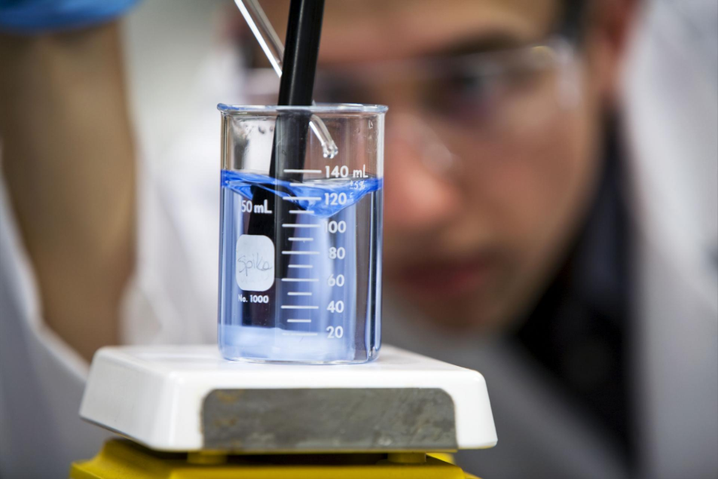
A pharmacist-analyst must be able to
determine the identity of medicinal substances;
conduct daily analysis of purified water and water for injection;
use calculation formulas for titrimetric methods of determination of medicinal substances;
calculate the mass of drug substance required for analysis, the volume of titrated solution, calculate deviations in % and evaluate the quality of manufactured dosage forms;

Slide 15
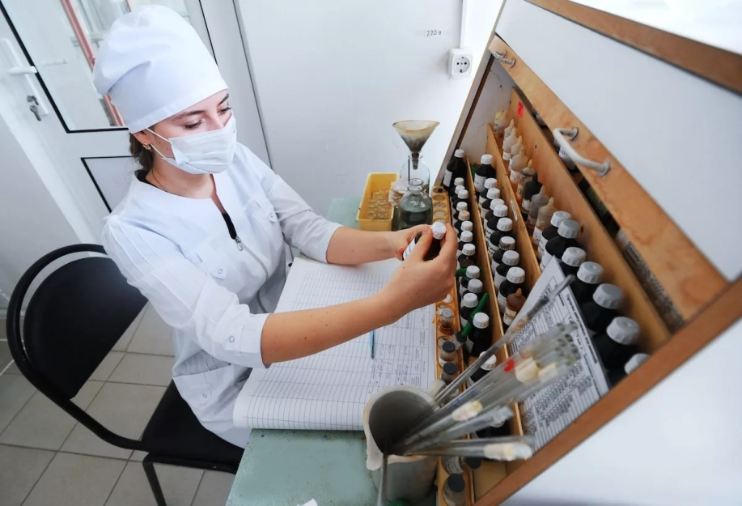
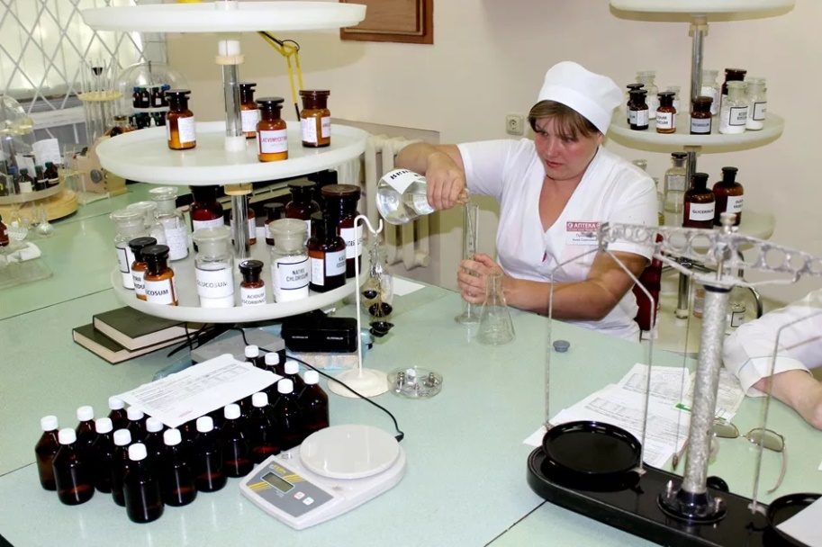
A pharmacist-analyst must be able to
monitor compliance with storage conditions, expiration dates and correct registration of dosage forms;
record the results of analysis, in case of unsatisfactory manufacturing to determine the cause of and take measures to eliminate the mistakes;
prepare a report on the work of the Pharmacy Control and Analysis Room according to the prescribed form.
monitor compliance with the technology for preparing dosage forms in the pharmacy;

Slide 16
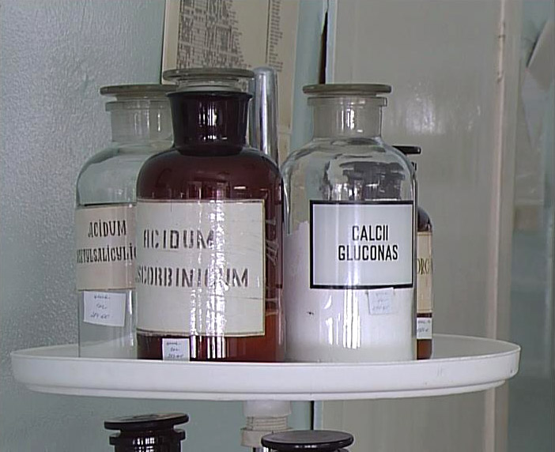
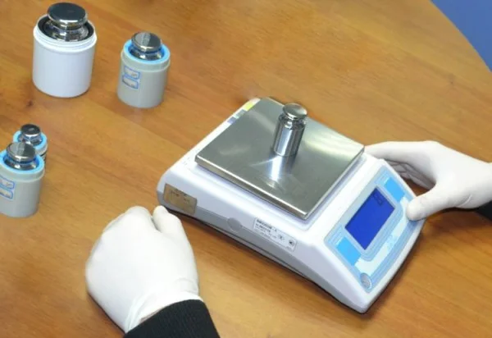
A pharmacist-analyst must be able to
conduct qualitative analysis of powders after filling jar by defectar;
monitor the conditions and expiration dates of medicines, concentrates and extemporaneous dosage forms produced in the pharmacy;
monitor the accuracy of weighing instruments;
monitor the quality of medicines received from suppliers;
control the withdrawal of counterfeit medicines specified in the information letters of the Centre for Certification and Quality Control of Medicinal Products;

Slide 17
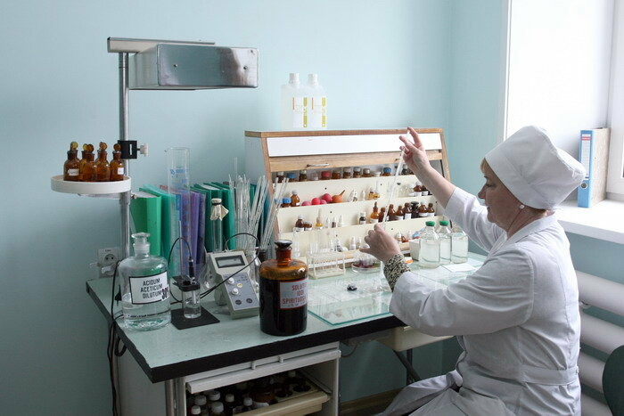
Analytical room
A special workplace must be provided for chemical quality control of medicinal products manufactured in pharmacies. It must be equipped with a standard set of equipment, instruments and reagents, and provided with regulatory documents, reference literature.
Analytical room shall be located near the assistant's room, aseptic room and room for the manufacture of intra-pharmacy preparations, concentrates and semi-finished products.

Slide 18
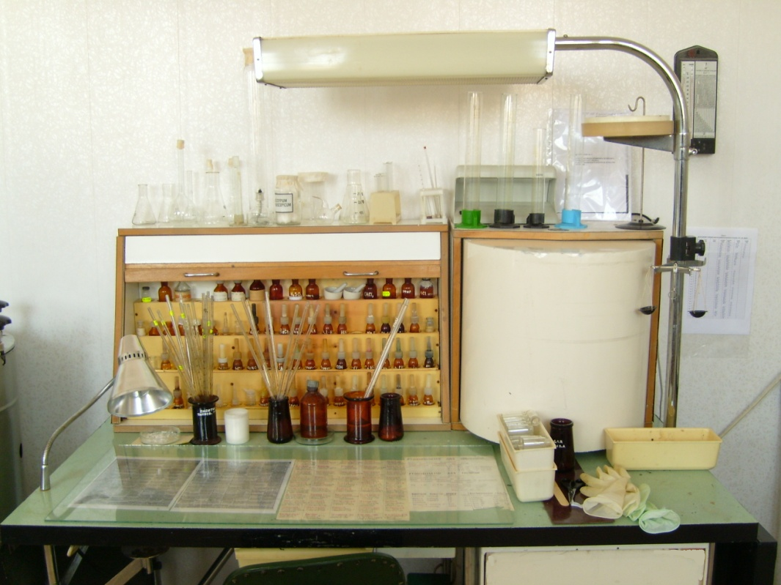
Analytical room
Recommendations:
The analysis room should have a standard analytical table that complies with modern workplace requirements, is easy to use, has a good appearance, and is painted in light-coloured, which helps to increase working efficiency and the analyst's efficiency and fatigue is reduced.
On a table under glass or on a special stand it is advisable to place the methods of analyses of concentrates and semi-finished dosage forms; tables of calculations of quantitative express analyses, tables of qualitative analyses, etc. Some reference materials it is convenient to arrange in the form of cards

Slide 19
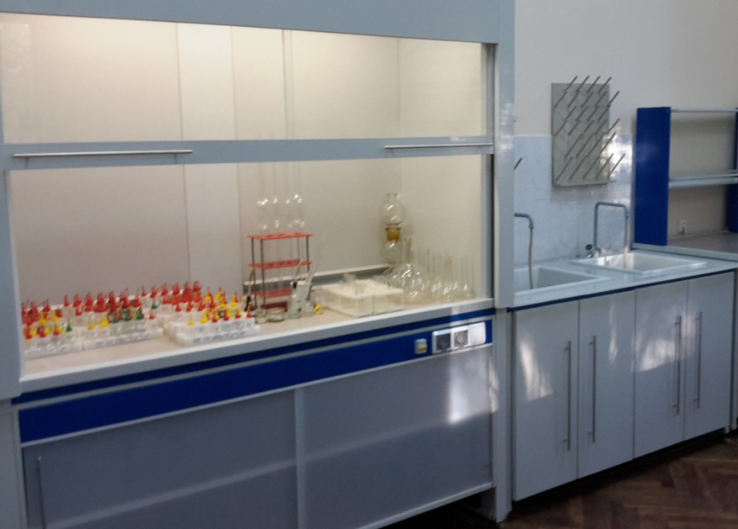
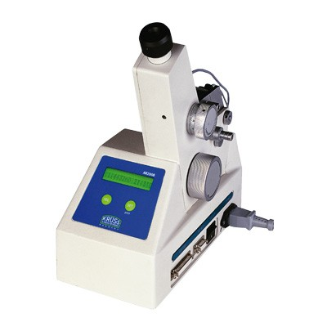
Analytical room
Recommendations:
The analysis room should have: a fume cupboard for work with poisonous, volatile substances and concentrated acids; a water supply with cold and hot water; a sink with a drain to the sewer and an electric supply
Analytical rooms should be equipped with the necessary equipment and inventory in accordance with the requirements of the instructions for drug quality control and the norms of technical and economic equipment of pharmacies

Slide 20
Testing equipment
The Analytical Balance
Quantitation in pharmaceutical analysis is based on accurate weighing of drug sub stances, chemicals, and samples. Such weighing is performed with analytical balances, semi-microbalances, microbalances, or ultra-microbalances to meet the requirements for high accuracy.
Different types of balances used in pharmaceutical analysis

Slide 21
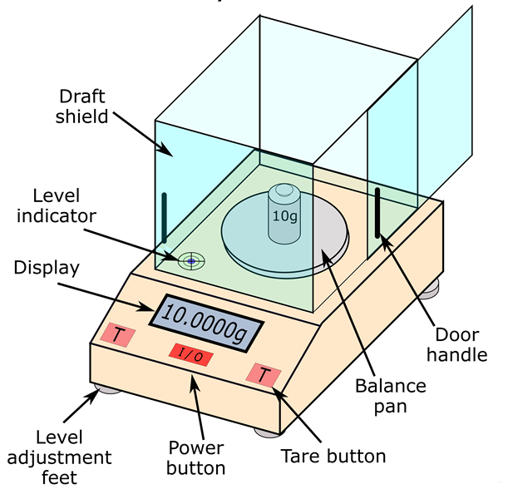
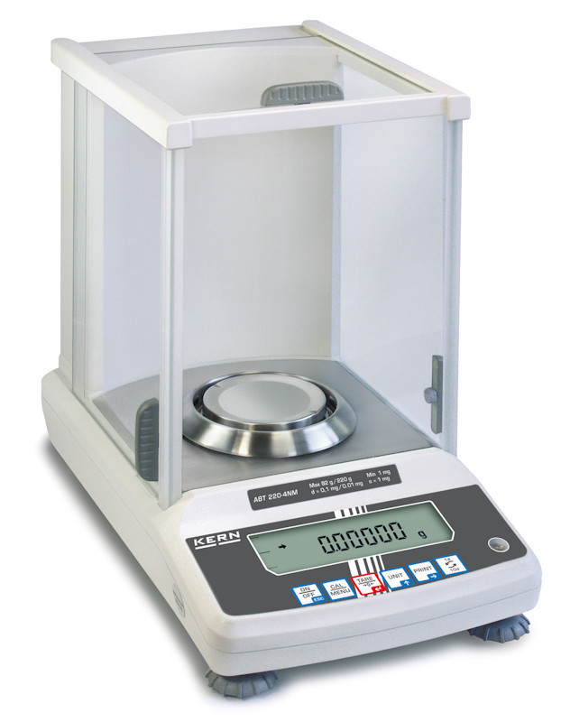
Testing equipment
The Analytical Balance

Slide 22
Testing equipment
The Analytical Balance
A normal weighing procedure with an analytical balance includes the following steps:
Place an empty weighing vessel on the weighing pan (use a vessel of such a size that the loading capacity is not exceeded).
Reset the reading of the balance (tare to 0.0000 or 0.00000 g).
Fill the substance or sample to be weighed into the weighing vessel.
Record the mass on the digital display.
Empty the vessel into the sample container.
Place the vessel on the balance again, read the balance, and subtract this mass from the mass from the first reading.
Clean the balance after use.

Slide 23
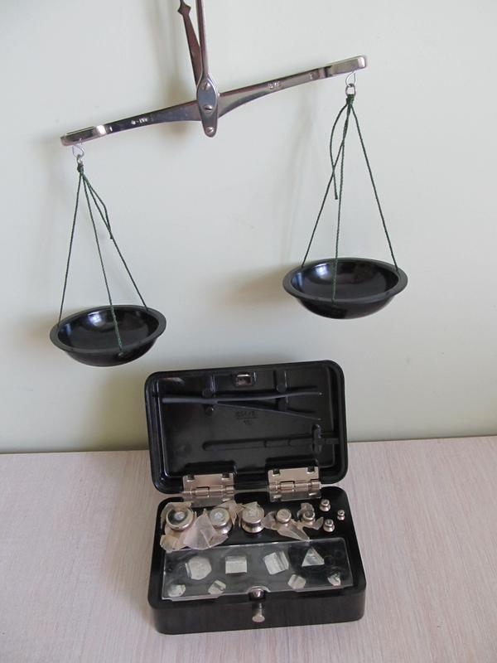
Testing equipment
Hand scales
are used for dosing bulk and viscous substances

Slide 24
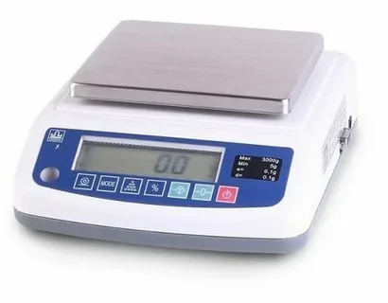
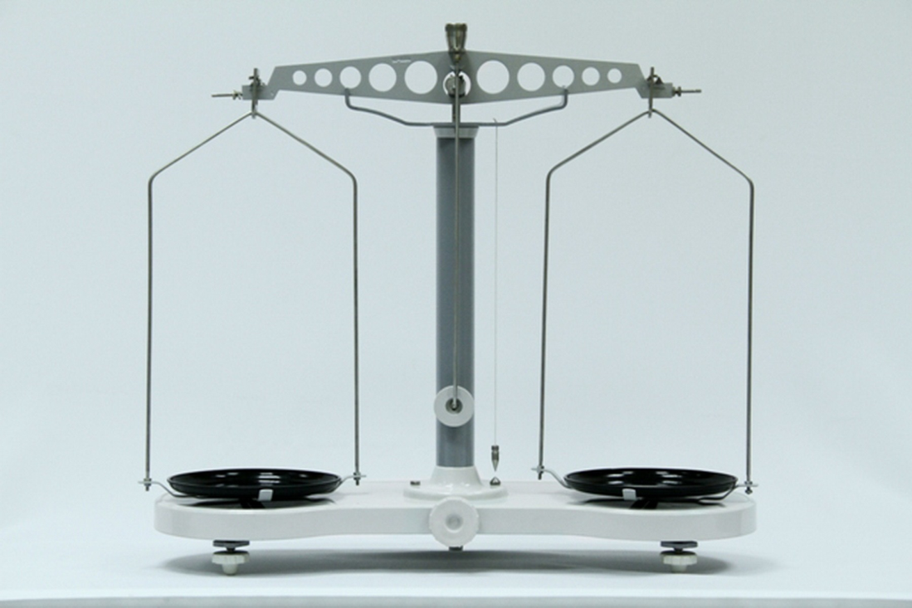
Testing equipment
Technical weights
are used for weighing solid, thick and liquid substances

Slide 25
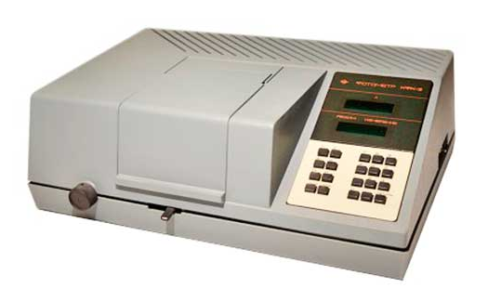
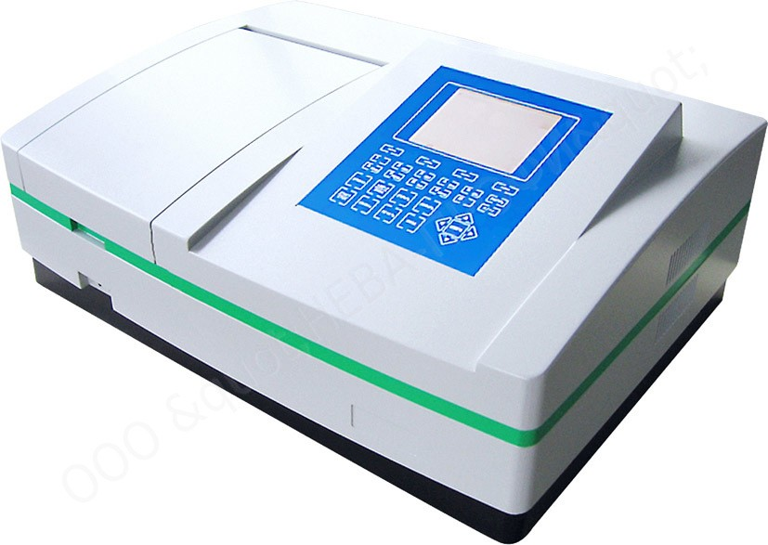
Testing equipment
Colorimeter
Spectrophotometer

Slide 26
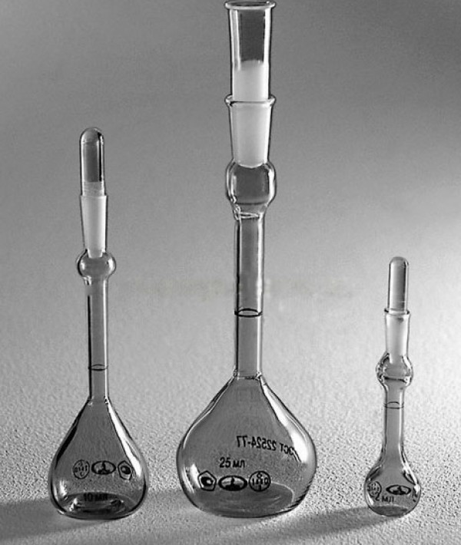
Testing equipment
Thermometers
Aerometers
Pycnometers

Slide 27
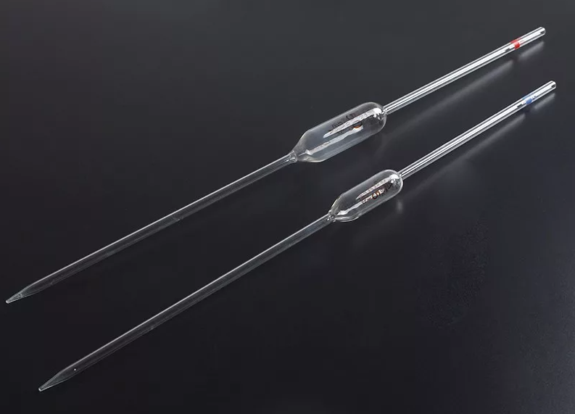
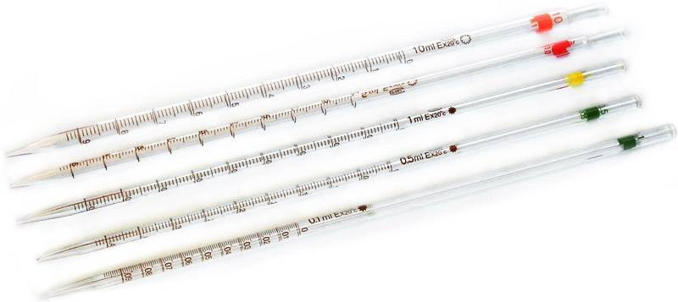
Laboratory utensils
Pipettes
Pipettes are used to deliver exact volumes of liquid.
There are two different types of pipettes, namely a transfer pipette and a measuring pipette.
Transfer pipettes deliver a specified volume, such as 5.00 or 10.00 ml.
Measuring pipettes are graded and used to deliver variable volumes within a specified range, such as, for example, 8.4 ml.

Slide 28
Laboratory utensils
Pipettes
Correct use of pipettes is essential in order to obtain high accuracy.
Place the tip of the pipette into the solution.
Use a rubber balloon to suck the liquid up into the pipette.
Never use your mouth to suck up the liquid.
The pipette is filled to a level higher than the calibration mark of the desired volume.
Then remove the pipette from the solution and remove traces of solution on the outer surface of the pipette with a paper towel.
Hold the pipette tip against the wall of an empty beaker (waste) and drain the liquid until the meniscus just reaches the calibration mark.

Slide 29
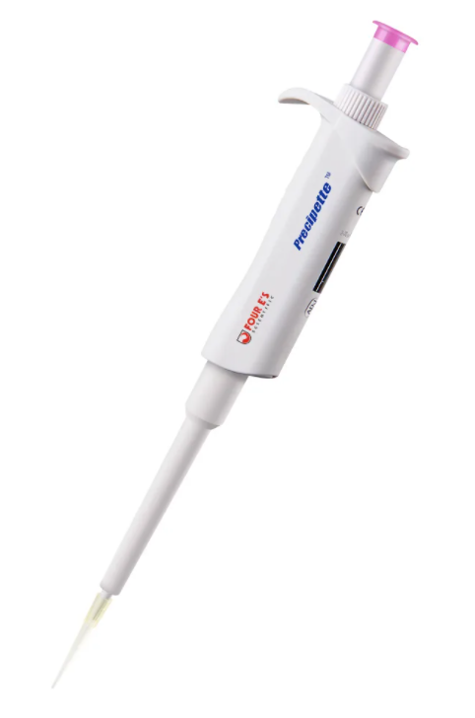
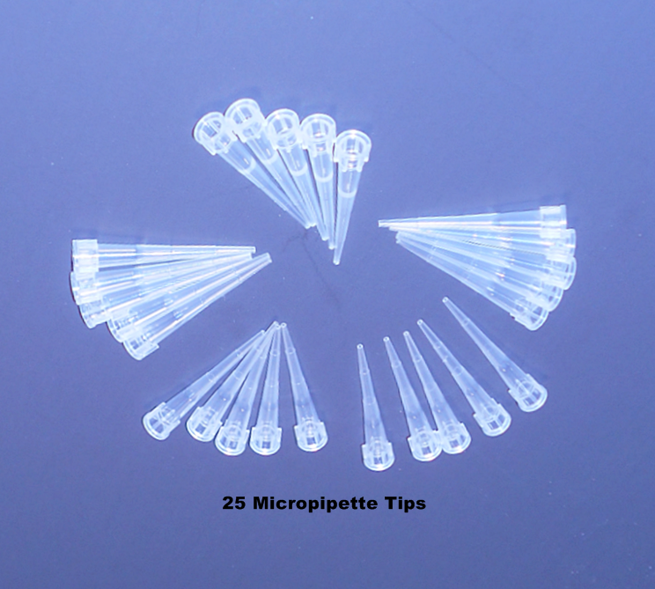
Laboratory utensils
Micropipettes
Micropipettes are typically used to deliver liquid volumes of between 1 and 5000 μL.

Slide 30
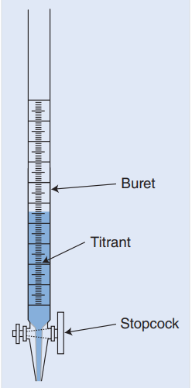
Laboratory utensils
A burette is a long tube of glass with a tap at the lower end.
Along the tube there is a graduation (millilitre scale) that makes it possible to continuously read the volume of liquid delivered from the burette.
Burettes are used in titration, where a solution (titrant) is added gradually to a sample (titrate) until a given point (endpoint) where the titration is terminated.
At this point, the operator can read off the consumption of titrant with high accuracy on the burette. Readings on the burette are made the same way as for pipettes. This means that it is the level of the lower meniscus that is used. When reading the titrant level on a burette, the eye of the operator should be at the same height as the top of the liquid.
Burettes

Slide 31
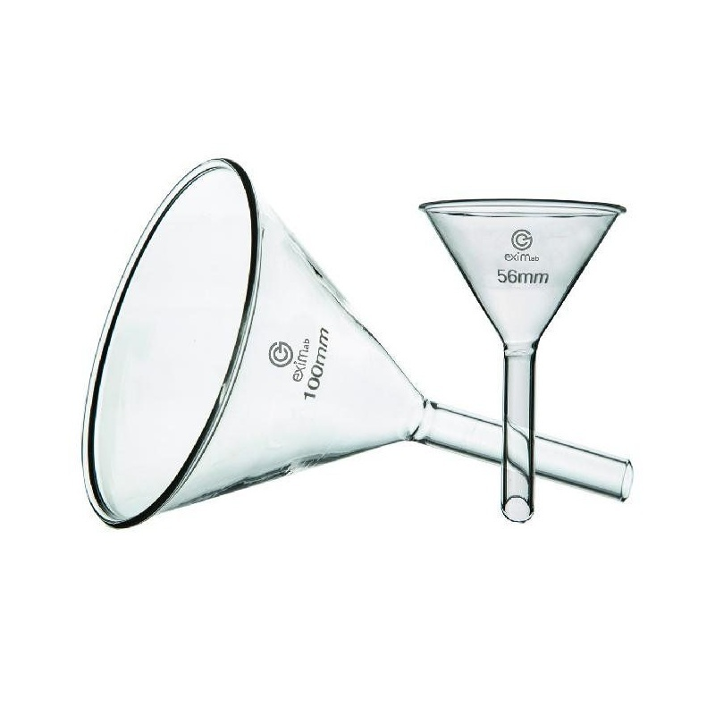
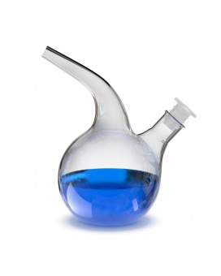
Laboratory utensils
Funnels
Droppers
are used to transfer drops of liquids

Slide 32
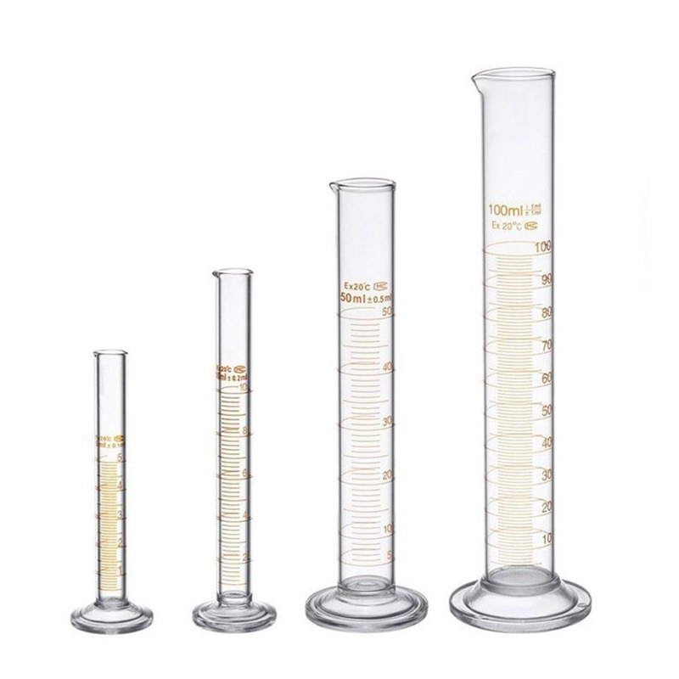
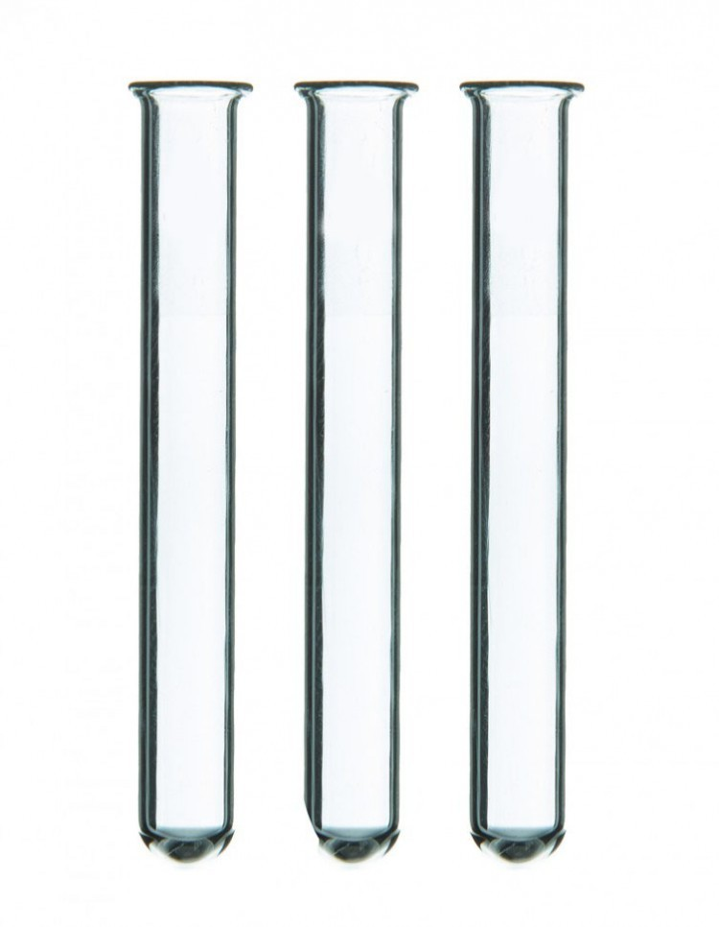
Laboratory utensils
Graduated cylinders
Test tubes
are used to make accurate measurements of liquid volumes

Slide 33
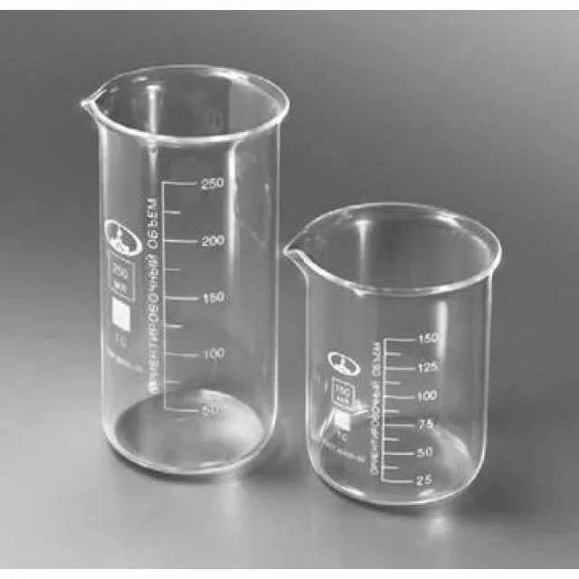
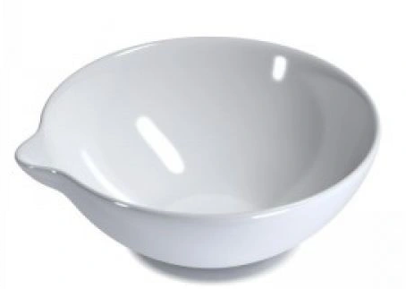
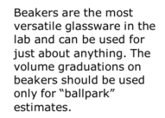
Laboratory utensils
Beakers
Evaporating dish

Slide 34
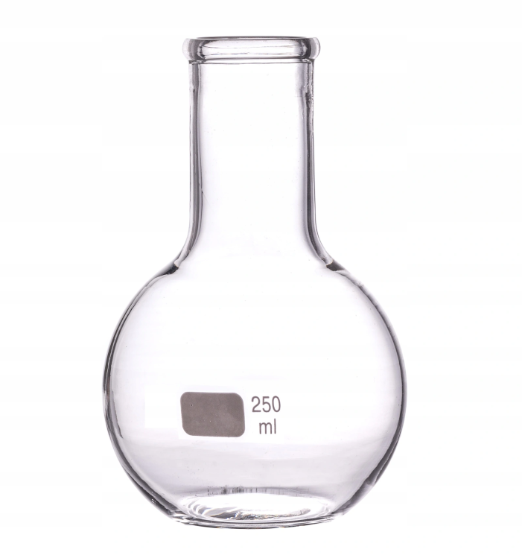
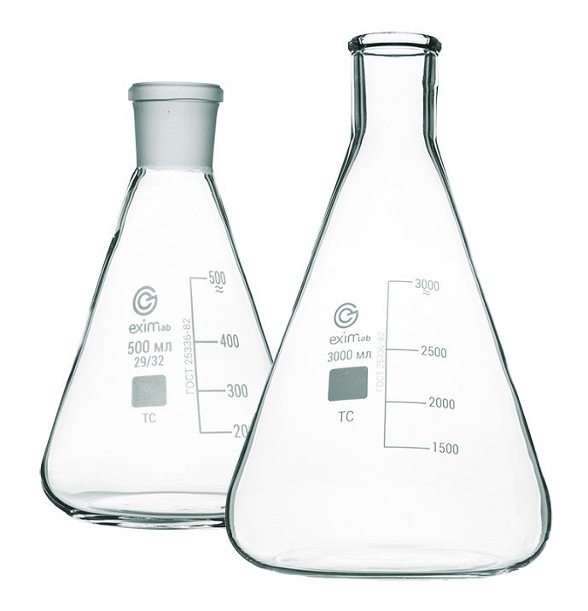
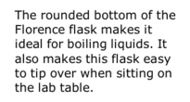
Laboratory utensils
Florence flask
Erlenmeyer flask

Slide 35
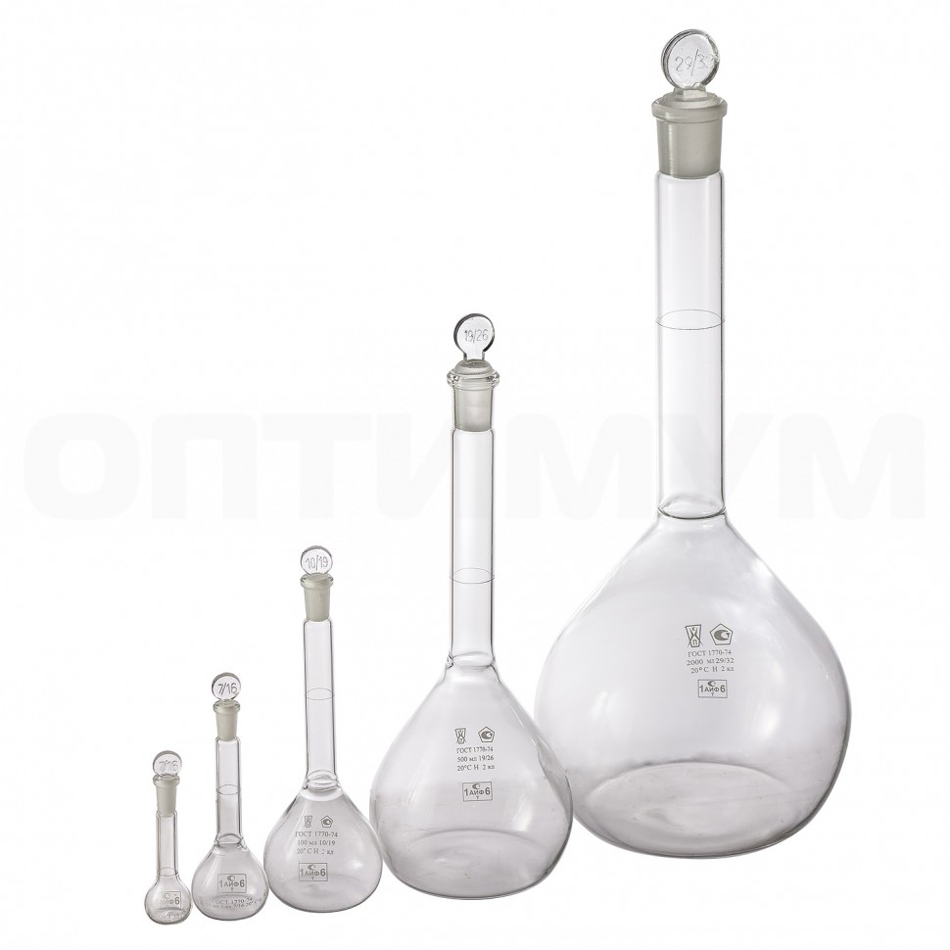
Laboratory utensils
Volumetric Flasks
To prepare a solution with exact concentration of a given solute, the solute has to be weighed exactly and subsequently dissolved in an exact volume of solvent. For exact weighing the analytical balance is used and for dissolution in an exact volume a volumetric flask is used.
A volumetric flask has a narrow neck with a calibration mark that shows to what exact level the solvent should be filled to get the exact and specified volume. Volumetric flasks are thus made for a particular volume at a particular temperature. This temperature is printed on the flask and is typically 20 ∘C.

Slide 36
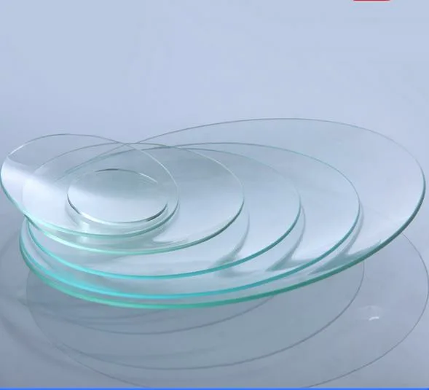
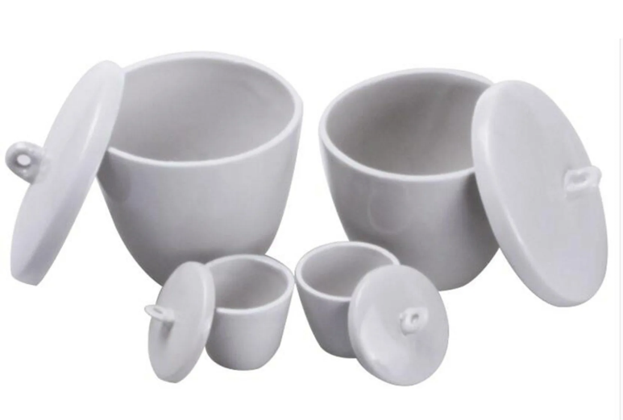
Laboratory utensils
Watch glass
Crucible with cover

Slide 37
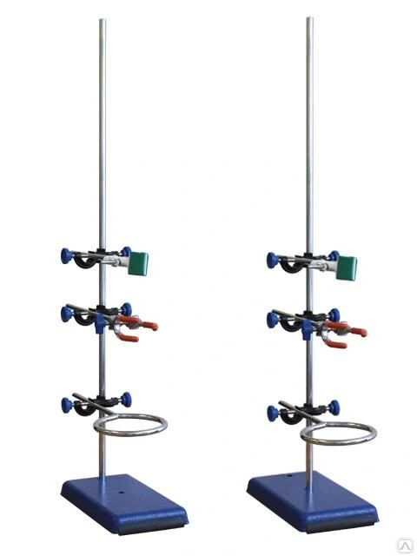
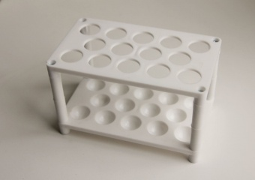
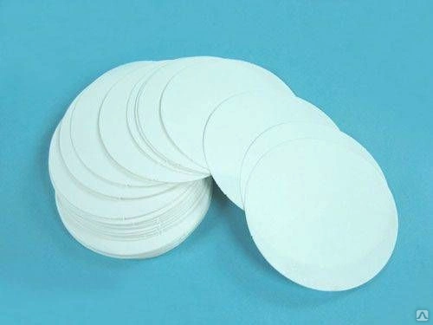
Auxiliary materials, instruments, devices
towels,
clamps,
tubes,
filter paper,
cotton wool, etc.

Slide 38
Titrated solutions
iodine,
iodine monochloride,
potassium bromate,
hydrochloric acid,
sodium hydroxide,
sodium nitrite,
silver nitrate, etc.

Slide 39
Indicators, indicator paper, reagents, solvents.

Slide 40
Thank you for attention!

