Slide 1
«Special pharmaceutical chemistry»
HETEROCYCLIC DRUGS WITH ONE HETEROATOM IN THE CYCLE. QUINOLINE DERIVATIVES.
Associate Professor Gureeva E.S.

Slide 2
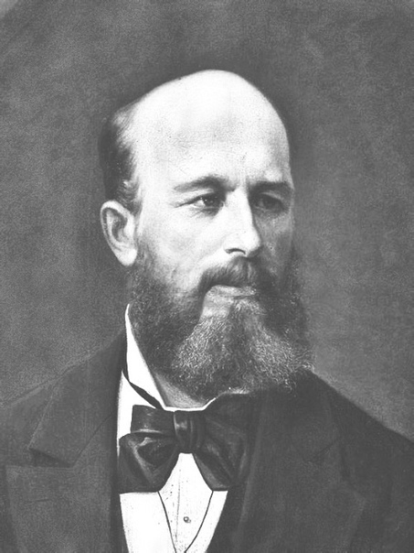
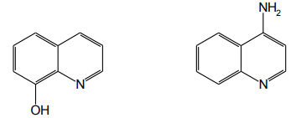
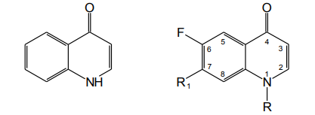
General characteristic
4-aminoquinoline 8-oxyquinoline
Quinoline
A.M. Butlerov
quinolone-4 fluoroquinolones

Slide 3
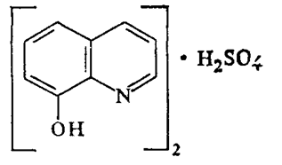
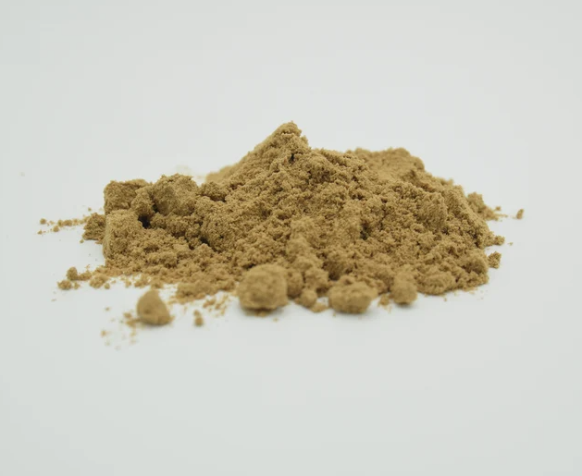
8-oxyquinoline derivatives. Chinosolum.
Fine crystalline powder with lemon-yellow color and peculiar odor, easily soluble in water and ethanol, practically insoluble in ether and chloroform.

Slide 4
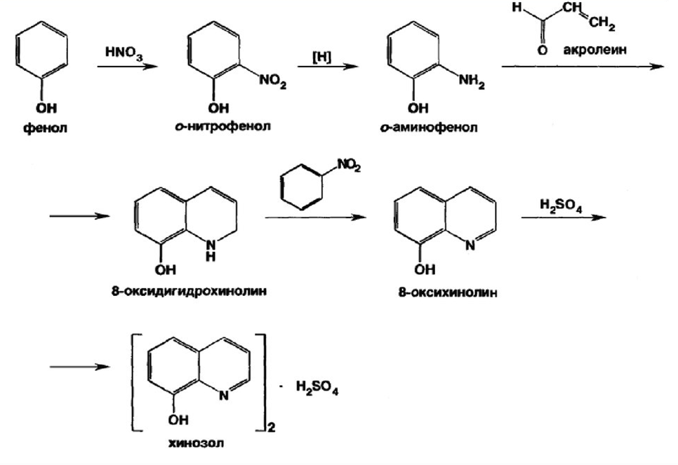
8-oxyquinoline derivatives. Chinosolum.
Obtaining

Slide 5
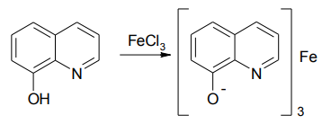
8-oxyquinoline derivatives. Chinosolum.
Identification
1. Instrumental methods
2. Interaction with ferric (III) chloride solution
green coloration

Slide 6
8-oxyquinoline derivatives. Chinosolum.
Identification
3. Formation of complex salt with metal cations
white precipitate

Slide 7
8-oxyquinoline derivatives. Chinosolum.
Identification
4. Formation of azo dye

Slide 8
8-oxyquinoline derivatives. Chinosolum.
Identification
5. Reaction with citric acid
When chinosol is heated in a solution of citric acid and acetic anhydride, purplish-red coloring appears (reaction with tertiary nitrogen atom).
6. Reaction with common alkaloid reagents
yellow precipitate

Slide 9
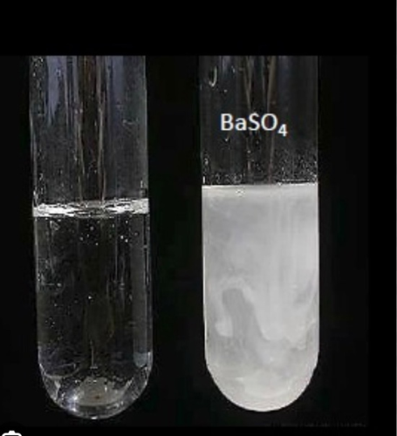
8-oxyquinoline derivatives. Chinosolum.
Identification
7. Formation of a quinoid structure
8. Detection of sulfate ion

Slide 10
8-oxyquinoline derivatives. Chinosolum.
Identification
9. Precipitation of chinosol base

Slide 11
8-oxyquinoline derivatives. Chinosolum.
Assay
1. Neutralization
Titrated with 0.1 M sodium hydroxide solution (indicator phenolphthalein). Titration is carried out in the presence of chloroform, which is added to extract the released chinosol base (8-oxyquinoline).

Slide 12
8-oxyquinoline derivatives. Chinosolum.
Assay
2. Complexometric titration

Slide 13
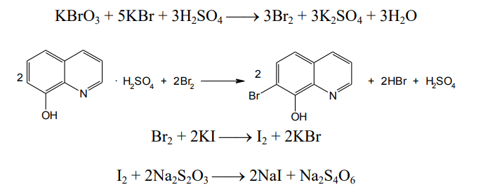
8-oxyquinoline derivatives. Chinosolum.
Assay
3. Bromatometric determination

Slide 14
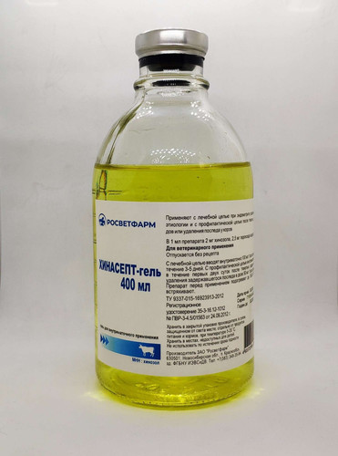
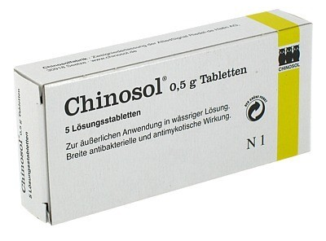
8-oxyquinoline derivatives. Chinosolum.
Storage
The medicinal substance is stored in a dry place protected from light, in well sealed containers.
Medical use
Chinosol has antiseptic properties. It is used for disinfection of hands, rinses, sphincters. It is included in the composition of ointments, powders.

Slide 15
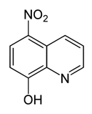
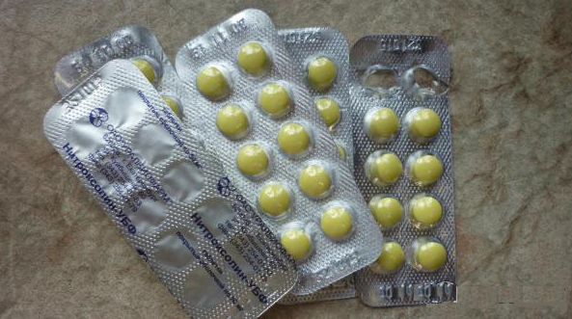
8-oxyquinoline derivatives. Nitroxoline.
Fine crystalline powder with yellow coloring and peculiar odor. Nitroxoline is practically insoluble in water, slightly soluble in ethanol. Nitroxoline is slightly soluble in ether and moderately soluble in chloroform.

Slide 16
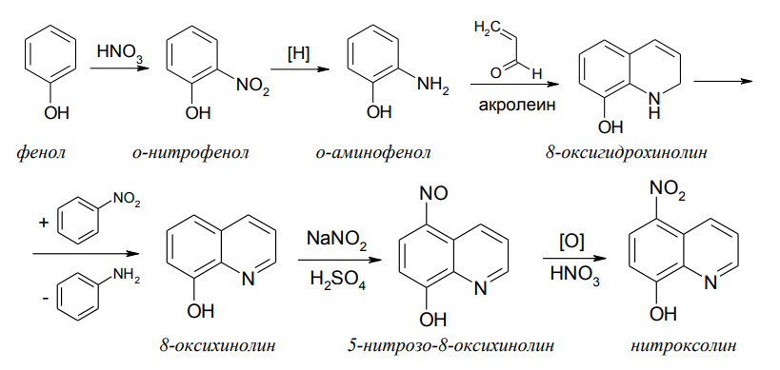
8-oxyquinoline derivatives. Nitroxoline.
Obtaining

Slide 17
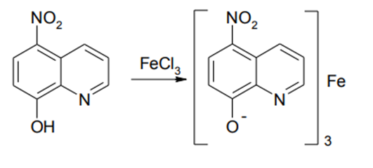
8-oxyquinoline derivatives. Nitroxoline.
Identification
1. Instrumental methods
2. Reaction with ferric (III) chloride
green

Slide 18
8-oxyquinoline derivatives. Nitroxoline.
Identification
3. Complex salt formation with metal cations
green precipitate

Slide 19
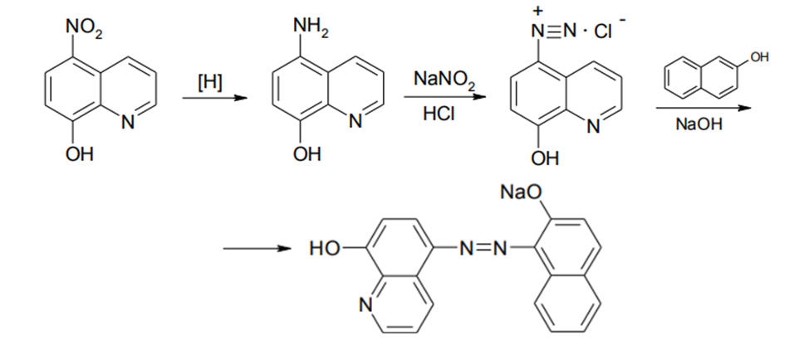
8-oxyquinoline derivatives. Nitroxoline.
Identification
4. Formation of azo dye after reduction
red-orange

Slide 20
8-oxyquinoline derivatives. Nitroxoline.
Identification
5. Reaction with diphenylamine in sulfuric acid
blue

Slide 21
8-oxyquinoline derivatives. Nitroxoline.
Identification
6. Reaction with general alkaloid reagents
yellow precipitate

Slide 22
8-oxyquinoline derivatives. Nitroxoline.
Identification
7. Oxidation with perhydrol after hydrogenation
red-violet

Slide 23
8-oxyquinoline derivatives. Nitroxoline.
Assay
Non-aqueous titration

Slide 24
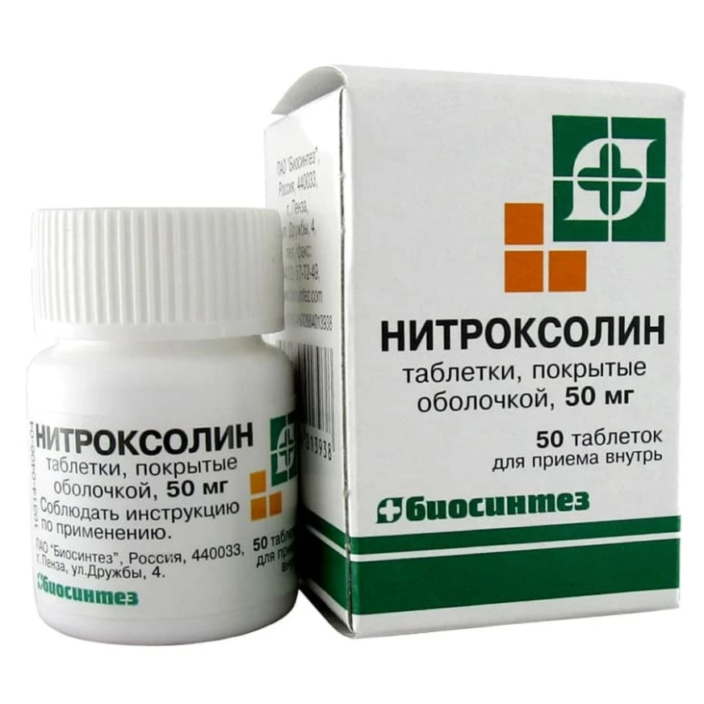
8-oxyquinoline derivatives. Nitroxoline.
Storage
The medicinal substance is stored in a dry place protected from light, in well sealed containers.
Medical use
Nitroxoline belongs to the number of antibacterial drugs. Nitroxoline is used as an antimicrobial agent for the prevention and treatment of genitourinary tract infections orally in the form of tablets of 0.05 grams.

Slide 25
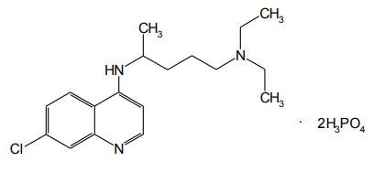
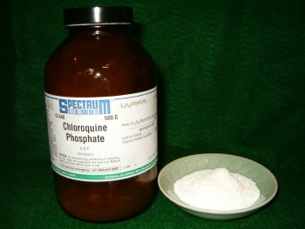
4-aminoquinoline derivatives. Chloroquine phosphate.
White or white with a slight creamy tinge, odorless or almost odorless crystalline powder. T.pl. 214,5-218°C (with decomposition). Easily soluble in water and very slightly soluble in organic solvents: ethanol, ether, chloroform.
Chloroquine Phosphate (Hingamine)

Slide 26
4-aminoquinoline derivatives. Chloroquine phosphate.
Obtaining

Slide 27
4-aminoquinoline derivatives. Chloroquine phosphate.
Identification
1. UV spectrophotometry
Chloroquine phosphate (hingamine) has three absorption maxima in the UV region (240-360 nm): at 257, 329, 343 nm (0.001% solution in 0.01 M hydrochloric acid solution) with optical densities of about 0.29, 0.32, and 0.37. The ratios of these values at 257 and 329 nm to the absorbance at 343 nm should be in the range 0.86-0.95.
2. Precipitation of the bases of Chloroquine phosphate

Slide 28
4-aminoquinoline derivatives. Chloroquine phosphate.
Identification
3. Action of common alkaloid reagents
yellow precipitate
Chloroquine phosphate picrate has a melting point of 204-207°C.

Slide 29
4-aminoquinoline derivatives. Chloroquine phosphate.
Identification
4. Detection of phosphate ion
yellow precipitate
white crystalline precipitate
yellow crystalline precipitate

Slide 30
4-aminoquinoline derivatives. Chloroquine phosphate.
Assay
1. Non-aqueous titration
2. UV-visible spectrophotometry

Slide 31
4-aminoquinoline derivatives. Chloroquine phosphate.
Storage
Chloroquine phosphate and hydroxychloroquine sulfate are stored according to List B, in well-closed containers of orange glass, protected from light. They gradually color in the light.
Medical use
Chloroquine phosphate and hydroxychloroquine sulfate are effective antiprotozoal and immunosuppressive agents. They have therapeutic and prophylactic antimalarial effect on both sexless and sexual forms of malarial plasmodia. They are also prescribed in the treatment of arthritis, lupus erythematosus and others.

Slide 32
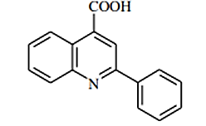
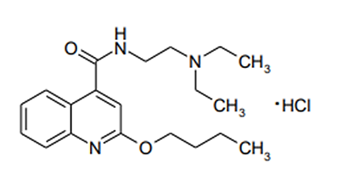
4-carboxyquinoline derivatives
(Cinchoninic acid)
Cinchophthene
(Cinchophtnum)
Sovcain (Sovcainum)
Used for gout, rheumatism, neuralgia.
In surgery for local Anesthesia and spinal anesthesia.

Slide 33
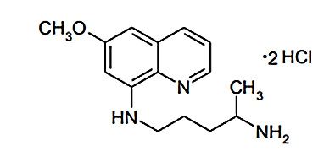
8-Aminoquinoline derivatives
Plasmocid (Plasmocidum)
For the treatment of three-day and tropical malaria.
For the treatment of three-day and four-day malaria.
Chinocid (Chinocium)

Slide 34
Thank you for attention!

