Slide 1
«General pharmaceutical chemistry »
Oxidimetry: Bromatometry. Nitritometry.
Associate Professor Gureeva E.S.

Slide 2
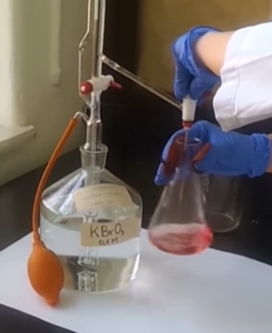
Bromatometry
Bromatometry is a redox titration method, based on the reduction reaction of a bromate ion.
The basic reaction bromatometry is:
If bromate ions are added to a solution of bromide ions in the presence of acid, molecular bromine is formed:
An aqueous solution of potassium bromate is used as a titrant.

Slide 3
Bromatometry
Types of bromatometry
1) Determinations based on the oxidation of the substance of interest with bromate in an acidic environment; the bromate ion is reduced to bromide:
2) Determinations based on the interaction of the substance of interest with bromine produced by the reaction of KBrO₃ with KBr in an acidic medium:
Definitions of the second kind are also called bromometric.

Slide 4
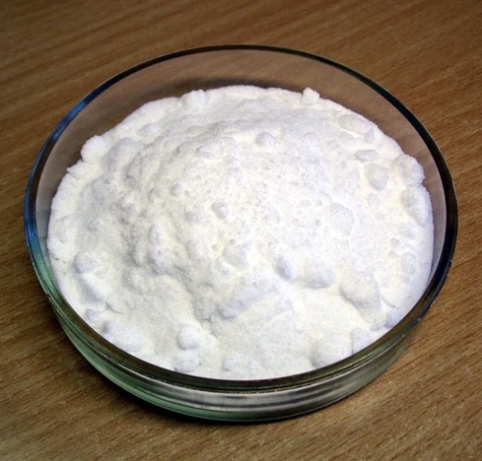
Bromatometry
Preparing a titrated solution of potassium bromate
A solution of potassium bromate can be prepared from an exact sample.
The standardisation of the KBrO₃ solution is carried out iodometrically. firstly the reaction of KBrO₃ with KI is conducted:
and then titrate the released iodine with a standard solution of Na₂S₂0₃.
The standard solution of KBrO₃ is stable during storage.

Slide 5
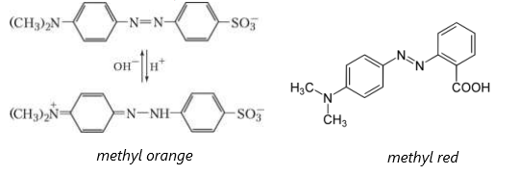
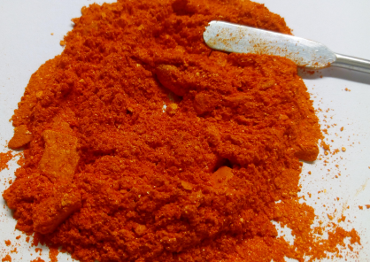
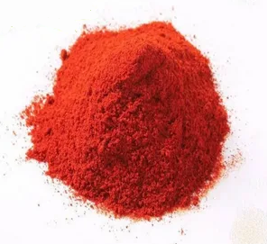
Bromatometry
Fixing the titration end point
The indication-free method
The endpoint in titration with KBrO₃ (or in cases of direct bromometric titration) is indicated by the appearance of free bromine in the solution. The release of bromine is indicated by a yellow colouring of the solution.
Indicators
Instrumental methods
The titration endpoint can also be detected potentiometrically or photometrically.

Slide 6
Bromatometry
Direct bromatometric titration
The direct bromatomeric determination is based on the equation for reducing bromates to bromides:
After all of the substance to be determined has reacted, the excess amount of titrant reacts with the bromide ions.
This produces Br2, which leads to the disappearance of the methyl orange colour.

Slide 7
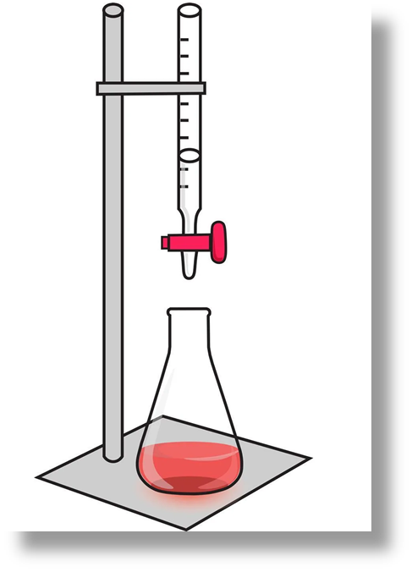
Bromatometry
Bromometric (bromatometric) determination
Bromometric determinations are carried out in the presence of excess KBr which is added to a solution of the substance to be determined or to a titrant (Potassium bromate).
Only in an acidic medium!
Titration is based on reaction:

Slide 8
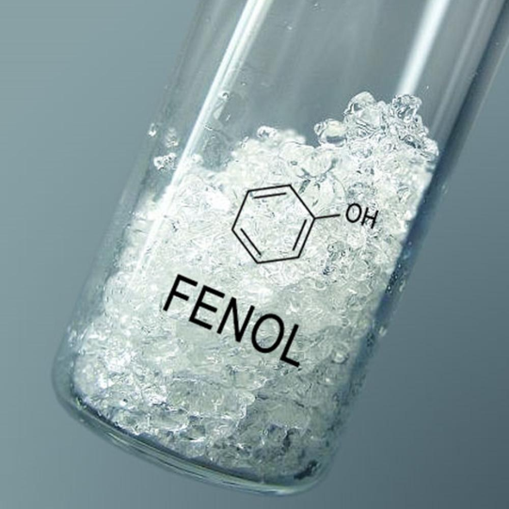
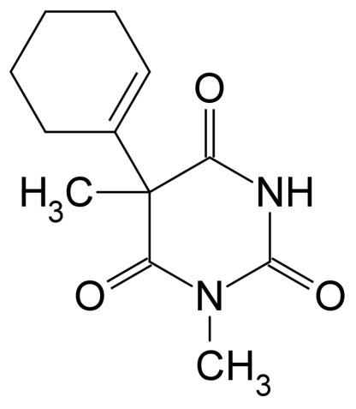
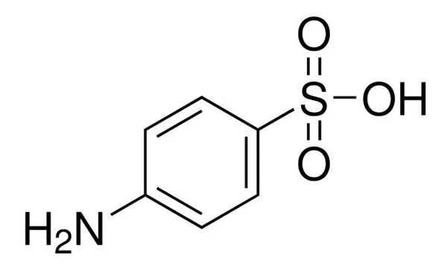
Bromatometry
Bromometric (bromatometric) determination
This type of titration is used to the determination of organic substances that undergo
electrophilic substitution reactions (phenols, aromatic amines)
electrophilic addition (organic substances with multiple bonds in the molecule) with bromine.

Slide 9
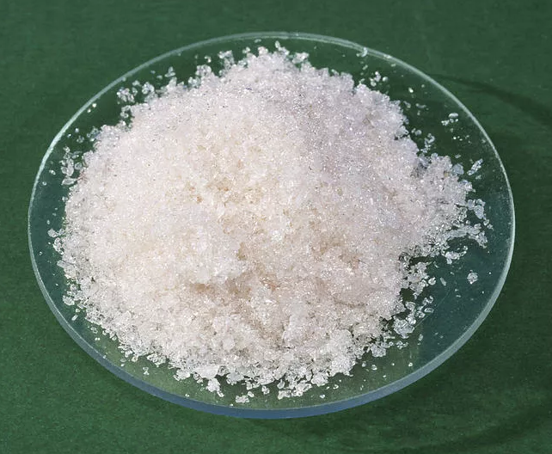
Bromatometry
Applications in pharmaceutical analysis
Direct bromometric titration
Phenol
Titrant KBrO₃
Indicator methyl orange

Slide 10
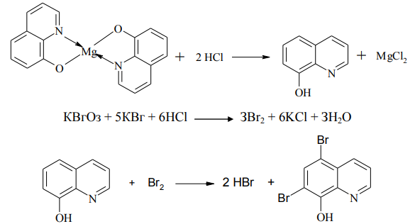
Bromatometry
Applications in pharmaceutical analysis
Indirect (substitution) bromometric titration
Magnesium salts
Titrant KBrO₃
Indicator methyl red

Slide 11
Bromatometry
Applications in pharmaceutical analysis
Reverse bromometric titration (bromide-bromate determination)
Salicylic acid
Titrant sodium thiosulphate Indicator starch

Slide 12
Bromatometry
Advantages
Widespread use
Stability of the potassium bromate solution during storage and accuracy of analysis

Slide 13
Bromatometry
Disadvantages
Water present in solution or produced during titration of non-aqueous solutions interferes with the determination of many organic compounds.
The oxidation of some organic compounds is accompanied by undesirable side reactions of hydrolysis, substitution and and addition caused by the action of water and bromine ions.
In some cases the reactions of potassium bromate with organic substances are not strictly stoichiometric. This leads to a distortion of the final analytical results.

Slide 14
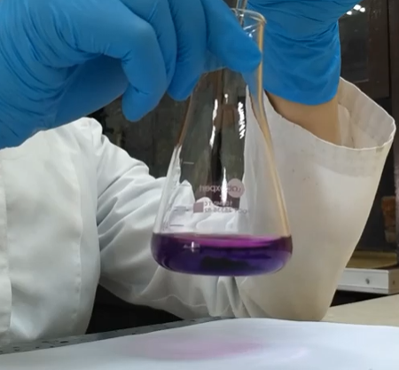
Nitritometry
Nitritometry, or nitrite titration, is a method of quantitative determination of substances using a titrant NaNO₂ sodium nitrite solution.
The method is based on the use of an acidic reaction medium:
The method is based on
oxidation-reduction reactions,
diazotization,
nitrosation,
azation.

Slide 15
Nitritometry
As an oxidising agent, sodium nitrite is used for the determination of the reducing agents tin Sn²⁺, iron Fe²⁺, hydrazine and other compounds. At the same time the nitrite is reduced to nitric oxide:
As a reducing agent, sodium nitrite is used for the determination of potassium permanganate, chlorine, potassium iodate and other compounds by reaction:
The most often used reaction is diazotation, which takes place with primary aromatic amines in an acidic medium:

Slide 16
Nitritometry
Preparation of the working solution and its standardization
The method titrant sodium nitrite (NaNO₂) is usually used as an aqueous solution with a concentration of 0.1 or 0.5 M.
The solution is prepared in an approximate concentration as sodium nitrite is unstable during storage and can oxidise to nitrate.
Standardisation of sodium nitrite is carried out according to the reaction that to be used for the determination.
If NaNO₂ is used
as an oxidizing agent, it is standardized for iron(II), arsenic(III), hydrazine,
as a reducing agent, it is standardized for potassium permanganate (secondary standard), potassium dichromate,
in diazotization reactions, it is standardized for sulphanilic acid, p-minobenzoic acid, p-aminoethylbenzoate.

Slide 17
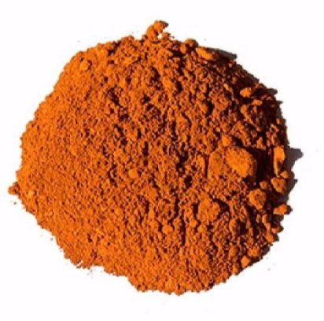
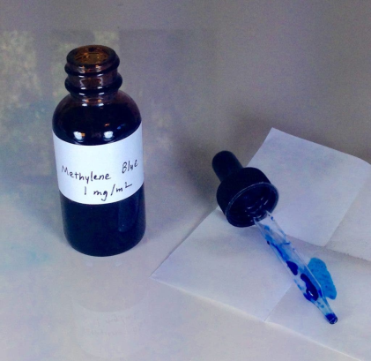
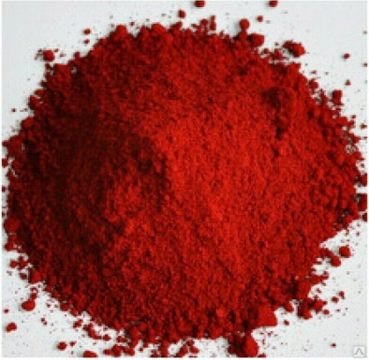
Nitritometry
Fixing the titration end point
Instrumental method. The end of the titration in nitrite titration is most often recorded electrometrically by a potentiometric titration.
Indicators
Internal indicators
tropeolin 00
(colour change from red to yellow)
methylene blue
(colour change from crimson to blue)
neutral red
(colour change from red-purple to blue)

Slide 18
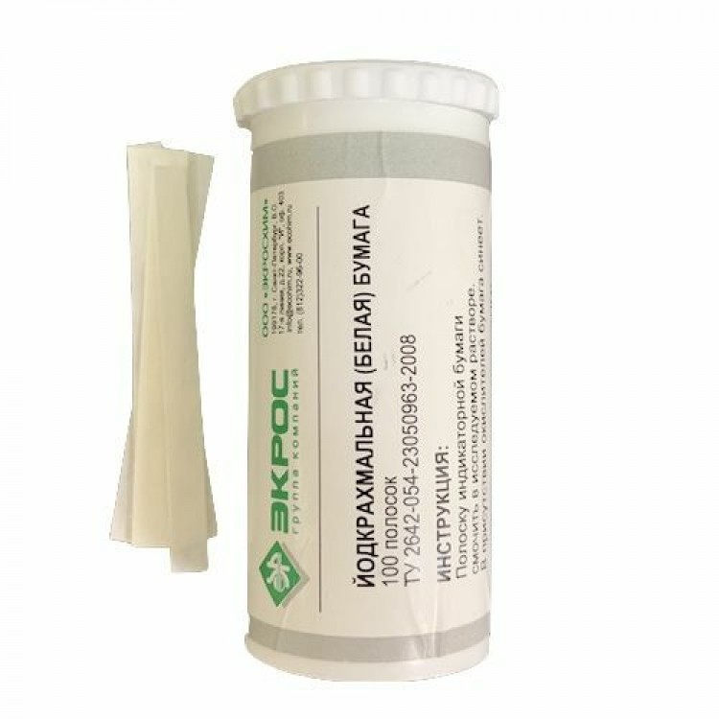
Nitritometry
Fixing the titration end point
Indicators
External indicators.
Starch-iodide paper is commonly used as an external indicator. It is a filter paper soaked in starch and potassium iodide solution and then dried.
The iodine produced in the presence of starch turns the paper blue.

Slide 19
Nitritometry
Conditions for nitritometric titration
Titration is carried out in an acidic medium (usually HCl).
It is necessary to work at 15-20 °C (in some cases with cooling down to 0-5 °C). Because at higher temperatures the resulting reaction products (diazonium salts) may be destroyed, and at lower temperatures the interaction speed of the titrant with the substance to be determined may decrease.
The titrant must be added slowly because the reaction goes through several intermediate stages.
KBr catalyst is used to speed up the reaction.

Slide 20
Nitritometry
Applications in pharmaceutical analysis
Inorganic substances
tin(II), arsenic (III), iron (II), hydrazine and its derivatives
Organic compounds containing
a primary or secondary aromatic amino group
aromatic nitro derivatives (after prior reduction of the nitro group to an amino group), and hydrazides

Slide 21
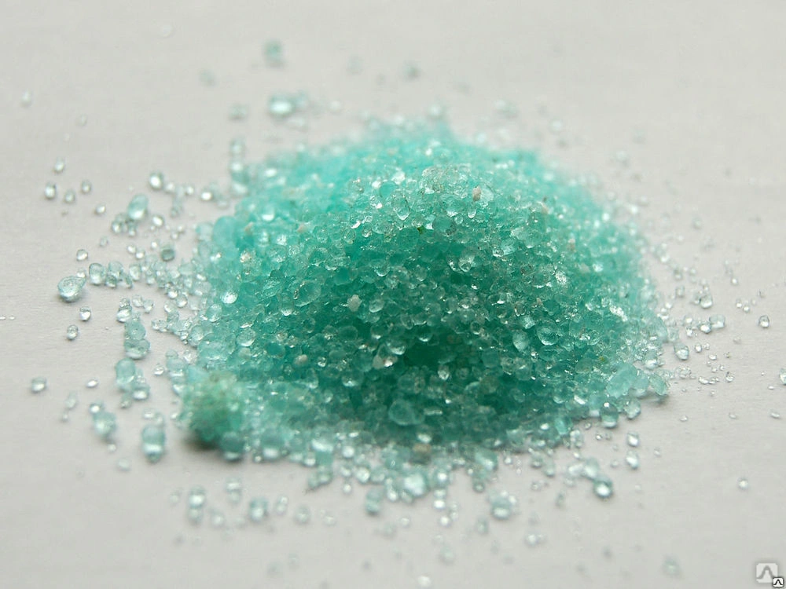
Nitritometry
Nitritometry
Applications in pharmaceutical analysis
Iron (II) salts
Titrant NaNO2

Slide 22
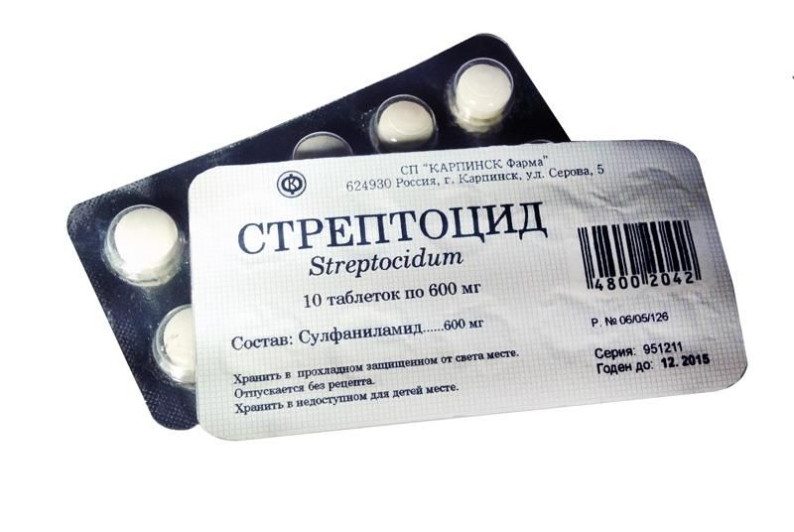
Nitritometry
Applications in pharmaceutical analysis
Sulphonamide
Titrant NaNO₂
Indicator tropeolin 00

Slide 23
Nitritometry
Applications in pharmaceutical analysis
Tetracaine
Titrant NaNO₂
Indicator tropeolin 00

Slide 24
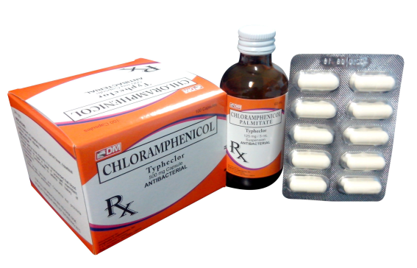
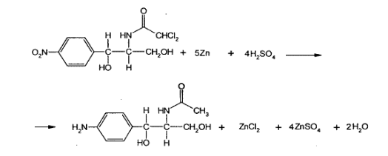
Nitritometry
Applications in pharmaceutical analysis
Chloramphenicol
Titrant NaNO₂
Indicator tropeolin 00

Slide 25
Thank you for attention!

