Slide 1
«Special pharmaceutical chemistry»
Vitamins of the alicyclic series.
Pterin vitamins.
Associate Professor Gureeva E.S.

Slide 2
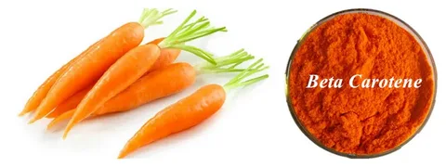
Retinols (A Vitamins)

Slide 3
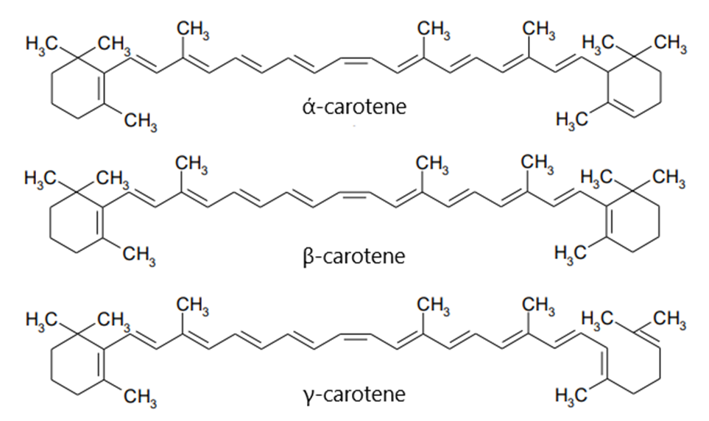
Retinols (A Vitamins)
Carotenes

Slide 4
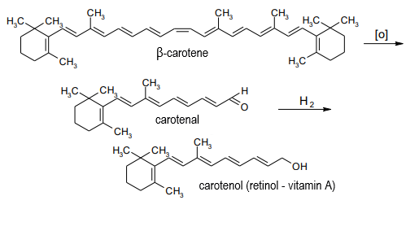
Retinols (A Vitamins)
Carotenes

Slide 5
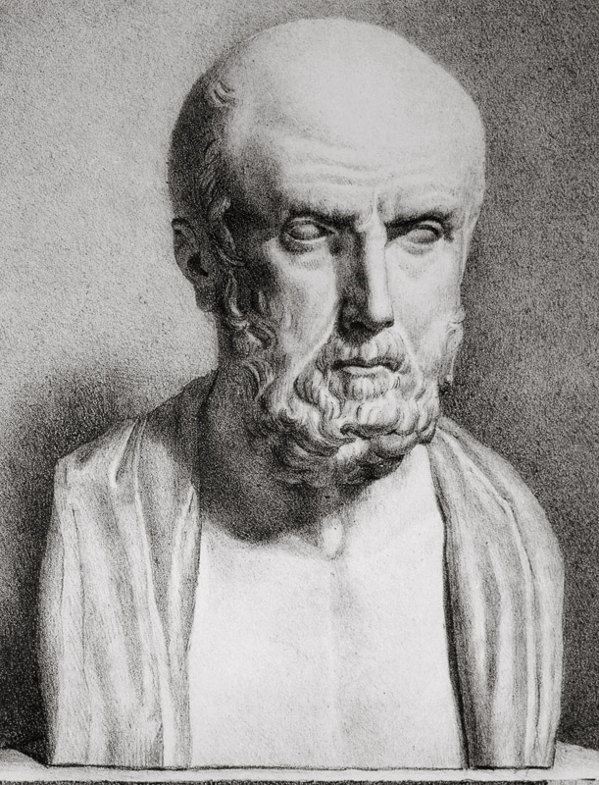
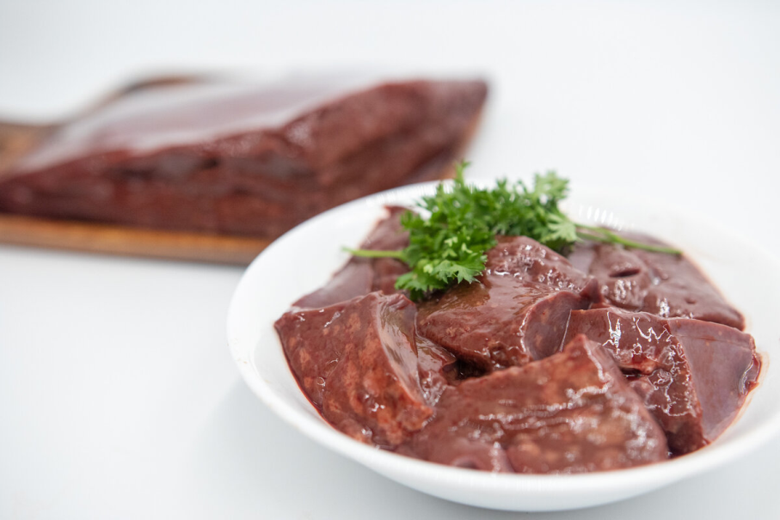
Retinols (A Vitamins)
History of discovery
In ancient Greece, Hippocrates gave liver as a treatment for night blindness without realizing that he was using a good source of vitamin A.

Slide 6
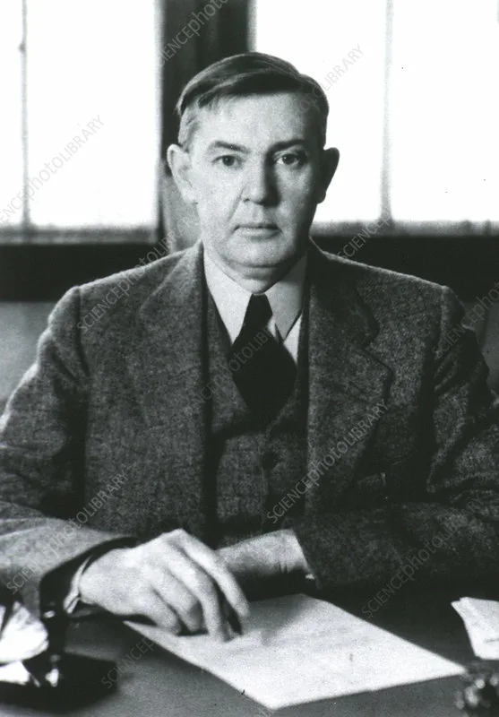
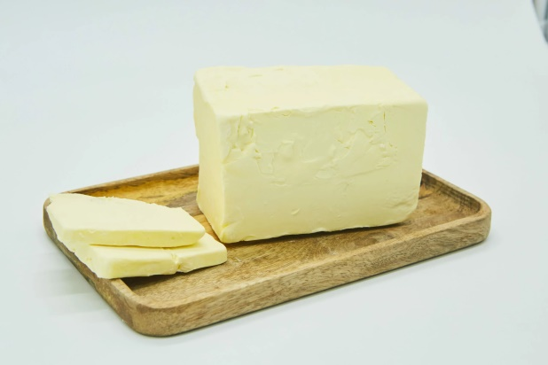
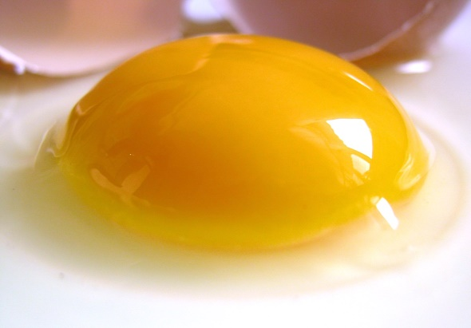
Retinols (A Vitamins)
History of discovery
Research by Elmer V. McCollum and M. Davis led to the discovery of vitamin A in 1914. They found a fat-soluble growth factor in butter and egg yolk.
Elmer V. McCollum

Slide 7
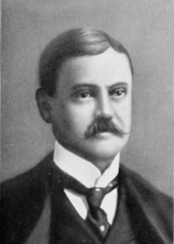
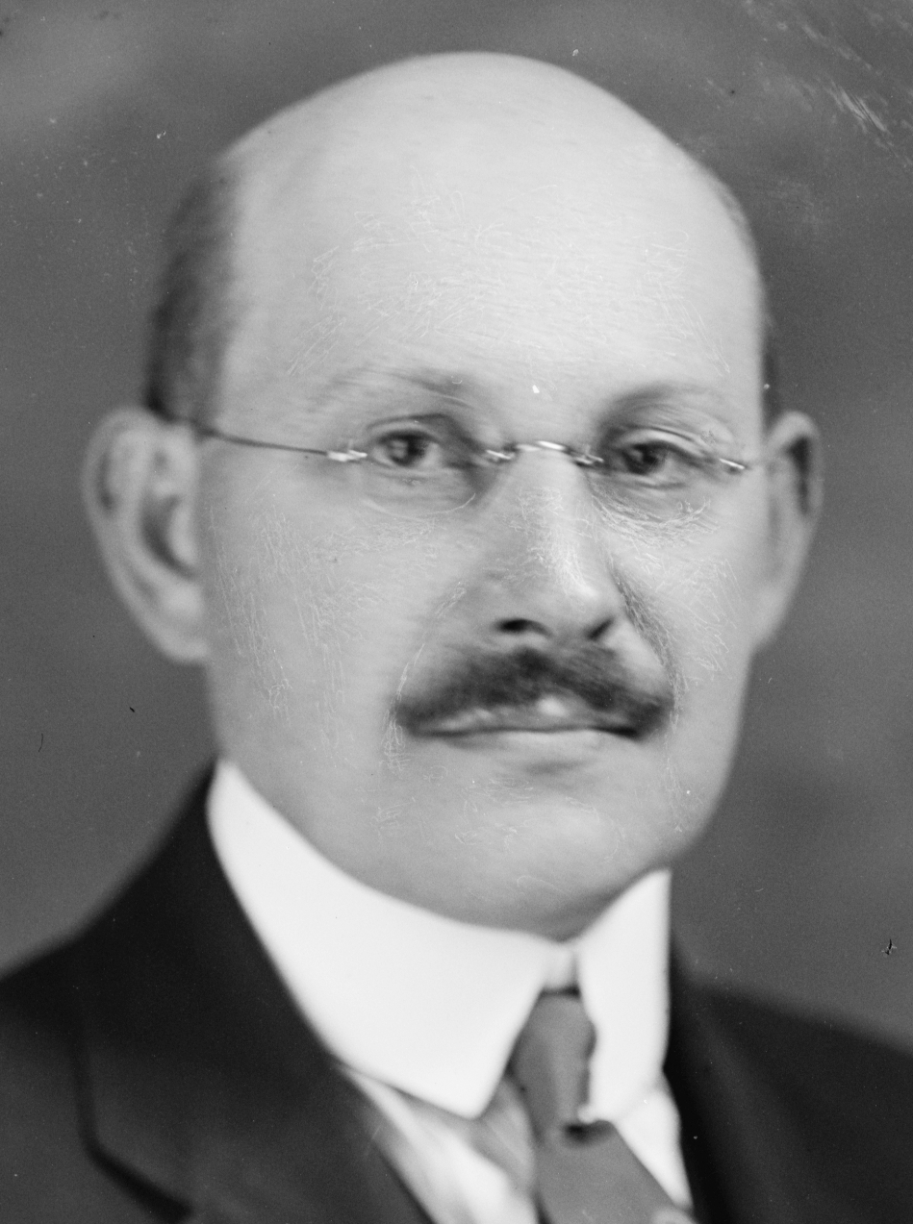
Retinols (A Vitamins)
History of discovery
Thomas Osborne and Lafayette Mendel confirmed the observations.
In 1916, McCollum introduced the term ‘fat soluble A’ to distinguish it from other nutritional factors named ‘water soluble B’.
Thomas Osborne
Lafayette Mendel

Slide 8
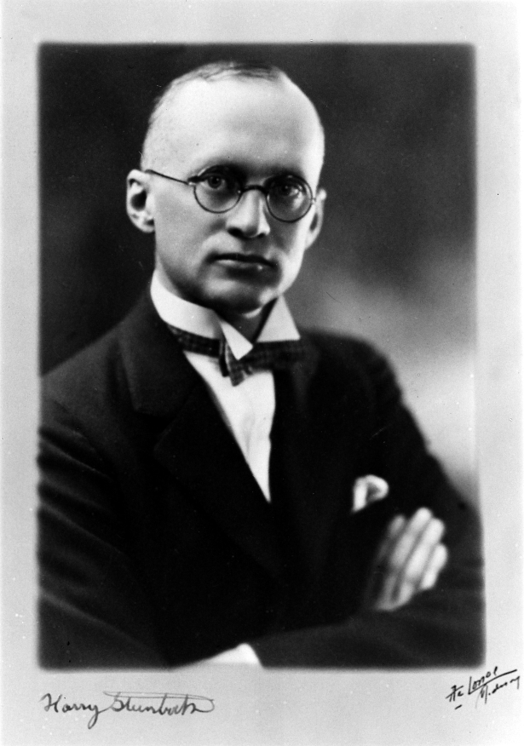
Retinols (A Vitamins)
History of discovery
In 1919, Harry Steenbock hypothesized that vitamin A was present in the yellow pigment (carotene) in colored plants such as carrots, sweet potatoes and corn.

Slide 9
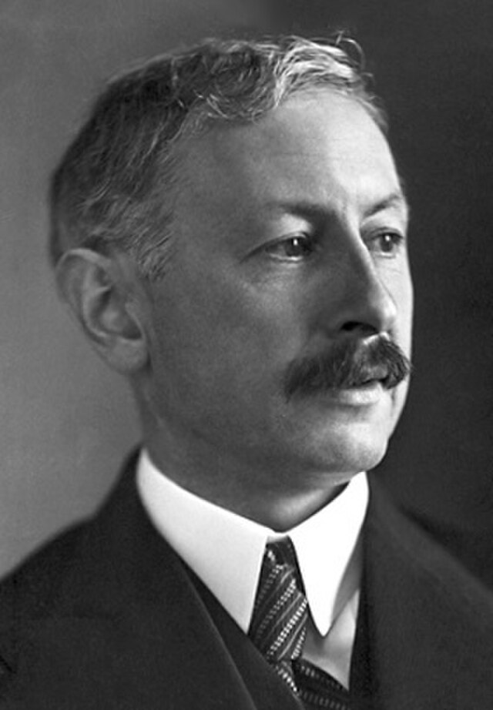
Retinols (A Vitamins)
History of discovery
Its chemical structure was described by Paul Karrer in 1931.
In 1932 an English physician successfully treated children ill with measles with vitamin A.

Slide 10
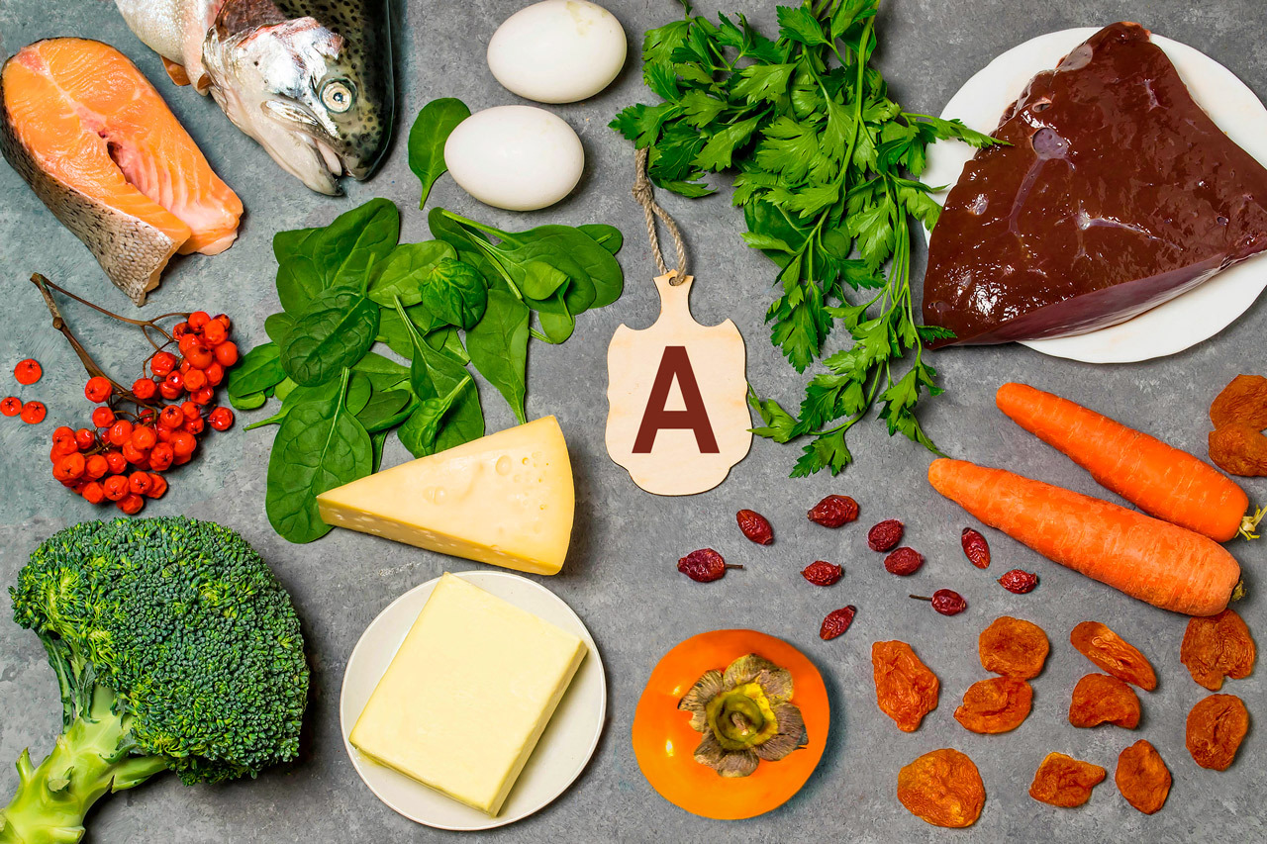
Retinols (A Vitamins)
Sources

Slide 11
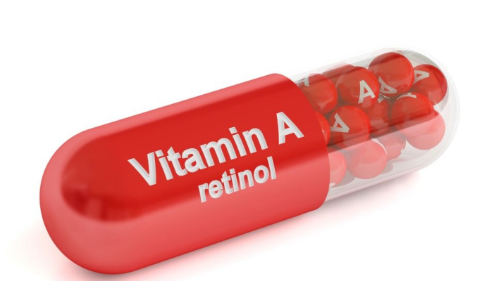
Retinols (A Vitamins)
Functions
1. Activates redox processes.
2. Stimulates the synthesis of purine and pyrimidine bases.
3. Participates in the energy supply of metabolism, creating favorable conditions for the synthesis of ATP.
4. Increases protein synthesis in cartilage and bone tissue, which determines the growth of bone and cartilage in length.
5. Stimulates epithelialization and prevents excessive keratinization of the epithelium.
6. Regulates the biosynthesis of cell surface membrane glycoproteins.
7. Regulates the normal function of single-layer squamous epithelium, which performs a barrier role, increases the body's resistance to infection.
8. Enhances antibody formation and activates phagocytosis.
9. Affects photoreception, participating in the construction of visual purpura.
10.Stimulates the synthesis of adrenal cortex hormones.

Slide 12
Retinols (A Vitamins)
Hypovitaminosis
Signs:
• Visual impairment: reduced adaptation of the eyes in conditions of darkness or poor illumination;
• xerophthalmia (dry eye syndrome): manifested by dryness, thickening of the cornea, it becomes cloudy, there may be itching, a feeling of sand in the eyes;
• keratomalacia (corneal ulceration);
• dryness, rashes on the skin;
• respiratory tract infections against the background of decreased immunity.

Slide 13
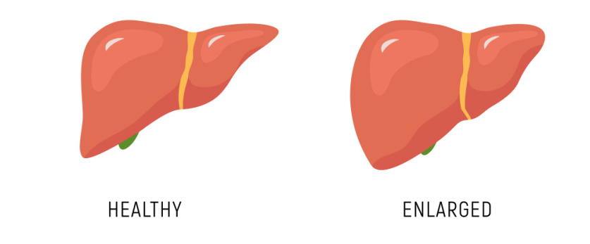
Retinols (A Vitamins)
Hypervitaminosis
Symptoms:
• Nausea,
• vomiting,
• dizziness,
• hair loss,
• headache,
• fever (sometimes),
• liver enlargement, increased intracranial pressure (in chronic overuse),
• swollen fontanel (in infants).

Slide 14
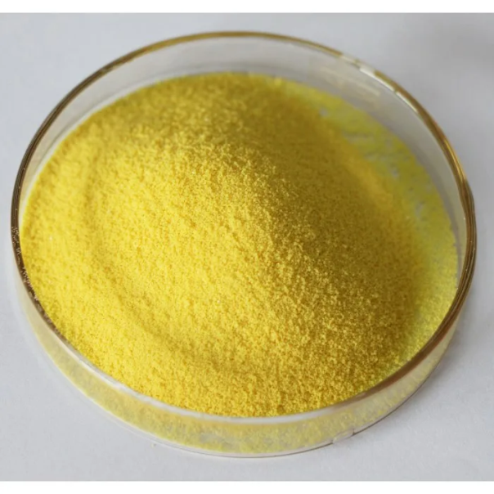
Retinol acetate
Physical properties
Retinol acetate is white or pale yellow crystals with a faint odor. The melting point of retinol acetate is 53- 57 ºC.
Soluble in chloroform, ether and fatty oils, insoluble in water.

Slide 15
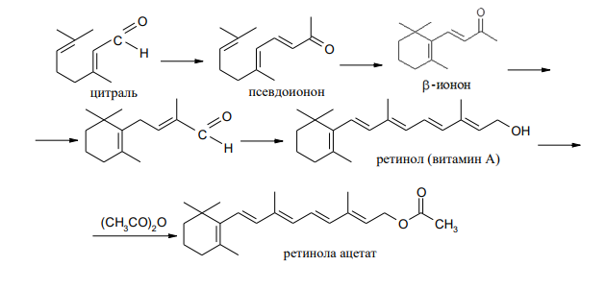
Retinol acetate
Obtaining

Slide 16
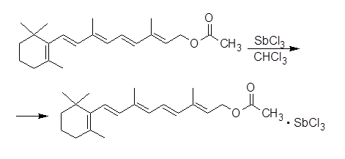
Retinol acetate
Identification
UV spectrometry
Reaction with antimony chloride

Slide 17
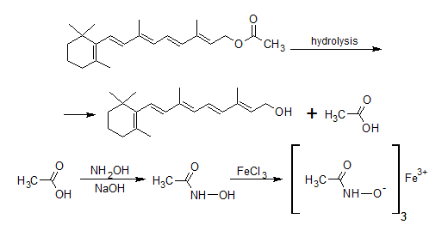
Retinol acetate
Identification
3. Hydroxamic reaction

Slide 18
Retinol acetate
Quantitation
Spectrophotometry and photocolorimetry in absolute alcohol
Spectrophotometry
Spectrophotometric determination conversion of retinol to anhydrovitamin A

Slide 19
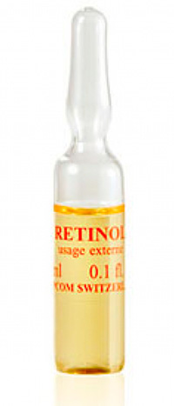
Retinol acetate
Storage
Retinol acetate is stored in sealed ampoules, at temperature not higher than +5 ºС, protected from light (due to slight oxidizability). Retinol acetate solution in oil is stored in well-corked orange glass vials filled to the top. Fish oil should be stored under identical conditions.
Medical Use
Indications for use are avitaminosis A, hypovitaminosis, infectious and cold diseases, skin lesions and diseases, diseases of the eyes and digestive organs. Prophylactic dose of vitamin A for an adult is 15 mg (5000 IU) per day, therapeutic dose up to 10 mg (33000 IU), but not more than 30 mg (to prevent hypervitaminosis).

Slide 20
Calcyferols (Vitamin D)
Cyclopentanophenanthrene General formula of calciferols

Slide 21
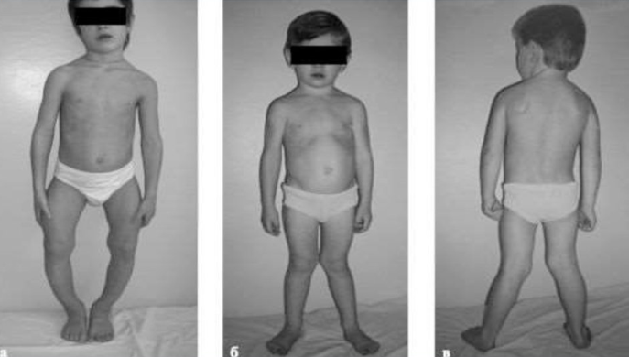
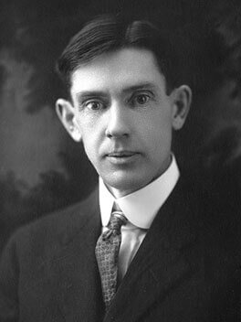
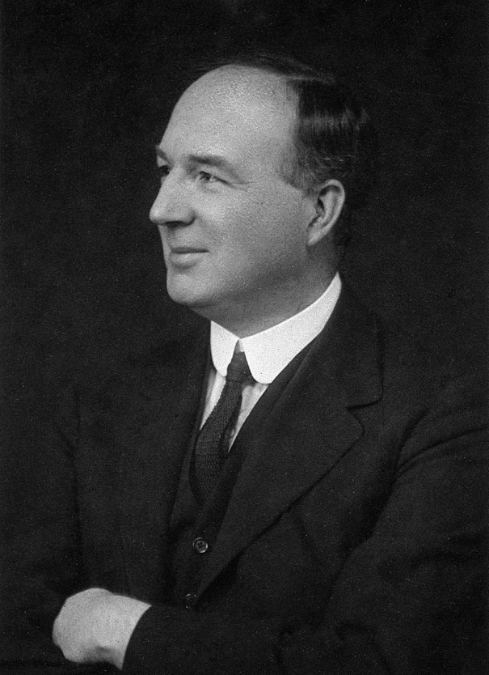
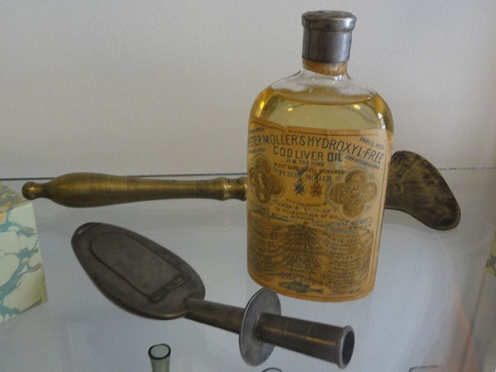
Calcyferols (Vitamin D)
History of discovery
childhood rickets
Elmer McCollum
Edward Mellanby

Slide 22
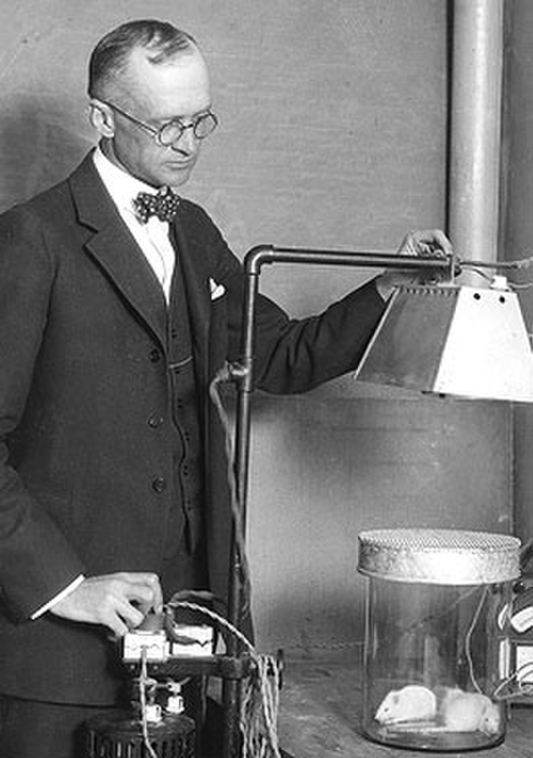
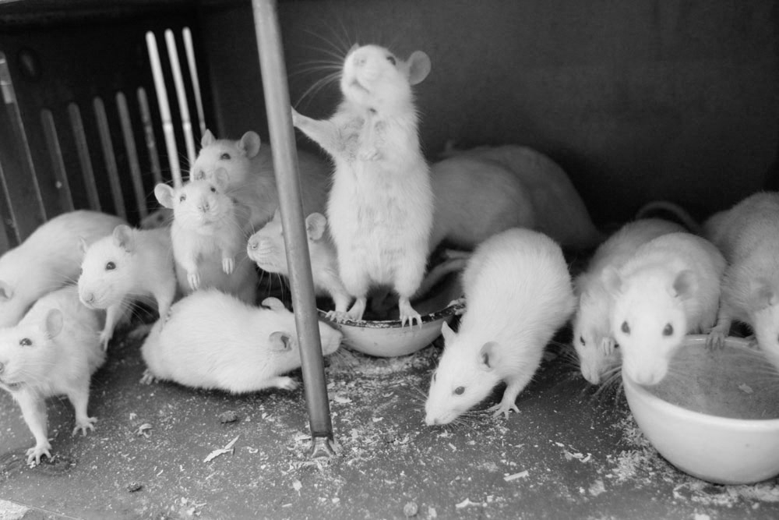
Calcyferols (Vitamin D)
History of discovery
Harry Stenbock

Slide 23
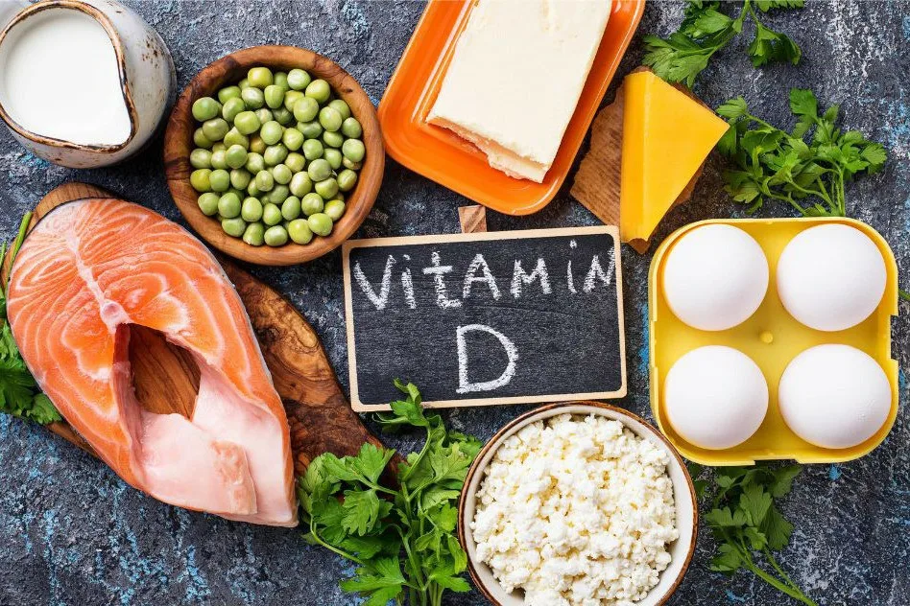
Calcyferols (Vitamin D)
Sources

Slide 24
Calcyferols (Vitamin D)
Functions
It helps absorb calcium and phosphate, which is essential for healthy bones and teeth. Without adequate levels of vitamin D, calcium and phosphate may not be absorbed into the bones, which can lead to osteoporosis, bone deformities, and other bone health problems.
Vitamin D also plays an important role in maintaining a healthy immune system. It helps immune system proteins, such as macrophages and T cells, fight infections and disease. Studies have shown that people with low levels of vitamin D are more prone to various infectious diseases, including influenza and acute respiratory infections.
In addition, vitamin D may help maintain cardiovascular health by reducing the risk of developing cardiovascular diseases such as heart attack and stroke.

Slide 25
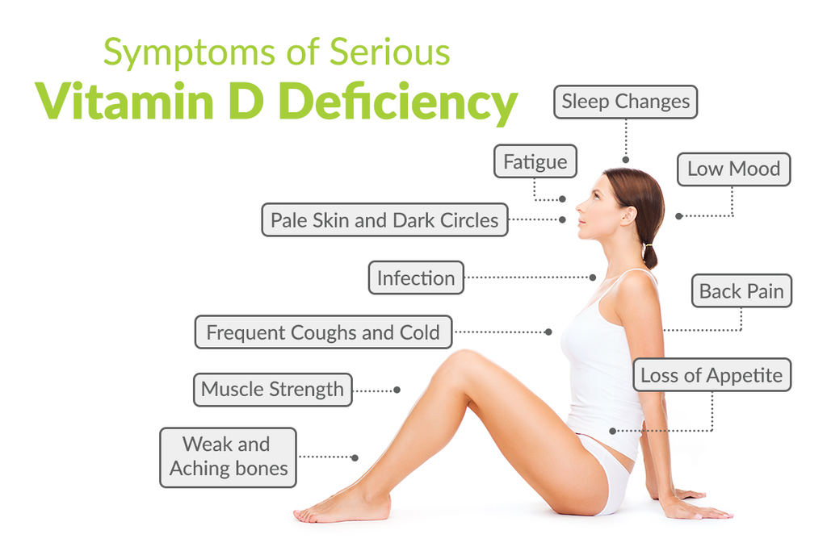
Calcyferols (Vitamin D)
Hypovitaminosis

Slide 26
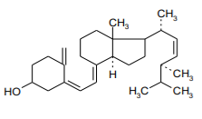
Calcyferols (Vitamin D)
Vitamin D drugs
Ergocalciferol (vitamin D2)
White crystalline powder, odorless. Oxidizes in the light. Melting point 113 - 118 °C. Practically insoluble in water, slightly soluble in ethanol.
Cholecalciferol (vitamin D3)
Colorless needle-like crystals. Insoluble in water, soluble in ethanol.

Slide 27
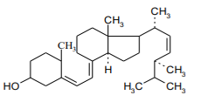
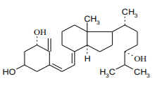
Calcyferols (Vitamin D)
Vitamin D drugs
Oxydevit
White crystalline powder, odorless. Not stable to light and air oxygen. Melting point 133 - 140 °C. Practically insoluble in water, slightly soluble in ethanol.
Dioxidevit
White crystalline powder without odor. Oxidizes with oxygen in air. Practically insoluble in water, slightly soluble in ethanol.

Slide 28
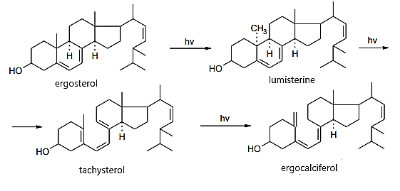
Calcyferols (Vitamin D)
Obtaining
Ergocalciferol (vitamin D2)

Slide 29
Calcyferols (Vitamin D)
Obtaining
Cholecalciferol (vitamin D3)

Slide 30
Calcyferols (Vitamin D)
Identification
IR and UV spectrometryDrip method
Reaction with antimony chloride

Slide 31
Calcyferols (Vitamin D)
Identification
Reaction with 3,5-dinitrobenzoyl chloride
melting point is about 148 ºC

Slide 32
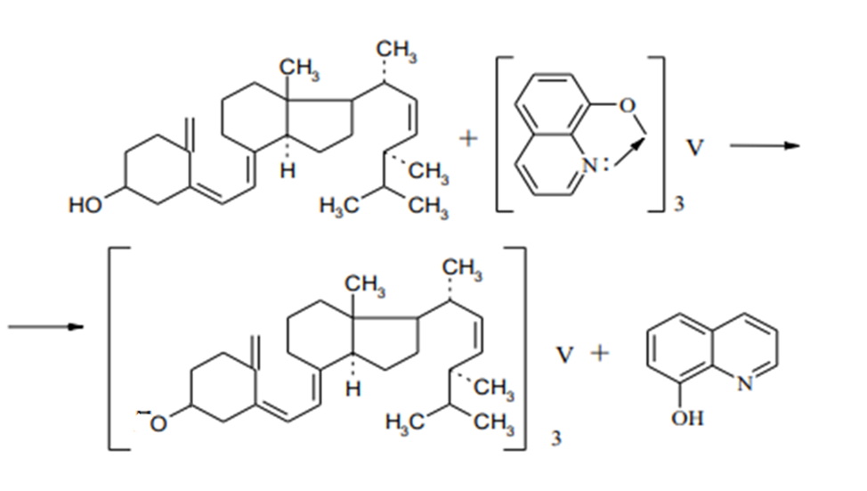
Calcyferols (Vitamin D)
Identification
4. Reaction with a benzene vanadium (III) quinolinate solution

Slide 33
Calcyferols (Vitamin D)
Identification
5. Interaction with acetic anhydride and sulfuric acid
A solution of ergocalciferol in chloroform when shaken with acetic anhydride and sulfuric acid acquires a red color, changing to violet, and then to blue and finally to green.
6. Interaction with concentrated sulfuric acid

Slide 34
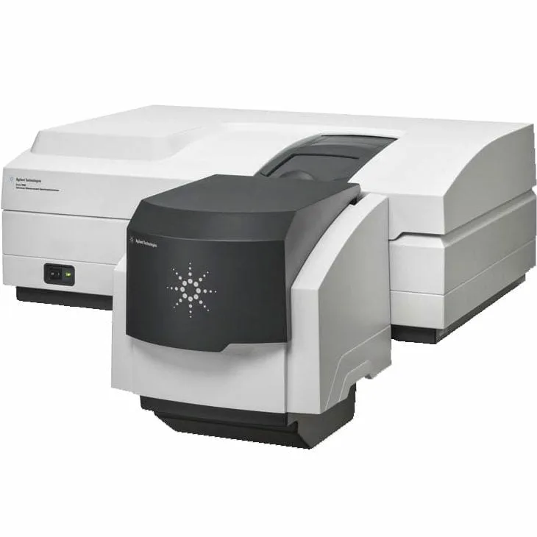
Calcyferols (Vitamin D)
Quantificification
Quantitative determination of ergocalciferol and oxydevit is performed by spectrophotometric method at wavelengths of 265, 251 and 265 nm, respectively. The solvent is ethanol.
The activity of the drug is measured in international units (IU). The international unit of vitamin D is 0.025 µg or 0.000025 mg of chemically pure crystalline vitamin D.

Slide 35
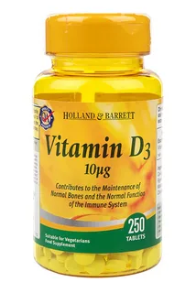
Calcyferols (Vitamin D)
Storage
Vitamin D in all its dosage forms should be stored according to List B, in geometrically closed, up to the top filled orange glass vials, in a dry place, protected from light, at a temperature not exceeding 10 ºC.
Medical use
Vitamin D is a specific remedy against rickets.
In addition to its main purpose as an anti-rachitic agent, vitamin D is effective for the prevention and treatment of all forms of lupus of the skin and diseases of the mucous membranes.
In addition, vitamin D is used in some forms of tuberculosis.

Slide 36
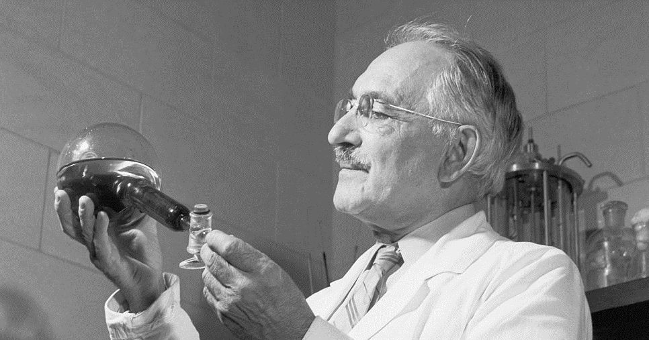
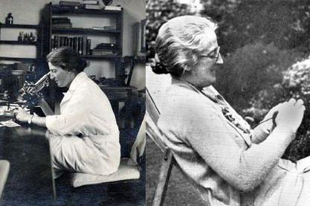
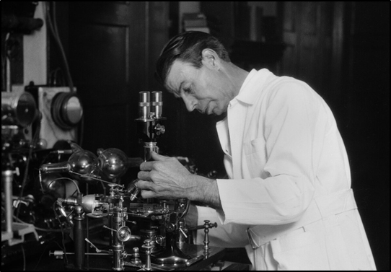
Pterin Vitamins. Folic acid
History of discovery
Viktor Efremov
Lucy Wills
Raphael Stockstead

Slide 37
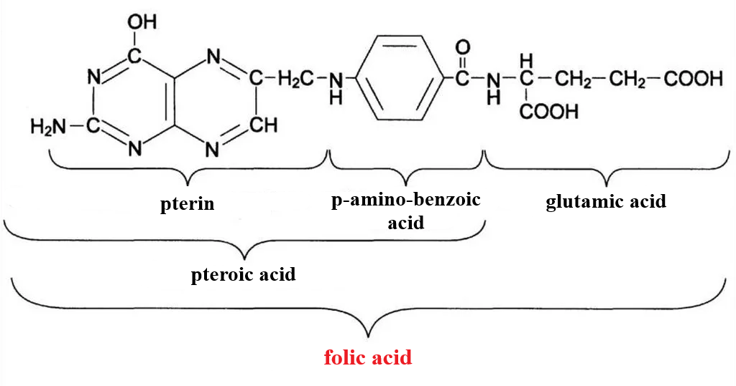
Pterin Vitamins. Folic acid
Structure

Slide 38
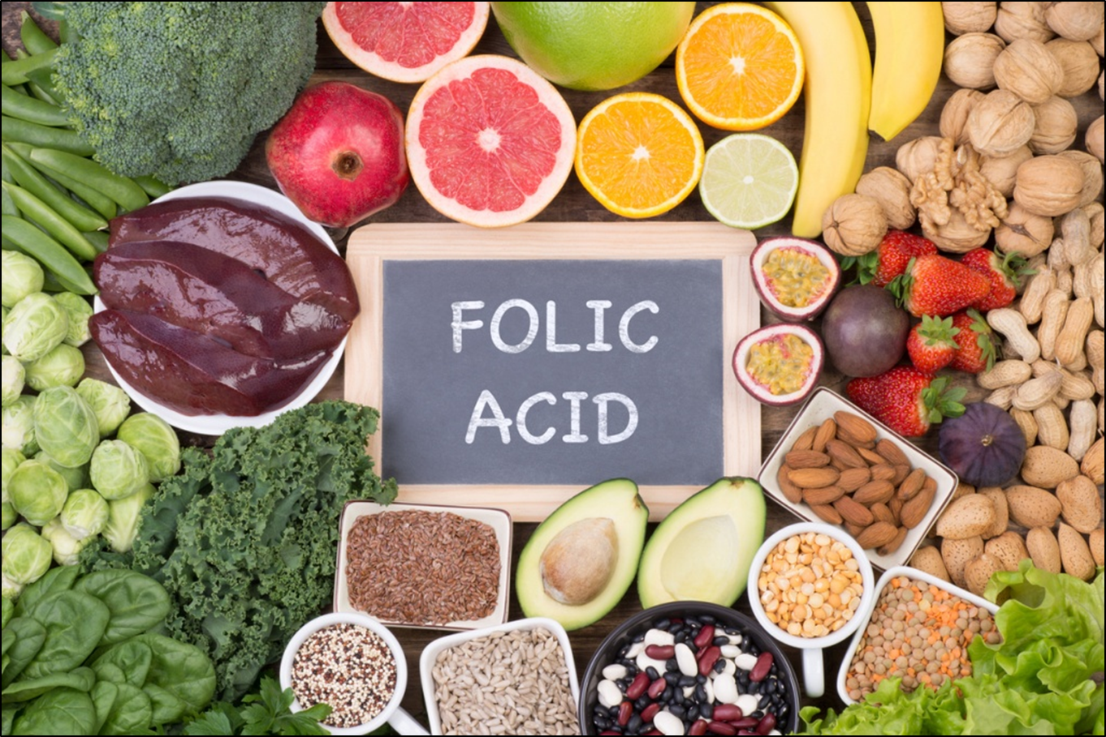
Pterin Vitamins. Folic acid
Sources of folic acid

Slide 39
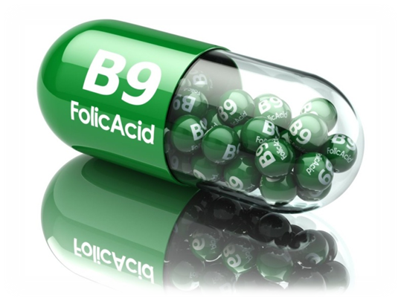
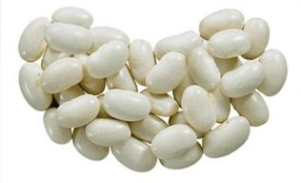
Pterin Vitamins. Folic acid
Functions of folic acid
The production and maintenance of healthy new cells;
The process of DNA replication;
Cell division;
Metabolism of nucleic and amino acids;
Maturation of red blood cells.

Slide 40
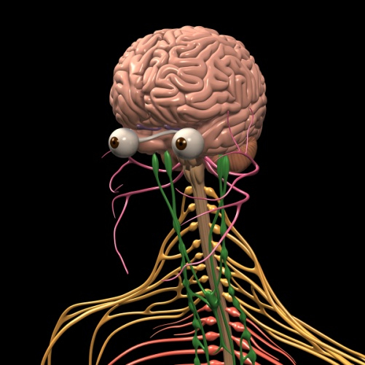
Pterin Vitamins. Folic acid
Hypovitaminosis
Hypervitaminosis
anemia,
fatigue,
irritability,
loss of appetite
various psychiatric symptoms
bloating in the intestines,
increased nervous system excitability to the point of seizures.

Slide 41
Pterin Vitamins. Folic acid
Obtaining
Folic acid is a crystalline substance of yellow or yellow-orange color.
The drug is soluble in dilute mineral acids (better when heated) and easily soluble in solutions of caustic alkalis.

Slide 42
Pterin Vitamins. Folic acid
Identification
1. Ultraviolet spectrophotometry
2. Oxidation

Slide 43
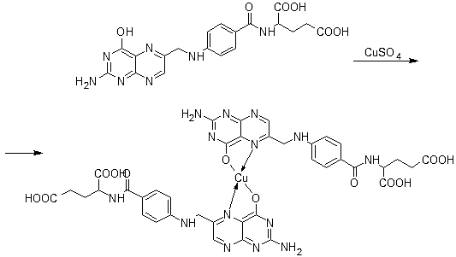
Pterin Vitamins. Folic acid
Identification
3. Complexation
Green precipitate

Slide 44
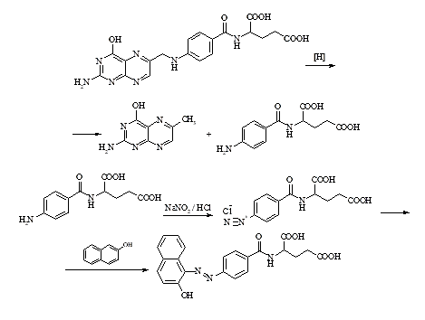
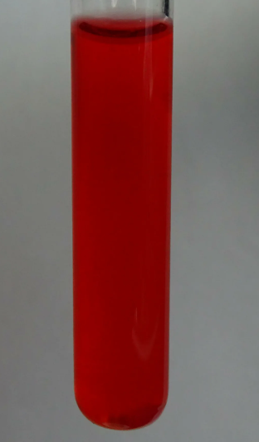
Pterin Vitamins. Folic acid
Identification
4. Formation of azo dye

Slide 45
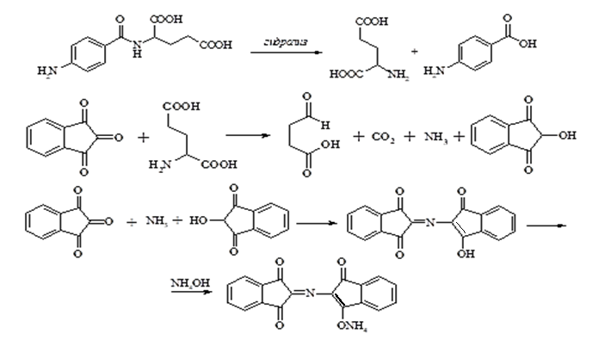
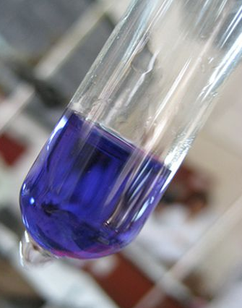
Pterin Vitamins. Folic acid
Identification
4. Detection of glutamic acid after hydrolysis

Slide 46
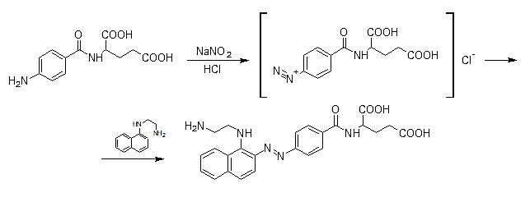
Pterin Vitamins. Folic acid
Quantificification
1. Photocolorimetric determination

Slide 47
Pterin Vitamins. Folic acid
Quantificification
2. Neutralization method
Titrant - 0.1 M hydrochloric acid solution
Indicator - phenolphthalein with methylene blue

Slide 48
Pterin Vitamins. Folic acid
Quantificification
Spectrophotometric determination
Polarographic determination
Storage
The drug is stored in well-corked containers, in a dry, dark place, as folic acid is hygroscopic and decomposes under the influence of light. This process inactivates folic acid and produces fluorescence due to the formation of pterinic acid. More stable solutions at pH 5.0-10.0.
Medical Use
The use of folic acid in medicine is caused by the important role of this vitamin in the process of hematopoiesis, metabolism in cells (including choline). Together with vitamin B₁₂ folic acid stimulates erythropoiesis, is involved in the synthesis of amino acids.

Slide 49
Thank you for attention!

