Slide 1
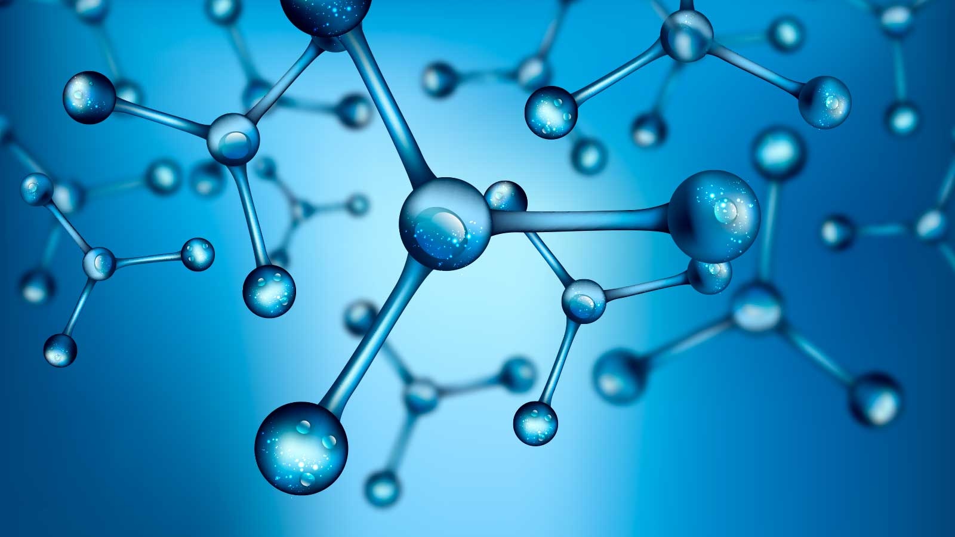
«Special pharmaceutical chemistry»
HORMONES OF THE ADRENAL MEDULA
Associate Professor Gureeva E.S.

Slide 2
Catecholamines
dopamine
epinephrine
norepinephrine

Slide 3
Catecholamine biosynthesis

Slide 4
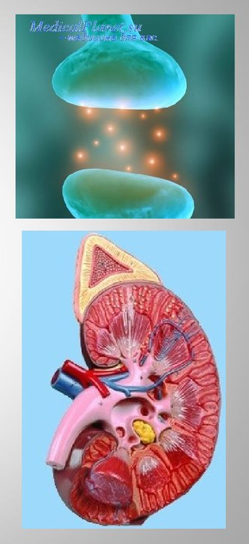
Catecholamines
Catecholamine receptors are found in almost all tissues of the human body. They regulate many physiological functions, including increasing heart rate and strength, reducing peripheral vascular resistance, stimulating glycogenolysis, lipolysis, protein metabolism, etc.
Dopamine, epinephrine (adrenaline), epinephrine hydrotartrate, norepinephrine hydrotartrate are used as drugs.

Slide 5
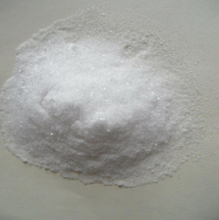
Dopamine hydrochloride
White or cream-coloured, odourless, crystalline powder. Melting point 245-259°C (with decomposition). Freely soluble in water, slightly soluble or soluble in 96 % alcohol, moderately soluble in acetone.
Obtaining

Slide 6
Dopamine hydrochloride
Identification
IR and UV spectrometry
The absorption bands of the IR spectrum should be fully consistent with the spectral figure in the pharmacopoeia monograph.
The UV spectrum of a 0.005% solution of dopamine in 0.1M hydrochloric acid in the 230-300 nm region should have an absorption maximum at 280 nm and an absorption minimum at 250 nm in methanol.
2. Interaction with iron (III) chloride
An emerald green colour appears. If 1 drop of ammonia solution is added to the test tube, the colour changes to cherry red.

Slide 7
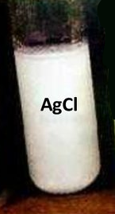
Dopamine hydrochloride
Identification
3. Formation of azo dye
4. Interaction with ninhydrin
Yellow stains appear.
5. Detection of chloride ion
The chloride ion is detected with silver nitrate solution. A white, curdled precipitate is formed.

Slide 8
Dopamine hydrochloride
Purity test
1. Determine the presence of impurity of the starting product of synthesis - homoveratrilamine (not more than 0.8%).
The test is carried out by TLC on plates with powdered cellulose in the system n-butanol - glacial acetic acid - water (40:10:50). After drying and exposure, the impurity stain should not exceed the witness stain (in size and colour intensity). The HPLC method is also used to detect this impurity.
2. Determine the content of sulphates and heavy metals.
3. Determine microbiological purity and bacterial endotoxins (for parenteral drugs).

Slide 9
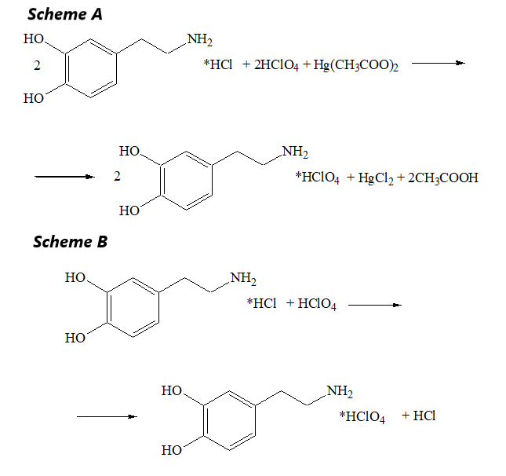
Dopamine hydrochloride
Assay
Non-aqueous titration
Dopamine is quantified by non-aqueous titration in glacial acetic acid with mercury acetate (A). A mixture of formic acid and acetic anhydride can be used as a medium (B).
Titrate with 0.1M perchloric acid solution (indicator methyl violet or crystal violet).
The end point of the titration can be determined potentiometrically.

Slide 10
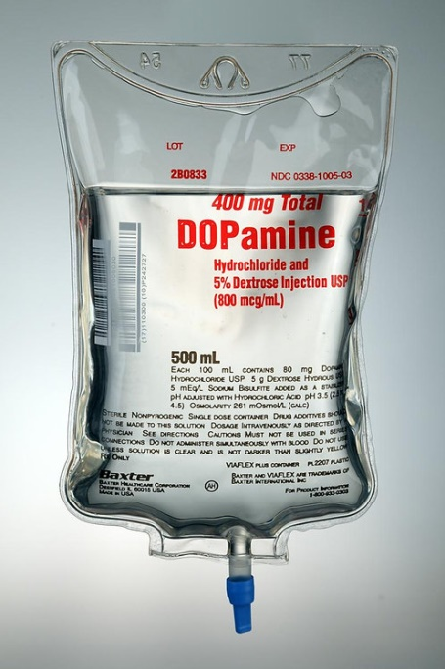
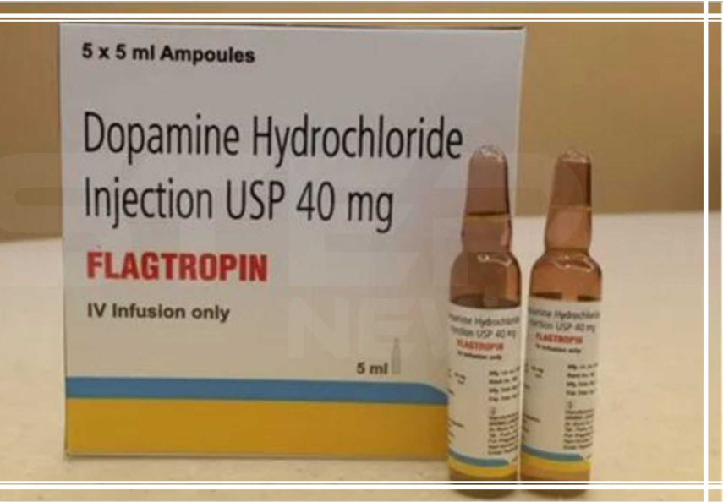
Dopamine hydrochloride
Storage
As dopamine is easily oxidised by light and atmospheric oxygen, it should be stored away from light in hermetically sealed orange glass containers or in sealed ampoules.
Medical use
Dopamine hydrochloride is used as a cardiac stimulant in shock. It is also used to improve haemodynamics in acute heart failure, renal failure, etc. It is usually given as a 0.5% or 4% solution (0.025 or 0.2 g).
Dopamine hydrochloride is available as 0.5%, 1%, 4% solutions in ampoules.

Slide 11
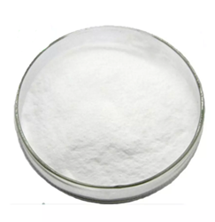
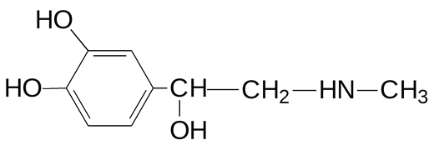
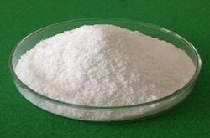
Adrenaline (epinephrine)
Adrenaline (epinephrine) hydrotartrate
Adrenaline
Adrenaline hydrotartrate

Slide 12
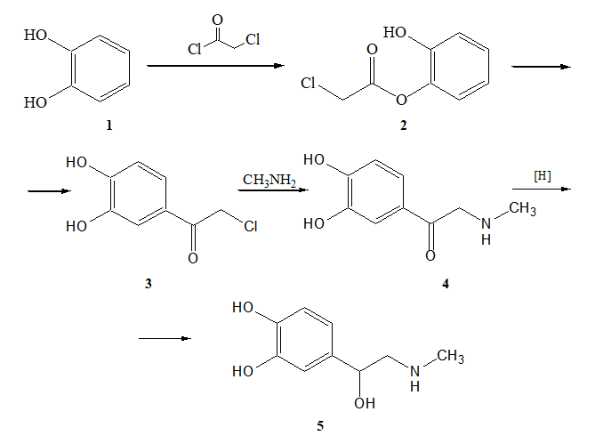
Adrenaline (epinephrine)
Adrenaline (epinephrine) hydrotartrate
Obtaining

Slide 13
Adrenaline (epinephrine)
Adrenaline (epinephrine) hydrotartrate
Physical properties
Adrenaline is a white or creamy-white odourless fine crystalline powder. Changes colour under the influence of air and light. Specific rotation from -50 to -54° (4% solution in 1 M hydrochloric acid).
Epinephrine is very slightly soluble in water, moderately soluble in 0.1 M hydrochloric acid, practically insoluble in ethanol and chloroform.
Adrenaline hydrotartrate is white or white with greyish tinge, odourless crystalline powder. Melting point is 147-152°C (with decomposition). Easily changed under the action of light and air oxygen.
Easily soluble in water, slightly or very slightly soluble in 96% alcohol, practically insoluble in chloroform.

Slide 14
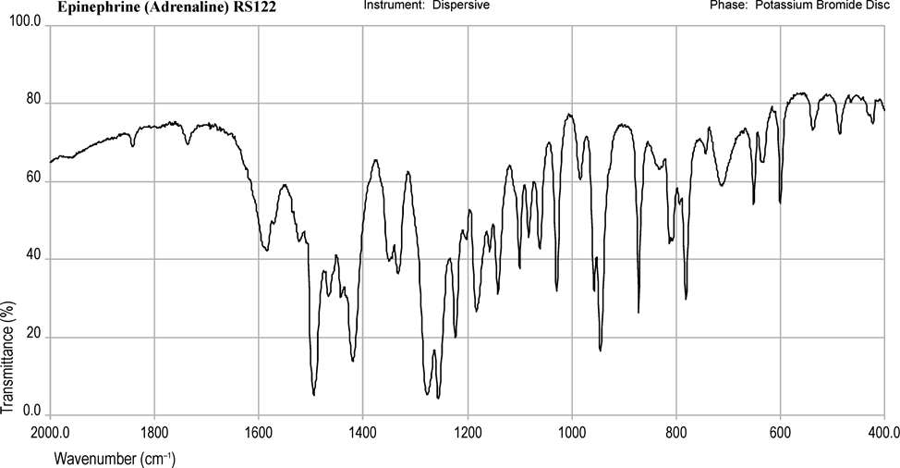
Adrenaline (epinephrine)
Adrenaline (epinephrine) hydrotartrate
Identification
IR spectroscopy

Slide 15
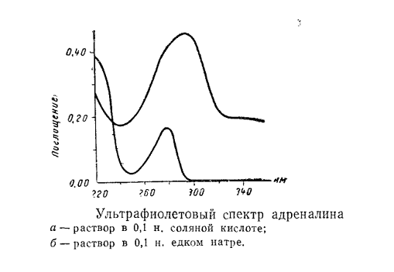
Adrenaline (epinephrine)
Adrenaline (epinephrine) hydrotartrate
Identification
UV spectrometry
The UV spectrum of a 0.005% solution of adrenaline in 0.1 M hydrochloric acid in the 230-300 nm region should have an absorption maximum at 279 nm.

Slide 16
Adrenaline (epinephrine)
Adrenaline (epinephrine) hydrotartrate
Identification
Formation of azo dye
red

Slide 17
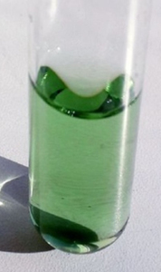
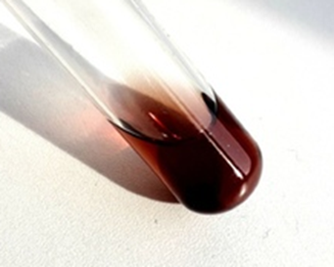
Adrenaline (epinephrine)
Adrenaline (epinephrine) hydrotartrate
Identification
Interaction with iron chloride
With iron (III) chloride an emerald green colouring is formed, which on addition of 1 drop of ammonia solution changes to cherry-red and then orange-red.

Slide 18
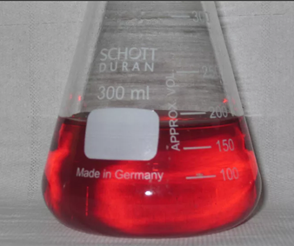
Adrenaline (epinephrine)
Adrenaline (epinephrine) hydrotartrate
Identification
Oxidation reaction with iodine solution (formation of coloured adrenochrome)

Slide 19
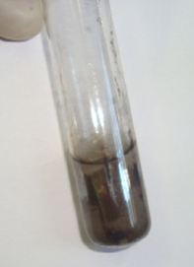
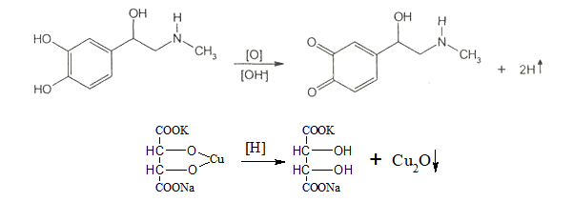
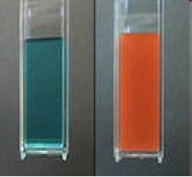
Adrenaline (epinephrine)
Adrenaline (epinephrine) hydrotartrate
Identification
The ‘silver mirror’ reaction
Reaction with Fehling's reagent

Slide 20
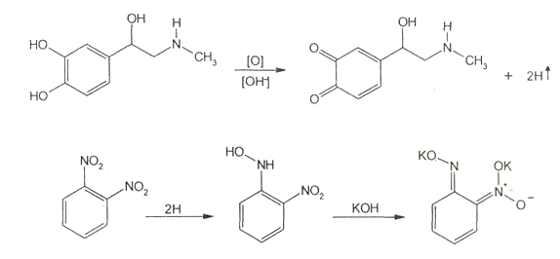
Adrenaline (epinephrine)
Adrenaline (epinephrine) hydrotartrate
Identification
Interaction with 1,2-dinitrobenzene
The reduction of 1,2-dinitrobenzene to blue-violet coloured compounds of o-quinoid structure takes place.

Slide 21
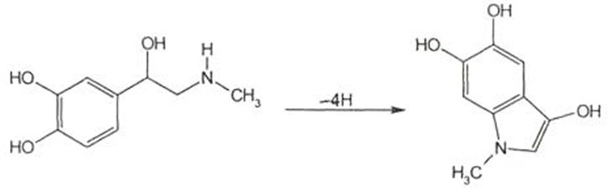
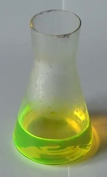
Adrenaline (epinephrine)
Adrenaline (epinephrine) hydrotartrate
Identification
Adrenolutine formation
When a small amount of alkali is added to a solution of adrenaline, its oxidation products (adrenolutin) fluoresce yellow-green.

Slide 22
Adrenaline (epinephrine)
Adrenaline (epinephrine) hydrotartrate
Identification
Colour reactions:
With a-nitroso-b-naphthol gives a reddish brown colour;
with ninhydrin gives a yellow colour;
if the adrenaline bitartrate solution is mixed with a 4% solution of mercuric sulphate, it gradually turns pink;
Specific for adrenalin is the reaction with a reagent prepared by rubbing yellow mercuric oxide and potassium thiocyanate in dilute nitric acid. When the reagent and adrenalin are brought to the boil, an intense red or purple colour appears.
With ammonium molybdate, sodium nitrite in the presence of diethylene-triaminepentaacetic acid has been used for the photometric determination of adrenalin at a wavelength of 465 nm.
The addition of concentrated sulphuric acid and resorcinol produces a cherry red colour.

Slide 23
Adrenaline (epinephrine)
Adrenaline (epinephrine) hydrotartrate
Identification
Interaction with common alkaloid reagents
Base isolation reaction
Ammonia solution is used to perform this test, as alkalis produce soluble phenoxides.

Slide 24
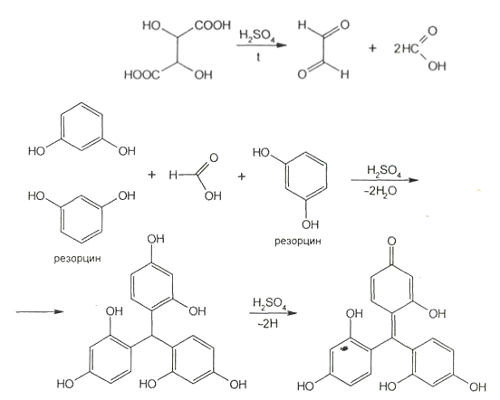
Adrenaline (epinephrine)
Adrenaline (epinephrine) hydrotartrate
Identification
Tartrate ion detections

Slide 25
Adrenaline (epinephrine)
Adrenaline (epinephrine) hydrotartrate
Purity test
The main test for the purity of adrenaline hydrotartrate is the detection of acceptable limits of impurities in synthesis intermediates. Adrenaline is detected by measuring the optical density of a solution in 0.01 M hydrochloric acid at 310 nm.
The presence of the impurity norepinephrine is also determined. The colour reaction with 1,2-naphthoquinone-4-potassium sulphonate and the TLC method on Silufol plates are used for detection, and the HPLC method in the mobile phase: water-methanol (85:15) is used for quantitative determination (maximum 0.0018 %). Calculate the norepinephrine content from the peak areas.

Slide 26
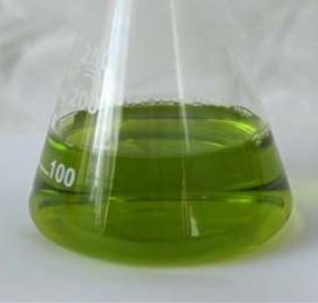
Adrenaline (epinephrine)
Adrenaline (epinephrine) hydrotartrate
Assay
Non-aqueous titration
UV spectrophotometry
Photocolorimetry based on colour reactions

Slide 27
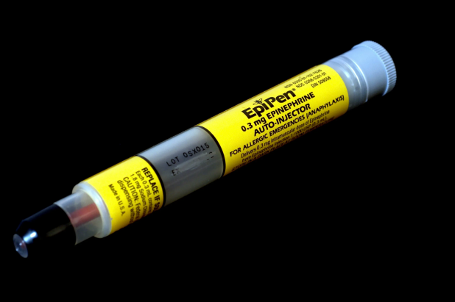
Adrenaline (epinephrine)
Adrenaline (epinephrine) hydrotartrate
Storage
As adrenalin is easily oxidised, especially in the presence of alkali, sodium chloride is added to its solutions, as well as stabilisers, most commonly sodium metabisulphite. However, even under these conditions, prolonged storage causes the solutions to turn brown and the physiological activity of the drug is greatly reduced.
Alkaline glass vials or ampoules, high external temperature, sunlight, contact with air contribute to the decrease in activity. Therefore, the medicine should be stored in vials filled to the top and sealed ampoules made of neutral glass in a place protected from light. Shelf life is 1 year.

Slide 28
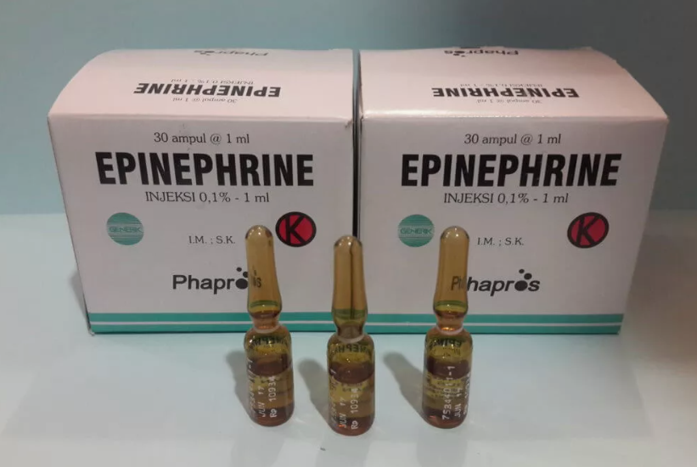
Adrenaline (epinephrine)
Adrenaline (epinephrine) hydrotartrate
Medical use
Sympathomimetic (vasoconstrictor, bronchodilator). It is used in hypotension, urticaria, bronchial asthma.
Adrenalin hydrotartrate solution 0.18% for injection; 0.1% for subcutaneous injection.

Slide 29
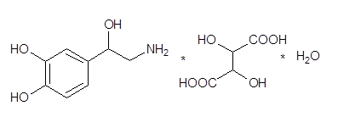
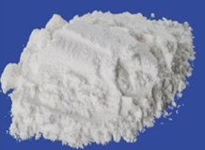
Noradrenaline (norepinephrine) hydrotartrate
White or almost white crystalline powder, odourless, bitter in taste. Easily changes under the influence of light and air oxygen. Melting point is 100-106° (the melting point is cloudy; the drug is not dried beforehand).
Easily soluble in water, slightly soluble in alcohol, practically insoluble in ether and chloroform.

Slide 30
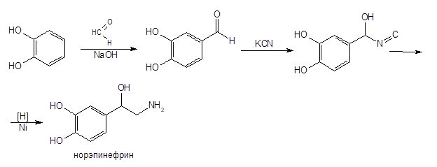
Noradrenaline (norepinephrine) hydrotartrate
Obtaining

Slide 31
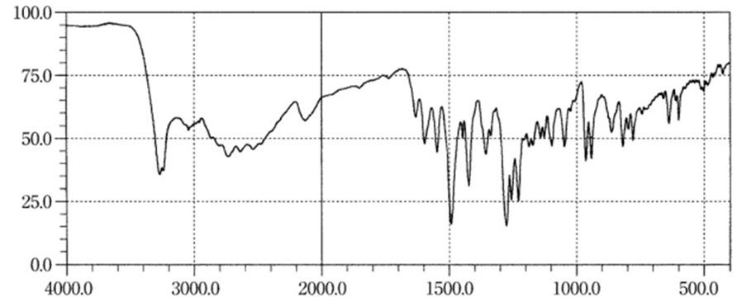
Noradrenaline (norepinephrine) hydrotartrate
Identification
IR spectroscopy
The absorption bands should coincide completely with the spectrum figure attached to the pharmacopoeial monograph.

Slide 32
Noradrenaline (norepinephrine) hydrotartrate
Identification
UV spectrophotometry
The UV spectrum of noradrenaline hydrotartrate in 0.1 M hydrochloric acid has absorption maxima at 279 nm. The FS recommends that the specific absorbance at 279 nm be determined to confirm identity.
Formation of azo dye

Slide 33
Noradrenaline (norepinephrine) hydrotartrate
Identification
Interaction with iron chloride
With iron (III) chloride an emerald green colouring is formed, which on adding 1 drop of ammonia solution changes to cherry-red and then orange-red.

Slide 34
Noradrenaline (norepinephrine) hydrotartrate
Identification
The formation of noradrenochrome
Adrenaline and noradrenaline can be distinguished by an oxidation reaction with 0.1 M iodine solution in two buffer solutions of pH 3.56 and 6.5. Noradrenaline forms noradrenochrome (red-violet colour) only in solutions of pH 6.5.

Slide 35
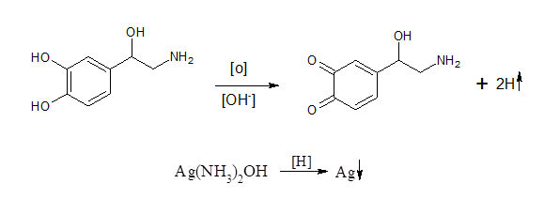
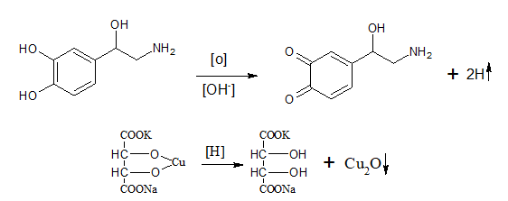
Noradrenaline (norepinephrine) hydrotartrate
Identification
The ‘silver mirror’ reaction
Reaction with Fehling's reagent

Slide 36
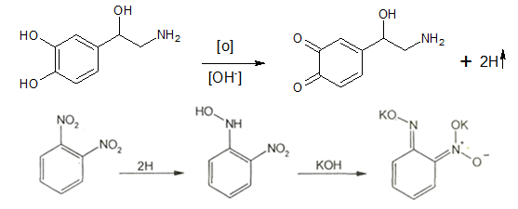
Noradrenaline (norepinephrine) hydrotartrate
Identification
Interaction with 1,2-dinitrobenzene
Base isolation reaction

Slide 37
Noradrenaline (norepinephrine) hydrotartrate
Identification
Tartrate ion detections

Slide 38
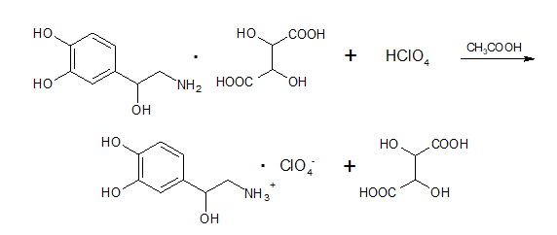
Noradrenaline (norepinephrine) hydrotartrate
Assay
Non-aqueous titration
UV-visible spectrophotometry at 279 nm light absorption maximum.
Photocolorimetry based on colour reactions

Slide 39
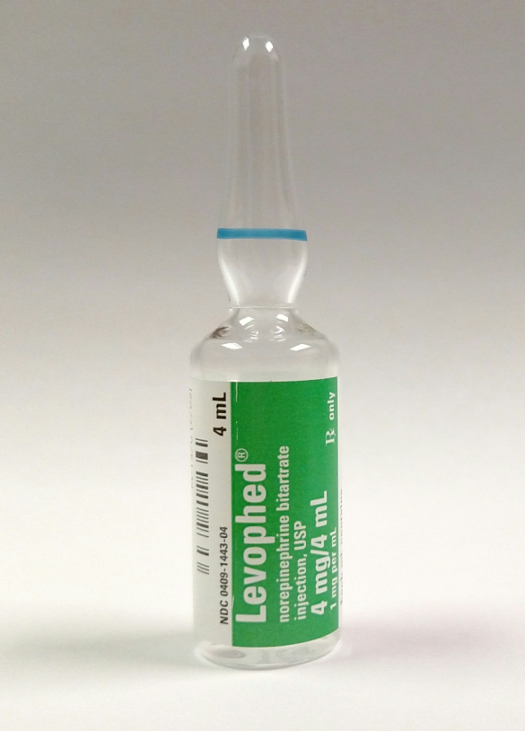
Noradrenaline (norepinephrine) hydrotartrate
Storage
As norepinephrine is easily oxidised by light and atmospheric oxygen, it should be stored away from light in hermetically sealed orange glass containers or in sealed ampoules. For stabilisation, 0.1% sodium metabisulphite [sodium pentaoxodisulphate (IV)], which has reducing properties, is added to injectable solutions.
Medical use
Norepinephrine is used in collapse, acute hypotension due to trauma, poisoning, to reduce haemorrhage and blood loss. It is administered intravenously as a 0.2% solution.

Slide 40
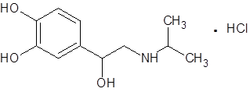
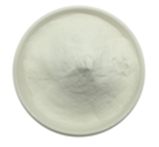
Isoprenaline hydrochloride (isadrine)
White crystalline powder without odour. Melting point 166-172°C. Easily soluble in water, moderately in alcohol, easily in alkalis.

Slide 41
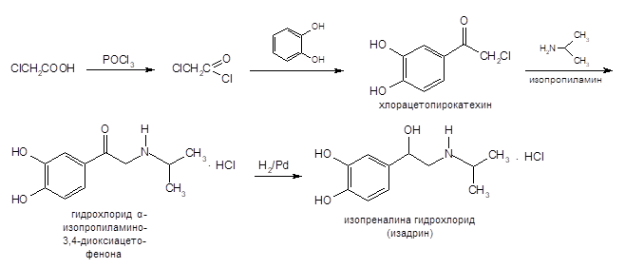
Isoprenaline hydrochloride (isadrine)
Obtaining

Slide 42
Isoprenaline hydrochloride (isadrine)
Identification
IR spectroscopy
The absorption bands should coincide completely with the spectrum figure attached to the pharmacopoeial monograph.
UV spectrophotometry
The UV spectrum of a solution of isoprenaline hydrochloride in 0.1 M hydrochloric acid is characterised by the presence of two absorption maxima - in the region of 223 and 279 nm.
Interaction with ferric chloride

Slide 43
Isoprenaline hydrochloride (isadrine)
Identification
Formation of azo dye
A cherry-red coloured azo compound is formed.

Slide 44
Isoprenaline hydrochloride (isadrine)
Identification
Colour reactions:
with nitrous acid, dirty purple;
with alpha-nitroso-beta-naphthol, reddish brown colour;
with ninhydrin yellow colouring;
with potassium iodate in acid medium, cherry red colour;
with phosphoric molybdenum acid, green colour;
with chloramine, isoprenaline hydrochloride gives a purple colour, which changes to red after the addition of 4-aminoantipyrine;
with selenic acid it forms a brown amorphous precipitate;
with cerium (IV) sulphate, a red-orange coloured product is obtained.

Slide 45
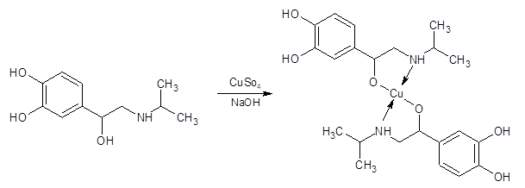
Isoprenaline hydrochloride (isadrine)
Identification
Complex formation with copper (II) ions
Interaction with phosphorus-tungstic acid
When interacting with phosphorus-tungstic acid, unlike adrenaline, isoprenaline hydrochloride forms a white precipitate, which turns brown on standing.

Slide 46
Isoprenaline hydrochloride (isadrine)
Identification
Formation of aminochrome
Reaction for chlorides in aqueous solution

Slide 47
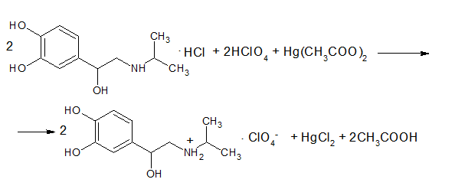
Isoprenaline hydrochloride (isadrine)
Assay
Non-aqueous titration
Isoprenaline hydrochloride, like other hydrochlorides of organic bases, is titrated in the presence of mercuric acetate. The solvent is glacial acetic acid, the titrant is 0.1 M perchloric acid solution and the indicator is crystal violet or 1-naphtholbenzene.

Slide 48
Isoprenaline hydrochloride (isadrine)
Storage
Isoprenaline hydrochloride oxidises even in the dark, especially when the temperature rises and in a humid atmosphere. It is therefore stored in tightly closed orange glass bottles. Aqueous solution of isoprenaline hydrochloride turns pink when standing. Do not freeze.
Medical use
The action of isoprenaline is explained by its stimulating effect on beta-adrenergic receptors. It is a potent bronchodilator, increases heart rate and contractions, and increases cardiac output and myocardial oxygen consumption.
Isoprenaline hydrochloride is most commonly prescribed as a bronchodilator in the form of 0.5% and 1% solutions for inhalation or as sublingual tablets.
It is available in vials of 25 and 100 ml of 0.5% and 1% solutions and in tablets of 0.005 g.

Slide 49
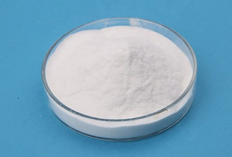
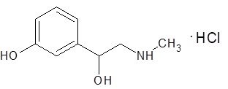
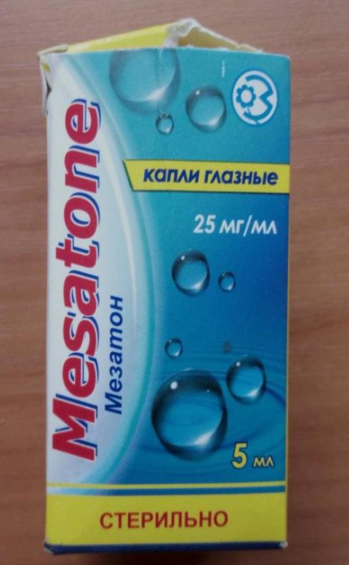
Mesatone
White or white with slightly yellowish tinge, odourless crystalline powder. Easily soluble in water, 95% alcohol and dilute solutions of alkalis and acids, practically insoluble in ether.

Slide 50
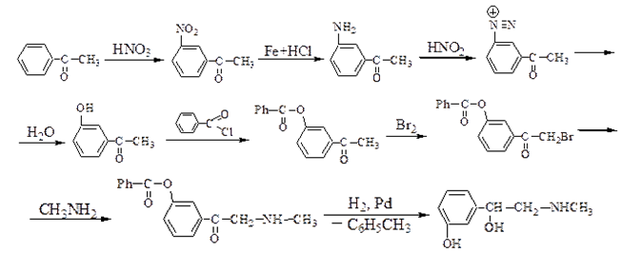
Mesatone
Obtaining

Slide 51
Mesatone
Identification
IR and UV spectrophotometry
2. Interaction with iron (III) chloride solution
A violet colouration appears.

Slide 52
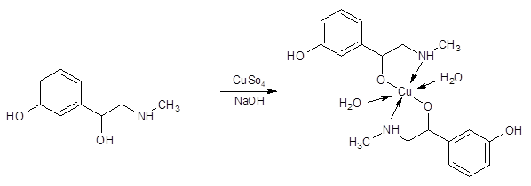
Mesatone
Identification
Reaction with copper sulphate solution in the presence of sodium hydroxide
A complex coloured blue-violet, insoluble in ether, is formed
Reaction for chlorides with silver nitrate solution.

Slide 53
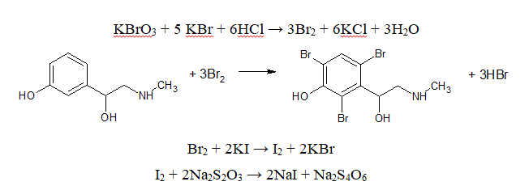
Mesatone
Assay
Bromatometry

Slide 54
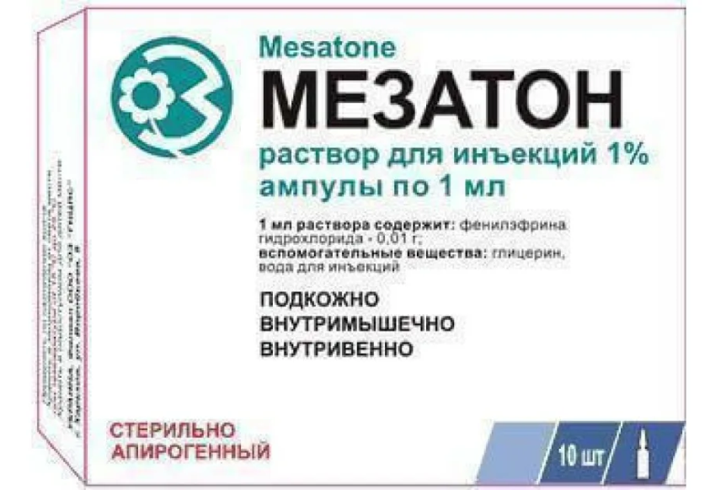
Mesatone
Storage
In well corked orange glass jars, away from light.
Medical use
Mesatone acts selectively on α-receptors. It is used to increase blood pressure (hypotension). Its structure is characterised by the presence of a hydroxyl group in the aromatic nucleus. Mesatone is much less effective than adrenaline, but it lasts much longer (due to slow degradation by enzymes).

Slide 55
Thank you for attention!

