Slide 1
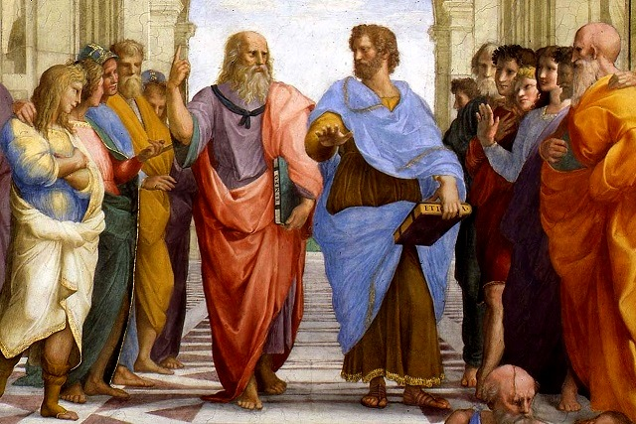
Theme: Ancient Greek philosophy.

Slide 2
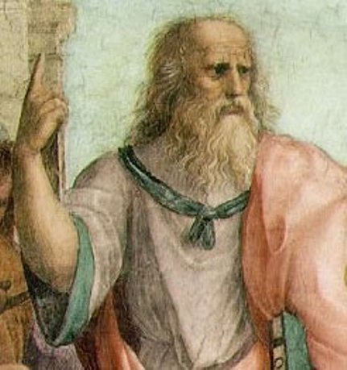
Plato was the great follower of Socrates. Plato organized his own school that is called Academy. According to Plato, world is dual in this nature: there are visible world of changeable things and invisible world of ideas. The world of ideas is true being, but concrete, sensually percepting things are only shadows of ideas, their deficient copies.
Plato 429-347 BC

Slide 3
Idea is the central category of Plato’s philosophy. Ideas are eternal specimens, paradigms, which form all things from formless and unstable matter. Perceptions can’t give a notion about ideas. But soul finds them in itself, because it has contemplated them once before its earthy existence. Soul is the immortal essence, which takes place in human body as prisoner in dungeon and “recalls the world of ideas”.
In the center of Plato’s book “The Republic” is the myth of the cave. It illustrates the connection between “world of ideas” and “world of things”.

Slide 4
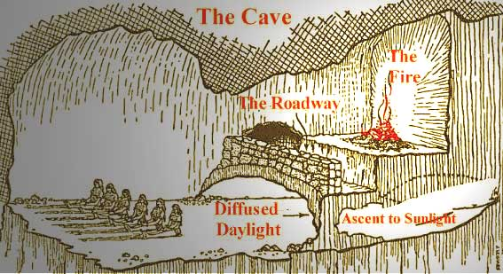
All people are prisoners of cave, who cannot take a turn to the light and go out from cave. Prisoners of cave are in chain. And behind them near the cave’s exit, fire is burning, the sun is shining and different people carry some interesting things: pictures, statuettes, images. But prisoners of cave can not see it; they can see only shadows of these images on the wall of cave. Sun is the idea of Blessing and God. Shadows on the wall of cave are visible, material world, world of things. People and images, which are in out of the cave, are invisible world, world of ideas.

Slide 5
The main mission of man is cognition of ideas imitation and following them. Man must devote himself to the world of idea. Man must develop in yourself love to beautiful, soul art and knowledge with purpose to approach to ideal world (world of ideas).
Plato’s idealism became one of the most important sources of anthropologic dualism and theoretically-cognitive rationalism.

Slide 6
Anthropologic dualism of soul and body is in accordance with metaphysical contrast of idea and thing.
The main in man is a soul but body is only the lowest and the hostile to soul matter.
Soul is heterogeneous and consists of three parts:
passion( sensual soul)
courage (volitional soul)
spirit (rational soul).
Spirit is the superior part of soul and only its domination ensure normal state for soul (orientation on the ideas).

Slide 7
Plato’s dualism of soul and body became determinative for subsequent understanding of man in western philosophy. Based himself on the theory of ideas, Plato solved problems of society and state. Plato builds his structure of ideal state, when three different sorts of people in depend of type of soul fulfill only theirs specific functions.
In “ideal state” only philosophers must govern, because, according to Plato, philosophers are aristocrats of spirit, the best and the most wise citizens. Other people: warriors, merchants need in rule of philosophers.

Slide 8
The form of ideal state may be monarchy, aristocracy and democracy, but monarchy is the best form of state.
In reality this forms of state can be transformed in opposite - tyranny, oligarchy and demagogy. It is happened, when ruler expresses not people but his personal interest. That it has not happened, Plato demands right organization of education of citizens.

Slide 9
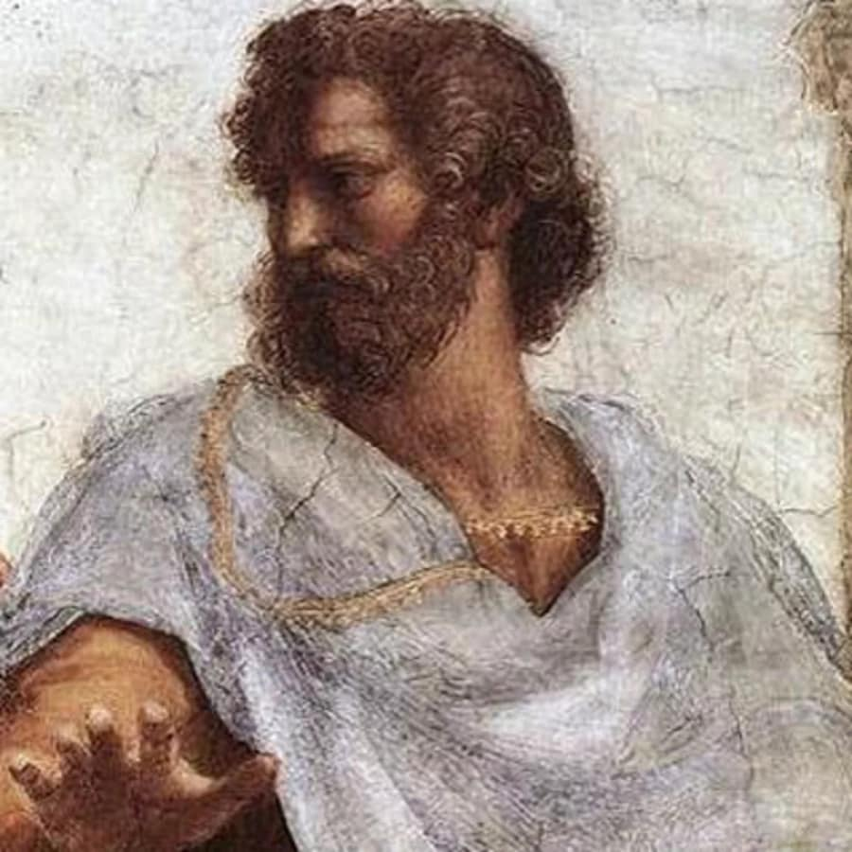
Aristotle was the great follower of Plato, founder of logic as the science about lows and rules of human thinking. He nevertheless disagreed with Plato in a number of important problems. Aristotle said: “Plato is my friend, but truth is more precious”. In Athens he founded his own school, the Lyceum, called the Peripatos. Aristotle delivered his lections, walking in the garden around Lyceum. The word “peripatetics” means walking philosophers.
Aristotle 384-322 BC

Slide 10
In the base of main treatise “Metaphysics” Aristotle put the theory about four causes of being:
material cause,
formal cause,
efficient cause,
final cause.
The main causes are two: material and formal.

Slide 11
Matter in itself is inert and passive. It has only possibility of origin of real things. Matter must get proper form so that this possibility transforms in reality.
Form is active creative factor owing to which things become real. Form is a stimulus, aim and cause of becoming of diverse things from matter: matter is like a clay. So that diverse things appeared from it, potter - God or mind – proto-engine - is necessary.
Aristotle approaches to the idea of isolated (individual) being of the thing. It is combination of matter and form. Matter is the possibility and substratum of being. God is the basic engine of the world, defining as top (summit) of the universe. Efficient cause helps real to happen and final cause explains why some things exist.

Slide 12
The second main treatise of Aristotle after “Metaphysics” is the treatise “About soul”. There are three type of soul:
vegetative soul, its attributes are feeding and growing;
animal soul, its attributes are sensation and movement;
intellectual soul, its attributes are cognition and choice.
According to Aristotle, only man possesses intellectual soul. The soul is the form of body, its Entelechy (purposeful energy, motive power, changing potentiality into reality).

Slide 13
In his social doctrine Aristotle developed the idea about middle element (“middle class”). It is the basis for the best contacts of people in the state.
Citizens with the middle income don’t aspire to have other people’s property and the rich men don’t envy them. Aristotle gives the classifications of right form of state’s rules (monarchy, aristocracy and polity) and wrong form of state’s rules (tyranny, oligarchy, democracy in sense of demagogy). According to Aristotle, the best form of rule is polity, it is balance between the rich and the poor, that gives the best intercommunication between people in the state.

Slide 14
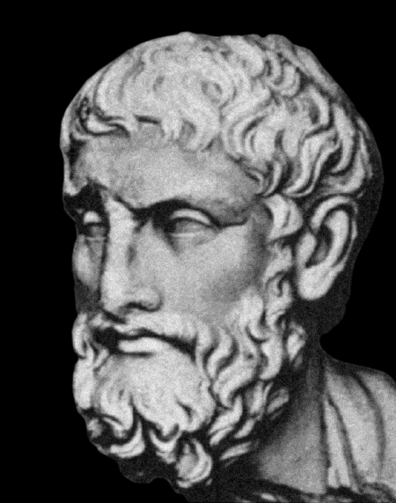
Period of Roman philosophy: Epicurism, stoicism and skepticism.
Epicureans are followers of Epicurus, who was the creator of specific ethics. He organized school in a long way from the city. This place was called Epicurean Garden.
Epicurus 342-270 ВС

Slide 15
Theory of Epicurus consists of some points:
reality is clear for human mind and cognition;
in the space of reality is the place of happiness;
happiness is the absence of sufferings and worries;
for happiness man needs only in yourself;
for happiness man doesn’t need in state, richness, society and Gods.
Epicureans supposed that after death is nothing, no soul, no God, no pleasure, therefore man must get maximum pleasure during his life. Happiness is in the pleasure. This ethics is called hedonism. Epicurus optimistic said, that
“death doesn’t exist, because when I am alive, death doesn’t exist, when I am dead, I don’t exist”.

Slide 16
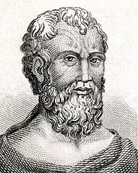
Founder of stoicism was Zeno. Knowledge is instrument of obtaining wise. They suppose that virtue and happiness can be attained only by submission to destiny and the natural law. Man must live in the connection with nature and yourself. Ideal of stoicism is quietness (ataraxia). Ataraxia - ἀταραξία, literally, "unperturbedness, generally translated as "imperturbability", "equanimity", or "tranquillity".
The main idea of stoics that man doesn’t rule of his fortune.
Rome stoic Seneca said:«Fortune conducts obedient man, and fortune drags disobedient man». Any values by stoicism have only inner nature and nether come from outside. The happiness depends on human’s attitude to the world.
Zeno 334-262 ВС

Slide 17
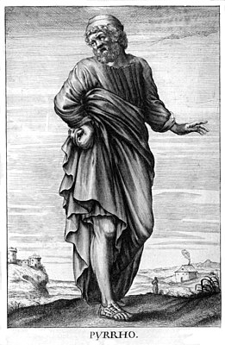
Word “skeptic” means doubting. Skeptics doubted in cognition of objective reality. Skepticism usually takes place in the time of social crisis and changes. According to skeptics man can live happy in the absence of objective truth and values. Skeptics proclaimed happiness in spite of values.
Pyrro 360-275 ВС

Slide 18
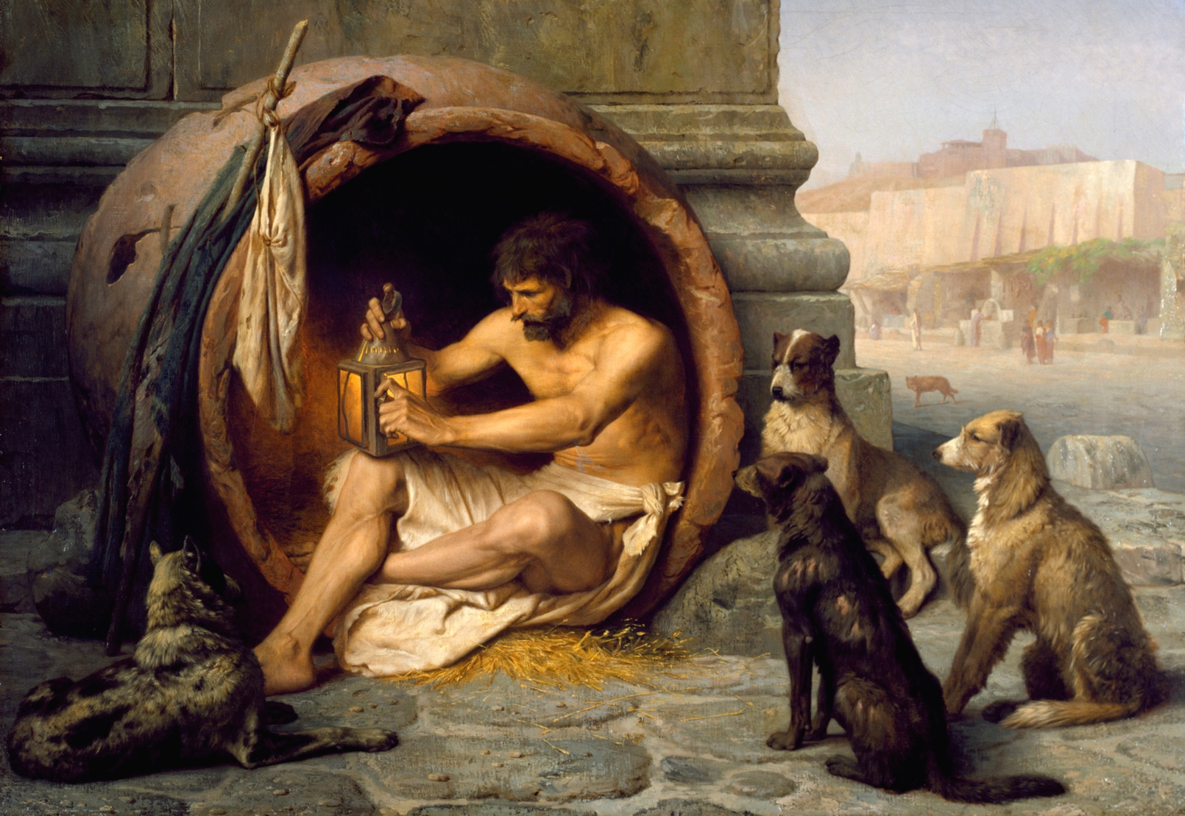
Cynics (lat. Cynics) follow the style of Socrates in theirs lifestyle.
According to legend, the representative of the school Diogenes lived like a dog in a big pot, rejecting all conventions, religions, manners, clothes, housing, food. It is well-known that when Alexander Makedonski visited Diogenes and asked if he wanted any mercy, “just do not block the light for me,” Diogenes answered.

Slide 19
The end of Ancient philosophy was in 529 year After Christian, when Christian emperor Justinian forbade the teaching and organization of pagan schools.

Slide 20
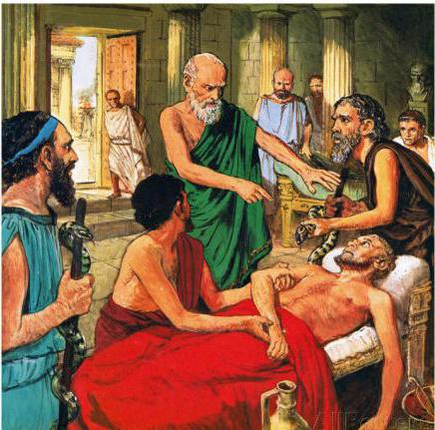
Correlation between Greek philosophy and medicine.
Great physician and thinker Hippocrates emphasized philosophic aspect in medicine. He claimed to define the empirical reason of illness with the help of vast and thorough observations. Hippocrates has determined morally-ethic regulations of physician.
Since the work of physician became moral duty, which prompted him to act in the limits of strict moral norms, that come from the philosophy of human being.

