Slide 1
MINISTRY OF HEALTH OF THE RUSSIAN FEDERATION VOLGOGRAD STATE MEDICAL UNIVERSITY DEPARTMENT OF PHARMACEUTICAL AND TOXICOLOGICAL CHEMISTRY LECTURE 1 TOXICOLOGIKAL CHEMISTRY
A group of substances isolated from biological objects by distillation. The problem of examination of alcohol intoxication.
Maria Petrovna Paramonova
Assistant professor, PHD

Slide 2
Toxicological significance of alcohols

Slide 3
Toxicological significance of alcohols
Ethanol, ethyl alcohol, C₂H₅OH (mp, –114°C; bp, 78°C), is a clear, colorless liquid widely used as a beverage ingredient, synthetic chemical, solvent, germicide, antifreeze, and gasoline additive.
In medical practice, ethyl alcohol is used as an external antiseptic and irritant for compresses, for the production of tinctures, extracts and medicines for external use.
It is produced by the fermentation of carbohydrates or by the hydration of ethylene, as shown by the following two reactions:

Slide 4
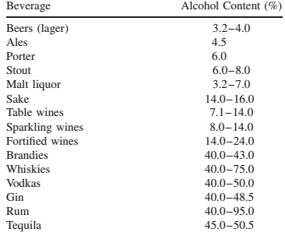
Alcoholic drinks are a mixture of water and ethyl alcohol mixed with other substances that give them a characteristic odor and taste.
Alcohol Content of Various Beverages

Slide 7
Toxicological significance of alcohols
Methyl alcohol CH₃OH (methanol, wood alcohol, carbinol) is a colorless liquid with a characteristic odor,
bp=64.5°C.
The taste and smell are no different from ethyl alcohol.
Methyl alcohol is a good solvent for fats, lipids, and oils. Methanol Burning blue flame.
Methyl alcohol is obtained by dry distillation of wood and chemical synthesis.

Slide 8
Toxicological significance of alcohols
Ethylene glycol is colorless, syrupy, non-volatile liquid, odorless, sweetish taste. Boiling point=195°C. Freezing temperature - 40°C. Ethylene glycol is highly soluble in water, ethyl alcohol, glycerin, benzene, fat.
Ethylene glycol is used in the pharmaceutical, textile, leather, and tobacco industries.
It is used in the production of ink, cellophane, synthetic fabrics, and for dissolving paints.
Ethylene glycol can lower the freezing point of water.
His used as a cooling and antifreeze liquid for engines in winter.

Slide 9
C₂H₅OH
Ethyl alcohol can enter the human body in several ways:
-through Gastrointestinal tract,
-intravenously,
-rectally
-by inhaling its vapors.
Abuse of ethyl alcohol leads to dependence on it and chronic alcoholism.
Alcoholism is a form of substance abuse. It is characterized by an addiction to drinking drinks containing ethyl alcohol, the development of mental and physical dependence, withdrawal syndrome, personality degradation (mental, physical, social). The formation of alcohol dependence has common traits with the mechanism of addiction to opiates, cocaine and other drugs.

Slide 10
C₂H₅OH
Ethyl alcohol is quickly absorbed from the gastrointestinal tract.
20% absorbed in the stomach, and 80% in the small intestine.
Absorption is affected by food. Absorption is slowed down by foods containing proteins, fats, and starch.
Lethal dose 6-8 ml of pure ethyl alcohol per 1 kg of body weight.

Slide 11
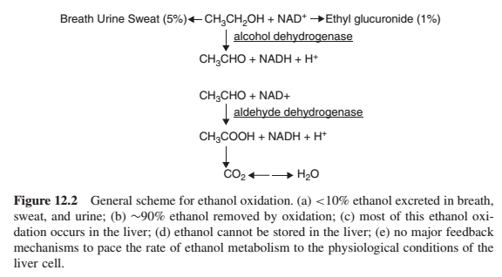
Biotransformation of C₂H₅OH

Slide 12
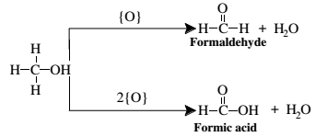
CH₃OH Absorption: from GIT, from skin, from lung
Methanol has been responsible for the deaths of many humans who ingested it accidentally or as a substitute for beverage ethanol. The fatal human dose is believed to lie 50g.
In the body, methanol undergoes metabolic oxidation to formaldehyde and formic acid:
The formic acid product of this reaction causes acidosis, with major adverse effects on the central nervous system, retina, and optic nerve, blindness.
Elimination from kidney, from skin, from lung

Slide 13
Objects of research for the detection of “alcohol poisons”:
NarcologicaL
blood,
Urine
exhaled air
Forensic chemical
internal organs of a corpse, blood, urine, vomit, food products.
+ methanol - 1/3 of the brain,
+ ethanol - blood from large veins, urine, muscle tissue.
Before the suspect’s skin is punctured with a sterile needle, it must be cleaned up by the swab of a non-alcoholic disinfectant
The use of an alcoholic disinfectant may either give false positive results or may contribute to falsely high alcohol contents of blood.
About 5-10 ml of blood sample must be collected in a test tube and must be stored in a refrigerator at 4 C
after adding the anticoagulant.
Clinical –
blood, urine, vomit

Slide 14
Preliminary method in living individuals.
A. M. Rapoport's test is based on the oxidation of ethyl alcohol with potassium permanganate in the presence of concentrated sulfuric acid.2 ml of purified water are added to two test tubes, a tube is placed in one of them, through which the subject passes 2 liters of exhaled air. Then 20 drops of concentrated sulfuric acid are added to both test tubes along the walls and added1 drop of 0.5% potassium permanganate solution. After 2-3 minutes, observe the result.If the exhaled air contained alcohol vapor, then within 10-15 minutes the analyzed solution will become discolored or the intensity of its color will become less compared to the control solution in the second test tube.
An evidentiary method for living individuals is gas-liquid chromatography.
We'll look at it later.

Slide 15
Installation for isolating volatile poisons by steam distillation
1 - steam generator;
2 – water separator;
3 – drain tube;
4 – flask with the object of study;
5 - refrigerator;
6 –flask with distillate
Distillation equipment and technology
Isolation of volatile poisons
•Crushing an object.
•Mixing with water to a thick paste.
•Acidification to pH 2-3 with oxalic acid solution.
•Distillation.

Slide 16
Detection C₂H₅OH in distillate
1. Iodoform Test
Take 1 ml of the distillate and add a few drops of 10% NaOH to it. This is followed by drop wise addition till the solution becomes brown. The mixture is warmed on low flame/water bath for few minutes. A few drops of I₂ solution are added to change the color of the solution from brown to yellow. The mixture is again heated on low flame/water bath, yellow colour precipitate is formed on standing. The precipitate is observed under microscope. Characteristics hexagonal crystals of iodoform are seen (also positive in presence of ethanol, acetaldehyde, iso-propanol)

Slide 17
Detection C₂H₅OH in distillate
2. The oxidation reaction of ethyl alcohol to acetaldehyde.
To 1 ml of distillate add 1 ml of 10% sulfuric acid solution and 1 ml of 5% potassium dichromate solution. After 20 minutes at room temperature you notice the fruity smell of acetaldehyde (the smell of fresh apples).

Slide 18
Detection C₂H₅OH in distillate
3. Reaction of formation of ethyl acetate.
To 1 ml of distillate add anhydrous sodium acetate and 2 ml of concentrated sulfuric acid drop by drop. The mixture is stirred and heated. Then the mixture is pouredinto water and stir. Feel the characteristic apple fruitiness.

Slide 19
Detection C₂H₅OH in distillate
Gas-liquid chromatography (GLC) method is based on the conversion of ethanol into a more volatile compound - ethyl nitrous acid (ethyl nitrite).
Advantages of the GLC method.
• High separating power
• Universality of the method.
• Possibility of qualitative and quantitative determination in one sample
• High sensitivity (10-5 – 10-9 g).
• Possibility of performing analysis in a small sample volume (0.5-2 ml of bio fluid).
• Accuracy of the method (error does not exceed 1-2%).
• Express (determination time 3-5 minutes)
• Simplicity and ease of implementation.
• Evidence and objectivity

Slide 21
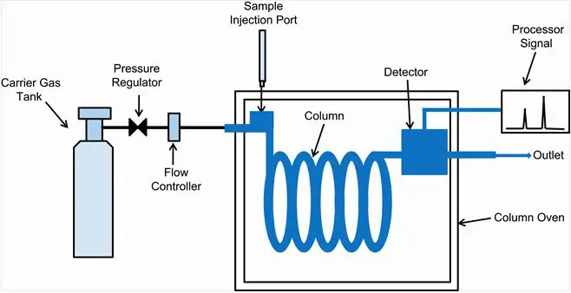

Slide 22
A chromatogram so obtained helps in qualitative as well as quantitative analysis. Position of the peak is representative of a particular compound and the area covered by the peak represents its amount
Operating Conditions:
· Column: Porapack polymer bead 80-100 mesh or its equivalent, which can separate or resolve the ethanol · Column Temperature: 1600 C
· Carrier Gas: Nitrogen
· Rate of Gas Flow: 50 ml/min
· Detector: Flame Ionization Detector
Alternative Operating Conditions:
· Column: 0.3% Carbowax 20 M on 80-100 mesh Carbopak C, 2m X 2mm ID or its equivalent
· Column Temperature: 350 C for 2 minutes and then programmed at 50 C per minute to 1750 C and hold for atleast 8 minutes
· Carrier Gas: Nitrogen at 30 ml/min

Slide 23
Add 0.5 ml of a 50% trichloroacetic acid solution to a 10 ml bottle, then 0.5 ml of isopropyl alcohol solution with a concentration of 4% o (internal standard) and 0.5 ml of the test sample (blood, urine or distillate). The bottle is closed with a stopper. The contents of the bottle are mixed and 0.35 ml of a 30% sodium nitrite solution is injected with a syringe, shaken and left for 1 minute. Then0.5 ml of the vapor-gas phase is taken and introduced into the GLC device. Based on the resulting chromatogram, the height (area) of the peaks of the “standard” and the substances being determined is measured.
R-OH + NaNO₂ + Cl₃C-COOH --- R-NO + H₂O

Slide 24
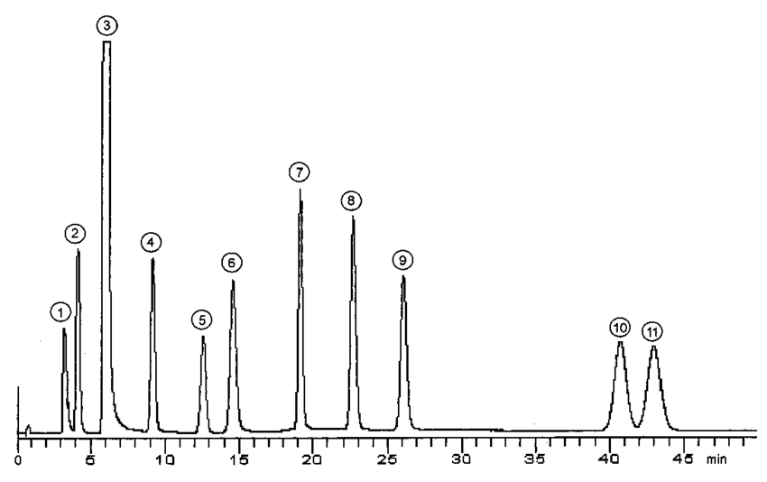
The peaks were identified from retention times as
methanol,
(2) acetone,
(3) ethanol,
(4) 2-propanol,
(5) t-butanol (internal standard),
(6) n-propanol,
(7) 2-butanol,
(8) isobutanol,
(9) n-butanol,
(10) 2-methyl-butan-1-ol,
(11) 3-methyl-butan-1-ol.

Slide 26
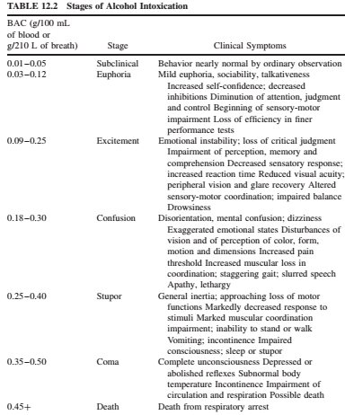

Slide 27
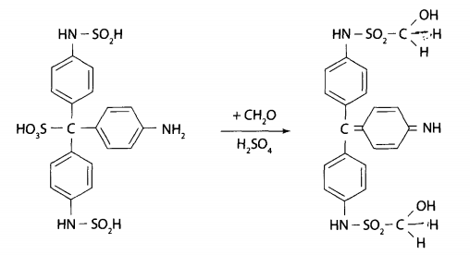
Detection CH₃OH in distillate:
Gas-liquid chromatography
2. The oxidation reaction of methyl alcohol to formaldehyde. To 5 ml of distillate add 2 ml of 10% sulfuric acid solution. The liquid is cooled by placing the test tube in cold water containing pieces of ice. Then a 1% solution of potassium permanganate is added drop wise to the mixture under study until the pink color remains.
REACTION WITH SOLUTION OF FUXINUSULPHINE ACID. To one part of the solution add 3 drops of concentrated sulfuric acid and 1 ml of fuchsinsulfurous acid solution. The appearance of a blue-violet color is observed.

Slide 28
The reaction of ester formation with salicylic acid (methyl salicylate).To 1 ml of distillate add 0.03 g of salicylic acid and 2 ml of concentrated sulfuric acid. The mixture is thoroughly mixed and carefully heated over a flame.burners, and then poured into purified water and smell the characteristic odor of salicylic acid methyl ester.
Quantitative determination of methyl alcohol
Gas-liquid chromatography for the determination of methanol is carried out using the same method as ethanol. Calculation of methyl alcohol content in the test objectcarried out according to the calibration graph, according to the calibration coefficient or by the internal standard method.
Photocolorimetric method.

Slide 29
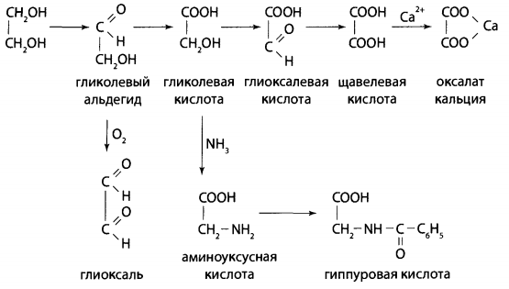
Absorption: from GIT
Biotransformation:
Objects of analysis:
• liquids containing ethylene glycol;
• stomach with contents;
• brain, liver;
• kidneys, urine.

Slide 30
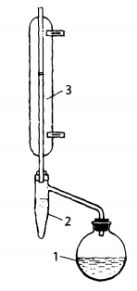
Testing for ethylene glycol is carried out upon special requests from the court investigative authorities or forensic expertis.
Ethylene glycol is an almost non-volatile liquid. During targeted analysis, ethylene glycol is isolated from objects according to the method proposed by N.B. Lapkina and V.A. Nazarenkoin a special apparatus.
10 g liver or stomach contents up to add 5 g of crystalline oxalic acid and grind. The mixture is transferred to a 100 ml round bottom flask and 50 ml of benzene is added. The flask is connected with a reflux condenser equipped with a device for collecting condensate. Then the flask is placed in a water bath and heated. Benzene vapor and the water and ethylene glycol carried away by it condense in the refrigerator and end up in a special device.
in this device, benzene (density 0.879) is on top of the water, it can flow back into the flask, and the water and ethylene glycol in it remain in the nozzle.
This solution is examined by reactions with ethylene glycol.

Slide 31
1. The oxidation reaction of ethylene glycol to formaldehyde.
To 3-5 ml of distillate add 5 drops of a 12% solution of sulfuric acid, 5 drops of a 5% solution of potassium periodate in a 5% solution of sulfuric acid and shake. Ethylene glycol will oxidize to formaldehyde.
After 5 minutes, add 3-5 drops of solution sulfurous acid and 4 drops of fuchsulfurous acid solution to detect the formed formaldehyde. A blue or violet color is observed.
2. The oxidation reaction of ethylene glycol to oxalic acid.
Part of the distillate is mixed with concentrated nitric acid and evaporated to dryness. The residue forms oxalic acid.
When calcium salt is added, a white precipitate of calcium oxalate appears. Under a microscope, calcium oxalate crystals have a characteristic shape that resembles postal envelopes.

Slide 32
Detection of ethylene glycol in technical fluids(antifreeze, brake fluids)
Reaction of formation of copper glycolate. An excess of 10% sodium hydroxide solution and a 10% copper sulfate solution are added drop wise to a portion of the analyzed liquid - copper hydroxide is formed, which dissolves in the presence of ethylene glycol to form a blue-colored solution.
Quantitative determination of ethylene glycol
Gas-liquid chromatography is used for ethylene glycol under special conditions. Since ethylene glycol has a high evaporation temperature, a programmed temperature mode is required to determine it.
Colorimetric method. It is based on the oxidation of ethylene glycol to formaldehyde. Quantitative determination is carried out after obtaining a colored compound with fuchsinous acid in the presence of concentrated sulfuric acid.

Slide 33
https://www.youtube.com/watch?v=ZpPzImDSfqc

