Slide 1
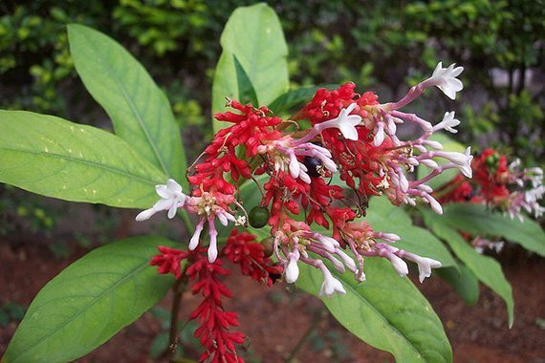
«Special pharmaceutical chemistry»
Alkaloids, indole derivatives.
Drugs derived from imidazole and bezimidazole.
Associate Professor Gureeva E.S.

Slide 2
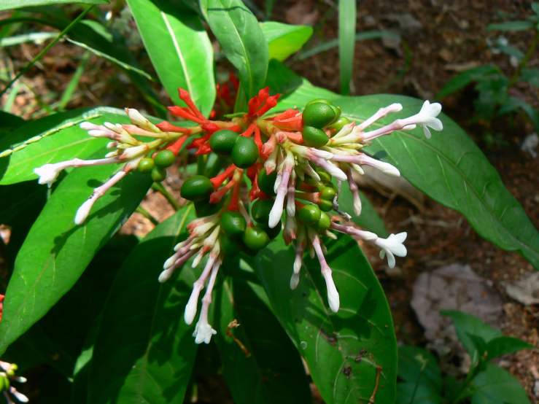
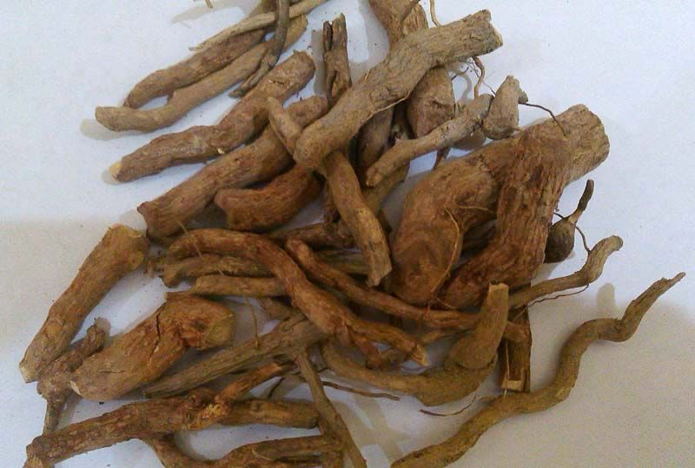
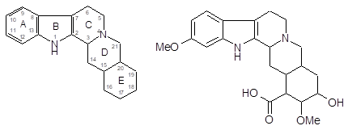
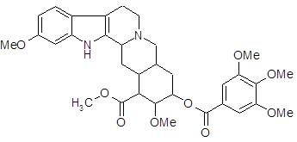
Alkaloids indole derivatives. Reserpine
Alliohimbane Reserpine acid
Reserpine

Slide 3
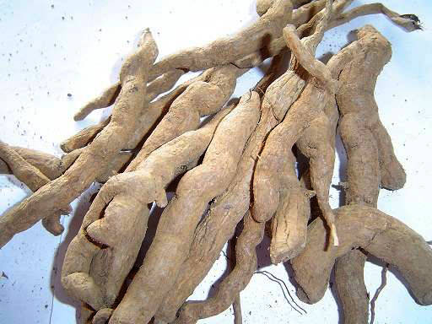
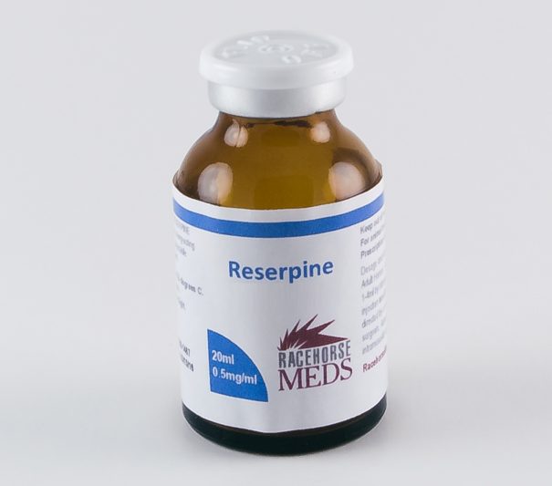
Alkaloids indole derivatives. Reserpine
Obtaining
The alkaloids are extracted from the crushed roots using ether as a base after treatment with ammonia solution.
They are then converted into tartaric acid salts and again into bases.
The alkaloid mixture is separated by adsorption chromatography. The reserpine zone is isolated and the alkaloid is extracted with dichloroethane.
and then recrystallised from methanol.
Physical properties
Reserpine is a white or yellowish fine crystalline powder. The left-rotating optical isomer of reserpine base is used in medicine. Like other bases, it is very insoluble in water and ethanol, but easily soluble in chloroform and acetic acid.

Slide 4
Alkaloids indole derivatives. Reserpine
Identification
IR and UV spectrophotometry
2. Colour reactions in the action of acids
It gives coloured reactions with
Concentrated sulphuric acid - (yellow),
Nitric acid (yellow, turning brick red),
A mixture of these acids (yellow-green).
When a reagent consisting of ferric chloride and phosphoric acid is added, the yellow colour changes to bright blue,
If potassium dichromate is used as a reagent in the presence of concentrated acetic acid, a bright green colour appears, which changes to violet and then reddish brown.

Slide 5
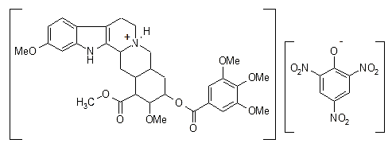
Alkaloids indole derivatives. Reserpine
Identification
3. Interaction with common alkaloid reagents
With picric acid it forms picrate
With Frede's reagent (saturated solution of molybdenum acid in concentrated sulphuric acid) (blue, turning green),
With Marquis’ and Mandelin reagents (200 millilitres of sulphuric acid per 1 gram of ammonium vanadate) (blue, turning green on heating).

Slide 6
Alkaloids indole derivatives. Reserpine
Identification
4. Reserpine nitrosation
green fluorescence

Slide 7
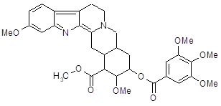
Alkaloids indole derivatives. Reserpine
Identification
5. Reserpine oxidation
Oxidation of reserpine with potassium iodate in acetic acid medium (after heating) results in formation of 3-dehydroreserpine, a yellow coloured product with maximum light absorption at 390 nm.

Slide 8
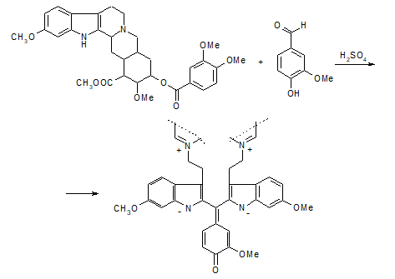
Alkaloids indole derivatives. Reserpine
Identification
6. Condensation with aldehydes (Van Urk reaction)
With a solution of vanillin in hydrochloric acid it acquires a pink colouring, and a solution of n-dimethylaminobenzaldehyde in the presence of glacial acetic and sulphuric acids is initially coloured green, which after the addition of an excess of glacial acetic acid turns to red.

Slide 9
Alkaloids indole derivatives. Reserpine
Assay
1. Non-aqueous titration in glacial acetic acid
2. Acidometry in alcoholic medium
3. Photometry

Slide 10
Alkaloids indole derivatives. Reserpine
Storage
Reserpine is stored in well-corked orange glass jars in a cool place protected from light. It is capable of isomerisation and oxidation under the influence of light, air and heat. Solutions in which reserpine can also be hydrolysed are particularly easily oxidised.
Medical use
Reserpine is used as a neuroleptic and hypotensive agent. It is prescribed for the treatment of hypertension and neuropsychiatric disorders.

Slide 11
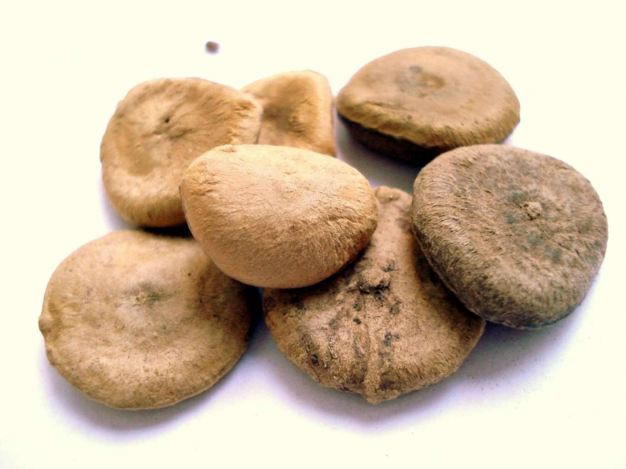
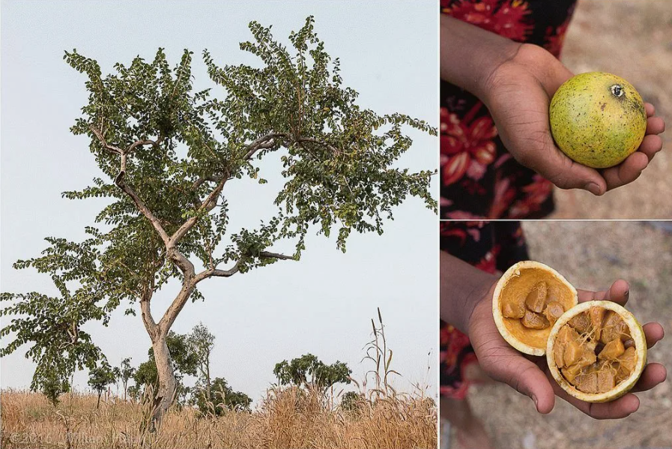
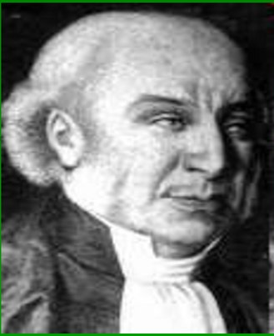
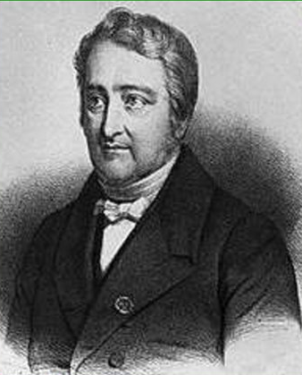
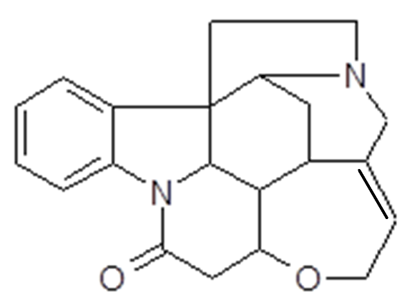
Alkaloids indole derivatives. Strychnine nitrate

Slide 12
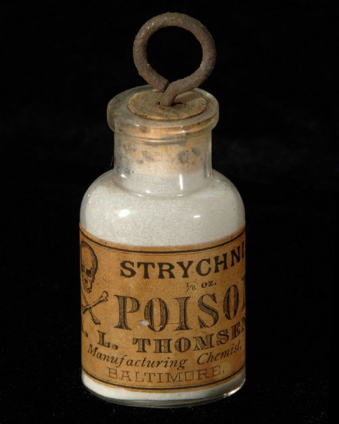
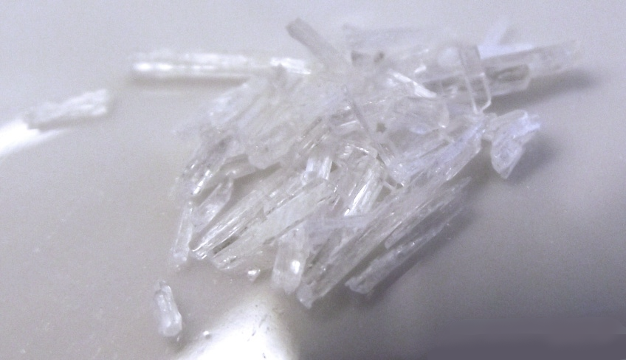
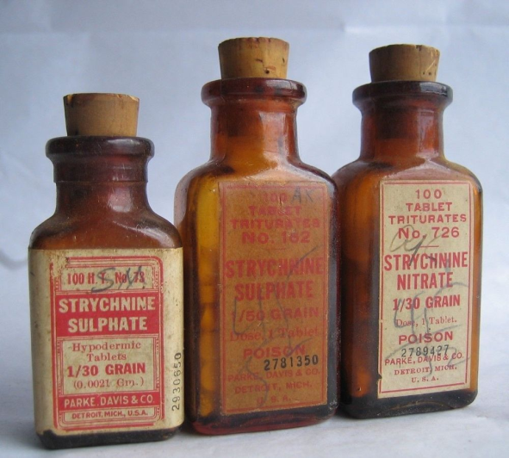
Alkaloids indole derivatives. Strychnine nitrate
Physical properties
The drug is colourless, shiny needle-like crystals or white crystalline powder of bitter taste. Hardly soluble in water and alcohol, easily in boiling water, insoluble in ether.

Slide 13
Alkaloids indole derivatives. Strychnine nitrate
Identification
IR and UV spectrophotometry
2. Vitali-Morin reaction
3. Oxidation in acidic medium
When the drug is exposed to potassium bichromate crystals in the presence of concentrated sulphuric acid, rapidly disappearing streaks of violet and blue colour are formed on the walls of the porcelain cup.

Slide 14
Alkaloids indole derivatives. Strychnine nitrate
Identification
4. Interaction reaction with common alkaloid reagents
Strychnine gives coloured precipitates with general alkaloid reagents. Particularly sensitive reagents for it are: Dragendorf's reagent, Meyer's reagent, phosphorus-tungstic acid.
Erdmann's, Frede's and Markus' reagents do not give colour reactions with strychnine.

Slide 15
Alkaloids indole derivatives. Strychnine nitrate
Identification
5. Condensation with vanillin
pink-purple colour
6. Detection of nitrate ion
blue colour

Slide 16
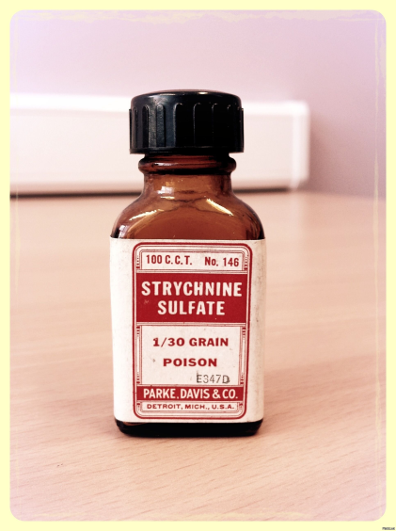
Alkaloids indole derivatives. Strychnine nitrate
Assay
Neutralisation
Medical use
Strychnine excitatory effect on the central nervous system, tones skeletal muscle, heart muscle, stimulates metabolic processes. In large doses causes convulsions. It is used as a tonic agent for low metabolic processes, rapid fatigue, hypertension.

Slide 17
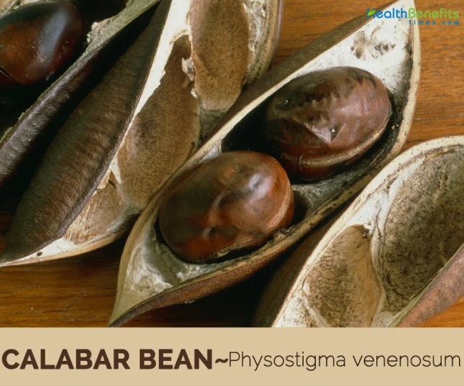
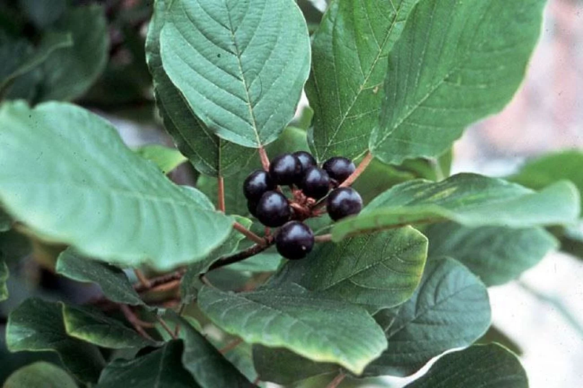
Alkaloids indole derivatives.
Physostigmine salicylate
Colourless lustrous prismatic crystals. Red coloured by light and air. Difficult to dissolve in water, soluble in alcohol, slightly soluble in ether.

Slide 18
Alkaloids indole derivatives.
Physostigmine salicylate
Identification
1. IR- and UV-spectrophotometry
2. Interaction with common alkaloid reagents
3. Colour reaction using ammonia solution
Ammonia solution is added to the drug solution and the mixture is evaporated in a porcelain cup on a water bath until dry; the residue should be blue in colour. Dissolve the residue in alcohol to give a blue solution. If this solution is acidified with acetic acid, a red colouring and fluorescence appear, which increases when the solution is diluted with water.
4. Determination of salicylates

Slide 19
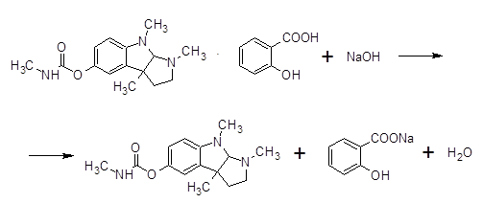
Alkaloids indole derivatives.
Physostigmine salicylate
Assay
Alkalimetry

Slide 20
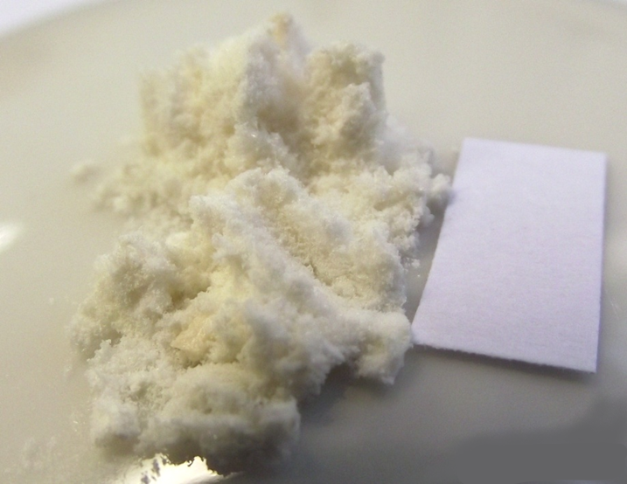
Alkaloids indole derivatives.
Physostigmine salicylate
Storage
In well-corked orange glass jars, in a place protected from light.
Medical use
Anticholinesterase, miotic agent. Used in the form of eye drops and ointment. Rarely injected under the skin.

Slide 21
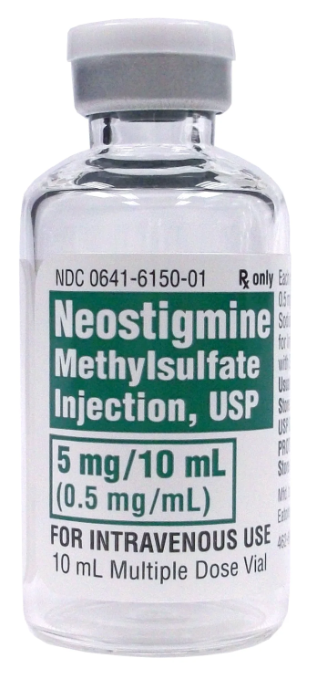
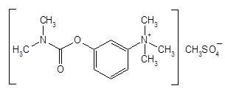
Neostygmine methylsulfate (Proserine)
Physical properties
White crystalline powder, odourless, bitter taste. Hygroscopic. Gains pink colour in the light.
Neostigmine methyl sulphate is very readily soluble in water, readily soluble in ethanol and chloroform, practically insoluble in ether.

Slide 22
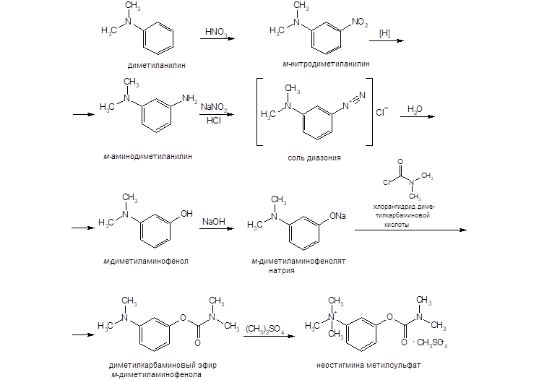
Neostygmine methylsulfate (Proserine)
Obtaining

Slide 23
Neostygmine methylsulfate (Proserine)
Identification
1. IR- and UV-spectrophotometry
2. Interaction with iodine solution
brown coloured precipitate

Slide 24
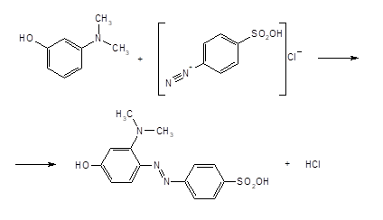
Neostygmine methylsulfate (Proserine)
Identification
3. Hydrolysis
The dimethylamine released during hydrolysis is detected by a characteristic odour and a blue colour change of wet litmus paper.
The sulphate ion is discovered by reaction with barium chloride solution.
red-orange

Slide 25
Neostygmine methylsulfate (Proserine)
Assay
1. Non-aqueous titration
2. Iodometry
3. Spectrophotometry
4. Extraction-photometric method

Slide 26
Neostygmine methylsulfate (Proserine)
Assay
5. Kjeldahl method

Slide 27
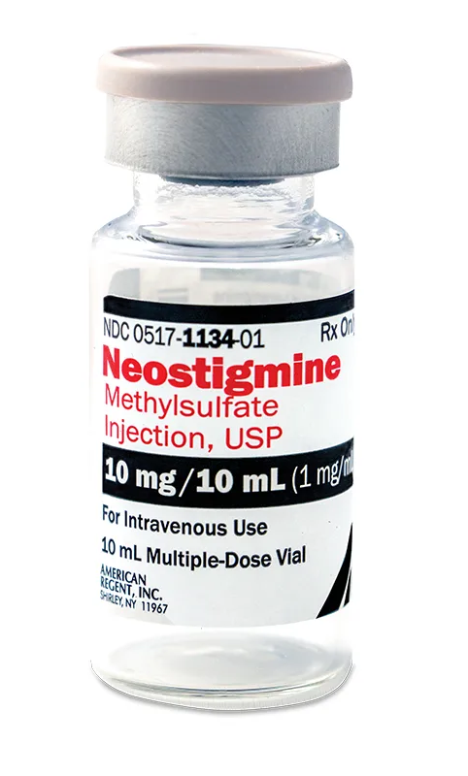
Neostygmine methylsulfate (Proserine)
Storage
Neostigmine methyl sulphate is stored in a light protected, dry place, taking into account not only its ability to oxidise in air but also its hygroscopicity.
Medical use
Neostigmine methylsulfate is used as a synthetic analogue of physostigmine as an anticholinesterase and antimyasthenic agent, antagonist of curare-like drugs. In ocular practice it is prescribed in the form of 0.5% solutions. In myasthenia gravis, motor disorders of various etiologies, neuritis, 0.05% solution is administered intravenously or subcutaneously

Slide 28
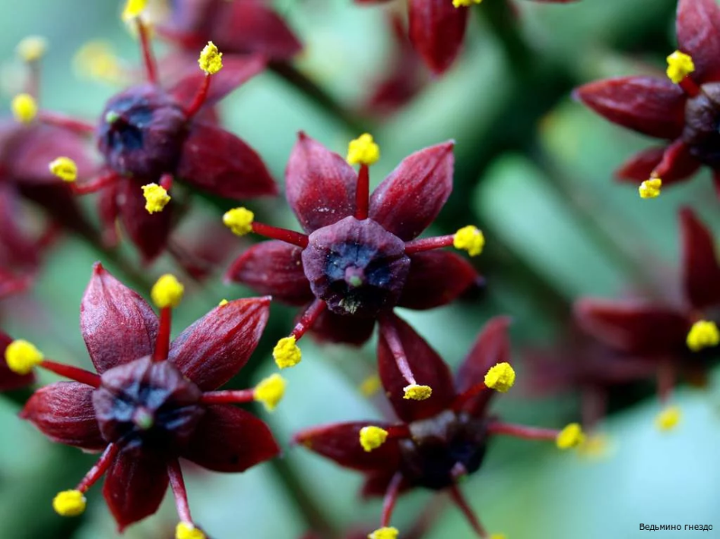
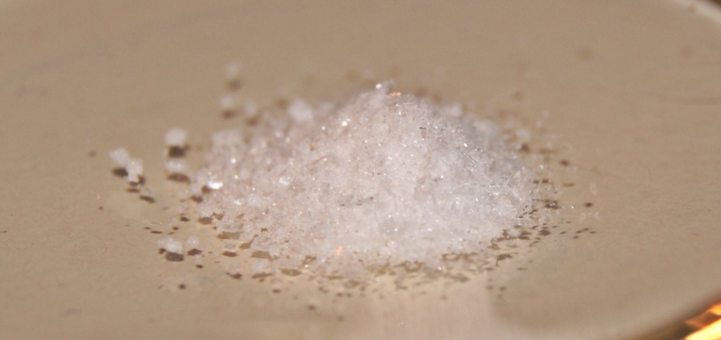
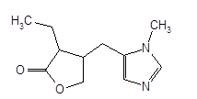
Imidazole derivative alkaloids. Pilocarpine hydrochloride
Colourless crystals or odourless crystalline powder. Hygroscopic. Temperature range 200-203oc. Specific rotation from +88.5 to +91° (2% aqueous solution).
It is very soluble in water, easily soluble in ethanol, practically insoluble in ether and chloroform.

Slide 29
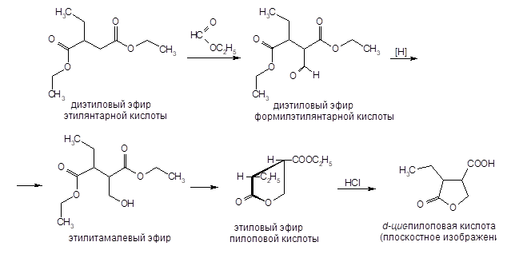
Imidazole derivative alkaloids. Pilocarpine hydrochloride
Obtaining
I

Slide 30
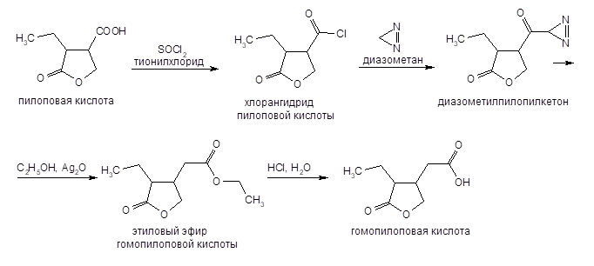
Imidazole derivative alkaloids. Pilocarpine hydrochloride
Obtaining
II

Slide 31
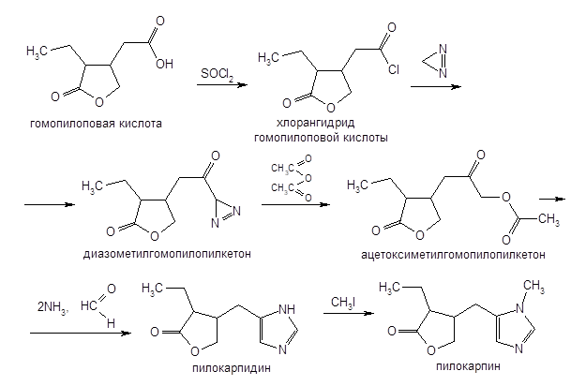
Imidazole derivative alkaloids. Pilocarpine hydrochloride
Obtaining
III

Slide 32
Imidazole derivative alkaloids. Pilocarpine hydrochloride
Identification
IR and UV spectrophotometry
2. Interaction with common alkaloid reagents
3. General detection reaction for tertiary amines
When heated with a 2% solution of citric acid in acetic anhydride, a red colouring occurs.

Slide 33
Imidazole derivative alkaloids. Pilocarpine hydrochloride
Identification
4. Reaction with sodium nitroprusside
In alkaline medium a cherry colouring is formed, which does not disappear when excess hydrochloric acid is added.
5. Formation of suprachromic acids
Benzene or chloroform extraction acquires a blue-violet colour (in the absence of pilocarpine, the coloured product is not extracted with benzene).

Slide 34
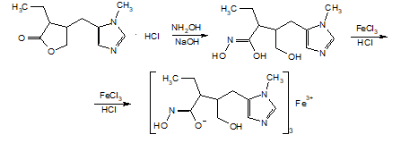
Imidazole derivative alkaloids. Pilocarpine hydrochloride
Identification
6. Hydroxamic reaction
violet-red

Slide 35
Imidazole derivative alkaloids. Pilocarpine hydrochloride
Assay
1. UV spectrophotometry
Water or 0.01 M hydrochloric acid solution is used as a solvent. The analysis is performed at a wavelength of 215 nm (specific absorption index 223.7).
2. Photocolorimetric determination
The method is based on the coloured reaction of pilocarpine with sodium nitroprusside. In alkaline medium a cherry colouring is formed, which does not disappear when excess hydrochloric acid is added.
3. Non-aqueous titration

Slide 36
Imidazole derivative alkaloids. Pilocarpine hydrochloride
Assay
4. Alkalimetry
5. Reverse iodometric titration

Slide 37
Imidazole derivative alkaloids. Pilocarpine hydrochloride
Storage
Pilocarpine hydrochloride is stored in well sealed containers protected from light and moisture. Such storage conditions should be observed due to its hygroscopic nature, as well as the possibility of hydrolysis and oxidation. Even in the absence of light, pilocarpine hydrochloride is destroyed in a humid atmosphere. The degradation is accelerated with increasing temperature.
Medical use
Pilocarpine hydrochloride is used as a cholinomimetic (miotic) agent (atropine antagonist). It is usually prescribed in the form of eye drops in the treatment of glaucoma, including acute attack, impaired trophism of the eye in thrombosis of the central vein of the retina or acute obstruction of its arteries, optic nerve atrophy, vitreous haemorrhage; elimination of mydriatic effect of atropine, homatropine, scopolamine.

Slide 38
Thank you for attention!

