Slide 1
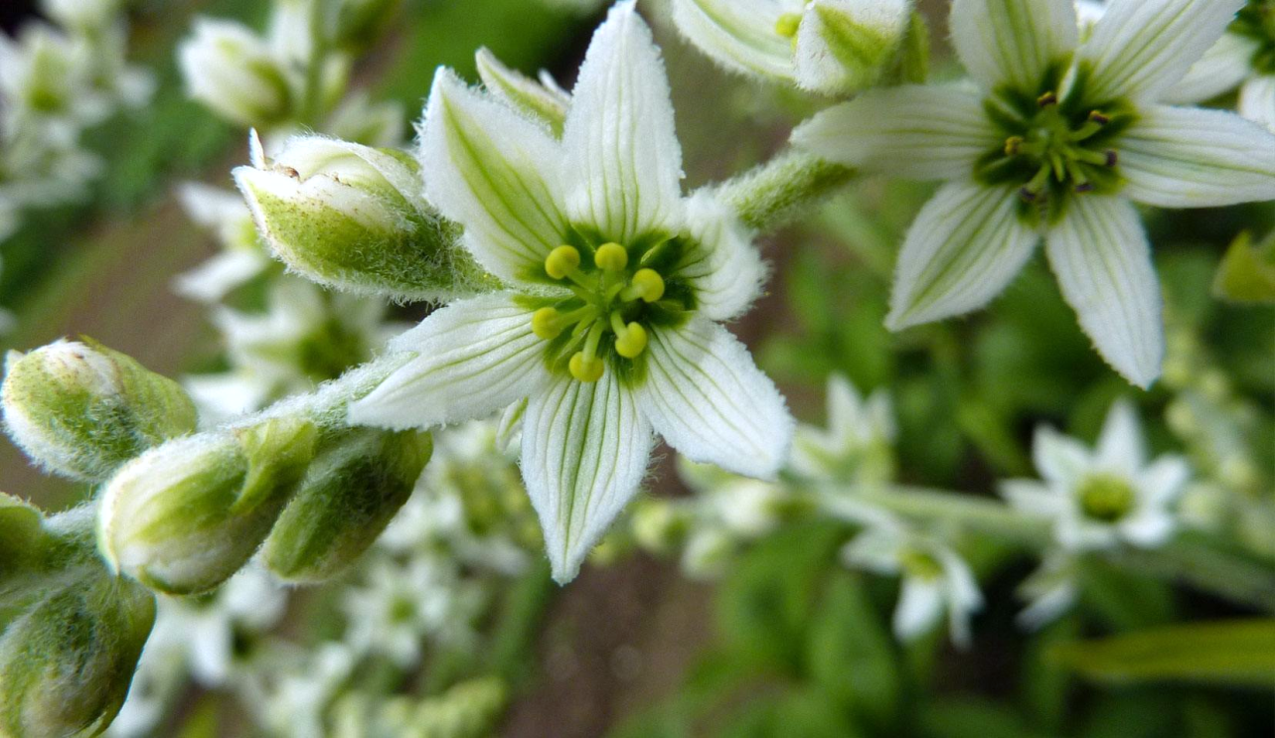
«Special pharmaceutical chemistry»
Alkaloids
Associate Professor Gureeva E.S.

Slide 2
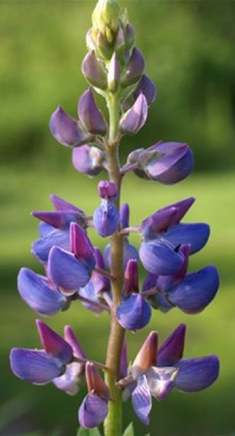
Definition
Alkaloids, which mean alkali-like substances, are basic nitrogenous heterocyclic compounds of plant origin generally possessing a marked physiological action.
Deviation from Definition
Some alkaloids are not basic e.g. Colchicine, Piperine, quaternary alkaloids
Few alkaloids contain nitrogen in a non-ring system e.g. Ephedrine, Colchicine. Mescaline
Plant origin: Some alkaloids are derived from bacteria, fungi, insects, frogs, animals.

Slide 3
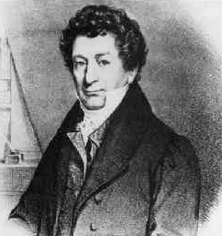
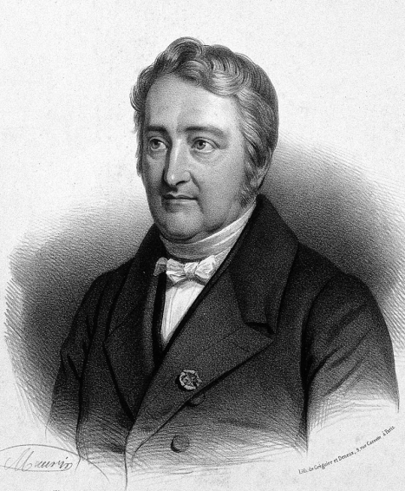
History of alkaloids
Alkaloids have been in use since ancient ages for various medicinal purposes. Egyptian mummies were being preserved by using extracts of many plants.
The term alkaloid was first coined by Meissner who was German pharmacist in 1819.
Derosne isolate Narcotine in 1803
Serturner isolated Morphine in the same year (1803)
Caventon and Pelletier isolated Emetine and Colchicines respectively in 1819
The first alkaloid to be synthesized was coniine in 1889
Over 6000 alkaloids have been discovered so far.

Slide 4
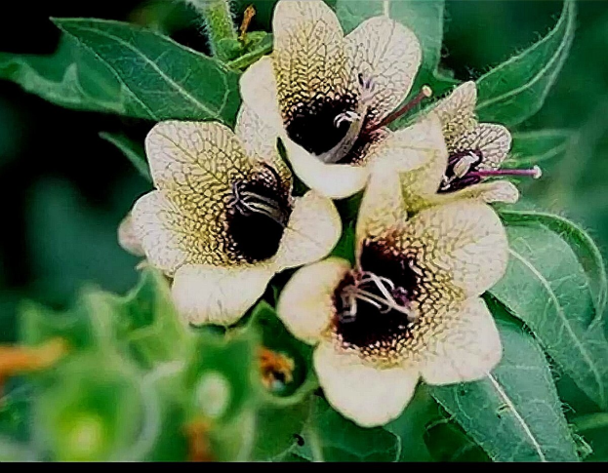
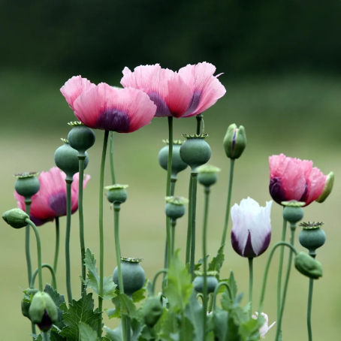
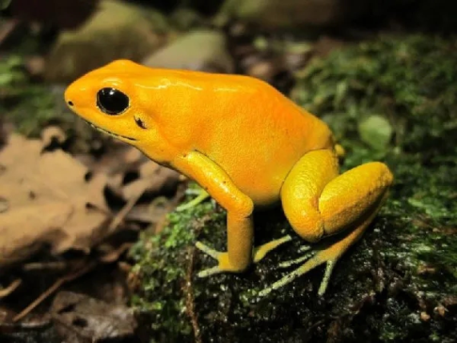
Occurrence
• Alkaloids are present in plants, animals, fungi and bacteria
• Alkaloids are mainly obtained from plants belonging to families:
1. Leguminosae
2. Papaveraceae
3. Rubiaceae
4. Ranunculaceae
5. Solanaceae
6. Berberidaceae
7. Chenopodiaceae
8. Lauraceae
• Rosaceae and labiatae are almost devoid of alkaloids
• Some alkaloids are present in specific family e.g.
hyoscyamine in Solanaceae
Colchicine in liliaceae
• Almost every fourth higher plant has alkaloids.
• 47-50% bacteria have alkaloids e.g. pyocyanin from Pseudomonas aeruginosa
• More than 300 Alkaloids have been reported to occur in the skin of amphibian e.g. bufotenin from toad skin.

Slide 5
Naming of Alkaloids
Alkaloids can be named according to the source or plant from which they are obtained e.g. atropine from Atropa. Hyoscyamine from Hyoscyamus.
OR On the basis of scientist who isolated that e.g. pelletierine
OR On the basis of their therapeutic action e.g. Emetine because it causes emesis.
However when the alkaloid are named chemically, names of alkaloids must end on suffix “–ine”
Prefixes:
"Nor-" designates N-demethylation or N-demethoxylation, e.g. norpseudoephedrine and nornicotine.
"Apo-" designates dehydration e.g. apomorphine.
"Iso-, pseudo-, neo-, and epi-" indicate different types of isomers.
Suffixes:
"-dine" designates isomerism as quinidine and cinchonidine.
"-ine" indicates, in case of ergot alkaloids, a lower pharmacological activity e.g. ergotaminine is less potent than ergotamine.

Slide 6
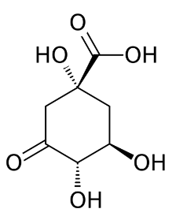
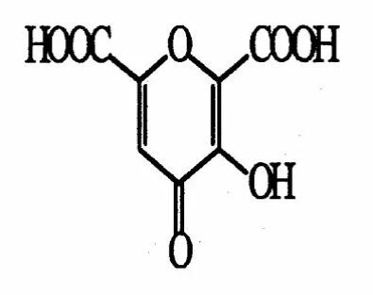
Structure and composition of alkaloids
Alkaloids are most often tertiary amines, much less often secondary amines or quaternary ammonium salts.
All alkaloids contain carbon, hydrogen, nitrogen, often oxygen and more rarely sulphur, chlorine, bromine or phosphorus.
In plants, alkaloids are always present in the form of salts with organic acids - oxalic, succinic, malic, citric, often with specific acids (quinic acid, meconic, etc.).
quinic acid
meconic acid

Slide 7
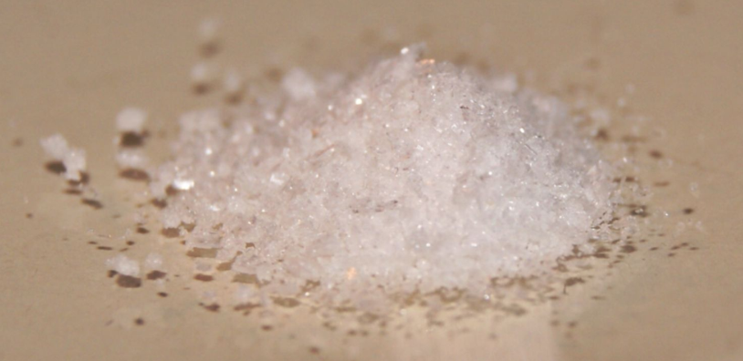
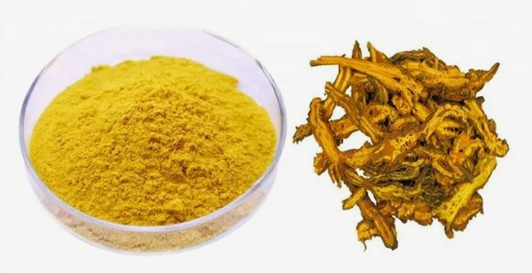
Physical properties
Condition
Most alkaloids are crystalline solids.
Few alkaloids are amorphous solids e.g. emetine.
Some are liquids that are either:
Volatile e.g. nicotine and coniine, or
Non-volatile e.g. pilocarpine and hyoscine.
Color
The majority of alkaloids are colorless but some are colored e.g.:
Colchicine and berberine are yellow.
Canadine is orange.
The salts of sanguinarine are copper-red.

Slide 8
Physical properties
Solubility
Both alkaloidal bases and their salts are soluble in alcohol.
Generally, the bases are soluble in organic solvents and insoluble in water.
Exceptions:
Bases soluble in water: caffeine, ephedrine, codeine, colchicine, pilocarpine and quaternary ammonium bases.
Bases insoluble or sparingly soluble in certain organic solvents: morphine in ether, theobromine and theophylline in benzene.
Salts are usually soluble in water and, insoluble or sparingly soluble in organic solvents.
Exceptions:
Salts insoluble in water: quinine monosulphate.
Salts soluble in organic solvents: lobeline and apoatropine hydrochlorides are soluble in chloroform.

Slide 9
Classification
Pharmacological Classification
Here the alkaloids are classified on the basis of their pharmacological actions e.g. They can be used as:
Analgesic and narcotics: e.g. morphine and strychnine
CNS stimulants: e.g. caffeine and strychnine
Anticancers: e.g. vincristine, vinblastine and taxol
Mydriatics: e.g. atropine
Myotics: e.g. eserine and pilocarpine.
Anti-asthmatics: e.g. ephedrine
Antitussives: e.g. codeine.
Expectorants: e.g. lobeline.
Anti-hypertensives: e.g. reserpine
Smooth muscle relaxants: e.g. atropine and papaverine
Skeletal muscle relaxants: e.g. tubocurarine.
Anthelmintics: e.g. pelletierine and arecoline.
Antiparasitics: e.g. quinine and emetine.

Slide 10
Classification
Hegnaur’s classification
(Classification of alkaloids according to precursors)
True alkaloids: those alkaloids that contain nitrogen in their heterocyclic ring system and biosynthesized from amino acids (Lysine, tyrosine & tryptophan) are termed as true alkaloids. They possess significant pharmacological activity & mostly found in higher plants as salts.
Examples are Atropine, Nicotine, Cocaine & morphine.
Proto alkaloids: These alkaloids most often possess characteristic true alkaloids, but they are not biosynthesized from amino acids; they are derived from the acetate pathway having an isoprenoid skeleton. Some steroidal alkaloids are also included under these paths.
Examples are Para-vallarine, Conine, etc.
Pseudo alkaloids: These are simple alkaloids in which the N atom is not a part of the heterocyclic ring system & is derived from amino acids. Nitrogen is outside of the cycle as exo-cycle. Biosynthethically true & proto alkaloids are similar because both get synthesize from aminoacids.
Examples are Mescaline, serotonin, etc.

Slide 11
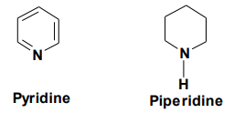
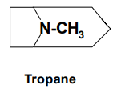
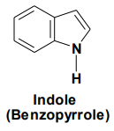
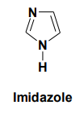
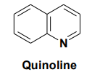
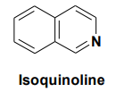
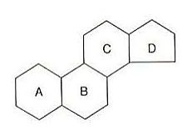
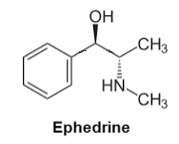
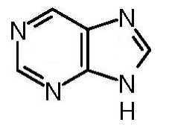
Classification
Classification of alkaloids based on chemical structure
1. Pyridine and Piperidine Alkaloids
2. Tropane alkaloids
3. Quinoline Alkaloids
4. Isoquinoline alkaloids
5. Indole alkaloids
6. Imidazole alkaloids
7. Steroidal alkaloids
8. Alkaloidal Amines
9. Purine Alkaloids e.g. Caffeine and theophylline.

Slide 12
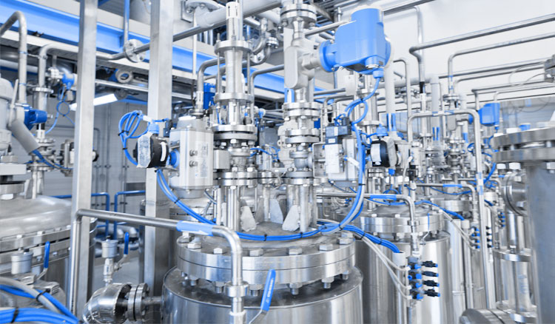
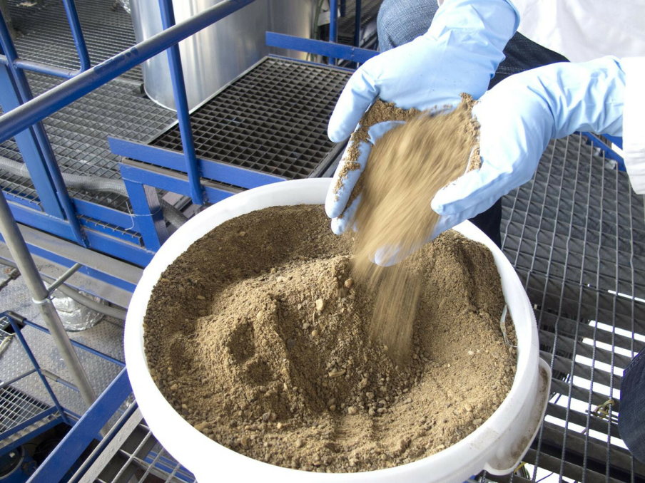
Extraction of Alkaloids
The process of extraction involves several steps, including
sample preparation,
extraction,
purification.
The first step is the selection and preparation of the natural source. The plant material is usually dried and ground into a fine powder.

Slide 13
Extraction of Alkaloids
The second step. There are two methods used for extraction of alkaloids:
Method 1
The powdered plant material containing alkaloidal salt is moistened with the solution of alkaline substance that combine with acids or tannins to set free the alkaloidal bases. These alkaloidal bases are than separated by extraction with some organic solvent like ether.
The organic solvent is then concentrated and mixed with aqueous acid to make and dissolve alkaloidal salts. The impurities will remain in organic solvent.
Method 2
The powdered plant material is extracted with water or aqueous alcohol containing dilute acid.
Impurities like pigments and other organic impurities are removed by shaking with some organic solvent like chloroform.
The alkaloids are freed or precipitated by adding alkalis.
Seperated by filteration or by extraction with some organic solvent.

Slide 14
Extraction of Alkaloids
The third step. Purification is usually achieved by a combination of techniques, including chromatography, crystallization, and distillation.
Chromatography is a powerful technique for separating mixtures of compounds based on their physical and chemical properties. The most commonly used chromatography methods for alkaloid purification are column chromatography, thin-layer chromatography, and high-performance liquid chromatography.
Crystallization involves the formation of crystals of the alkaloid by cooling or evaporation of the solvent.
Distillation is used to separate alkaloids with high boiling points from other compounds.

Slide 15
Tests for detection and identification
Precipitation reactions
Precipitation reactions result amorphous or crystalline precipitates of various colors.
Precipitating agent is added to a neutral or slightly acidic aqueous solution of the Alkaloidal salts.
The reagents used contain heavy metals such as Hg, Pt, Bi etc. and form double salts with most alkaloids.
These reactions could be used for extraction and purification.
Care must be taken in the application of these tests as certain alkaloids such as caffeine and some others do not react.
False positive response may be obtained in certain cases as most of the reagents used precipitate proteins, tannins, coumarins and certain flavonoids.

Slide 16
Tests for detection and identification
Color reactions
These reactions are usually performed by the addition of color reagents to free bases not to their salts to produce characteristic colored solutions.
The reagents contain concentrated sulfuric acid and an oxidizing agent.
They give colors with most alkaloids, or may be specific for one alkaloid or a group of related alkaloids.
Examples of specific color reactions are:
• Van-Urk’s test for ergot alkaloids: A blue color is obtained when treated with pdimethylaminobenzaldehyde in concentrated sulfuric acid.
• Vitali’s test for solanaceous alkaloids: These give a violet color when treated with concentrated nitric acid and alcoholic potassium hydroxide.

Slide 17
Common reagents for Alkaloids
Alkaloidal precipitants
Mayer’s reagent (Potassium mercuric iodide)K₂[HgI₄]. Creamy white precipitate (positive with most alkaloids except caffeine and dilute ephedrine)
Wagner’s reagent (Iodine in potassium iodide)K[I₃]. Reddish brown precipitate.
Hager’s reagent (Saturated solution of picric acid). Yellow precipitate (except theophylline, theobromine and morphine).
Dragendorf’s reagent (Potassium bismuth iodide) K[BiI₄]. Orange-reddish brown precipitate
Marme’s reagent (Potassium cadmium iodide) K₂[CdI₄]. Yellow precipitate
Sonnenstein reagent (phosphorus-molybdenum acid) H₃PO₄*12MoO₃*2H₂O. Yellow precipitate changing to blue or green colouration.
Scheibler's reagent (Phosphorus-tungstic acid) H₃PO₄*12WO₃*2H₂O. White precipitate.
Water-alcohol solution of tannin. White or light yellow precipitate

Slide 18
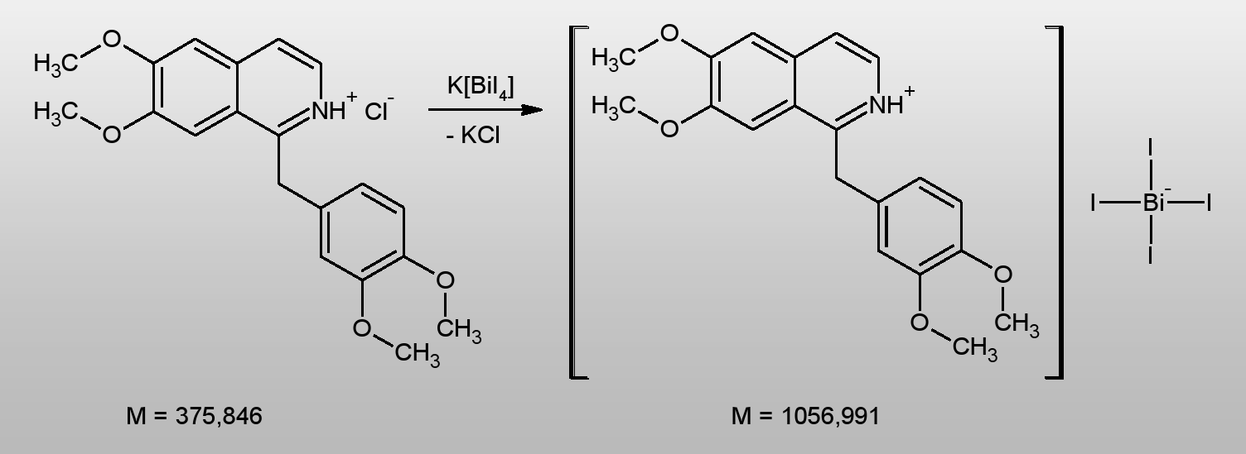
Common reagents for Alkaloids
The mechanism of action of precipitation reagents is ion exchange reaction
Example:
Interaction of papaverine hydrochloride with Dragendorff's reagent

Slide 19
Common reagents for Alkaloids
Color reagents
Froehd’s reagent (Ammonium molybdate/sulfuric acid)
Mandalin’s reagent (Ammonium vanadate/sulfuric acid)
Marquis’ reagent (Formaldehyde/sulfuric acid)
Erdman’s reagent (Nitric acid/sulfuric acid)
Mecke’s reagent (Selenious acid/sulfuric acid)
Shaer’s reagent (Hydrogen peroxide/sulfuric acid)
Rosenthaler’s reagent (Potassium arsenate/sulfuric acid)
The colors formed are characteristic. The tests are sensitive to micro amounts and can be used for colorimetric estimations.

Slide 20
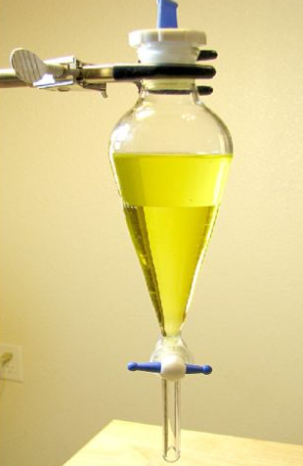
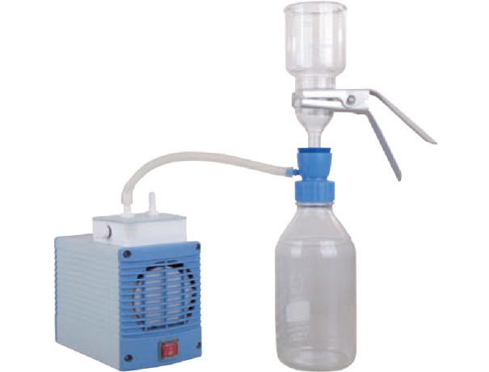
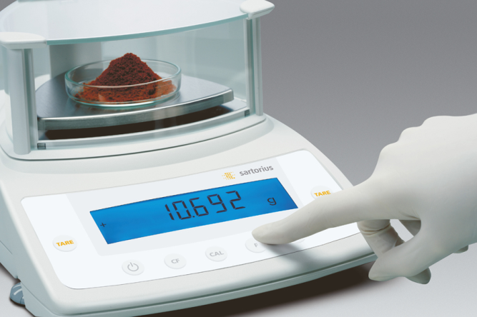
Quantitative analysis
The weight method
The weight method consists in determining the weight of the alkaloid base extracted from salts after removal of the solvent.
The base is extracted from salts by the addition of alkaline reagents, then extracted with organic solvents.
The alkaloid extracts are then filtered, the solvent is distilled off, the residue is dried to constant weight, cooled and weighed.

Slide 21
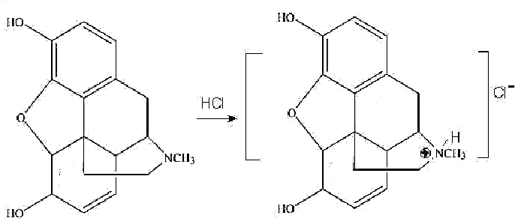
Quantitative analysis
Volumetric methods
Neutralisation method
An excess of the titrated acid solution is added to the alkaloid base. The base dissolves to form the corresponding salt and the excess acid is titrated with alkali in the presence of methyl orange or red (reverse titration).
The base alkaloid is directly titrated with acid over methyl orange to form a salt (direct titration). Used for single base alkaloids: atropine, cocaine, codeine, morphine, etc.

Slide 22
Quantitative analysis
Volumetric methods
Neutralisation method
Solutions of alkaloid salts can be titrated with alkali using phenolphthalein.

Slide 23
Quantitative analysis
Volumetric methods
Titration in non-aqueous media
Titrated with perchloric acid in acetic acid medium, indicator - crystal violet.
More recently, physicochemical methods have been widely used: spectrophotometry, photoelectrocolourimetry.

Slide 24
Thank you for attention!

