Slide 1
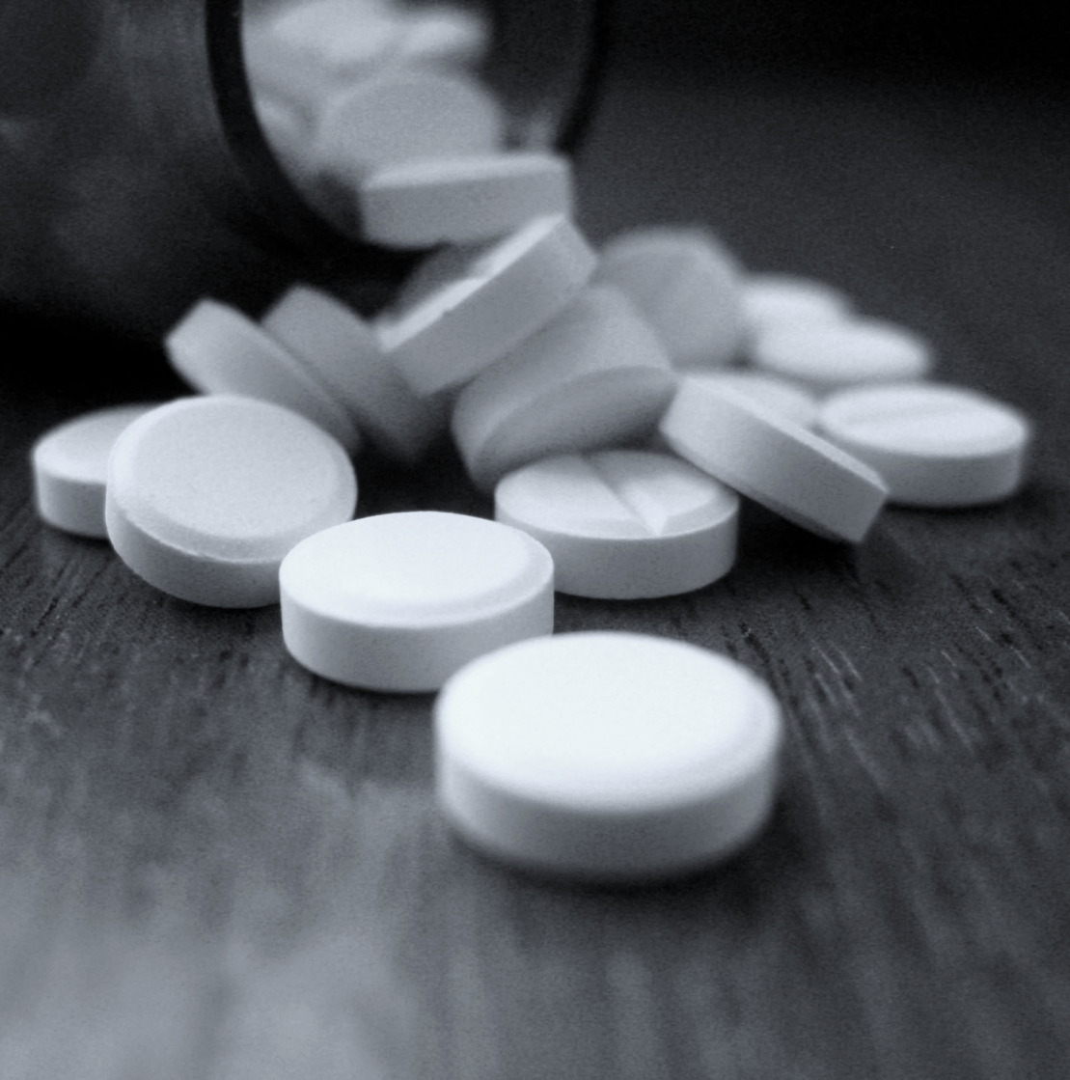
«Special pharmaceutical chemistry»
Barbituric acid derivatives
Associate Professor Gureeva E.S.

Slide 2
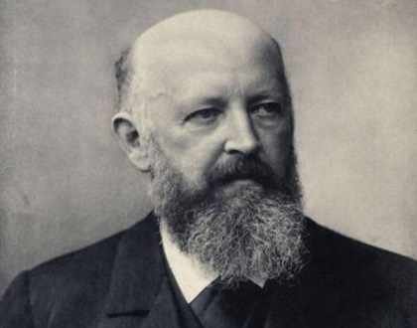
Barbituric acid derivatives
Johann Friedrich Wilhelm Adolf von Bair (1835-1917)
Winner of the Nobel Prize (1905) "For services to the development of organic chemistry and the chemical industry".
For the first time synthesised barbituric acid (1864), isatin, indole, developed industrial synthesis of indigo, developed the theory of stress in cyclic compounds, theoretically substantiated and then experimentally confirmed the presence of cis-trans isomerism.
He created a great scientific school of German organic chemists (Liebermann, Fischer, Büchner, etc.).

Slide 3
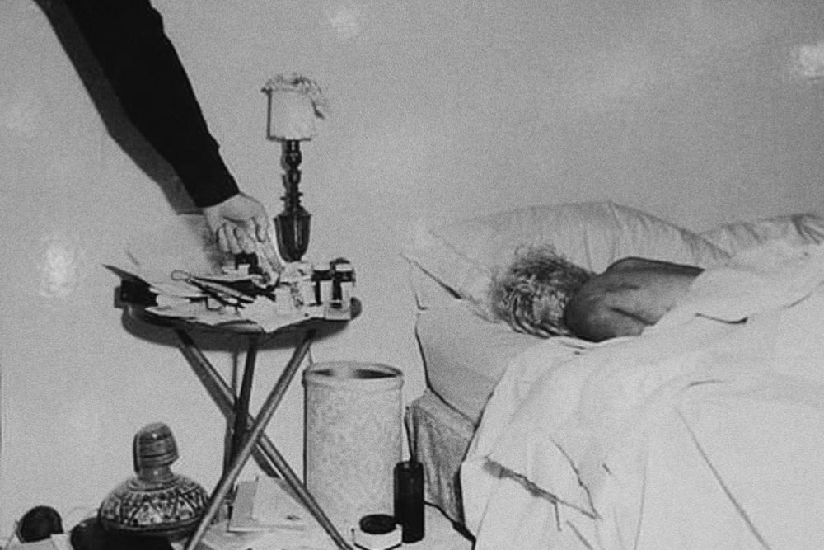
Interesting fact about barbiturates
Experts have established that the cause of death of Marilyn Monroe was acute poisoning with barbiturates. Pentobarbital (Nembutal) and phenobarbital were found in the liver of the actress. Empty bottles containing these medications were found next to her bed.
The possibility that it was an accidental overdose is ruled out because the dosage found in her body was several times the permissible limit.
Due to these facts and the absence of any signs of forced death, the doctors determined the cause of her death as suicide.

Slide 4
Synthesis of barbituric acid from uric acid (Bayer, 1864)
uric acid
alloxan
barbituric acid

Slide 5
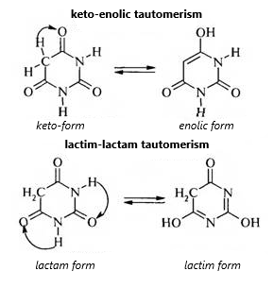
Properties of barbituric acid
In the case of barbituric acid, tautomerism can occur, both keto-enolic (due to the hydrogen of the methylene group) and lactim-lactamic (due to the hydrogen of the imide groups)

Slide 6
Properties of barbiturates
In the case of barbituric acid derivatives, when the hydrogen of the methylene group is replaced by radicals, only lactim-lactamic tautomerism is possible:

Slide 7
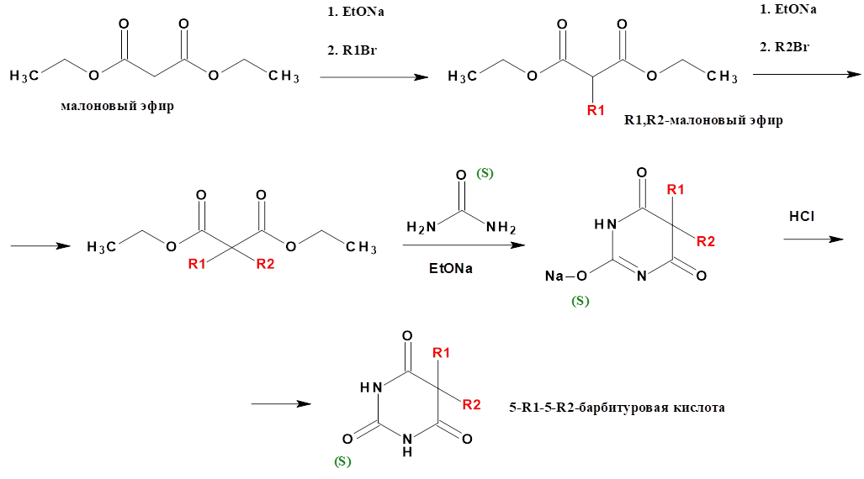
General method of obtaining
malonic ester
R1,R2-malonic ester
5-R1-5-R2-barbituric acid

Slide 8
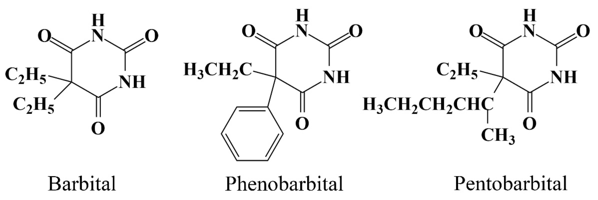
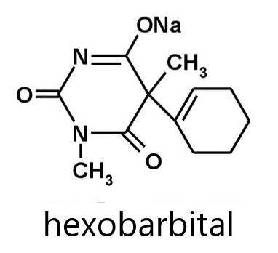
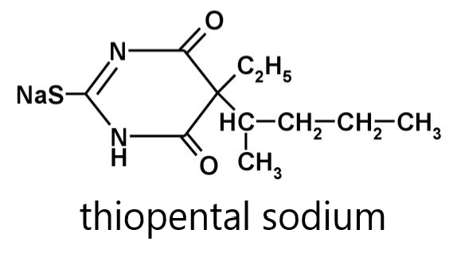
Examples of barbiturates

Slide 9
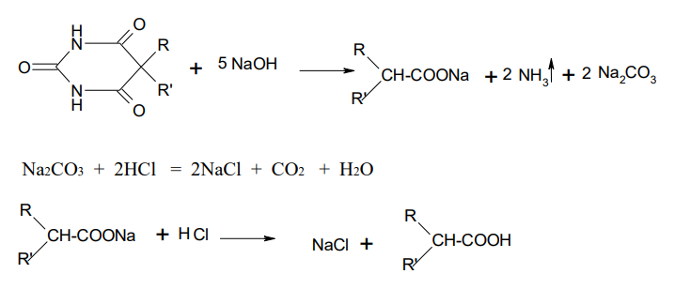
General identity reactions
Melting with alkalis

Slide 10
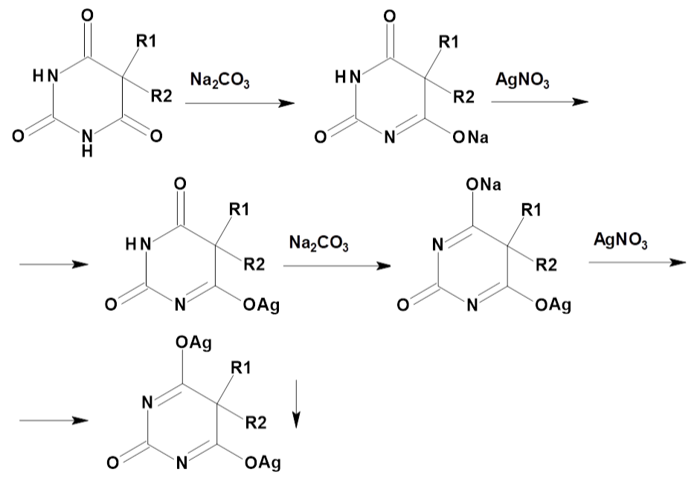
General identity reactions
Interaction with silver nitrate
white precipitate

Slide 11
General identity reactions
Interaction with copper salts in the presence of pyridine
With salts of divalent copper in the presence of pyridine, barbiturates form one- and two-substituted complexes coloured lilac.

Slide 12
General identity reactions
Reaction with cobalt nitrate and calcium chloride in the presence of one drop of alkali solution
A blue-violet colouring appears

Slide 13
General identity reactions
Interaction with mineral acids
Barbiturate salts, when mineral acid is added to their aqueous solution, produce an acid form that is insoluble in water and therefore precipitates.

Slide 14
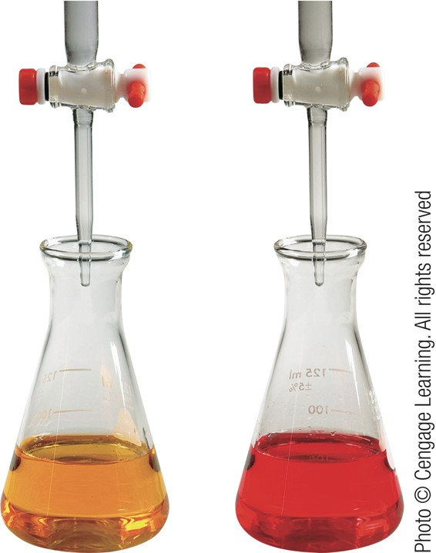
General methods of quantification
Gravimetry
The acidic forms of barbiturates are extracted with ether from the acidic medium. The ether is then distilled off, the residue is dried and weighed. This method is usually used for the determination of the sodium salts of barbiturates and for the analysis of drug mixtures.
Acidometry (for salt forms)
Titrant - hydrochloric acid
Medium - aqueous
Indicator - methyl orange or methyl red

Slide 15
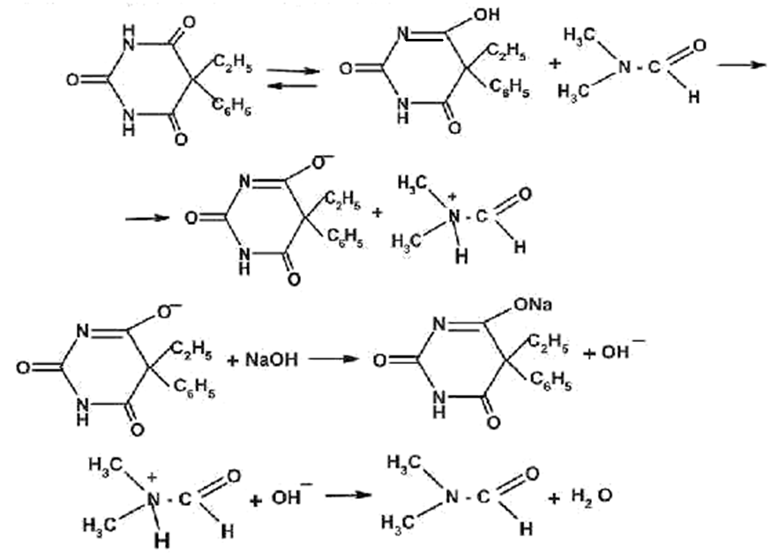
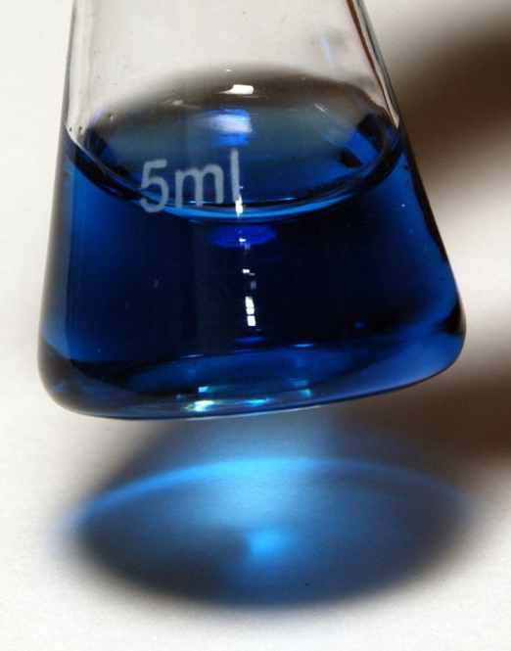
General methods of quantification
Non-aqueous titration (for acid forms)
Phenobarbital
Solvent: DMF
Titrant: NaOH
Indicator: Thymol blue

Slide 16
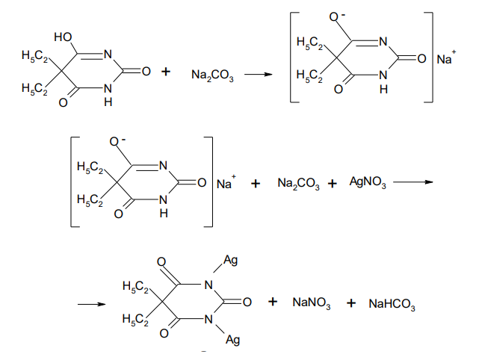
General methods of quantification
Argentometry
Barbital
Titrant: AgNO₃
Without indicator

Slide 17
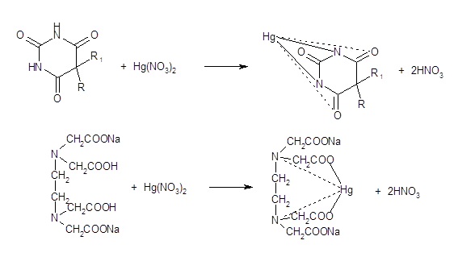
General methods of quantification
Mercurimetry

Slide 18
General methods of quantification
Bromatometry

Slide 19
General methods of quantification
Iodochlorometry
Spectrophotometry
In biological fluids, barbiturates are determined spectrophotometrically by the formation of coloured copper or cobalt complexes.

Slide 20
Relationship between chemical structure, narcotic and anticonvulsant action in a series of barbiturates
1. Lengthening the chain of the alkyl substituent at C5 to 5-6 carbon atoms increases sedative and sleeping effects. Further increasing the chain decreases the activity of the substance and stimulates convulsions.
2. The introduction of an aromatic substituent at the C5 position increases activity and gives anticonvulsant properties.
3. Branching the chain of the alkyl substituent at C5 increases activity and decreases duration of action.
4. The introduction of halogens or a double C=C bond in the substituent at C5 increases the activity.
5. Substitution at one nitrogen atom decreases the duration of action, substitution at both nitrogen atoms gives a convulsive effect.
6. Thiobarbiturates have a shorter duration of action than similarly structured barbiturates.

Slide 21
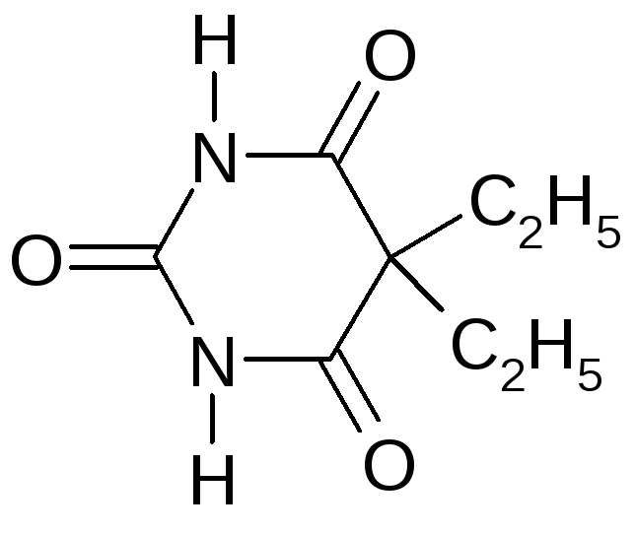
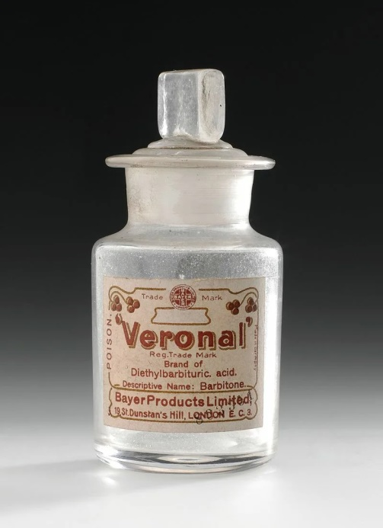
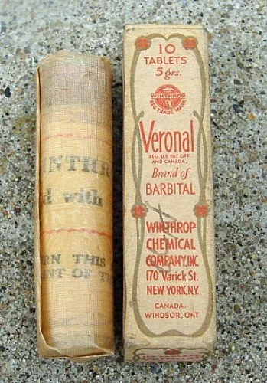
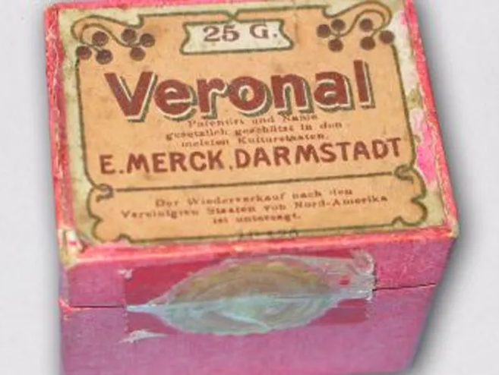
Barbital
Barbitalum
5,5-Diethylbarbituric acid
Barbital (Veronal) is one of the first sleeping pills from the group of barbituric acid derivatives. It was first obtained in 1881 and has been used in medicine since 1905.

Slide 22
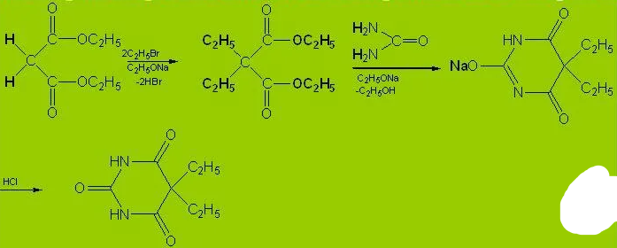
Barbital
Obtaining
Physical properties
White crystalline powder of slightly bitter taste, odourless. Melting point is 191°.
Difficult to dissolve in cold water, easier to dissolve in hot water, forming a liquid with acidic reaction. Being an acid, barbital dissolves in alkalis, easily dissolves in some organic solvents: alcohol, ether.

Slide 23
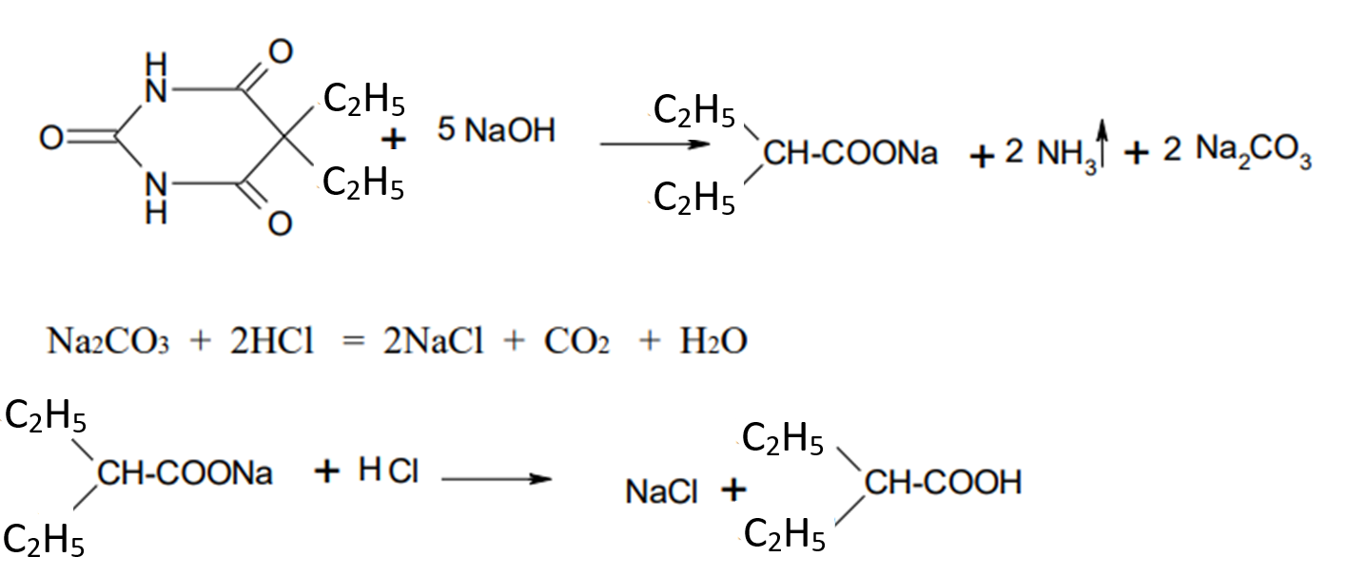
Barbital
Identification
Alloying with alkali
Barbital breaks down when melted with alkali, and an odour of ammonia is sensed. On following acidification, the release of gas bubbles (CO2) is observed and a specific odour of diethylacetic acid is sensed.

Slide 24
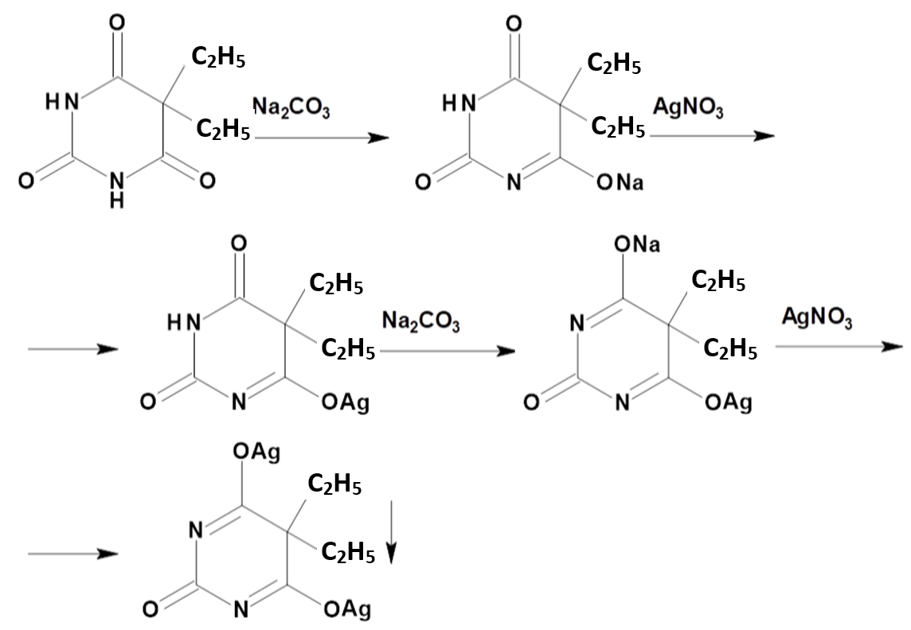
Barbital
Identification
Interaction with silver nitrate

Slide 25
Barbital
Identification
Interaction with cobalt salts
Barbital gives a blue-violet colouring when solutions of cobalt chloride or cobalt nitrate are added to it.

Slide 26
Barbital
Identification
Interaction with copper sulphate
A blue colouration appears, followed by the formation of a reddish purple precipitate.
Reaction with calcium oxide
A mixture of calcium oxide and barbital is heated in a porcelain cup. At first ammonia vapours are released, then a brick-red colouring appears on the surface of the reaction mass.

Slide 27
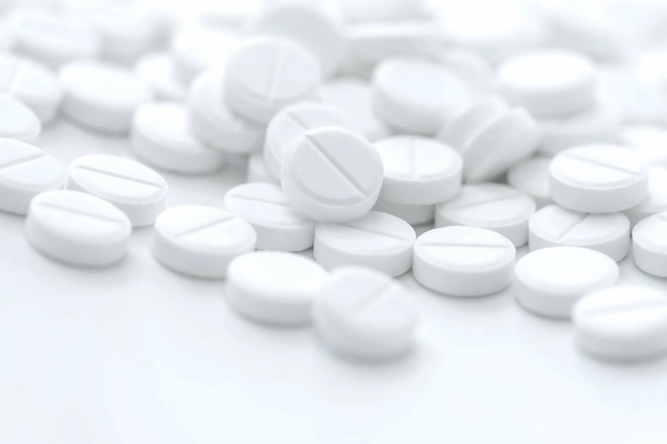
Barbital
Purity test
Diethylbarbituric acid, diethylacetylurea and other organic impurities are determined.
Quantification
Storage
1. Non-aqueous titration
2. Argentometry
3. Mercurimetry
4. Gravimetry
In well sealed containers, in a dry place.
Medical use
Barbital is used as a sleeping pill in powders and tablets

Slide 28
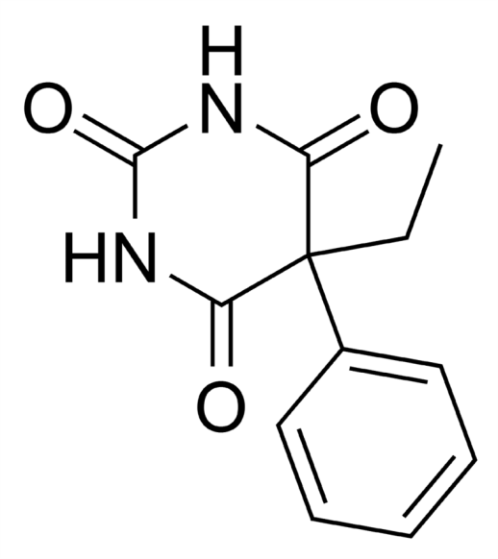
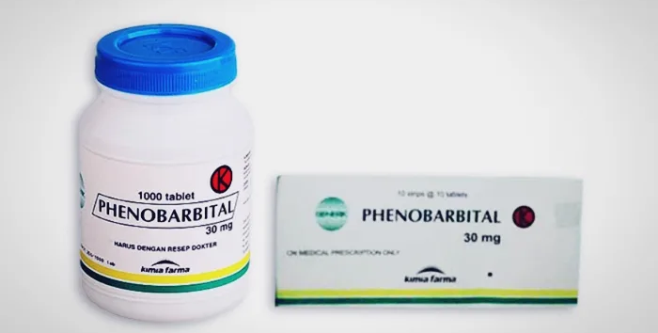
Phenobarbital
luminal
Phenobarbitalum
5-Phenyl-5-ethylbarbituric acid
Bayer released phenobarbital for sale in 1912 under the trade name Luminal. The new barbiturate was synthesised by German chemist Emil Fischer in 1904, 2 years after the synthesis of the first barbiturate, barbital. Luminal remained a common sedative and sleeping pill until the advent of benzodiazepines in the 1950s.

Slide 29
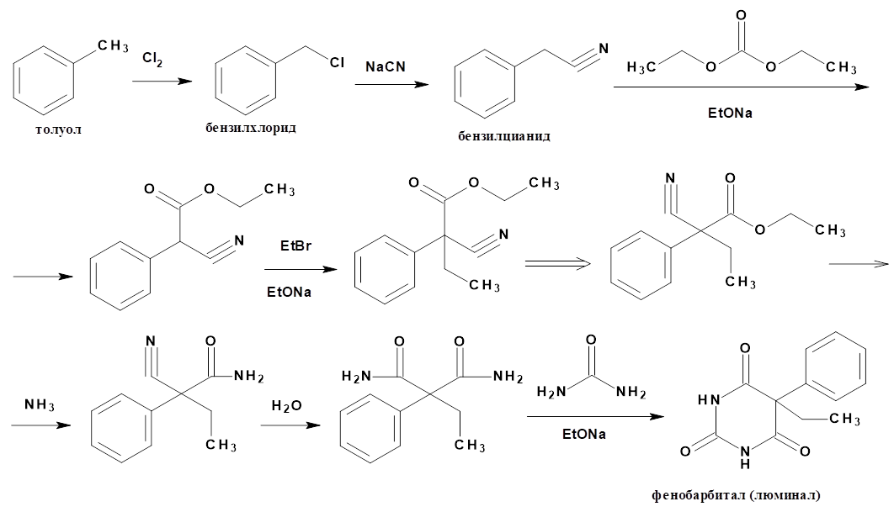
Phenobarbital
Obtaining

Slide 30
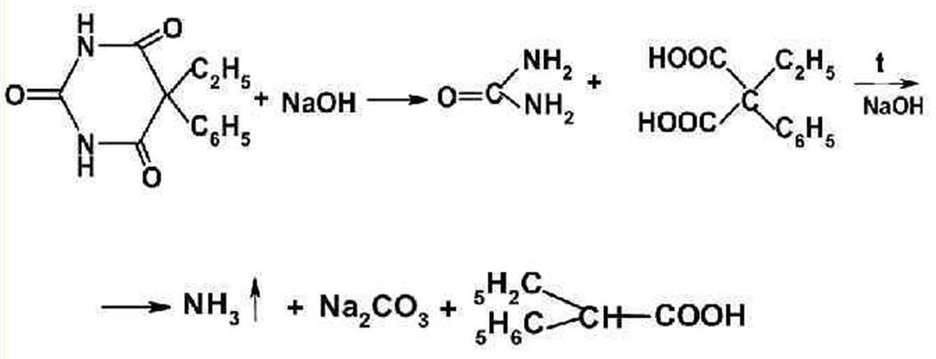
Phenobarbital
Physical properties
White crystalline powder without odour. Melting point 175-179 C.°
Very slightly soluble in cold water, hardly soluble in boiling water and chloroform, easily soluble in 95% alcohol and alkali solutions, soluble in ether.
Identification
Alloying with alkali

Slide 31
Phenobarbital
Identification
Interaction with silver nitrate
Interaction with cobalt salts
blue-violet colouring

Slide 32
Phenobarbital
Identification
Interaction with copper sulphate
The reaction produces a pale lilac coloured precipitate.

Slide 33
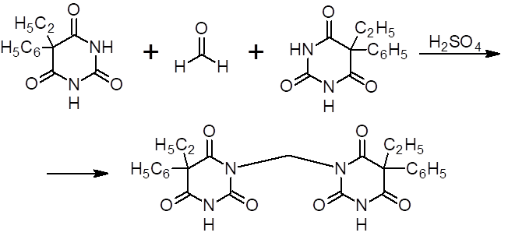
Phenobarbital
Identification
Reaction with formaldehyde solution and sulphuric acid
A pink ring is formed at the boundary of the two liquids.

Slide 34
Phenobarbital
Identification
Interaction with vanillin
Cherry colouring appears, changing to blue-violet colouring

Slide 35
Phenobarbital
Identification
Nitration reaction of the aromatic ring
yellow colouration
Purity test
Determine the content of phenylbarbituric acid and other organic impurities.

Slide 36
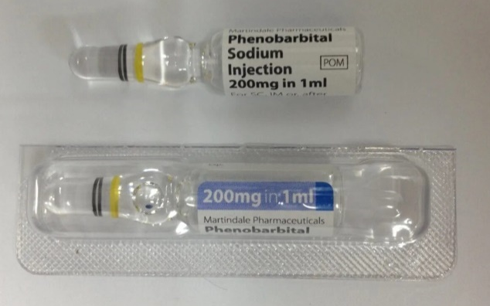
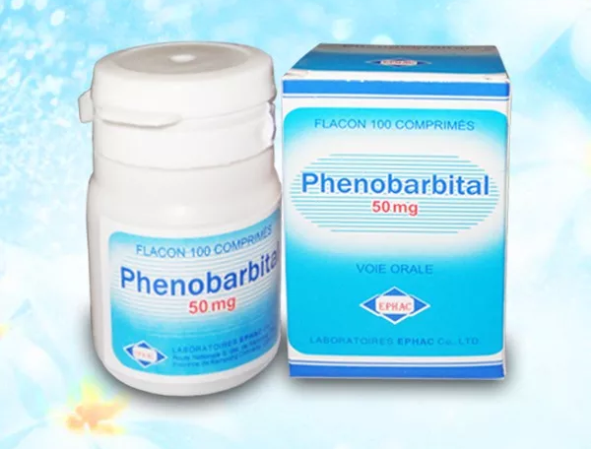
Phenobarbital
Quantification
Storage
1. Non-aqueous titration
2. Argentometry
3. Mercurimetry
4. Gravimetry
Store in dark glass jars in a place protected from light.
Medical use
Phenobarbital is a long-acting sedative; it also slightly reduces arterial blood pressure and stops epileptic attacks.

Slide 37
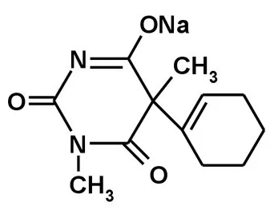
Hexenal
Hexenalum
Hexobarbital
1,5-Dimethyl-5-cyclohexene-1'-yl-barbiturate sodium
Physical properties
White or slightly yellowish crystalline powder of slightly bitter taste. Easily soluble in water and alcohol, insoluble in ether.

Slide 38
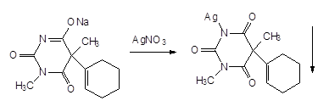
Hexenal
Identification
Alloying with alkali
Interaction with silver nitrate

Slide 39
Hexenal
Identification
Interaction with cobalt salts
Hexenal gives a blue-violet colouring when solutions of cobalt chloride or cobalt nitrate are added to it.
Interaction with copper sulphate
A blue colouration appears, changing to bright blue, followed by a white precipitate.
Reaction with formaldehyde solution and sulphuric acid
A small amount of Hexenal is dissolved by heating in a formaldehyde solution in a water bath. Then concentrated H₂SO₄ is carefully poured over the walls of the test tube and the mixture is heated again. A dark red ring appears at the boundary between the two liquids and green fluorescence appears above the ring.

Slide 40
Hexenal
Identification
Interaction with potassium permanganate
Discolouration of the solution is observed.
Interaction with bromine water
Discolouration of the solution is observed.

Slide 41
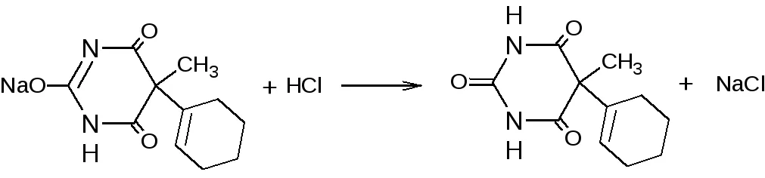
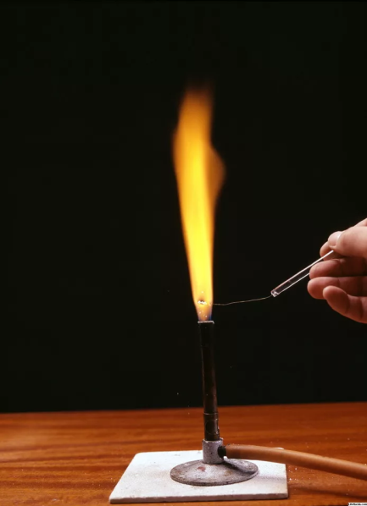
Hexenal
Identification
Interaction with acids
Detection of sodium

Slide 42
Hexenal
Quantification
Storage
1. Gravimetry
2. Acidometry
3. Argentometry
4. Mercurimetry
5. Bromatometry
6. Iodochlorometry
Hexenal is not stable in the presence of moisture and C02 of air. Moisture promotes hydrolysis of the drug, therefore solutions of hexenal should not be prepared in advance.
Non-stability of hexenal in the presence of moisture and air CO2 determines its storage conditions - in sealed ampoules at moderate temperature.
Medical use
Hexenal is used as a narcotic sedative, intravenously, intramuscularly, subcutaneously, most commonly used for preoperative anaesthesia.

Slide 43
Thank you for attention!

