Slide 1
MINISTRY OF HEALTH OF THE RUSSIAN FEDERATION VOLGOGRAD STATE MEDICAL UNIVERSITY DEPARTMENT OF PHARMACEUTICAL AND TOXICOLOGICAL CHEMISTRY LECTURE 7 TOXICOLOGIKAL CHEMISTRY
Chemical-toxicological analysis of 1,4-benzodiazepins and phenothiazine derivatives.
Maria Petrovna Paramonova
Assistant professor, PHD

Slide 2
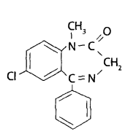
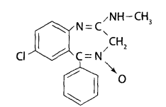
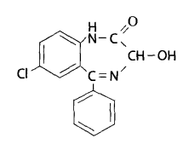
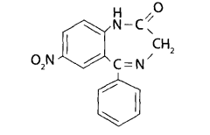
1,4 - Benzodiazepine derivatives
Diazepam (sibazon)
Chlordiazepoxide (chlozepid)
Oxazepam (nozepam)
Nitrazepam

Slide 3
Properties and toxicological significance
Drugs of this group are used in psychiatric practice as antipsychotics, but they differ lack of antipsychotic activity. The effect of benzodiazepines is due to a decrease in the excitability of the amygdala-shaped formations of the anterior temporal lobes at the diencephalic and limbic levels. Benzodiazepine derivatives are used in the form of tablets of 0.005-0.01 g. Due to the widespread abuse of compounds of this group,
In 1984, the UN Commission on Narcotic Drugs included them in the list of compounds under international control.
When tranquilizers are abused, a single dose reaches 10 tablets or more per dose. Patients experience a feeling of peace and relaxation.

Slide 4
Outwardly, such patients look as if they are in a mild stage of intoxication: an uncertain gait, carelessness, a blissful smile. With prolonged abuse, withdrawal syndrome develops, expressed in anxiety, restlessness, fear, insomnia, excessive sweating, and tachycardia.
Their combination with analgesics and antihistamines is especially dangerous, which leads to delusional psychoses and psychoorganic syndrome. Benzodiazepines have pronounced toxic properties. Cases of poisoning as a result of accidents (most often involving small children) or for the purpose of suicide have been described. The lethal dose for an adult is 0.1-0.15 g per 1 kg of body weight (68-120 chlozepid tablets), for children - 0.02-0.15 g per 1 kg of body weight (29 chlozepid tablets for children 7-14 years).The drugs are well absorbed from the digestive tract. Clinic; Mild chlozepid poisoning results in lethargy, drowsiness, lethargy, dilated pupils, and decreased muscle tone. In case of poisoning of moderate severity, the signs of poisoning are indicated above and are more clearly expressed. There was increased facial hyperemia, dry skin, tachycardia, tremor of the limbs, and the absence of many reflexes. In severe cases of poisoning, confusion occurs, psychomotor agitation, clonic convulsions or hallucinatory syndrome, respiratory and heart failure develop.

Slide 5
Diazepam has a similar effect on the body to chlozepid, but its toxic effect occurs in smaller doses.
Oxazepam (tazepam) is less toxic than chlozepid.
Nitrazepam has a more pronounced sedative and hypnotic effect.
The picture of poisoning is similar to chlozepid.
During the pathological examination of the corpse, hemorrhages in the mucous membrane of the stomach and small intestine, acute pulmonary emphysema, and plethora were noted internal organs, dilated pupils of the eyes.

Slide 6
Metabolism
In phase I of metabolism, demethylation processes are characteristic (diazepam, chlozepid) in positions 1 and 2, oxidation in position 3 to form a hydroxyl group, reduction of the nitro group in position 7 (nitrazepam).
In phase II of metabolism, the drugs themselves, which have a hydroxyl in the 3rd position, and the products of their metabolism, are conjugated with glucuronic or sulfuric acids. The metabolite of nitrazepam (aminozepam) forms a conjugate with acetic acid.
Metabolites, conjugates with acids and native compounds of benzodiazepine derivatives are excreted from the body by the kidneys.

Slide 7
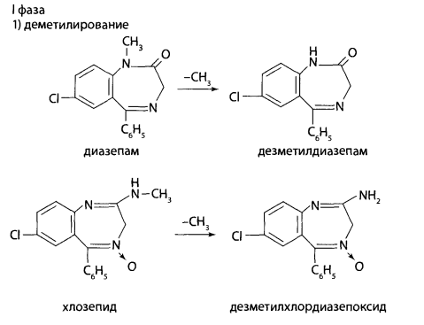
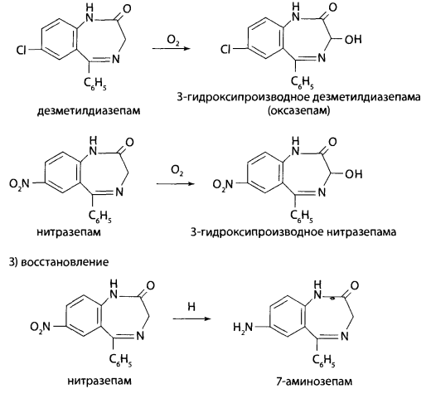
Phase I
demethylation
2) oxidation
3) reduction

Slide 8
Phase II
1) formation of conjugates with glucuronic or sulfuric acids.
Characteristic of benzodiazepines and their 3-hydroxy derivatives.
2) formation of conjugates with acetic acid.
Characteristic of reduced nitrazepam.
2) formation of conjugates with acetic acid.
Characteristic of reduced nitrazepam.

Slide 9
Objects of study:
Corpse material: 1/3 liver, 1 kidney, 1 meter intestin, stomach with contents, brain; blood, urine
Acute poisoning: gastric lavage water, dialysis water, vomit, blood, urine.
Narcological research : blood, urine, hair, nails

Slide 10
Methods of isolating :
General methods:
• Stass-Otto method (isolation with acidified alcohol)
• Shvaikova-Vasilieva method (isolation with acidified water)
In a non-targeted test for 1,4-benzodiazepine derivatives, the study carried out after isolation from biological material with acidified alcohol or acidified water with chloroform extract from the aqueous phase with pH=2 and pH=10.At pH=2, chlordiazepoxide is completely extracted with chloroform, diazepam is partially extracted but, nitrazepam and oxazepam are extracted with chloroform at pH=10.

Slide 11
When studying extracts from biological objects for 1,4-benzodiazepine derivatives, two directions are used in the analysis.
Direction 1 is based on the hydrolysis of benzodiazepines to 2-aminobenzophenones, this method allows you to detect and determine native compounds in the extract and their metabolites. This direction is given forensic chemical significance in the case of negative result.
The 2nd direction is used if benzophenones are detected in the 1st direction of analysis during the study. This method allows you to accurately determine the nature of 1,4-beyazodiazepine from native compounds and their metabolites.

Slide 12
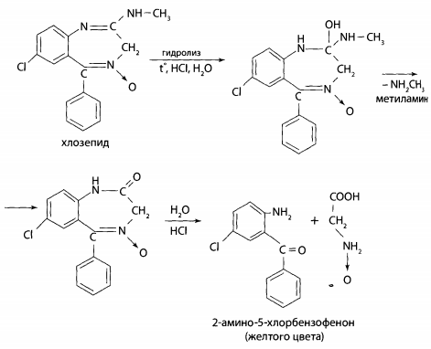
Direction 1 Bratton-Marshall reaction
A certain volume of eluate or extract is evaporated to dryness. To the dry residue, a sample of organ tissue, to 10 ml of urine or 2 ml of blood, add 2 ml of a 6 M solution of hydrochloric acid. The mixture is heated in a boiling water bath for 1 hour or 5-10 minutes in a glycerin (sand) bath at 120°C. If there are 1,4-benzodiazepine derivatives in the object, the solution turns yellow due to the formation of benzophenones.

Slide 13
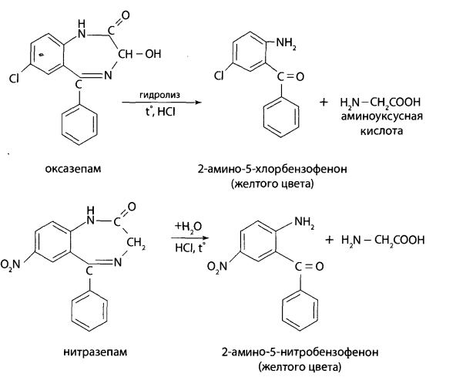

Slide 14
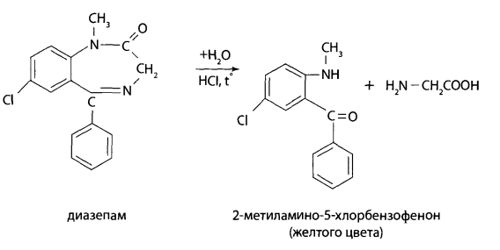

Slide 15
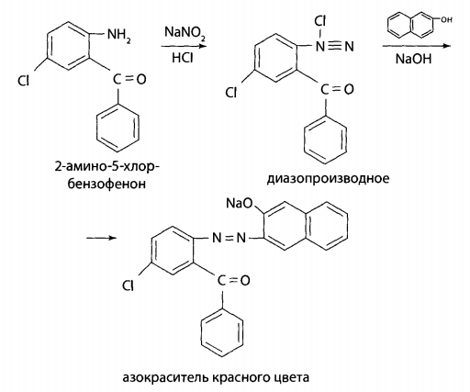
After cooling, add a drop of 5% sodium nitrite solution to part of the hydrolyzate and mix. A few drops of the resulting solution are added to 2 ml of a freshly prepared 2% alkaline solution of resorcinol or r-naphthol - the formation of a cherry-red color or an orange-red precipitate is observed.

Slide 16
The second part of the hydrolyzate is carefully alkalized with a 50% sodium hydroxide solution to pH = 10-11 and extracted with hexane.
The hexane extracts are evaporated to dryness at room temperature, the residue is dissolved in a small volume of ethanol and examined by TLC and UV spectrophotometry.
Chromatography is carried out on Silufol plates. Benzene is used as the mobile phase
The 2nd direction
Chromatography in a thin layer of sorbent.
UV spectrophotometry
IR spectroscopy
High performance liquid chromatography (HPLC)
Chemical method:
Reaction with ninhydrin. To 2-3 ml of a solution of the residue or eluate in ethyl alcohol add 10 mg of ninhydrin and heat for 2 minutes in a water bath. The solution becomes colored in blue. When a 1% solution of copper(II) sulfate is added, the color turns red or orange-red (diazepam), yellow-brown (nitrazepam), brown (chlozepid).

Slide 17
Hydrolysis reaction of amidocarbinol group. This reaction is used to detect oxazepam (nozepam). Add 5 ml of 96% ethyl alcohol to the dry residue and 4 drops of concentrated phosphoric acid. The mixture is heated in a boiling water bath for at least 5 minutes. The solution is cooled. Add to 1 ml of the resulting solution 5 ml of purified water and 1 ml of fuchsinsulfur (chromotropic) acid – observe the appearance of a purple color. As a result of hydrolysis of the amidocarbinol group, formaldehyde is formed, which with fuchsulfuric acid (or chromotropic acid) gives a characteristic color.
Reaction with Marquis and Frede reagents. When applied to the dry residue in a porcelain cup obtained by evaporation of a chloroform extract or eluate, the reagent Mark or Frede's reagent, chlozepid forms a yellow color.

Slide 18
Quantitative determination
HPLC method:
Additive Method
External standard method
Internal standard method
Photocolorimetry using the reaction of azo dye formation (Bratton-Marshall reaction). The method is based on the hydrolysis of benzodiazepines to aminobenzophenones.

Slide 19
Phenothiazine derivatives
Phenothiazine derivatives in medical practice used for more than 50 years. Many phenothiazine derivatives exhibit specific effect on the central nervous system and mental sphere.
In medical practice, drugs are used in a dose of 0.025 g (aminazine); 0.005-0.01 g (thioridazine). The drugs are available in the form of tablets and injection solutions.

Slide 20
Of this group of drugs, chlorpromazine has the greatest toxicological significance. cases of poisoning due to overdose, accidents with children and when taken for the purpose of suicide have been described. It is known that for adults the lethal concentration of chlorpromazine is 0.03-0.12 g/l of blood. For children, the lethal dose of chlorpromazine is 0.25 g. In large doses, chlorpromazine causes a state close to physiological sleep. In case of poisoning, severe weakness, dizziness, dry mouth, nausea, convulsions, loss of consciousness, increased sleep, pulse, drop in pressure, and allergic skin reactions are noted.
Acute poisoning: coma, pupils are dilated and do not respond to light, the respiratory and vasomotor centers, Cheyne-Stokes breathing are sharply depressed, the skin is cyanotic, intestinal obstruction develops, tachycardia and epileptic convulsions appear. Death occurs with symptoms of increasing pulmonary heart failure.
CHLORPROMAZINE
AMINAZINE

Slide 21
In phase I of metabolism, hydroxylation of the phenothiazine nucleus occurs at positions 3 and 7, dealkylation at the nitrogen atom at position 10, demethylation at the nitrogen in the alkyl radical and oxidation to form S- and N-oxides.
Metabolic phase I
hydroxylation at position 3, 7 or 7
2. dealkylation at position 10 at the nitrogen atom with simultaneous
hydroxylation at positions 3 and 7

Slide 22
3. demethylation at the nitrogen atom
4. formation of sulfoxides

Slide 23
Metabolism II phase
In phase II of metabolism, glucuronides are formed (most often with hydroxy derivatives).
Objects of study:
Corpse material: 1/3 liver, 1 kidney, 1 meter intestin, stomach with contents, brain; blood, urine
Acute poisoning: gastric lavage water, dialysis water, vomit, blood, urine.

Slide 24
Isolation method
Infusion with acidified water (Vasilieva’s method)
Infusion with acidified alcohol (Stas-Otto method).
Infusion with acidified alcohol (method of E.M. Salomatin).
1st stage. The object is filled with 96% ethyl alcohol, acidified with oxalic acid to pH = 2-3 and infuse 3 times for 2 hours. The alcohol extracts are evaporated at 40°C until the syrup becomes thick. The proteins in the residue are precipitated with 96% alcohol, filtered and evaporated to dryness. The purified residue is dissolved in 100 ml of water heated to a temperature of 40-60°C, cool and filter.
2nd stage. The filtrate is extracted twice with diethyl ether at pH=2-3. Then
the aqueous phase is made alkaline with 50% sodium hydroxide solution and extracted again diethyl ether. The combined ethereal extracts are shaken with a 0.5 M solution sulfuric acid and the resulting acidic aqueous extract are used to detect phenothiazine derivatives.

Slide 25
DETECTION
1. Thin layer chromatography method.
2. IR spectroscopy. In the IR spectra of phenothiazine derivatives, certain characteristic frequencies are detected, reflecting the types of bonds and functional groups in molecules. To carry out the analysis, the purified residue after evaporation of the extract from the biological object is ground with potassium bromide crystals and pressed and the resulting disk is placed into the device. The IR spectrum is compared with spectra available in special reference books.
3. GLC Phenothiazine derivatives are separated using medium polarity phase OV-225 (3-5% on chromatone). Detection of phenothiazine derivatives is carried out using retention parameters (time or retention volume or relative retention time). Imisine is used as an internal standard.

Slide 26
4. UV spectrophotometry. In the UV region of the spectrum, phenothiazine derivatives exhibit two light absorption maxima at 250-255 and 300-315 nm. The main metabolites of phenothiazine derivatives (sulfoxides) in the UV region are characterized by 4 light absorption maxima at 239, 274, 300 and 341 nm. Analysis of UV absorption spectra is carried out after purification of extracts from objects using thin chromatography sorbent layer. Measurements are carried out in a 0.5 M sulfuric acid solution and characteristic absorption bands are recorded.
5. HPLC
6. Chemical reactions:

Slide 27
Coloring reactions. To obtain colored products, the following chemical reactions are used:
oxidation reactions (using perchloric acid, sodium nitrite, Frede's, Mandelin's reagents, concentrated sulfuric acid);
reaction with formaldehyde in the presence of concentrated sulfuric acid (Marquis reagent);
oxidation by compounds containing metals with the highest oxidation state [iron(III) chloride (FeCl3), hydroplatinic acid (H2PtCl6)].
To carry out the reactions, the chloroform extract is evaporated in porcelain dishes and the corresponding reagents are applied to the dry residues - the appearance of a characteristic color is observed.
These reactions are of little specificity, since mixtures of oxidation products are formed and the initial color quickly turns into red, cherry-red, red-orange, crimson, brown or violet coloring.

Slide 28
Microcrystalscopic reactions. For phenothiazine derivatives, these reactions few and uncharacteristic. Aminazine, diprazine with a 5% solution of chlorauric acid form crystalline precipitates.
Quantitative determination
The HPLC method is used after thorough purification of biological extracts. objects using TLC or by stripping. The additive method, external and internal standard methods are recommended.
Photometry in the visible region of the spectrum.

