Slide 1
«General pharmaceutical chemistry»
Drugs for the treatment of infections caused by herpesviruses
Associate Professor Gureeva E.S.

Slide 2
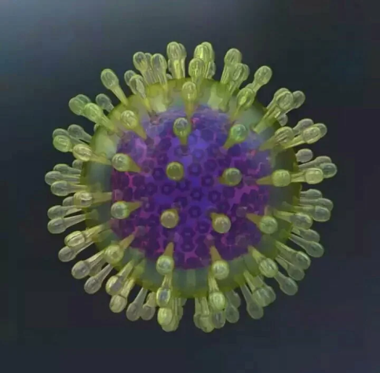
General characteristics of herpesviruses
Herpesviridae is a large family of DNA-containing viruses.
The family is divided into three subfamilies: alpha-, beta- and gammaherpesvirinae and 13 genera.
The subfamily alphaherpesvirinae includes herpes simplex virus types 1 and 2 and varicella virus.

Slide 3
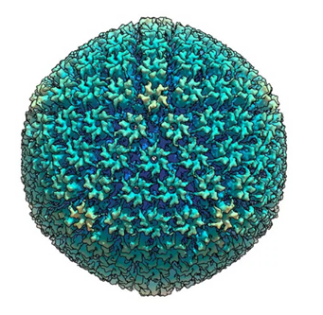
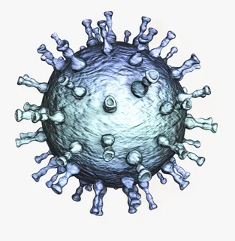
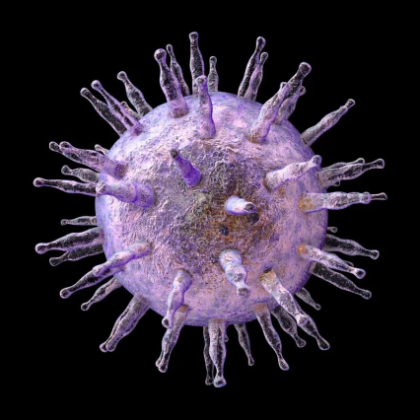
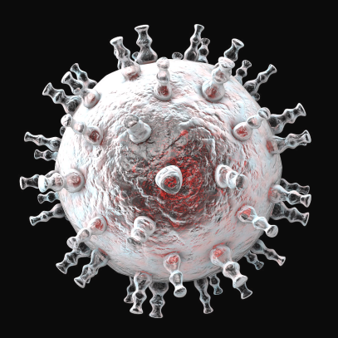
General characteristics of herpesviruses
The betaherpesvirinae subfamily includes
cytomegalovirus and Varicella Zoster Virus.
The gammaherpesvirinae subfamily includes the Epstein-Barr virus and the herpesvirus associated with Kaposi's sarcoma.

Slide 4
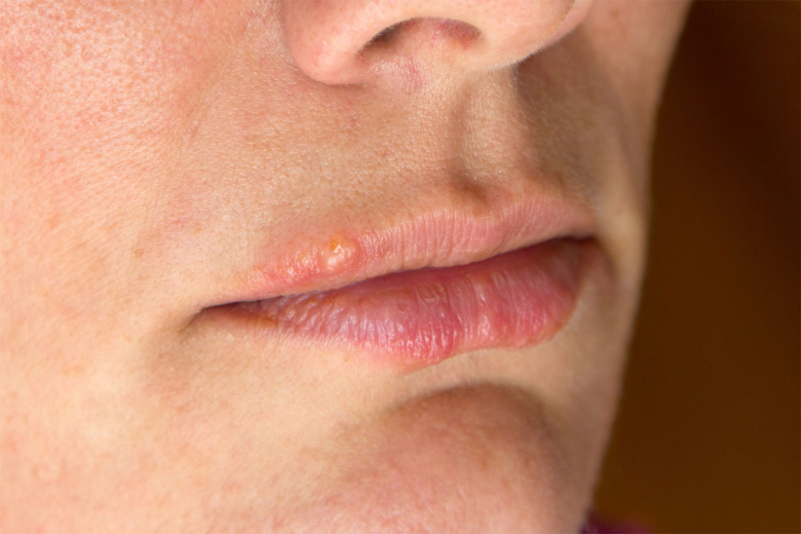
General characteristics of herpesviruses
Herpes simplex virus infection
Herpesviruses are widespread in the human population.
About 70% are infected with herpes simplex virus (HSV), which is responsible for the development of oral herpes (usually HSV-1) or genital herpes (usually HSV-2).
They can also cause central nervous system lesions - various infections including encephalitis.

Slide 5
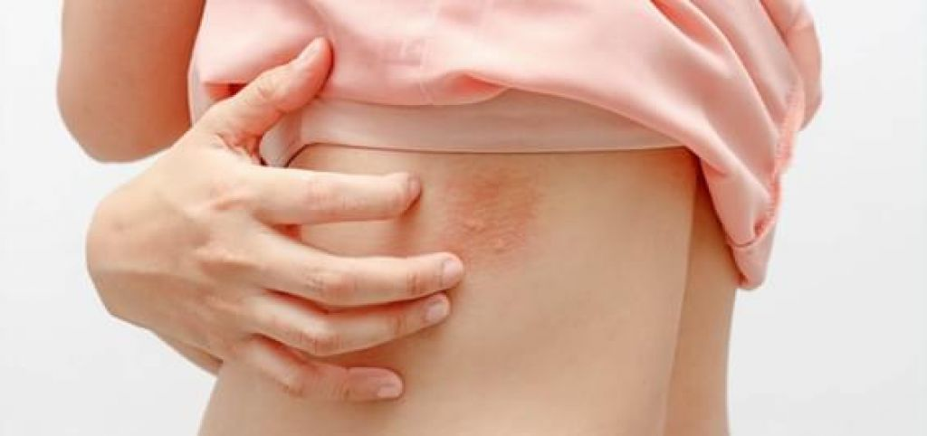
General characteristics of herpesviruses
Varicella zoster virus infection
Primary varicella zoster virus (VZV) infection usually occurs in children and causes chickenpox after which the virus persists in the cervical ganglion.
Reactivation of VZV infection occurs when the host's immune response decreases naturally due to old age or immune status.
The reactivated virus causes shingles, a debilitating disease that can be fatal in patients with low immune status.

Slide 6
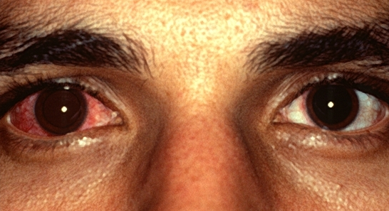
General characteristics of herpesviruses
Cytomegalovirus infection
Cytomegalovirus (CMV) is found in almost all parts of the world. About 60% of people aged 6 years and older are infected with CMV.
In immunocompromised individuals, the virus poses a serious threat to life, especially in AIDS patients, transplant recipients, and newborns who acquire the infection congenitally.
CMV is able to pass through the placenta and infect the foetus, leading to stillbirths and congenital malformations.

Slide 7
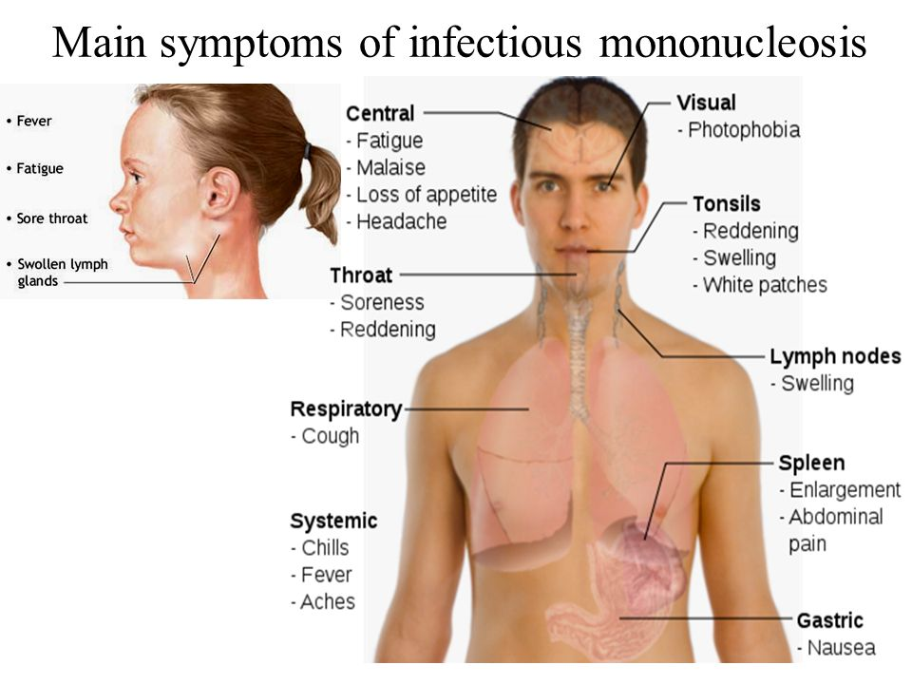
General characteristics of herpesviruses
Epstein-Barr virus infection
Epstein-Barr virus (EBV) is the leading cause of infectious mononucleosis in adolescents. About 50% of adults have the infection during adolescence.
EBV forms a latent infection in B-lymphocytes.
EBV infection is highly associated with two forms of human cancer: Burkitt's lymphoma, the most common tumour in African children, and nasopharyngeal carcinoma, the most common tumour in China.

Slide 8
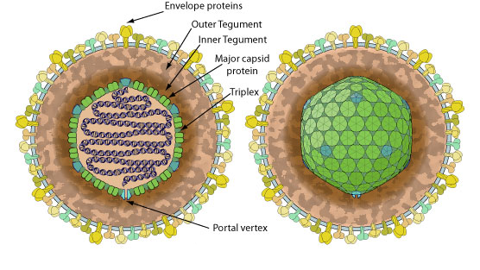
General characteristics of herpesviruses
Structure of the virus

Slide 9
General characteristics of herpesviruses
Life cycle of the herpes virus

Slide 10
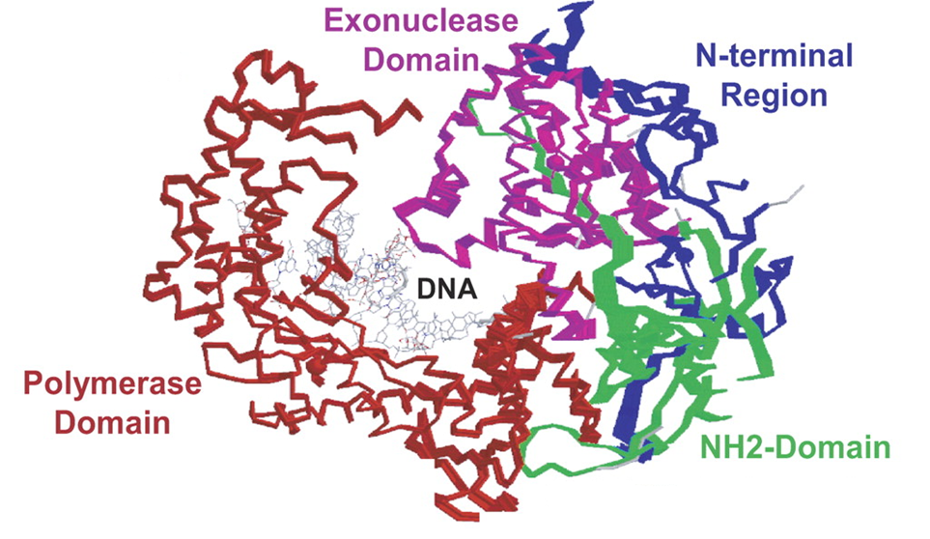
Anti-herpes medicines in clinical practice
DNA-dependent DNA polymerase

Slide 11
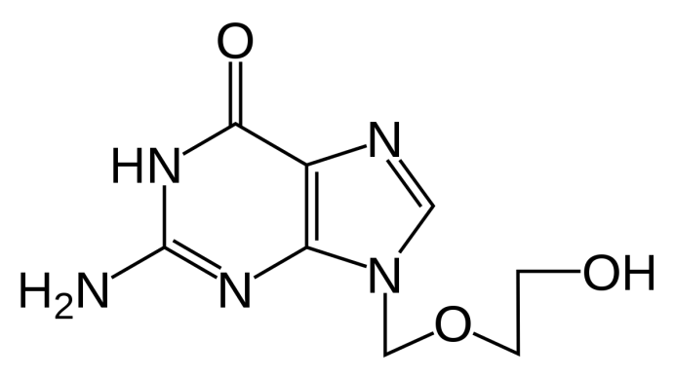
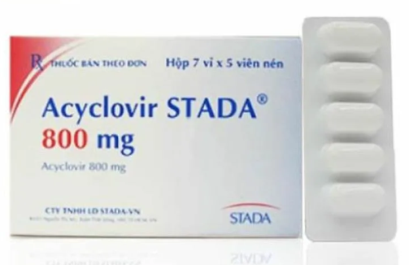
Anti-herpes medicines in clinical practice
Acyclovir
Acyclovir, 9-(2-hydroxyethoxymethyl) guanine (ACV), has been and remains the main drug of choice for the treatment and prevention of infections caused by HSV and VZV.
It is a potent inhibitor of HSV-1 and -2 replication with an EC₅₀ of 0.1 and 0.5 µM, respectively, and is also active, although to a lesser extent, against VZV (EC₅₀ 1.1 µg/ml).
ACV is widely used orally and topically for the treatment and prevention of HSV-1, HSV-2, and VZV. Treatment of herpes on the lips with ACV slightly reduces the duration of symptoms and healing time.
ACV has a low bioavailability when taken orally (10-12%).

Slide 12
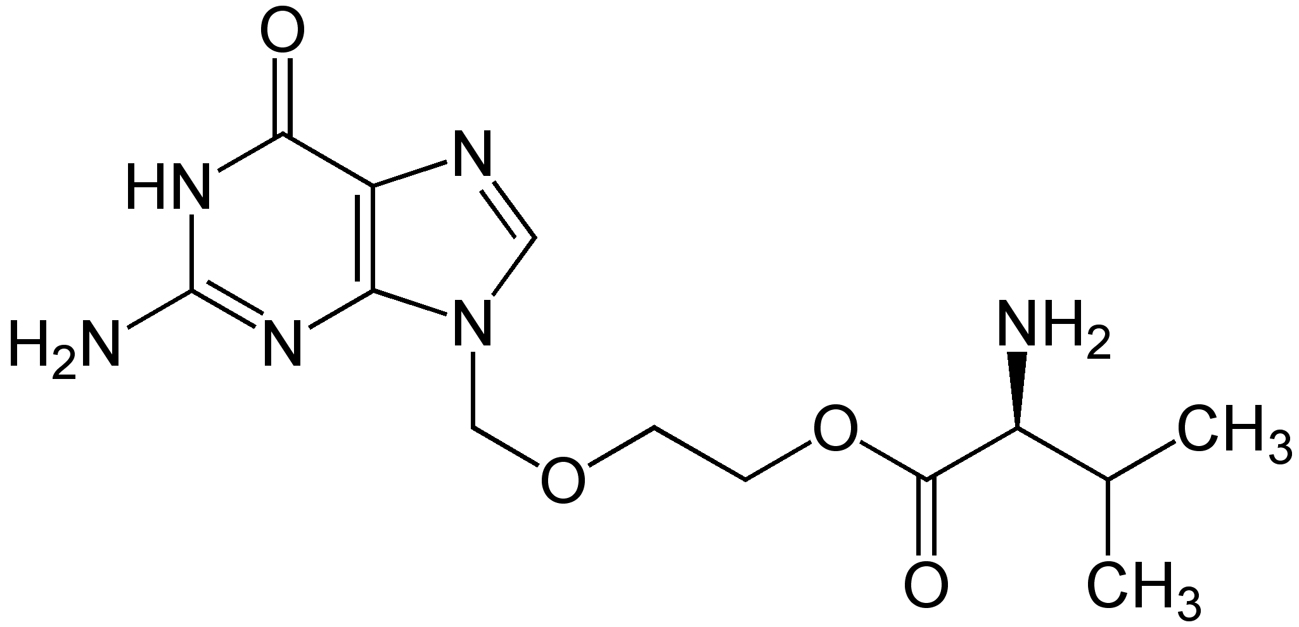
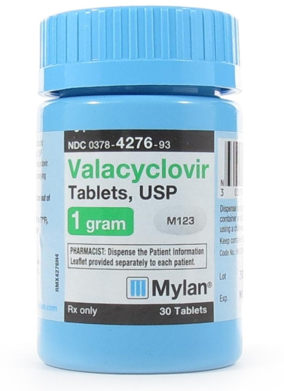
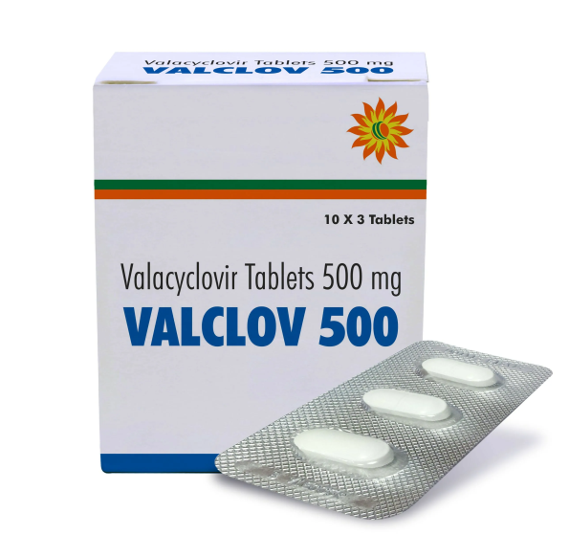
Anti-herpes medicines in clinical practice
Valacyclovir
Valacyclovir (VACV) is the L-valine ester of ACV. When administered orally, the prodrug is absorbed in the gastrointestinal tract and is rapidly metabolised by liver enzymes to ACV and valine.

Slide 13
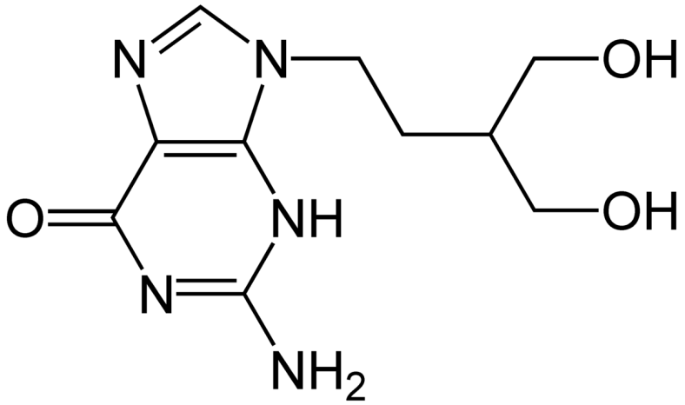
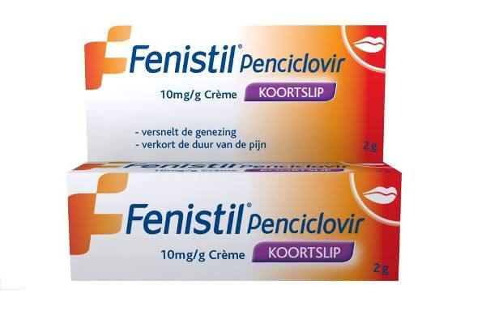
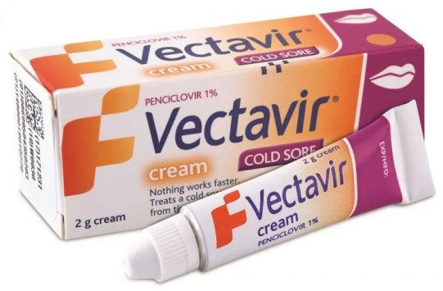
Anti-herpes medicines in clinical practice
Penciclovir
Penciclovir has a broad spectrum of antiviral activity against HSV-1, HSV-2, VZV, and EBV.
When administered orally, pencyclovir has an extremely low bioavailability (2-5%) and thus can only be used topically.

Slide 14
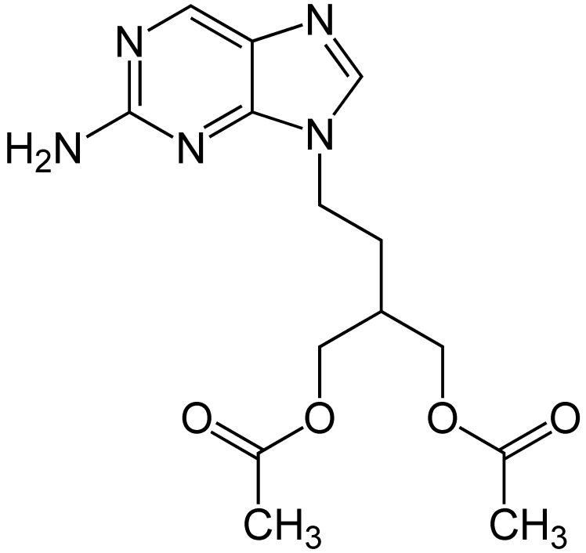
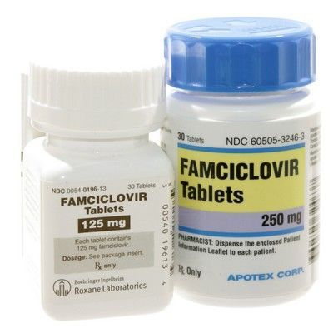
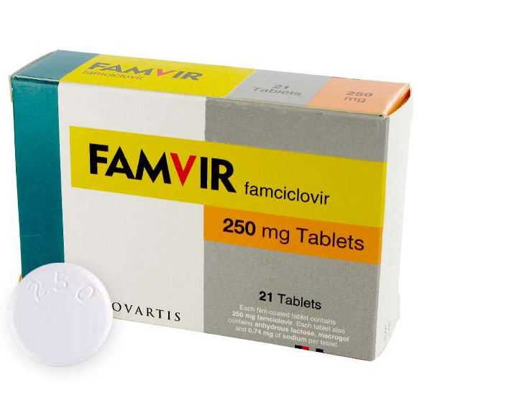
Anti-herpes medicines in clinical practice
Famcyclovir
Famiclovir, is the oral prodrug form of penciclovir.
However, its prodrug, famcyclovir, has a significantly higher oral bioavailability (77%). famcyclovir is rapidly absorbed in the gut, deacetylated and oxidised by xanthine oxidase to pencyclovir.

Slide 15
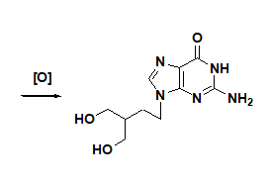
Anti-herpes medicines in clinical practice
Biotransformation of famcyclovir to penciclovir

Slide 16
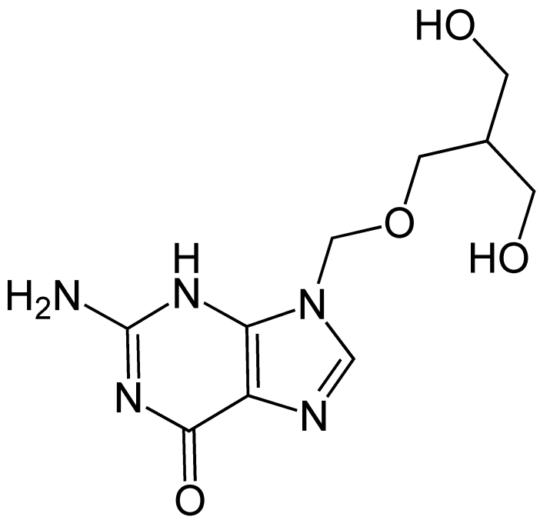
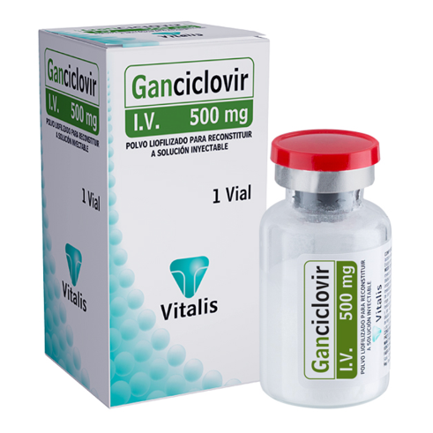
Anti-herpes medicines in clinical practice
Ganciclovir
Ganciclovir is a broad spectrum anti-herpetic agent (EC₅₀ 0.1, 0.1, 2.8, 3.4 and 0.1 µM against HSV-1, HSV-2, VZV, CMV and EBV, respectively).
Because of its high activity against CMV, it is widely used for the treatment and prevention of cytomegalovirus retinitis in immunodeficient patients and organ transplant recipients.
Ganciclovir has poor pharmacokinetic properties. Its oral bioavailability is around 5%.

Slide 17
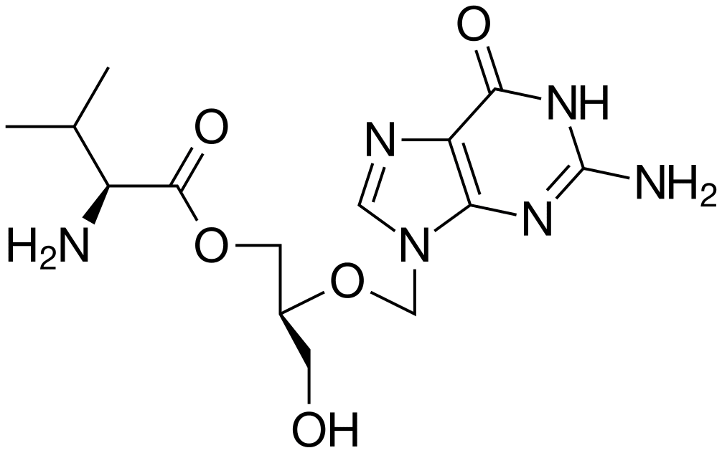
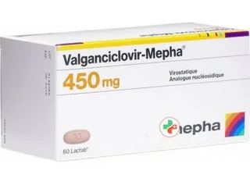
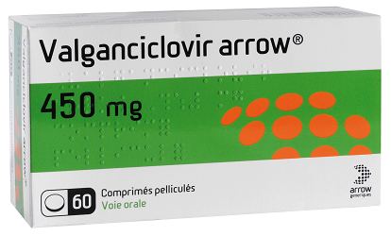
Anti-herpes medicines in clinical practice
Valganciclovir
Valganciclovir is a monovalent ester of ganciclovir with an oral bioavailability of up to 60%.
The ester bond is easily hydrolysed by intracellular esterases, which explains why valganciclovir is easily converted into Ganciclovir.

Slide 18
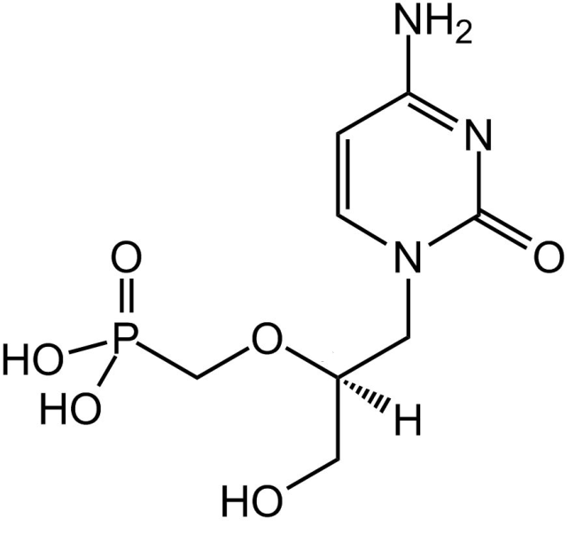
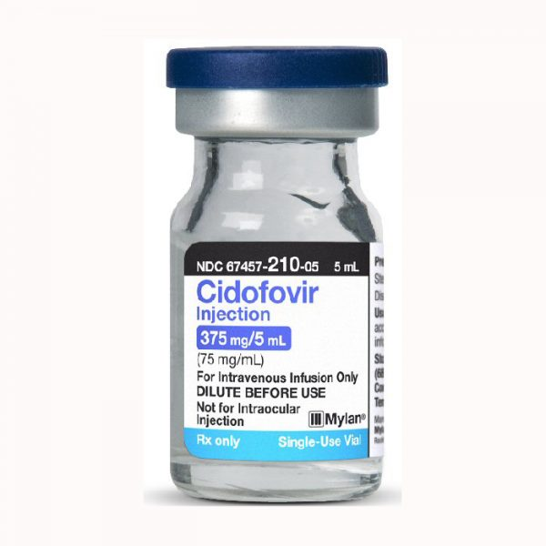
Anti-herpes medicines in clinical practice
Cidofovir
Cidofovir is active against various herpes viruses (EC₅₀ 5.4, 2.3 and 0.2 µg/ml against HSV-1, HSV-2, and CMV).
It is used in the clinic for the treatment of HSV infection and CMV infection in acquired immunodeficiency syndrome (AIDS).
The plasma half-life of cidofovir after intravenous administration is 3-4 hours. It is excreted 90% unchanged by the kidneys.

Slide 19
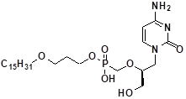
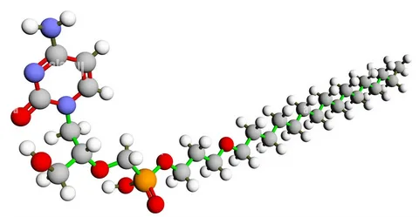
Anti-herpes medicines in clinical practice
Brincidofovir
Brincidofovir is a prodrug form of cidofovir. It is converted to active cidofovir intracellularly.

Slide 20
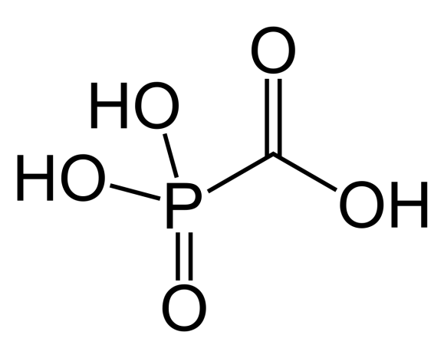
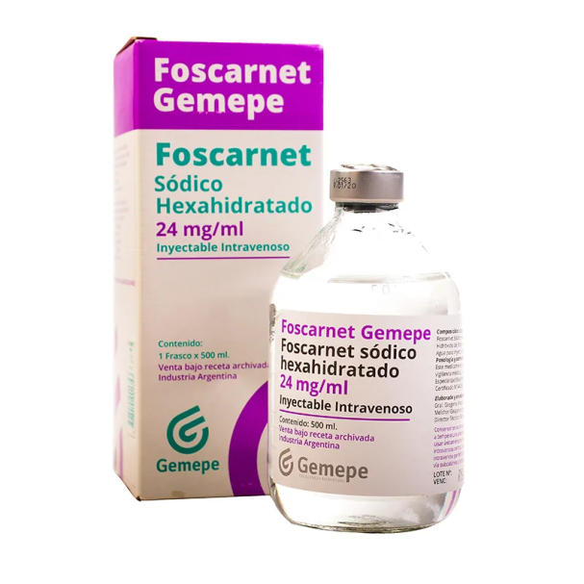
Anti-herpes medicines in clinical practice
Foscarnet
Foskarnet, a phosphomorubic acid, is a potent and broad-spectrum anti-herpetic agent and is used in the clinic for the treatment of cytomegalovirus infection.
Due to its high polarity and low oral absorption, foscarnet is administered intravenously and high plasma concentrations can only be achieved this way.

Slide 21
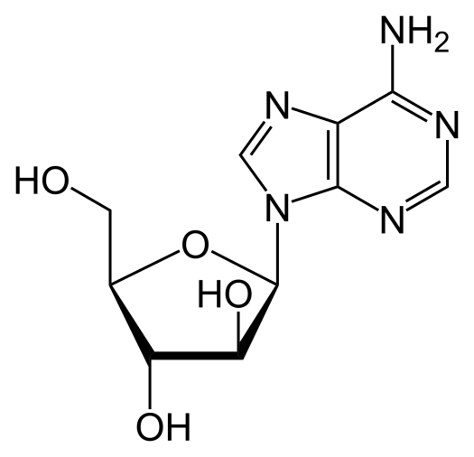
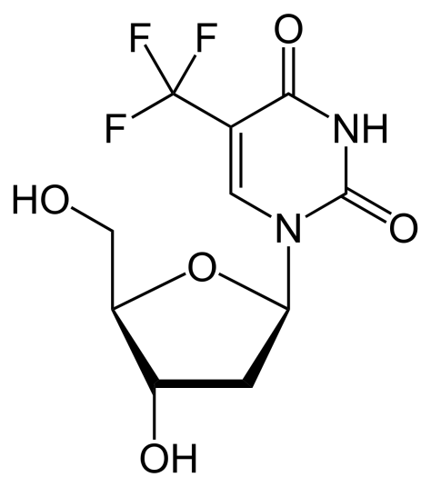
Anti-herpes medicines in clinical practice
Other substances used in the clinic
vidarabine
iodoxuridine
trifluridine
brivudine

Slide 22
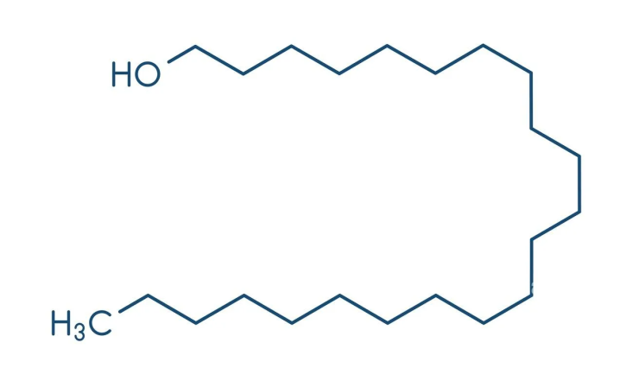
Anti-herpes medicines in clinical practice
Other substances used in the clinic
Docosanol
Docosanol is a saturated 22-carbon aliphatic alcohol and is used as a 10% cream for the treatment of herpes on the lips. It is thought that docosanol can inhibit the fusion of the plasma membrane of the host cell and the virion sheath, thus blocking virus entry.

Slide 23
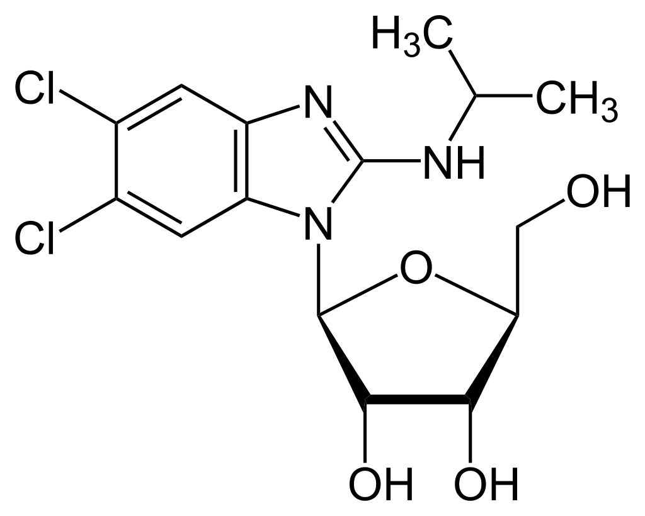
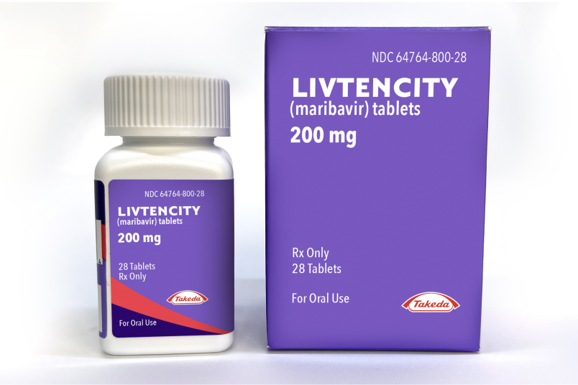
Anti-herpes medicines in clinical practice
Other substances used in the clinic
Maribavir
Maribavir is an antiviral medicine that is used for the prevention and treatment of post-transplant cytomegalovirus. Maribavir is an inhibitor of cytomegalovirus kinase pUL97, thereby blocking the replication of the virus.

Slide 24
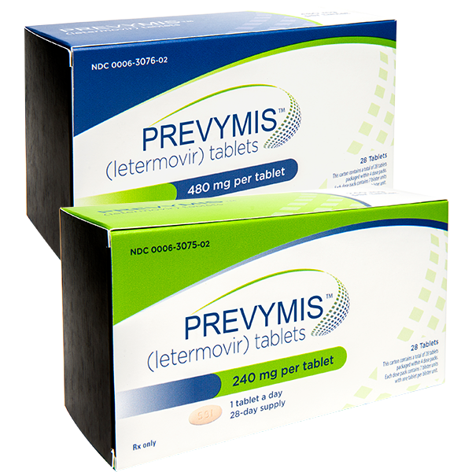
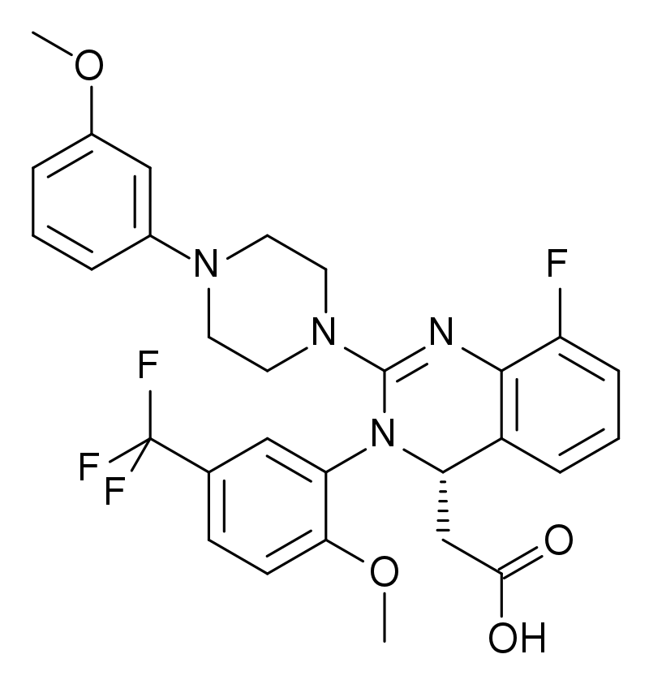
Anti-herpes medicines in clinical practice
Other substances used in the clinic
Letermovir
Letermovir has been tested in CMV-infected stem cell transplant patients. It may also be useful in other patients with compromised immune systems, such as organ transplant patients or HIV-infected patients.

Slide 25
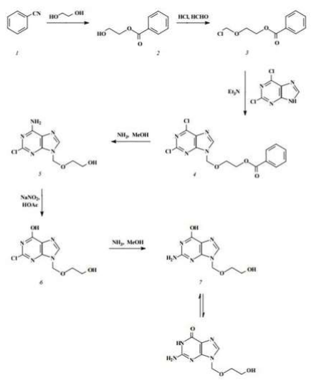
Anti-herpes medicines in clinical practice
Acyclovir
Synthesis
Chemical synthesis of acyclovir can be done in different ways.
The classical method of synthesis from benzonitrile

Slide 26
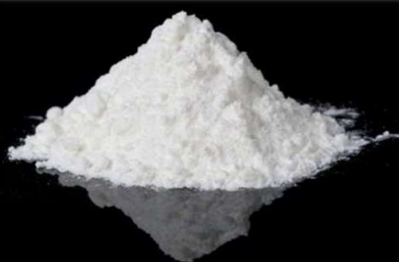
Anti-herpes medicines in clinical practice
Acyclovir
Physical properties
White or almost white crystalline powder.
Little soluble in water, very little soluble in 96% alcohol, soluble in diluted solutions of mineral acids and alkali metal hydroxides.

Slide 27
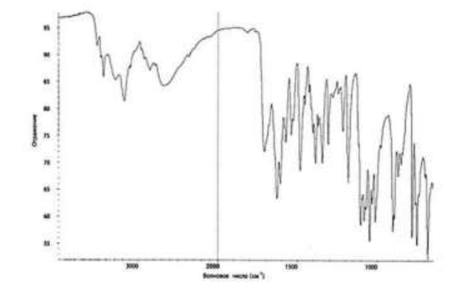
Anti-herpes medicines in clinical practice
Acyclovir
Identification
Absorption spectrophotometry in the infrared range. Comparison with spectra:

Slide 28
Anti-herpes medicines in clinical practice
Acyclovir
Identification
UV spectra; acyclovir has: max at λ = 255 ± 2 nm min at λ = 227 ± 3 nm and a shoulder in the region of 270 - 290 nm; 3.
TLC
HPLC
Positive murexide assay for purine cycle.
When heated with NaOH solution, ammonia is released, which detectable by smell or blueing on wet red litmus paper.
The amino group gives positive reactions with vanillin, with 2,4-dinitrochlorobenzene and p-dimethylaminobenz-aldehyde.

Slide 29
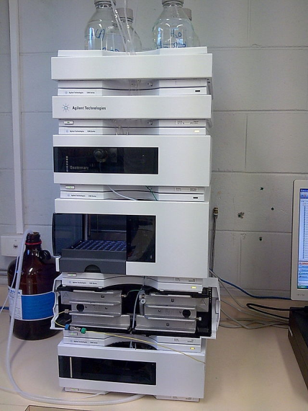
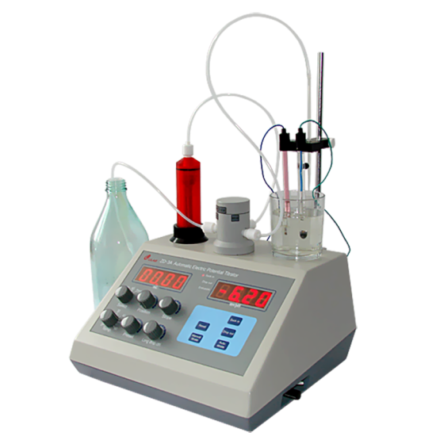
Anti-herpes medicines in clinical practice
Acyclovir
Quantification
High performance liquid chromatography
Non-aqueous titration. 0.150 g of the preparation dissolved in 60 ml anhydrous acetic acid. Titrate with 0.1 M perchloric acid solution. The indicator is crystal violet. The equivalence point can also be determined potentiometrically.

Slide 30
Anti-herpes medicines in clinical practice
Valaciclovir
Physical properties
White or almost white crystalline powder.
Little soluble in alcohol, ether and chloroform, soluble in water.
Identification
Infrared spectra
UV spectra;
TLC
HPLC
Positive murexide assay for purine cycle.

Slide 31
Anti-herpes medicines in clinical practice
Valaciclovir
Identification
When heated with NaOH solution, ammonia is released, which detectable by smell or blueing on wet red litmus paper.
The amino group gives positive reactions with vanillin, with 2,4- dinitrochlorobenzene and p-dimethylaminobenz-aldehyde.
Quantification
HPLC .
Non-aqueous titration. 0.150 g of the preparation dissolved in 60 ml anhydrous acetic acid. Titrate with 0.1 M perchloric acid solution. The indicator is crystal violet. The equivalence point can also be determined potentiometrically.

Slide 32
Thank you for attention!

