Slide 1
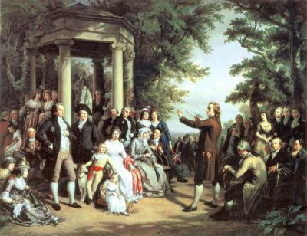
Theme: German classic philosophy.

Slide 2
The main distinctive features of German classic philosophy are globalization, systematic and classic character, the high degree of generalization, gnosiologism, dialectical character, interpretation of man as active subject.

Slide 3
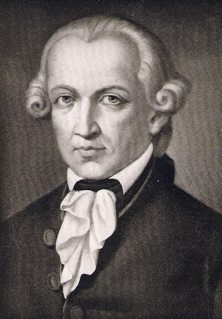
E. Kant is the founder of German classic philosophy and one of the greatest minds of humankind. It was Kant who realized radical change in philosophy, demolished the idea about passive, contemplative nature of mind, human consciousness in general. Kant thoroughly investigated the possibilities of human cognition and established its limits. Work of philosophers of New Time revealed irreconcilable contradiction between rationalism and empiricism.
E. Kant
(1724-1804)

Slide 4
Kant thought, that neither sense perceptions independently nor rational ideas accordingly can be placed at the basis of knowledge. In one of his main works “The critique of pure reason” he writes about that very clearly: “Our nature is like that contemplations can be only sense, that is contain in themselves only way by which things influence us. The ability to think the object of sense contemplation is reason.
Acquaintance with things is always a matter of the exercise of the senses. But senses without concepts are blind. Equally, the concepts of reason are empty, without sense content. For reason can not contemplate and senses can not think. And knowledge can arise only through connecting of reason and senses.”

Slide 5
Connecting of senses and reason can be made only in activity, in arbitrary, subjective activity of productive imagination. According to Kant, man is a creature, having surprising and incomprehensible productive ability of imagination. Owing to this ability man can get notions about things as phenomena. However, each thing has its independent of human consciousness essence. Kant called this essence “thing in itself”. The absolute cognition of “thing in itself” is impossible.

Slide 6
Man, getting down to cognition, has been possessing cognitive forms - apriori, which has appeared before him. Apriori are forms, acquired by man in the process of his drawing into forms of culture, which has appeared before him. The most important apriori are the ideas of space and time.
In his gnosiology, Kant used dialectics: contradiction for him is necessary feature of cognition. But dialectics for him was only gnosiological principle, its subjective for reflects contradictions not things as themselves, but only contradictions of thinking.

Slide 7
There are four antinomies of pure reason that Kant formulated:
The world is finite in time and space. The world is infinite in time and space.
The world consists of indivisible elements. The world does not consists of indivisible elements.
Freedom exists as a causality in the world. There is no freedom and everything in the world takes place according to laws of nature.
There is an absolutely necessary being (such as God) in the causal chain of beings. There is no absolutely necessary being.

Slide 8
Kant revealed two forms of human life: man belongs to the world of phenomena, natural world, there is no freedom in this world, it is the world of limitation, necessity. But man at the same time is the “thing in itself”, for he has productive ability of imagination, which we can call freedom. When man treats himself as single ground of his own action, then he acts freely.
Kant came to a conclusion, that it is impossible to cognize the man as free and responsible creature with the aid of “pure reason”, it is impossible to investigate man as phenomenon, as object. Man can be investigated only from the inside, as the subject of free, independent action.

Slide 9
Kant calls this special cognitive faculty “practical reason”. Practical reason is the basis of will, it appeals to man so that he would act beyond dependence on possible consequences of this action. The subject of practical reason (Kant called it also moral consciousness) intentionally excludes himself from the natural necessity. For him true reality is his immortal soul, freedom and God.
Kant proposed categorical imperative (moral law) which does not contain concrete orders, but appeals to autonomous subject and therefore nothing imposes upon him.

Slide 10
Categorical imperative speaks only about necessity to treat himself and other people as the subjects of free will:
“Act only on that maxim through which you can at the same time will that it should become a universal law”.
Formulation of practical imperative of Kant:
«One should treat oneself and all humanity as an end and never as a means».

Slide 11
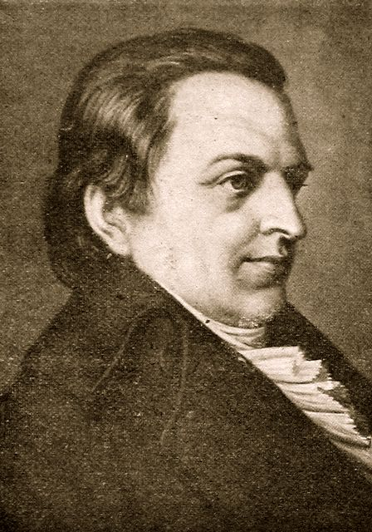
In the philosophy of Fichte the chief datum is the human self and its self-consciousness.
Mind, according to Fichte, is the action. Mind gives being. All are deduced from it. Fichte thought, that contradiction is the beginning of creation, the origin of action and self-development. In fact, according to Fichte, there is something like a cosmic self and the world as a whole is spiritual through and through. This is the position of absolute idealism.
I.G. Fichte
1762-1814

Slide 12
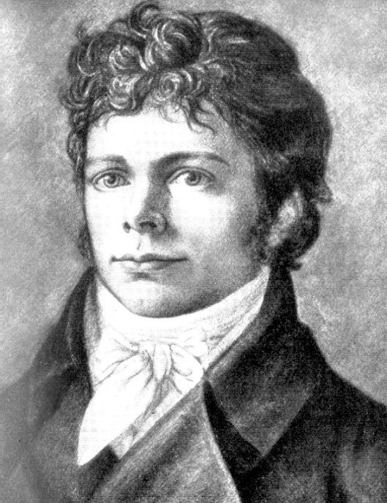
F. Schelling directly proceeded from the principle of identity of spirit and nature, which are only different manifestations of the single active substance – that is “the Absolute” or God. The absolute identity of Schelling is original substance. The force, acting in nature, in fact, is identical with the force which is discovered in spiritual world.
F. Schelling
1775-1854

Slide 13
The creative force of Absolute displays the panorama of world’s life, transformation of its forms from the lowest to the highest, which is crowned by human self-awareness. The same creation as identity of theoretical and practical activity one must find in subjective intellect. There, according to Shelling, the aesthetic and artistic activity has such character and it is able to express the nature of creative origin with the largest wholeness. The ideal world of art and real world of things are the products of the same activity, which creating unconsciously, makes the world of nature, but creating consciously, aesthetic world of art. All world is the living work of art.

Slide 14
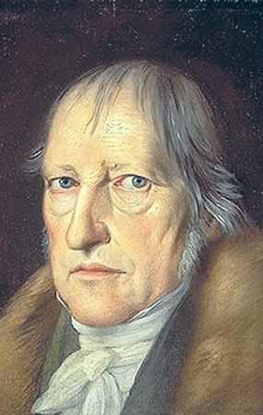
G. W. F. Hegel tried to make comprehensive, all-embracing philosophic system, embracing all field of human knowledge. German philosopher considered identity of thought and being in the process of development. Rational development of the world is the main subject of Hegel’s philosophy. According to Hegel, the origin of development is Mind or Spirit, absolute idea. It is true reality. But world, nature is only reflection, another being of absolute idea.
G. W. F. Hegel
(1770-1831)

Slide 15
Hegel regarded nature in its innumerable empirical phenomena as a sort of “scales, which the snake of absolute dialectics sheds in its motion”. Hegel developed the study about laws and categories of dialectics, for the first time in systematic form worked out fundamental principles of dialectical logic.

Slide 16
In the process of its dialectical self-development absolute idea passes through tree stages. The first stage is logical. Hegel begins from the concept of absolute (“pure”) being, which has not concrete characteristics and therefore is equal to its opposite, that is – nothing. Absolute idea turns out to be, identity of being and nothing, which forms the concept of becoming, as something more concrete, substantial, as the moment of transition in another state of “absolute anxiety of becoming”.

Slide 17
The special features of construction of Hegel’s logic are obvious in this three concepts:
thesis-antithesis-synthesis.
The result of becoming (synthesis) Hegel calls “available being”. It’s inherent in real objects. The results of cognition of object show themselves in its concept, which is the conception of object as itself. Concept is the absolute creative power, generating all available. In other words, according to Hegel, all concepts transfer from the sphere of spirit to the material sphere and begin to live independent life.
The second stage begins. Nature is the idea in its another being. Hegel said that though it is possible to deduce all knowledge about nature from the single concept of “absolute idea”, there is no need to do that, since there are concrete sciences. Therefore, it is necessary to correct all existing knowledge (physics, chemistry, biology) in order to reveal more distinctly the motion of idea in this world.

Slide 18
On the one hand Hegel tried to deduce general laws and forms of nature from absolute world-Spirit. But on the other hand, he had to acknowledge, that something inexplicable, similar to Kant’s “thing in itself” exists in nature.
For Hegel nature is the place where idea will free itself from its nature’s form and with the aid of human consciousness will return to its pure spiritual being. This is the third stage of the self-development of idea. Here idea gets necessary concreteness. It gets the form of concretization in the appearance of the subjective, objective and at last, where man and social life appeared, Absolute spirit.

Slide 19
Subjective spirit is the consciousness of subject, the psychological characteristics of man (habit, appetite, judgment). The objective spirit is the human family mind, got historical expression in the organizations of social life (the family, civil society, the state). The absolute spirit is the spirit of freedom, infinite, aspiring to cognize itself and express its essence. According to Hegel, spirit contemplating itself in complete freedom is art, spirit, representing itself with respect, is religion, spirit, thinking its essence in concepts and cognizing it, is philosophy.

Slide 20
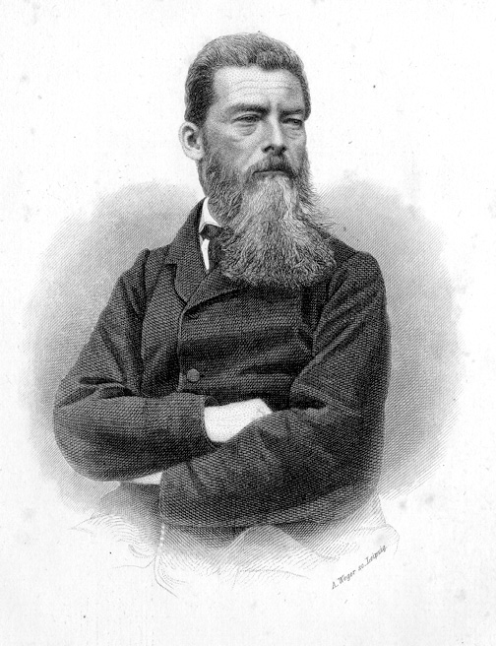
L. Feuerbach is the founder of one of the versions of philosophic materialism. The starting-point of Feuerbach’s philosophy is the idea, which is expressed in aphorism: “It is not God created man, but man created God”. Nature is the basis of spirit. It must become the basis of new philosophy, which must reveal the earthy essence of man, whom nature has given senses and mind and whose mentality, depends on his corporal organization.
L. Feuerbach
(1804-1872).

Slide 21
Feuerbach proposed anthropological principle. He became to interpret the concept “object” in a new way. This concept is originally formed in the experience of human dealings and therefore the first object for man is the other man, or “You”.

