Slide 1
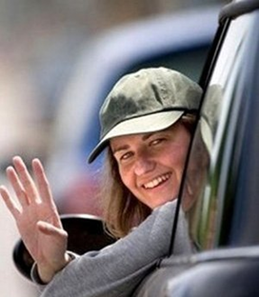
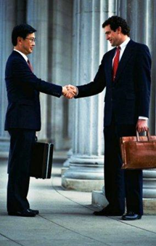
Приветствие / Прощание Greetings / Farewells

Slide 2
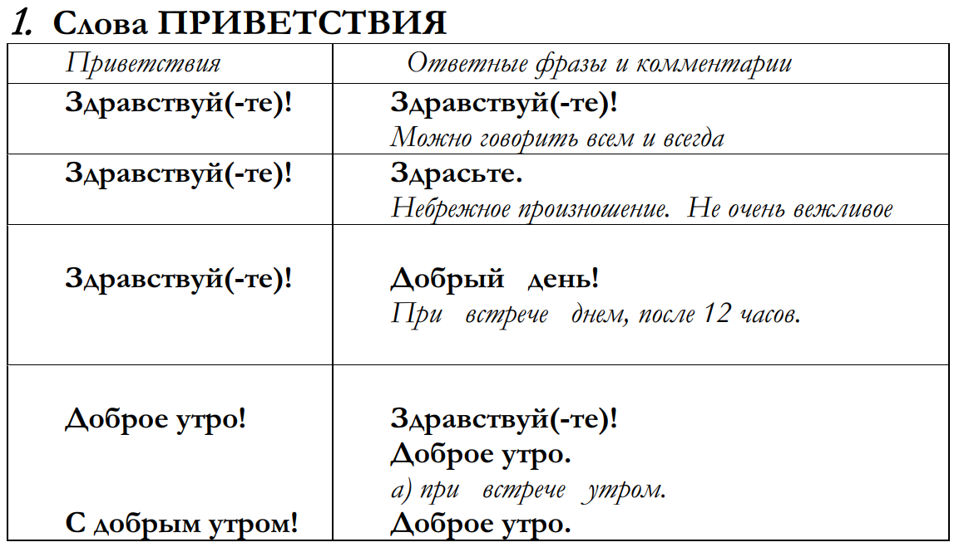
Greeting phrases

Slide 3
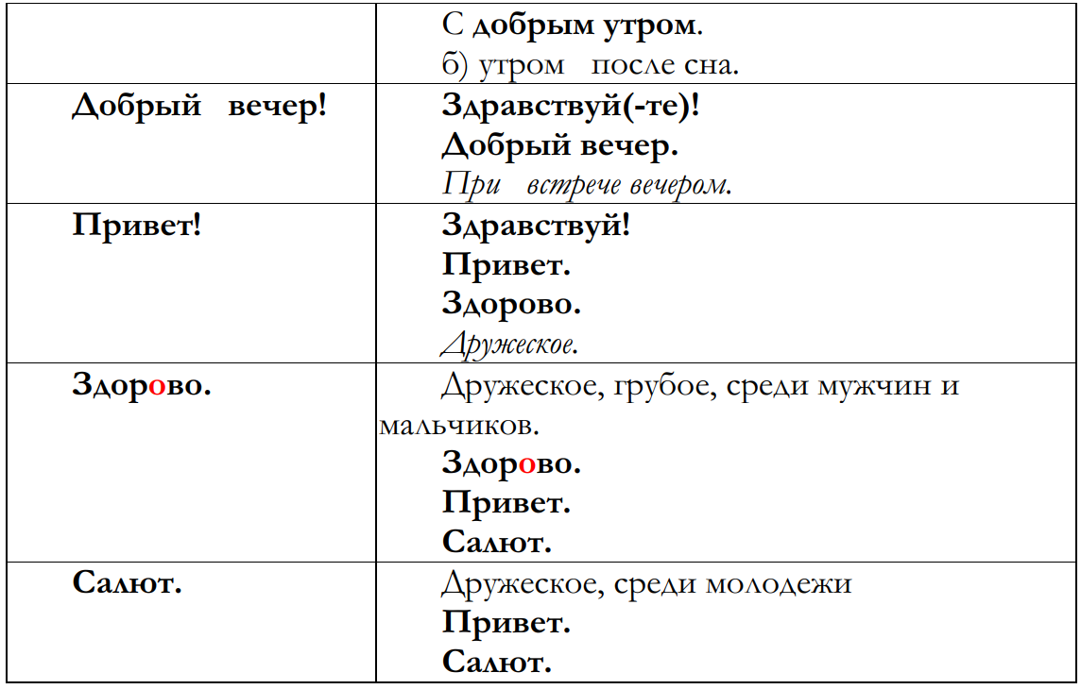

Slide 4
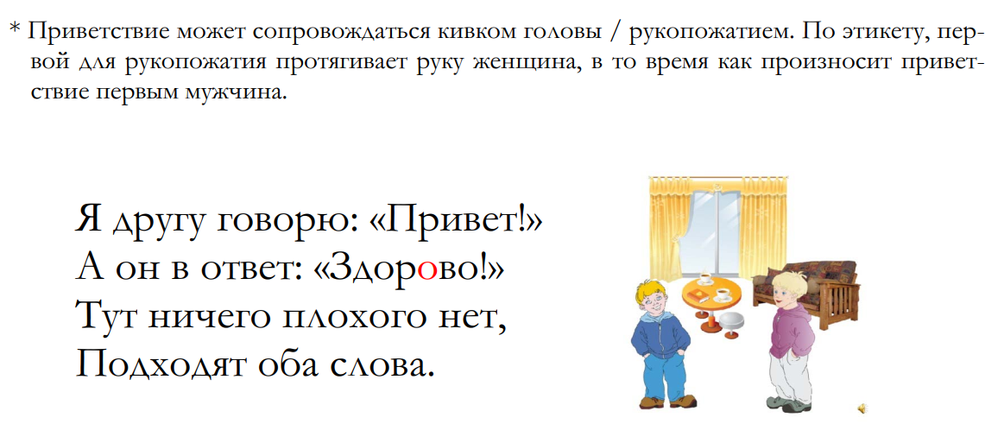
* The greeting may be accompanied by a nod/handshake.
According to etiquette, the woman extends her hand first for a handshake,
while the man says the greeting first.

Slide 5
Phrases after greetings

Slide 6
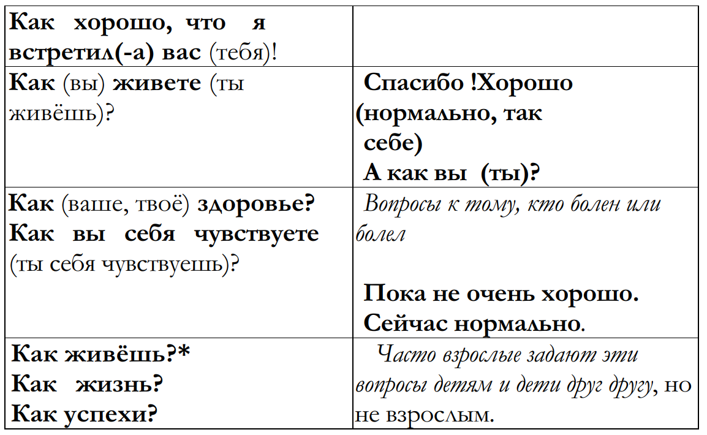

Slide 7
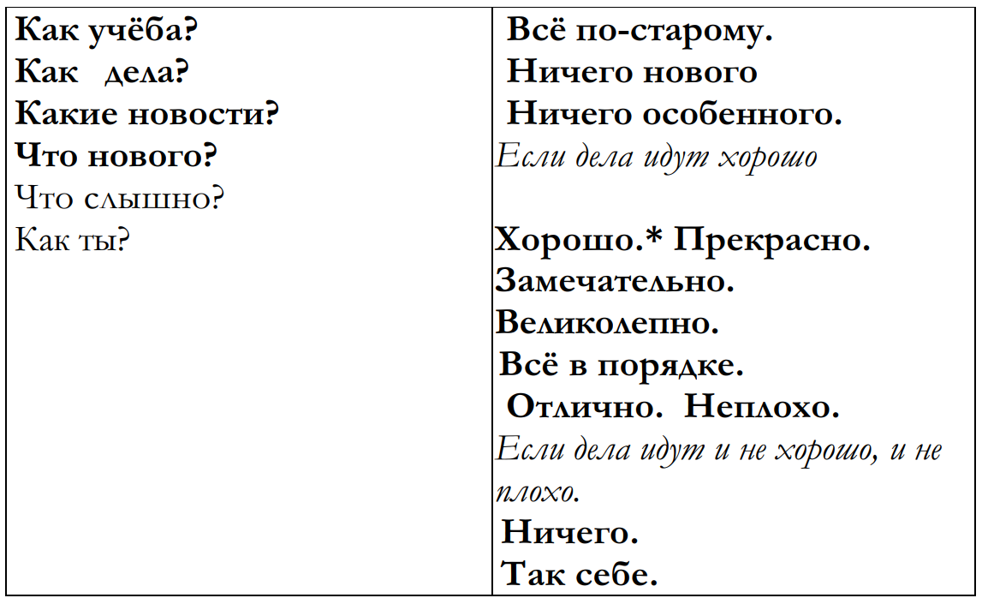

Slide 8
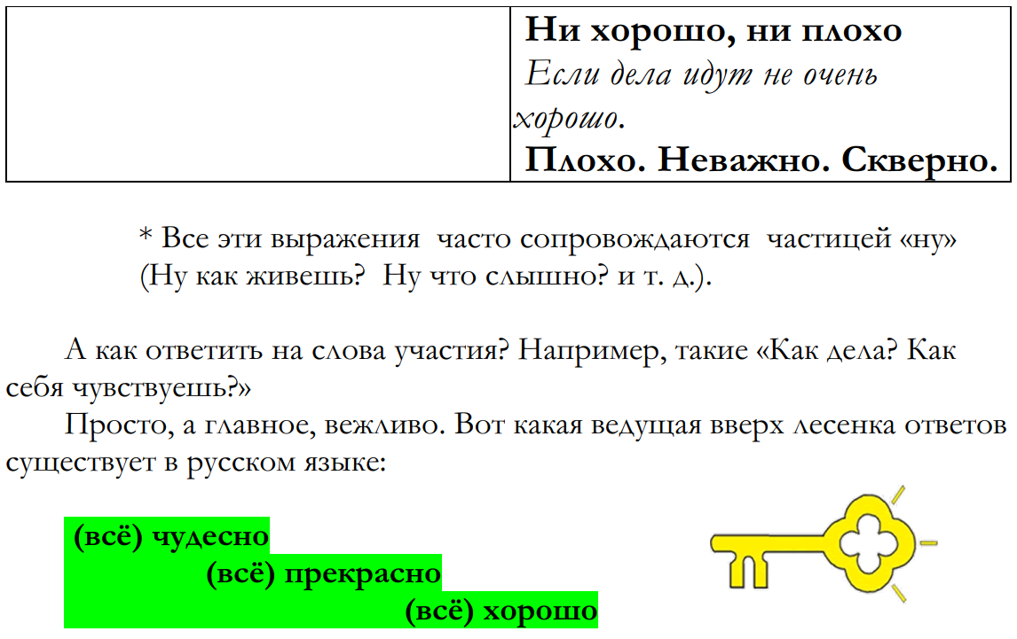
All these expressions are often accompanied by the particle "well"
(Well, how are you? Well, what do you hear? etc.).
And how do you respond to words of sympathy? For example, "How are you? How
do you feel?"
Simple, and most importantly, polite. Here is the upward ladder of answers
that exists in the Russian language:

Slide 9
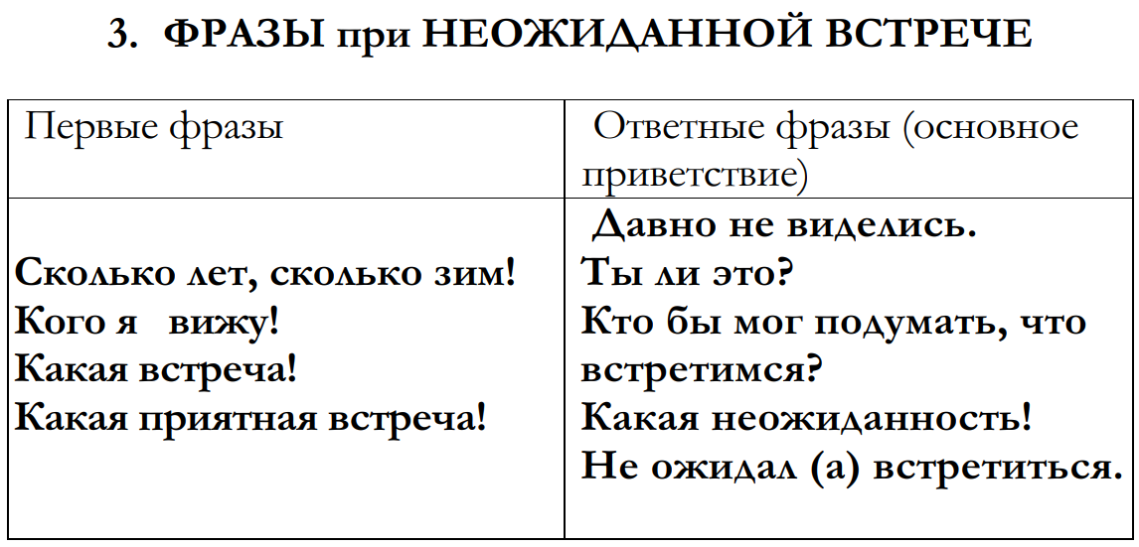
Phrases for an unexpected meeting

Slide 10
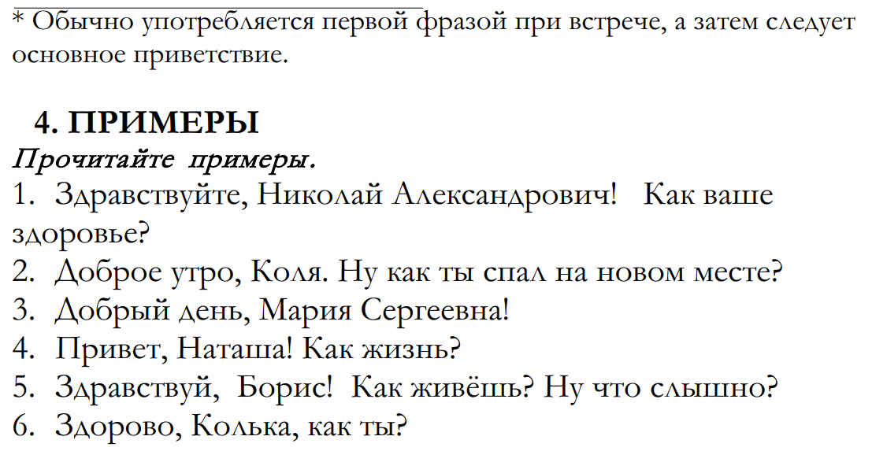
Hello, Nikolay Alexandrovich! How is your health?
Good morning, Kolya. How did you sleep in your new place?
Good afternoon, Maria Sergeevna!
Hi, Natasha! How are you?
Hello, Boris! How are you? What's the news?
Hi, Kolka, how are you?
*Usually used as the first phrase when meeting, followed by the main greeting

Slide 11
Greeting
Modern etiquette obliges to greet all acquaintances
and even strangers. The fact is that, by saying to each other "Hello", people express a friendly attitude towards others, show an intention to make contact, a desire to extend the acquaintance. Often people greet each other with gestures, facial expressions: a slight bow, a nod, a handshake.
A handshake is a desirable but not obligatory element of greeting, today a handshake is one of the most common gestures used when meeting, saying goodbye, getting to know each other.
If decide to extend a hand to greet, they do so with pleasure, and not sluggishly or with the air of a favor. At the same time, they do not go to the other extreme, putting all their strength into the handshake. The choice of one or another greeting depends on various reasons.
Firstly, on whether it is a man or a woman speaking. For example, "hello!" is acceptable for men, but in the mouths of women, it sounds too rude.
Secondly, on the person's age. Young people, teenagers and children use in their speech much more often: "Hello!" and "Salut"

Slide 12
Thirdly, depending on the degree of closeness of the communicators, they differ:
-neutral: “Hello!”,
-friendly: “Hello!”, (“Hi”)
-youthful: “Hi!”
Fourthly, from the time of day ("Good morning", "Good afternoon", "Good evening"). Many elderly people, especially men, greet each other with the words "Good health", "My respects".

Slide 13
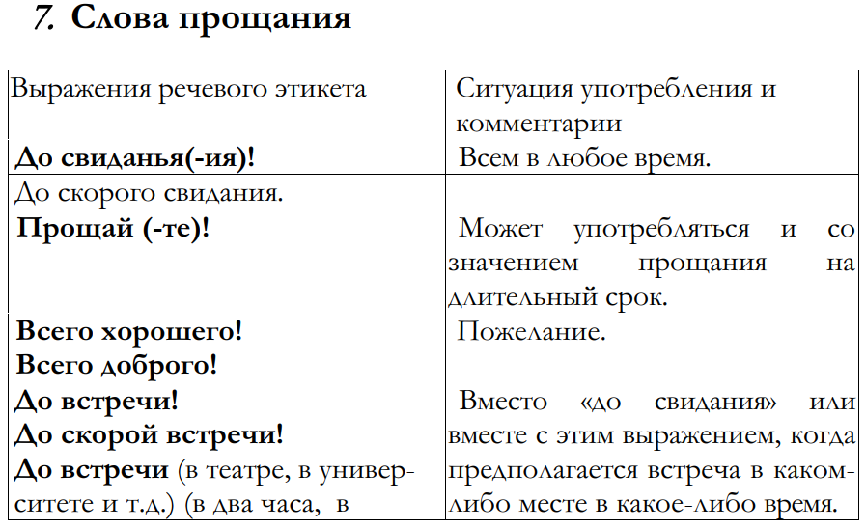
Words of farewell

Slide 14
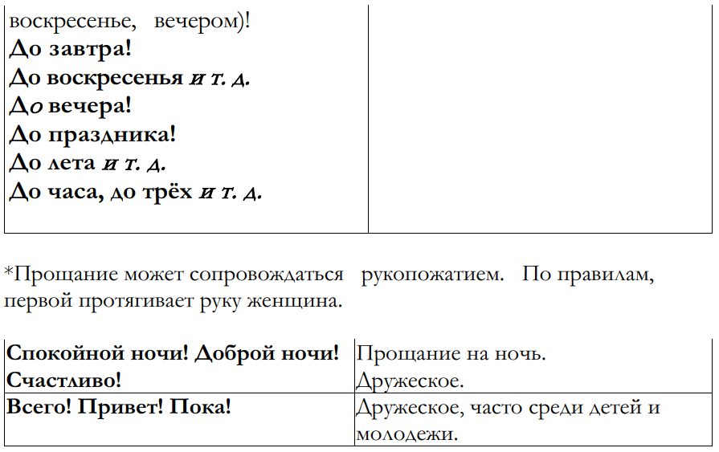
*Farewell may be accompanied by a handshake. According to the rules, the woman extends her hand first.

Slide 15
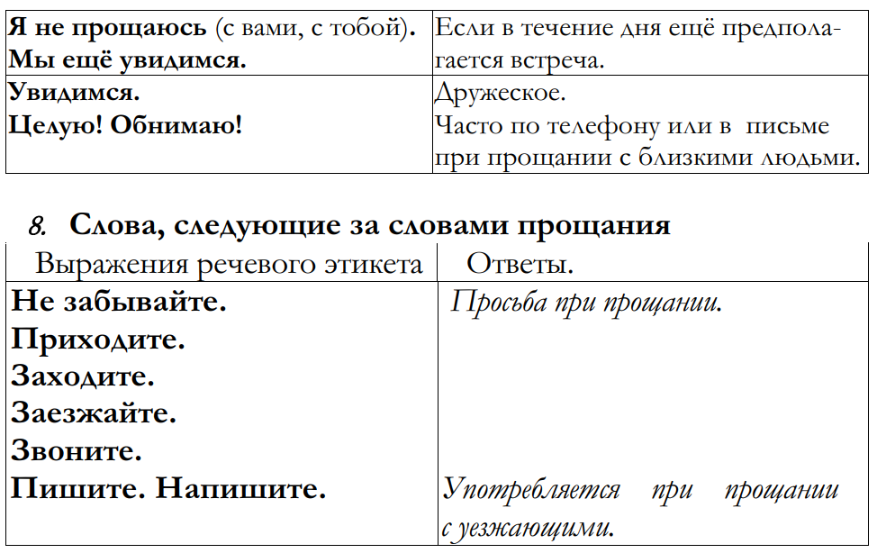
words following words of farewell

Slide 16
