Slide 1
«General pharmaceutical chemistry »
QUALITY CONTROL OF MEDICINES IN PHARMACIES. INTRACHEMIST'S CONTROL.
Associate Professor Gureeva E.S.

Slide 2
Quality control of medicines in pharmacies
Quality control of medicines in a pharmacy setting involves a range of activities, which include:
compliance with sanitary norms and rules, sanitary-hygienic and anti-epidemic regimes, asepsis rules for preparing medicines, pharmaceutical order in accordance with the current regulatory and methodological documents and orders;
ensuring the terms and conditions of storage of medicines in the pharmacy in accordance with the physical and chemical properties and requirements of the State Pharmacopoeia, current orders and instructions;
a thorough review of prescriptions received by the pharmacy and the requirements of medical institutions in order to verify the correctness of their prescribing, the compatibility of the drugs that make up the medicines; compliance of the prescribed doses with the age of the patient;
compliance with the technology for preparing medicines in accordance with the requirements of the State Pharmacopoeia, current orders and instructions.

Slide 3
Quality control of medicines in pharmacies in Russia
The Order of Ministry of Health of the Russian Federation dated October 26, 2015 № 751н
"On approval of the rules for the manufacture and dispensing of drugs for medical use by pharmacy organizations, individual entrepreneurs licensed for pharmaceutical activities"

Slide 4
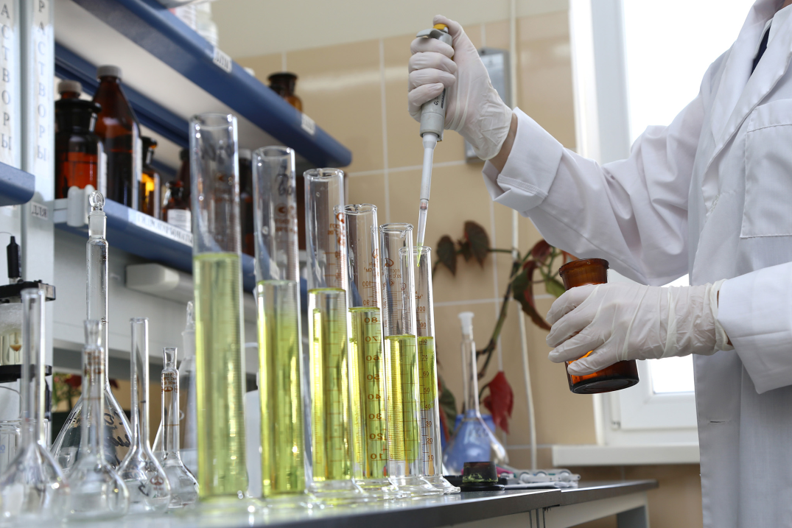
Quality control of medicines in pharmacies in Russia
Quality control of drugs manufactured in pharmacies should be carried out by a pharmacist-analyst accredited for this type of pharmaceutical activity.
The specialist must own all types of intra-pharmacy control. The implementation of certain types of intrachemist's control is carried out by a pharmacist-technologist.

Slide 5
Types of intrachemist's control
Medicinal products of industrial production received by the pharmacy
Medicinal products of in-pharmacy manufacture
The control over realisation
The organoleptic control
The written control
Obligatory controls
The acceptance control
The polling (oral) control
The physical control
The chemical control
Obligatory control for all medicines coming into the pharmacy
Selective controls

Slide 6
Intrachemist's control
The results of organoleptic, physical and chemical control of manufactured medicinal products, including in-pharmacy preparations and prepackages, concentrated solutions, trituration, ethyl alcohol are recorded in the journal of the results of organoleptic, physical and chemical control of medicinal products manufactured by prescription, requirements and in-pharmacy preparations, concentrated solutions, trituration, ethyl alcohol and prepackages of medicinal products.

Slide 7
Intrachemist's control
The following information shall be entered in this journal:
date of control and number in order;
number of the prescription, requirements, name of the medical organisation issuing them (if any);
series number of an industrially produced medicinal product;
composition of the medicinal product: substance or ion to be determined (to be specified in case of physical or chemical control of prescription dosage forms)
results of physical, organoleptic, qualitative control (each on a scale: positive or negative), chemical control (qualitative and quantitative determination);
full name of the person who has prepared, packaged the medicinal product;
signature of the person who has checked the medicinal product manufactured;
Conclusion on the results of the written control: satisfactory or unsatisfactory.

Slide 8
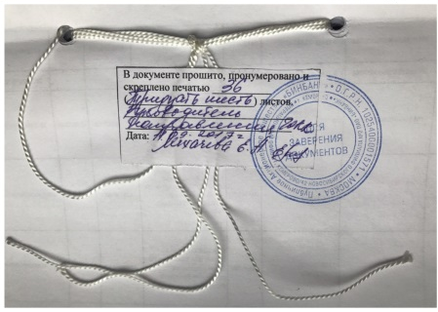
Intrachemist's control
The journal recording the results of organoleptic, physical and chemical control of medicinal products manufactured in accordance with prescriptionws, requirements and intra-pharmacy preparation, concentrated solutions, trituration, ethyl alcohol and packaging of medicinal products must be numbered, laced and signed by the head of the pharmacy (individual entrepreneur) and stamped (if applicable).

Slide 9
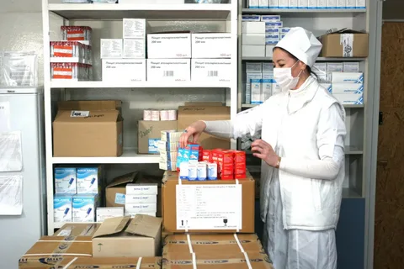
The acceptance control
The acceptance control is organised in order to prevent the receipt by a pharmacy or an individual entrepreneur of substandard medicinal substances used for manufacturing medicinal products, as well as substandard packaging materials.
All incoming medicines (irrespective of their source) are subject to acceptance control.

Slide 10
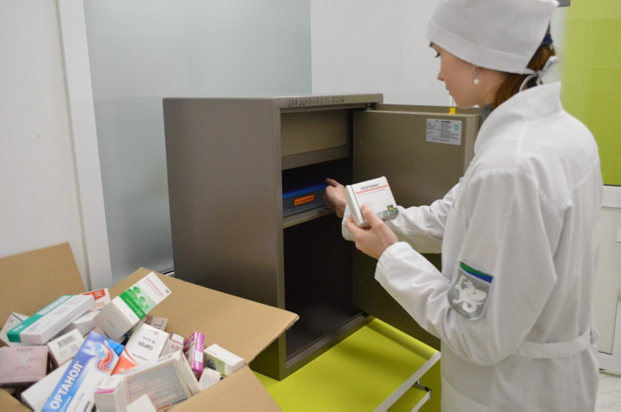
The acceptance control
Acceptance control consists of checking incoming medicinal substances and medicinal products for compliance with the requirements on the indicators:
"Description",
"Packaging",
"Labelling",
as well as checking the correctness of accompanying documents, including documents confirming the quality of medicinal products (medicinal substances).

Slide 11
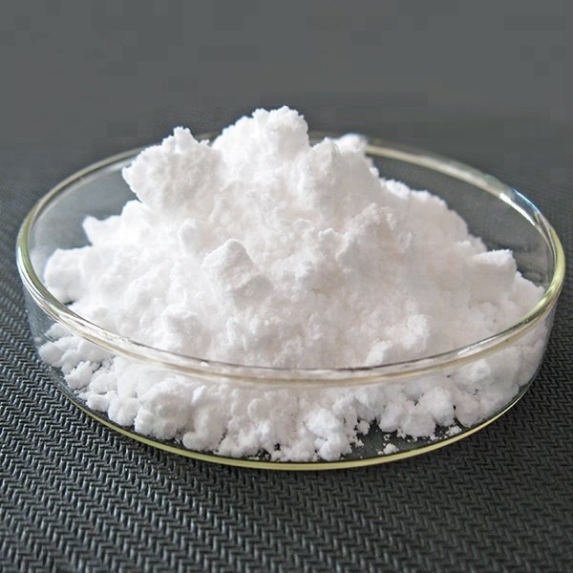
The acceptance control
The "Description" control includes an inspection of
external appearance,
aggregate state,
colour,
smell of the medicinal product.
If there are doubts about the quality of medicinal substances, samples are sent to an accredited testing laboratory (centre) for additional testing.
Such medicinal substances marked "Denied for acceptance control" are stored in the quarantine area of the storage facility isolated from other medicinal products.
For example: salicylic acid, an odourless white crystalline powder

Slide 12
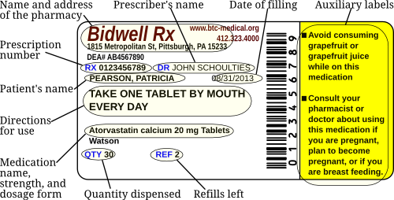
The acceptance control
When checking the indicator "Packaging" special attention is paid to its integrity and compliance with the physical and chemical properties of medicinal products.
When controlling for "Labelling" indicator, compliance of the labelling of primary and secondary packaging of the medicinal product (substance) with the requirements of the quality control document, availability of the leaflet-insert in the national language in the package (or separately in the package for all quantities of finished medicinal products) is checked.

Slide 13
Written control
When a medicinal product is manufactured as well as intra-pharmacy preparations, a written control passport must be completed, stating
date of manufacture of the medicinal product;
prescription number or requirement number;
name of a medical organisation, name of a department (if any); series number, quantity in a series - for medicinal products in the form of inter-pharmaceutical preparations;
names of the medicinal substances taken and their quantities, the degree of homeopathic dilutions or homeopathic substances taken, the number of doses, signatures of persons who have prepared, packed and checked the medicinal product.

Slide 14
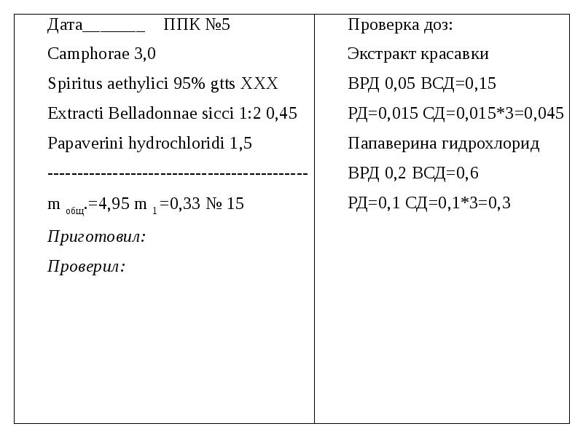
Written control
The written control passport must be completed immediately after the manufacture of the medicinal product, indicating the medicinal products in Latin, in accordance with the sequence of technological operations.
Written control passports are stored for two months from the date of manufacture of medicinal products.
All calculations for manufacturing a medicinal product are made prior to the manufacture of the medicinal product and are recorded on the written control passport.
If the medicinal product contains narcotic drugs, psychotropic, poisonous and potent substances and other medicinal substances subject to quantity control, their quantity is indicated on the reverse side of the prescription.

Slide 15
Written control
The manufactured medicinal products, prescription and requirement for which the medicinal products have been manufactured, the completed written control passport shall be submitted for inspection to the pharmacist performing control functions for the manufacture and dispensing of medicinal products.
Control consists in verifying that the records in the written control passport correspond to the prescription or requirement and that the calculations made are correct.
If the pharmacist-analyst has performed a full chemical control of the quality of the manufactured medicinal product, the number of the chemical analysis and the signature of the pharmacist-analyst shall be affixed on the certificate of written control.

Slide 16
Polling control
Polling is carried out randomly and is carried out after a pharmacist has prepared no more than five dosage forms.
During the Polling control, the supervising pharmacist names the first ingredient of the medicinal product and, in the case of compounded medicinal products, also the quantity of the medicinal substance. The pharmacist who prepared the medicinal product then lists all other medicinal substances used and their quantities. If concentrated solutions are used, the pharmacist also lists their composition and concentration.

Slide 17
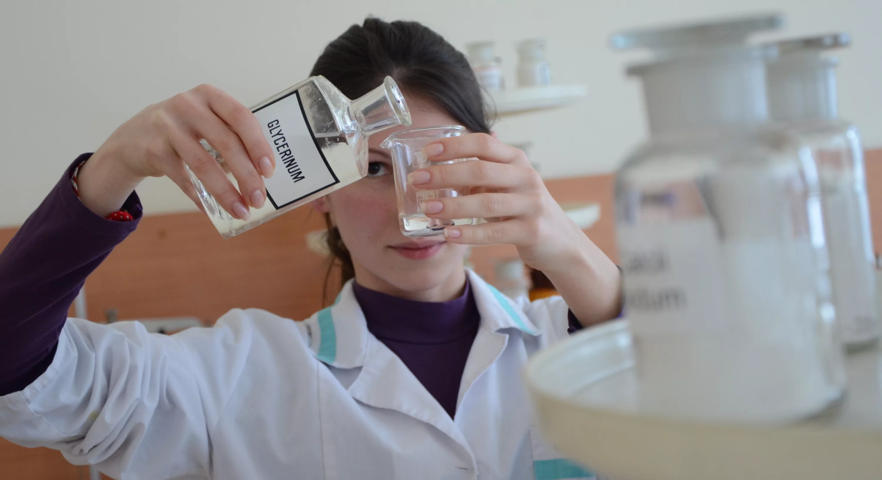
Organoleptic control
Organoleptic control is a mandatory type of control and consists in checking the medicinal product according to
appearance,
smell,
homogeneity of mixing,
the absence of mechanical inclusions in liquid dosage forms.

Slide 18
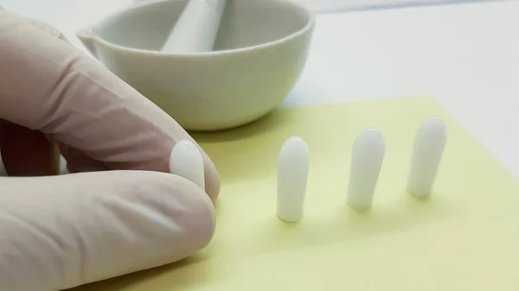
Organoleptic control
The taste is checked selectively in dosage forms intended for children.
The homogeneity of powders, homeopathic triturations, oils, syrups, ointments, suppositories is checked selectively by each pharmacist during the working day, taking into account all types of manufactured dosage forms.

Slide 19
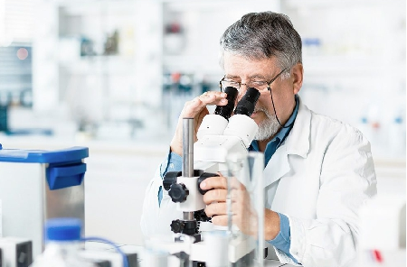
Physical control
Physical control consists in checking the total mass or volume of the medicinal product, the number and mass of individual doses (at least three doses) included in the medicinal product, the number of granules in one gram of homeopathic granules, the disintegration of homeopathic granules.
As part of the physical control, the quality of the closure of the manufactured medicinal product is also checked.

Slide 20
Physical control
Medicinal products manufactured in accordance with prescriptions, requirements shall be subject to physical control selectively during the working day, taking into account all types of manufactured dosage forms, but not less than 3% of their quantity for the day.
Medicinal products manufactured in the form of intra-pharmacy are subject to physical control in an amount of at least three packages of each series (including prepackaging of industrial products and homeopathic medicinal products).
Physical control is obligatory for medicines intended for use in children under 1 year of age, containing narcotic drugs, psychotropic and potent substances, medicines requiring sterilisation, suppositories.

Slide 21
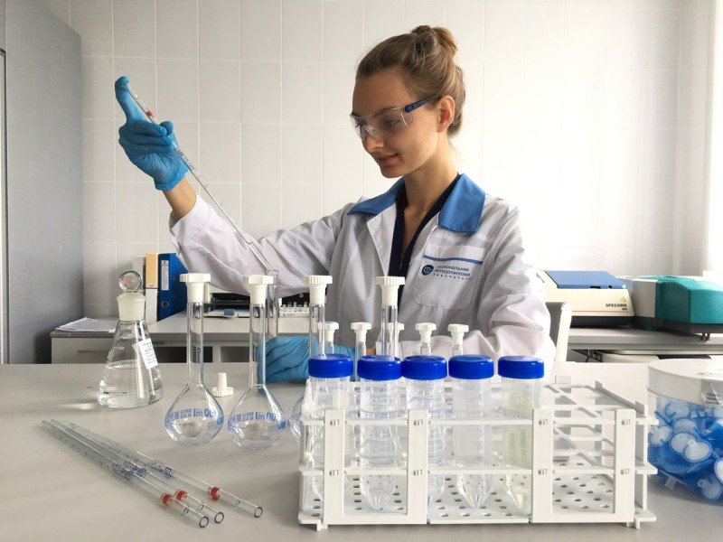
Chemical control
Chemical control consists in assessing the quality of manufacture of medicinal products according to indicators:
qualitative analysis: identification of medicinal products;
quantitative analysis: quantification of drugs.
For chemical control, a special workplace shall be equipped with the necessary equipment, instruments and reagents, quality control documents and reference literature.

Slide 22
Chemical control
Qualitative analysis is obligatory:
Purified water and water for injection daily from each bottle, for the absence of chlorides, sulphates and calcium salts. Water intended for manufacturing sterile solutions must also be tested for the absence of reducing agents, ammonium salts and carbon dioxide;
all medicines and concentrated solutions from storage rooms to the drug manufacturing facilities;
medicinal products arriving at a pharmacy in case of doubt as to their quality;
concentrated solutions, liquid pharmaceuticals in burettes in the drug manufacturing premises when they are filled;
prepackaged drugs of industrial production;
Homeopathic medicinal products as intra-pharmacy. The quality of the medicinal product is assessed by the excipients.

Slide 23
Chemical control
During chemical control of purified water and water for injection, the purified water and water for injection must be recorded in journal of registration of results of control of purified water and water for injection:
date of receipt (distillation) of water;
date of water control
number of chemical analysis performed;
number of bottle or burette from which water was taken for analysis
the results of the control for the absence of impurities;
pH of the water;
conclusion of the water analysis (satisfactory / unsatisfactory);
signature of the person who carried out the analysis.
The journal of registration of results of control of purified water and water for injection must be numbered, laced and stamped with the signature of the head of the organisation and the seal of the superior organisation.

Slide 24
Chemical control
Qualitative analysis should be carried out selectively on medicinal products of various dosage forms manufactured by a pharmacist during the working day, but not less than 10% of the total number of medicinal products manufactured by each pharmacist, except for homeopathic ones.
When carrying out chemical control of the identity of medicinal products in burettes and jars, the following information shall be obligatorily recorded in the journal of the results of control of medicinal products for authenticity:
date of filling the burette, jars;
serial number of chemical analysis;
name of the medicinal product;
drug series number or analysis number of the drug manufacturer;
number of the jar to be filled in;
substance (ion) to be determined;
results of the control on a scale of "plus" or "minus";
signatures of persons who have completed and verified the completion.
The journal of the results of control of medicinal products for authenticity must be numbered, laced and signed by the head of the pharmacy (individual entrepreneur) and stamped (if there is a seal).

Slide 25
Chemical control
Qualitative and quantitative analysis (full chemical control) is obligatory:
all solutions for injections and infusions.
sterile solutions for external use (ophthalmic solutions for irrigations, solutions for treating burns and open wounds, for intravaginal injection and other sterile solutions);
eye drops and unguents containing narcotic drugs, psychotropic, potent substances.
all dosage forms intended for the treatment of infants and children up to 1 year of age;
solutions of atropine sulphate and hydrochloric acid (for internal use), silver nitrate solutions;

Slide 26
Chemical control
Qualitative and quantitative analysis (full chemical control) is obligatory:
all concentrated solutions, trituration;
intra-pharmaceutical preparations of each series;
stabilisers used in the manufacture of solutions for injections and infusions, buffer solutions used in the manufacture of eye drops;
concentration of ethyl alcohol in dilution, as well as in case of doubts as to the quality of ethyl alcohol upon its receipt by a pharmacy, to an individual entrepreneur;
injectable homeopathic solutions;
dosage forms prepared in accordance with prescriptions and requirements, in the number of at least three dosage forms when working in one shift, taking into account the different types of dosage forms.

Slide 27
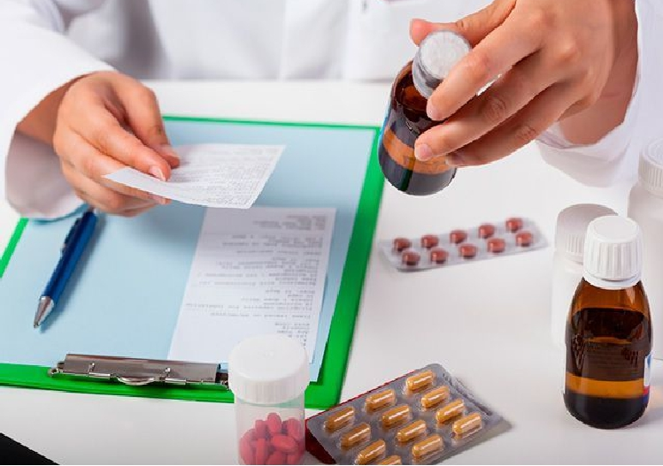
Control over realization
All manufactured medicinal products are subject to Control over realization, within the framework of which compliance is checked:
the packaging of the medicinal product to the physico-chemical properties of the medicinal products included therein;
the doses of narcotic drugs, psychotropic substances or potent substances specified in the prescription or requirement - in relation to the patient's age
details of the prescription, the requirement to the information specified on the packaging of the manufactured medication
labelling of a medicinal product in accordance with the requirements set out in regulatory documentation.
If one of the above mentioned discrepancies is detected, the manufactured medicinal product shall not be dispensed.

Slide 28
Thank you for attention!

