Slide 1
«General pharmaceutical chemistry »
Methods for the determination of heavy metal and arsenic impurities in medicinal products
Associate Professor Gureeva E.S.

Slide 2
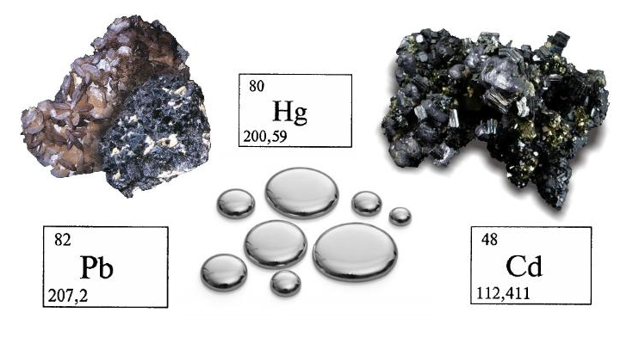
The definition of heavy metals
The concept of a “heavy metal” is not clearly scientifically defined.
The State Pharmacopoeia of the Russian Federation lists the following heavy metals:
lead, Pb
mercury, Hg
bismuth, Bi
antimony, Sb
tin, Sn
cadmium, Cd
silver, Ag
copper, Cu
molybdenum, Mo
vanadium, V
ruthenium, Ru
platinum, Pt
palladium, Pd

Slide 3
The origin of heavy metals in nature
Heavy metals are largely found in nature as minerals and ores.
They get into the environment as a result of being extracted, from erosion or from volcanic activity.
Heavy metals are used in a number of technical applications and processes and can get into the environment or into products unintentionally.

Slide 4
Heavy metals in medical plants
Intake of heavy metals occurs in the growth process of plants by absorption from water, from the ground and by aerosols from the ambient air.
Contamination can also occur from the spillage of pesticides or sewage sludge containing heavy metal.

Slide 5
Heavy metals in finished products and raw materials
In the manufacturing of pharmaceutical products, catalysts containing heavy metals are often involved in the synthesis.
Heavy metals can also transfer into the process by abrasion or by leaching (e.g. Fe, Ti, Cu, Cr and so on.) If they are not removed efficiently, then the tainted products could get into the market.

Slide 6
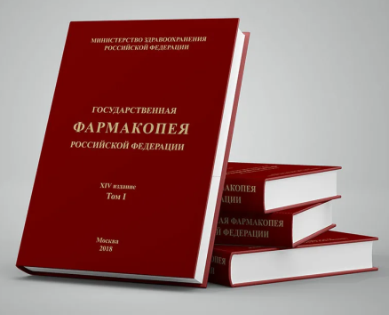
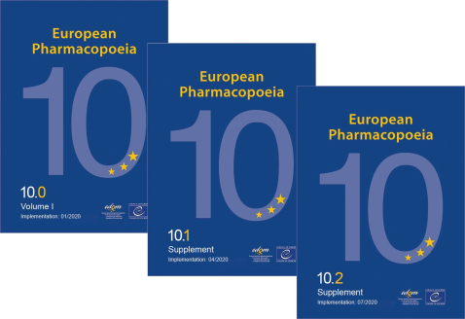
Legal regulations
For many years, it has been known that certain heavy metals exhibit toxic effects even at low concentrations. As a result, limit values for the protection of the patients have been defined in the legislation and in the various pharmacopoeias (e.g. SPRF., Ph. Eur., USP, JP, BP).

Slide 7
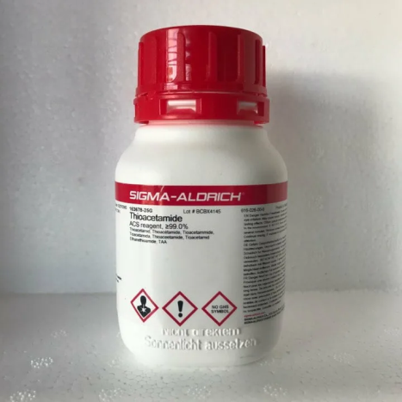
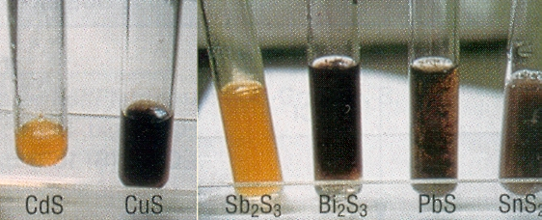
Detection methods
Method 1
Method 2

Slide 8
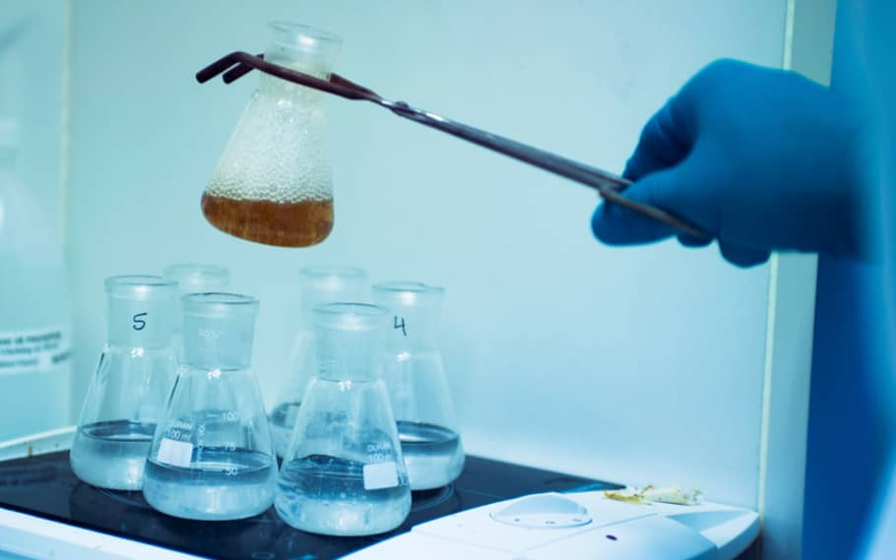
Detection methods
Test is considered accurate if the reference solution has a slight brownish colour compared to blank solution.

Slide 9
Detection methods
These limit tests still form the majority of testing for heavy metals in the current national and international Pharmacopoeias. Thereby, it is possible however to make only a semi-quantitative statement about the total contents of heavy metals in the sample.
Determination of heavy metal content in pharmaceutical products is possible for substances that form a clear, colourless solution and do not affect the interaction between metal ions with sulphide-ions due to complex-forming properties.
In all other cases, determination is performed using sulphate ash or other mineralization technique of the test pharmaceutical product.

Slide 10
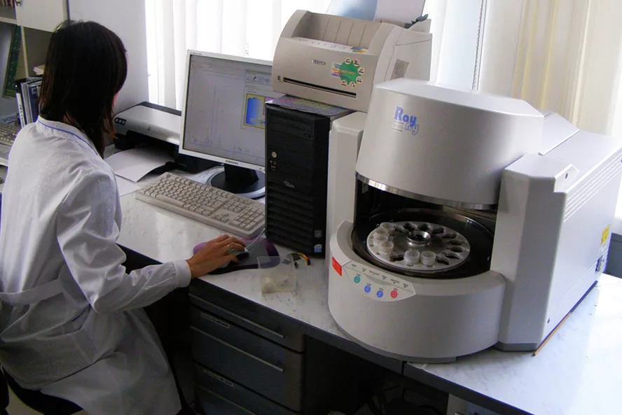
Detection methods
Maximum permissible content of heavy metals, testing method and conditions for preparation of the test sample must be indicated in the general monograph.
The following methods can be used for quantitative determination:
atomic absorption spectrometry;
atomic emission spectrometry with inductively coupled plasma;
inductively coupled plasma mass spectrometry.

Slide 11
Determination of heavy metals in pharmaceutical solutions
Test solution. 10 ml of a test solution prepared according to the general monograph.
Reference (Standart) solution. Add 8 ml of water to 2 ml of lead ion reference solution (5 μg/ml).
Blank solution. 10 ml of water.
Method 1. To the obtained solutions add 2 ml of acetate buffer solution pH 3.5, stir, add 1 ml of thioacetamide reagent, stir and compare colouring of solutions after 2 minutes.
Method 2. To the obtained solutions add 1 ml of diluted 30% acetic acid, 2 drops of 2% sodium sulphide solution, stir and compare colouring of solutions after 1 minute.
Slight opalescence of test solutions from precipitated sulphur is acceptable.

Slide 12
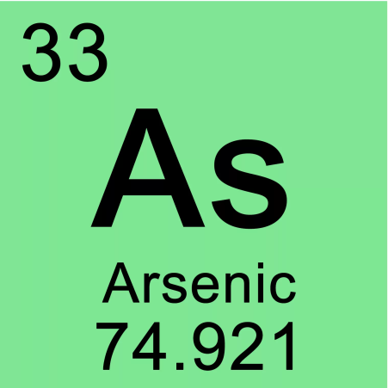
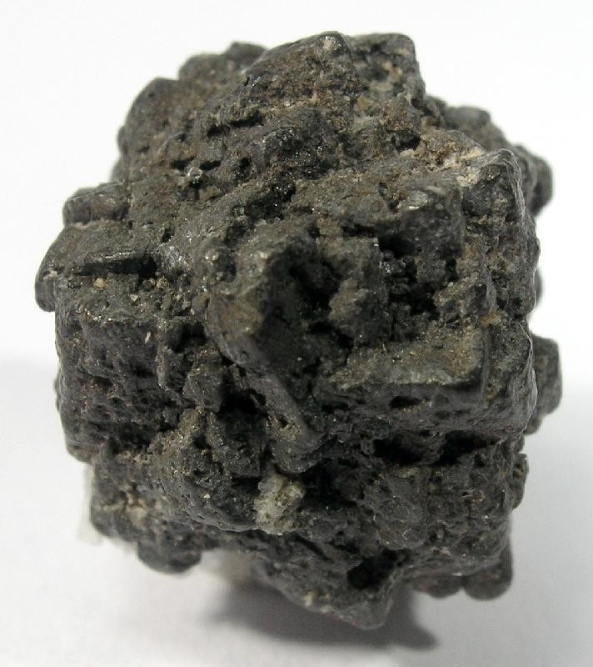
Arsenic
Arsenic (Latin Arsenicum, chemical symbol — As) — chemical element of the 15th group of the fourth period of the periodic system; has the atomic number 33.
The simple substance is a brittle steel-colored semi-metal with a greenish tinge (in a gray allotropic modification).
Poison and carcinogen. The lethal dose of arsenic for humans is 50-170 mg.

Slide 13
Arsenic
Arsenic can get into medicines
from the material of equipment used in the manufacture of drugs,
together with raw materials, solvents, most often with sulfuric acid, used in most pharmaceutical industries.

Slide 14
Methods for detecting arsenic impurities
Bugo and Thiele
Gutzeit
Bettendorf
Marsh

Slide 15
Gutzeit method
1. Reduction of arsenic compounds to arsin AsH₃.
2. The interaction of arsin with a solution of silver nitrate, which is soaked with filter paper.
3. Under the influence of moisture, the complex is destroyed with the release of metallic silver, which forms a dark spot on the filter paper.

Slide 16
Disadvantages of the Gutzeit method
Arsenic can be determined by the Gutzeit reaction if it is known that there are no antimony or phosphorus impurities in the samples under study. Since under these conditions of reduction of arsenic compounds by zinc, SbH3 and PH3 can be formed from these impurities, which will mask the main reaction to arsenic.
It is impossible to open an impurity of arsenic in the presence of mercury or silver salts, since they are also restored and mask the discovery of arsenic.
Oxidizing agents, compounds forming chlorine, bromine, iodine, hydrogen sulfide, and sulfur dioxide in an acidic environment, which have high volatility and can react with AgNO3 solution, interfere with the reaction.

Slide 17
Modified version of the Gutzeit reaction
1. Reduction of arsenic compounds to arsin AsH₃.
2. Filter paper soaked with an alcoholic solution of sulema (mercury dichloride) HgCl₂ as an AsH₃ fixative
3. Decomposes to form arsenic and mercury chloride (I):

Slide 18
Capturing the hydrogen sulphide released
A cotton swab soaked with lead acetate is placed in the test tube where the reaction takes place. It captures hydrogen sulfide H2S, which is formed if there are sulfur compounds in the test sample.

Slide 19
The device for the determination of arsenic by Gutzeit method
5
flask;
glass tube;
cotton swab soaked in lead acetate;
glass tube;
a strip of paper soaked in a solution of mercury dichloride.
4
2
3
1

Slide 20
The Bugo and Thiele method
Under the action of sodium hypophosphite in an acidic medium, when heated, arsenic compounds are reduced by phosphoric acid to elemental arsenic. Depending on the concentration of arsenic, a brown precipitate or dark brown staining of the liquid is observed.

Slide 21
Options for testing
Method A (without using a standard solution) - by browning the solution or the formation of a brown precipitate;
Method B - by comparing the intensity of the resulting color with the color of the reference solution.

Slide 22
The disadvantage of the method
The Bugo and Thiele method, although less sensitive than the Gutzeit method.
The advantage of the method
It can be used for testing for arsenic in the presence of antimony compounds, phosphorus, lead, sulfides that are not reduced by phosphoric acid.

Slide 23
Thank you for attention!

