Slide 1
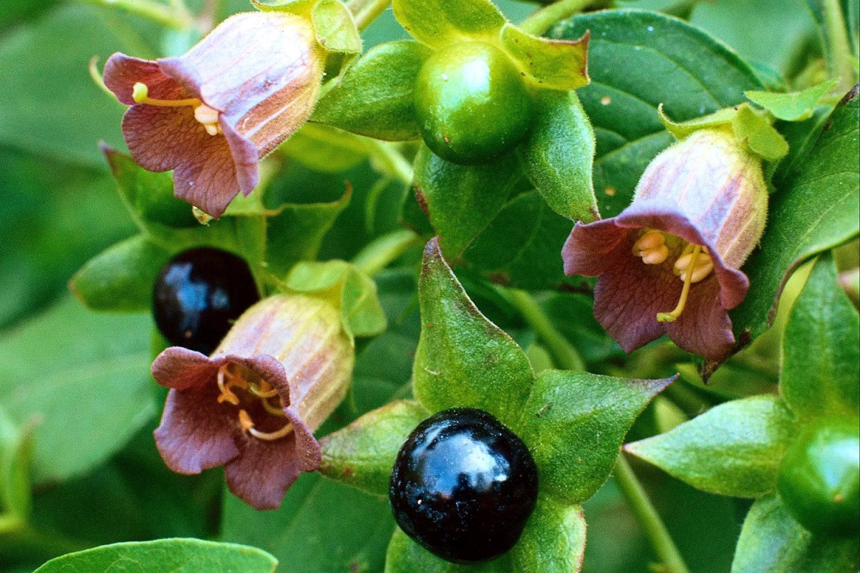
«Special pharmaceutical chemistry»
Tropane alkaloids
Associate Professor Gureeva E.S.

Slide 2
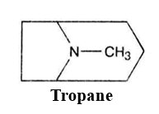
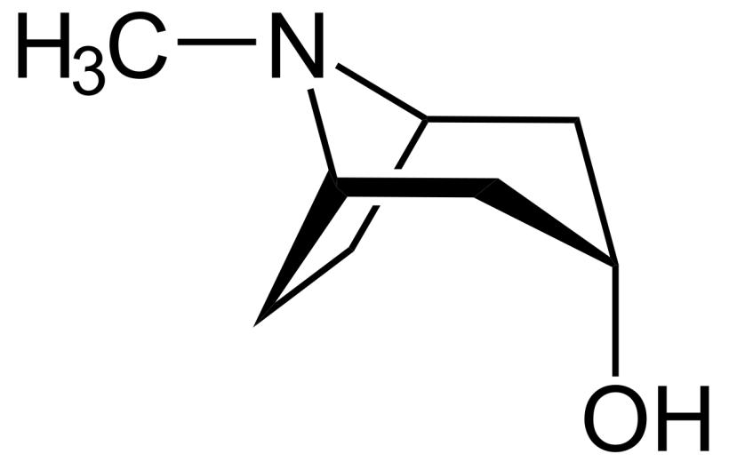
General characteristic
II
II
I
I
Tropane is a bicyclic system consisting of two heterocyclic rings: a five-membered pyrrolidine ring (I) and a six-membered piperidine ring (II).

Slide 3
General characteristic
Amino alcohols
Acids

Slide 4
General characteristic
Tropane-based drugs
Atropine group
atropine sulphate, homatropine hydrobromide, scopolamine hydrobromide, tropacin, tropafen, troventol
Cocaine group
Cocaine hydrochloride

Slide 5
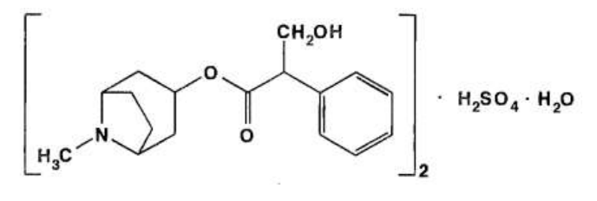
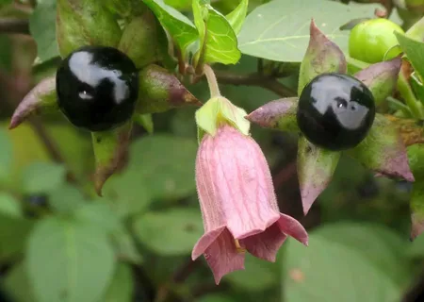
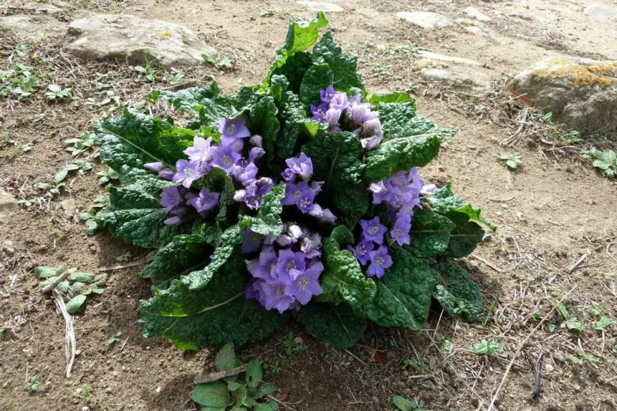
Atropine sulphate
Atropa belladonna
Datura stramonium
Mandragora officinarum

Slide 6
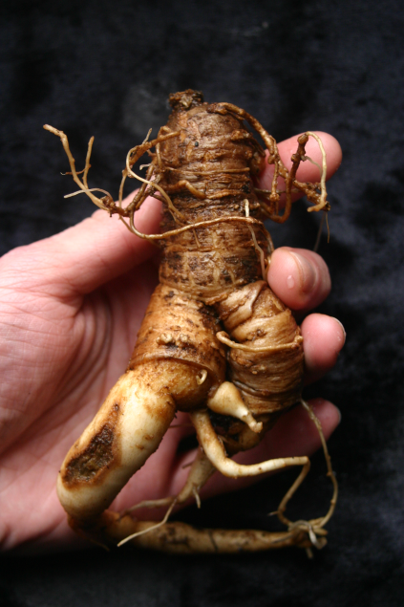
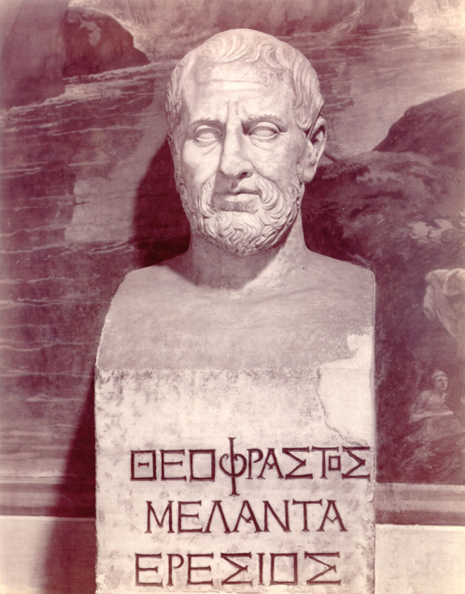
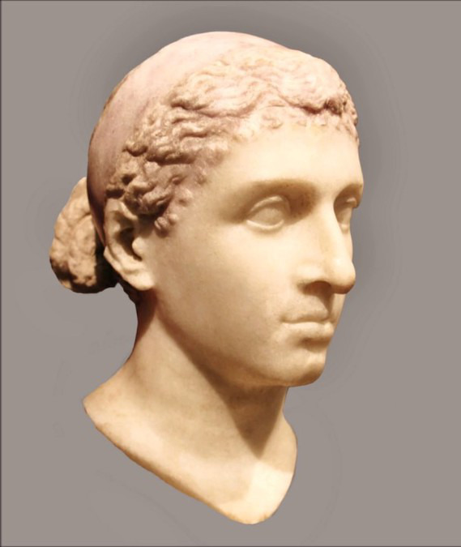
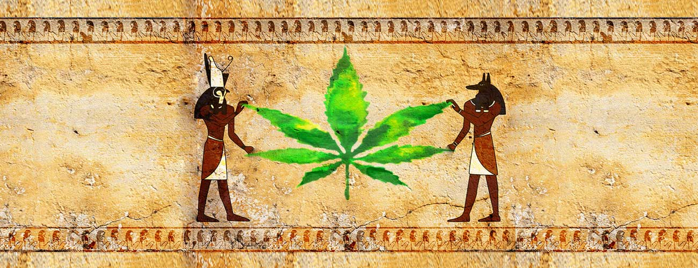
Atropine sulphate
History

Slide 7
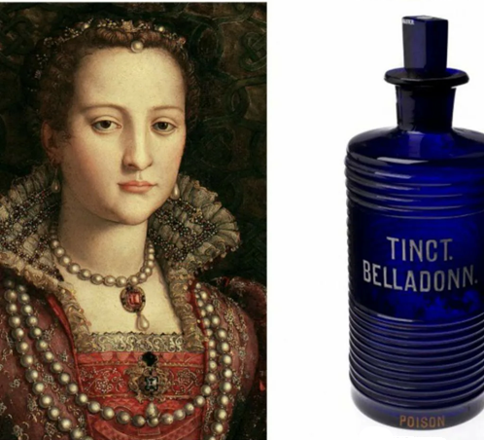
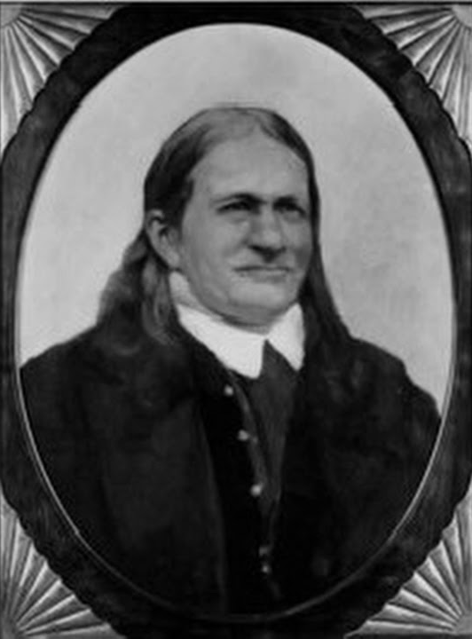
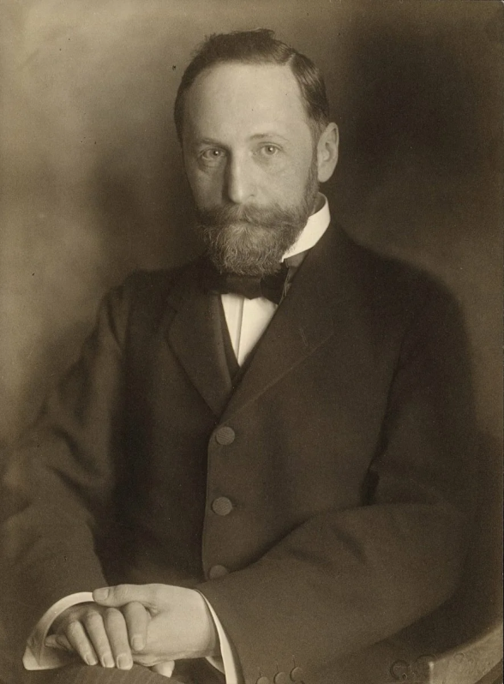
Atropine sulphate
History
Friedrich Ferdinand Runge
(1795–1867)
Richard Willstätter

Slide 8
Atropine sulphate
Method of obtaining

Slide 9
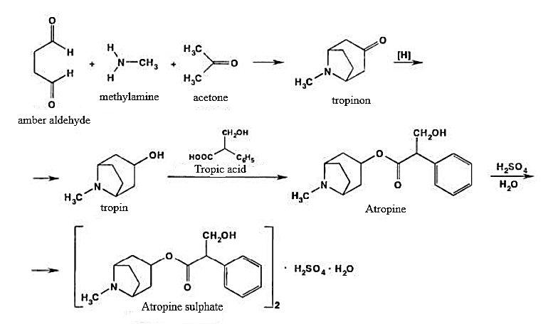
Atropine sulphate
Method of obtaining

Slide 10
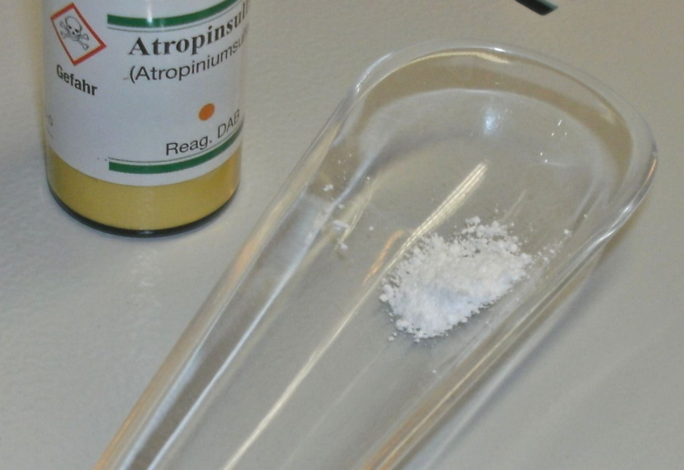
Atropine sulphate
Physical properties
White crystalline or slightly clumping powder without odour, melting point of atropine sulphate 188-194°C, Angle of rotation not more than -0.6° (5% aqueous solution in a 2 dm tube).
Very easily soluble in water, easily soluble in ethanol, practically insoluble in chloroform.

Slide 11
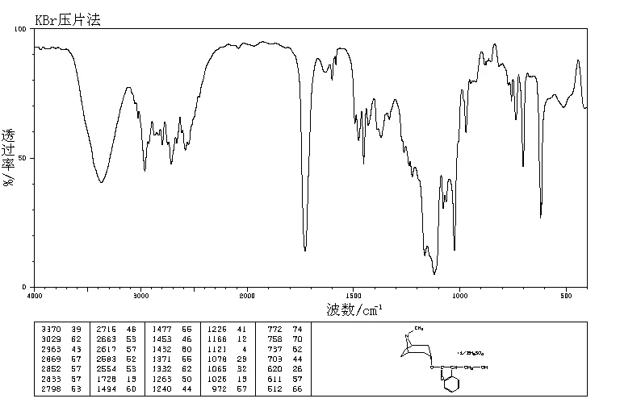
Atropine sulphate
Identification
IR and UV spectrophotometry
The infrared spectrum of the atropine sulphate sample under test must match the spectrum of the standard sample.
IR spectra

Slide 12
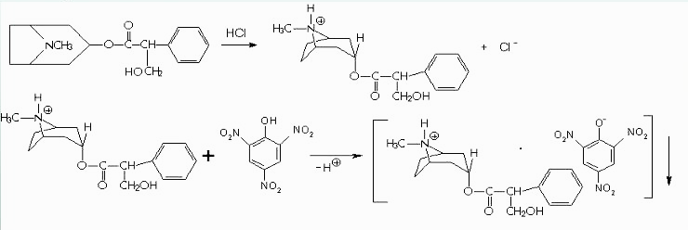
Atropine sulphate
Identification
Interaction with common alkaloid reagents
yellow crystalline precipitate

Slide 13
Atropine sulphate
Identification
Vitali-Morin reaction
violet-coloured compound of quinoid structure

Slide 14
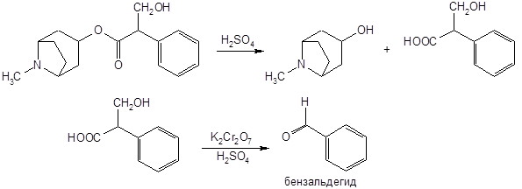
Atropine sulphate
Identification
Benzaldehyde formation reaction
smell of bitter almond

Slide 15
Atropine sulphate
Identification
5. Sulphate determination
6. Atropine base isolation
Crystals of atropine base dried to a constant mass melt at 190°C with decomposition.

Slide 16
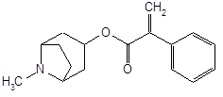
Atropine sulphate
Purity test
The absence of other alkaloids and degradation products in the pharmaceutical substance of atropine sulphate is determined by TLC.
Apoatropine is an unacceptable impurity in a tropane alkaloid pharmaceutical substance.
The presence of apoatropine can be detected as follows: add ammonia solution to an aqueous solution of atropine sulphate and shake vigorously: a slight opalescence is acceptable and rapid clouding or precipitation is not acceptable.
The presence of apoatropine in the anhydrous atropine sulphate is determined spectrophotometrically.

Slide 17
Atropine sulphate
Quantification
1. Non-aqueous titration
Dissolve atropine sulphate in anhydrous acetic acid.
Titrate with 0.1 mol/l HClO4 solution and determine the end of titration potentiometrically.

Slide 18
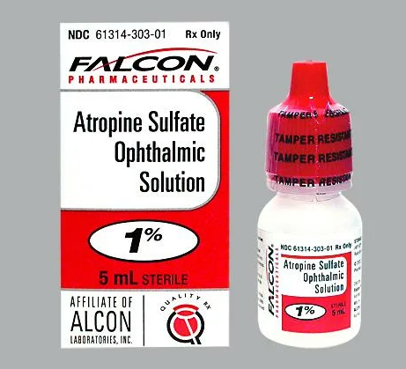
Atropine sulphate
Quantification
2. Acid-base titration in aqueous-alcoholic medium
Titrate with alkali solution.
3. Photocolorimetry
4. Photonephelometry
Storage
Store in tightly closed containers away from light and moisture.

Slide 19
Atropine sulphate
Medical use
Ophthalmic use
Topical atropine is used as a cyclo plegic, to temporarily paralyze the accommodation reflex, and as a mydriatic, to dilate the pupils.
Resuscitation
Injections of atropine are used in the treatment of bradycardia (an extremely low heart rate), asystole and pulseless electrical activity (PEA) in cardiac arrest.
Secretions and broncho constriction
Atropine's actions on the parasympathetic nervous system inhibits salivary, sweat, and mucus glands. This can be useful in treating hyperhidrosis. Atropine is used in gastric and duodenal ulcers, pylorospasm, cholecystitis, cholelithiasis, cholelithiasis, spasms of the intestinal and urinary tract, bronchial asthma, to reduce the secretion of salivary, gastric and bronchial glands.
Treatment for organophosphate poisoning
Atropine is not an actual antidote for organophosphate poisoning. However, by blocking the action of acetylcholine at muscarinic receptors, atropine also serves as a treatment for poisoning by organophosphate insecticides and nerve gases.

Slide 20
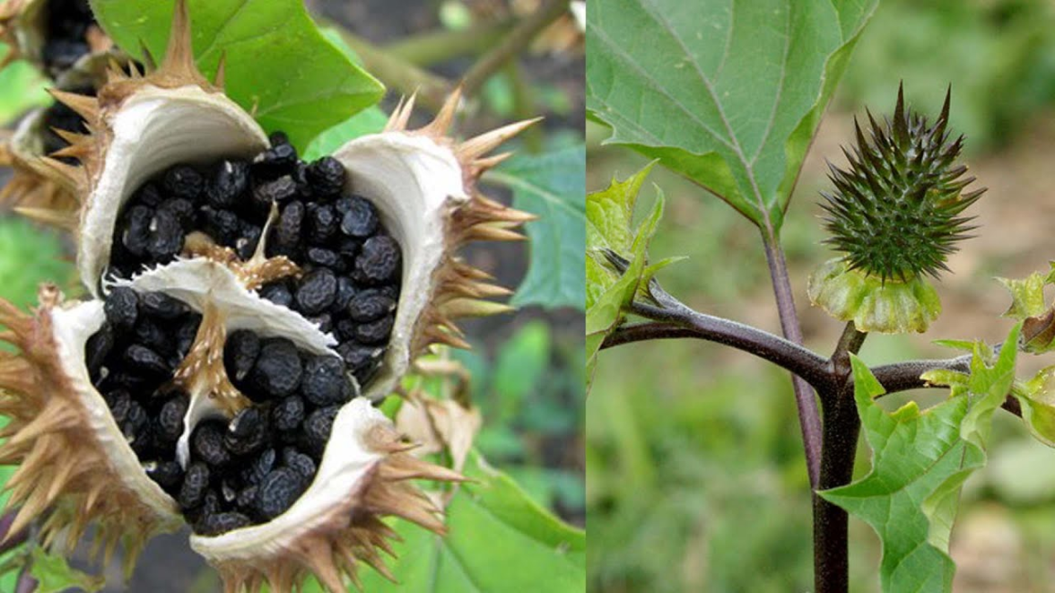
Scopolamine hydrobromide
Obtaining
The demand for scopolamine hydrobromide is fully met by its production from plant raw materials, in particular from the seeds of the Indian durman - Datura innoxia Mill (Solanaceae family).

Slide 21
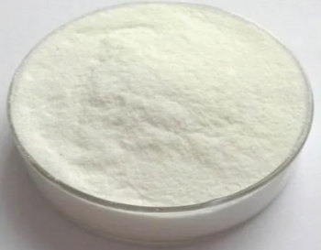
Scopolamine hydrobromide
Physical properties
Colourless transparent crystals or white crystalline powder. Melting point 193 to 197° C. Specific rotation from -24 to -27° (5% aqueous solution).
Easily soluble in water and ethanol, very slightly soluble in chloroform.

Slide 22
Scopolamine hydrobromide
Identification
1. Infrared spectroscopy
2. Interaction with common alkaloid reagents
3. Vitali-Morin reaction
4. Benzaldehyde formation reaction
5. Scopolamine base isolation
Crystals of the base, dried to a constant mass, melt at 192-196°C.
6. Bromide detection
a) with silver nitrate solution
b) after oxidation and Br2 extraction by yellow-brown colouring of the chloroform layer.

Slide 23
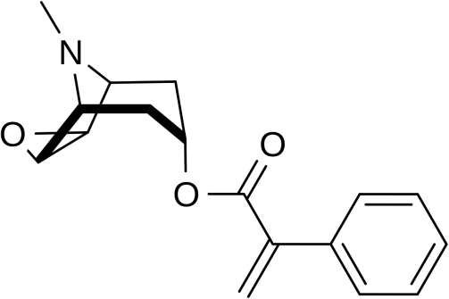
Scopolamine hydrobromide
Purity test
To assess purity, check the transparency and colour of the solution, the acidity and alkalinity, the absence of impurities such as aposcopolamine and apoatropine, and the residue after drying.

Slide 24
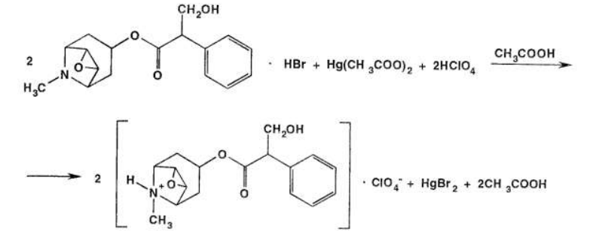
Scopolamine hydrobromide
Quantificification
1. Non-aqueous titration
Carried out in acetic anhydride and acetic acid medium, titrant - 0.1 mol/l HClO₄ solution. The end of titration is determined potentiometrically.
2. Acid-base titration in aqueous-alcoholic medium
Titrate with alkali solution.

Slide 25
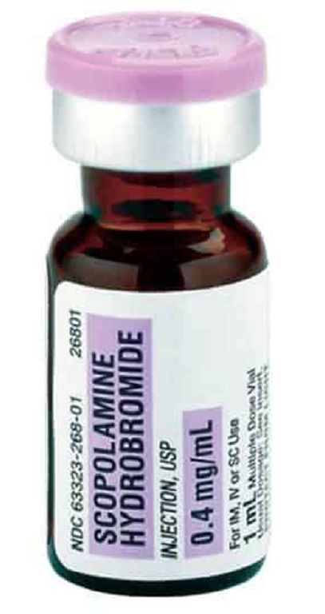
Scopolamine hydrobromide
Storage
Store in tightly closed containers away from light and moisture.
Medical use
M-choline blocker, has antiemetic, sedative and antispasmodic effects. It is used in Parkinsonism, VSD, Meniere's disease, motor and mental restlessness, premedication, hypersalivation, vomiting. For pupil dilation for diagnostic purposes (including fundus examination, determination of the true refraction of the eye), in inflammatory eye diseases (including iritis, iridocyclitis, keratitis), eye trauma. Prophylaxis against sea and air sickness.

Slide 26
Homatropine hydrobromide
Obtaining
1 method
2 method

Slide 27
Homatropine hydrobromide
Physical properties
White crystalline powder, odourless, easily soluble in water, difficult in alcohol.
Identification
1. IR spectrophotometry
2. Unlike atropine, it does not give the Vitali-Morin reaction and does not precipitate with tannin. !!!
3. Isolation of homotropin base
Under the action of an alkaline solution, a white precipitate of homatropine base is formed which dissolves in excess of the reagent.
4. Interaction with iodine solution
When iodine solution is added to the drug, a brown precipitate is formed.

Slide 28
Homatropine hydrobromide
Identification
5. Reaction with mercuric dichloride
Ammonia solution precipitates homatropine base, which is extracted with chloroform.
A solution of mercuric dichloride is then added to the residue, which turns yellow and then brick red.
This reaction distinguishes homatropine from most alkaloids except atropine and scopolamine.
6. Bromide detection
a) with silver nitrate solution
b) after oxidation and Br2 extraction by yellow-brown colouring of the chloroform layer.

Slide 29
Homatropine hydrobromide
Purity test
To assess the purity of the substance, colour and clarity of an aqueous solution of homatropine hydrobromide, pH of the aqueous solution (5.0 to 6.5), associated impurities (HPLC), loss on drying, sulphate ash are monitored.
Quantificification
1. Acid-base titration
Titrant - 0.1M NaOH solution, end of titration. The end of titration is set potentiometrically.
2. Non-aqueous titration
In this case, the titrant is chloric acid solution, the indicator is crystal violet and the drug is dissolved in anhydrous acetic acid.

Slide 30
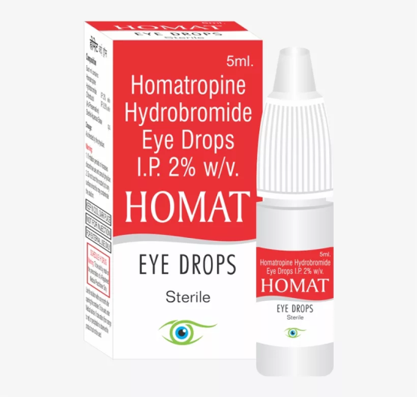
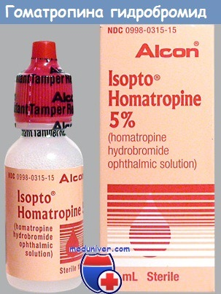
Homatropine hydrobromide
Storage
In well corked glasses, away from light.
Medical use
Homatropin hydrobromide is used in ophthalmology in the form of 0.25%-1.0% aqueous solutions for pupil dilation and as a means of inducing paralysis of accommodation (during examination of the ocular fundus).

Slide 31
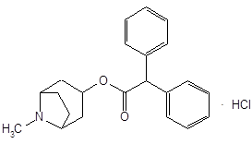
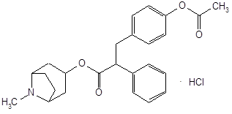
Other sythetic analogues of atropine
In internal medicine, tropacin is used for smooth muscle spasms of abdominal organs, gastric and duodenal ulcers, bronchial asthma and other diseases accompanied by increased vagus nerve tone and smooth muscle spasms. In obstetrics, it is used as an antispasmodic agent that inhibits the contractile activity of the uterus and can therefore be used in cases of threatened premature labour and abortion.
Tropafen is used in the treatment of diseases associated with impaired peripheral circulation (endarteritis, Raynaud's disease, acrocyanosis, trophic ulcers of the extremities), slow-healing wounds, to eliminate sympathomimetic reactions during surgery.

Slide 32
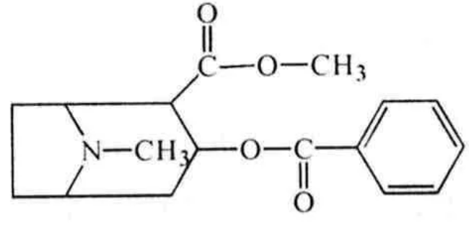
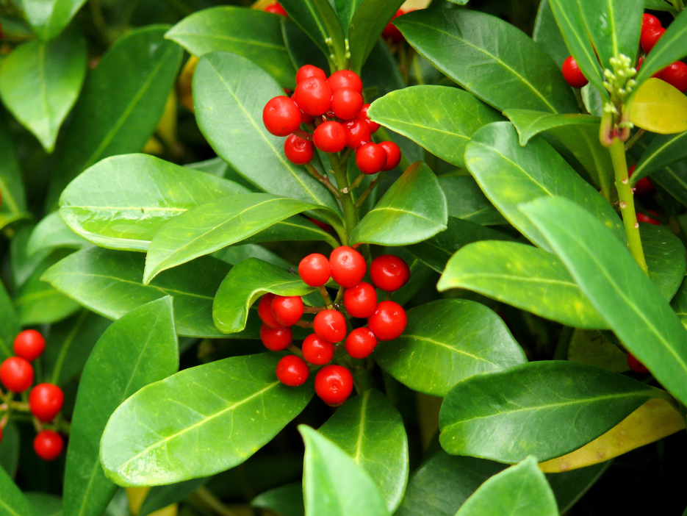
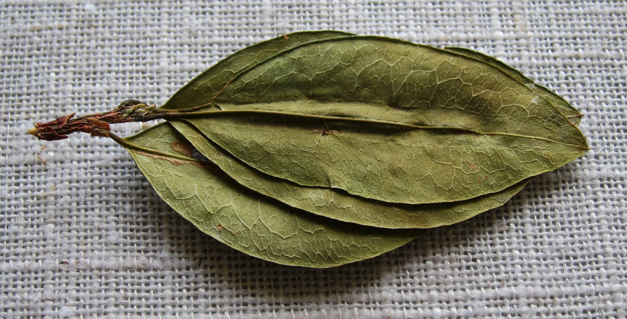
Cocaine hydrochloride

Slide 33
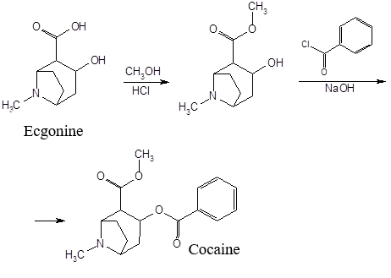
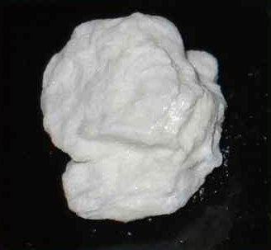
Cocaine hydrochloride
Obtaining
Cocaine hydrochloride is a colourless, needle-like crystals, soluble in water and alcohol, insoluble in ether. Aqueous solutions have an acidic reaction to litmus and a bitter taste. Causes numbness of the tongue.

Slide 34
Cocaine hydrochloride
Identification
1. Chloride detection
2. Interaction with KMnO4 solution
A violet-coloured crystalline precipitate (cocaine permanganate) is formed with KMnO4 solution
3. Interaction with common alkaloid reagents
Of the common alkaloid reagents, phosphorus tungstic acid, Dragendorf's reagent, Bouchard's reagent and phosphorus molybdenum acid are the most sensitive to cocaine. Coloured amorphous precipitates are formed.

Slide 35
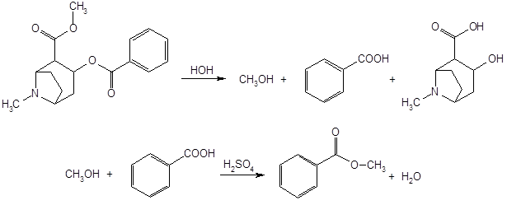
Cocaine hydrochloride
Identification
4. Hydrolysis
After hydrolysis of the drug with concentrated acid, the odour of benzoic acid methyl ester is felt on heating, crystals of benzoic acid precipitate on cooling and prolonged standing

Slide 36
Cocaine hydrochloride
Purity test
Cocaine must be free from impurities of cinnamylcocaine and reducing agents, which are detected by discolouration of the potassium permanganate solution. The impurity of truxilline and other coca alkaloids is determined by adding ammonia to a solution of cocaine hydrochloride: if there is no truxilline impurity, cocaine base precipitates; if there is impurity, no precipitate precipitates.
Quantificification
Non-aqueous titration
Titrated in anhydrous acetic acid with 0.1M chloric acid solution (crystal violet indicator).
The titration is carried out in the presence of mercury (II) acetate, which inhibits the dissociation of chloride ions.

Slide 37
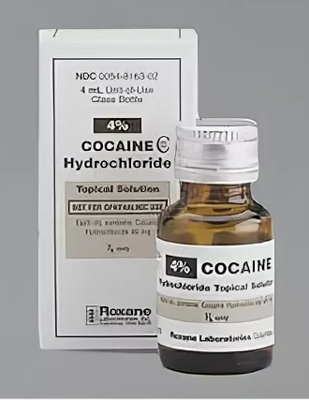
Cocaine hydrochloride
Storage
Store in well corked orange glass jars or in sealed ampoules in a dark place.
Medical use
As a local anaesthetic, cocaine is used mainly in ophthalmology and otolaryngology clinics in the form of 2-10% solutions. In addition to anaesthesia, cocaine also causes vasoconstriction.
A major disadvantage of cocaine, which limits its use, is its "intoxicating" effect on the central nervous system, resulting in the development of a painful habit - cocainism. Other disadvantages of cocaine are its high toxicity and the instability of its solutions during sterilisation.

Slide 38
Thank you for attention!

