Slide 1
Theme: Ancient Greek philosophy. .
The term “antique” is used in the signification of history, culture and philosophy of Ancient Greek and Rome. Ancient philosophy covers nearly one thousand years of history. That arises in Ancient Greece in the middle of the first millennium Before Christians.
Particular feature of Ancient philosophy is the formation of qualitatively new method of spiritual self-consciousness. In the first ancient philosophers take place beautiful logical form and rational reflection of the world. In Ancient Greek philosophy universe is considered as regulated system, the space full of sense, absolute sense. And man is included in this general and obligatory order.

Slide 2
In Ancient philosophy is distinguished three periods: : .
Early or archaic period (in VI-V centuries B.C.) The first period includes Miletus and Eleatic philosophy, Pythagoras, Heraclitus and atomistic school (Leucippus and Democritus). The basic theme of the first period was problem of origin – Arche.
Classical period (in V century B.C.) The second period includes philosophy of sophists and Socrates, Plato and Aristotle. The main problems of this period were the problem of human essence.
Period of Roman philosophy (IV century B.C.– V century A. D.) The main schools of this period are: epicurism, skepticism, stoicism and kinism. The main problems of this period were the problem of will and freedom, moral and pleasure, happiness and sense of life, axiological and praxeological problems.

Slide 3
In Miletus in VI century B.C. took place great intellectual break-through. Three famous thinkers (Thales, Anaximander and Anaximenes) dwelt here.
They tried to solve problems where do all come from and where do all disappear to.
Thales was the founder of Miletus school. He was the first who has predicted the eclipse of sun. He considered that the origin is water. From water all things come from and disappear to water.
Water was the main element for Greeks, because Greece is the sea country and Greeks were sailors and travelers.
Thales
( near 625-547 years B.C.)

Slide 4
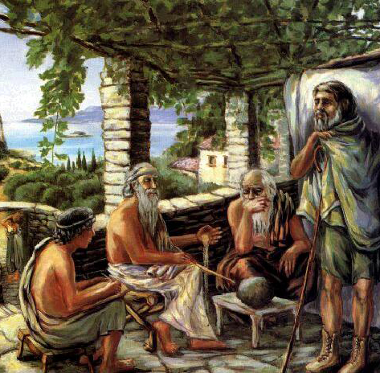
Apprentice of Thales – Anaximander considered that origin is something infinite, boundless – Apeiron, which is impossible to identify with any element of nature. Apeiron is intelligible only by mental contemplation. So, in philosophy for the first time transition from concrete to abstract, from imaginative mentality to conceptual one, was realized.
Anaximenes considered that the origin is air, because all living creatures can’t live without air.

Slide 5
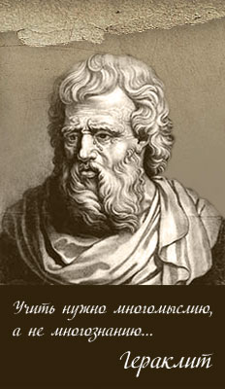
Heraclitus of Ephesus
( near 544 - 483 years B.C.) has formulated the main dialectical ideas.
He put the fire in the base of his philosophy, fire is the most movable. All things, even soul, come from the fire, according to necessity.
The world is changing, “logos” (general law), rules of all process in universe. Life of the nature is uninterrupted process of movement. All things transform to its opposites: cold to hot, hot to cold.
«All is flux, nothing stays still»
“In one river impossible to come twice, because in second once will flow the new water”.

Slide 6
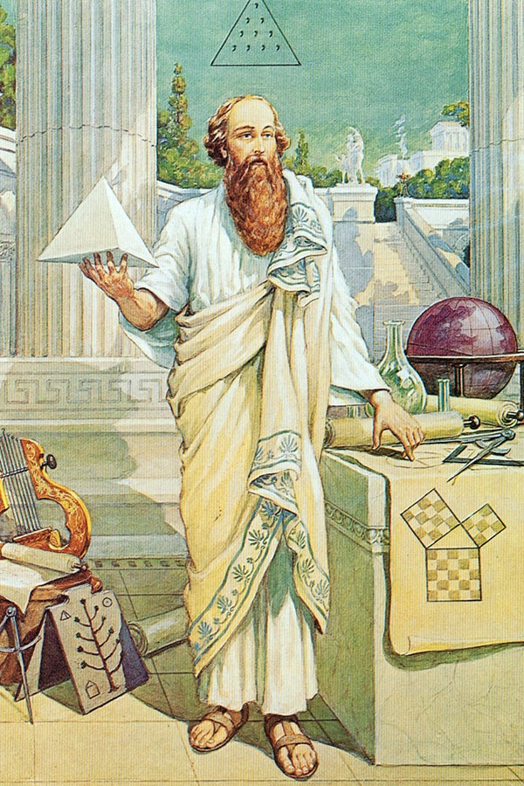
The idea of mathematical exactness penetrates all philosophy of Pythagoras and his school. Pythagoras and his supporters considered number as original metaphysical essence. Number is the origin of all things and phenomena, number is deified and mystified.
Pythagoras gave to himself divine character and said that «there are three sorts of intellectual animals: firstly – god, secondly – man, and thirdly man as a Pythagoras».
Pythagoras
(580 – 500 years B.C.)

Slide 7
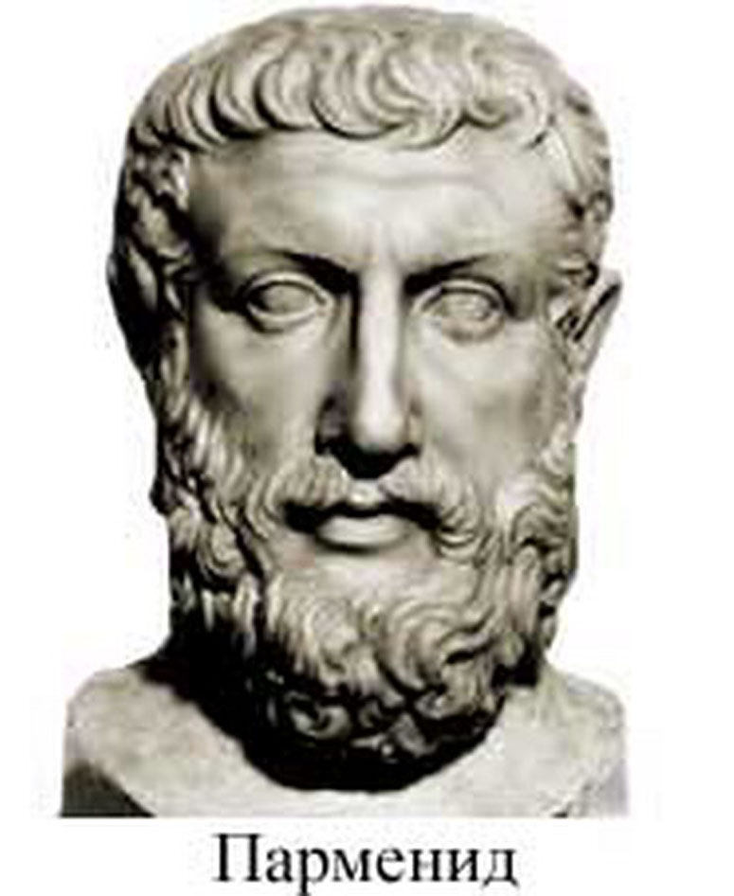
The first representative of Eleatic school was Xenophancs of Colophon (near 570 – 478 B.C.), a rhapsodist and poet. He criticized the popular notions of gods, saying that people made their gods in their own image, but he argued that there could be only one God, the ruler of the universe, who must be eternal.
Great representative of Eleatic philosophy, Parmenides. He was founder of metaphysical trend in philosophy.
Parmenides said:
“Being is, non-being is not”.
According to him being is permanent, infinite, eternal, absolute, integrated, fundamental sphere.
Parmenides (540 – 480 B.C.).

Slide 8
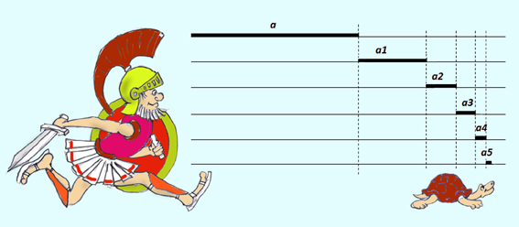
Apprentice of Parmenides, Zeno has formulated forty paradoxes, insoluble difficulties.
The most famous of all Zeno’s paradoxes Achilles and the tortoise. If Achilles can run ten times faster than the tortoise, and the tortoise has a ten yard lead at the outset – then when Achilles has run ten yards to catch up with the tortoise, the latter has moved ahead one yard. When Achilles runs this yard, the slow tortoise has moved on one tenth of a yard. Each time Achilles reaches the position where the tortoise had been, the tortoise has moved on some small distance, so that Achilles will never catch up, even though he moves so much faster.

Slide 9
Philosophers Leucippus ( 500 – 440 B.C.) and Democritus were creators of atomistic view of world. Atoms are elements, supersmall and indivisible grain of which all nature consists. Atoms are indivisible. The strict causality exists in the world.
Every atom is eternal, immutable, and impenetrable. Therefore the world is eternal and exists always. Atoms always move and where atoms don’t exist, there is emptiness. Atoms have different forms, in depend of its things are acquired different structures.
Democritus
(460 – 370 B.C.)

Slide 10
The term “sophist” means “wise man”, expert of knowledge, however knowledge of sophist’s was superficial and not effective, because they didn’t pursue a goal the search of truth.
They took money for their classes (they were erudite persons), and sought theirs profit. It was negative in sophists. Sophists taught and developed rhetoric, art of beautiful speaking, art of argumentation and dispute. Truth wasn’t important for their, sophists denied existence of objective truth, all truth is subjective. Any opinion can be proven with the help of rhetoric.
Great positive meaning of sophistical philosophy is in anthropological turn. They transferred the main attention of philosophy from problem of nature to problem of man.

Slide 11
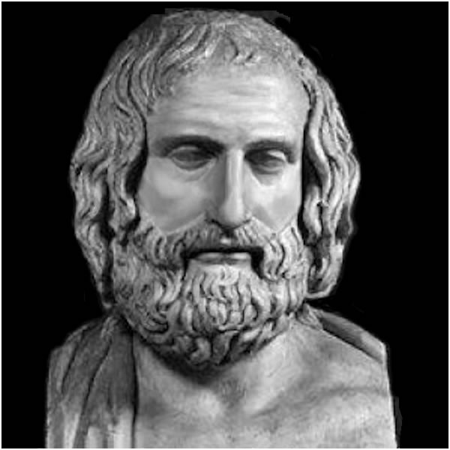
The base of world outlook of the first and famous sophist Protagoras was formed from interpretation of Heraclitus philosophy.
According to Protagoras, any opinion is true, because there are two opposite statements about every thing.
Protagoras was the founder of philosophical subjectivism.
“Man is the measure of all things, of those which are that they are and of those which are not that they are not”

Slide 12
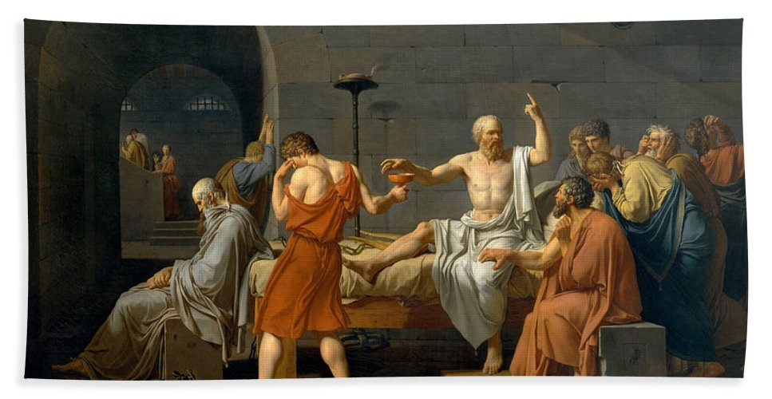
Socrates ( 470 or 469 -399 B.C.) He was son of Sophroniscus an Athenian stone mason and sculptor and Phaenarete, a midwife.
In 399 BC Socrates is accused of introducing other deities, corrupts the youth - he was punished by death. Socrates was sentenced to death by 500 people of the court. 361 votes for the death of Socrates. He drank a cup of poison in the presence of students (on the picture).

Slide 13
Socrates nothing wrote, because he supposed that only living word can send his thoughts through the verbal dialogue. Evidence of his life and activities must come from the writings of Plato and Xenophon (historian). He went on the streets of Athens and asked people about sense of human being. Socrates looked like a folk wise man, while making a great impression on the interlocutor, no less than his words. He was bald, with a big belly, walked in a holey cloak and without shoes. He slept in different places on the street near the trash. He was shown as a tourist attraction. Xanthippus - his wife, an absurd woman, talkative, grumpy.

Slide 14
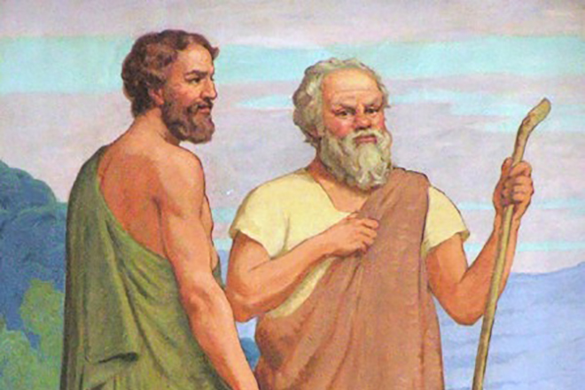
Socrates discussed with those who seemed to be wiser than him and saw that their wisdom was not wisdom, but it is only appear that it is wisdom. What they only think that they understand true.

Slide 15
Most of the time, Socrates hung out in the squares, talking to everyone who wanted to talk to him, asking about the meaning of human life. Socrates pretended to be stupid and simple man, while the interlocutor took the pose of a knowledgeable person, and then interlocutor got caught. Socrates asked several thoughtful questions and perplexed the interlocutor. The interlocutor got rid of complacency. But Socrates believed that he does not have the truth, he helps this truth to be born in the soul of the interlocutor. According to Socrates, the truth already potentially exists in the soul of every person.

Slide 16
Method of Socrates has the name
mayevtica – art to seek the true. “I know, that I know nothing”
“Know yourself”.
Man, according to Socrates, must perceive and do kindness. Man makes bad actions because he does not know what is good. Therefore man must be educated in order to do good.

