Slide 1
Theme: Russian philosophy: the main features.
The christening of Russia in Kiev in waters of Dnepr in 988-989 years.

Slide 2
Periods of Russian philosophy is original but not unique. It repeats development of world philosophy in the main moments.
Russian philosophy are divided on periods:
1) XI-XVII centuries Russian Middle Ages – early period of Russian philosophy. When Russia adopted Christianity and used Greek patristic that led to original wise world outlook.
2) XVIII century – Russian Renaissance.
3) XIX century – the origin of Russian philosophic consciousness, Russian philosophy is phenomenon of contradictory – whole and various-singularity.

Slide 3
Russian philosophy is busy with questions about sense and purposes of history about life and destination of man that is caused of spiritual aspirations from the past of Russian people and peculiarity of Russian spirit. In Russia problem of man always was connected in social-politic, psychological, ethical and philosophical aspects.
Man is regarded as a small part of the universe connected with nature and society.
Philosophical thought in Russia investigated dialectics of human soul. In the centre of attention was interior life of man, aspects of conscience, compassion. In whole, soul associated with conscience. Russian philosophers aspired to formation of man as a whole, fighting against all types of estrangements.

Slide 4
Specific anthropological orientation of Russian thought explains the important role of Russian literature and connected with its critics and sociopolitical journalism in development of philosophy. The great Russian writers were deep and original thinkers. F.M. Dostoevsky and L.N. Tolstoy proposed on the first plan the idea of investigation of human soul in the unprecedented aspects (dimensions). Russian philosophers investigated personality and nation, freedom and morality in indissoluble connection with concept of fatherland. Russia, her historical destiny and patriotic love to her have social-philosophic and moral sense.

Slide 5
One of the characteristic of Russian thought is the comprehension of world as a whole system, absolute unitotality that founds in the process of dynamic, making and therefore having a risk of deformation and destruction. Russian philosophy postulated the idea of anthropocosmic synthesis, joining history, nature and society and idea of the transformation of this in all-embracing, universal history of mankind.

Slide 6
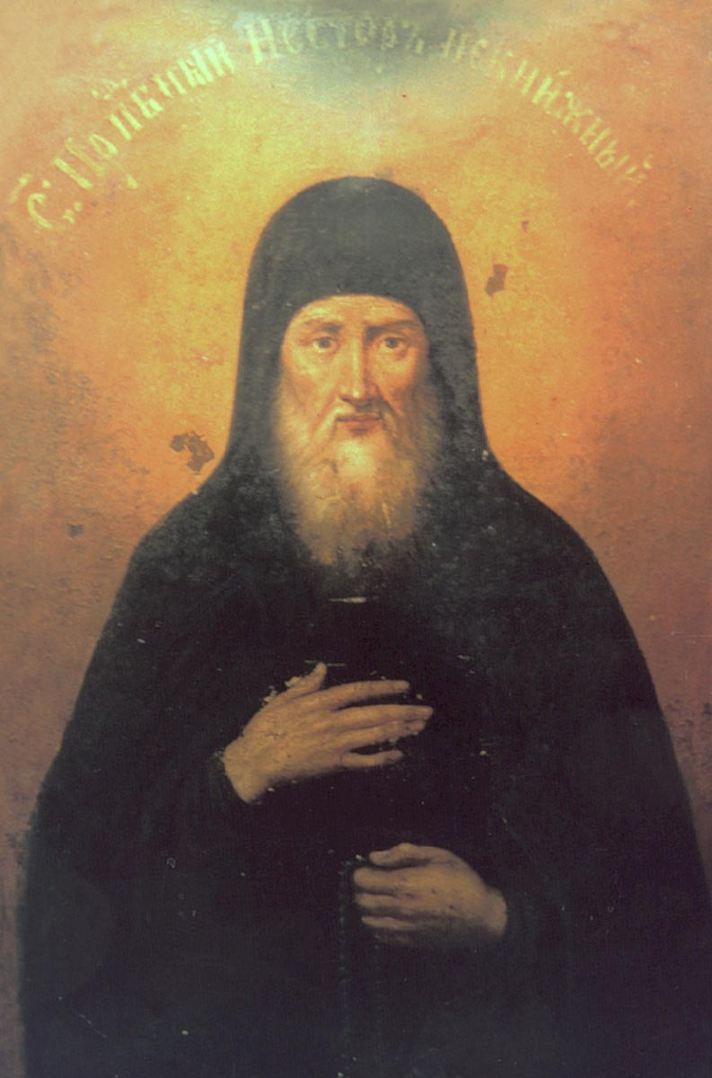
Philosophy of Russian
Middle Ages.
The origin of Russian philosophy was the treatise «Tale of Bygone Years», created by the monk Nestor. It is the tale of years gone by, from whence the Russian land came to be. He proposed the ideas about the origin of Russian land and about responsibility of man (that has immortal soul and freedom) for his action before God.
monk Nestor
end of XI-beginning of XII ages

Slide 7
In XVI century the monk Philotheus of Pskov created religions theory about Moscow as a third Rome. Philotheus said: «Two Romes have fallen, but the third stands and a fourth there will not be». He postulated that the old Rome that was the centre of Christians was conquered of barbarians. The new Rome – Constantinople has fallen under attack of Turkish conquerors. The third Rome – Moscow has destination to perform the role of follower of Christianity. The fall of the old and the new Rome Philotheus explained that they have been punished for change of Christianity as a true faith.

Slide 8
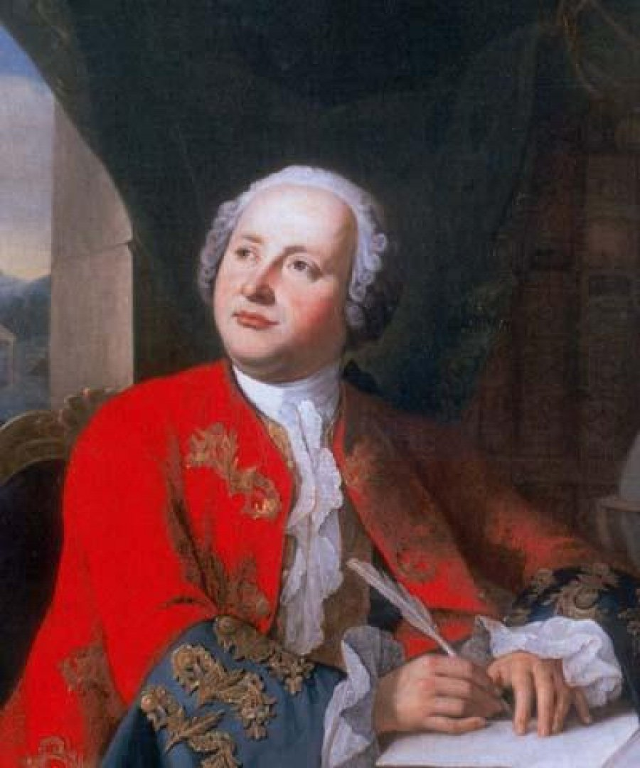
XVIII century – is the period of development of sciences, culture, technical skills. Important representative of this period was M.V. Lomonosov – the scientist, thinker, poet, public figure. He founded materialistic tradition in Russian science and philosophy; he was the founder of some branches in scientific knowledge.
M.V. Lomonosov
1711-1765

Slide 9
Slavophiles and Westernizes.
In 1829-1831 years P.Y. Tchaadaev wrote his famous book «Philosophical letters». In this treatise Tchaadaev characterized of unhappy place of Russian people, tried to answer on question about fate of Russia. He tried to seek the roots of modern life in the past history. He said that Russia had lagged behind Western countries and had contributed nothing to the world's progress. He therefore concluded that Russia must start new line. His conclusions were deeply pessimistic, because he did not find any internal stimulus of progress and any conditions for its formation. The main problems of Russian life are ‑ autocracy and serfdom.

Slide 10
Philosophy of Tchaadaev has given to start of two main leading opposite directions: Slavophiles and Westernizes. Westernizes believed that Russia's development depended upon the adoption of Western European technology and liberal government. Slavophiles supposed that Russia must have her original way of development, independently from West and East.
Developing in the 1830s concerned with German philosophy, the Slavophiles were influenced greatly by Friedrich Schelling. Leaders of Slavophiles were Aleksey S. Khomyakov, the brothers Konstantin S. and Ivan S. Aksakov, the brothers Ivan V. and Pyotr V. Kireyevsky, and Yury F. Samarin. They all concluded that Russia should not use Western Europe as a model for its development and modernization but should follow a course determined by its own character and history.

Slide 11
Slavophiles postulated «Christian community» model of society. They thought that once such a society was established, Russia's duty would be to revitalize the West by reintroducing spiritual values, that replace rationalism, materialism, and individualism. Slavophiles orientated on Orthodoxy, that was considered as a spiritual basis of Russian society. According to Slavophiles, Ortodoxal Church has the purpose to establish holiness and unshakeable of the highest spiritual truths, that was contained in Orthodoxy. Slavophile concepts were reflected in the philosophical doctrines advanced by Vladimir Solovyov and Nikolai Berdyaev in the late of 19th century and the early of 20th century.

Slide 12
Leaders of Westernizes were Piotr Y. Chaadayev, Aleksandr I. Herzen, and Vissarion G. Belinsky. Representatives of Westernizes rejected feudalism and serfdom in the economy, political life and culture, and demanded Western-style socio-economic reforms. The Westernizers called for overcoming Russia’s socio-economic backwardness on the basis of progressive European experience, rather than promoting unique elements of national culture. They prioritized the common aspects of Russian-Western historical and cultural destinies, rather than mutual disagreements.

Slide 13
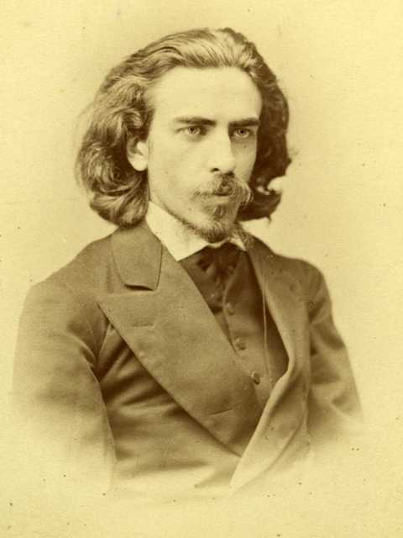
The main concept of the Solovyov theory is the divine idea of «absolute unitotality» (wholeness of all existence). Real world is the realization of it. All things and phenomenon don’t exist without each other and each thing is total combination of different parts.
V. S. Solovyov
1853—1900

Slide 14
Absolute unitotality are comprehended only with help of whole knowledge, which representatives the synthesis of theology, philosophy and empirical science. The centre of this whole knowledge is God.
The world which was created from God is dynamic, always develops, because has the active origin – World Soul. This soul is creative energy, that has in itself the idea of unitotality. World Soul can be cognized of two methods: scientific knowledge and religious faith. This divine idea was called «Divine Wise» or «Divine Sofia». This personification of wisdom expresses the eternal feminine and the world soul. Divine Sofia assists the formation of Divine Kingdom on the earth.

Slide 15
Essence of human being is in connection between God and man and in the formation of Godmanhood. Ideal of human society, according to Solovyov, is free theocracy. According to him, Christian culture and free theocracy must be created on the base of joining of positive features of Western and Eastern culture. Solovyov asserted, by his concept of Godmanhood, that the unique intermediary between the world and God could only be man, who alone is the vital part of nature capable of knowing and expressing the divine idea of "absolute unitotality" in the chaotic multiplicity of real experience. Consequently, the perfect revelation of God is Christ's incarnation in human nature.

Slide 16
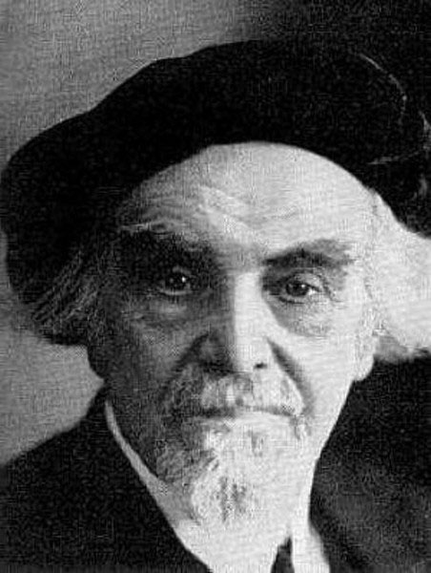
Philosophy of Nicolai Berdyaev. His philosophy is anthropocentric. He seeks for the meaning of life. His approach to philosophical problems is through their significance and relevance for the human being.
Berdyaev makes a distinction between spirit and nature; he is not opposing soul to body or to the material world in general.
Nicolai Berdyaev
1874 - 1948

Slide 17
Soul and body are distinguished, but they are distinguished as realities within the one objectified world. Spirit, however, is life. Man, according to Berdyaev, is the mystery not as an organism, but as a personality. Personality means the independence from nature, from society. Personality cannot be indentified to spirit; this is not psychological category, but ethical and spiritual. The cosmos is the part of personality; therefore every man as a personality has the points of similarity with all mankind.

Slide 18
One of the important themes in creation of Berdyaev is the theme of freedom. For him freedom was the fundamental metaphysical reality upon which all else is based. From the primary notion of freedom he developed his own existential interpretation of ultimate truth in terms of subjectivity. Freedom is the creative force. Freedom is conceived as the inner dynamic of the spirit, the principle of spiritual life; it tends to be identified with spirit.

Slide 19
Freedom is spirit as self-determining. This does not mean determination by given physiological or psychological factors in a human being, with the consequence that freedom can be explained, rationally derived. It is not the result of any factors save the spirit itself, and it cannot be grasped by the categories of the discursive reason. Berdyaev said that freedom is in the fact a mystery. The source of freedom is in the soul of man. Man irrational freedom has the root in nothing, from which God created world. There are three sorts of freedom, according to Berdyaev, primary (irrational) freedom, rational freedom (fulfillment of duty) and freedom that is the characteristic of divine love.

Slide 20
Theme of creativity connects with theme of man. Creativity is the fundamental attribute of man, that leads to activity in the environment. Creativity is the aspiration of man to the better existence. Man, according to Berdyaev, must do the eighth day of creation with the purpose to collaborate with God to re-create the world to its original state. The new in the world appears only due to creation, with the help of free spiritual aspirations.

Slide 21
Estrangement demoralizes and misinterprets all human values. Estrangement in the modern time achieves to limit under which, according to Fromm, it borders with madness, because there is termination of spiritual cultural tradition and creation of global destruction.

