Slide 1
Theme: Philosophy of Ancient East. Peculiarity of Eastern culture and Eastern philosophy.
There are some basic features of Ancient East culture as a whole and philosophy specifically:
traditionalism;
socio-ethic orientation;
erudition;
close intercommunication of philosophy, religion and mythology.

Slide 2
The territory of Eastern culture in usually was territories in valleys of big rivers (Ind and Ganga in India, Huanhe (yellow river) in China). And the basis of agriculture’s activity was irrigation work.
The main act of people was agriculture and basic role in all regions belonged to town.
Revolutionary changes arose with discovery of iron.
Character of the power was despotic; tsar had absolute power and also deputy of God.
Formation of state was connected with formation of writing from pictography to hieroglyphics.

Slide 3
In Ancient India, society was divided into varnas (according to professions): the brahmаns are responsible for teaching and maintaining knowledge, kshatriya - warriors and kings, vaisya -farmers or merchants, and shudra - servants and handicraftsman.

Slide 4
Philosophy of Ancient India.
The oldest memorial of literature is Vedas (written near II thousand years B.C.) The word “Vedas” means knowledge.
Vedas divided on four parts:
Rigveda - Veda of hymns
Yajurveda - Veda of worship rituals
Samaveda - The Veda of songs
Atharva Veda - The Veda of spells

Slide 5
After that from different religious schools were written -Brahmans – that contains mythological and ritual additions and commentary to Vedas.
The third part - Aranyaki, describes the lifestyle of ascetics, who lived in forests.
Upanishads the fourth part of Shruti (holy books)- the most philosophical part.
The word Upanishads means “sitting near teacher getting knowledge”.

Slide 6
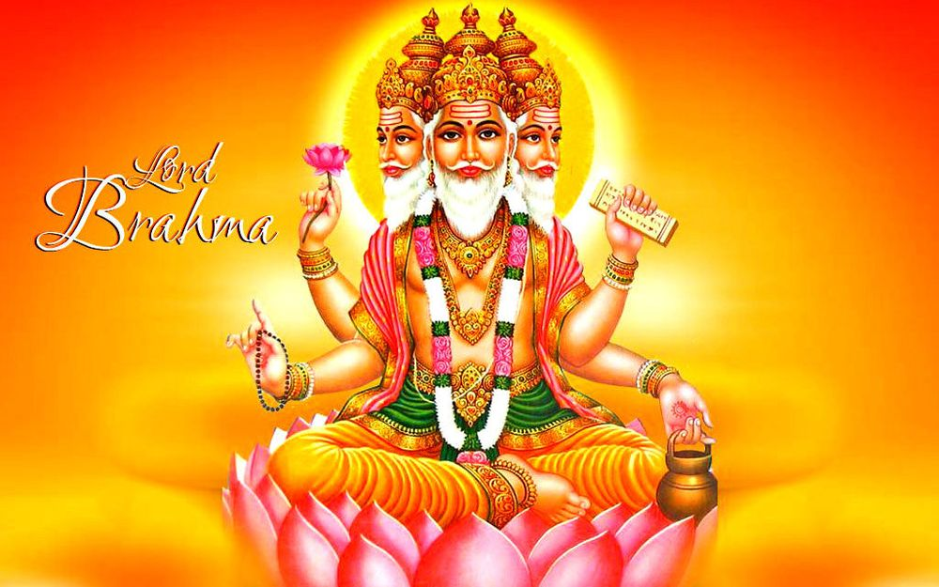
The fundamental doctrine of Vedas and Upanishads is the theory about the basis of universe.
This basis is united absolute origin – Brahman. All things result from it, are supported by it and dissolve in it.

Slide 7
In Ancient India the essence of man was comprehended at first through the cognition of characteristics of his mentality.
Breath - prana- was considered the beginning of human life. Joining with manas - mind, prana forms Atman. Atman is individual and universally-space mental being, taking place in all persons and things.
Brahman and Atman become identical with each other, when a man achieves the highest spiritual manifestations.

Slide 8
After death of body, soul doesn’t disappear. This process, cycle of regeneration has the name sansara.
This process is not accidental. There is low of retribution – karma.
Enlightened is а man who can win the low of retribution – karma and achieve moksha or nirvana.
The word nirvana means “disappearance”, “end”, “stop of existence”. Nirvana is release from sansara and karma, stop of sufferings and reincarnation (regeneration).

Slide 9
Acceptance of the authority of the Vedas
orthodox system:
Vedanta
Mimansa
Yoga
Samkhya
Vaishesika
Nyaya
Not acceptance of authority of Vedas
unorthodox systems:
Carvaca (radical materialism)
Buddhism
Jainism

Slide 10
Vedanta is continuation of Vedas, end of Vedas; it is the most orthodox system. Recognizes Lord Brahma as the absolute spiritual essence, creator of the world. Individual souls through knowledge or love achieve to God. The main way to achieve this true knowledge is to observe moral standards and meditation, which means intensive reflection on the problems of the Vedas. Important idea of Vedanta to follow to teacher.
Mimansa (meditation, study of the Vedic text of sacrifice) The teachings of the Vedas here are closely connected with the idea of ​​duty, the fulfillment of which involves, first of all, sacrifice. It is the fulfillment of one's duty that leads to release from karma and stop sufferings. Mimansa supposes that release can not be achieved only with the help of knowledge, but only acceptance of religious rules can give it.

Slide 11
Yoga (in sanskrit – concentration, connection) supposes that the main on the way of union of individual soul with God is the system of exercises - asans, mantras, meditations [concentration].
Samkhya (in sanskrit is a number). Wise man Kapila was founder. Accepts the existence of two substances: spiritual and material (Purusha – spiritual and Prakriti –material), that gives evolution of man and world.
According to Vaishesika and Nyaya (logic) - our universe consists of material atoms. Vaisesika represents the world as a set of substances, which includes elements (water, earth, air, fire), space and time, as well as thin matter- ether [sky], soul and mind. In general, the universe consists of material atoms, the combination of which forms all objects.

Slide 12
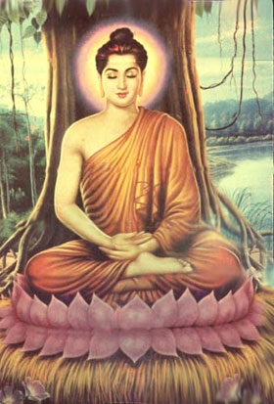
He was the son of king.
His mother died when he was born. Grandmother educated him. His father forbad him to go out from palace. Was predicted that one day he will go from palace and will follow to individual asceticism. But his farther wished to save him from life. In the finish Siddhartha didn't know that death exist. But one day predicted has happened Siddhartha left palace and looked three things: illness, age and death. He begins the way of asceticism. One day he sat under the tree and achieved to release.
The founder of Buddhism was Siddhartha Gautama (Buddha - enlightened).

Slide 13
Buddha formulated four noble truths :
life of man is the chain of suffering, even joy have in itself sufferings, because it’s not perpetual;
the causes of sufferings are human desires;
therefore, it is necessary to get rid of desires to stay sufferings;
how this cessation is to be achieved – for which the Eightfold Path is the means.

Slide 14
The eight components of the Path are the following:
right understanding (knowledge of fourth noble truth);
right thought (control of thinking);
right speech (absence of lie, rudeness);
right action (humanism, ahimsa);
right livelihood (absent of bad action that connected with lie and violence);
right effort (consentration, harmony, quietness);
right mindfulness (awareness of own body, sensations, mind and mental objects);
right concentration (meditation).
Hinayana (narrow way) was orientated towards rigid individualistic asceticism.
Mahayana (wide way) is the way of release for all people.

Slide 15
The word Jainism means winner. Jainism as Buddhism believes in sansara, karma, its purpose to achieve to nirvana.
Enlightened is а man who can win the low of retribution – karma. For release during the life must be fulfilled of three rules:
right behavior
right knowledge
right faith.
The main rule of Jainism – ahimsa - don’t do harm for living creatures.

Slide 16
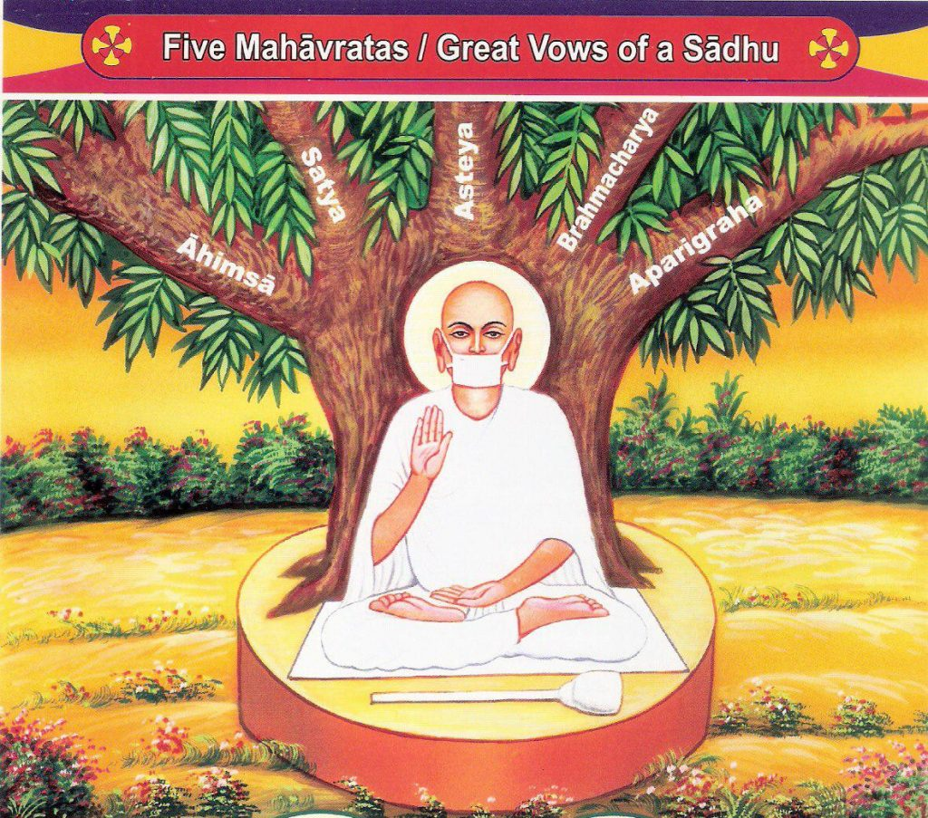
Orthodox Jain filters drinking water so that living creatures do not happen to be there, sweeps a path with a special panicle so as not to crush the ant or the worm. Jain is strictly forbidden to move around or do anything at night, because in the dark you can uncontrollably harm a living creature.

Slide 17
In “Book of change” is distinguished ten elements of being: in, yan, sky, earth, man, fire, water, metal, tree, ground.
Philosophy of Ancient China.
The oldest memorials of literature in China were five books:
Book of songs;
Book of ceremonies;
Book of change;
Book of history
Chronicle.

Slide 18
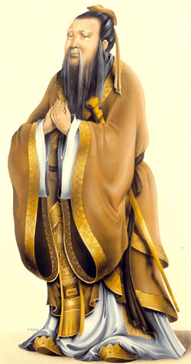
Confucius was the founder of Confucianism. The fundamental aspects of Confucianism: sky and spirits. Sky is one of the central categories of this philosophy. In Confucianism it is understood as fate, lot, Tao. Sky looks after the justice in the world and protects social inequality.
Confucius approved of cult of ancestors, but considered alive people to be more important than dead. Confucianists are supporters of society. The most attention is given to the problems of people’s relations and education.
Confucius’ theory about morality is expressed in wined phrase: “Don’t do the thing you don’t want to be done to you”. It’s principle Jen (Ren) “humanity,” “humaneness,” “goodness”.
Xiao principle - respect to ancestors
Confucius

Slide 19
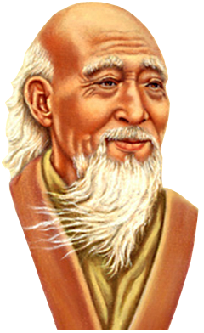
The founder of Taoism was Lao-tzu, half-legendary person. For Taoism Tao is comprehensive world outlooking concept. It is the beginning and the end of everything in the world and comprehensive law of universe.
According to main treatise of Taoism
“Tao-to-ching”, the structure of universe have the following view. Nothing is prime. It is Tao, which haven’t got name.
Lao-tzu

Slide 20
Ethical ideal of Taoses is world-wise man, who is like Tao, which haven’t got name. His main feature is victorious inaction. The principle of inaction as the highest principle of behavior is in the base of Taoist conception of ruling.
World-wise ruler leaves all to go its natural way – Tao. Therefore “the best ruler is that, about whom people know only that he exists”. The Taoist ideal is harmony of man with Universe and himself.

Slide 21
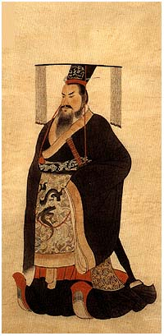
Qin Shihuandi Emperor of China he bilt he Great Chineese wall
The founder of Moism was Mo-tzu. Moism attempted to connect in one node the justice and profit. Justice is the profit. Criterion of truth by moism was the use of this knowledge for the realization of people’ interests in harmony with principle of “common love and profit”.
School of law or Legism proclaimed motto: “the main value is law!” The main purpose was the victory of its kingdom in the struggle of kingdoms. Art and philosophy were abolished; agriculture and war were considered as the main values.

