Slide 1
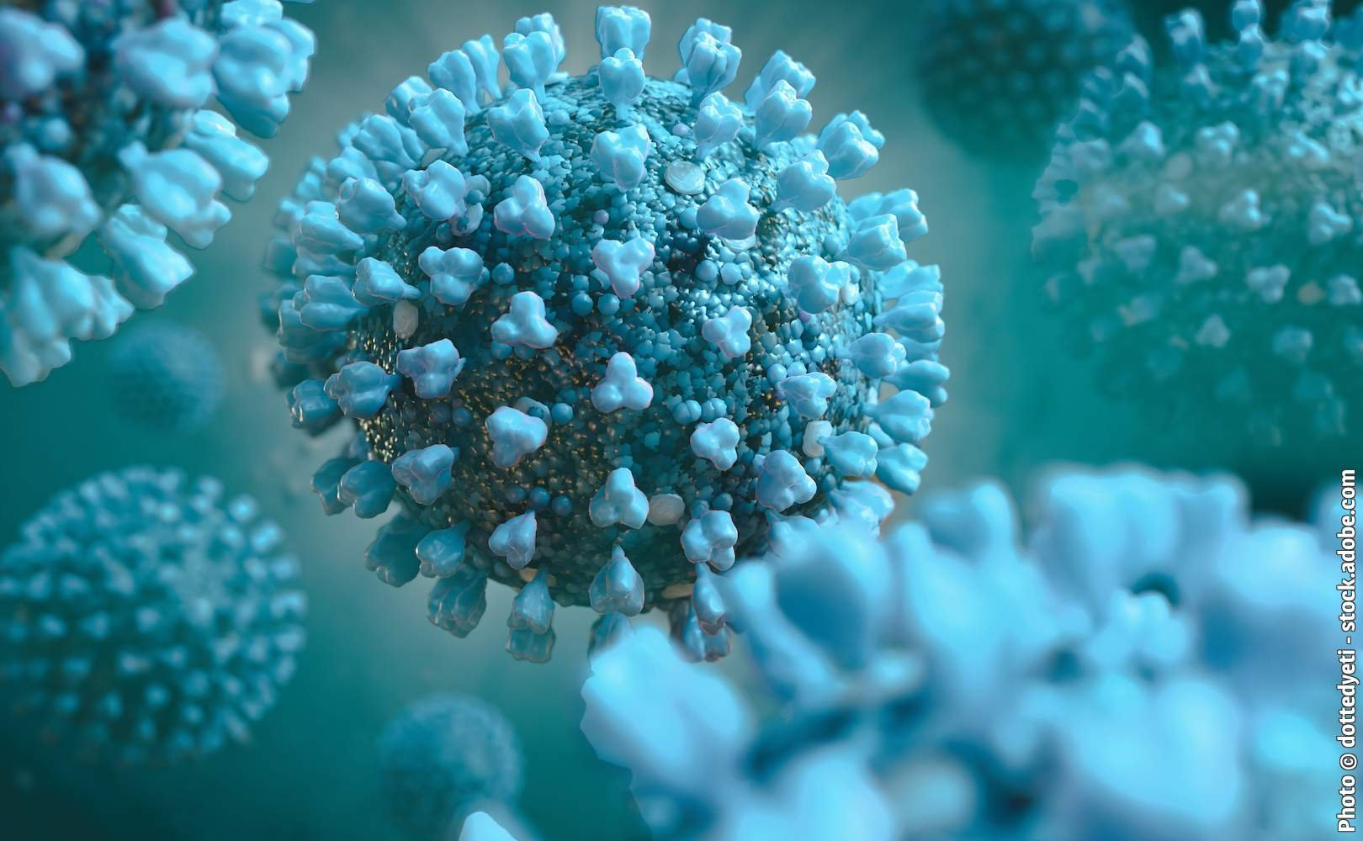
«General pharmaceutical chemistry»
Drugs to treat infections caused by the coronaviruses
Associate Professor Gureeva E.S.

Slide 2
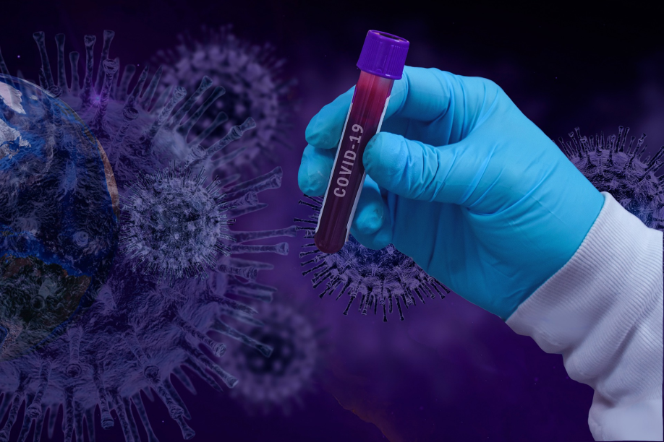
General characteristics of coronaviruses
Coronaviridae is a family of viruses that includes two subfamilies: Coronavirinae and Torovirinae. Pathogens important to humans belong to the subfamily Coronavirinae.
Human coronaviruses (CoV) were first identified in the 1960s: HCoV-OC43 (OC43) and HCoV-229E (229E).
Other human coronaviruses were subsequently identified: HCoV-NL63 (NL63) in 2004 and HCoV-HKU1 (HKU1) in 2005.

Slide 3
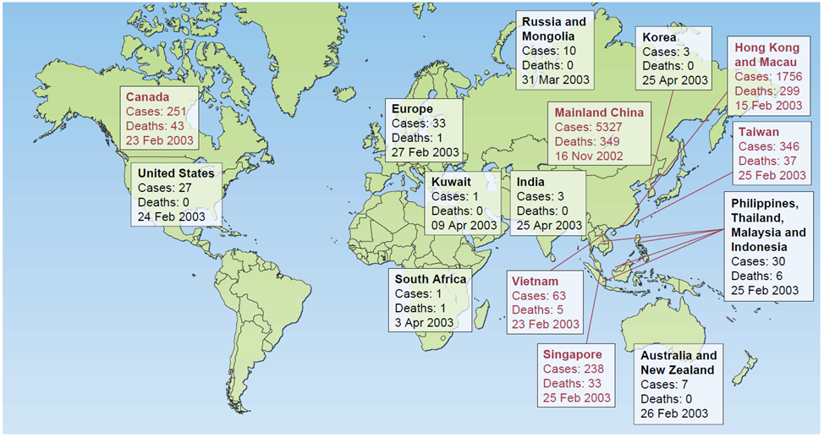
General characteristics of coronaviruses
In the past 15 years, two new human coronaviruses have emerged that cause significant morbidity and mortality.
Severe acute respiratory syndrome (SARS) was identified in 2003. SARS-CoV causes acute, atypical pneumonia and diffuse alveolar damage, which has been reported in about 8000 patients.

Slide 4
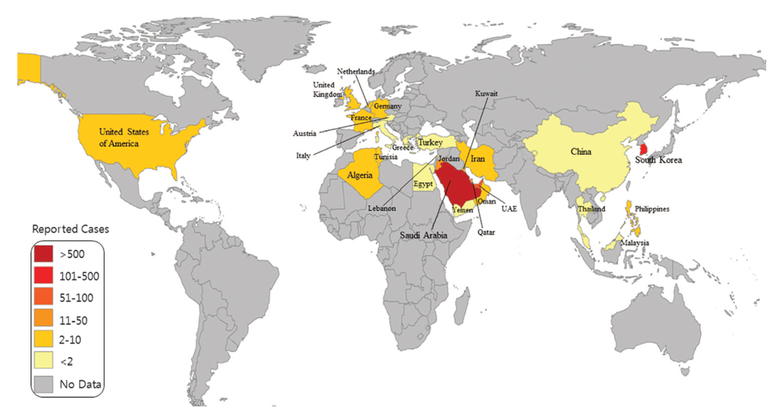
General characteristics of coronaviruses
More recently, in 2012, a new human coronavirus, Middle East respiratory syndrome coronavirus (MERS-CoV), was identified. There have been 1728 cases of MERS and the disease has caused 622 deaths, accounting for about 36% of deaths.

Slide 5
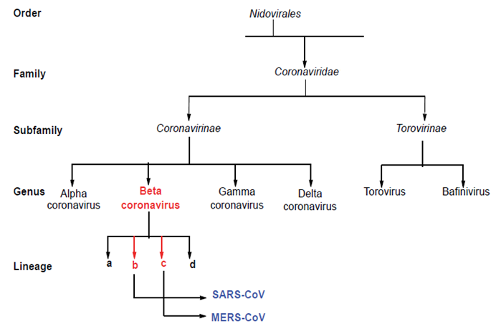
General characteristics of coronaviruses
Schematic representation of the taxonomy of Coronaviridae (according to the International Committee on Virus Taxonomy). SARS-CoV and MERS-CoV belong to the genus Betacoronavirus but have different lineages.

Slide 6
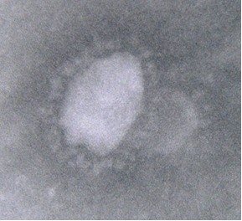
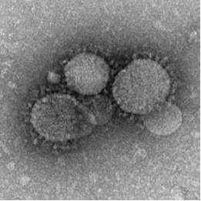
structure of coronavirus
Electronic photographs of SARS-CoV and MERS-CoV virions

Slide 7
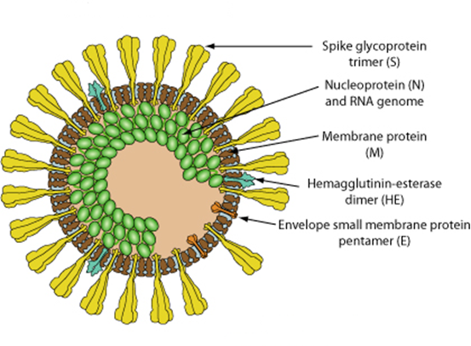
structure of coronavirus

Slide 8
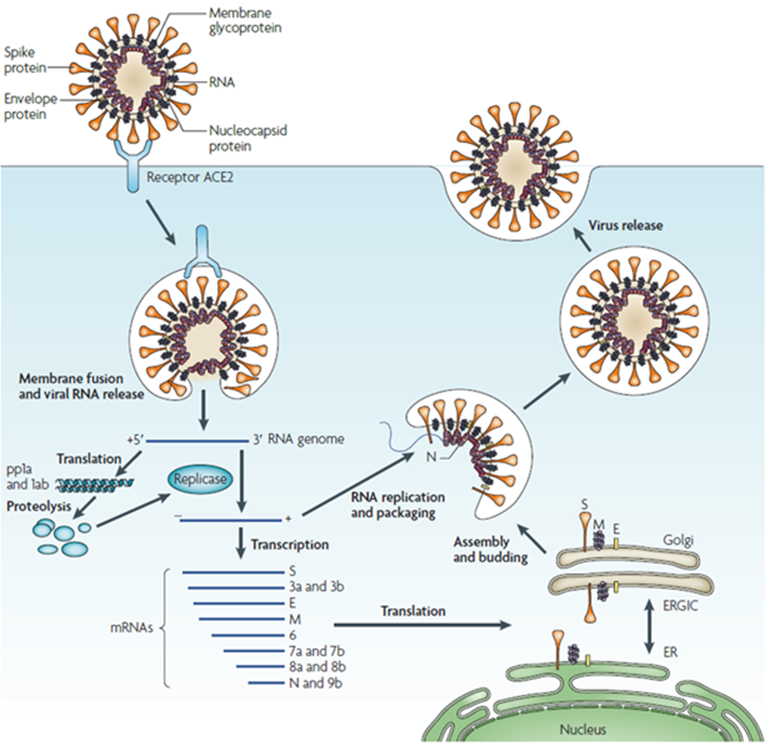
Life-cycle of coronavirus

Slide 9
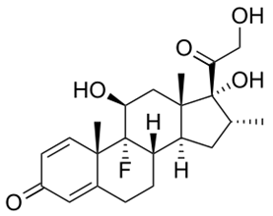
Therapy for coronavirus infections
There is currently no adequate treatment.
SARS-CoV-2 leads to a large release of cytokines, causing a strong immune response. The immune response is one of the causes of acute lung injury and acute respiratory distress syndrome. Corticosteroids were used by China at the start of the pandemic.
According to preliminary results from a UK study, dexamethasone helped reduce deaths by a third among ventilator patients and by a fifth among patients requiring oxygen therapy.
dexamethasone

Slide 10
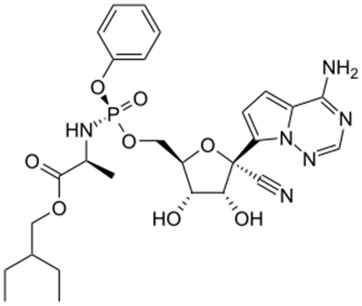
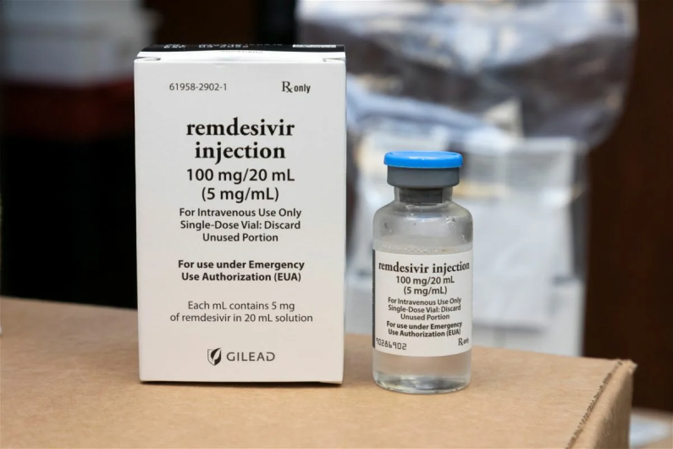
Therapy for coronavirus infections
Remdesivir
Remdesivir, a drug developed against the Ebola virus, has been found to have antiviral activity against SARS-CoV-2 in the laboratory.
The positive results of the early studies attracted media attention and led to the launch of emergency use of the drug.
However, remdesivir has a negligible effect on all-cause mortality up to 28 days in hospitalized adults with SARS-CoV-2 infection.

Slide 11
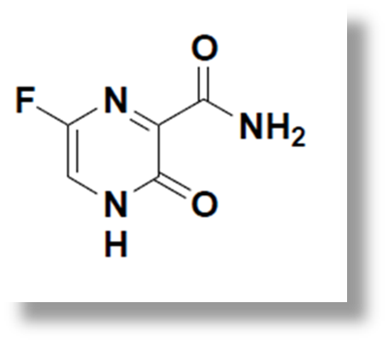
Therapy for coronavirus infections
Favipiravir
Favipiravir has been studied as a potential treatment for COVID-19 since February 2020. No significant effect of favipiravir in the treatment of COVID-19 was found in an evidence-based standard of care study completed in Japan in 2020.
As of August 2021, favipiravir has no evidence of efficacy on criteria to reduce mortality and risk of EVI. As of November 2021, favipiravir did not accelerate recovery in patients with COVID-19. The Canadian biotechnology company that conducted the trial declared it to be futile against COVID-19.

Slide 12
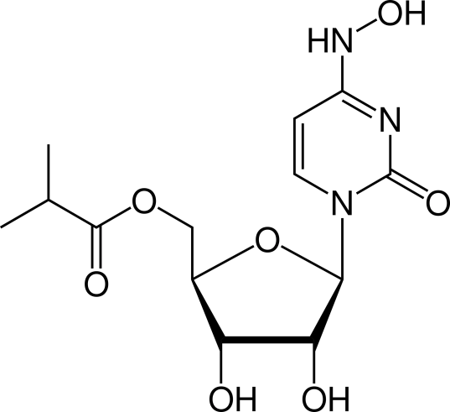
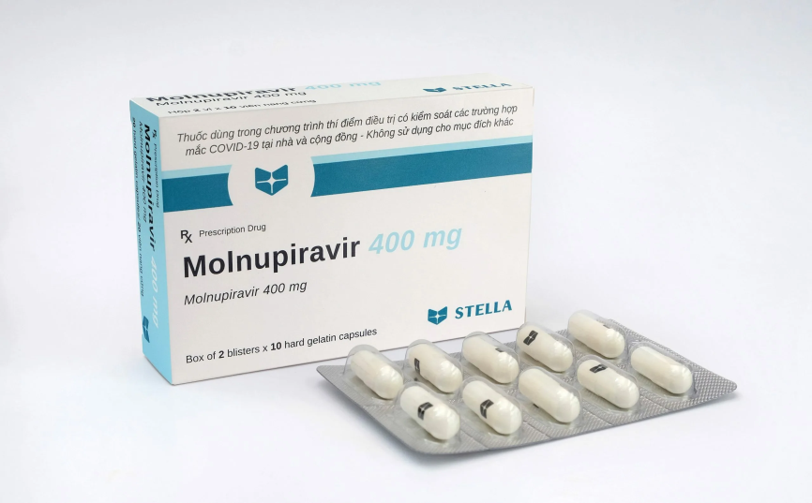
Therapy for coronavirus infections
Molnupiravir
Molnupiravir is a prodrug of the synthetic nucleoside N4-hydroxycytidine and exerts its antiviral action by introducing copying errors during viral RNA replication.

Slide 13
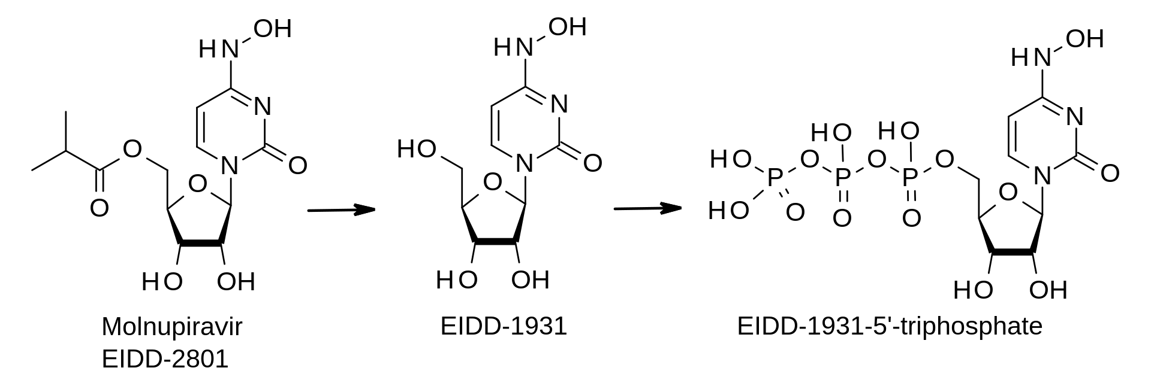
Therapy for coronavirus infections
Molnupiravir
Mechanism of action

Slide 14
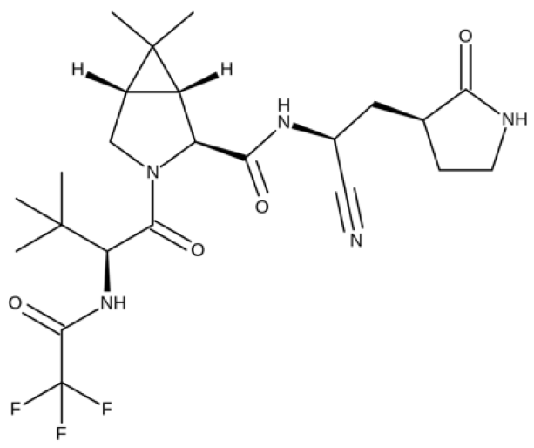
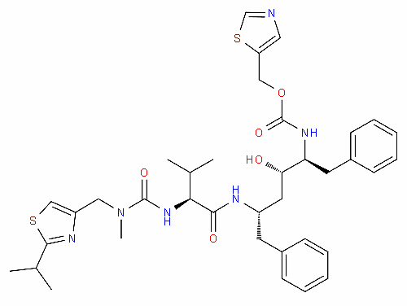
Therapy for coronavirus infections
Nirmatrelvir/ritonavir
Nirmatrelvir
ritonavir
Nirmatrelvir/ritonavir, sold under the brand name Paxlovid, is a co-packaged medication used as a treatment for COVID‑19. It contains the antiviral medications nirmatrelvir and ritonavir and was developed by Pfizer.

Slide 15
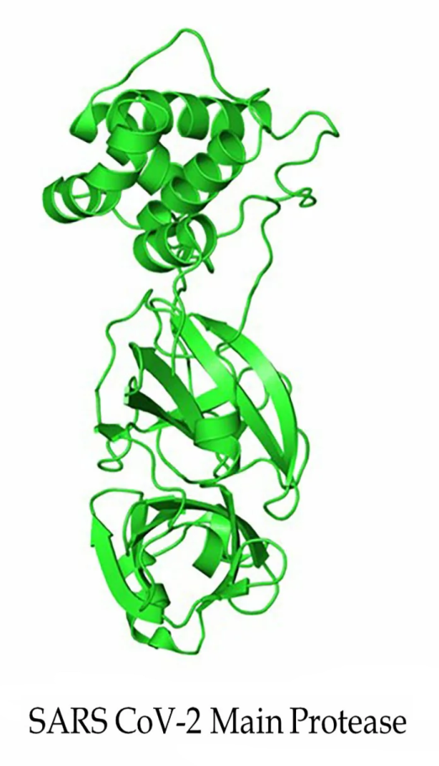
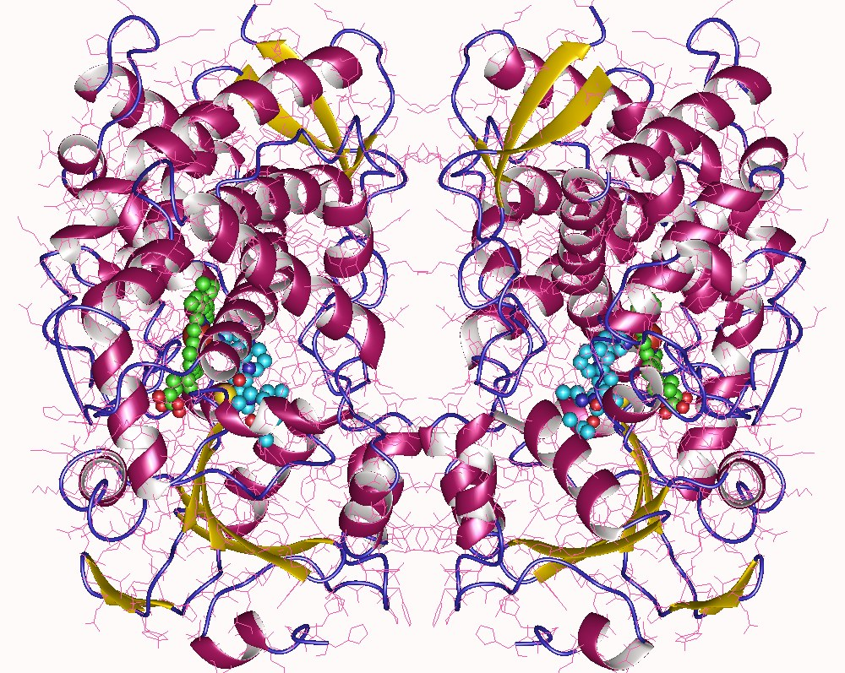
Therapy for coronavirus infections
Nirmatrelvir/ritonavir
Nirmatrelvir inhibits SARS-CoV-2 main protease, while ritonavir is a strong CYP3A inhibitor, slowing down nirmatrelvir metabolism and therefore boosting its effect.

Slide 16
Pharmaceutical analysis
Remdesivir (Remdesivirum)
Description
A white to off-white to slightly yellow powder.
Solubility
It is soluble in ethanol, freely soluble in methanol and sparingly soluble in dimethylsulfoxide . It is practically insoluble in water.
Identity tests
Spectrophotometry in the infrared region
Spectrophotometry in the visible and ultraviolet regions
High-performance liquid chromatography
Thin-layer chromatography
Specific optical rotation

Slide 17
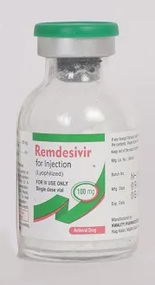
Pharmaceutical analysis
Remdesivir (Remdesivirum)
Purity test
Determination of water by the Karl Fischer method
Limit test for heavy metals
High-performance liquid chromatography for determination of Related substances
Assay
High-performance liquid chromatography
Storage
Remdesivir should be kept in tightly closed containers, protected from moisture.

Slide 18
Pharmaceutical analysis
Favipiravir
Description
White to light yellow coloured crystalline powder.
Solubility
Easily soluble in dimethyl sulfoxide, moderately soluble in methanol, slightly soluble in ethanol, slightly soluble or practically insoluble in water.
Identity tests
Spectrophotometry in the infrared region
High-performance liquid chromatography

Slide 19
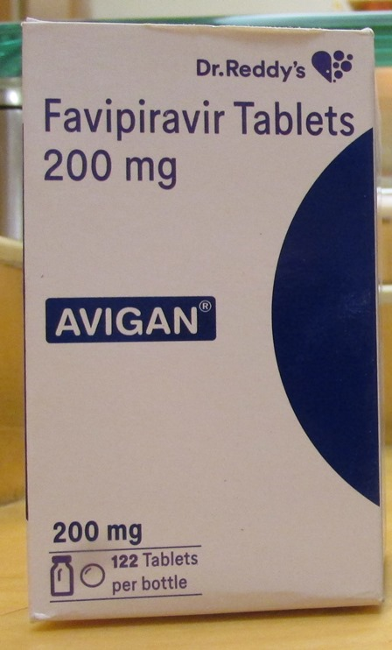
Pharmaceutical analysis
Favipiravir
Purity test
Transparency of the solution.
Determination of water by the Karl Fischer method
High-performance liquid chromatography for determination of Related substances
Limit test for heavy metals
Sulphate ash
Residual organic solvents
Microbiological purity
Assay
High-performance liquid chromatography
Storage
Favipiravir should be kept in tightly closed containers.

Slide 20
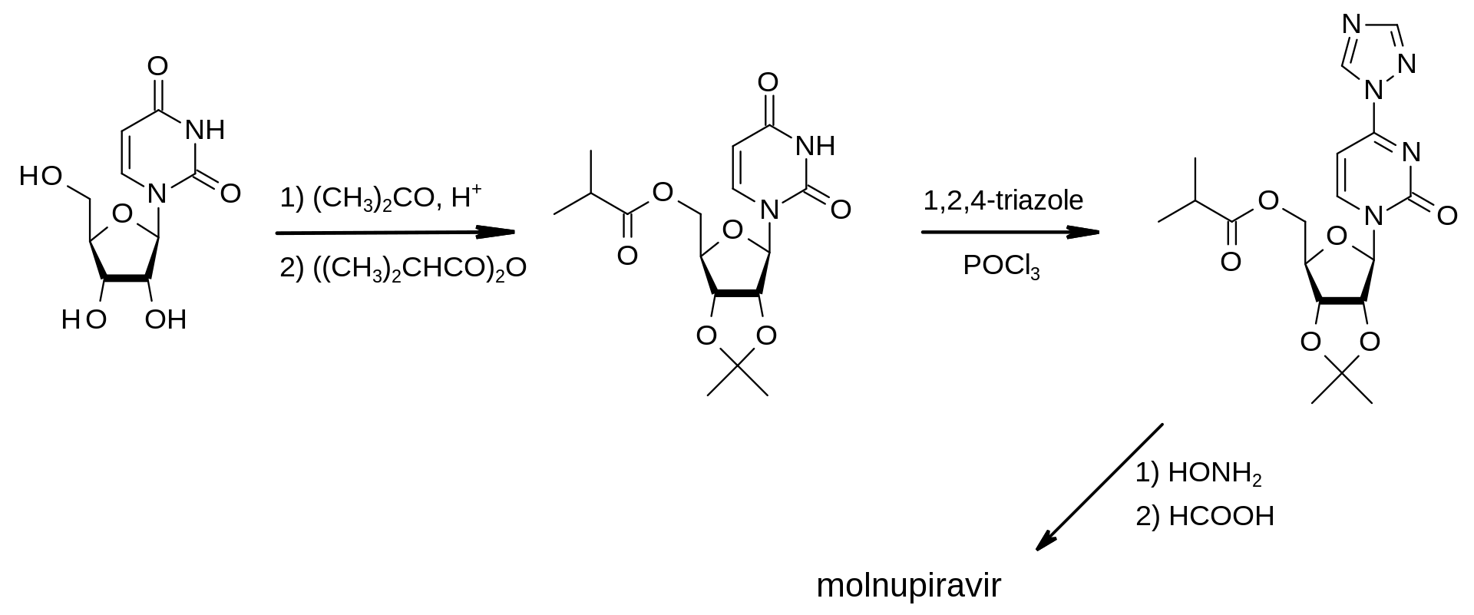
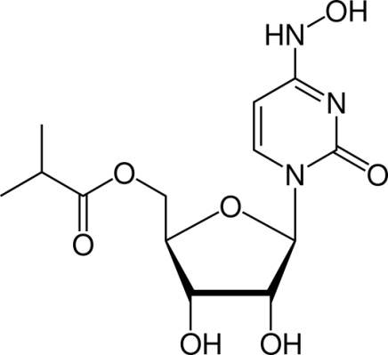
Pharmaceutical analysis
Molnupiravir
Synthesis of molnupiravir

Slide 21
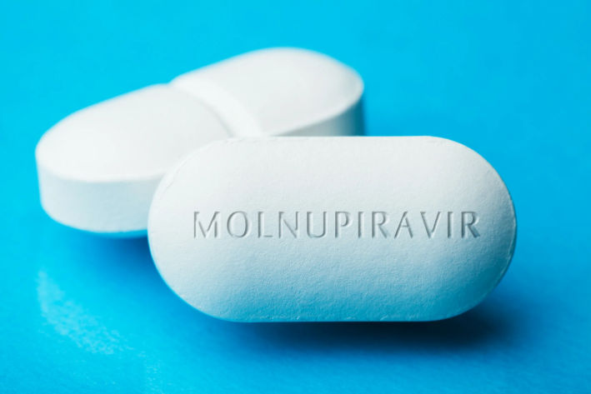
Pharmaceutical analysis
Molnupiravir
Description
A white or almost white powder.
Solubility
Easily soluble in dimethyl sulfoxide and in methanol, moderately soluble in water, practically insoluble in dichloromethane.
Identity tests
Spectrophotometry in the infrared region
High-performance liquid chromatography

Slide 22
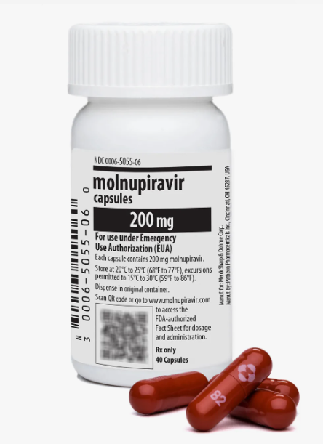
Pharmaceutical analysis
Molnupiravir
Purity test
Specific rotation.
Determination of water by the Karl Fischer method
High-performance liquid chromatography for determination of Related substances
Limit test for heavy metals
Sulphate ash
Residual organic solvents
Microbiological purity
Assay
High-performance liquid chromatography
Storage
Molnupiravir should be kept in tightly closed containers.

Slide 23
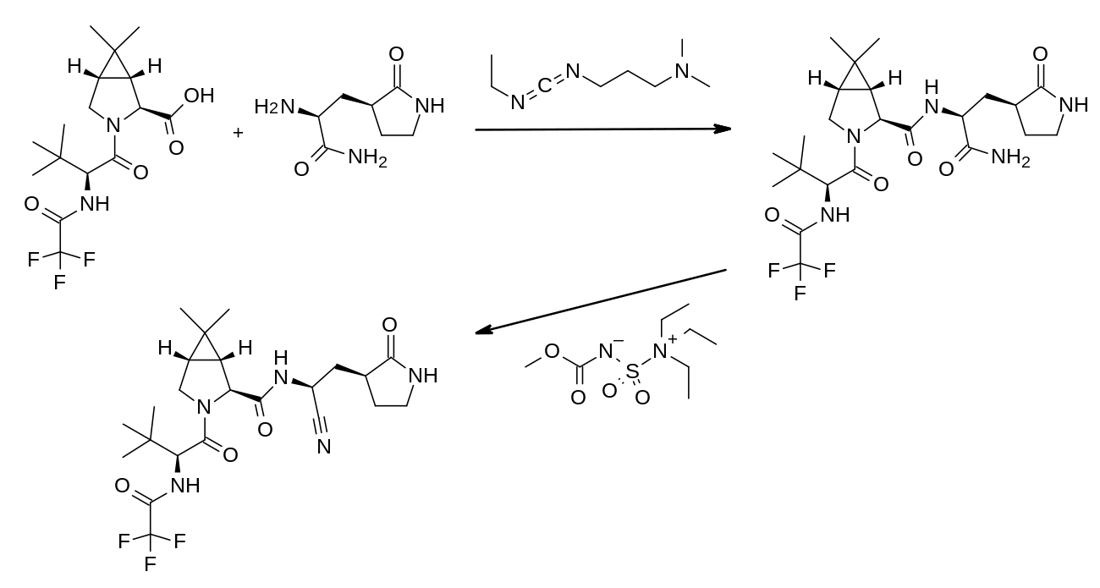
Pharmaceutical analysis
Nirmatrelvir
Synthesis of Nirmatrelvir

Slide 24
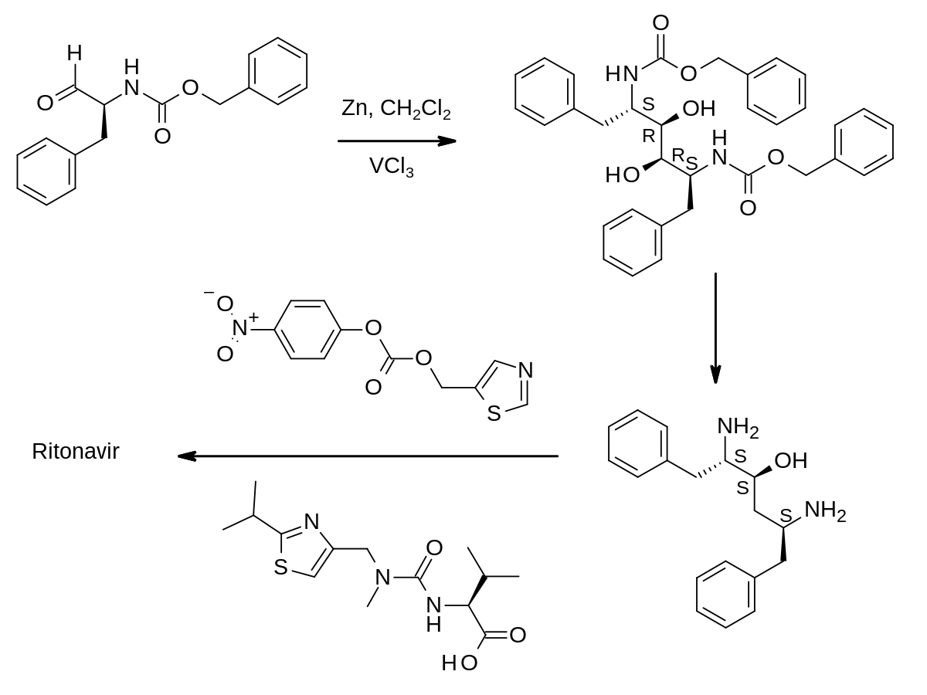
Pharmaceutical analysis
Ritonavir
Synthesis of ritonavir

Slide 25
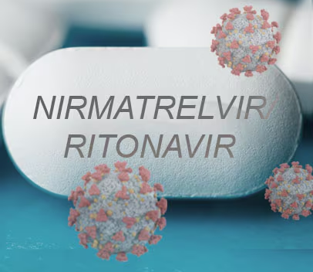
Pharmaceutical analysis
Ritonavir
Description
A white or almost white powder.
Solubility
Practically insoluble in water, freely soluble in methanol, sparingly soluble in acetone and very slightly soluble in acetonitrile.
Identity tests
Spectrophotometry in the infrared region
Thin-layer chromatography,

Slide 26
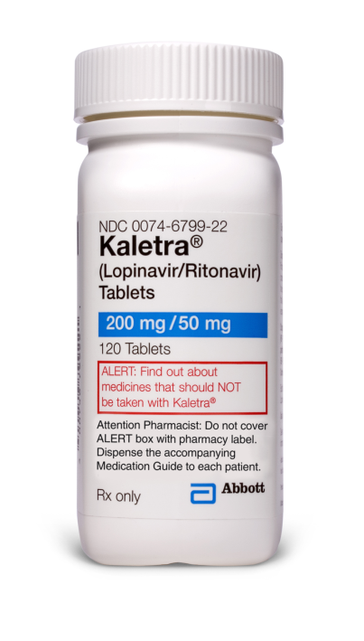
Pharmaceutical analysis
Ritonavir
Purity test
Specific rotation.
Loss on drying
High-performance liquid chromatography for determination of Related substances
Limit test for heavy metals
Sulphate ash
Assay
Non-aqueous titration. Dissolve in glacial acetic acid and titrate with perchloric acid, determine the end point potentiometrically.
Storage
Ritonavir should be kept in a well-closed container, protected from light.

Slide 27
Thank you for attention!

