Slide 1
ADRENAL GLAND DISEASE Part I
Volgograd State Medical University
PhD MD Professor A.R .Babaeva

Slide 2
Adrenal anatomy and function
Adrenals (8-10 g) comprise an:
outer cortex
Reticularis (outer), fasciculata and glomerulosa (inner) zones
Adrenal cortex produces steroids
inner medulla
produces catecholamines
The adrenal steroids are grouped into
three classes:
Glucocorticoids (zona fasciculata)
Mineralocorticoids (zona glomerulosa))
Androgens (zona reticularis)

Slide 5
Mineralocorticoids
Aldosterone - predominant mineralocorticoid.
Effect - extracellular balance of sodium and potassium in the distal tubule of the kidney.
Androgens
Although secreted in considerable quantities, most have only relatively weak intrinsic androgenic activity until metabolized peripherally to testosterone or dihydrotestosterone.

Slide 6
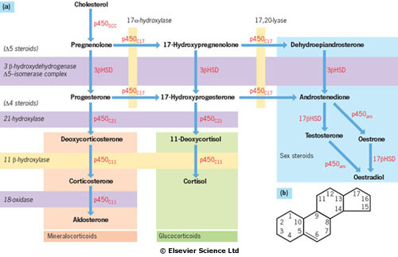
The major steroid biosynthetic pathways. Enzymes catalysing reactions are in red:
p450 enzymes are in mitochondria and each catalyses several reaction steps;
3βHSD (hydroxysteroid dehydrogenase) is in cytoplasm, bound to endoplasmic reticulum;
17βHSD and p450aro are found mainly in gonads. (b) The steroid molecule.

Slide 7
Physiology
Glucocorticoid production by the adrenal is under hypothalamic-pituitary control. Corticotropin-releasing hormone (CRH) is secreted in the hypothalamus in response to circadian rhythm, stress and other stimuli. CRH travels down the portal system to stimulate ACTH release from the anterior pituitary corticotrophs.

Slide 8
Physiology
ACTH is derived from the prohormone pro-opiomelanocortin, which undergoes complex processing within the pituitary to produce ACTH and a number of other peptides including beta-lipotrophin and beta-endorphin. Many of these peptides, including ACTH, contain melanocyte-stimulating hormone (MSH) like sequences which cause pigmentation when levels of ACTH are markedly raised.

Slide 9
Physiology
Circulating ACTH stimulates cortisol production in the adrenal. The cortisol secreted (or any other synthetic corticosteroid administered to the patient) causes negative feedback on the hypothalamus and pituitary to inhibit further CRH/ACTH release. The set-point of this system clearly varies through the day according to the circadian rhythm, and is usually overridden by severe stress.

Slide 10
Physiology
Following adrenalectomy or other adrenal damage (e.g. Addison's disease), cortisol secretion will be absent or reduced; ACTH levels will therefore rise.
Mineralocorticoid secretion is mainly controlled by the renin-angiotensin system.

Slide 11
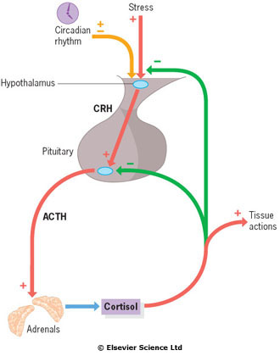
Physiology
Control of the hypothalamic-
pituitary-adrenal
axis.
CRH, corticotropin-
releasing hormone.

Slide 12
Investigation of glucocorticoid abnormalities
1. Basal levels
ACTH and cortisol are released episodically and in response to stress.
The following precautions are therefore necessary when taking a blood sample:
Sampling time should be recorded accurately. Conventionally, basal levels are obtained at between 0800h and 0900h near the peak of the circadian variation.
Stress should be minimized.
Sampling should be delayed for 48 hours after admission if Cushing's syndrome is suspected.
Appropriate reference ranges (for time and assay method) should be used.
2. Dexamethasone suppression tests
3. ACTH stimulation tests

Slide 13
Details of dexamethasone suppression and ACTH (synacthen) tests
in the diagnosis of Cushing’s syndrome and Addison’s disease.
Test and protocol | Measure | Normal test result or positive suppression | Use and explanation
Dexamethasone Overnight Take 1 mg on going to bed at 2300h | Plasma cortisol at 0900h next morning | Plasma cortisol <100 nmol/L | Outpatient screening test Some ‘false positives’
‘Low-dose’ 0,5 mg 6-hourly Eight doses from 0900h on day 0 | Plasma cortisol at 0900h on days 0 and +2 | Plasma cortisol < 50 nmol/L on second sample | For diagnosis of Cushing’s syndrome
‘High-dose’ used in differential diagnosis 2 mg 6-hourly Eight doses from 0900h on day 0 | Plasma control at 0900h on days 0 and +2 | Plasma cortisol on day +2 less than 50% of that on day 0 suggests pituitary-dependent disease | Differential diagnosis of Cushing’s syndrome Pituitary-dependent disease suppresses in about 90% of cases
ACTH (synacthen) Short Tetracosactide 250 μg i.v. or i.m. at time 0 | Plasma cortisol at times 0, +30 min | Cortisol at +30 min > 600 nmol/L | To exclude primary adrenal failure
Long Depot tetracosactide 1 mg i.m. at time 0 | Plasma cortisol at times 0, +1, +2, +3, +4, +5, +8 and +24 h | Maximum > 1000 nmol/L Rise > 550 nmol/L | To demonstrate or exclude adrenal suppression (rather than primary adrenal failure)

Slide 14
Cushing's syndrome/disease
It is the clinical state of increased free circulating glucocorticoid - hypercorticosolizm
It occurs most often following the therapeutic administration of synthetic steroids or ACTH –exogenous hypercorticosolizm.

Slide 15
Pathophysiology and causes
Causes of Cushing's syndrome are usually
subdivided into two groups:
increased circulating ACTH from the pituitary (65% of cases), known as Cushing's disease, or from an 'ectopic', non-pituitary, ACTH-producing tumour elsewhere in the body (10%) with consequential glucocorticoid excess
a primary excess of endogenous cortisol secretion (25% of spontaneous cases) by an adrenal tumour or nodular hyperplasia, with subsequent (physiological) suppression of ACTH (Cushing's syndrome).

Slide 17
Clinical features
The symptoms and signs of Cushing's syndrome

Slide 18
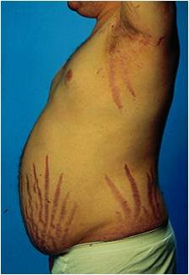

Slide 19
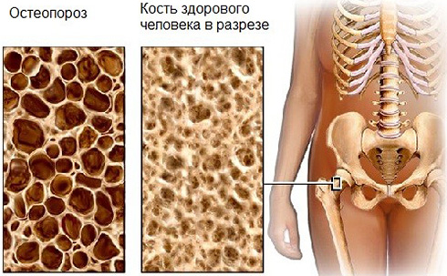

Slide 20
Pigmentation occurs only with ACTH-dependent causes.
A Cushingoid appearance can be caused by excess alcohol consumption (pseudo-Cushing's syndrome) - the pathophysiology is poorly understood.
Impaired glucose tolerance or frank diabetes are common, especially in the ectopic ACTH syndrome
Hypokalaemia due to the mineralocorticoid activity of cortisol is common with ectopic ACTH secretion.

Slide 21
Diagnosis
There are two phases to the investigation:
confirmation of the presence or absence of Cushing's syndrome
differential diagnosis of its cause (e.g. pituitary, adrenal or ectopic)

Slide 22
1. Confirmation
Investigations to confirm the diagnosis include:
48-hour low-dose dexamethasone test.
Normal individuals suppress plasma cortisol to < 50 nmol/L. Patients with Cushing's syndrome fail to show complete suppression of plasma cortisol levels (although levels may fall substantially in a few cases).
This test is highly sensitive (> 97%).
24-hour urinary free cortisol measurements.
Circadian rhythm.
After 48 hours in hospital, cortisol samples are taken at 0900h and 2400h (without warning the patient).
Normal subjects show a pronounced circadian variation.
Those with Cushing's syndrome have high midnight cortisol levels (> 100 nmol/L), though the 0900h value may be normal.
Other tests.
insulin stress test
desmopressin stimulation test
CRH tests.

Slide 24
2. Differential diagnosis of the cause
Biochemical and radiological procedures for diagnosis include:
Adrenal CT or MRI scan.
adenomas and carcinomas (large size, irregular outline and signs of infiltration or metastases)
bilateral adrenal hyperplasia
Pituitary MRI.
a pituitary adenoma may be seen.
Plasma potassium levels.
hypokalaemia (ectopic ACTH secretion). All diuretics must be stopped.
High-dose dexamethasone test.
failure of significant plasma cortisol suppression suggests an ectopic source of ACTH or an adrenal tumour.
Plasma ACTH levels.
low or undetectable ACTH levels (< 10 ng/L) on two or more occasions ⇒ non-ACTH-dependent disease.
CRH test.
an exaggerated ACTH and cortisol response to exogenous CRH suggests pituitary-dependent Cushing's disease, as ectopic sources rarely respond.
Chest X-ray
carcinoma of the bronchus or a bronchial carcinoid.
if ectopic ACTH is suspected, whole-lung and mediastinal CT scanning should be performed.

Slide 25
•МРТ/КТ: При МРТ в сочетании с контрастированием гипофиза (гадолиний) аденома выявляется в 80% случаев.
◊ Однако следует иметь в виду, что аденома гипофиза выявляется у 10% лиц без нарушения функции гипофиза, поэтому биохимические исследования гормонов имеют решающее значение.
◊ В случае подозрения на АКТГ-независимый синдром Иценко – Кушинга при МРТ/КТ в надпочечниках можно выявить характерные морфологические изменения.

Slide 26
МРТ/КТ

Slide 27
Визуализация гипофиза

Slide 29
Further investigations:
catheterization of the inferior petrosal sinus to measure ACTH for pituitary lesions
blood samples taken throughout the body in a search for ectopic sources
bronchoscopy
cytology
regional arteriograms are occasionally necessary
radiolabelled octreotide (111In octreotide) is occasionally helpful in locating ectopic ACTH sites.

Slide 30
Treatment
Metyrapone (11β-hydroxylase blocker) 750 mg to 4 g daily in three to four divided doses.
Ketoconazole (200 mg three times daily) is also used and is synergistic with metyrapone.
Aminoglutethimide and trilostane (which reversibly inhibits 3β-hydroxysteroid dehydrogenase/δ-5, 4 isomers) are occasionally used.
Plasma cortisol should be monitored, aiming to reduce the mean level during the day to 150-300 nmol/L, equivalent to normal production rates.
Choice of further treatment depends upon the cause.

Slide 31
Cushing's disease (pituitary-dependent hyperadrenalism)
Trans-sphenoidal removal of the tumour is the treatment of choice.
External pituitary irradiation alone is slow acting, only effective in 50-60% even after prolonged follow-up and mainly used after failed pituitary surgery
Medical therapy to reduce ACTH (e.g. bromocriptine, cyproheptadine) is rarely effective.
Bilateral adrenalectomy is an effective last resort if other measures fail to control the disease.

Slide 32
Other causes
Adrenal adenomas should be resected after achievement of clinical remission with metyrapone or ketoconazole.
-Contralateral adrenal suppression may last for years.
Adrenal carcinomas (highly aggressive, the prognosis is poor).
-The adrenolytic drug op'DDD (Mitotane) may inhibit growth of the tumour and prolong survival (it can cause nausea and ataxia).
-Some would also give radiotherapy to the tumour bed after surgery.
Tumours secreting ACTH ectopically should be removed if possible.
-Otherwise chemotherapy/radiotherapy may be used, depending on the tumour.
If the source of ACTH is not clear, cortisol hypersecretion should be controlled with medical therapy until a diagnosis can be made.

Slide 33
Nelson's syndrome
It occurs in about 20% of cases after bilateral adrenalectomy for Cushing's disease.
Increased pigmentation (because of high levels of ACTH) + enlarging pituitary tumour.
Treatment: pituitary surgery and/or radiotherapy (unless given previously).
Incidental adrenal tumours ('incidentalomas')
Surgical treatment of adenomas if they:
secrete cortisol
are large (> 4-5 cm)
If they are small and hormonally inactive ⇒ observation.

Slide 34
Congenital adrenal hyperplasia (CAH)
Pathophysiology
An autosomal recessive deficiency of an enzyme
in the cortisol synthetic pathways
(21-hydroxylase deficiency most common)
⇓
Cortisol secretion is reduced
⇓
Increased ACTH secretion
⇓
Diversion of the steroid precursors into the
androgenic steroid pathways
⇓
17-hydroxyprogesterone, androstenedione and
testosterone levels are increased
⇓
Virilization.
Aldosterone synthesis may be impaired with resultant salt wasting.
The other forms affect 11β-hydroxylase, 17α-hydroxylase,
3β-hydroxysteroid dehydrogenase and a cholesterol
side-chain cleavage enzyme (p450scc).

Slide 35
Clinical features
At birth:
sexual ambiguity or adrenal failure (collapse, hypotension, hypoglycaemia)
salt-losing state (hypotension, hyponatraemia)
clitoral hypertrophy, urogenital abnormalities and labioscrotal fusion (in the female)
Precocious puberty:
hirsutism is a later presentation
In adult life:
primary amenorrhoea.
Hirsutism developing before puberty is suggestive of CAH

Slide 36
Investigations
17-Hydroxyprogesterone levels are increased.
Urinary pregnanetriol excretion is increased.
Basal ACTH levels are raised.
Treatment
Replacement of glucocorticoid activity, and mineralocorticoid activity if deficient, is as for primary hypoadrenalism.

Slide 37
Uses and problems of therapeutic steroid therapy
Supervision of steroid therapy
All patients receiving steroids should carry a 'Steroid Card'. They should be made aware of the following points:
Long-term steroid therapy must never be stopped suddenly.
Doses should be reduced very gradually, with most being given in the morning at the time of withdrawal - this minimizes adrenal suppression. Many authorities believe that 'alternate-day therapy' produces less suppression.
Doses need to be increased in times of serious intercurrent illness (defined as presence of a fever), accident and stress. Double doses should be taken during these times.
Other physicians, anaesthetists and dentists must be told about steroid therapy.
Patients should also be informed of potential side-effects and all this information should be documented in the clinical record.

Slide 38
Common therapeutic uses of glucocorticoids
Respiratory disease
-Asthma
-Chronic obstructive pulmonary disease
-Sarcoidosis
-Hayfever (usually topical)
-Prevention/treatment of ARDS
Cardiac disease
-Post-myocardial infarction syndrome
Renal disease
-Some nephrotic syndromes
-Some glomerulonephritides
Gastrointestinal disease
-Ulcerative colitis
-Crohn's disease
-Autoimmune hepatitis
Rheumatological disease
-Systemic lupus erythematosus
-Polymyalgia rheumatica
-Cranial arteritis
-Juvenile idiopathic arthritis
-Vasculitides
-Rheumatoid arthritis
Cerebral oedema
Skin disease
-Pemphigus, eczema Tumours
-Hodgkin's lymphoma
Other lymphomas
Transplantation
-Immunosuppression

Slide 39
Major adverse effects of corticosteroid therapy
Physiological
-Adrenal and/or pituitary suppression
Bone and muscle
-Osteoporosis
-Proximal myopathy and wasting
-Aseptic necrosis of the hip
-Pathological fractures
Skin
-Thinning
-Easy bruising
Eyes
-Cataracts (including inhaled drug)
Increased susceptibility to infection
-(signs and fever are frequently masked)
-Septicaemia
-Reactivation of TB
-Skin (e.g. fungi)

